Slide 1
ECIE4017C
Mae Microsoft Translator wedi cael ei ddefnyddio ar gyfer rhai sleidiau
Microsoft Translator has been used for some slides
Anghenion Ychwanegol mewn Cyd-destun /Additional Needs in Context Darlith 1/ Lecture 1

Slide 2
Amcanion y modwl:
• Deall natur anghenion ychwanegol ac egwyddorion adnabod ac ymyrryd yn gynnar.
The module aims:
• To understand the nature of additional needs and the principles of early identification and intervention.

Slide 3
Deilliannau Dysgu
Learning Outcomes
trafod yr ystod o anghenion ychwanegol
nodi rôl yr ymarferydd wrth ddiwallu anghenion pob dysgwr
dangos cysylltiadau rhwng theori ac ymarfer.
discuss the range of additional needs
identify the role of the practitioner in meeting the needs of each learner
demonstrate links between theory and practice.

Slide 4
Aseiniad
Assignment
Portffolio
3 Elfen
3000 o eiriau (-/+10%)
Dyddiad cyflwyno 01/11/2026, 23.59 drwy Turnitin.
Rhoddir Arweiniad ar Aseiniadau bob wythnos
Portfolio
3 Elements
3000 words (-/+ 10%)
Hand in date 01/11/2026, 23.59 via Turnitin.
Assignment Guidance will be given each week

Slide 5
Portffolio
Elfen 1: Cynllun Datblygu Unigol
25% (Cyfwerth â 1000 o eiriau)
Elfen 2: Poster – Amlinellu arfer da o ran cefnogi dysgwyr ag angen dysgu penodol
25% (Cyfateb i 500 gair)
Elfen 3: Cyflwyniad fideo lle rydych chi'n dangos eich dealltwriaeth o arfer cynhwysol wrth ddiwallu'r Angen Dysgu Ychwanegol (ADY) penodol a nodir ar eich poster
50% (3 munud)

Slide 6
Portfolio
Element 1: Individual Development Plan
25% (Equivalent to 1000 words)
Element 2: Poster – Outlining good practice in terms of supporting learners with a specific learning need
25% (Equivalent to 500 words)
Element 3: Video Presentation in which you demonstrate your understanding of inclusive practice in meeting the specific Additional Learning Need (ALN) identified on your poster
50% (3 minutes)

Slide 7
Templed Portffolio
Portfolio Template
Mae copïau ar gael ar ein tudalennau modwl ar Moodle a Teams
Copies are on our module pages on Moodle and Teams

Slide 8
Felly, beth mae’r modwl hwn yn ymwneud ag ef?
So, what is this module about?
Anghenion Ychwanegol mewn
Cyd-destun
Beth yw Angen?
Beth yw Angen Ychwanegol?
Pa gyd-destun?
Additional Needs in Context
What is a Need?
What is an Additional Need?
What is our context?

Slide 9
Diffiniad o ADY / Definition of ALN
Defnyddir y term ‘Anghenion Dysgu Ychwanegol’ i adnabod disgyblion y mae eu hanghenion dysgu yn ychwanegol i rai mwyafrif eu cyfoedion.
Y Cod Anghenion Dysgu Ychwanegol (L.C., 2021)
The term ‘Additional Learning Needs’ is used to identify pupils whose learning needs are additional to the majority of their peers.
The Additional Learning Needs Code for Wales (W.G., 2021)

Slide 10
Mae disgyblion yn fwy tebygol o fod ag angen dysgu ychwanegol (ADY) os ydynt yn perthyn i grŵp agored i niwed, e.e. yn cynnwys
Grwpiau lleiafrifoedd ethnig
Ffoaduriaid/Ceiswyr lloches/Teuluoedd gweithwyr mudol/Plant sy’n dysgu Saesneg neu Gymraeg fel Iaith Ychwanegol
Plant sy’n Derbyn Gofal
Rhieni ifanc/Menywod ifanc beichiog
Troseddwyr ifanc
Plant a theuluoedd mewn amgylchiadau anodd
Gofalwyr ifanc
Plant ag anghenion sgiliau sylfaenol
Plant sy’n derbyn addysg heblaw yn yr ysgol
Sipsiwn/ Teithwyr (Llywodraeth Cymru, 2009)
Faint o’r grwpiau agored i niwed hyn ydych chi’n gweithio gyda nhw?

Slide 11
Pupils are more likely to have additional learning need (ALN) if they belong to a vulnerable group, e.g. if
They have a disability
They have medical needs
They have gaps in their knowledge or skills due to prolonged absences from the education system e.g. school refusers, school phobics or young offenders
They have difficult family circumstances e.g. due to bereavement
They access education inconsistently e.g. Gypsy and traveller pupils
Their first language is not English or Welsh e.g. asylum seekers/ refugees/children of migrant workers
They are looked after by the local authority e.g. a child whose schooling was disrupted before being taken into care or has had frequent changes of school since taken into care
They are underachieving due to care responsibilities e.g. young carers; or • they are pregnant or a young parent
They are being bullied by their peers or other persons, due to their sexual orientation e.g. lesbian, gay, bisexual and transgender pupils
They are pupils who perform or who have employment (Welsh Government, 2009)
How many of these vulnerable groups do you work with?

Slide 12
Mae 4 maes cyffredinol o angen:
Anghenion cyfathrebu a rhyngweithio
Anawsterau gwybyddiaeth a dysgu
Anawsterau cymdeithasol, emosiynol ac iechyd meddwl
Anghenion synhwyraidd a/neu gorfforol

Slide 13
There are 4 broad areas of need:
Communication and interaction needs
Cognition and learning difficulties
Social, emotional and mental health difficulties
Sensory and/or physical needs

Slide 14

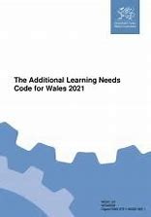
Anghenion Dysgu Ychwanegol
Additional Learning Needs
Newidiodd Llywodraeth Cymru’r fframwaith ar gyfer Anghenion Addysgol Arbennig i un ar gyfer Anghenion Dysgu Ychwanegol.
Mae’r ddogfen yn nodi’r gofynion a chanllawiau i ysgolion, sefydliadau addysg bellach, awdurdodau lleol, cyrff y GIG ac eraill ar y system anghenion dysgu ychwanegol.
The Welsh Government changed the framework for Special Educational Needs to one for Additional Leaning Needs.
The document sets out the requirements and guidance for schools, further education institutions, local authorities, NHS bodies and others on the additional learning needs system.

Slide 15
Cod ADY Cymru
ALN Code of Practice Wales
Bydd Cynlluniau Datblygu Unigol (IDPs) yn cael eu darparu i blant a phobl ifanc ag ADY waeth beth yw difrifoldeb neu gymhlethdod eu hanghenion.
Cânt eu darparu i gefnogi anghenion dysgu plant a phobl ifanc ag AAA o enedigaeth hyd at 25
Darpariaeth dysgu Ychwanegol (DDY) y gelwir y cymorth ychwanegol a roddir i blant ag AAA
Ffocws ar waith amlasiantaeth
Bydd statws statudol yr IDP yr un fath waeth beth fo anghenion y plentyn neu’r person ifanc, a bydd gan unrhyw un ag IDP yr un hawliau i apelio i Dribiwnlys Addysg Cymru.
(Llywodraeth Cymru, 2021)
Individual Development Plans (IDPs) will be provided to children and young people with ALN irrespective of the severity or complexity of their needs.
They will be provided to support the learning needs of children and young people with ALN from birth up to 25
The extra support given to children with ALN is called Additional Learning Provision (ALP)
Focus on multi-agency working
The statutory status of the IDP will be the same irrespective of the child or young person’s needs, with the same rights of appeal to the Education Tribunal for Wales for anyone with an IDP.
(Welsh Government, 2021)

Slide 16
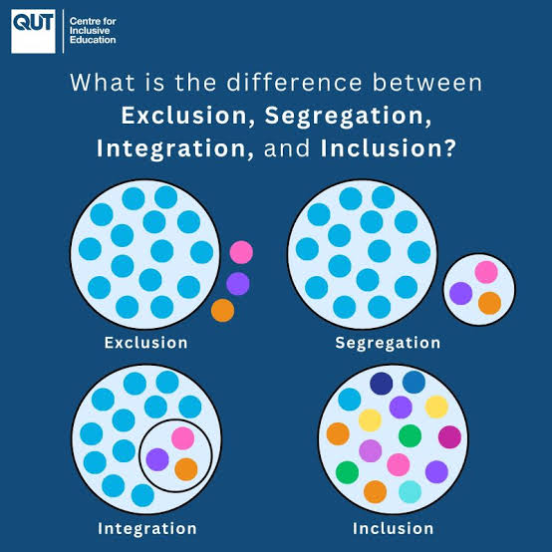
Cynhwysiad
Inclusion
(Image: CIE, 2026)
‘’Exclusion occurs when students with disability are denied access to education.
Segregation is when students with disability are educated separate education settings, away from their same-age peers and other children who do not have a disability.
Integration occurs when students with disability are placed in mainstream classrooms, but no adjustments take place. This means the student must adapt or change, but the environment, teaching practices, teaching resources, and assessment remain the same.
Inclusion involves systemic reform and is when students with disability are educated in regular classrooms, alongside their same-age peers. Barriers are removed proactively, and adjustments are provided as required’’. UNICEF ( 2017)

Slide 17
Arfer da wrth gefnogi dysgwyr ag AAA
Good practice in supporting learners with ALN
Cânt eu cefnogi i oresgyn rhwystrau
Cyflawni eu potensial llawn
Cynhwysol
Cynaliadwy
Amgylchedd dysgu effeithiol
Beth arall allwn ni ei gynnwys?
Cysylltiadau rhwng damcaniaethau, polisïau ac arfer gorau
Supported to overcome barriers
Achieve their full potential
Inclusive
Sustainable
Effective learning environment
What else can we include?
Links between theories, policies and best practice

Slide 18
Tasg: Nodi sut y gallai'r damcaniaethau allweddol hyn gysylltu â chefnogi dysgwyr gyda rhywfaint o ADY penodol
Task: Identify how these key theories could link to supporting learners with some specific ALN
Hierarchy of Needs (Maslow, 1943)
Zone of Proximal Development (Vygotsky, 1933)
Spiral Curriculum (Bruner, 1960)
Experiential Education (Dewey, 1938)
Mindblindness (Baron-Cohen, 1985)
Attachment (Bowlby, 1958)
Unrhyw un arall?
Hierarchy of Needs (Maslow, 1943)
Zone of Proximal Development (Vygotsky, 1933)
Spiral Curriculum (Bruner, 1960)
Experiential Education (Dewey, 1938)
Mindblindness (Baron-Cohen, 1985)
Attachment (Bowlby, 1958)
Other theories?

Slide 19
Cysylltiadau â’r asesiad: Elfen 1
Elfen 1: Crëwch boster – Yn amlinellu arfer da o ran cefnogi dysgwyr ag angen dysgu penodol.
Gwnewch yn siŵr fod y poster yn dangos ystyriaeth i gynwysoldeb, cynaliadwyedd a’r amgylchedd dysgu
(Tua 500 o eiriau)
O’r meini prawf marcio:
Rydym yn edrych am eich ‘Sgiliau Gwybodaeth a Dealltwriaeth’
Ar lefel 4, dylech fod yn gallu dangos gwybodaeth o’r cysyniadau a’r egwyddorion sylfaenol sy’n gysylltiedig â’ch maes/meysydd astudio. Mae gwybodaeth yn ymwneud â’r ffeithiau, y wybodaeth a’r sgiliau rydych chi wedi’u caffel trwy eich dysgu. Rydych yn arddangos eich dealltwriaeth trwy ddehongli ystyr y ffeithiau a’r wybodaeth (gwybodaeth). Mae hyn yn golygu bod angen i chi ddewis a chynnwys yn eich gwaith y cysyniadau, technegau, modelau, damcaniaethau, ac ati sy’n briodol i’r dasg/tasgau a osodwyd. Dylech fod yn gallu egluro’r damcaniaethau, cysyniadau, ac ati i ddangos eich dealltwriaeth. Bydd eich marc/gradd hefyd yn dibynnu ar i ba raddau rydych yn dangos eich gwybodaeth a’ch dealltwriaeth.

Slide 20
Links to assessment: Element 1
Element 1: Produce a poster – Outlining good practice in terms of supporting learners with a specific learning need.
Make sure that the poster demonstrates consideration of inclusivity, sustainability and the adjustments required in the learning environment.
(Approx. 500 words)
From the marking criteria:
We’re looking for your ‘Knowledge and Understanding Skills’
At level 4, you should be able to demonstrate knowledge of the underlying concepts and principles associated with your area(s) of study. Knowledge relates to the facts, information and skills you have acquired through your learning. You demonstrate your understanding by interpreting the meaning of the facts and information (knowledge). This means that you need to select and include in your work the concepts, techniques, models, theories, etc. appropriate to the task(s) set. You should be able to explain the theories, concepts, etc. to show your understanding. Your mark/grade will also depend upon the extent to which you demonstrate your knowledge and understanding.

Slide 21
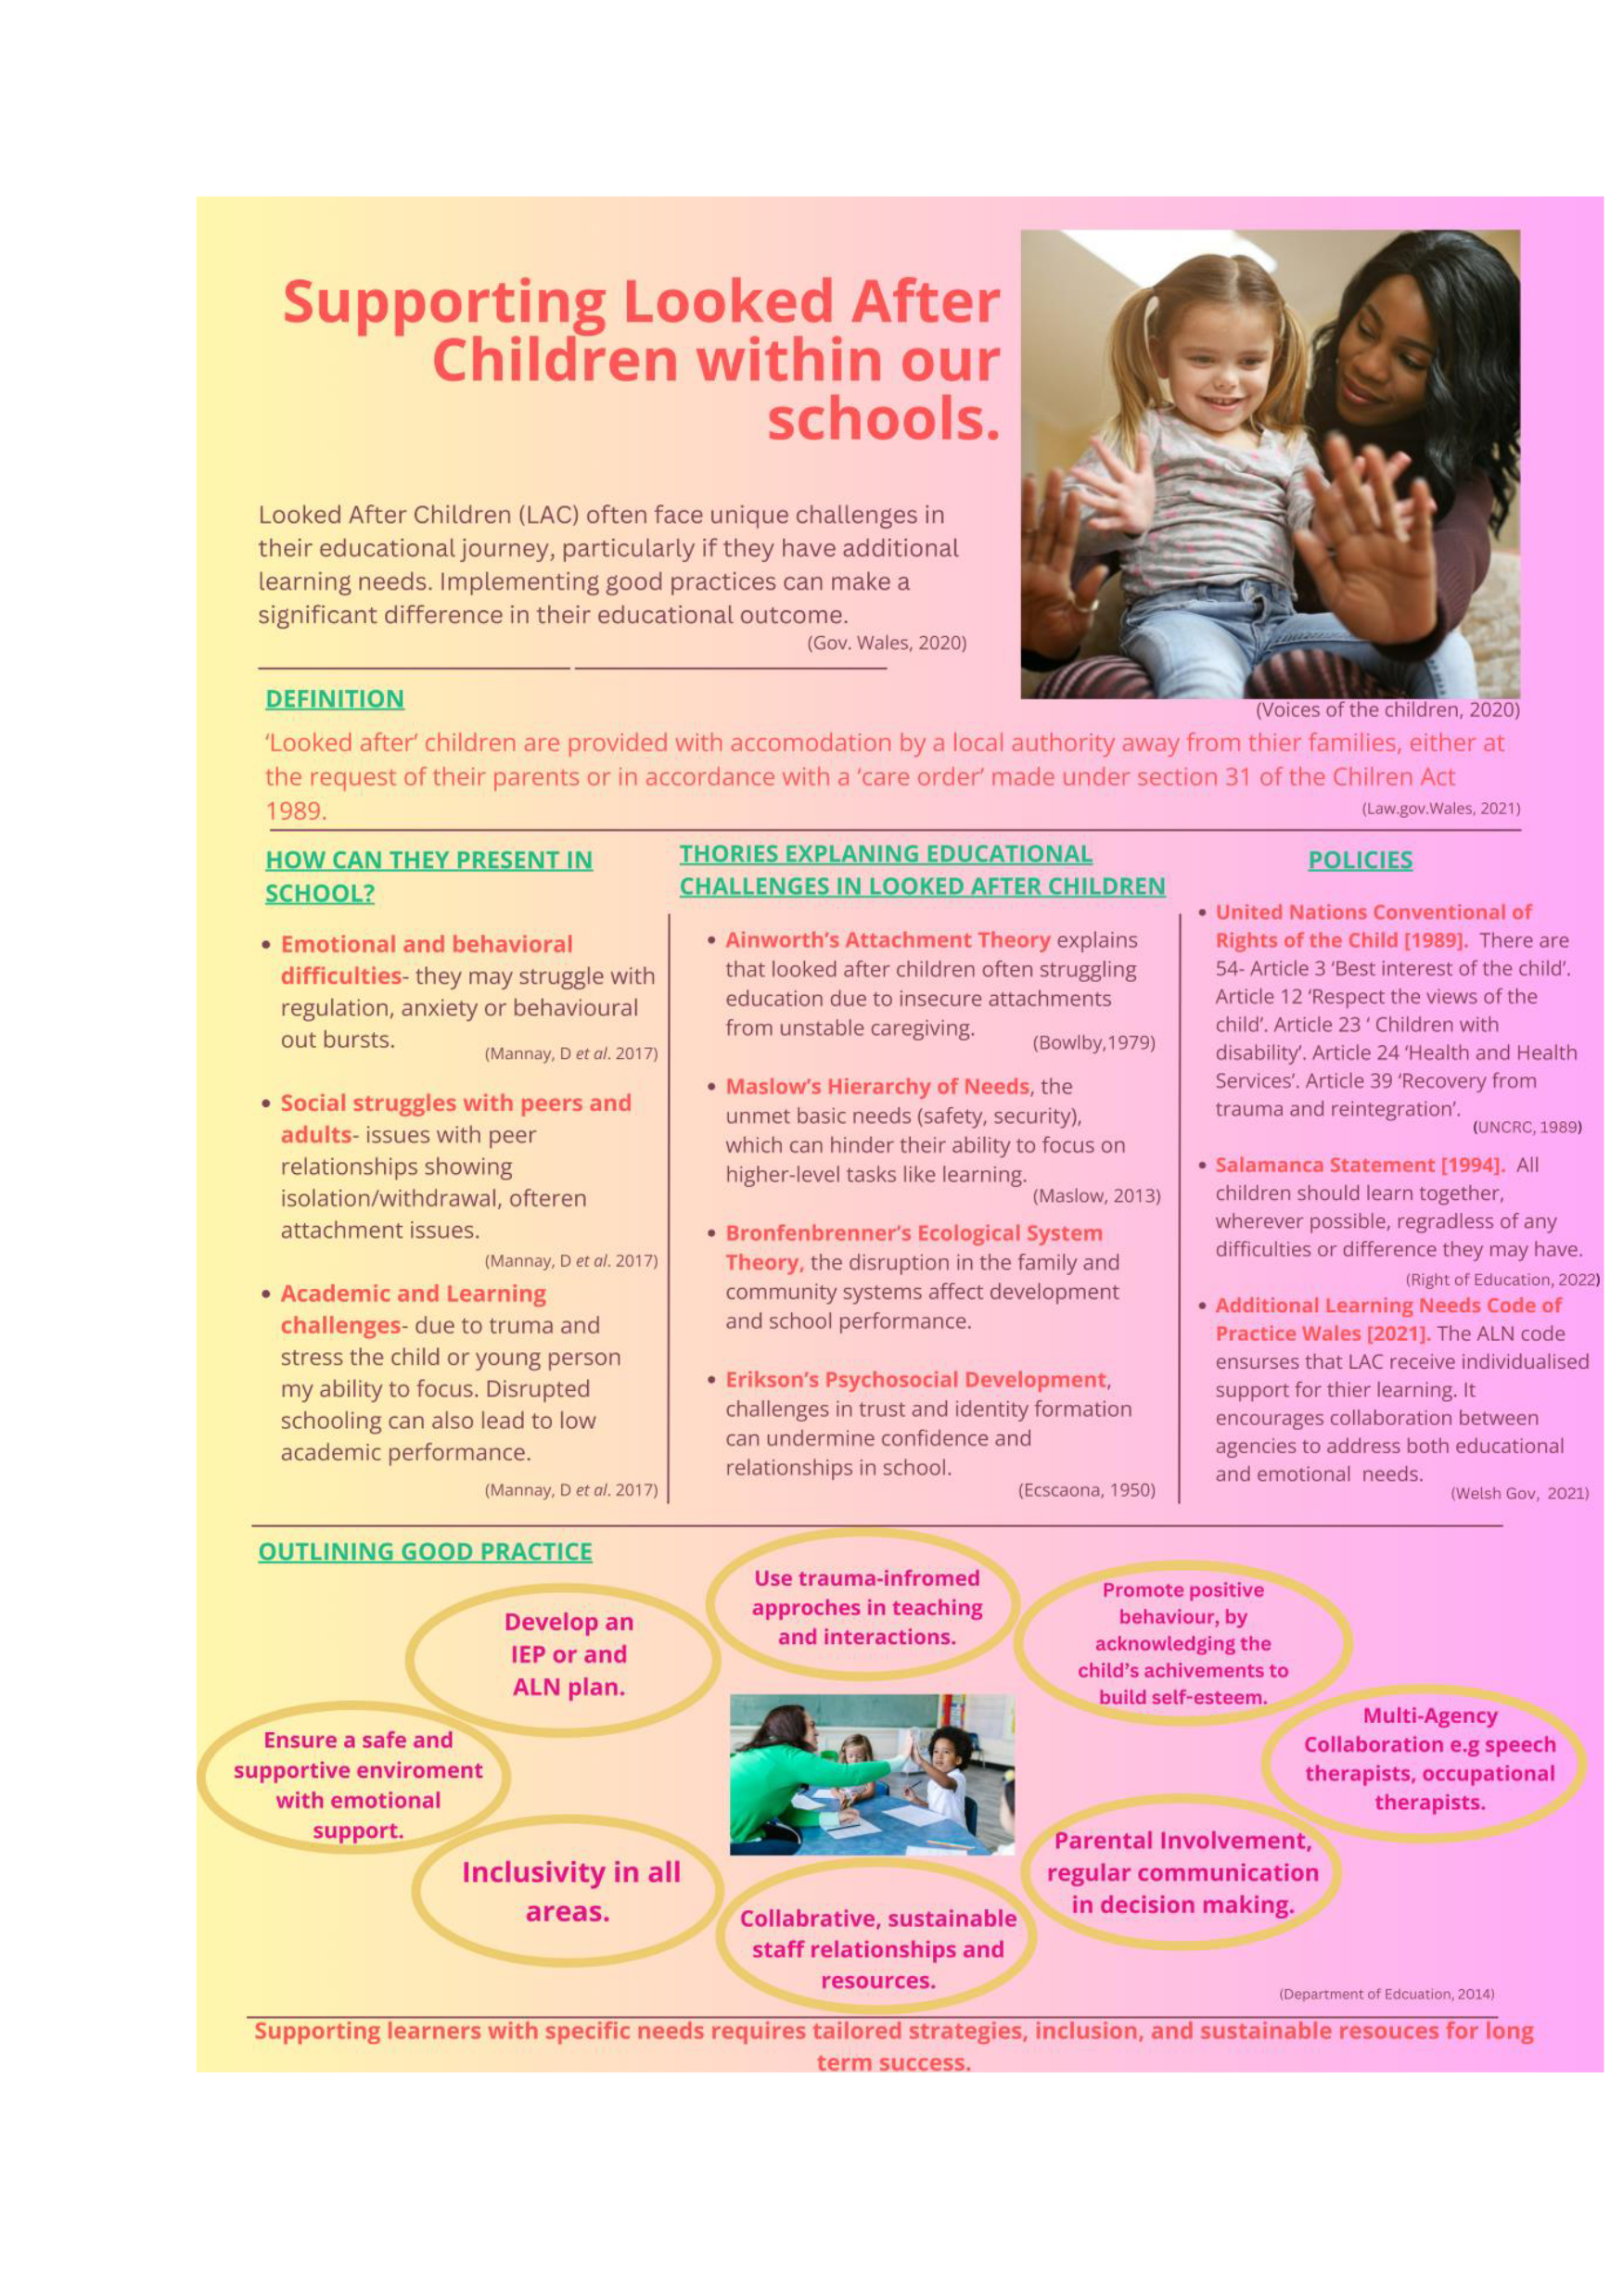
Enghraifft o arfer da gan fyfyriwr blaenorol
An example of good practice from a previous student
Sylwch fod y poster hwn yn cynnwys:
Gwybodaeth allweddol am yr ADY
Dolenni i theori a pholisi
Awgrymiadau ar gyfer arfer cynhwysol gorau
Mae gan ffynonellau gyfeiriadau academaidd credadwy
Arddull ddeniadol o gyflwyniad sy'n hawdd ei ddarllen
Note this poster includes:
Key information about the ALN
Links to relevant theory and policy
Suggestions for best inclusive practice
Sources have credible academic references
Attractive reader-friendly style of presentation

Slide 22
Cyfeiriadau
Reference List
Central South Consortium (2021) Inclusion, Additional Learning Needs, Additional Learning Provision. Guidance for mainstream schools on the expectations of the ALN Code. Ar gael yn aln-guidance-final-sept21.pdf (Cyrchwyd/ Accessed 29.06.2026)
Centre for Inclusive Education (2026) Image of exclusion, segregation, integration & inclusion. Ar gael yn/Available at UCL Centre for Inclusive Education | UCL Institute of Education (Cyrchwyd/Accessed 29.06.2026)
Children’s Commissioner for Wales (2024) A Child’s Rights Approach to Additional Learning Needs. Available at A Children’s Rights Approach to Additional Learning Needs - Children’s Commissioner for Wales (Accessed 29.06.2026)
Comisiynydd Plant Cymru (2024) Dull Gweithredu ar sail Hawliau Plant tuag at Anghenion Dysgu Ychwanegol. Ar gael yn
Dull Gweithredu ar sail Hawliau Plant tuag at Anghenion Dysgu Ychwanegol - Children’s Commissioner for Wales (Cyrchwyd 29.06.2026)
Llywodraeth Cymru (2021) Y Cod Anghenion Dysgu Ychwanegol. Ar gael yn Y cod anghenion dysgu ychwanegol | LLYW.CYMRU (Cyrchwyd 29.06.2026)
Llywodraeth Cymru (2021) Rheoliadau Deddf Cydraddoldeb 2010 (Disgyblion Ysgol Anabl) (Cymru) 2021. Ar gael yn Rheoliadau Deddf Cydraddoldeb 2010 (Disgyblion Ysgol Anabl) (Cymru) 2021 | LLYW.CYMRU (Cyrchwyd 29.06.2026)
UNICEF (2017) Inclusive Education. Ar gael yn/Available at Inclusive Education - Understanding Article 24 of the Convention on the Rights of Persons with Disabilities (Cyrchwyd /Accessed 29.06.2026)
Vale of Glamorgan (2021) Inclusion for all: Meeting the needs of children in Early Years’ settings. Available at early-years-good-practice-guide-inclusion-for-all-eng (Cyrchwyd/ Accessed 29.06.2026)
Welsh Government (2009) Children with Additional Learning Needs: Guide to the Law. Available at Microsoft Word - 13 Children with Additional Learning Needs (Cyrchwyd /Accessed 29.06.2026)
Welsh Government (2021) The Additional Learning Needs Code for Wales. Available at The additional learning needs code | GOV.WALES (Accessed on 29/06.2026)
Welsh Government (2021) The Equality Act 2010 (Disabled School Pupils) (Wales) Regulations 2021. Available at The Equality Act 2010 (Disabled School Pupils) (Wales) Regulations 2021 | GOV.WALES (Accessed 29.06.2026)

