Slide 1
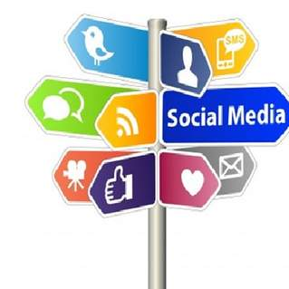
In the 21st century, the rise of social media means that one’s sense of ‘self’ is now more unstable than ever!
1603261 ASSIGNMENT 2 , SJSI 5018
(Gilbert, 2015)

Slide 2
Entering and throughout the 21st centuary, social Capital has depleted,
due to the rising levels of the means of social media. For example, the
shared; values, trust, norms, interpersonal relationships and the shared sense
of identity does not function efficiently due to the vastly growing diversity in
societies utilising social media platforms.
Beck T (2019)

Slide 3
The diversity of society on social media, grants individuals
the opportunity to rise in social status. However, it is not a
stable concept as individuals can just as easily lower their
status without intention. This is due to the dysfunctional
understanding of social values in a diverse social culture
‘almost like entering a gambling casino for social gains’.
Spencer K (2018)

Slide 4
Individuals turning to social media to gain social
capital may gain power and self worth. However,
they do not obtain full control of the outcomes and
can easily lose power at the slightest change of
circumstance.
Spencer K (2018)

Slide 5
A recent study was conducted, analysing social Capital to measure the
values and benefits that platform users gain from social relationships online.
Research has found two distinct concepts within social capital. Bonding
Capital; received from intimate relationships , such as family and friends,
and Bridging Capital, which has weaker ties to individuals, whilst
influencing world views.
Beck T (2019)

Slide 6
Bridging Social Capital has closely been linked to
psychological factors. Study’s have found that it is not
just the simple use social media that causes stress,
anxiety, depression and low self esteem. Concluding
that a platform users expansion of social networking,
gaining Bridging Capital, is one of the leading causes
of such negative psychological influences to ones-self.
Beck T 2019

Slide 7
Social Re-production for example; would be a high social
status gained by right, from parents or family members.
However, individuals without this social investment may be
subject to social inequality, due to the fact that social
status must be gained on ones own
Spencer K 2018

Slide 8
Studies in recent years suggest that over use of social media
and screen time can lead to depression, however, other
study’s challenge this pessimistic approach, stating that
individuals acquire a sense of connectivity, thus increasing
self worth. If social media is used for the sole purpose of
comparing ones self to others, then there is a high risk of
depression and low self esteem.
Beck T 2019

Slide 9
Advocates in the political spectrum have engaged tech
companies to recognise and be more responsible for the
material content that could offend communities or manipulate
the values and beliefs of social communities. Tech companies
have some power to block certain advertisements or speech.
Etzioni A 2019

Slide 10
However, this content is not subject to public review and more
often is firstly reported buy the public review and more often is
firstly reported by the public before being removed. Thus giving
tech giants (within moderation) the power to deny certain
voices. Furthermore, tech tycoons who deny free speech on or
within its platforms are at risk of not reaching high community
Masses.
Etzioni A 2019

Slide 11
In 2019 a small group of 15 teenagers got together to discuss with other mums in their community the effects and their understanding of mental health. The teenagers had expressed that social media was one of the leading elements that was factored into their own experiences of poor mental health.
Childreth A (2019)
Information and communication technologies have tajken over in educational regards. Nine out of ten teenagers aged 13 – 17 use social media platforms for education purposes and communications and 71% of these statistics use multiple social media platforms for such use.
Inov8tiv (2019)

Slide 12
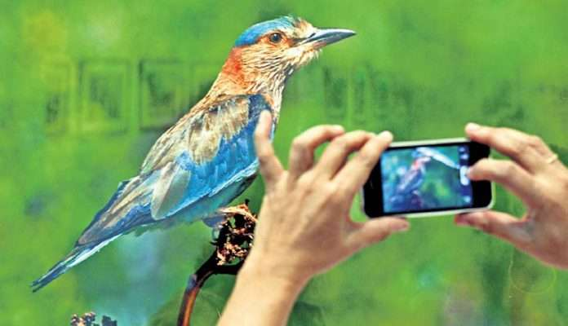
In 2015 the term ‘Influencer’ was created to describe individuals
who were content creators. For example; youtubers, bloggers, Facebook users and Instagram users. Influencers obtain their fame from sharing content that fans like. However, as most big influencers have up to millions of fan followers, they do express that their life is not as bliss as it is portrayed to be to its fans and that it can be very stressful because they have to constantly think of new fresh content for the followers to indulge in on their chosen social media platforms.
Daily Hunt (2019)
Daily Hunt (2019)

Slide 13
https://news.yahoo.com/experience-social-media-restrictions-free-204200372.html?guccounter=1
https://www.madinamerica.com/2019/12/social-media-use-improve-connections-weaken-attention/
https://www.salon.com/2018/01/21/a-psychology-researcher-explains-how-social-media-is-changing-us/
Childreth A (2019) What Teens Think About Depression and Suicide.
https://thriveglobal.com/stories/what-teens-think-about-depression-and-suicide/
Inov8tv (2019) The Impact of Social Media in Education
https://innov8tiv.com/the-impact-of-social-media-in-education/

Slide 14
Thomson D (2019) Is technology exacerbating depression, anti-social tendencies?
https://www.northernsentinel.com/columns/is-technology-exacerbating-depression-anti-social-tendencies/
Daily Hunt (2019) Find Fame on social media
https://m.dailyhunt.in/news/india/english/telangana+today+english-epaper-teltdyen/find+fame+on+social+media-newsid-153498660

