Slide 1
The Sound of Illustration

Slide 2
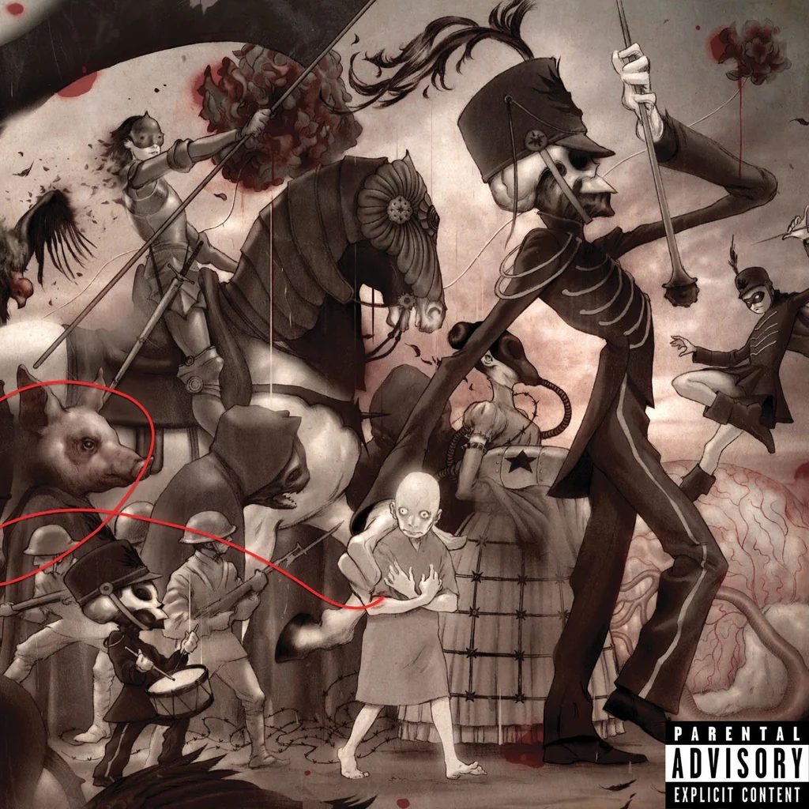
James Jean 2006

Slide 3
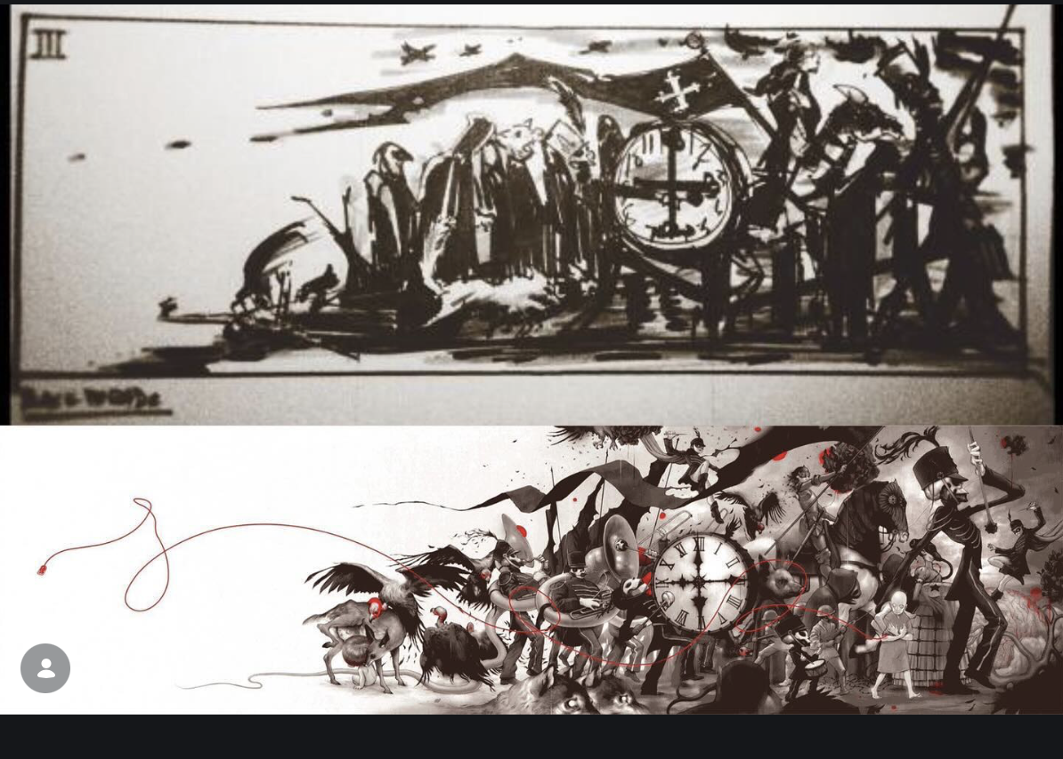
Original concept sketch by Gerard Way
Album art by James Jean

Slide 4
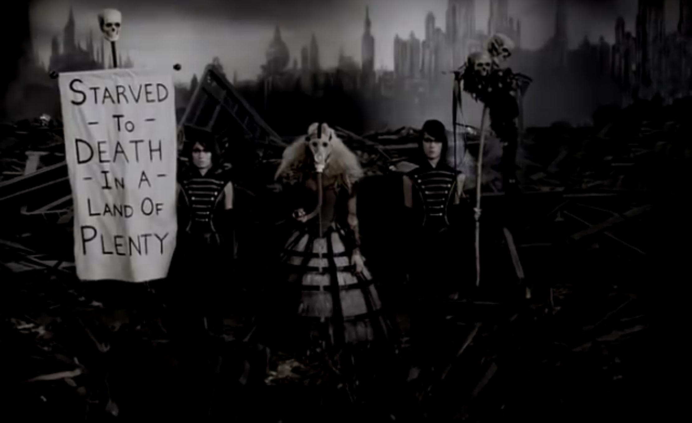

Slide 5
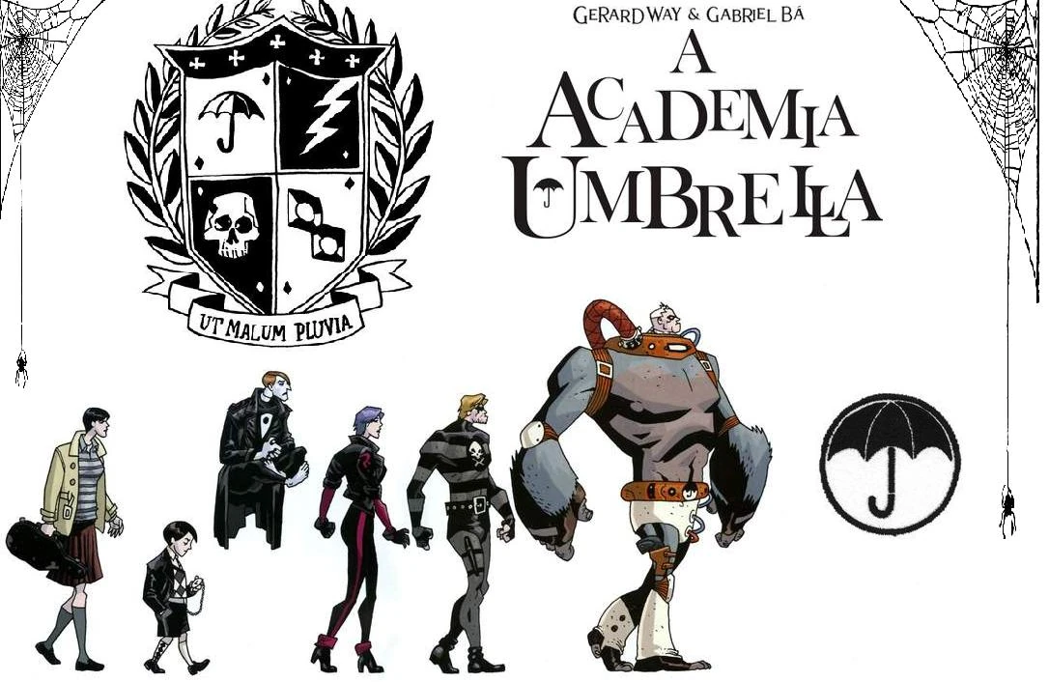

Slide 6
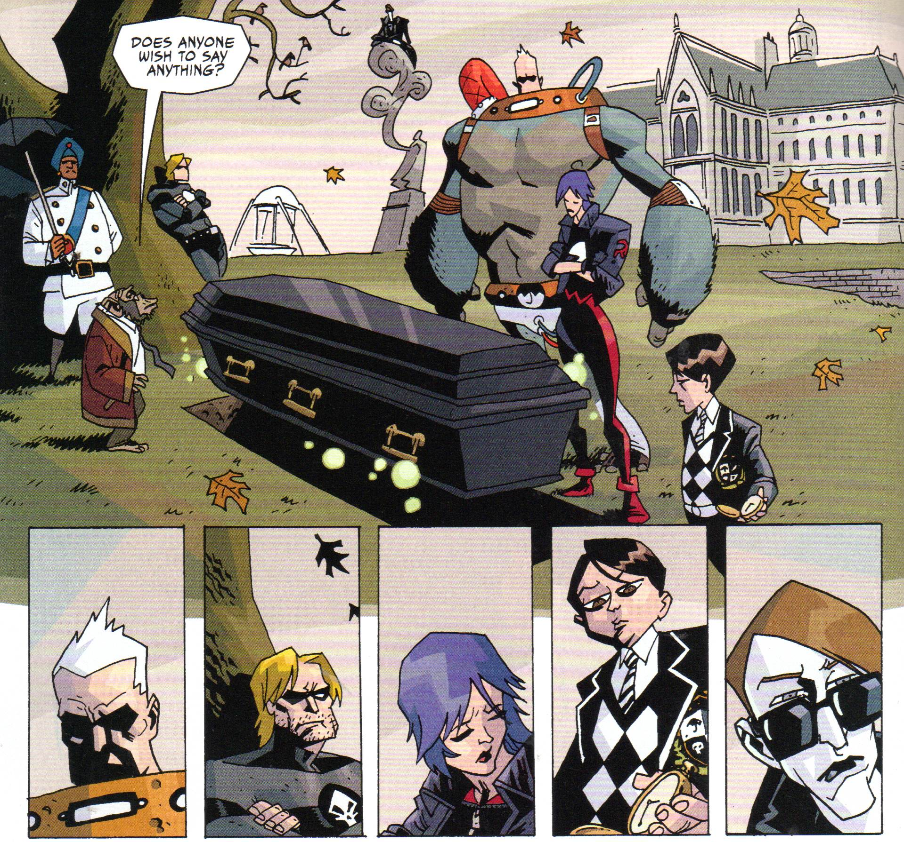

Slide 7


Slide 8

Jamie Hewlett, 2001

Slide 9
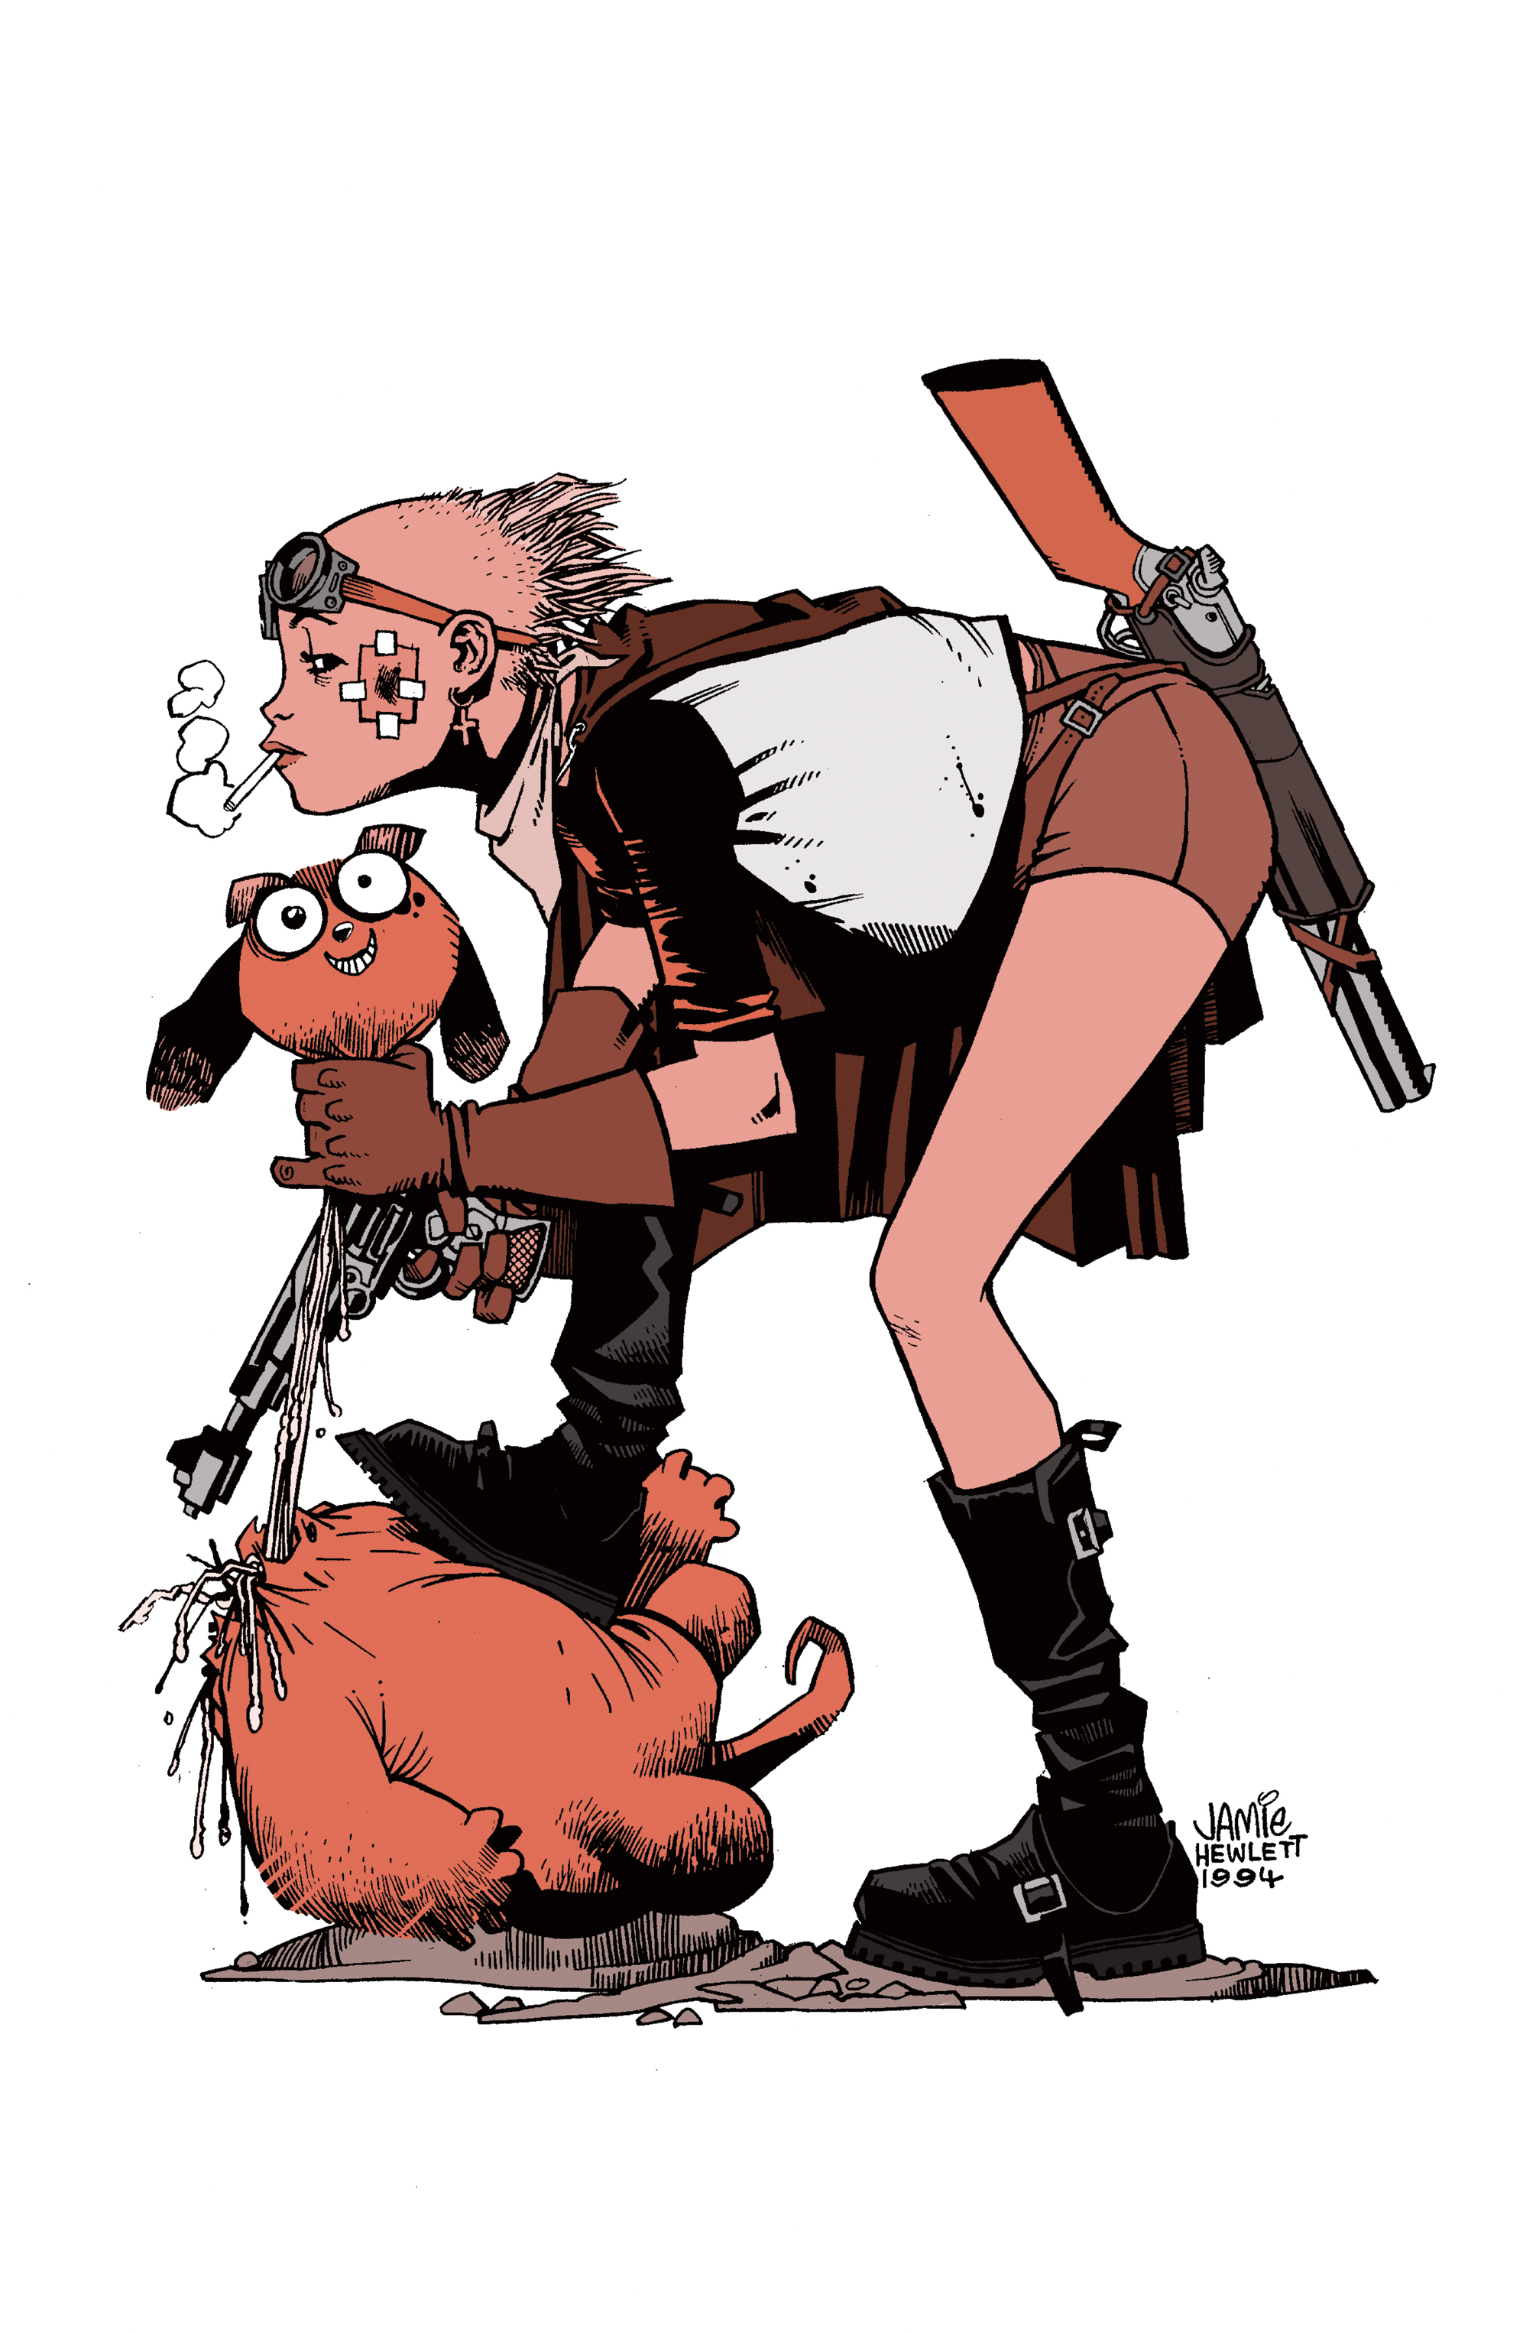
Tank Girl
Jamie Hewlett, 1988

Slide 10
Tank Girl, 1991

Slide 11
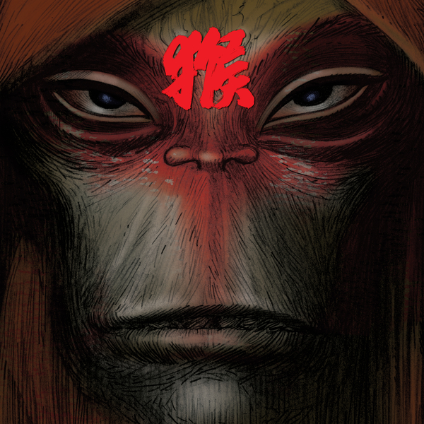
Monkey: Journey to the West.
Music by Damon Albarn
Illustration by Jamie Hewlett
2008
Notes:
Monkey: Journey to the West is a stage adaptation of the 16th century novel Journey to the West by Wu Cheng'en. It was conceived and created by the Chinese actor and director Chen Shi-Zheng along with British musician Damon Albarn and British artist Jamie Hewlett.

Slide 12
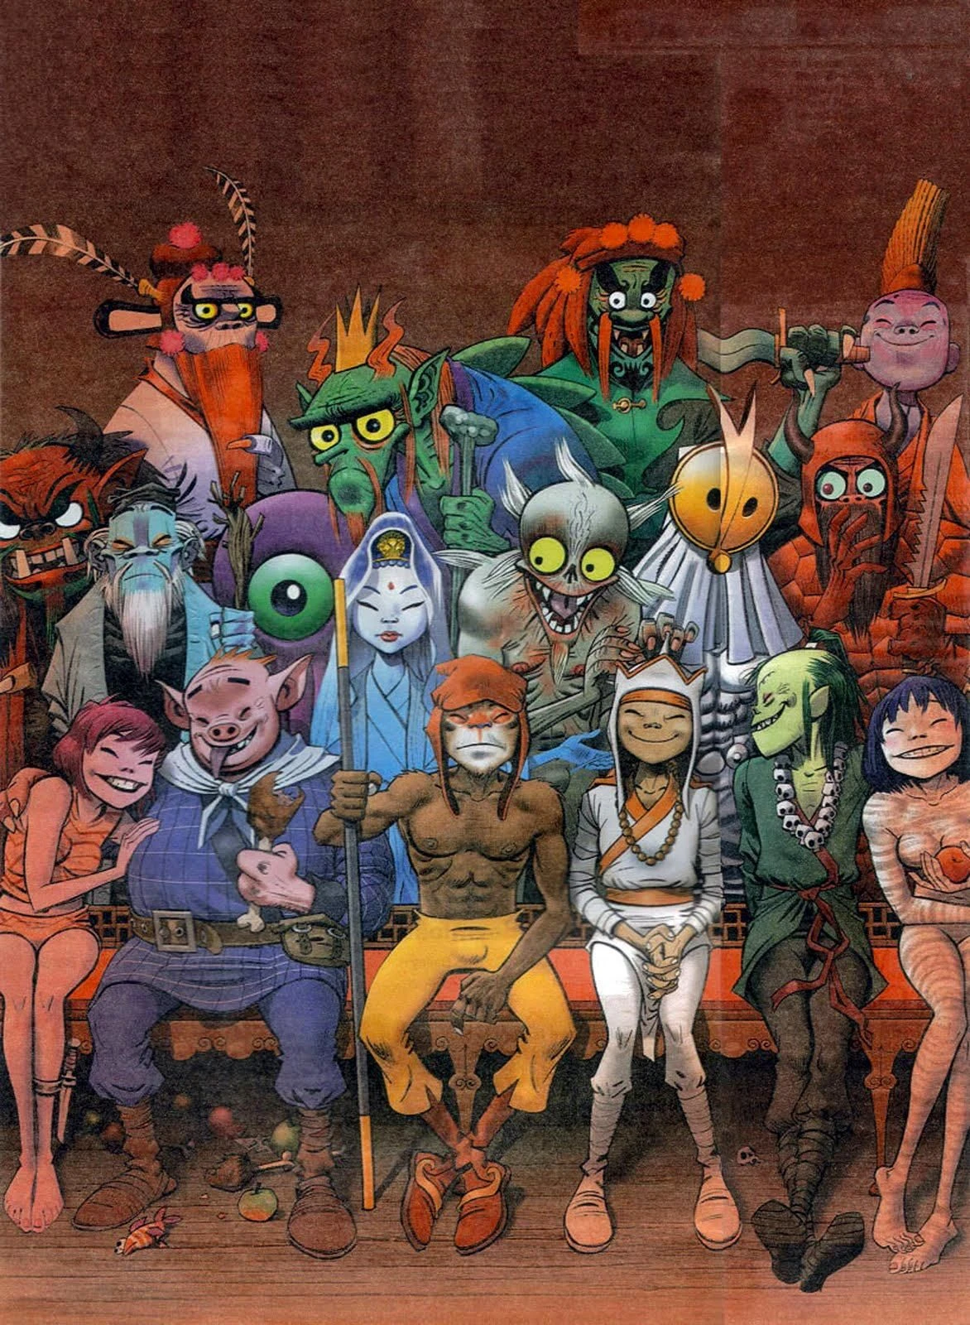
Monkey: Journey to the West.
Music by Damon Albarn
Illustration by Jamie Hewlett
2008

Slide 13
Monkey: Journey to the West.
Music by Damon Albarn
Illustration by Jamie Hewlett
2008

Slide 14
Hawiian Crow
Ghosts of Gone Birds
Jamie Hewlett 2012

Slide 15
Gorillaz 2001- Present

Slide 16
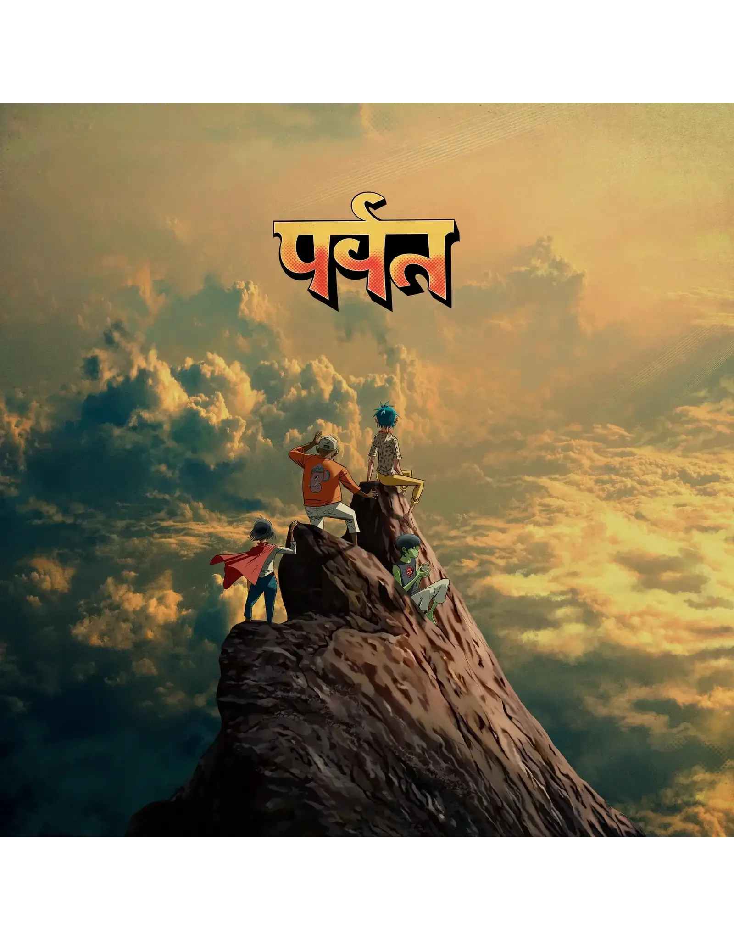
Gorillaz, The Mountain

