Slide 1

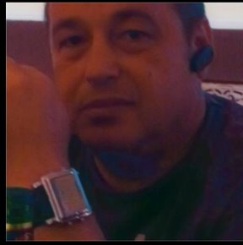
Module: Managing Enterprise in the 21st Century
Module code: BMSW 4006
Module Lecturer: Light Zaglago
Assignment Title: Business Plan Presentation
Student
Ion Adrian Barbu - 2113245
Marius Ioan Farkos - 2111975
Razvan Banica - 2112397
Ion Adrian Barbu
2113245

Slide 2
Business plan
Company name
Smart Useful App`s

Slide 3
Business Concept
Our company create applications for the industrial fire sprinklers controller.
Sprinklers work automatically when their heat-activated elements reach a temperature that enables them to discharge water over a specified area upon reaching their temperature.
Providing solutions, delivering active fire detection, suppression, and smoke management systems, as well as voice alarms and emergency voice communication systems, is what we do.

Slide 4
“We’re in business to save your home and your business”
This is our statement and our promises!!!
Smart Useful App`s help any business.

Slide 5
The Target Market
For all the major buildings like hospitals, university, city hall, police so go on.
We conducted social media surveys and introduced promotion schemes before having the product (app) ready for sale.
Pricing
We will be the lowest on the market, for the first 3-4 months. And for the first 10 customers the maintenance will be free for 1 year
Advertising
1. We must determine the purpose of advertising.
2. We must determine our target audience.
3. We must decide our advertising budget size.
4. We must selecting media for advertising and deciding the schedule.

Slide 6
Market audit
SWOT Analysis
Strengths | Weaknesses
Because we have the lowest prince on the market, strong balance sheet, unique technology, | We are new, and we need to find customers. An inadequate supply chain, or lack of capital.
Opportunities | Threats
We are new and a focused to find and keep our customer. The biggest opportunity that our company is working on, is helping our customers to take right decision with their business. One big opportunities as well is to expand a franchise into a new city. | Lack of experience and new and existing regulations, new and existing competitors, new technologies that may make your products or services obsolete, unstable political and legal systems in foreign markets.

Slide 7
Pestle analysis
Political | Economic | Social | Tehnological | Enviromental | Legal
Judiciary Independence | International and local price fluctuations | Changing demographics | Infrastructure development related to e-commerce | Changing climate's influence | Regulatory laws for businesses
Regulatory Practices | Inflation Rate | Educated Society | Productivity and Costs |  | Legislation on health and safety
Role Local Governments Play | Income dispensable by consumers | Attitudes towards immigrants and types of immigration | Mobile payment acceptance |  | Rights protection for intellectual property

Slide 8
Competition
Our competitors is Integrated Fire Safety Systems Ltd
Having spent over 15 years building knowledge and forming relationships with some of the fire industries best manufacturers, suppliers, and installers.
Vipond Fire Protection this company it began as a small family business in 1969.
UK Sprinklers Ltd, they design, fabricate, install, and maintain sprinkler systems according to all applicable codes and standards.
Our advantage over our competitors is first of all our lower prices, and last but not least our desire to assert ourselves and achieve something important for us and for the community.

Slide 9
Goals and Objectives
Business Expenses Can Be Reduced
Make Our Business More Productive
Improve Customer Service by Creating New Processes
We make our business website or blog more popular
  For inbound and content marketing to generate revenue of £200,000, we need 10,000 website visitors within the next 6 months.
  It is necessary to increase the number of recommendations from 5 to 12 influencers in the second half of 2022 in order to raise brand awareness.
Profitability is the key to success
Achieving cash flow stability
Attracting and retaining customers
A marketing strategy that reaches and grows an audience

Slide 10
The Team
Ion Adrian Barbu (partner):
Passionate about computers and app creator.
Received a 'Team Player' award for his teamwork.
He create a lot of app which improve life of the people.
He create a strong network
Marius Farkos (partner):
Passionate about gaming and web designer.
Developed and maintained an internet site with 2,000 stages and images.

Slide 11
The Team Organization Chart
[Ion Adrian Barbu] President, CEO
[Full Name] Marius Farkos
[Full Name] Razvan Banica
[Erica Right] Manager
[Chris Dwanson] Manager
[John Dove] Manager
[Martin Webber] Manager

Slide 12
Resource Requirements
List requirements for the following resources:
  Personnel-CEO, Manager, Employee
  Technology-Computers, Piping in a multi-purpose system
  Finances-Grants, Invested by owners
  Distribution-Vehicles
  Promotion- Advertising ,Web Site.
  Products- Parts, Pumps, Nozzles, Heads
  Services-Fixing or replacing leaking or broken sprinkler heads, Repairing or replacing broken pipes, Capping off sprinkler heads, Adjusting poor spray patterns and wasted water.

Slide 13
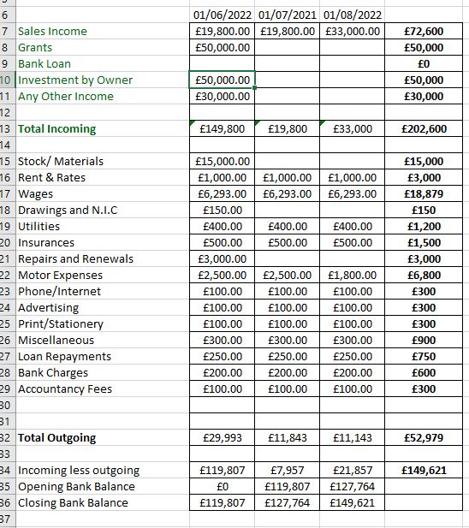
Financial Plan
Cashflow Forecast

Slide 14
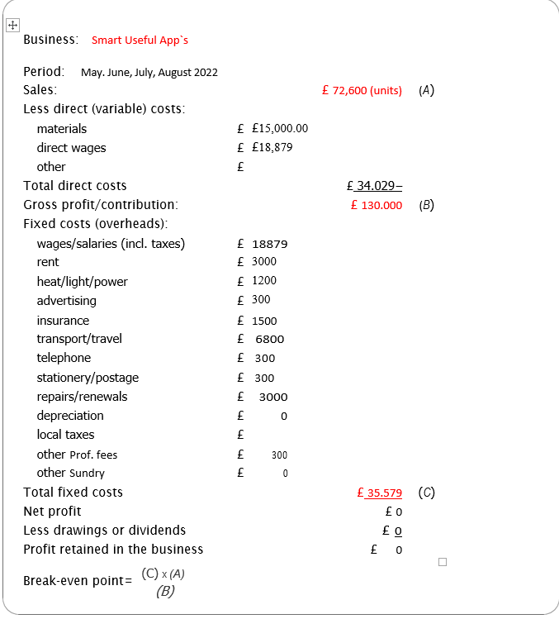
Profit & Loss

Slide 15
Risks and Rewards
Risks: Market Risks, Risks to mental and physical health, Cash flow problems and financial risks.
Rewards: Having your own business gives you a sense of freedom, giving back to the community is one way to make a difference.

Slide 16
Key Issues & SOLUTION
Near term
  Marketing lacks: Learn marketing so people know you exist and are here to help.
  Attracting and retaining customers: Promotion and marketing of your product or brand will certainly bring you new customers, but it's not the only debate here.
  Controlling your finances: Small business cash flow problems arise when accounts are not handled efficiently or customers do not produce enough revenue.
Long term
Dependence on clients: Expand your business on-line
Fatigue
Time Management: Make a list of goals, If you don't need to be involved in the work, delegate it, Eliminate the unnecessary tasks.

Slide 17
reference
Dheeraj Vaidya (2020) Target Market Definition.
Available at: https://www.wallstreetmojo.com/target-markets/
(Accessed: 17 June 2022).
templates. office (2020) Business plan templates.
Available at: https://templates.office.com/en-us/collection-business-plan-templates-small-business
(Accessed: 17 June 2022).
Sprinklers Direct (2020) FIRE SPRINKLER SYSTEM COST.
Available at: https://www.sprinklersdirect.co.uk/fire-sprinkler-system-cost/
(Accessed: 20 June 2022).
Alyssa Gregory(2019) 19 Small Business Goals You Can Set This Year.
Available at: https://www.thebalancesmb.com/small-business-goals-4126116
(Accessed: 20 June 2022).
Intellspot (2019) 27 SMART Marketing Objectives Examples.
Available at: https://www.intellspot.com/marketing-objectives-examples/
(Accessed: 21 June 2022).
EMBA Pro (2019) Jain Irrigation Systems Limited.
Available at: https://embapro.com/frontpage/pestelcase/4476-jain-irrigation
(Accessed: 20 Ju;y 2022).
UMass Global (2019) Accomplishment statement examples to help make your resume stand out.
Available at: https://www.umassglobal.edu/news-and-events/blog/writing-an-accomplishment-statement
(Accessed: 20 Ju;y 2022).
Robin Booth(2019) What are the Risks and Rewards of Starting Your Own Business?
Available athttps://brixx.com/what-are-the-risks-and-rewards-of-starting-your-own-business/
(Accessed: 24 Ju;y 2022).

