Slide 1

The role of youth workers in supporting young people’s psychological wellbeing and adolescent transitions.
ECYW4012
Component 2
10-minute seminar

Slide 2
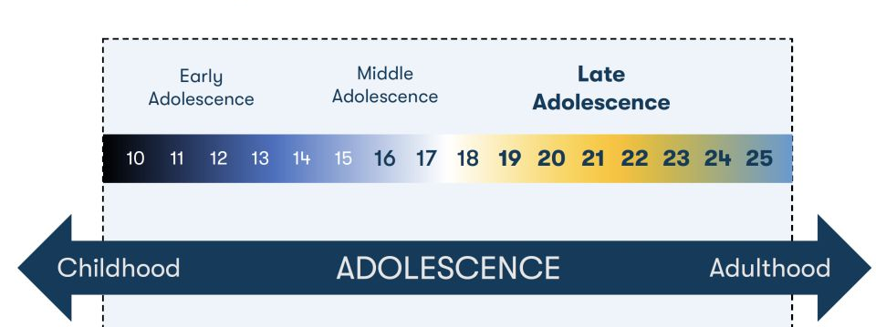
Definition
(UCLA, 2026)
Adolescence is the phase of life stretching between childhood and adulthood… Rather than age 10–19 years, a definition of 10–24 years corresponds more closely to adolescent growth and popular understandings of this life phase and would facilitate extended investments across a broader range of settings.
(Sawyer, Azzopardi, Wickremarathne and Patton, 2018)

Slide 3

The Role of the Youth Worker in Psychological well-being
Initiate, build and maintain relationships with young people
(CLD YW01)
Assist young people to learn and engage with the youth work service
(CLD YW02)
Enable young people to identify, reflect and use their learning to enhance their future development (CLD YW05)
Explore the concept of values and beliefs with young people
(CLD YW06)
Engage with and empower young people to make use of digital media in their daily lives
(CLD YW08)
Support young people to become responsible citizens through active involvement with youth work
(CLD YW09)
Advocate with and on behalf of young people so that their interests are represented (CLD YW10)
Plan, prepare and facilitate learning activities with young people
(CLD YW11 )
Access information with and for young people to inform decision making
(CLD YW 13 )
(CLD Standards Council, 2019)
What is youth work? The key purpose of youth work is to... “enable young people to develop holistically, working with them to facilitate their personal, social and educational development, to enable them to develop their voice, influence and place in society and to reach their full potential” (WG, 2019).

Slide 4
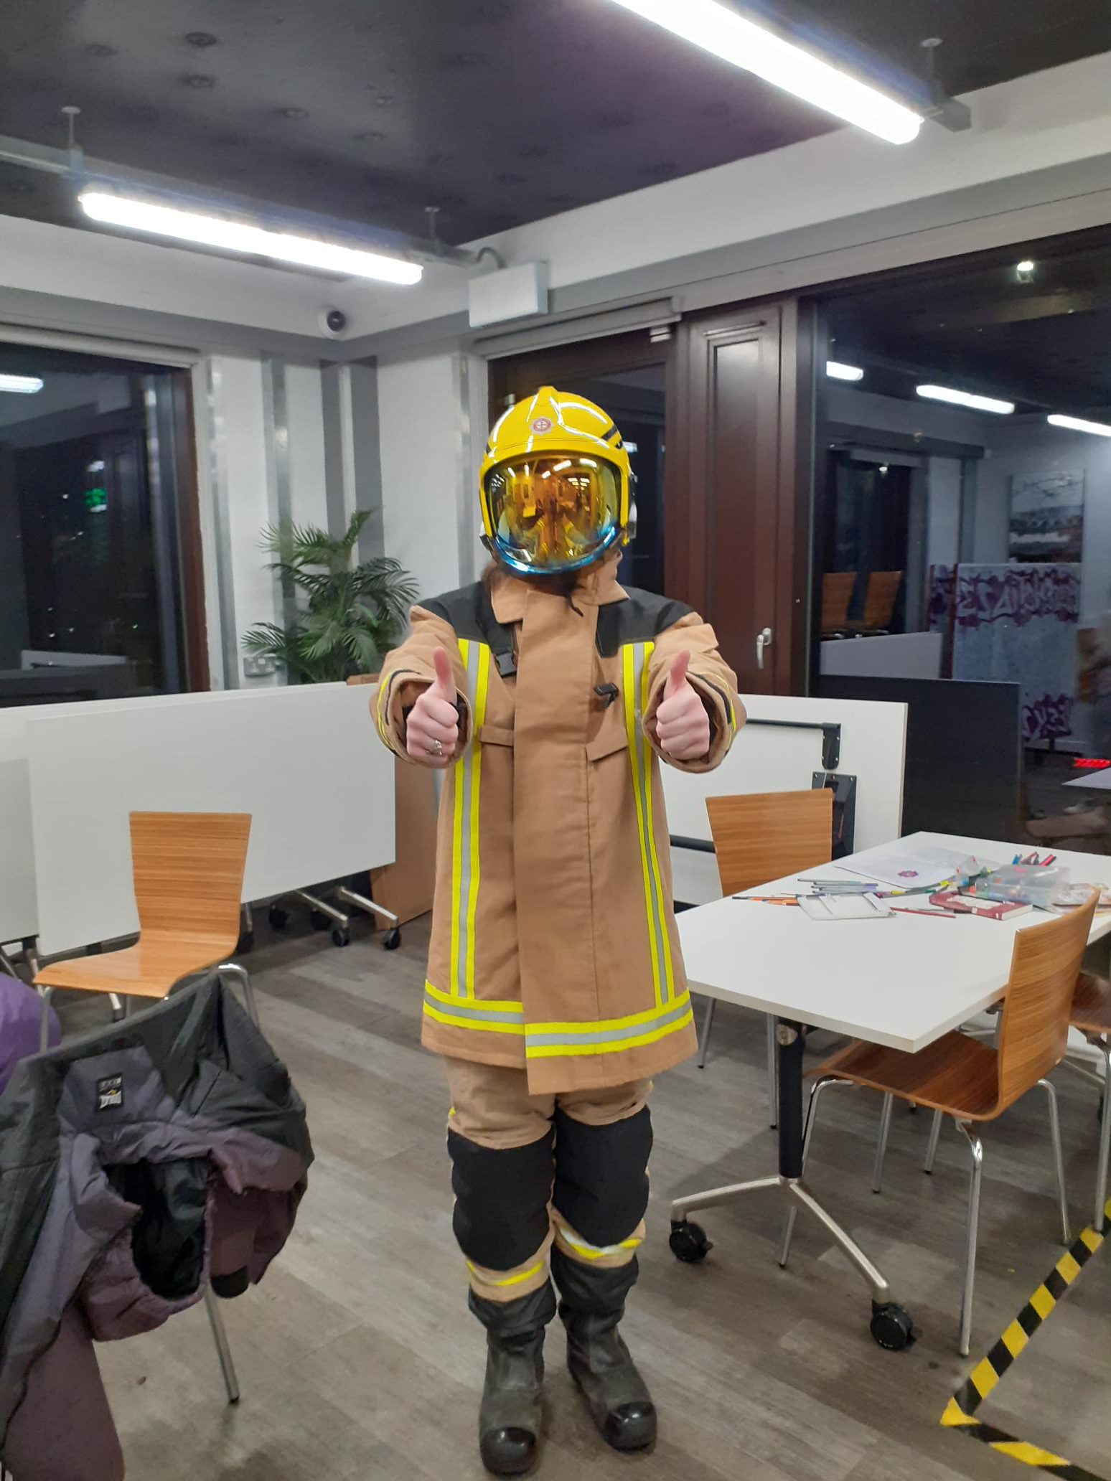
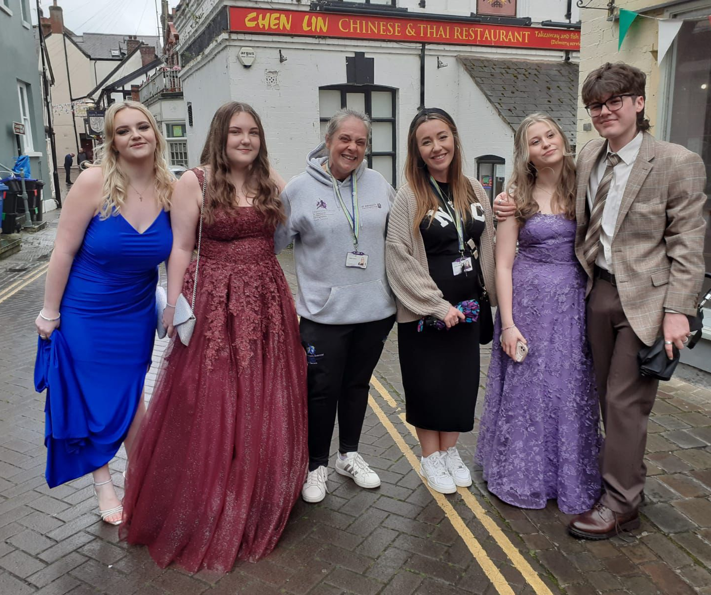
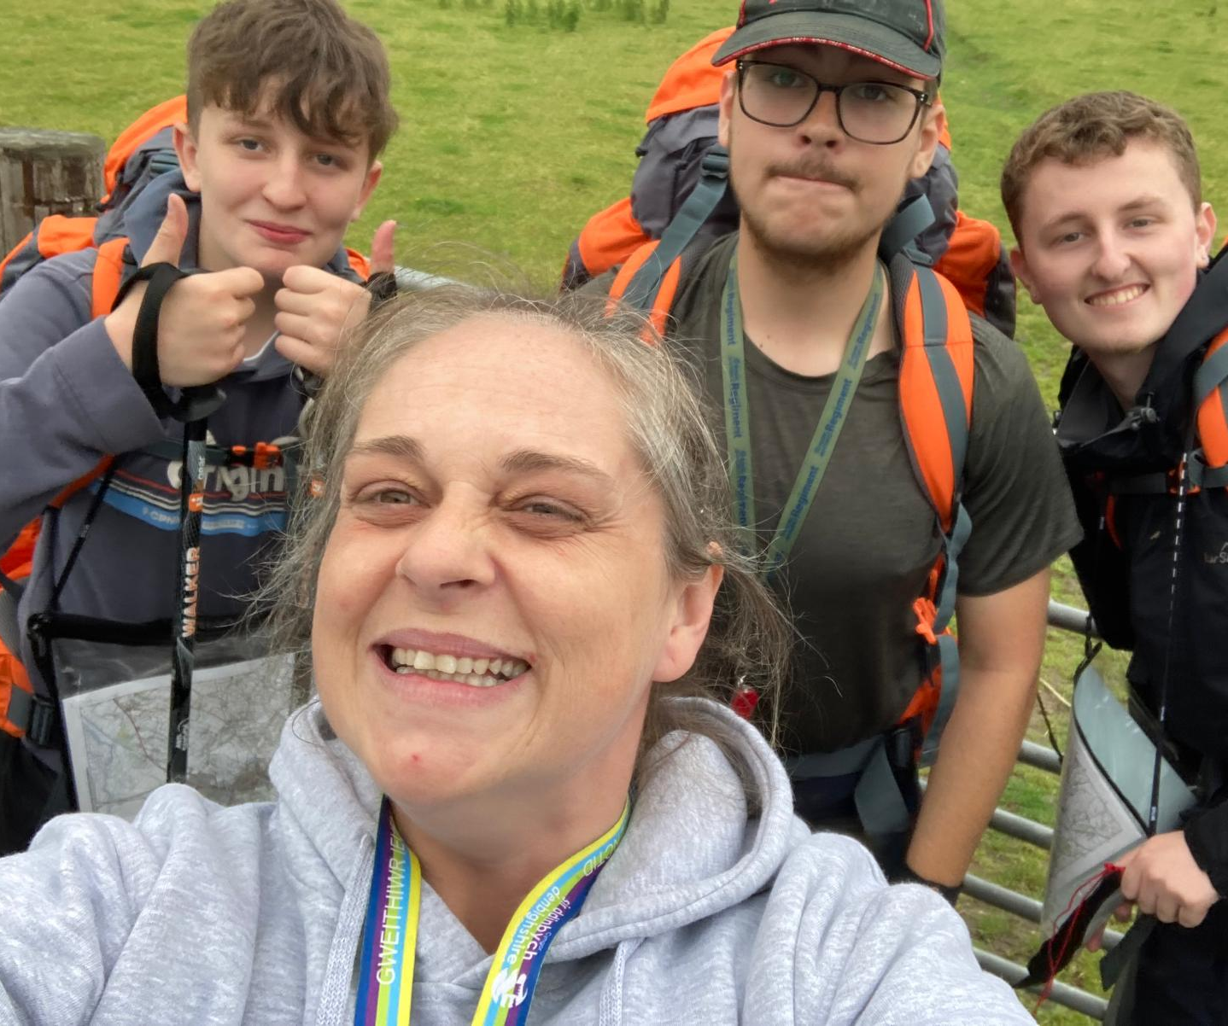
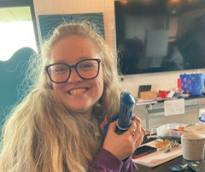
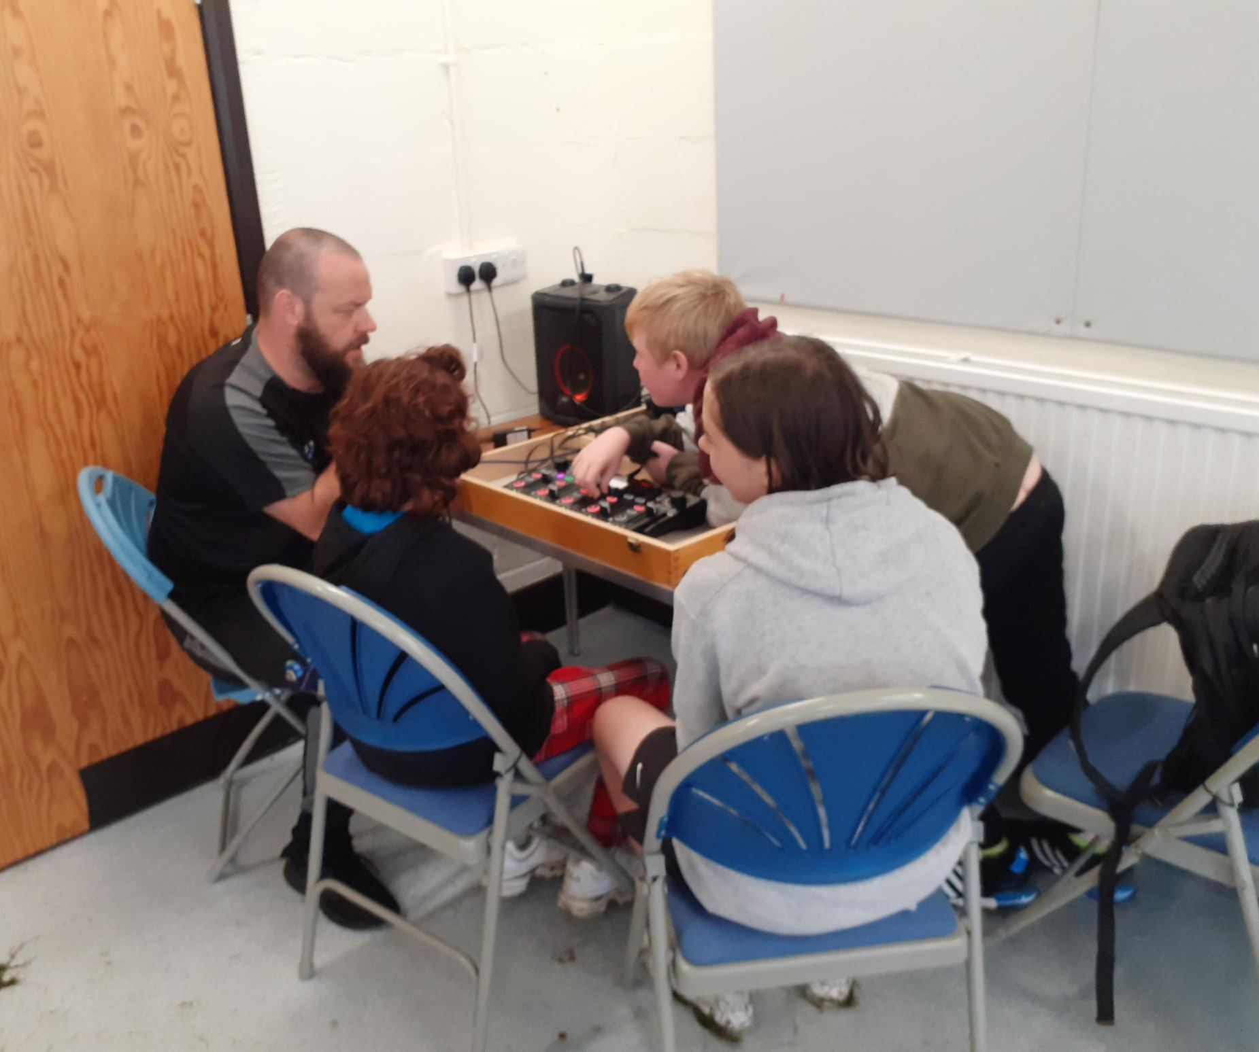
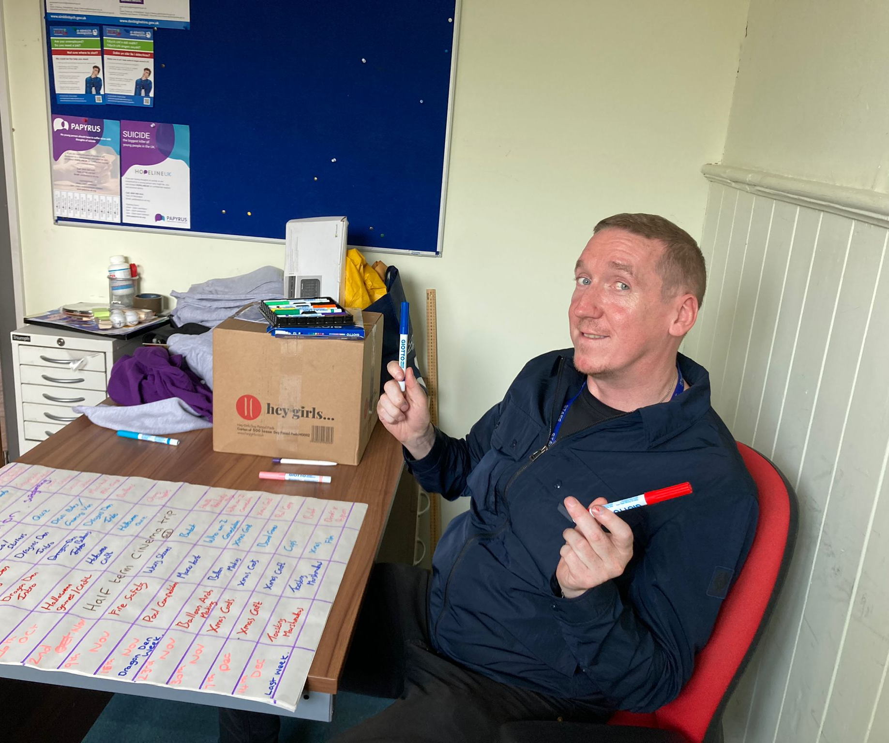
Youth Worker going first to encourage YP
Fire Service visit Denbigh open access
Youth Workers showing up!
Denbigh Prom 25
Encouragement at the last check point, DofE 25
Youth workers getting informed, sexual health training
Consultation will YP plan the programme, Quarter Plans 25
Youth Worker sharing knowledge, Podcast Project 25
Notes:
Photographs taken by author
Figure 1: Young leaders’ group going to 2024/2025 Denbigh high prom [Photograph] (2025)).
Figure 2: Fire service visit after rises in fires near local castle, the dangers and what Photographs to do in an emergency. [Photograph] (2025).
Figure 3: The last check point of the day, with my targeted DofE group [Photograph] (2025).
Figure 4: Sexual health training, Amanda demo practice [Photograph] (2025).
Figure 5:’What strong, not wrong’ podcast 2025, Wills speaking to the young people at camp about the project overview. [Photograph] (2025).
Figure 6: Gaz writing up the plans that young people wanted in the termly/ quarterly plan. [Photograph] 2025).

Slide 5
Cognitive Transition in Adolescence
Youth work interventions
Young person experiences
Thinking is predominantly concrete and black-and-white. Focus is often self-centered (egocentrism), leading to high self-consciousness.
Advanced problem-solving and abstract thinking abilities emerge, though impulse control is still developing.
Fully developed abstract reasoning, future planning, and long-term decision-making skills.
Provide opportunities to take risks safely
We walk beside them on the adventures
Challenge our young people to have a go
We practice with them
Build their confidence in safe environments
We celebrate their achievements

Slide 6
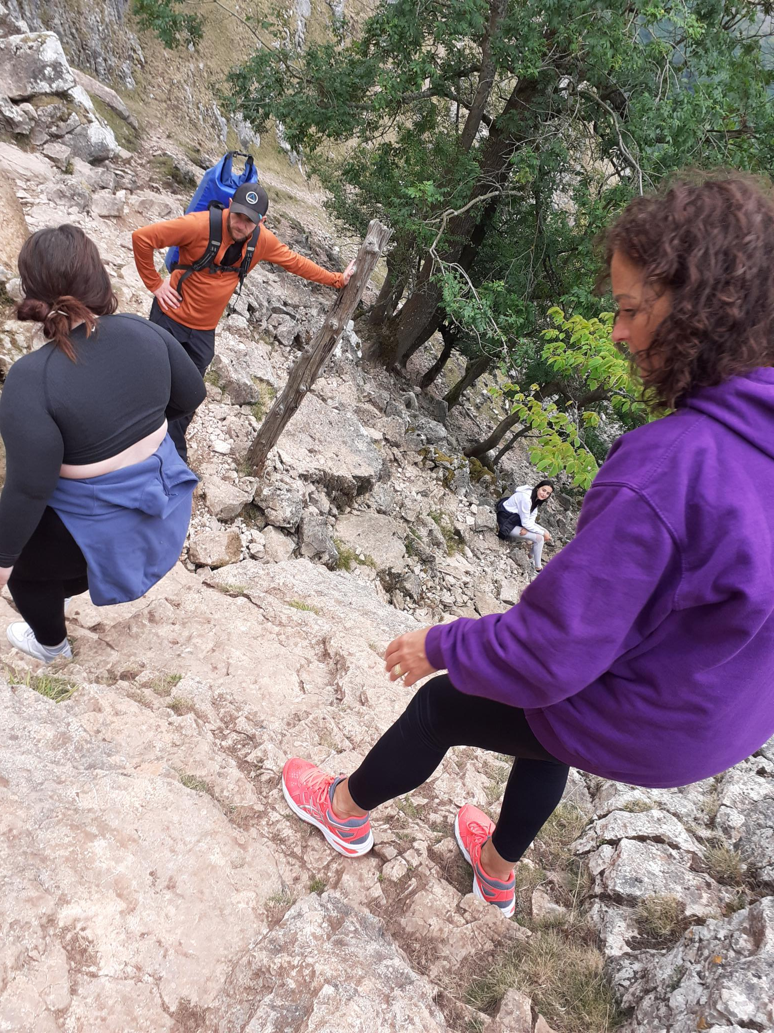
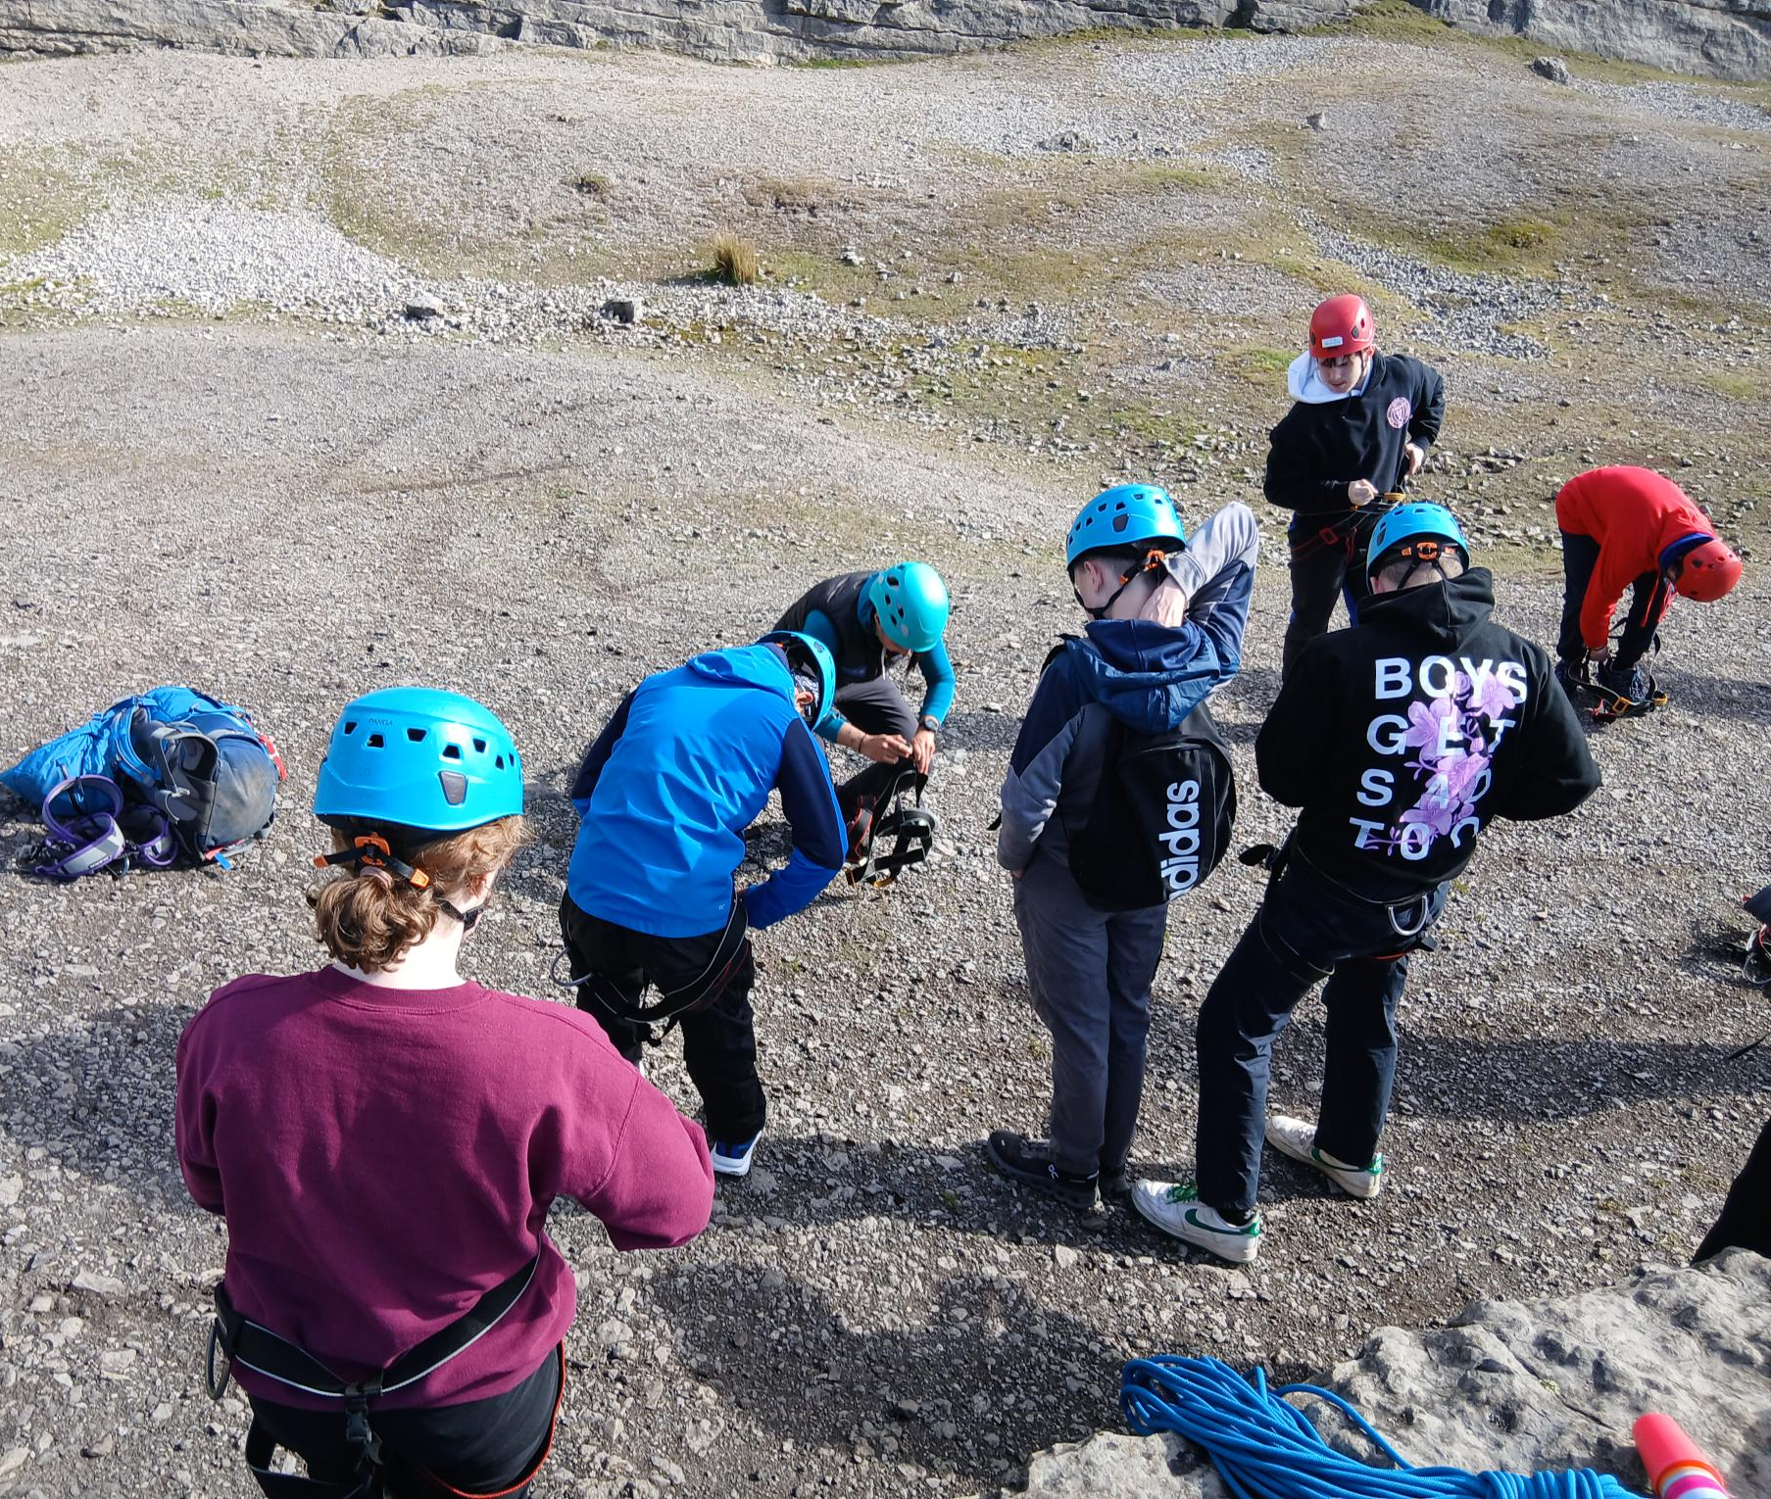
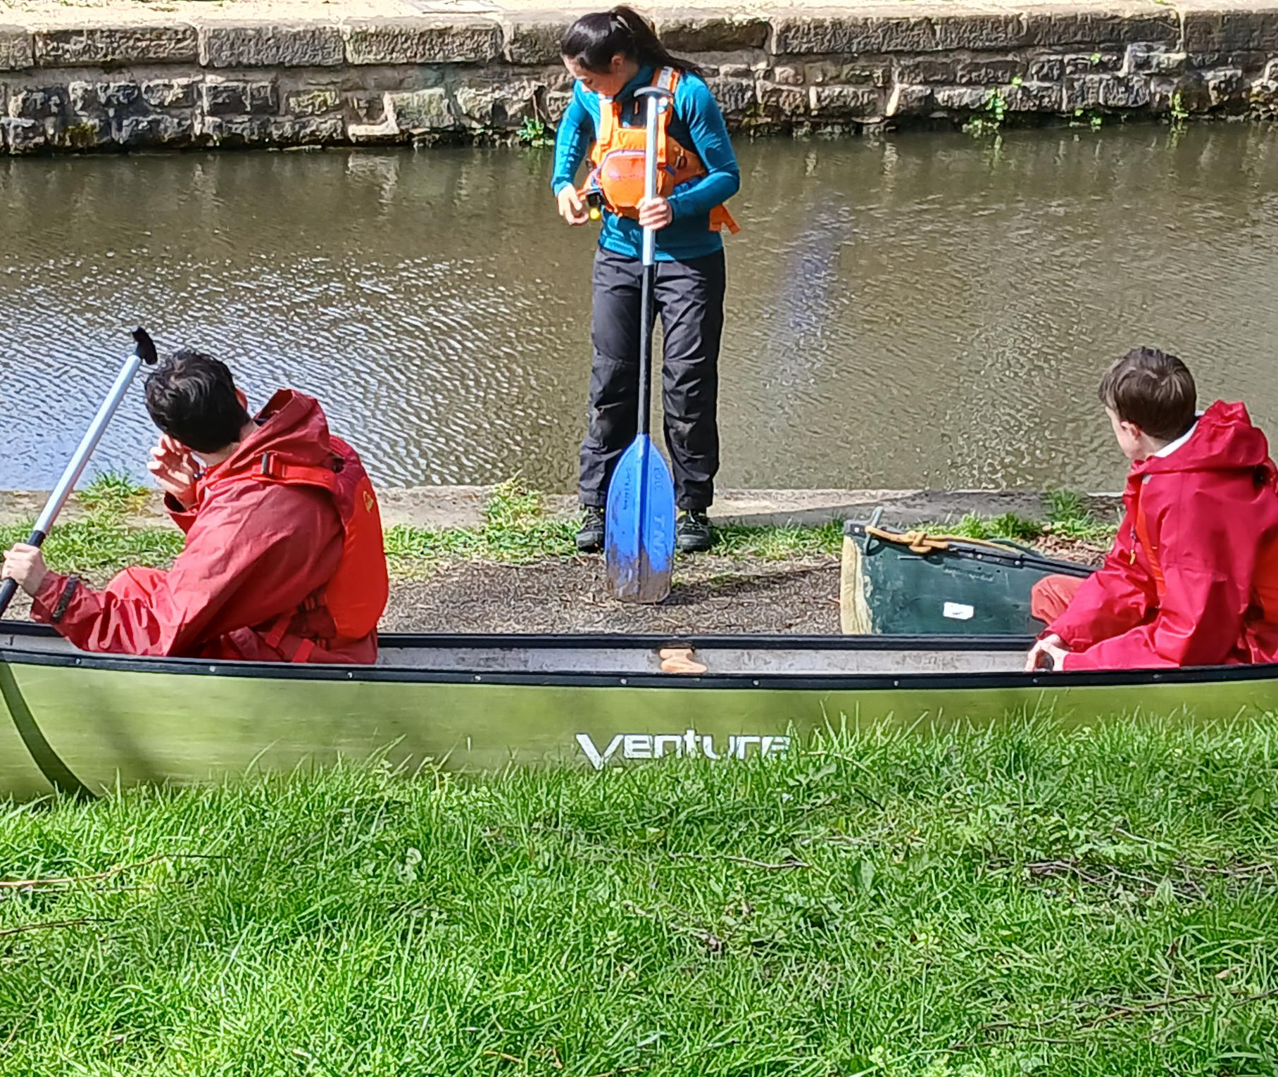
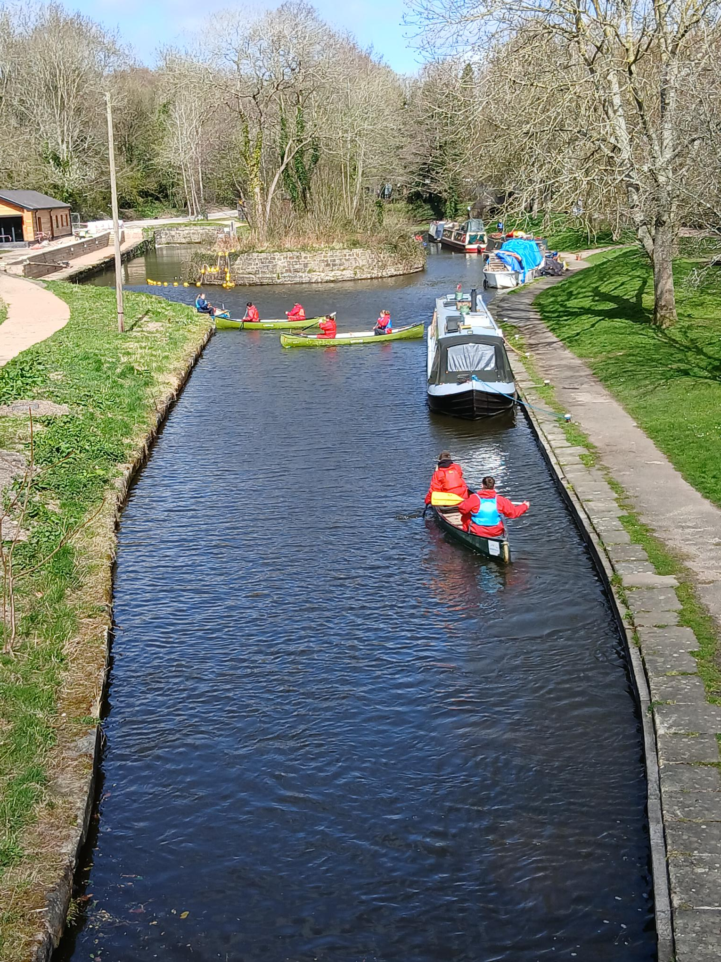
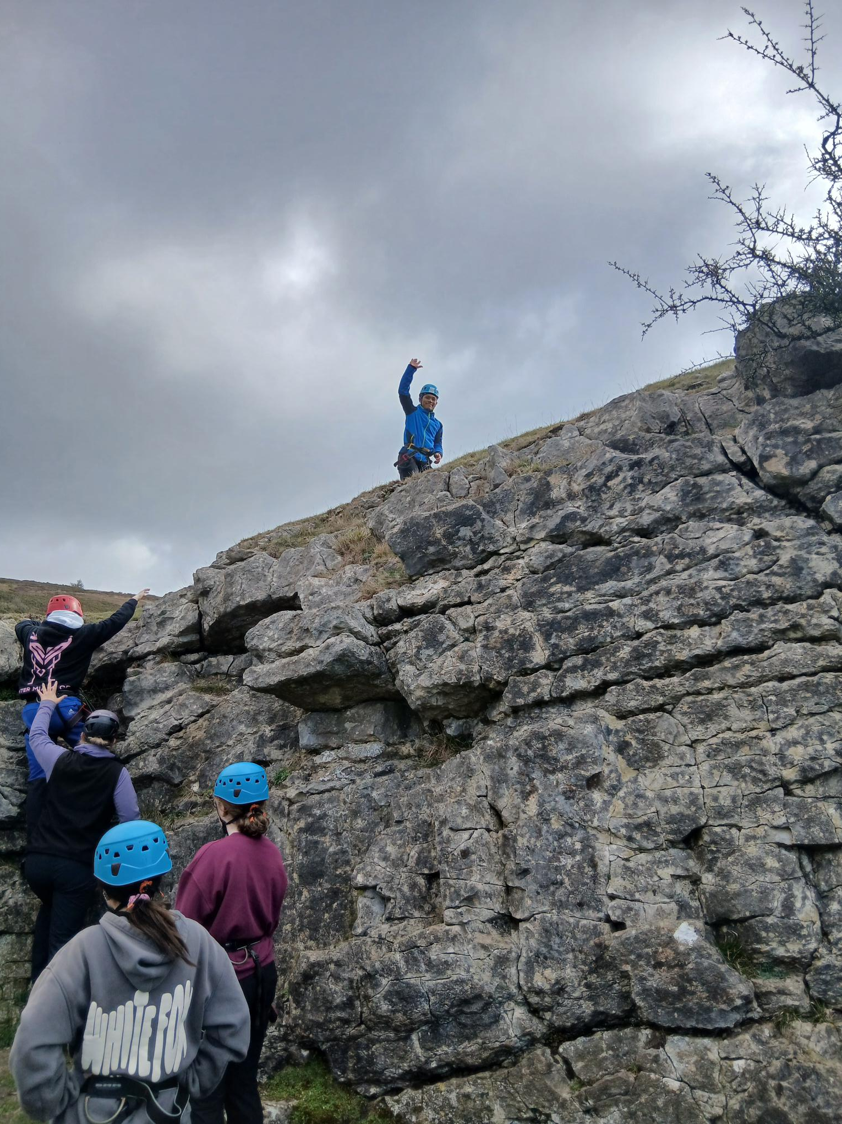
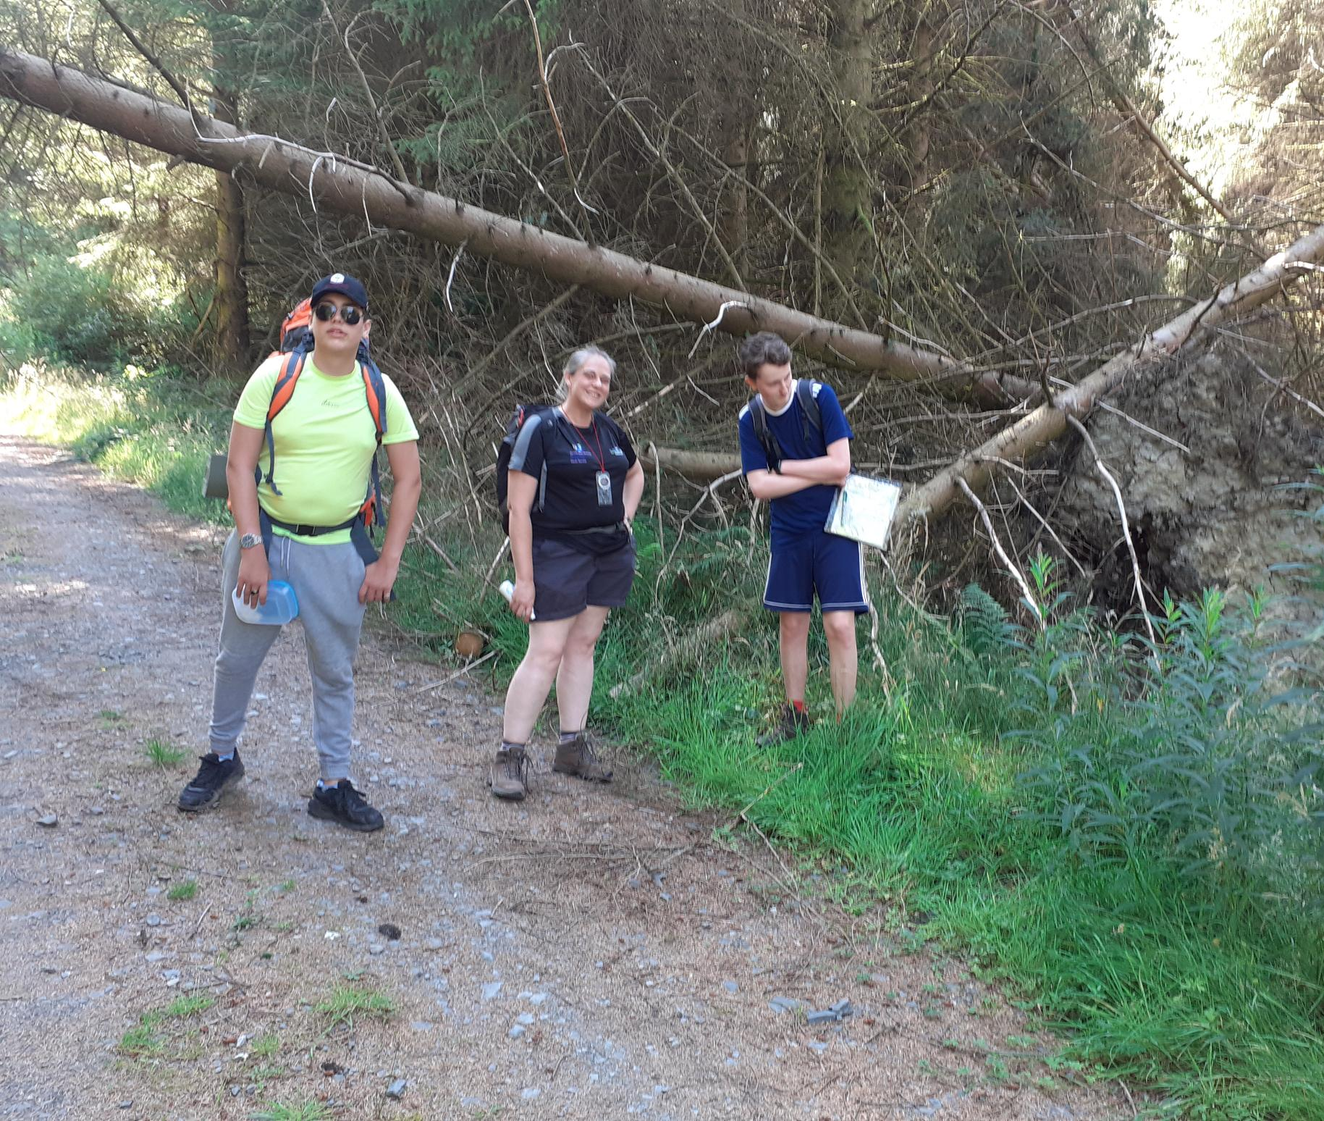
Provide opportunities to take risk, safely Young leaders residential 26
We walk beside you on the adventures, Targeted Girls’ group 25
Challenge our young people to have a go, YL residential 26
We celebrate their achievements, Young leaders residential 26
We practice with them, DofE practice walk 25.
Build their confidence in safe environments, YL residential 2026
Notes:
Photographs taken by author
Figure 7. Young leader residential 2026, calming the rocking climbing nerves while we got them ready [Photograph] (2026).
Figure 8. Targeted girls group 2025, out of 8 YP only 2 would come out the mini bus in Llangollen [Photograph] (2025).
Figure 9. Safety briefing before canoeing day on Llangollen canal. Young leaders 2026 water safety award [Photograph] (2026).
Figure 10.Taking a break in the shade on practice walking at Llyn Brenig on hottest day. Targeted Boys DofE group[Photograph] (2026).
Figure 11.YL finding their confidence before going over the aqueduct [Photograph] (2026).
Figure 12. After a shaking start with the nerve the YL reaching the top and overcoming their fears. YL residential [Photograph] (2025).

Slide 7
Biological Transition
Young person experiences
Youth work interventions
Onset of puberty, including growth spurts, development of pubic hair, and initial breast or testicular development.
Puberty-related changes are mostly complete for females, while males continue their growth spurts and voice changes.
Physical maturation is generally complete, with ongoing development of muscle bulk in young men
Explore Identity
Informal opportunities to learn
Discuss the issues
Informative Visitors
Space to socialise
Safe environments to be

Slide 8
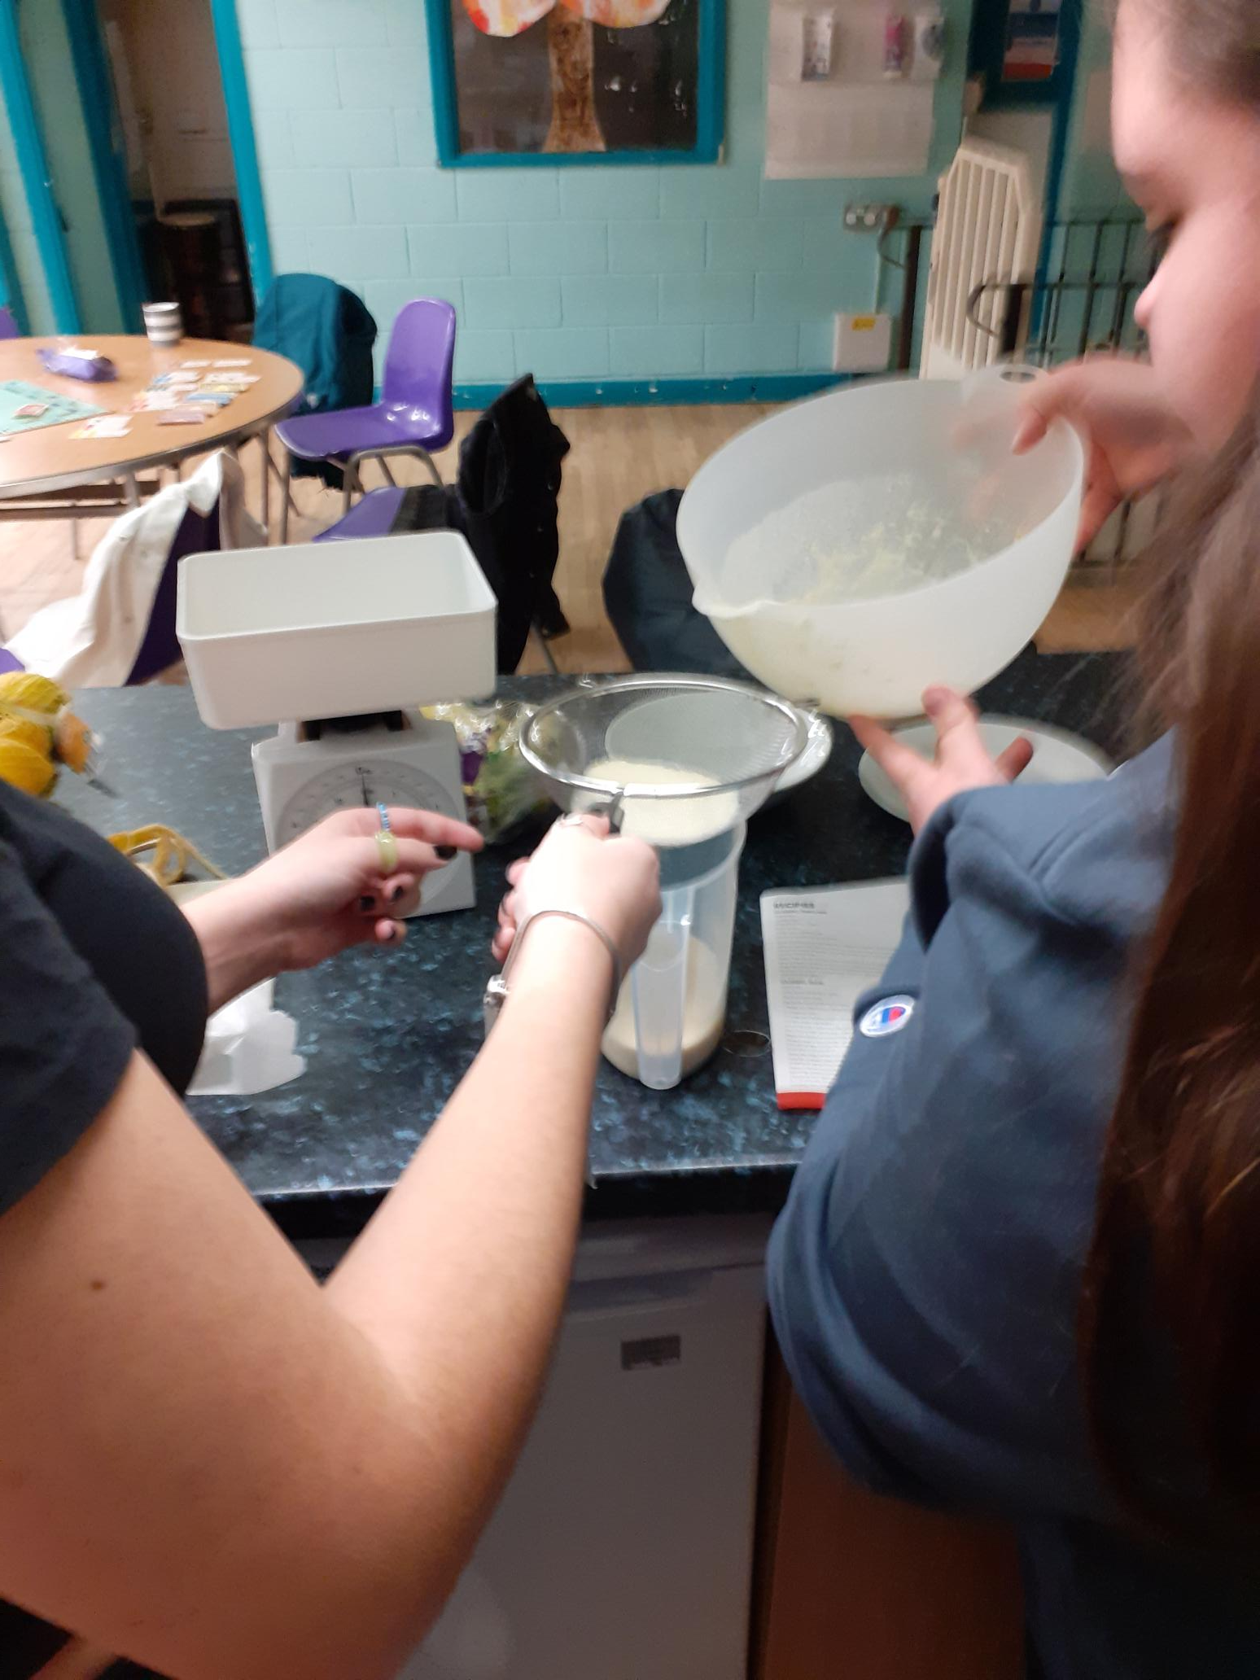
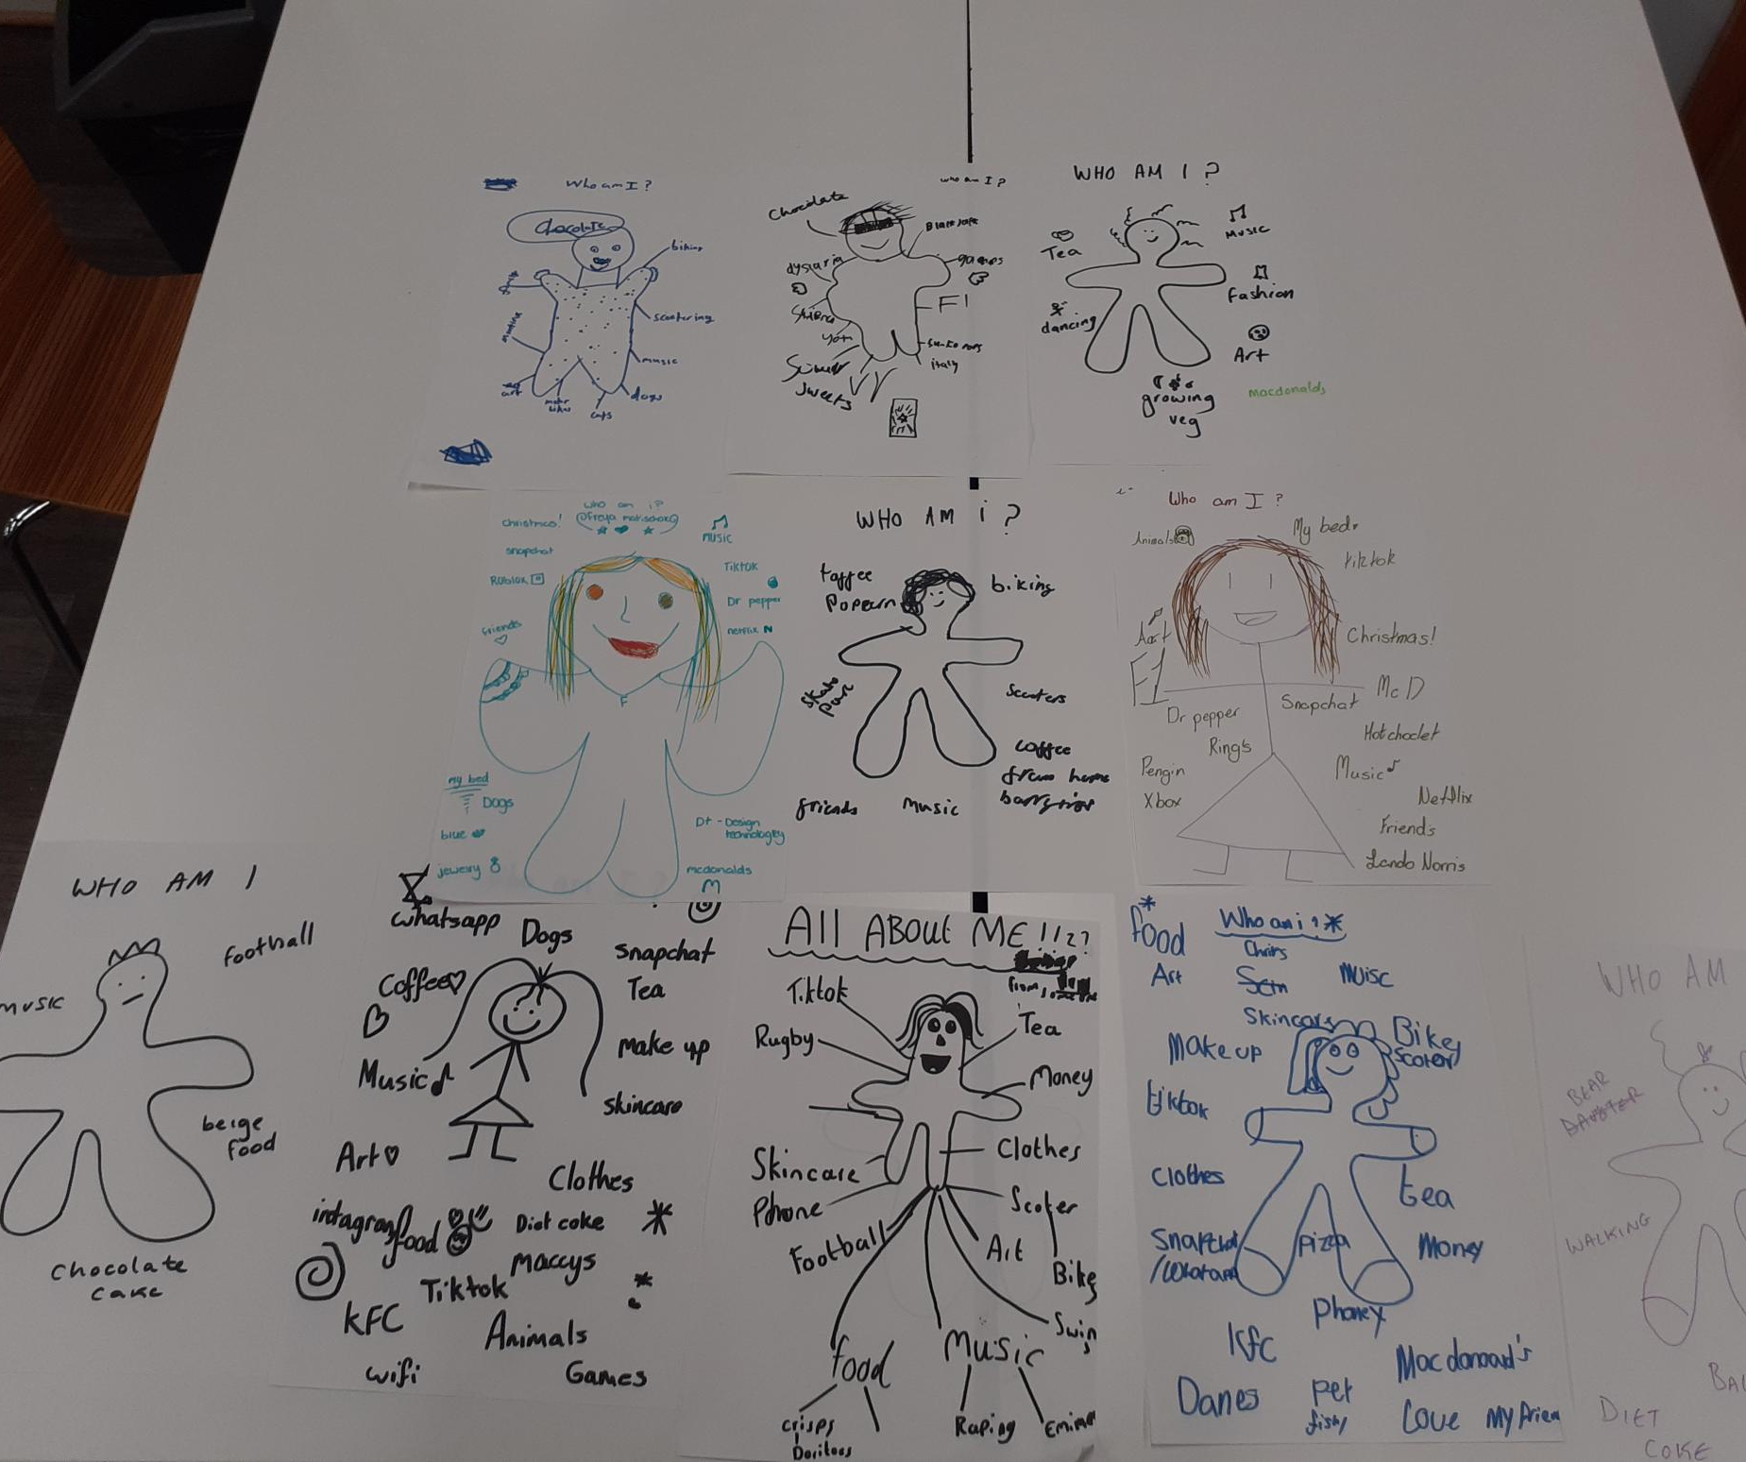
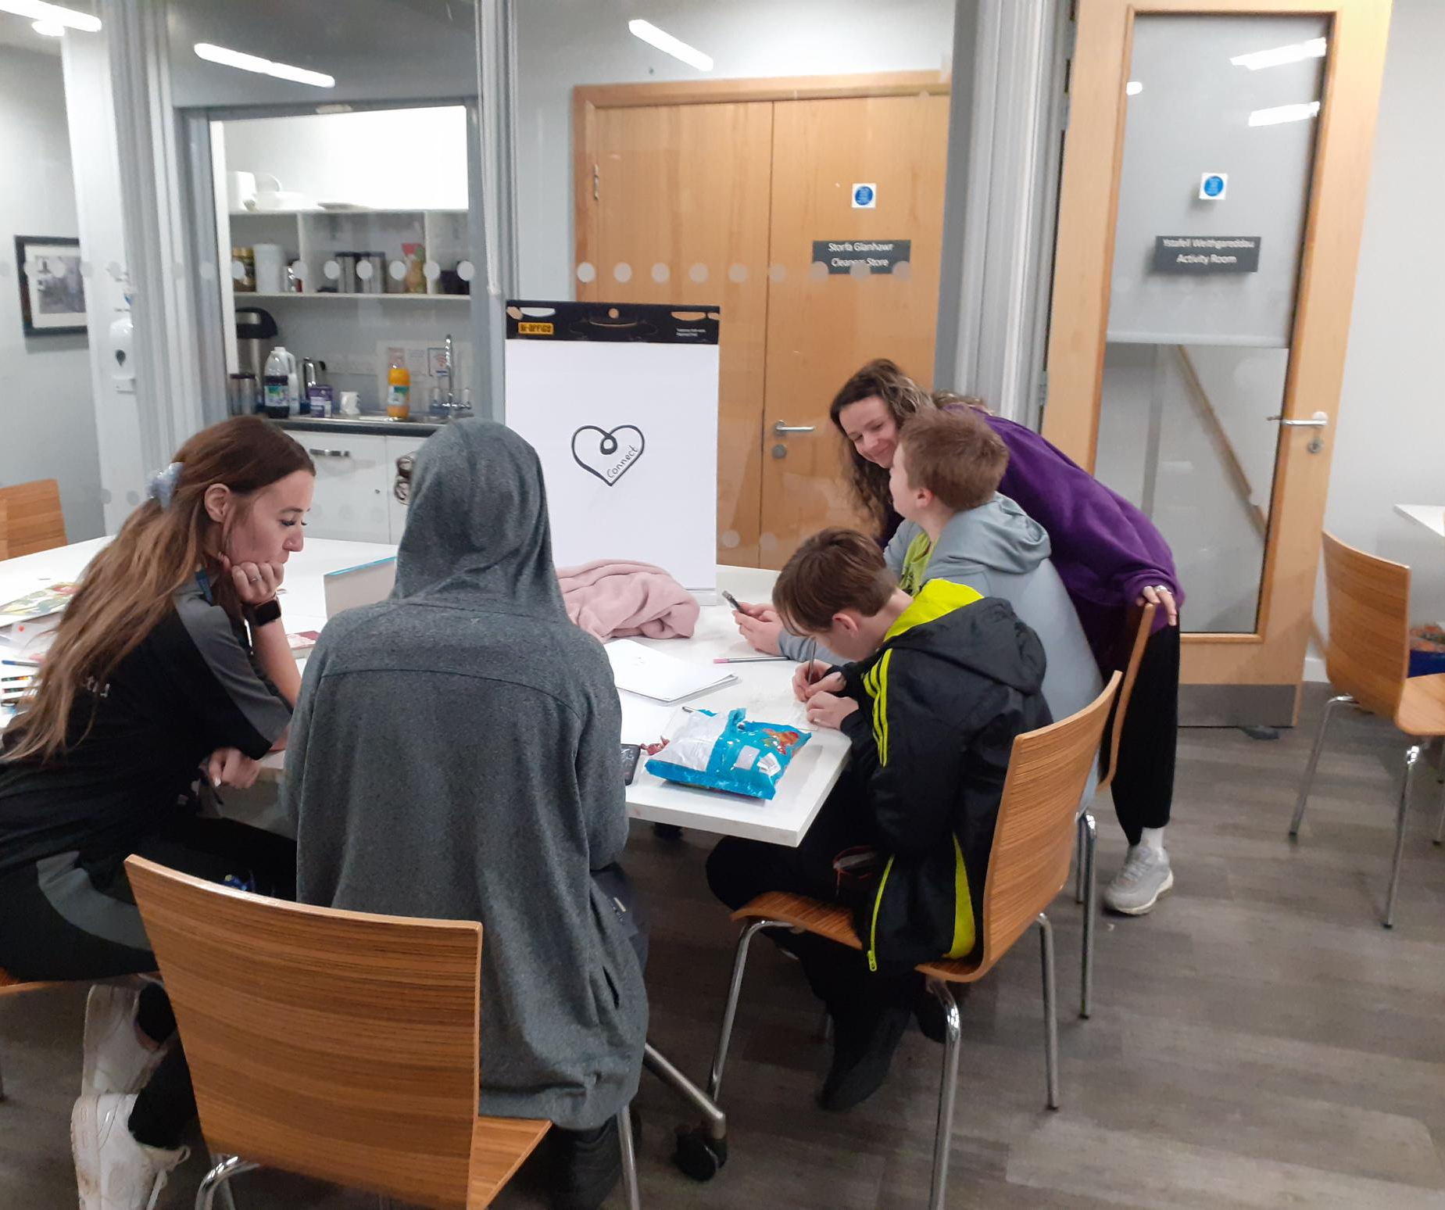
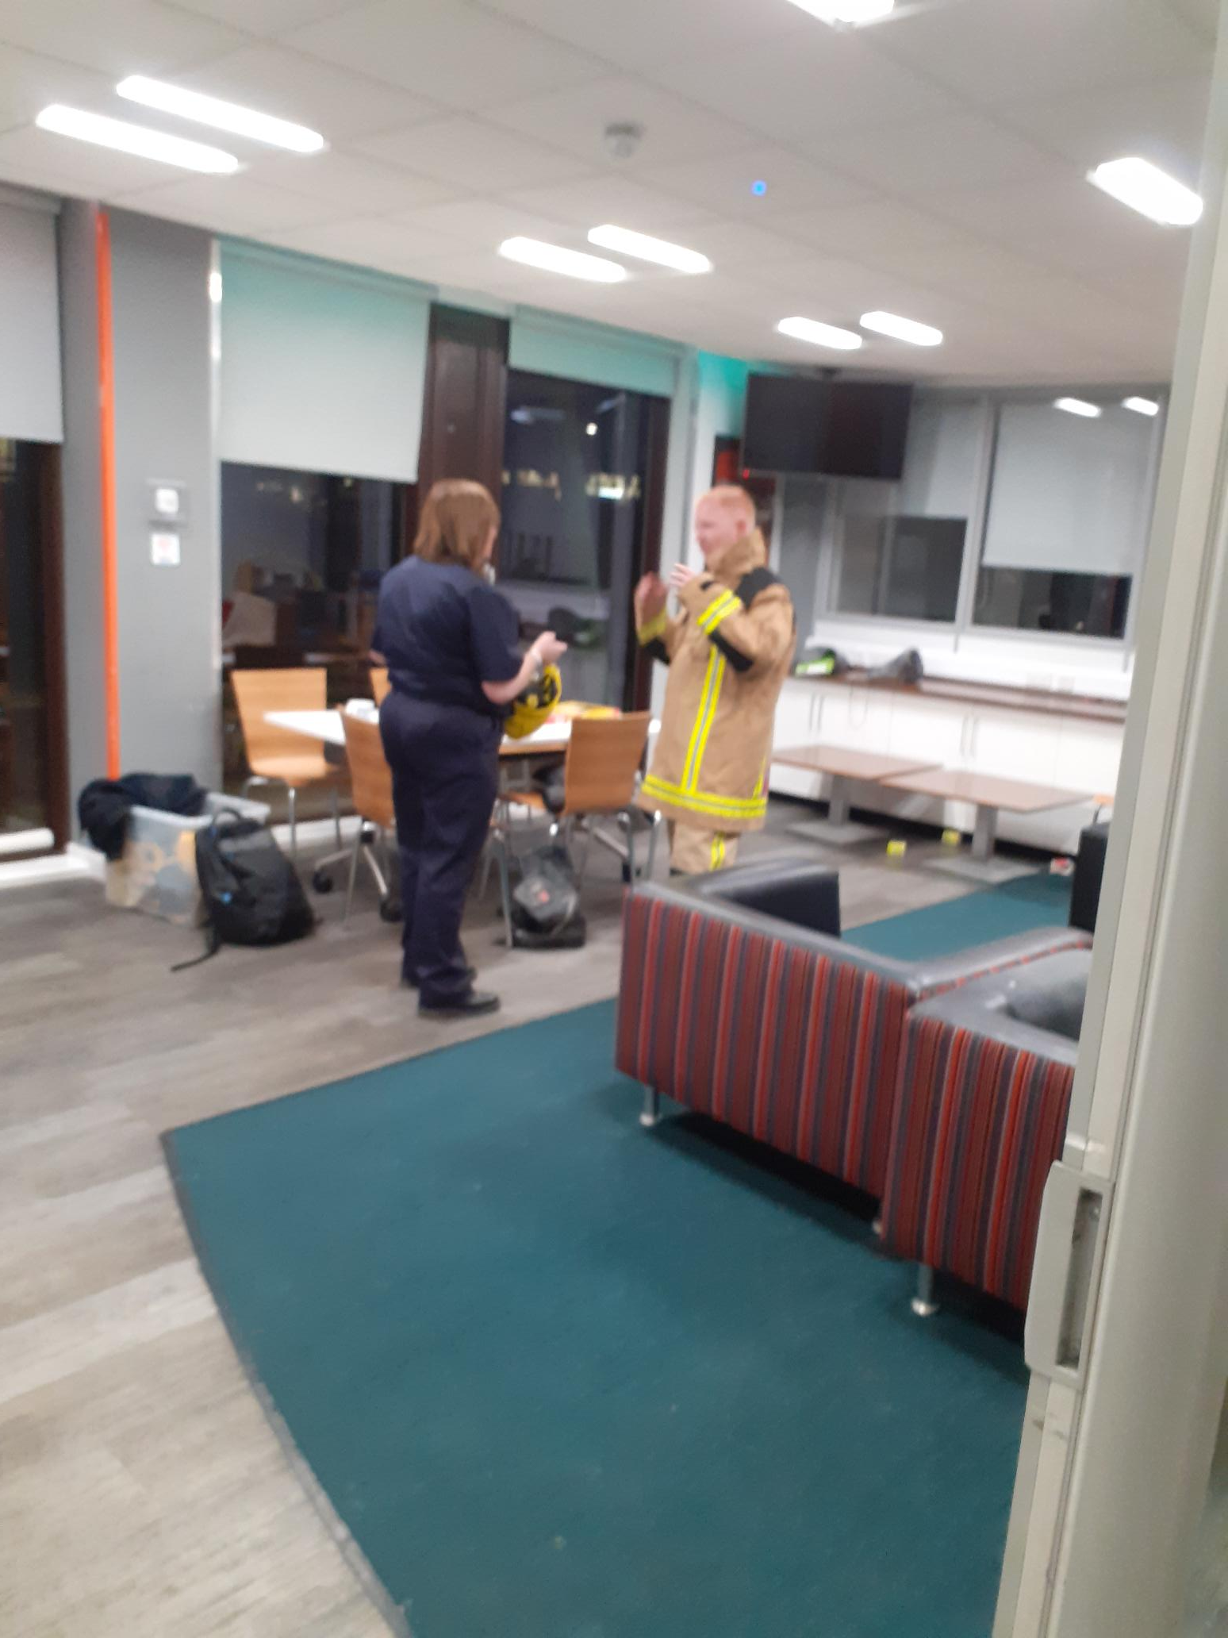
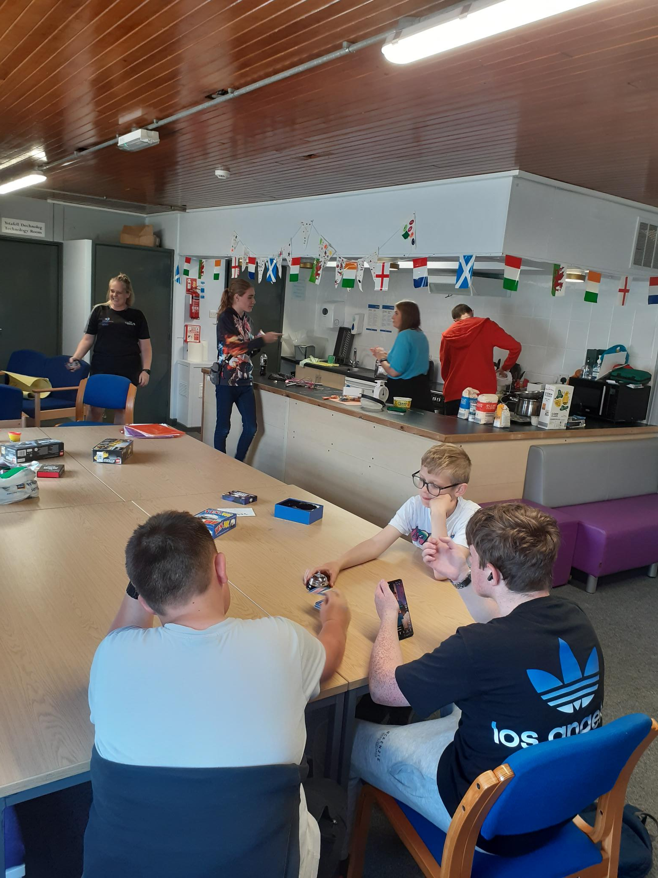
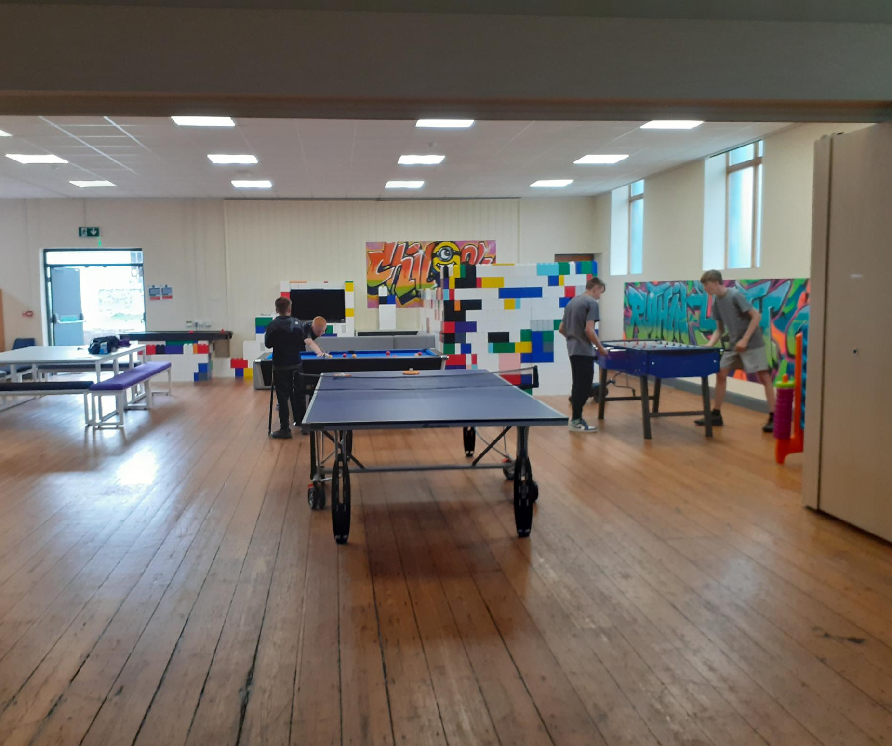
Explore Identity
Informal opportunities to learn
Discuss the issues
Safe environments to be
I
nformative Visitors
Space to socialise
Notes:
Photographs taken by author
Figure 13: Asking questions, who am i? activity Ruthin Open access 2025 [Photograph] (2025).
Figure 14: Learning new skills, cooking session Llangollen [Photograph] (2024).
Figure 15: Informed discussions, consultation for community improvement, Denbigh Hwb Bumps and Jumps [Photograph] (2025).
Figure 16: Safety talks for external visitors, Fire service Denbigh Hwb [Photograph] (2024).
Figure 17: Euros open day and celebrations Prestatyn Youth centre in partnership with DLL [Photograph] (2025).
Figure 18: Ruthin Youth centre the day I moved to my new role in the north, I was based here for 5 years [Photograph] (2025).

Slide 9
Social Transition
Young person experiences
Youth work interventions
Begins to separate emotionally from parents, seeking increased privacy and testing boundaries. Peer identification starts to strengthen.
Focus shifts towards romantic relationships, peer groups, and the initial development of a vocational identity. The desire for autonomy can create friction at home.
Achieves financial and social independence. Focus is placed on establishing a firm identity, career direction, and intimate, long-term relationships.
Sometimes just playing a board game
Going on trips
Provide opportunities to learn
We provide advice
Meeting young people where they are
Challenge young people to “Give it a go”

Slide 10
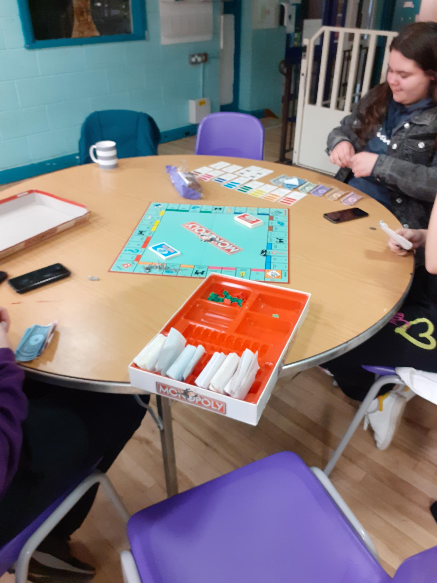
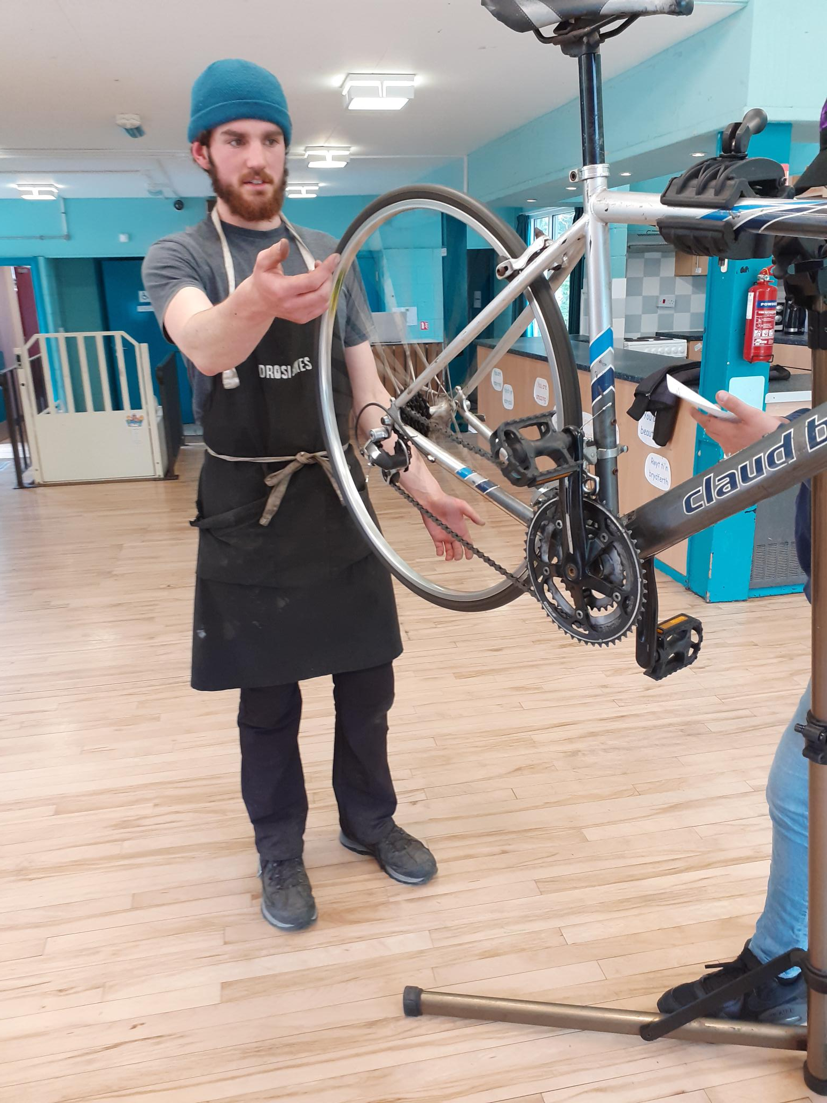
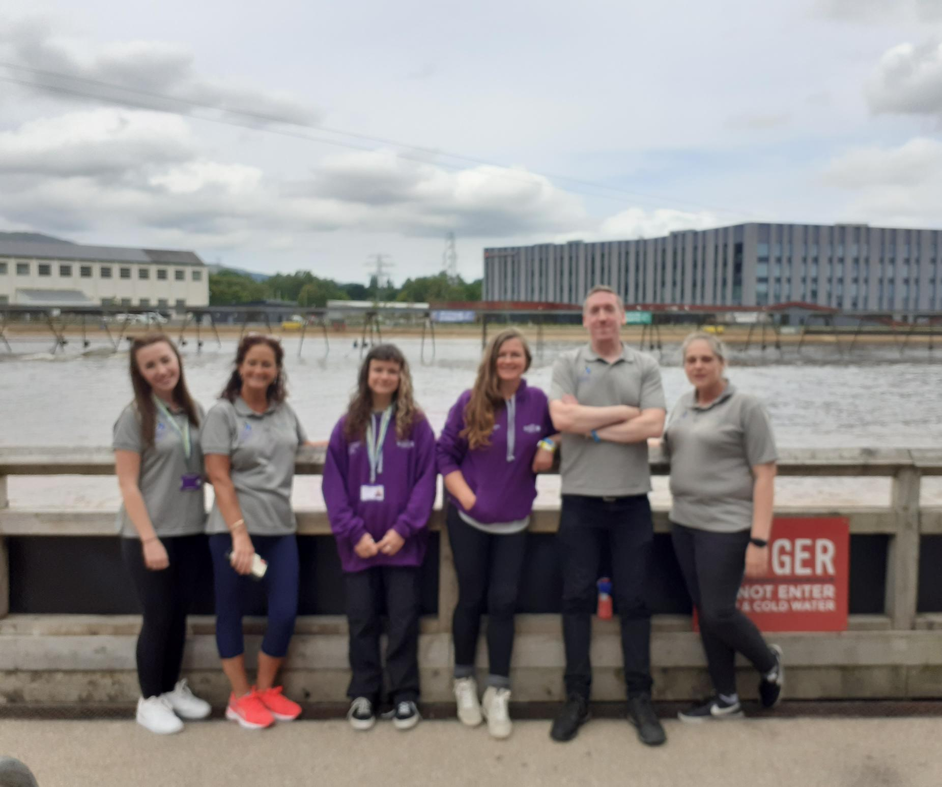
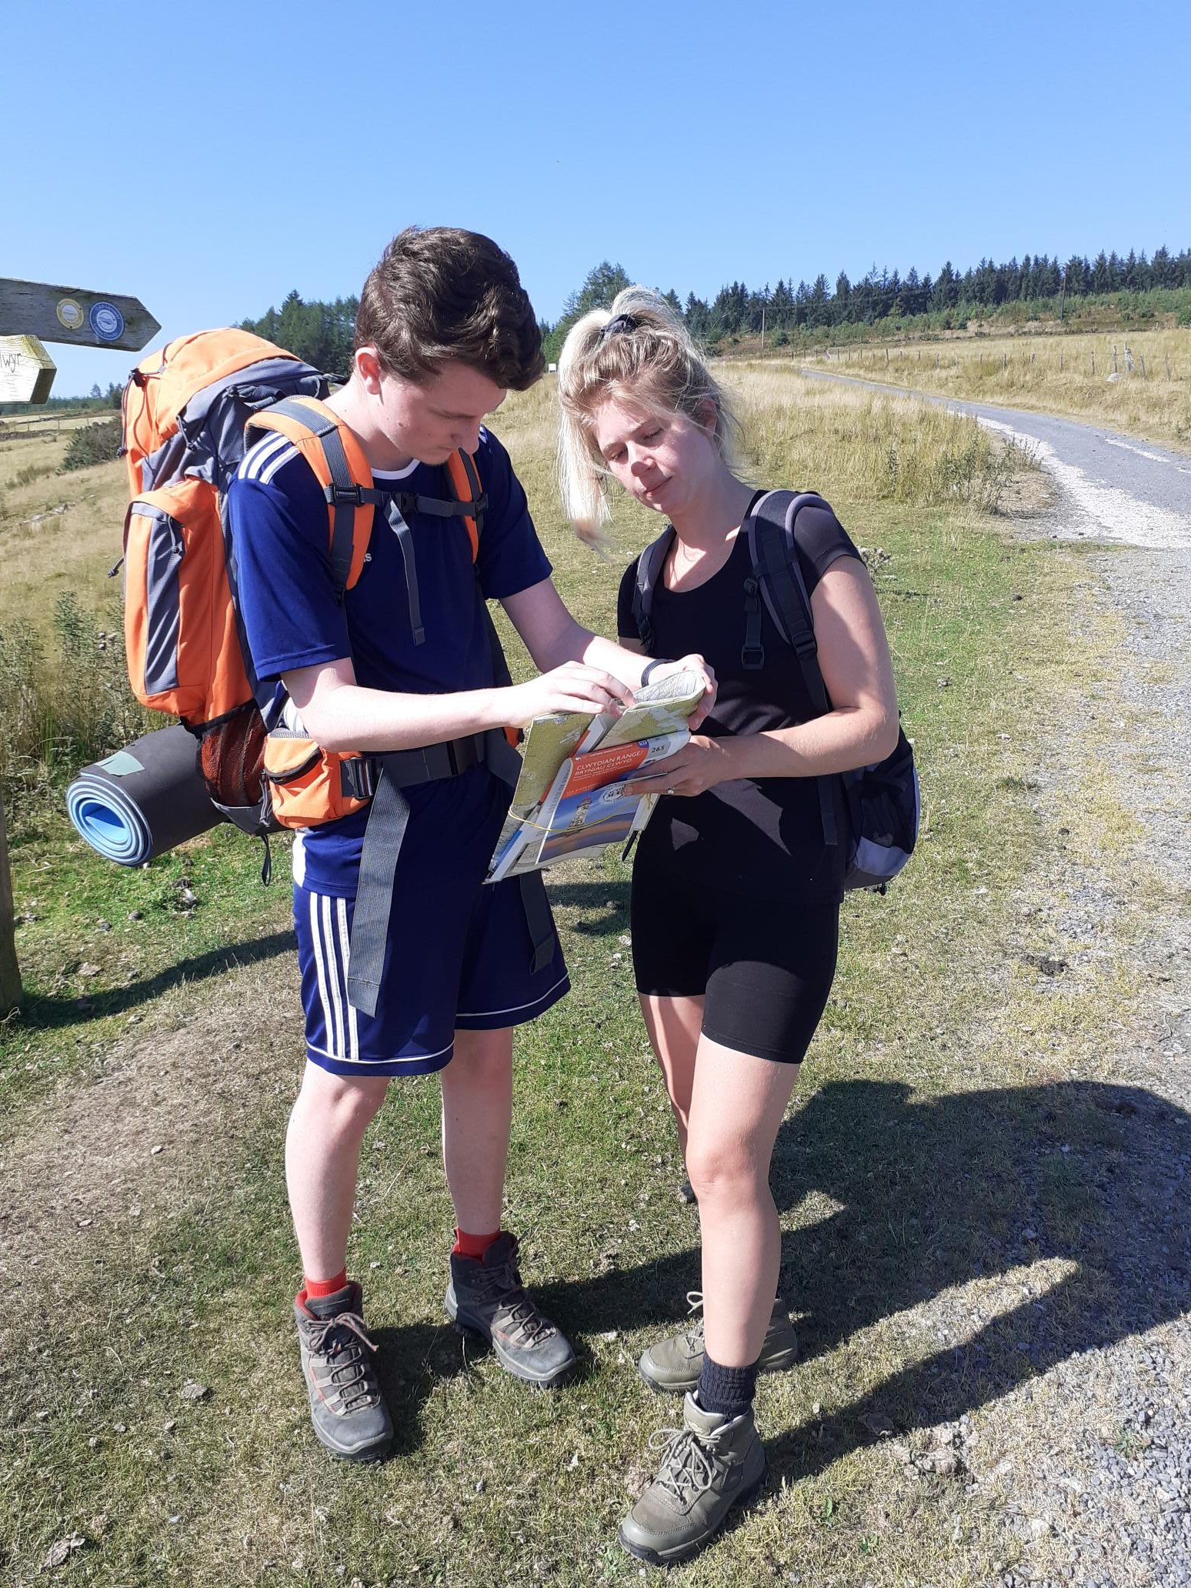
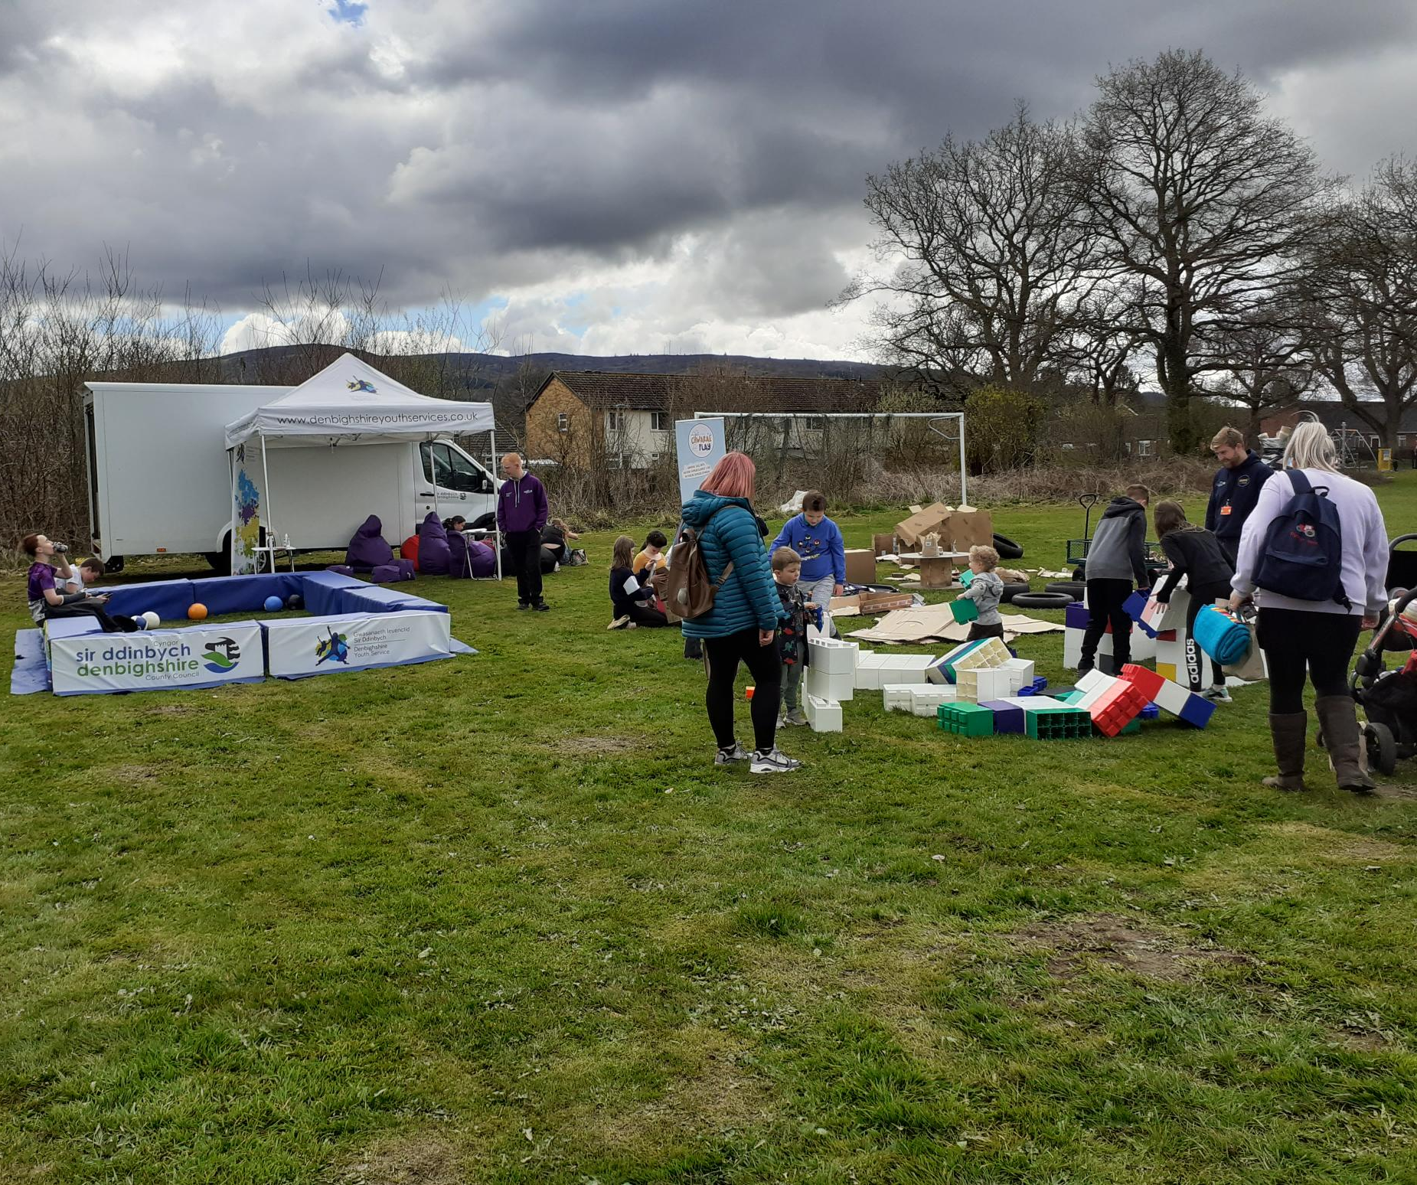
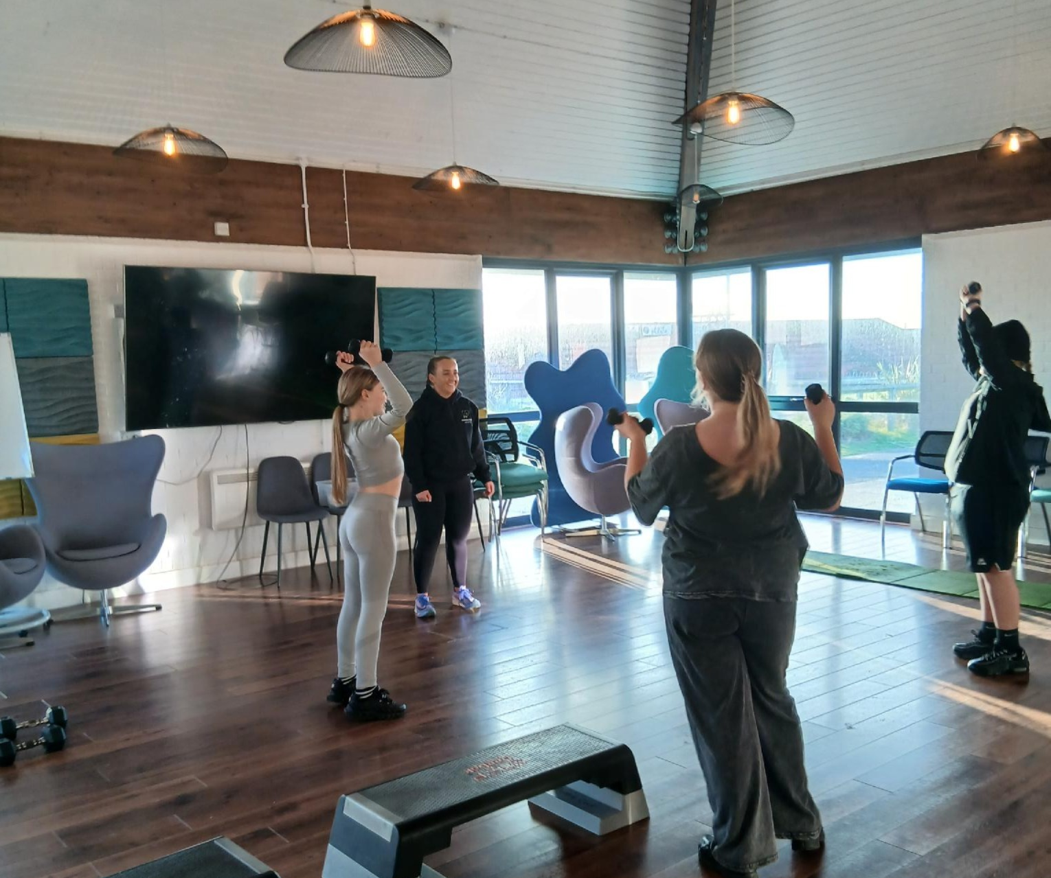
Sometimes just playing a board game
Going on trips
Provide opportunities to learn
We provide advice
Challenge young to ‘Give it a go’
Meeting young people where they are
Notes:
Photographs taken by author
Figure 19: We play games, Rhyl seniors’ Open access [Photograph] (2025).
Figure 20: Go of trips, the team at Surf Snowdonia [Photograph] (2024).
Figure 21: Learn new skills and development your knowledge further, Drosi Bike workshop Rhyl [Photograph] (2025).
Figure 22: Support them to make informed decisions, DofE Navigation practice [Photograph] (2025).
Figure 23: We meet them where they are at! Community consultation event [Photograph] (2025).
Figure 24: Encouraging positive activities to support wellbeing, Give it a Go session Rhyl youth centre [Photograph] (2026).

Slide 11
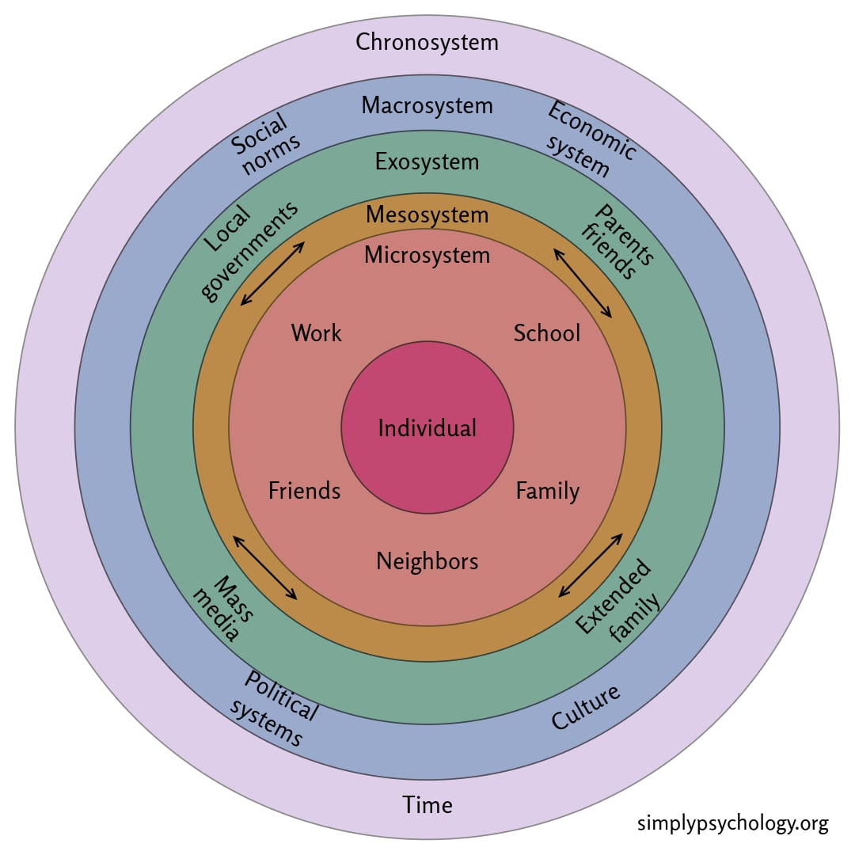
Bronfenbrenner’s Ecological Systems Theory
Bronfenbrenner stated “Every child needs at least one adult who is irrationally crazy about him or her” (Guy-Evans, 2025).
(Guy-Evans, 2025)

Slide 12
Reference page
CLD Standards Council (2019) Youth work NOS. Available at: https://cldstandardscouncil.org.uk/resources/standards-and-benchmarks/national-occupational-standards/youth-work-nos/ (Accessed: 24 February 2026).
Guy-Evans, O. (2025) Bronfenbrenner’s Ecological Systems Theory. Available at: https://www.simplypsychology.org/bronfenbrenner.html (Accessed on: 09th May 2026)
Sawyer, S, Azzopardi, P, Wickremarathne, D, Patton, G. (2018)The age of adolescence, Available at : https://www.sciencedirect.com/science/article/abs/pii/S2352464218300221 (Accessed on: 10th May 2026)
The Council for Wales of Voluntary Youth Services (2018) The Principles and Purposes of Youth Work. Available at: https://www.cwvys.org.uk/youth-work-in-wales/ (Accessed on: 26 February 2026).
UCLA, (2026) Image from: 16 to 25: Building Pathways toward a Thriving Adulthood, Available at : https://developingadolescent.semel.ucla.edu/topics/item/16-to-25-building-pathways-toward-a-thriving-adulthood (Accessed on: 9th May 2026)

Slide 13
All photographs taken by Author
Unwin,S. (2025) Young leaders’ group going to 2024/2025 Denbigh high prom [Photograph].
Unwin,S. (2025) Fire service visit after rises in fires near local castle, the dangers and what to do in an emergency. [Photograph].
Unwin,S. (2025) The last check point of the day, with my targeted DofE group[Photograph].
Unwin,S. (2025) Sexual health training, Amanda demo practice [Photograph].
Unwin,S. (2025)’What strong, not wrong’ podcast 2025, Wills speaking to the young people at camp about the project overview [Photograph].
Unwin,S. (2025) Gaz writing up the plans that young people wanted in the termly/ quarterly plan [Photograph].
Unwin,S. (2026) Young leader residential 2026, calming the rocking climbing nerves while we got them ready [Photograph].
Unwin,S. (2025) Targeted girls’ group 2025, out of 8 YP only 2 would come out the mini-bus in Llangollen [Photograph].
Unwin,S. (2025) Safety briefing before canoeing day on Llangollen canal. Young leaders 2026 water safety award [Photograph].
Unwin,S. (2025) Taking a break in the shade on practice walking at Llyn Brenig on hottest day. Targeted Boys DofE group 2025 [Photograph].
Unwin,S. (2026) YL finding their confidence before going over the aqueduct. 2026 [Photograph].
Unwin,S. (2026) After a shaking start with the nerve the YL reaching the top and overcoming their fears. YL residential 2026

Slide 14
Unwin,S. (2025) Asking questions, who am I? activity Ruthin Open access [Photograph].
Unwin,S. (2025) Learning new skills, cooking session Llangollen [Photograph].
Unwin,S. (2025) Informed discussions, consultation for community improvement, Denbigh Hwb Bumps and Jumps [Photograph].
Unwin,S. (2024) : Safety talks for external visitors, Fire service Denbigh Hwb [Photograph].
Unwin,S. (2025) Euros open day and celebrations Prestatyn Youth centre in partnership with DLL [Photograph].
Unwin,S. (2025) Ruthin Youth centre the day I moved to my new role in the north, I was based here for 5 years [Photograph].
Unwin,S. (2025) We play games, Rhyl seniors’ Open access [Photograph].
Unwin,S. (2024) Go of trips, the team at Surf Snowdonia [Photograph].
Unwin,S. (2025) Learn new skills and development your knowledge further, Drosi Bike workshop Rhyl [Photograph].
Unwin,S. (2025) Support them to make informed decisions, DofE Navigation practice [Photograph].
Unwin,S. (2025) We meet them where they are at! Community consultation event [Photograph].
Unwin,S. (2026) Encouraging positive activities to support wellbeing, Give it a Go session Rhyl youth centre [Photograph].

