Slide 1
Adventure and challenge in the curriculum
Session 3
Experiential learning

Slide 2
Outline of the session
Theory
Recap
Experiential education
Practical
Practical
Introduction to basic orienteering activities
Recap affordances
Star course

Slide 3
Recap:
The curriculum
Physical literacy
OAE pedagogical model (Williams and Wainwright, 2016)

Slide 4
The curriculum- where do we see outdoor learning and adventure?
Foundation Phase
Key stage 2
Key stage 3
Key stage 4
Extra curricula opportunities

Slide 5

Teacher expertise to facilitate subject-specific learning takes two forms: content knowledge and pedagogical content knowledge (Kirk 2010; Metzler 2011)
The recent introduction of the Outdoor Learning Cards resource appears to meet the needs of non-specialist primary school teachers to teach OAE in and around the school within the normal lesson constraints of the school day and without needing specialist skills or equipment (Wainwright & Williams 2012).
Teachers with the skills and knowledge to deliver new and traditional forms of OAE are more likely to be specialist secondary school physical education teachers who have a personal as well as a professional interest in outdoor pedagogy.
Many of these teachers will have taken additional external qualifications such as rock climbing or mountain biking and have demonstrated their personal skills and leadership competency in a particular outdoor sport.
Increasingly, it is anticipated that more aspirant teachers will be drawn from the growing number of outdoor education type undergraduate courses that have flourished in the UK in the last 10 years
Content knowledge for OAE requires teachers to have a basic understanding of skills, techniques and knowledge related to specific activities for younger age pupils and increased levels of understanding
Notes:
Drawing upon the idea of more learning experiences being located in and around the school site and the absence of physical education specialists in most primary schools, it is unreasonable to expect, and indeed not necessary for teachers to have, high levels of personal ability in the broad range of traditional outdoor activities such as rock climbing, canoeing, sailing or mountain biking. The recent introduction of the Outdoor Learning Cards resource appears to meet the needs of non-specialist primary school teachers to teach OAE in and around the school within the normal lesson constraints of the school day and without needing specialist skills or equipment (Wainwright and Williams 2012).
Authors do not feel that residential outdoor experiences should be limited to a single week-long experience as part of Key Stage 3. In line with others (Williams 2013; Christie, Higgins, and McLaughlin 2014), we believe that residential experiences have huge potential benefits at all stages of learning when introduced appropriately

Slide 6
Physical literacy - an aim of physical education
Think - pair - share
Think about what you understand about physical literacy
Write down what you think
Share this with a partner
Discuss

Slide 7
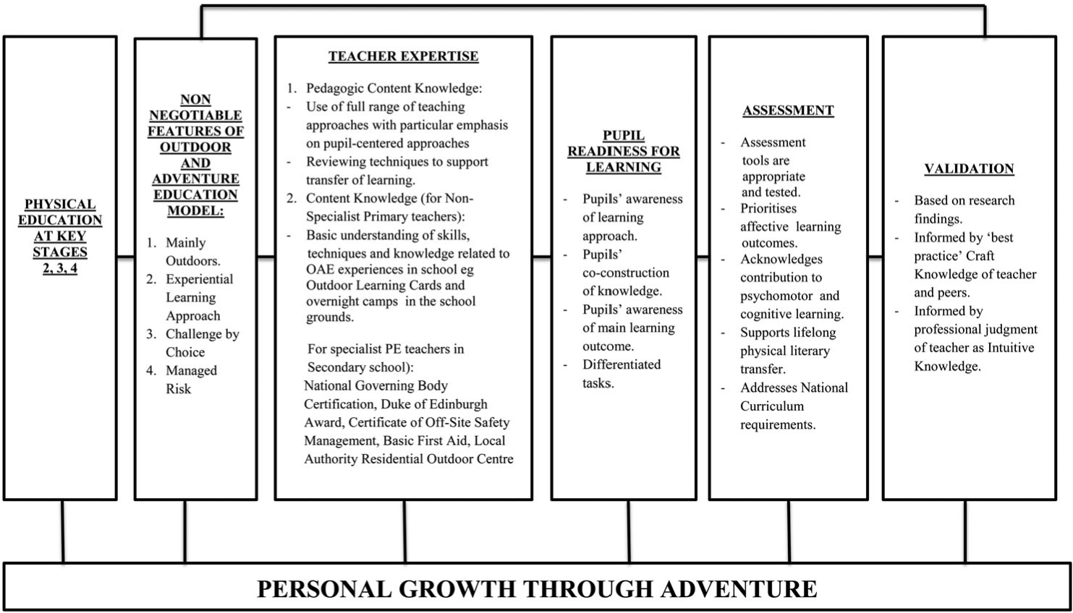

Slide 8
OAE model – key features
Mainly outdoors
2. Experiential
Experiential learning
3. Challenge self determined
Challenge by choice
4. Acceptable risk
Managed risk
1. outside
Four non-negotiable features

Slide 9
Key concerns
A) encouraging pupils to take more responsibility for their own learning
B) developing closer links between school OAE and local opportunities
C) supporting teachers in making judgements about pupils managing their own risk
D) developing teachers’ expertise in reviewing and developing assessment tools that measure pupils’ affective learning
arising from the implementation of these non-negotiable features

Slide 10
Unupacking the non-negotiable features
1. Emphasising taking the learning outdoors-contextual considerations
2. The use of experiential learning as a method
3. The challenge by choice recognises the value of pupils taking greater responsibility for their own learning.
4. Making use of managed risk as an educational tool.
Notes:
2. Sutherland, Ressler, and Stuhr (2009) into adventure-based facilitation suggests that pre-service physical education teachers in particular struggle with how to facilitate an effective pupil-focused review. In response she has developed a Sunday Afternoon Drive debrief/review model for novice teachers to teach adventure-based learning working within the normal time constraints of a school lesson (Sutherland 2012). Balancing the need to support pupil learning through positive reviewing with opportunities for pupils to think independently and construct their own meaning from experience, a pedagogical model for OAE advocates the need for regular reviewing of OAE experiences and that teacher professionalism should determine precisely when, where and how that should happen.
4. Propose a broad understanding of managed risk to include social, emotional and psychological risk as equally relevant to the OAE model as physical risk (Priest 1999).
N.b. teachers need to be aware that novice participants often overestimate the level of risk due to their minimal experience and introductory level skills.

Slide 11
. Advocating managed risk as a non-negotiable feature of a model of OAE brings with it genuine tensions that will need to be resolved
Over time, older pupils should develop higher skill levels, greater experience and continued motivation (premised on previous successes) to continue to engage with progressively more challenging activities, and they should do so as experienced, skilled, confident young people able to make decisions that are increasingly independent of teacher support
It raises teachers’ awareness of risk as a multifaceted concept inclusive of social, emotional, psychological and physical dimensions and more accurately reflects the potential for personal growth that is at the heart of the OAE model

Slide 12

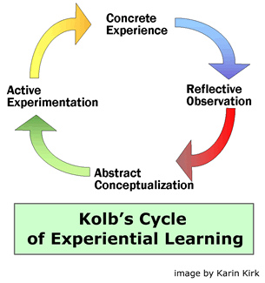

Experiential learning is ‘‘a process through which a learner constructs knowledge, skills, and value from direct experiences’’ (Jacobs 1999, p. 51). It relates to the learner who undergoes what David Kolb (1984) has described as ‘‘the transformation of experience’’ (p. 38)
This Photo by Unknown Author is licensed under CC BY-SA

Slide 13
A primary responsibility of educators is not only to be aware of the general principle of the shaping of actual experience, but also to recognise that experience should lead to growth.
According to Dewey, experiences are preplanned educational devices which consciously and intentionally utilise the potential embedded within the social and physical surroundings of the individual to enhance specific educational ends meant to construct and deconstruct the individual’s worldview, value system and moral code

Slide 14
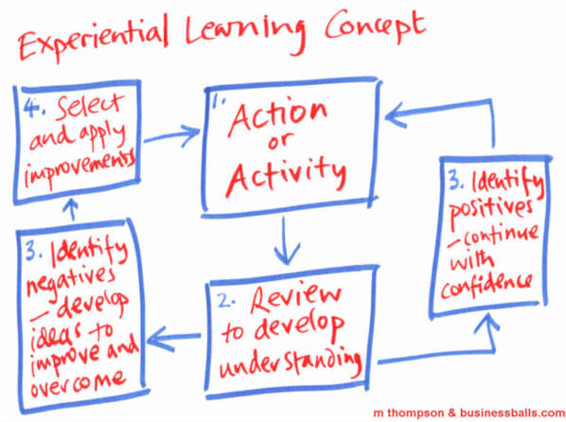
Notes:
Let’s take what we have in our PE model and extend it through primary aged children experiencing learning beyond the school environment.

Slide 15
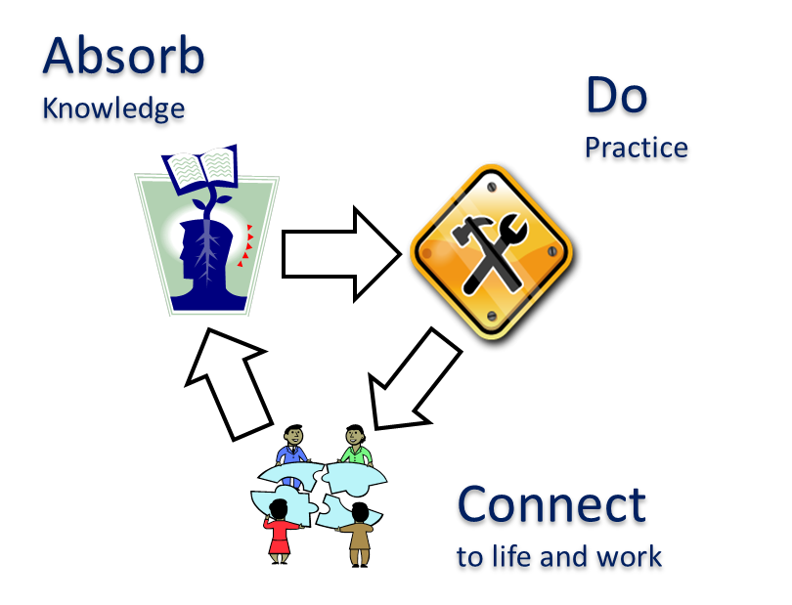
strong scholarly debate about the differences between experiential education and informal education
Scholars have distinguished between three different forms of learning: formal learning, within school classroom settings; informal education, as a ‘‘lifelong process’’ of ongoing learning through exposure to different experiences; and non-formal education, which relates to organised educational activities outside of the formal, school framework (Dave 1976; La Belle 1981, 1982)
1. formal learning
2. informal education
3. non-formal education
Experiential education refers to a specific pedagogy, which can take place in formal, informal and non-formal settings and contexts ( Gross & Rutland, 2017).

Slide 16
Lets go and be active ….
Activities that develop orienteering

