Slide 1

Self Awareness Presentation
Working in Teams
Name: Nageena Akhtar
Student ID: 2232594
Module: LCHS4009

Slide 2

Introduction to Working in Teams
Working in teams means individuals collaborating to achieve shared goals and outcomes.
Teamwork involves communication, cooperation, trust, and shared responsibility among all team members (AIU, 2025).
In health and social care, teamwork supports coordinated, safe, and patient-centred service delivery (Rosen, 2020).
Self-awareness helps me understand my role, strengths, and contribution within a professional team.
Notes:
In this slide, I will describe what teamwork involves and the reasons it is relevant to health and social care. I define teamwork as the act of people working together by means of communication and mutual responsibility. I also associate this with self-awareness by considering how my knowledge of my role can make me a productive team member.

Slide 3
Importance of Teamwork in Health and Social Care
Teamwork improves communication between professionals, leading to better decision-making and care outcomes.
It reduces the risk of errors and increases patient safety within complex healthcare environments.
Multidisciplinary teamwork ensures holistic care by combining different professional skills and knowledge (Pradelli et al., 2025).
Effective teamwork enhances job satisfaction and reduces stress among health and social care workers.
Notes:
In this slide, I give the reasons why teamwork is paramount in health and social care. Teamwork positively influences communication among professionals and contributes to the minimisation of errors. It also upholds the safety of the patients and holistic care. I suppose that teamwork can be significant since healthcare workers need the resources and skills of other professionals to provide quality and safe services.

Slide 4
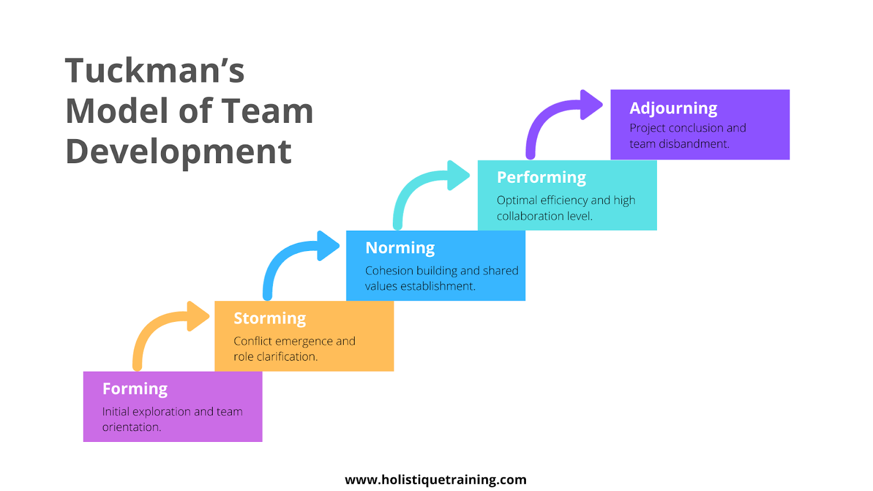
Theoretical Model: Tuckman’s Team Development Model
Tuckman’s model explains how teams develop through forming, storming, norming, and performing stages (Keene, 2024).
Forming involves getting to know team members and understanding roles and responsibilities.
Storming includes conflicts and disagreements as individuals express different opinions and expectations.
Performing occurs when the team works effectively towards shared goals with strong cooperation.
Figure 1: Tuckman’s Team Development Model Source: (Holistique Training, 2024) https://holistiquetraining.com/en/news/tuckmans-model
Notes:
In this slide, I present the model of team development as proposed by Tuckman. This model indicates that teams experience various phases to be effective. I know that the storming phase is normal, and as the teams communicate with each other and cooperate, they can achieve the performing stage and collaborate effectively.

Slide 5

Self-Awareness in Teamwork
Self-awareness helps me recognise my strengths and weaknesses when working within a team.
It allows me to understand how my behaviour impacts other team members.
Being self-aware improves my communication and ability to accept feedback from others.
Self-awareness supports personal development and professional growth in team environments (Cherry, 2024).
Notes:
In this slide, I consider the importance of self-awareness in teamwork. In my opinion, self-awareness is useful because it helps me to comprehend my behavior within a team and how I can be observed by other people. I will be able to enhance my communication, receive feedback, and become a better professional in a team environment by understanding my strengths and weaknesses.

Slide 6

Practical Example of Working in Teams
In a hospital ward, nurses, doctors, and healthcare assistants work together to support patient care (Hall-Lord et al., 2024).
Effective communication ensures patient needs are clearly shared among team members (Shrivastava et al., 2025).
Team members support each other during busy shifts to manage workload and reduce stress.
Working together improves efficiency and leads to better patient outcomes and satisfaction.
Notes:
In this slide, I give a real-life example of teamwork within a hospital. Effective communication is important among nurses, doctors, and healthcare assistants to deliver safe care. In my opinion, patient needs are better addressed, and the quality of care is higher when the team partners are supportive of one another and share information.

Slide 7

Conclusion
Working in teams is a vital professional skill in health and social care practice.
Effective teamwork improves communication, patient safety, and quality of care delivery.
Self-awareness helps me understand my role and improve my team contribution.
Overall, teamwork supports professional development and positive health outcomes.
Notes:
Overall, I can state that teamwork is a necessary professional competency in health and social care. Teamwork is effective and enhances the quality of care, communication, and patient safety. Self-awareness will help me to comprehend my role, handle challenges, and positively influence the performance and professional practice in the team.

Slide 8

Reference
AIU (2025). The Importance of Work and Teamwork | Foundations for Success. [online] Atlantic International University. Available at: https://www.aiu.edu/blog/the-importance-of-work-and-teamwork-building-strong-foundations-for-success/.
Cherry, K. (2024). How to boost your self-awareness. [online] Verywell Mind. Available at: https://www.verywellmind.com/what-is-self-awareness-2795023.
Hall-Lord, M.L., Bååth, C. and Nordin, A. (2024). Patient Safety Culture and Teamwork in Hospital Wards: Registered Nurses’ and Nursing Assistants’ Perceptions and Attitudes. Nursing Forum, 2024(1). doi: https://doi.org/10.1155/nuf/9410721.
Holistique Training (2024). Tuckman’s Model: Definition & Why Its Important in Agile Team Development. [online] Holistique Training. Available at: https://holistiquetraining.com/en/news/tuckmans-model.
Keene, B. (2024). Tuckman’s Stages of Group Development | EBSCO. [online] EBSCO Information Services, Inc. | www.ebsco.com. Available at: https://www.ebsco.com/research-starters/social-sciences-and-humanities/tuckmans-stages-group-development.
Pradelli, L., Risoli, C., Summer, E., Bellini, G., Mozzarelli, F., Anderson, G., Guasconi, M., Artioli, G., Bonacaro, A. and Sarli, L. (2025). Healthcare professional perspective on barriers and facilitators of multidisciplinary team working in acute care setting: a systematic review and meta-synthesis. BMJ open, [online] 15(3). doi: https://doi.org/10.1136/bmjopen-2024-087268.
Rosen, M.A. (2020). Teamwork in healthcare: Key Discoveries Enabling safer, high-quality care. American Psychologist, [online] 73(4), pp.433–450. doi: https://doi.org/10.1037/amp0000298.
Shrivastava, S.R., Chong, S.V. and Bobhate, P.S. (2025). Facilitating effective communication through the adoption of SBAR tool in medical training. Journal of Education and Health Promotion, 14(1). doi:https://doi.org/10.4103/jehp.jehp_1213_24.

