Slide 1
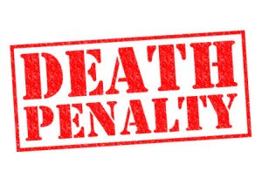
Death Penalty
Liam Carroll, Irtaza Sardar and Kyle Brittan

Slide 2
Introduction
In this presentation we will be covering information on Death Penalty and how members of the public responded to being asked questions about it and what they thought about potentially bringing it back and how it would affect our public services and laws.
We will talk about what is the Death Penalty and who was given it, such as criminals who committed crimes such as murder and terrorism.
We will give facts and figures about the Death Penalty and reasons behind it.
We will also talk about who produced the Death Penalty and when it was first introduced.

Slide 3
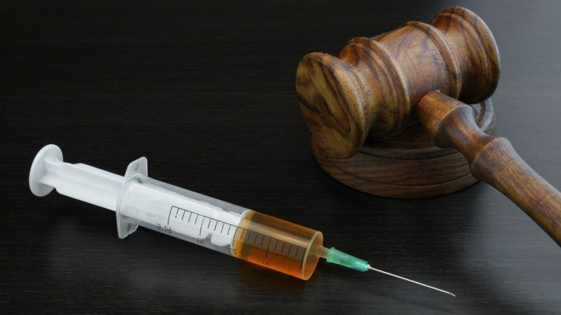
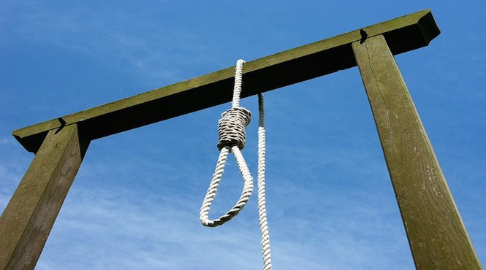
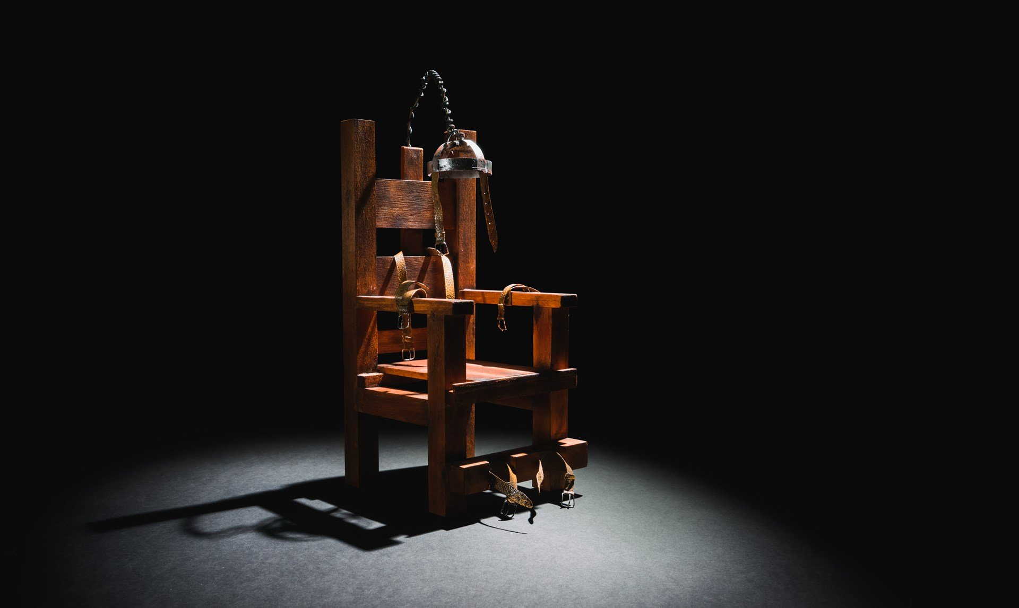
Background
When was the death penalty introduced and when did it get removed?
Why did people get given the death penalty sentence?
Did it prevent or lower the crime rate?
Which crimes were punishable by execution?
What were the laws behind the death penalty?

Slide 4
The Death Penalty was introduced in the 18th century and consisted of 25 different crimes punishable this way but didn’t officially come into action until 1990 and is still around in some countries today, it was abolished in the UK in 1998.
People were given the Death Penalty for treason, espionage, murder, large-scale drug trafficking or attempted murder of a witness, juror or court officer in certain cases. As of 2019 all inmates currently under federal death sentences were condemned for aggravated murder. It was also used for rapists and armed robbers.
There isn't much information on whether it lowered or prevented crimes, but scientists believe that either way if we had the death penalty crimes would still be the same.
Basically it was used to prevent and deter the same actions from happening in the future that was its sole purpose. If you committed a crime you were basically injected or electrocuted to death.

Slide 5
Objectives
The objective for this presentation was to present all our findings that we got from a variety of people on the death penalty and whether they thought it should be brought back or not.

Slide 6



Process
The way in which we found out what people thought was by doing 1 on 1 interviews, online surveys and questionnaires. This was to find out from multiple people and produce the results from it.

Slide 7
Findings
We collected all the relevant data for our research, we put it all together and produced the percentages for each question we could but not all questions we asked gave us a percentages as some of them were questions in which we needed people's reasons for the answer they gave.

Slide 8
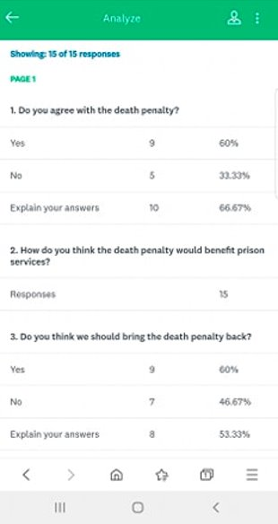
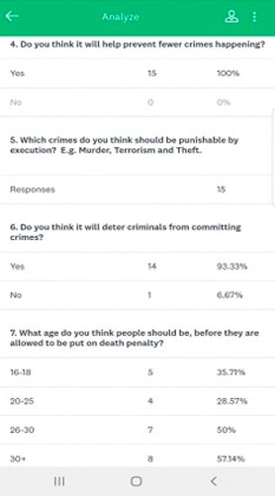
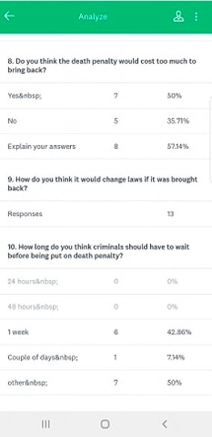
Online Survey

Slide 9
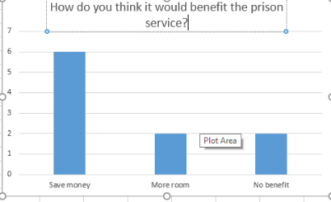
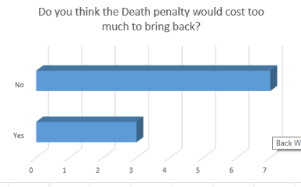
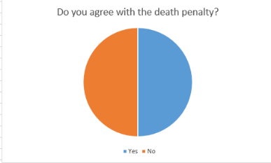
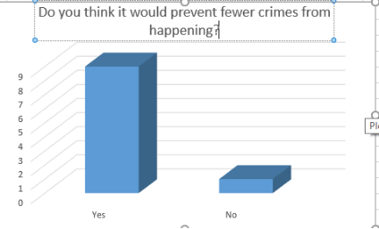
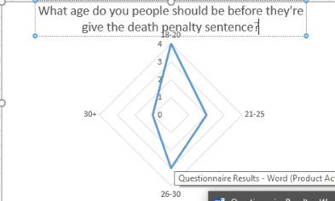
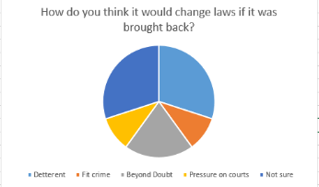
Questionnaire

Slide 10
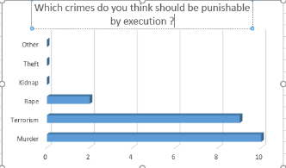
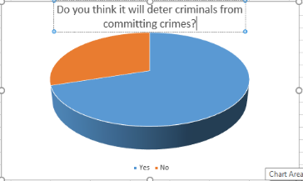
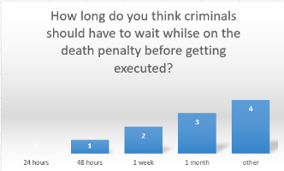
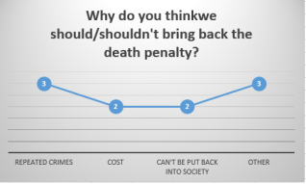

Slide 11
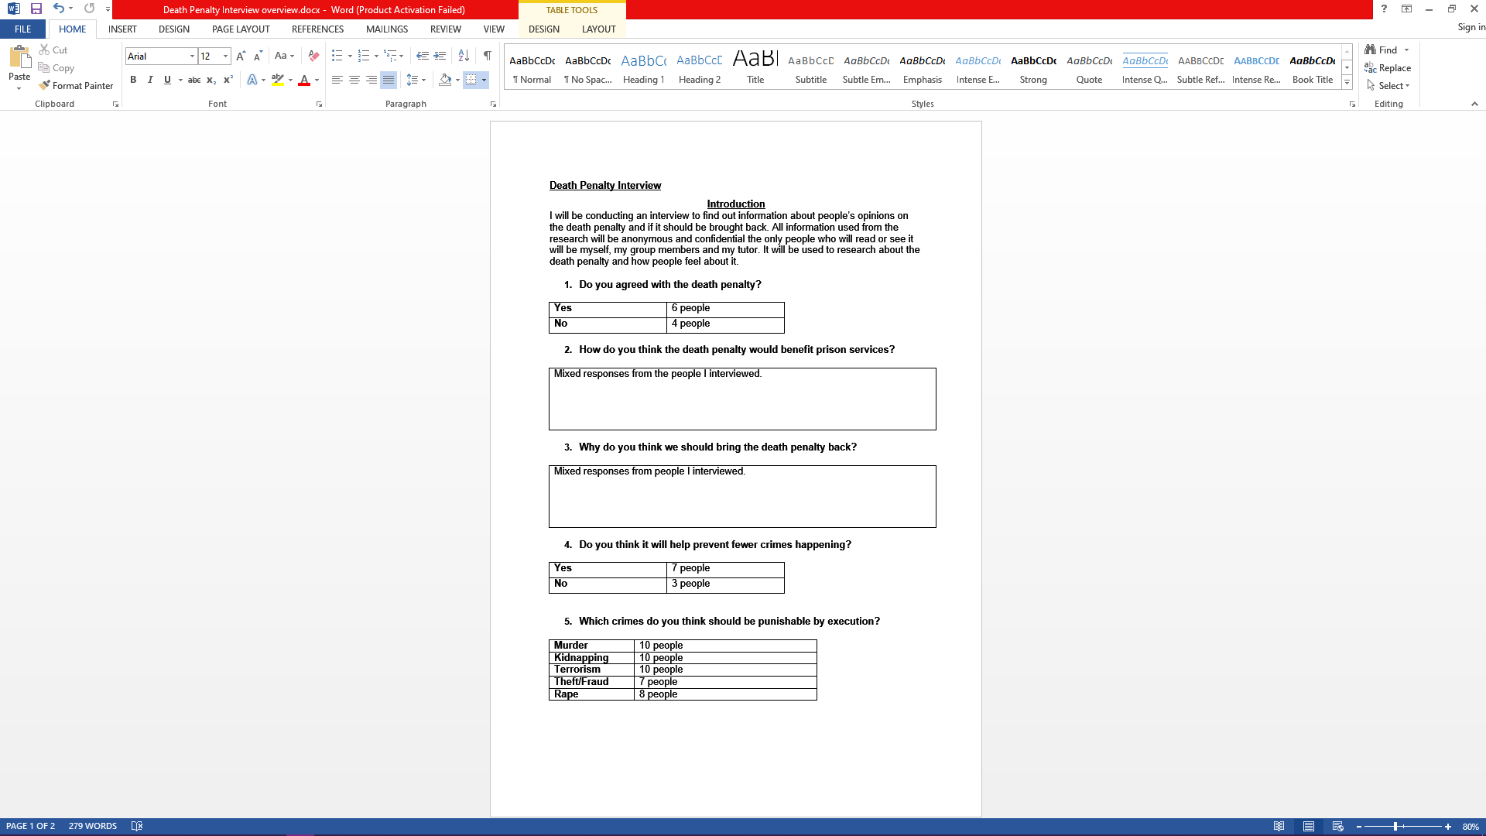
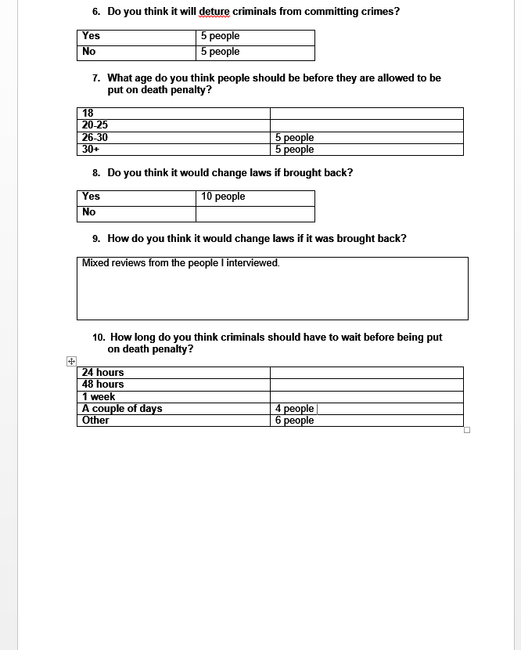
Interview

Slide 12
Conclusion
Overall from our findings people thought that the Death Penalty should be looked into and maybe brought back, but only for desperate measures and situations.
We think that the Death Penalty should be an option that could be brought back in desperate times. We think that it was very interesting to ask people their thoughts and feelings about the Death Penalty and to hear what they had to say about it.
We think that people should be allowed to learn more about the death penalty and how it works in order to understand why it is still used today in some countries.

Slide 13
Recommendations
We recommend that you look into it at some point as it is a very interesting topic and has lots of information about it. We think that it has a lot of history to it and seems very strange to us as we have never had to learn about it too much but when we have it has given us more knowledge about it.
We recommend that if you are going to look into it you use the:
Internet
Books
Articles
And even case studies to find out more about it.

Slide 14

Any questions?

