Slide 1
Secret Diner
Student Name: Lidia Antonache
Student ID:2025569

Slide 2
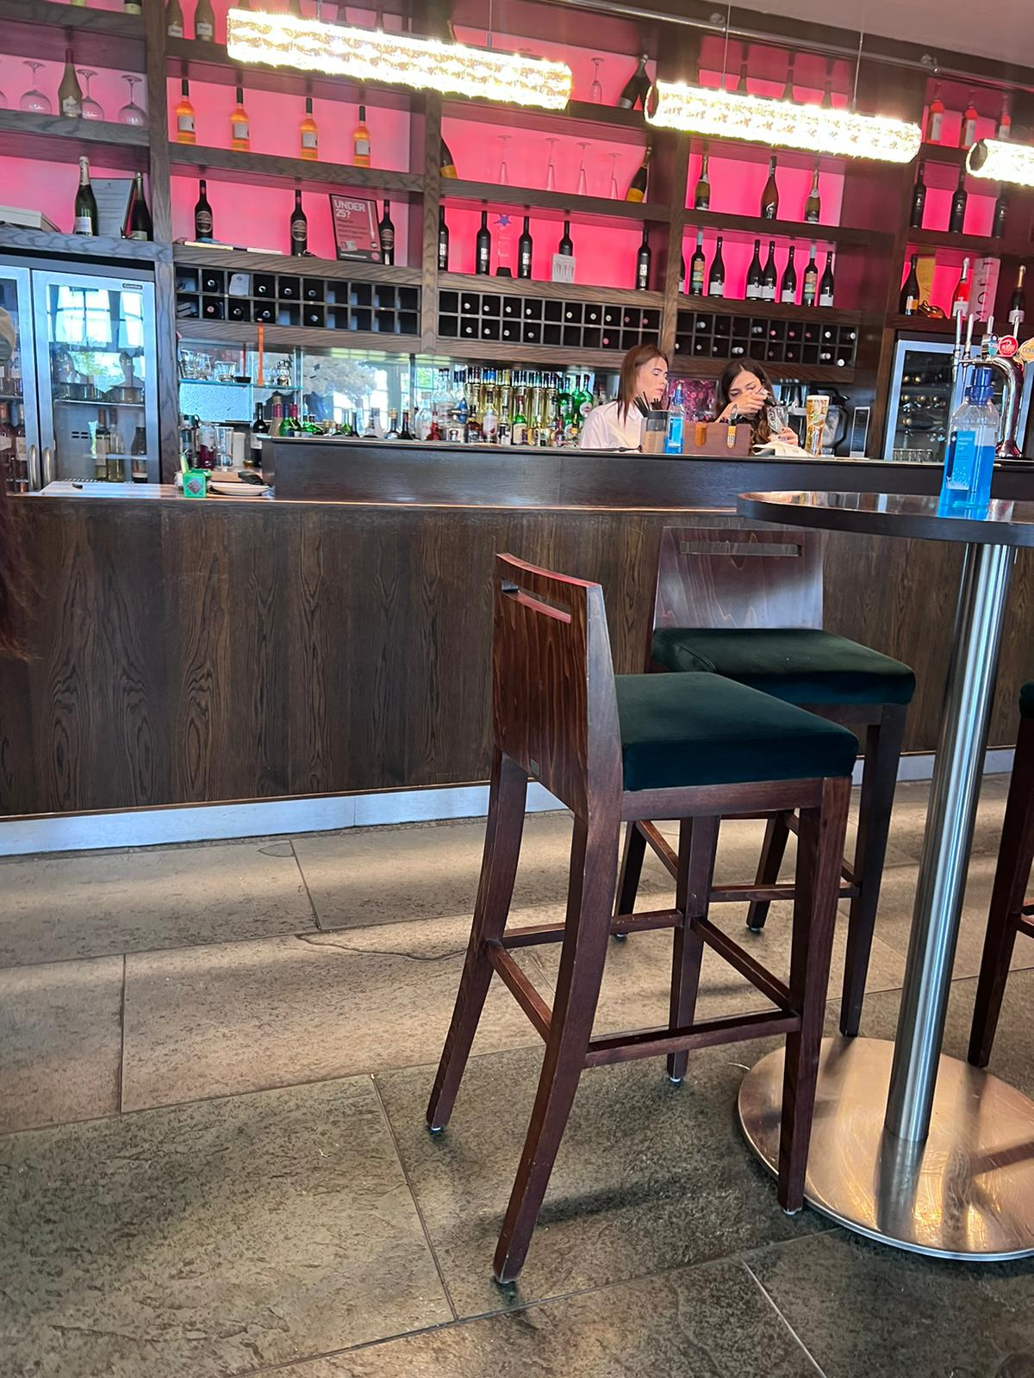
My Role – Secret Diner(Seco Femández, 2019)
Secret diner evaluates a restaurant based on the time it takes to order and receive each course of the meal, as well as the complete taste, presentation, and other amenities.
The secret diner, include the following information in their reports to consider: Service Sequence, Quality Control, Cleanliness, and some other aspects directly related to service delivery.
Notes:
For this assignment my role is to be a Secret diner. If you want to know what the secret diner is, I have an interesting definition for you guys.

Slide 3
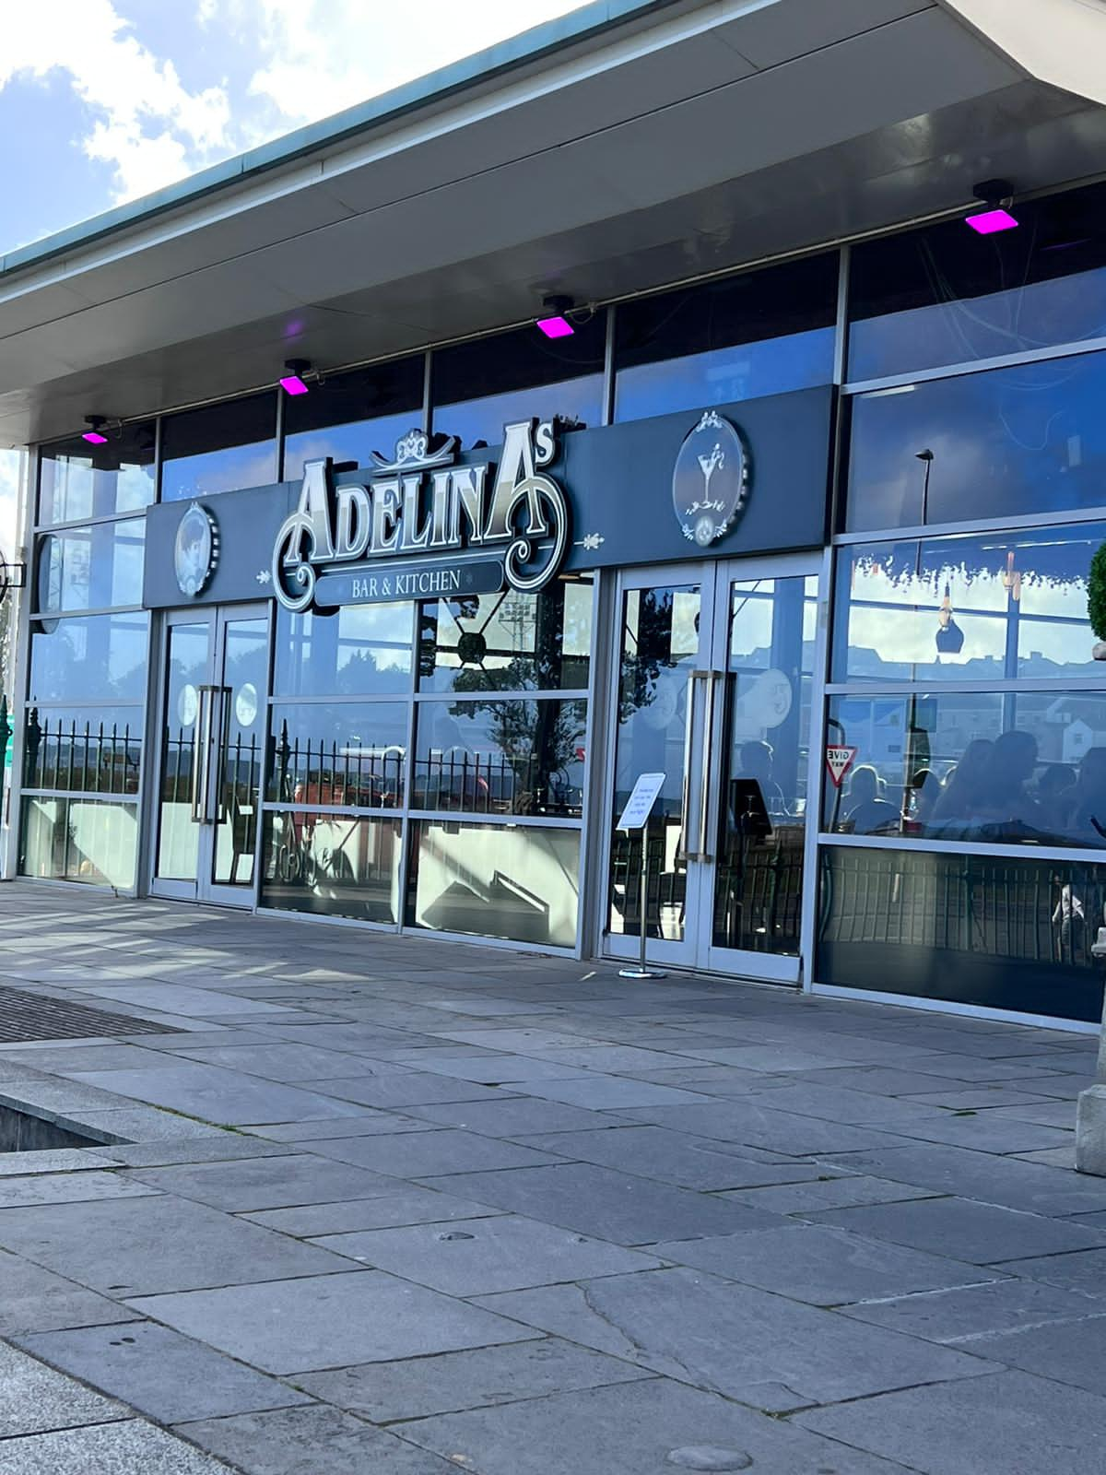
Adelinas Bar And Indian Kitchen (Adelina's Bar & Kitchen, 2022)
Home of decadent, gourmet Indian food with a combination of Eastern and Western flavors and spices, a rich history, trendy and sophisticated décor.
Inside the Patti Pavilion, you'll find this delicious Indian cuisine.
Indian exquisite food in a large, contemporary restaurant with floor-to-ceiling windows that overlook the bay. It is offering amazing scenery of Swansea Bay in a prime location.
This restaurant has a pleasant and friendly ambiance with all modern amenities.
Notes:
So, let me introduce the restaurant, were I was a secret diner…

Slide 4
This presentation is prepared not only for My Lecturers but also for The Publics
As I played role as a secret diner, these primary data will be helpful for public also.
The data are shown in this presentation are the combination of
my learnings and study,
restaurant's public statements, sharing,
and customers review after service encounter.
Notes:
Basically this presentation is being prepared for The publics and my lecturers. It will cover both delivering true review about a beautiful ambient restaurant and satisfying my academic purpose.

Slide 5
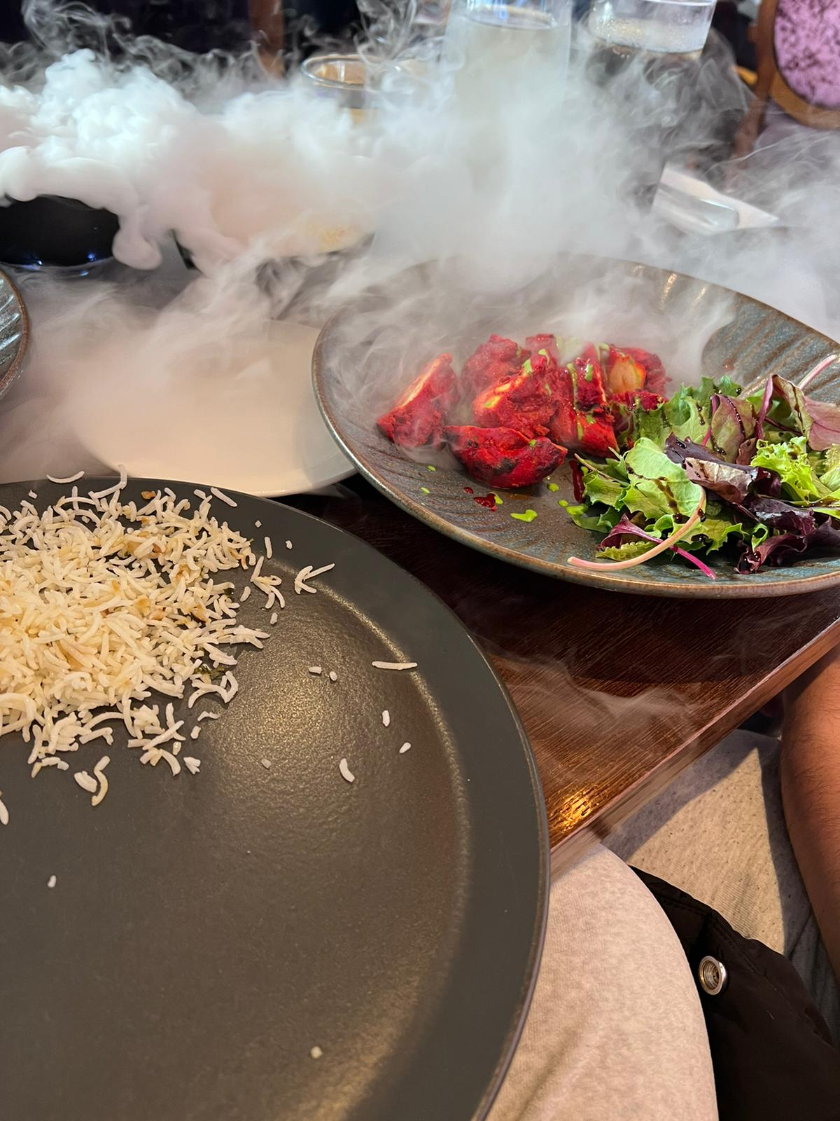
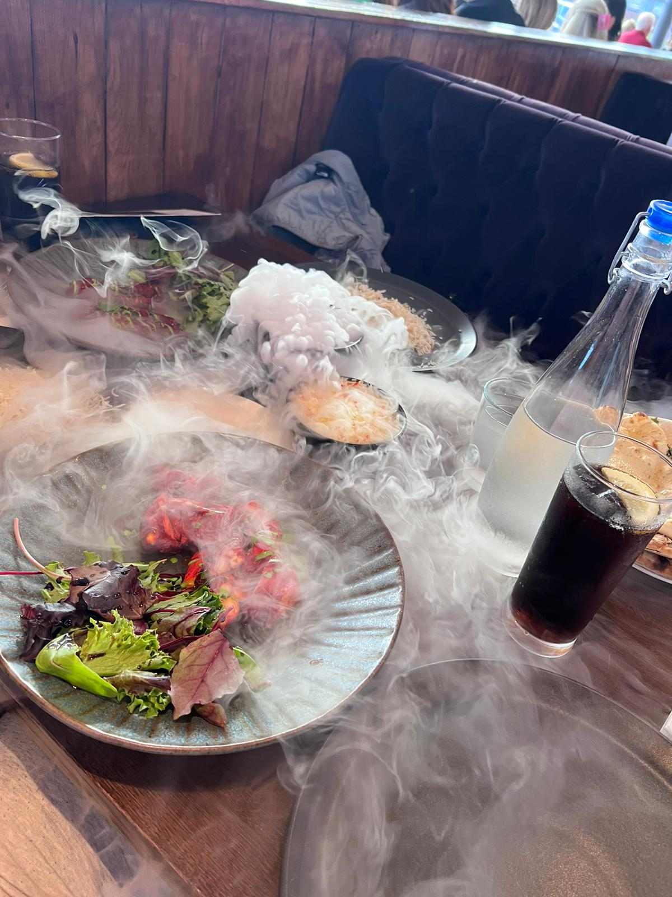
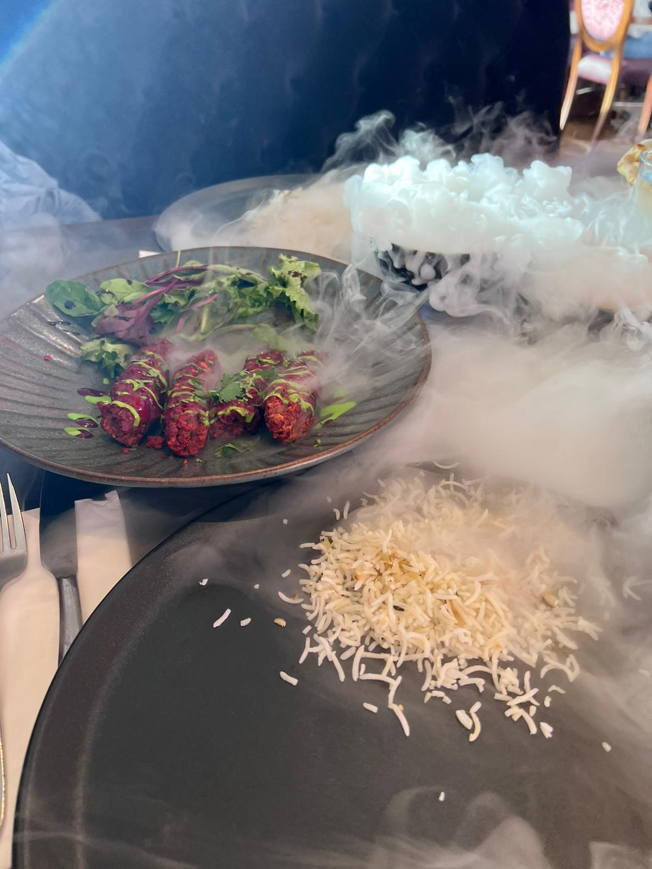
Products
Adelinas Bar And Indian Kitchen’s has different categories in its products portfolio that makes it trendy in Indian food based restaurants.
The menu here is another level of presentation of traditional and modern foods(tripadvisor, 2022).
The restaurant is currently offering different segments of foods also considering vegan and non vegan customers, kids specials, and the Chefs special menus, different types of drinks etc.
The food selection of this restaurant is commendable to many indian and non-indian customers as per the reviews in different sources.
Notes:
If I talk about the products of Adelinas Bar And Indian Kitchen, I would like to focus on the different product categories and its various segments. From menu we can get clear idea about it products.

Slide 6
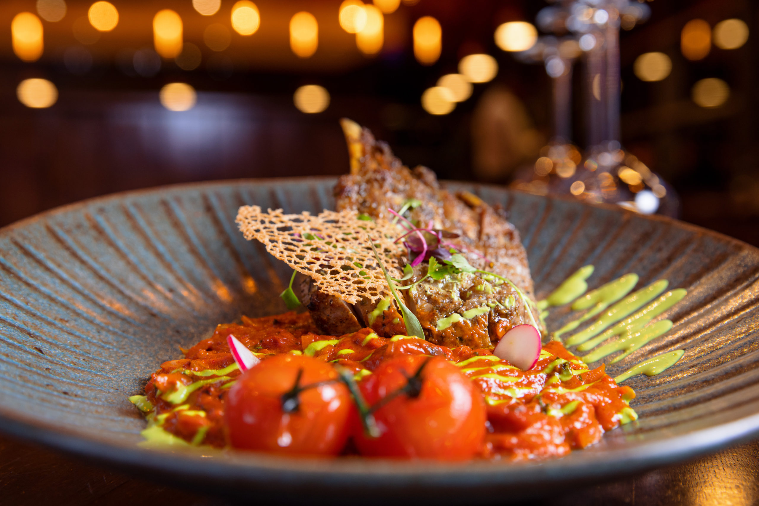
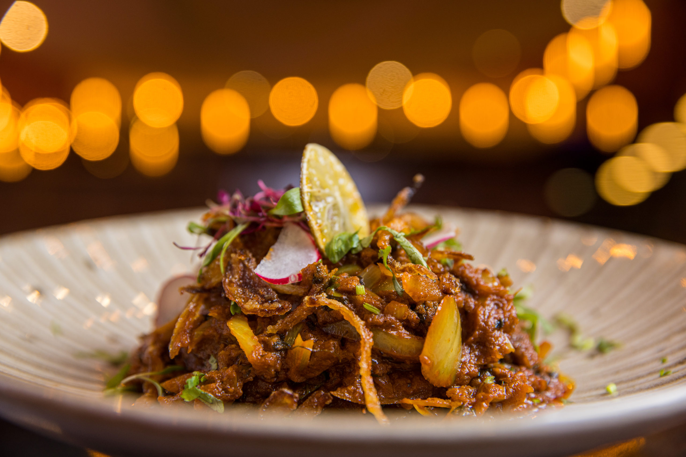
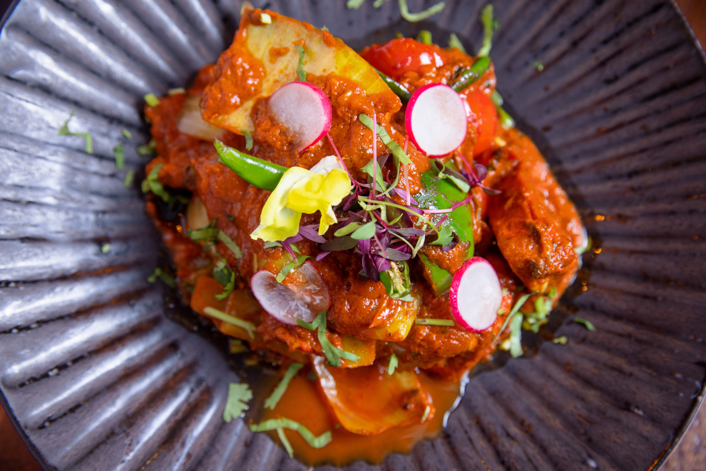
Products
Different types of drinks ( Vodka, Tequila, Liqueurs, whiskey, red wine, rose wine, white wine etc.) can surely match anyone's taste.
Appetizers are shown with a large portfolio in the bill of fare.
Large Varieties of Starters including pakoras, kebabs, chicken and lamb tikkas and so many mouth watering foods.
Traditional Mains including a large portfolio of food with detailed description so that people can have basic idea about those. (just-eat.co.uk, 2022)
Notes:
From menu we can get clear idea about it products. There are some segments that covers all foods offers by the restaurant.

Slide 7
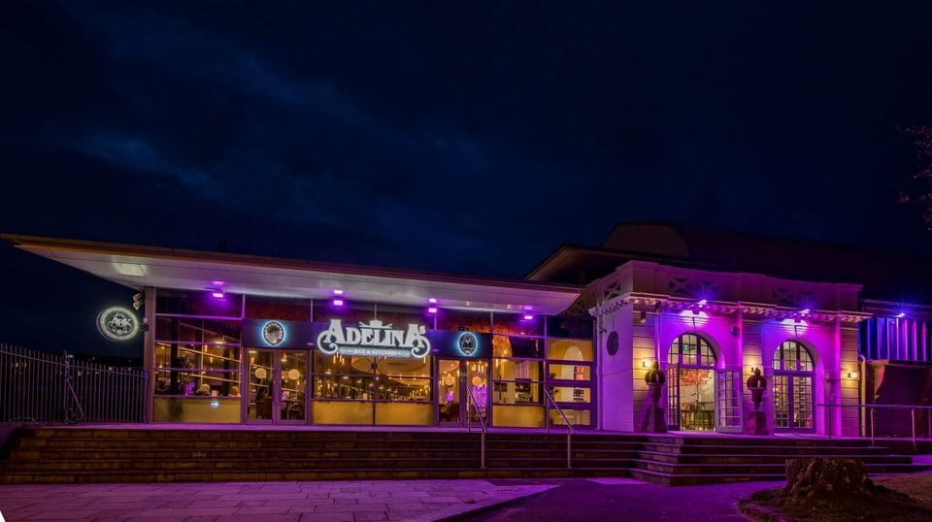
Place
Adelinas Bar And Indian Kitchen is currently located in Patti Pavilion, Mumbles Road, Swansea, SA1 4PQ United Kingdom (UK's Top 100 Restaurants, 2022)
Transport link is well conditioned here. There are so many transport options to get (Adelinas bar and kitchen Delivery | Swansea | Uber Eats, 2022).
This includes train, bus, bikes, and taxi.
In every several minutes, buses run across the town.
Taxis can be ordered through ride sharing apps.
There is a spacious and well equipped parking facilities .
The advertisement of the restaurant makes it easily accessible in this city.
Notes:
Here I would like to describe its location, transport and parking facilities. Public transport and other facilities are fluent here. On the other hand proper advertising makes it easily discoverable.

Slide 8
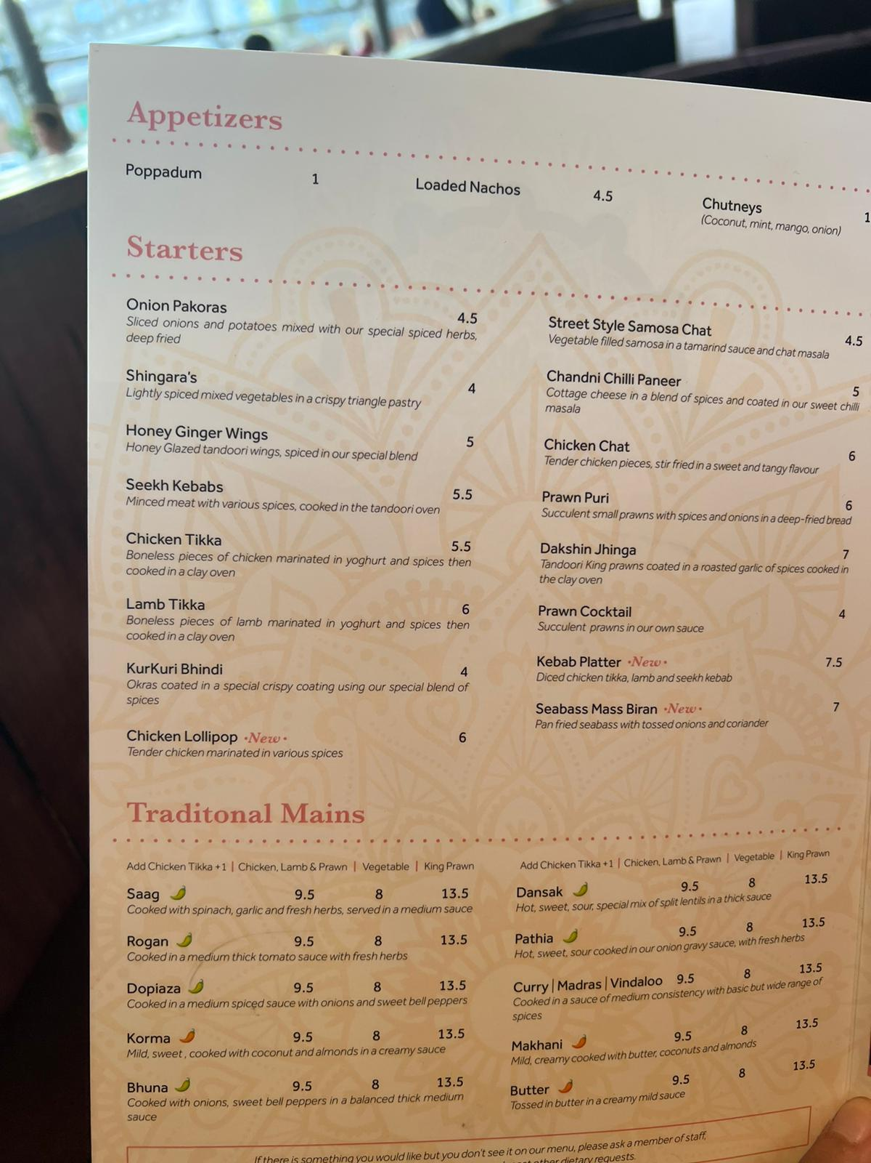
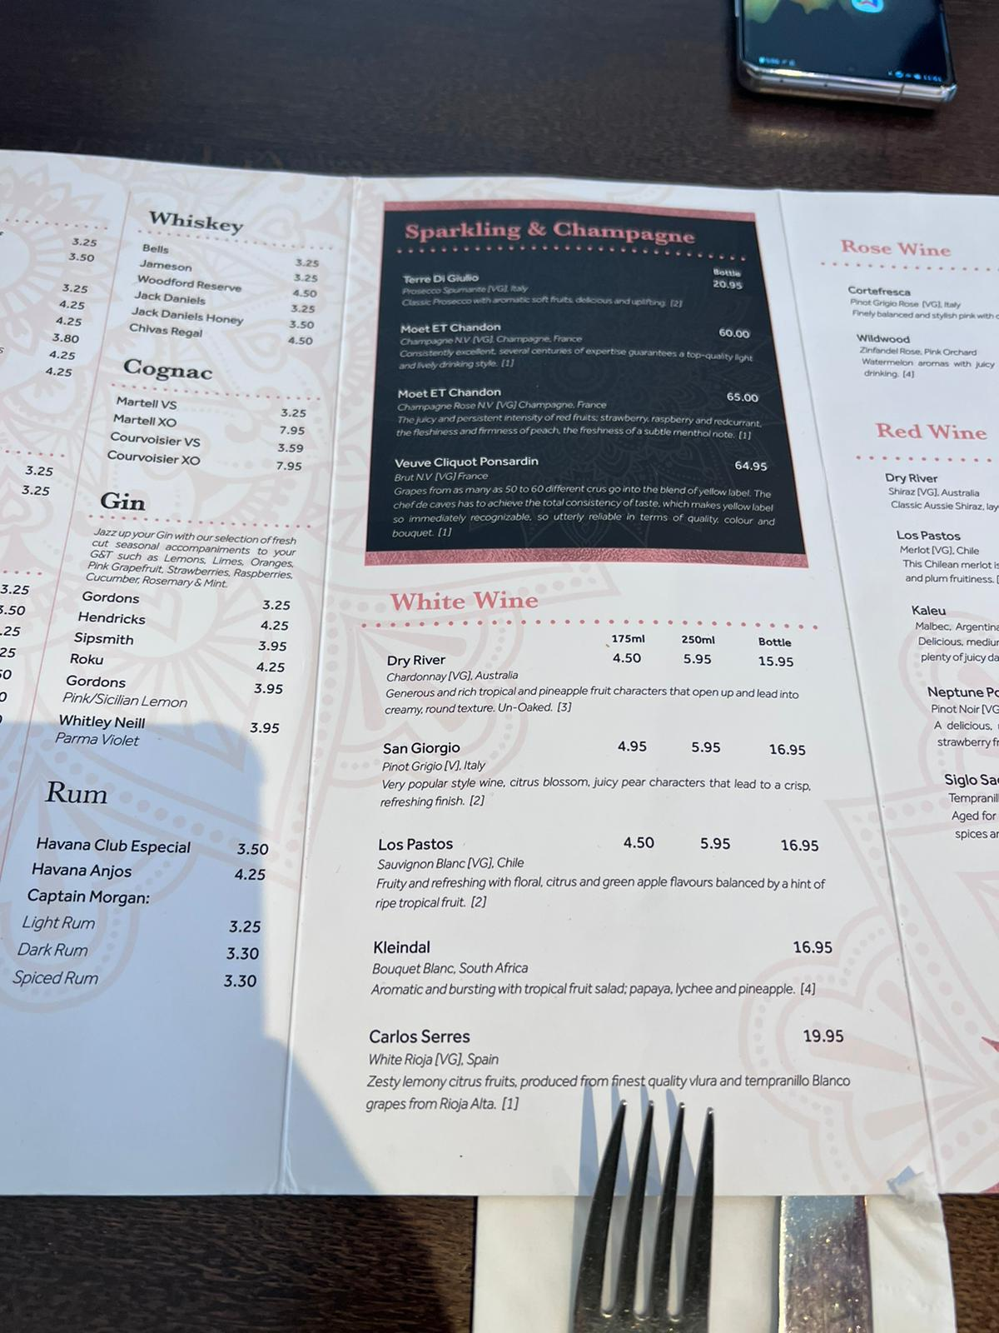
Price (TheRichest, 2022)
Comparing with other similar types of restaurants, Adelinas Bar And Indian Kitchen charges higher than average. Its logical when you consider the total value of excellent quality food with charming location (Gray, 2022).
Considering the price point of Adelinas Bar And Indian Kitchen, everyone can afford something among it’s product portfolio.
The range of price at Adelinas Bar And Indian Kitchen can be generally classified in to four categories, appetizers, starters, traditional mains, special menus.
Notes:
Price can be found little costly. But after considering other factors it appears as logical. Considering the price point of Adelinas Bar And Indian Kitchen, everyone can afford something among it’s product portfolio. The range of price at Adelinas Bar And Indian Kitchen can be generally classified in to four categories, appetizers, starters, traditional mains, special menus.

Slide 9
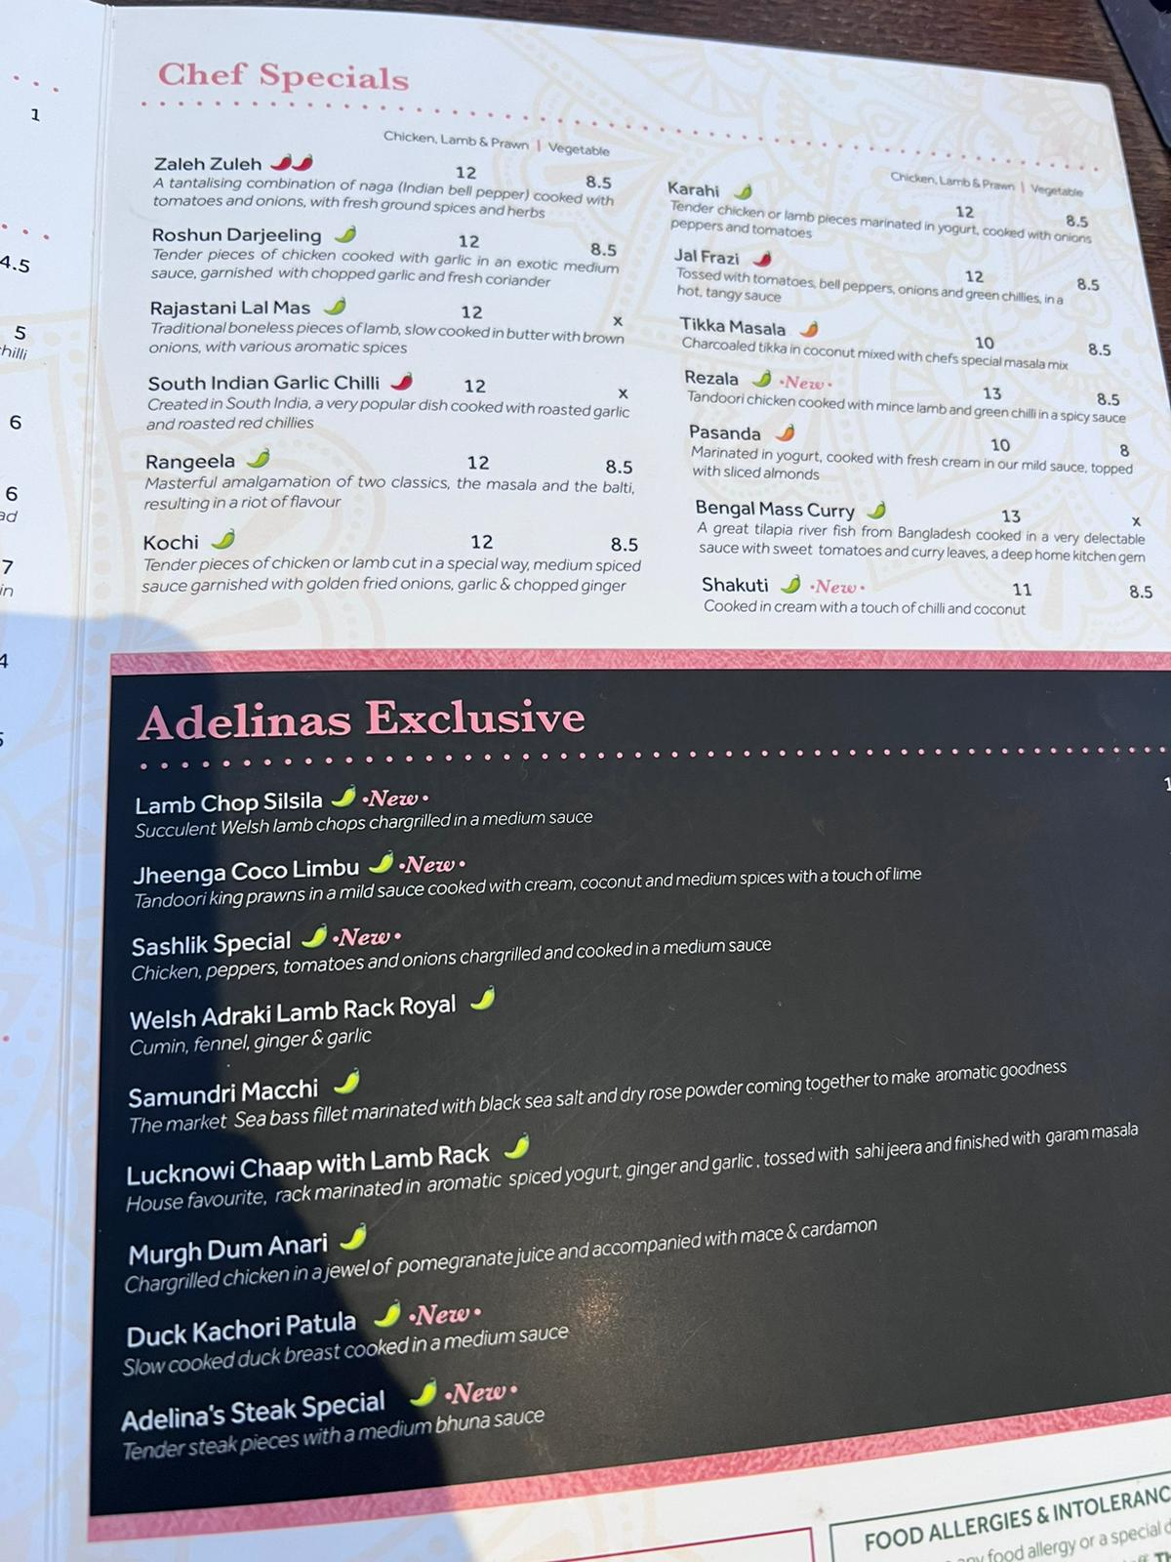
Price
The price range of food on manue of Adelinas Bar And Indian Kitchen is between the £2-£60.
Starters start at £4, with traditional main dishes costing between £6 and £15 and special menus costing between £10 and £60.
Notes:
The price range of food on manue of Adelinas Bar And Indian Kitchen is between the £2-£60. Starters start at £4, with traditional main dishes costing between £6 and £15 and special menus costing between £10 and £60.

Slide 10
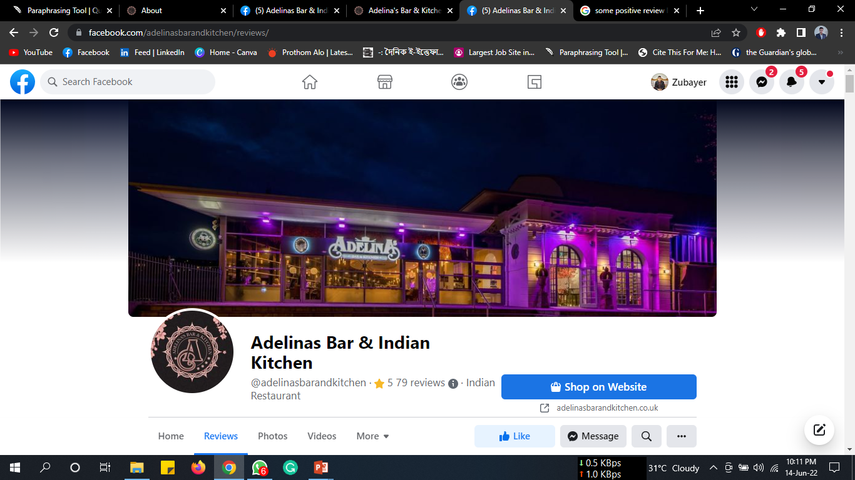
Promotions
The restaurant has a strong online presence, with a vibrant social media presence and a well-designed website. They also advertise extensively in local newspapers and publications (Herrington, 2020)
For below the line promotion,
Exciting price cut offers in different vacations,
Offering pre-booking facilities through out phone call and other one to one communication media.
Notes:
The restaurant has a strong online presence, with a vibrant social media presence and a well-designed website. They also advertise extensively in local newspapers and publications. Below the line promotion is one to one promotion. For this the restaurant does these

Slide 11
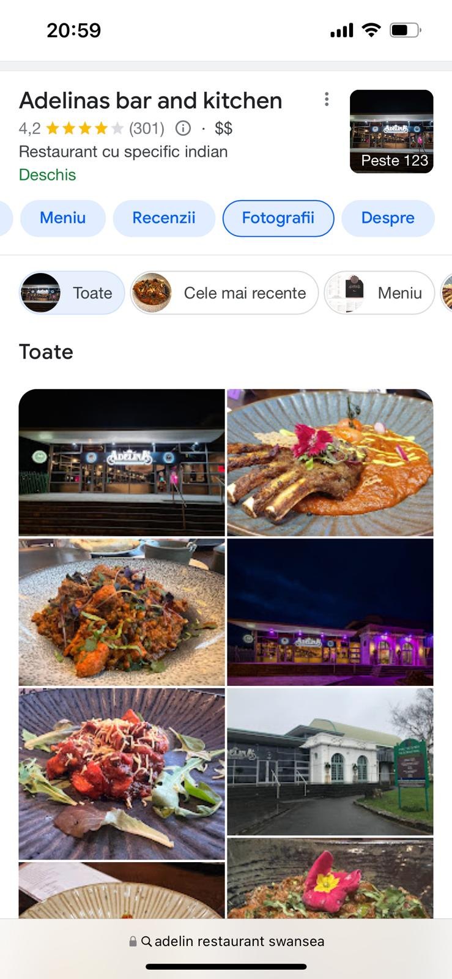
Promotions
For the above the line promotion,
Adelinas Bar And Indian Kitchen maintain its web presence with updated exciting offers and price list.
Posting different programmes and gatherings post in social medias like Facebook and Instragram captures a lot of peoples attention at low cost.
Conventional approaches like advertising in news paper and magazines are also doing well for the restaurant.
Notes:
Avobe the line is mass promotion, for doing this the organisation

Slide 12
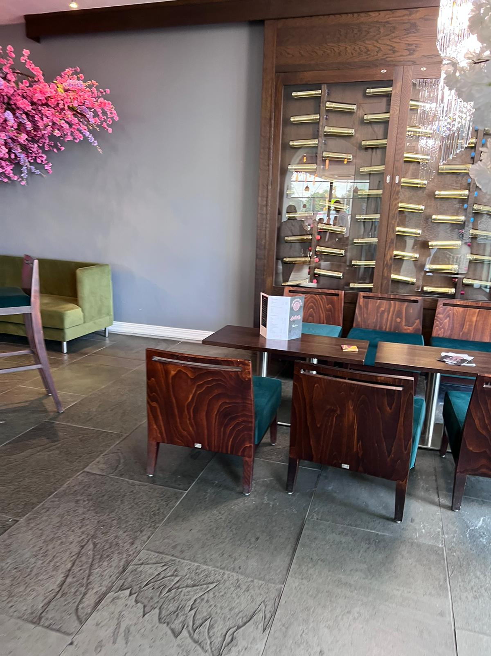
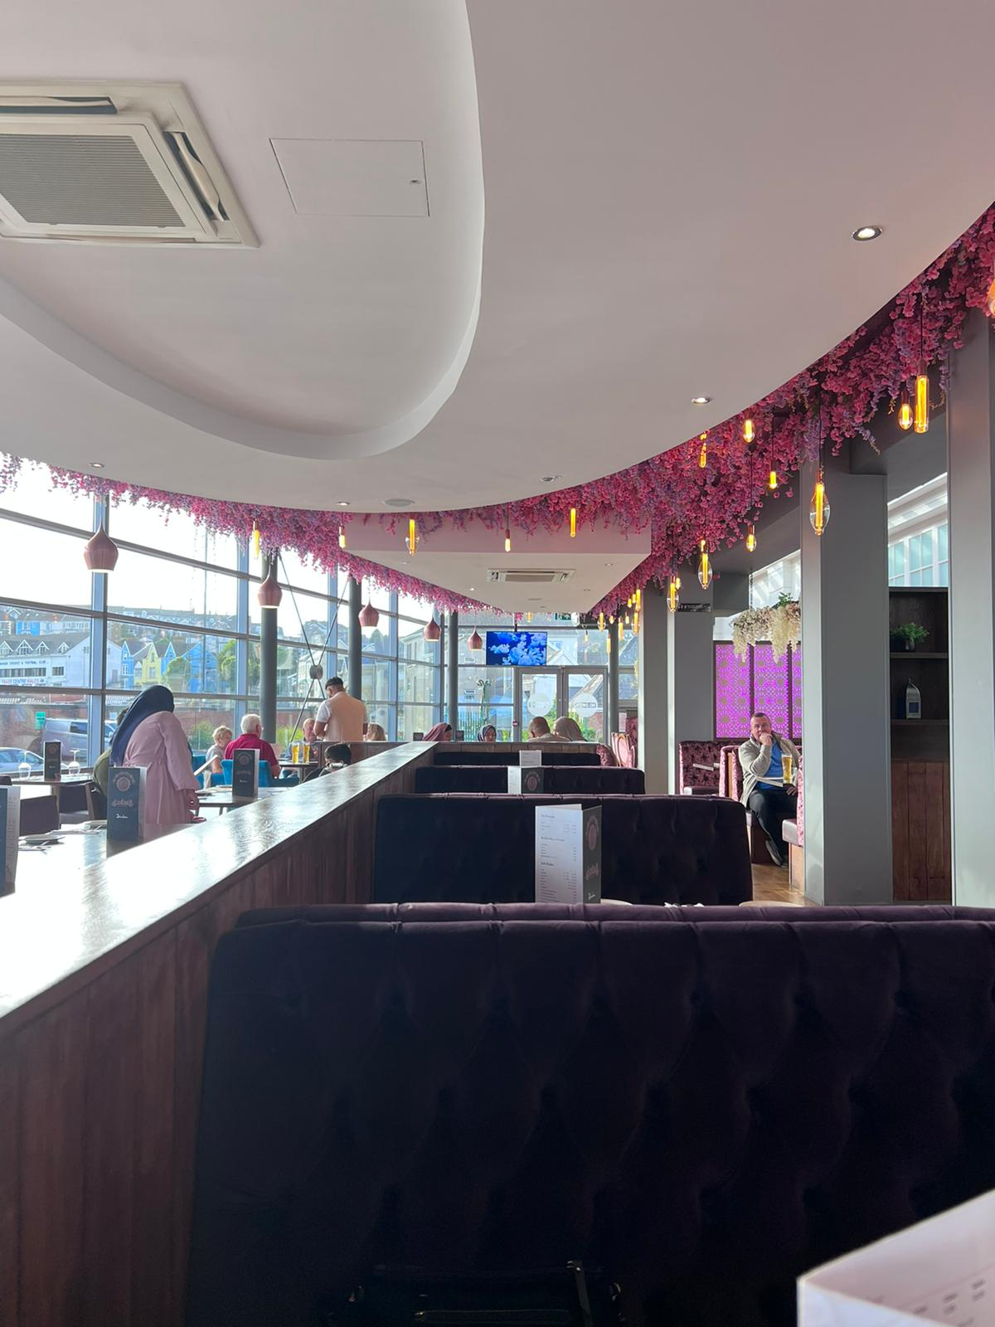
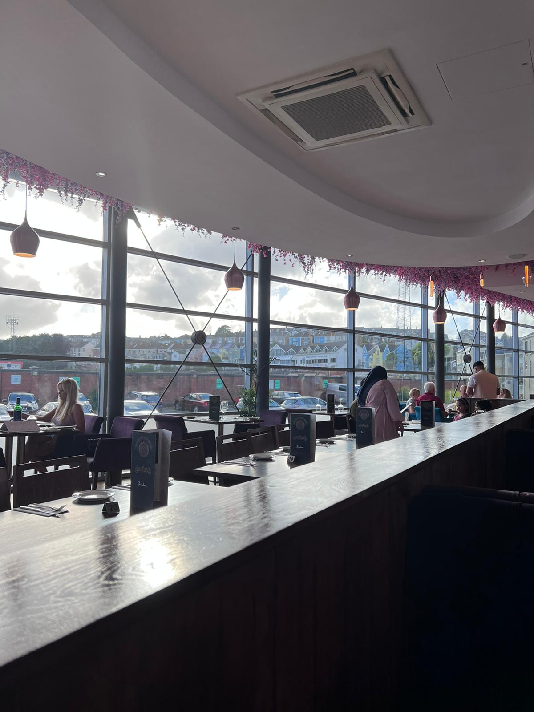
Customer Value (Erkmen and Hancer, 2022)
The restaurant adds value to its customers by serving high-quality, ethically sourced meals.
The restaurant focuses on providing clients with a one-of-a-kind dining experience. This is accomplished through the restaurant's wide range of dishes and drinks, as well as the intimate environment.
The interior and exterior environment is so fantastic that can impress any aged customers instantly.
The overall service package is dedicated to make your visit to the restaurant a memorable one.
Notes:
Here I would like to talk about the value to the customers. The restaurant adds value to its customers by serving high-quality, ethically sourced meals. The restaurant focuses on providing clients with a one-of-a-kind dining experience. This is accomplished through the restaurant's wide range of dishes and drinks, as well as the intimate environment. The interior and exterior environment is so fantastic that can impress any aged customers instantly. They make recipes that are flavorful and healthful by using high-quality ingredients and expert cooks. To achieve rich flavor profiles, all of the cuisine is created from scratch with fresh herbs and spices.

Slide 13
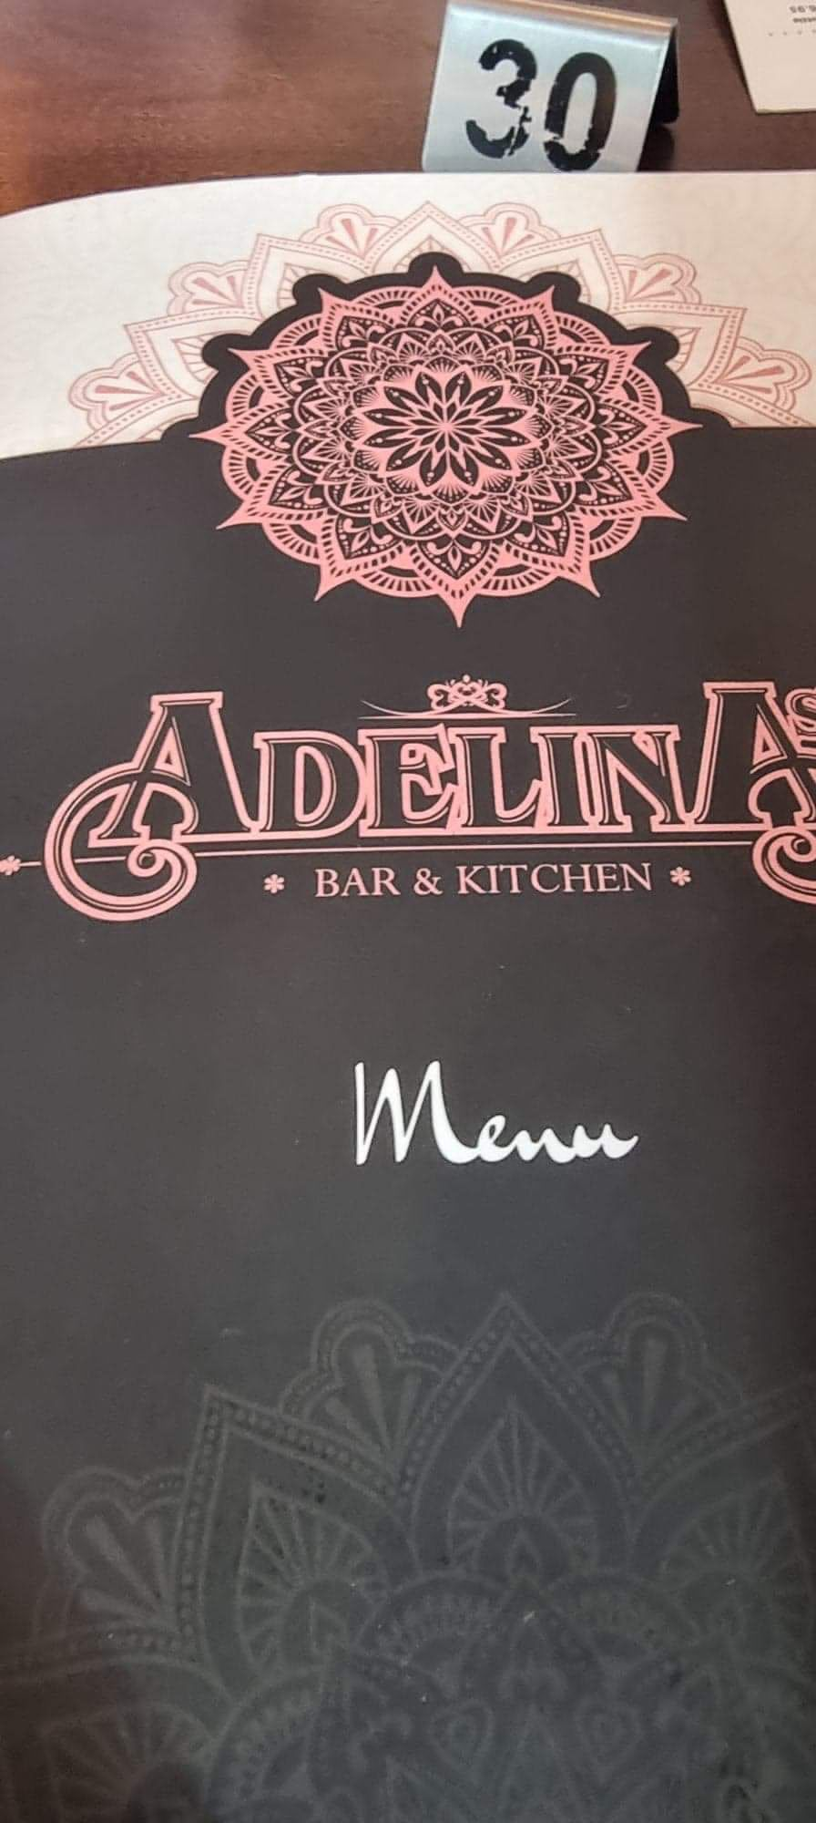
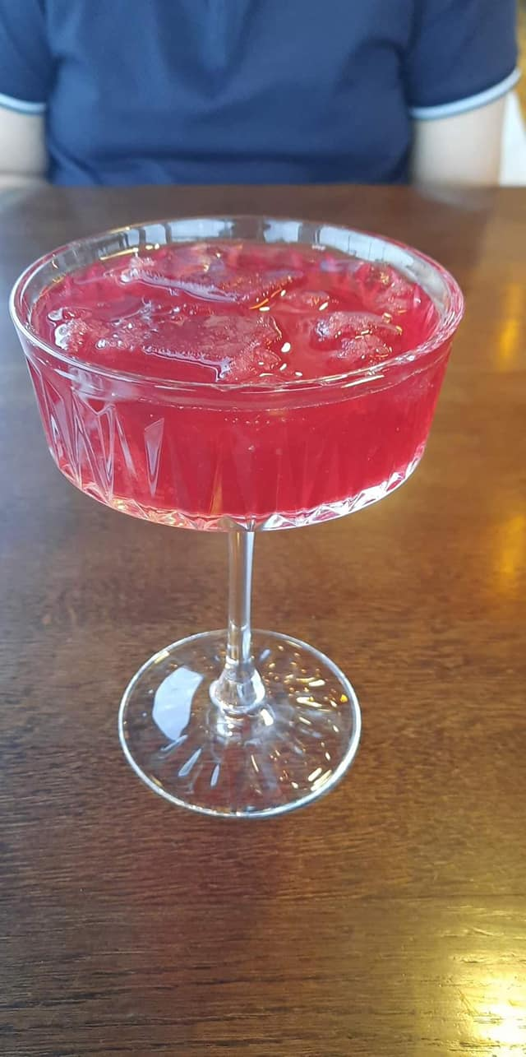
Current and Potential Diners Offers (Foodhub.co.uk. 2022)
They provide a large menu with starters, main dishes, and drinks.
It has a wide menu that includes tandoori meats and chicken curries, which are served with rice and naan breads.
Anyone can select from a number of vegetarian and non-vegetarian options.
Adelinas Bar And Indian Kitchen has a large range of drinks to choose from, including both non-alcoholic and alcoholic options.
Notes:
Now the restaurant provide a large menu with starters, main dishes, and drinks. It has a wide menu that includes tandoori meats and chicken curries, which are served with rice and naan breads. Adelinas Bar And Indian Kitchen has a large range of drinks to choose from, including both non-alcoholic and alcoholic options

Slide 14
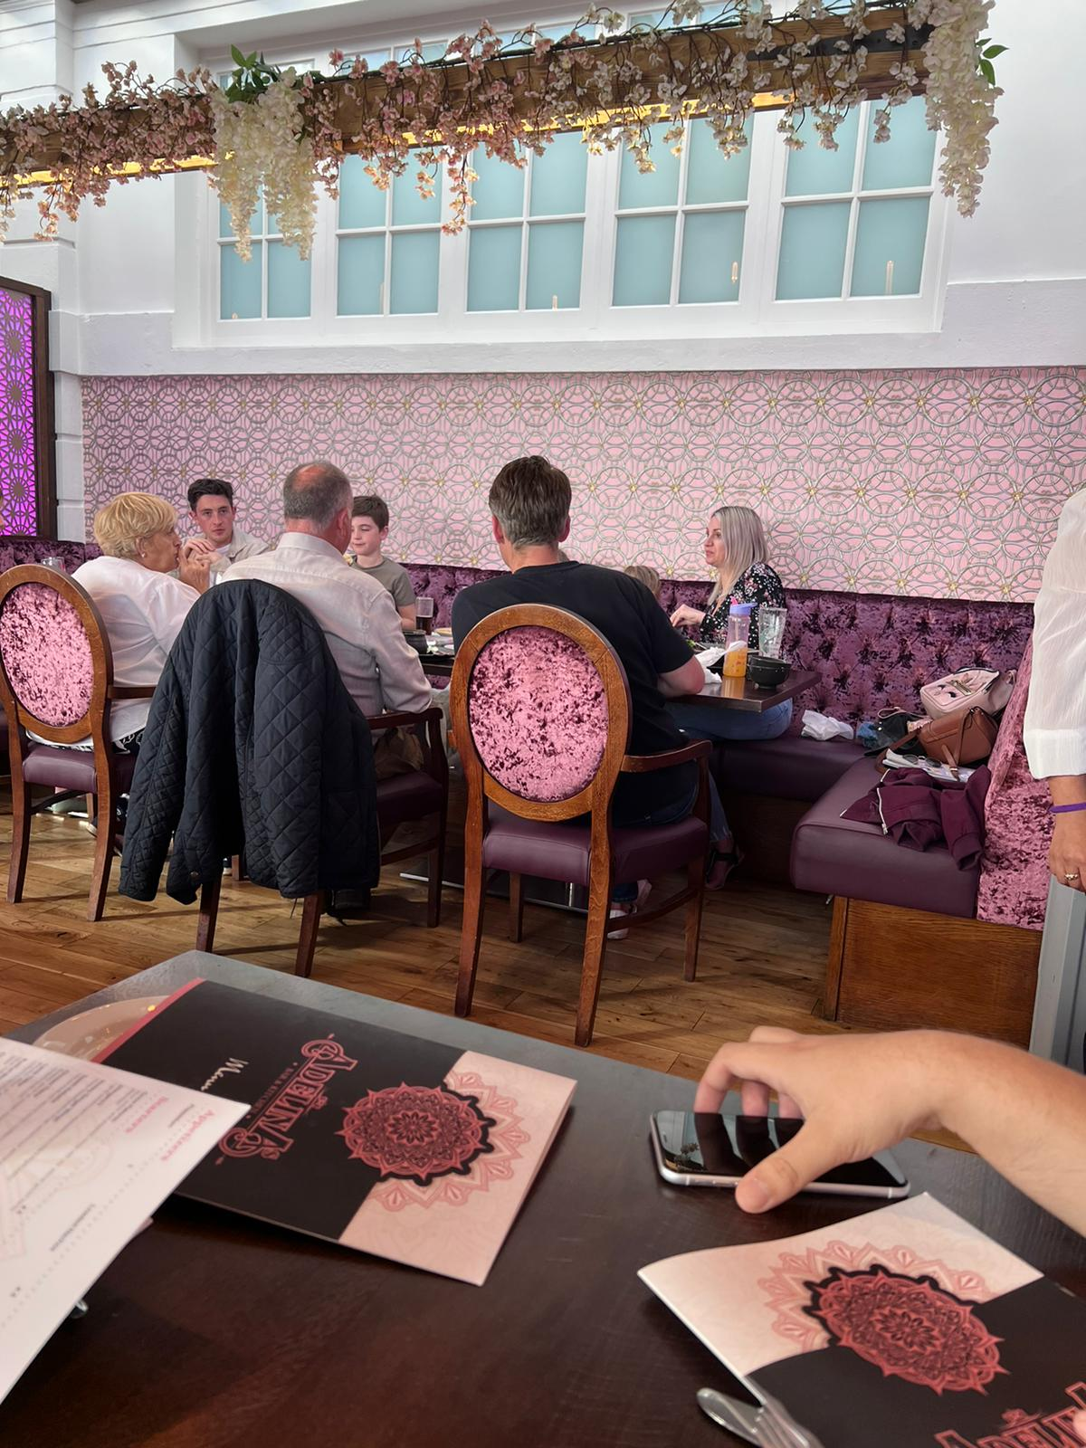
Positive Experiences (Kanget et al., 2018)
The décor of the restaurant is very charming.
The location of this restaurant is convenient and its easy to get there.
The advertisement and branding makes it easily accessible.
It is great to pass some time there, because the total service scope makes the overall experience premium.
Notes:
If I talk about the positive experiences , The décor of the restaurant is very charming, The location of this restaurant is convenient and its easy to get there, The advertisement and branding makes it easily accessible, It is great to pass some time there, because the total service scope makes the overall experience premium.

Slide 15
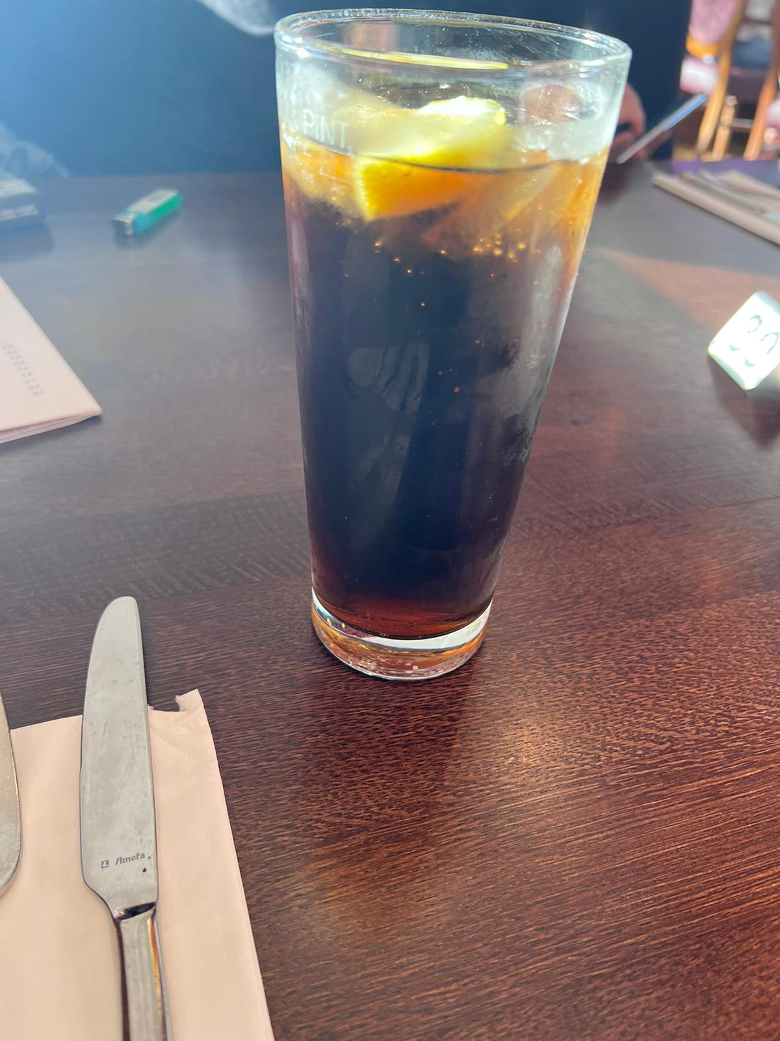
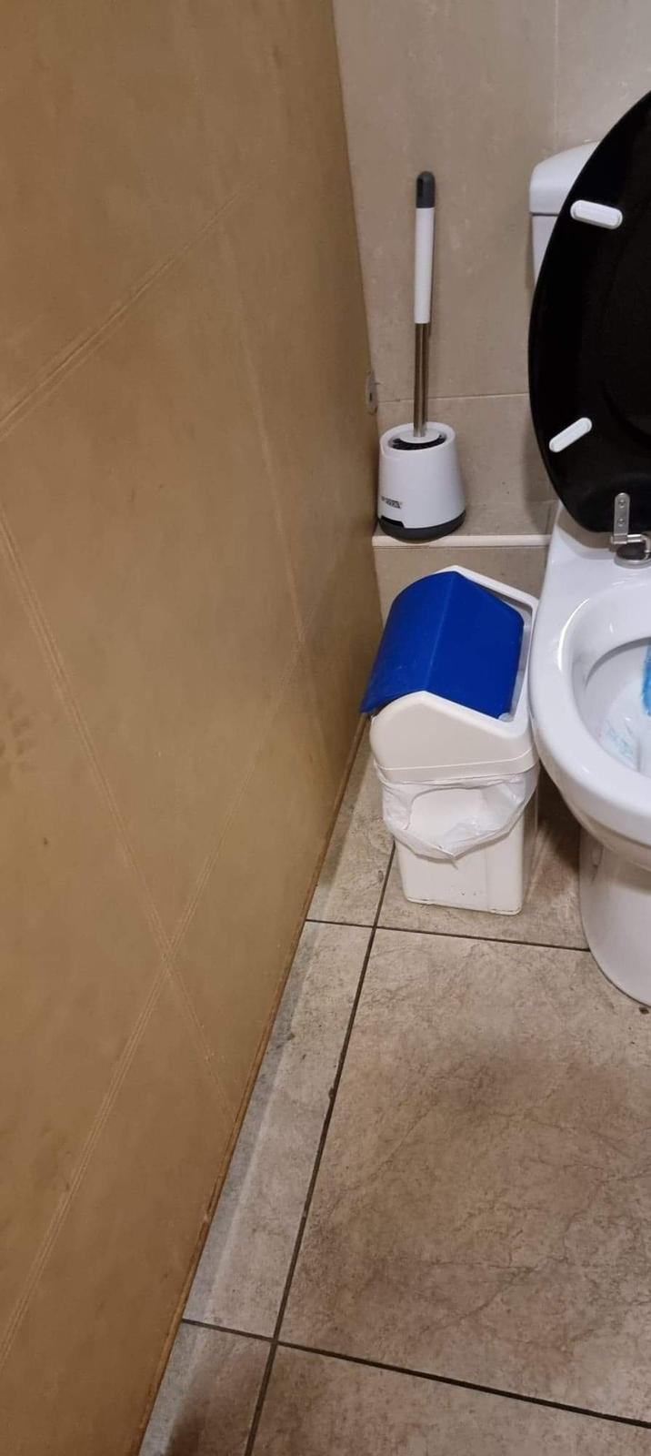
Negative Experiences (Whaley et al., 2019)
Too many waiters in the restaurant.
Unorganised human resources.
The glasses are dirty.
Order takes to many times.
Staffs are not careful during taking orders (example: I ordered an ice-free coke and they brought me an ice coke.)
Foods are tasteless to me
The water was not sealed
Washrooms should be more premium according to the rating it has.
Notes:
I have some negative experiences those are given as a list.

Slide 16
Opinion (Lynn, 2019)
The restaurant serves a wide range of meals centered on traditional Indian cuisine.
Despite some of the more expensive meals, the restaurant was reasonably priced. and offered a wide range of delicious and healthy dishes.
In social media it has 5 star rating that because of mainly its ambiance. Because in some other parts I found some draw backs.
I highly recommend the restaurant to anyone seeking for Indian cuisine or options that are reasonably priced and have a great ambiance ((Indian Restaurants in the UK, 2022)).
Notes:
Basically in my opinion The restaurant serves a wide range of meals centered on traditional Indian cuisine. Despite some of the more expensive meals, the restaurant was reasonably priced. and offered a wide range of delicious and healthy dishes
In social media it has 5 star rating that because of mainly its ambiance. Because in some other parts I found some draw backs. I highly recommend the restaurant to anyone seeking for Indian cuisine or options that are reasonably priced and have a great ambiance

Slide 17
References
Adelinasbarandkitchen.co.uk. 2022. Adelina's Bar & Kitchen. [online] Available at: <https://adelinasbarandkitchen.co.uk/> [Accessed 16 June 2022].
Erkmen, E. and Hancer, M., 2022. Creating Value for Restaurant Customer: The Role of Other Customers in Dining Experience.
Gray, R., 2022. The secret tricks hidden inside restaurant menus. [online] Bbc.com. Available at: <https://www.bbc.com/future/article/20171120-the-secret-tricks-hidden-inside-restaurant-menus> [Accessed 16 June 2022].
Herrington, J., 2020. Are Restaurant Franchisees Getting a Positive Return on Their Advertising Fees?. Journal of Promotion Management, 11(1), pp.71-81.
MICHELIN Guide. 2022. Indian Restaurants in the UK. [online] Available at: <https://guide.michelin.com/gb/en/article/features/indian-restaurants-in-the-uk-and-ireland> [Accessed 16 June 2022].
just-eat.co.uk. 2022. just-eat.co.uk. [online] Available at: <https://www.just-eat.co.uk/restaurants-adelinas-bar-and-kitchen-new-swansea/menu> [Accessed 16 June 2022].
Lynn, M., 2019. Knowledge About the Restaurant Tipping Norm. Journal of Applied Social Psychology, 36(3), pp.740-750.
Seco Femández, E., 2019. Project and construction of modular restaurants: "Diner Project." Informes de la Construcción, 53(478).
TheRichest. 2022. TheRichest. [online] Available at: <https://www.therichest.com/luxury/uk-expensive-restaurant-meals/> [Accessed 16 June 2022].
Squaremeal.co.uk. 2022. UK's Top 100 Restaurants | Best restaurants in UK. [online] Available at: <https://www.squaremeal.co.uk/restaurants/best/uk-top-100-restaurants_238> [Accessed 16 June 2022].
Squaremeal.co.uk 2022. [online] Available at: <https://www.squaremeal.co.uk/offers/> [Accessed 16 June 2022].
tripadvisor. 2022. [online] Available at: <https://www.tripadvisor.com/ShowUserReviews-g186466-d23774921-r829425158-Adelinas_Bar_And_Indian_Kitchen-Swansea_Swansea_County_South_Wales_Wales.html> [Accessed 16 June 2022].
Ubereats.com. 2022. Adelinas bar and kitchen Delivery | Swansea | Uber Eats. [online] Available at: <https://www.ubereats.com/gb/store/adelinas-bar-and-kitchen/o8QHqUPKSDiAhRdWbDde0A> [Accessed 16 June 2022].
Yelp.com. 2022. Adelina's Bar & Kitchen. [online] Available at: <https://www.yelp.com/biz/adelinas-restaurant-and-bar-philadelphia> [Accessed 16 June 2022].
Yrjölä, M., Rintamäki, T., Saarijärvi, H., Joensuu, J. and Kulkarni, G., 2022. A customer value perspective to service experiences in restaurants.

