Slide 1
Signals and Systems
Week 3
Dr. Gary Jones

Slide 2
RS232 System
Data transmitted on the left is displayed on the right and vice versa

Slide 3
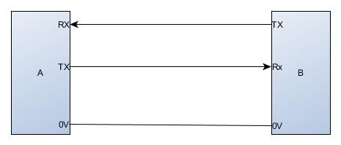
A Typical RS232 connection
The diagram above shows typical rs232 connect details.
Tx on device A connects to RX on device B
Tx on device B connects with RX on device A
The 0v signals are connected together to provide a reference voltage
This is a point to point protocol

Slide 4
SPI System
SPI (Serial Peripheral Interface) Serial transmission system
The Serial Peripheral Interface (SPI) is a synchronous serial communication interface specification used for short-distance communication, primarily in embedded systems. The interface was developed by Motorola in the mid-1980s and has become a de facto standard. Typical applications include Secure Digital cards and liquid crystal displays.
SPI devices communicate in full duplex mode using a master-slave architecture (alternate terminology being main and secondary) with a single master. The master device originates the frame for reading and writing. Multiple slave-devices are supported through selection with individual slave select (SS), sometimes called chip select (CS), lines.

Slide 5
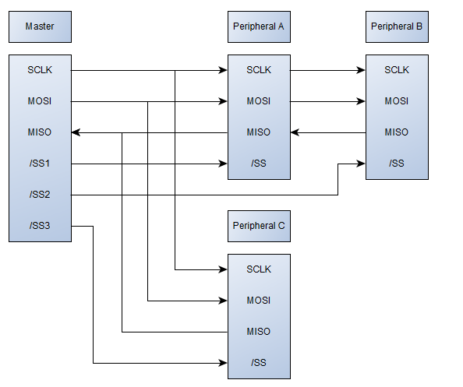
SPI System
SPI (Serial Peripheral Interface) Serial transmission system

Slide 6
I²C System
I²C (Inter-Integrated Circuit) Serial transmission system
I²C (Inter-Integrated Circuit), pronounced I-squared-C, is a synchronous, multi-master, multi-slave, packet switched, single-ended, serial computer bus invented in 1982 by Philips Semiconductor (now NXP Semiconductors). It is widely used for attaching lower-speed peripheral ICs to processors and microcontrollers in short-distance, intra-board communication. Alternatively, I²C is spelled I2C (pronounced I-two-C) or IIC (pronounced I-I-C).

Slide 7
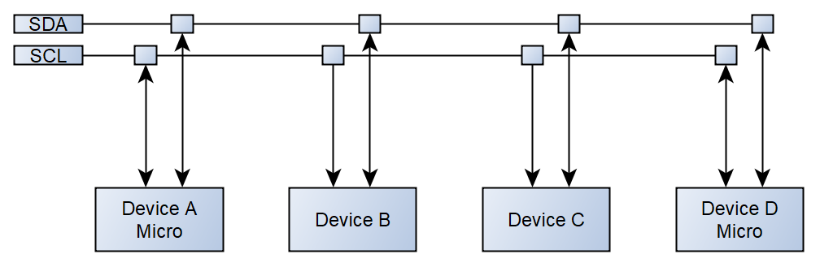
I²C System
I²C (Inter-Integrated Circuit) Serial transmission system

Slide 8
I²C System
I²C (Inter-Integrated Circuit) Serial transmission system
When there are many I²C devices in a system, there can be a need to include bus buffers or multiplexers to split large bus segments into smaller ones. This can be necessary to keep the capacitance of a bus segment below the allowable value or to allow multiple devices with the same address to be separated by a multiplexer. Many types of multiplexers and buffers exist and all must take into account the fact that I²C lines are specified to be bidirectional. Multiplexers can be implemented with analogue switches, which can tie one segment to another. Analogue switches maintain the bidirectional nature of the lines but do not isolate the capacitance of one segment from another or provide buffering capability.
Buffers can be used to isolate capacitance on one segment from another and/or allow I²C to be sent over longer cables or traces. Buffers for bi-directional lines such as I²C must use one of several schemes for preventing latch-up. I²C is open-drain, so buffers must drive a low on one side when they see a low on the other. One method for preventing latch-up is for a buffer to have carefully selected input and output levels such that the output level of its driver is higher than its input threshold, preventing it from triggering itself. For example, a buffer may have an input threshold of 0.4 V for detecting a low, but an output low level of 0.5 V. This method requires that all other devices on the bus have thresholds which are compatible and often means that multiple buffers implementing this scheme cannot be put in series with one another.

Slide 9
I²C System
I²C (Inter-Integrated Circuit) Serial transmission system
Alternatively, other types of buffers exist that implement current amplifiers or keep track of the state (i.e. which side drove the bus low) to prevent latch-up. The state method typically means that an unintended pulse is created during a hand-off when one side is driving the bus low, then the other drives it low, then the first side releases (this is common during an I²C acknowledgement).

Slide 10
I²C System
I²C (Inter-Integrated Circuit) Serial transmission system – EEPROM 24LC64
“A control byte is the first byte received following the Start condition from the master device (Figure 5-1).The control byte consists of a four-bit control code. For the 24XX64, this is set as ‘1010’ binary for read and write operations. The next three bits of the control byte are the Chip Select bits (A2, A1, A0). The Chip Select bits allow the use of up to eight 24XX64 devices on the same bus and are used to select which device is accessed. The Chip Select bits in the control byte must correspond to the logic levels on the corresponding A2,A1 and A0 pins for the device to respond. These bits are, in effect, the three Most Significant bits of the word address. For the SOT-23 and Chip Scale packages, the address pins are not available. During device addressing, theA2, A1 and A0 Chip Select bits (Figure 5-2) should beset to ‘0’.The last bit of the control byte defines the operation to be performed. When set to a ‘1’, a read operation is selected. When set to a ‘0’, a write operation is selected. The next two bytes received define the address of the first data byte (Figure 5-2). Because only A12...A0 are used, the upper-three address bits are “don’t care” bits. The upper-address bits are transferred first, followed by the Less Significant bits. Following the Start condition, the 24XX64 monitors the SDA bus, checking the device-type identifier being transmitted. Upon receiving a ‘1010’ code and appropriate device-select bits, the slave device outputs an Acknowledge signal on the SDA line. Depending on the state of the R/W bit, the 24XX64 will select a read or write operation.” Microchip 24LC64 data sheet

Slide 11
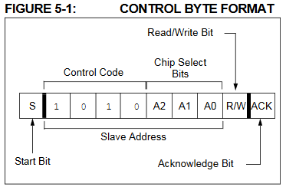
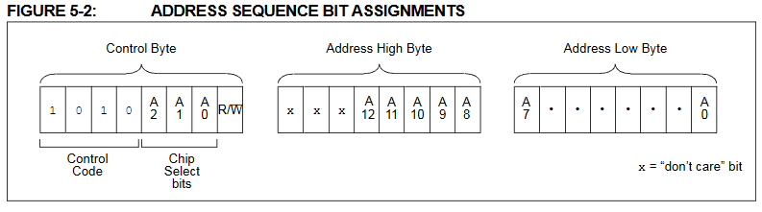
I²C System
I²C (Inter-Integrated Circuit) Serial transmission system – EEPROM 24LC64
Microchip 24LC64 data sheet

Slide 12
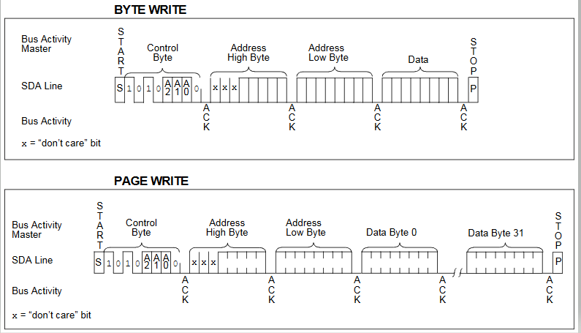
I²C System
I²C (Inter-Integrated Circuit) Serial transmission system – EEPROM 24LC64
Write instructions
Microchip 24LC64 data sheet

Slide 13
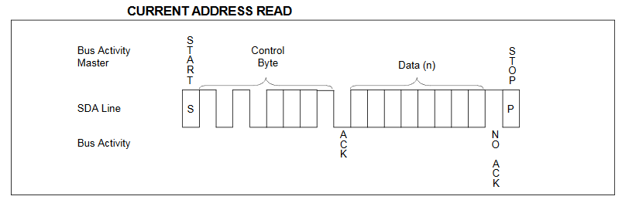
I²C System
I²C (Inter-Integrated Circuit) Serial transmission system – EEPROM 24LC64
Read instructions
Read operations are initiated in the same way as write operations, with the exception that the R/W bit of the control byte is set to one. There are three basic types of read operations: current address read, random read and sequential read.
Microchip 24LC64 data sheet

Slide 14
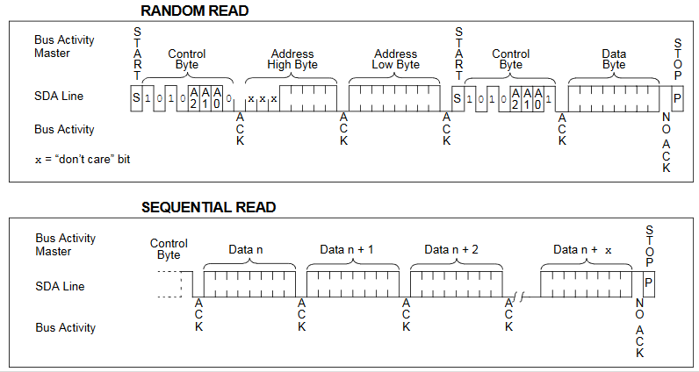
I²C System
I²C (Inter-Integrated Circuit) Serial transmission system – EEPROM 24LC64
Read instructions
Microchip 24LC64 data sheet

