Slide 1



Temporality in Phenomenology of Perception.
“Consciousness is the contemporary of all times”.
Elis Williams-Huw 2100766

Slide 2
References
Camele, A., 1975. TIme in Merleau-Ponty and Heidegger. Philosophy Today, 19(3), pp. 256-267.
Merleau-Ponty, M., 2014. Phenomenology of Perception. Oxford: Routledge.
Strobach, N., 2013. Academia.edu. [Online]
Available at: http://www.iep.utm.edu/zeno-par/
[Accessed 2 February 2024].

Slide 3
Phenomenology
“Phenomenology is an attempt to describe the basic structures of human experience and understanding from a first person point of view, in contrast to the reflective, third person perspective that tends to dominate scientific knowledge and common sense………..
……..Phenomenology is thus descriptive, not an explanatory or deductive enterprise, for it aims to reveal experience as such, rather than frame hypotheses or speculate beyond its bounds”. (PhP p.viii)

Slide 4
II.Temporality
(a) There is no time in things
(b) Nor is time to be found in “states of consciousness”
(c) Ideality of time? Time is a relation of being
(d) The “field of presence,” the horizons of past and future
(e) Operative intentionality
(f) Cohesion of time through the very passage of time
(h) Constituting time, and eternity
(i) Ultimate consciousness is presence in the world
(j) Temporality [as] self-affection of itself
(k) Passivity and activity
(l) The world as the place of significations
(m) presence in the world

Slide 5
Experiencing Temporality
All experience is arranged according to the before and after (p.432)
Understanding time will not be in its pure form, rather at the intersection of its various dimensions (p.433)
We say that time passes or flows by; but this metaphor is quite confused

Slide 6
Time is not a collection of events
The very notion of an event has no place in the objective world
“Events” are carved out of the spatio-temporal totality of the objective world by a finite observer.
World is but a single indivisible being that does not change
Time supposes a view upon time
Thus, time is neither a real process nor an actual succession that we could limit ourselves to simply recording.

Slide 7
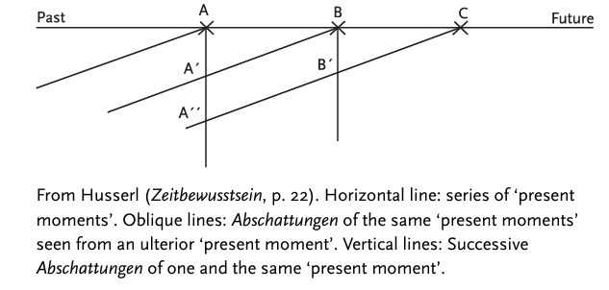
(f) Cohesion of time through the passage of time

Slide 8
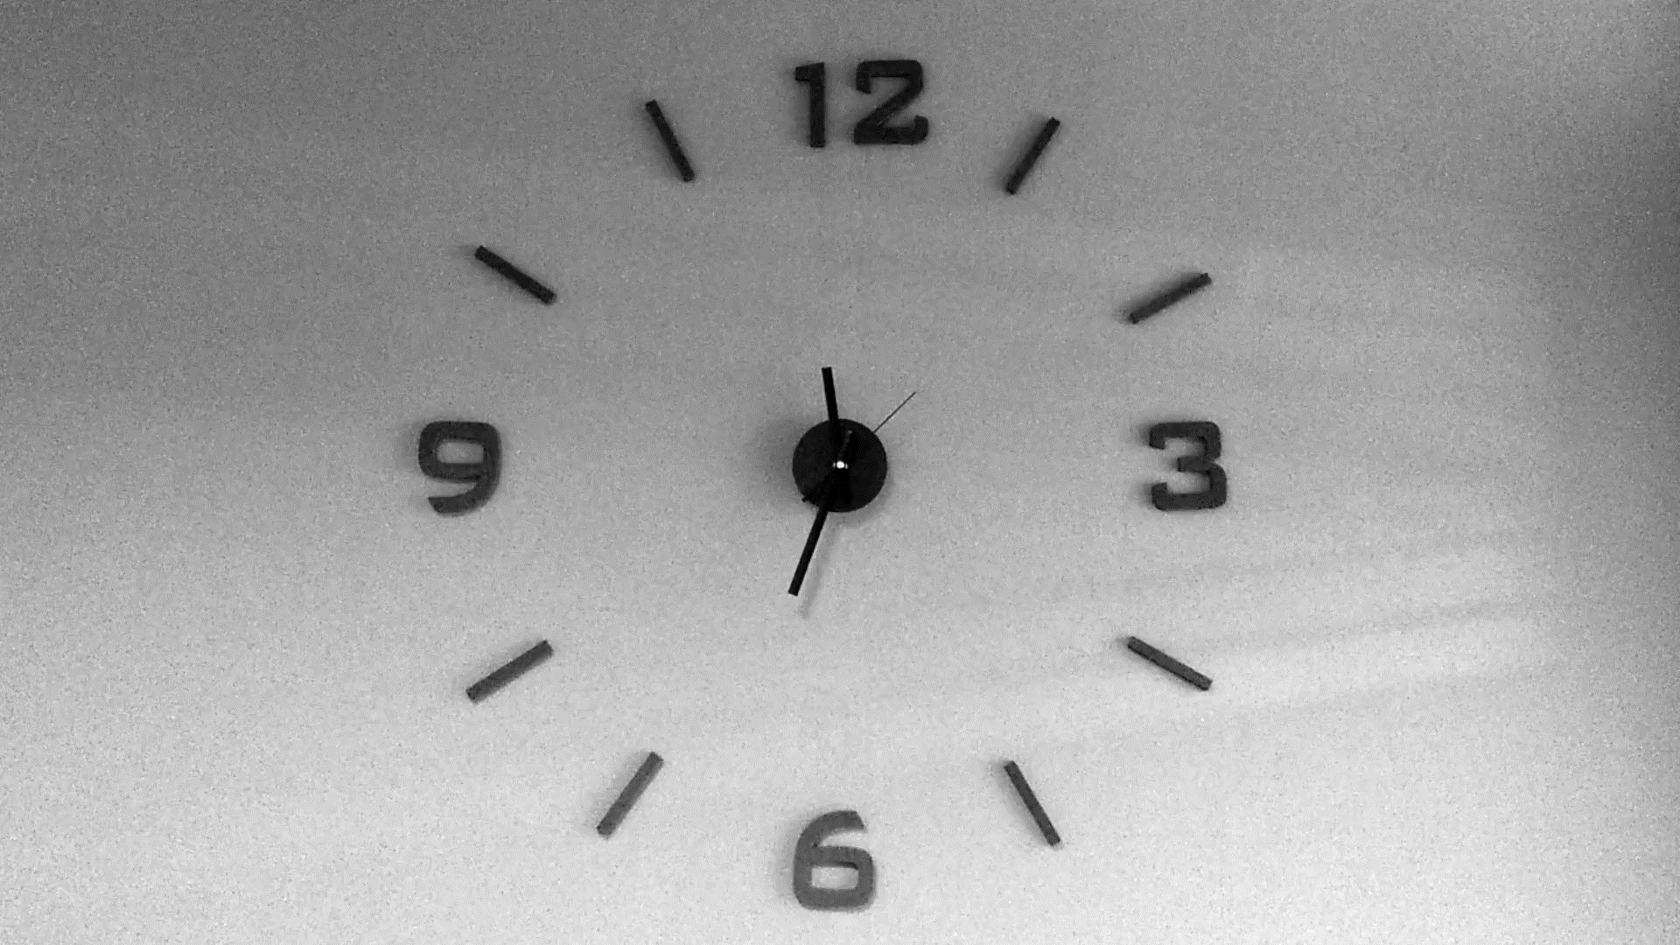
Recap & Conclusion

