Slide 1
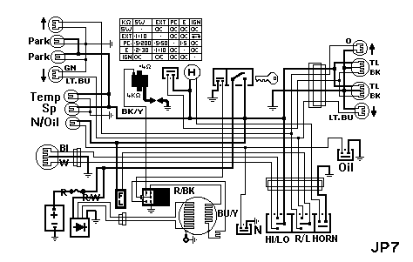
Engineering Science
Electronics
Level : Foundation
Lecturer :Tim Tudor
Email : timothy.tudor@smu.ac.uk
Year : 2010

Slide 2
Topic 1 – DC Theory
Capacitors - Introduction
We learned in Outcome 1 that Electric charge ‘Q’ is a quantity of electricity measured in Coulombs.
The energy possessed by the charge depends upon the voltage.
Relative to zero potential, the energy that a charge possesses is
E = Q V Joules.
When a charge is transferred as electrons in a conductor, the
charge per second is the current ‘I’ Amperes. 1 Amp =1 Coulomb/s.

Slide 3
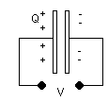
Topic 1 – DC Theory
Capacitors - Introduction
Capacitors are basically two parallel plates separated by an insulating material called a dielectric.
There are many types for a variety of purposes but the basic theory is the same for all.
If a voltage V is connected across the plates, electrons are forced onto one plate and a corresponding number is removed from the other plate.

Slide 4
Topic 1 – DC Theory
Capacitors - Introduction
If a plate has a surplus of electrons it becomes negatively charged and the plate with a deficiency of electrons becomes positively charged.
In other words the capacitor has been made to store charge and hence
energy.

Slide 5
Topic 1 – DC Theory
Capacitors - Introduction
We may make an analogy with a vessel used to store gas under pressure.
These are known as accumulators. If a gas is pumped into a container, the pressure ‘p’ rises as the quantity of gas increases (e.g. pumping up a bicycle tire).
Work is done during the pumping and the energy used is stored in the container.
The energy stored is directly proportional to the pressure and the volume of the vessel. E = pV.

Slide 6
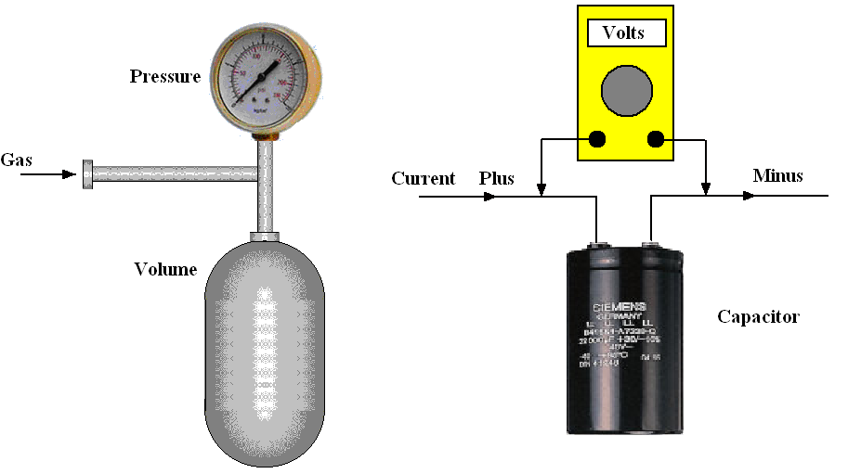
Topic 1 – DC Theory
Capacitors - Introduction
A capacitor is the electrical equivalent of this.
Electrons (charge ‘Q’) are pumped into the capacitor and the voltage ‘V’ rises as the charge increases. The energy stored is given by the formula E = VQ

Slide 7
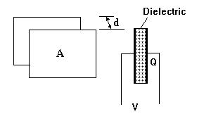
Topic 1 – DC Theory
Capacitors - Introduction
Consider two plates each with an area A and separated by a distance d.
The material between them is the dielectric. The charge Q stored on the pair of plates depends upon the voltage and the physical dimensions and properties of the plates and dielectric.

Slide 8
Topic 1 – DC Theory
Capacitors - Introduction
For a given capacitor it is found that charge is directly proportional to voltage such that
Q = CV
The constant C is the CAPACITANCE. Capacitance is measured in Farads (F) but this is a large unit so we use the following multiples.
mF = F x 10⁻³ μF = F x 10⁻⁶ nF = F x 10⁻⁹ pF = F x 10⁻¹²

Slide 9
Topic 1 – DC Theory
Capacitors - Example
A capacitor stores 0.05 Coulombs when the terminal voltage is 160V. What is the capacitance?
Q = CV
C = Q/V
C = 0.05/160
C = 0.0003125 F
Or
C = 312.5 μF

Slide 10
Topic 1 – DC Theory
Capacitors – Energy Stored
A charge of 1 Coulomb carries energy of 1 Joule for each volt.
The energy in a charge is QV.
When a capacitor is charged, the voltage has to build up from 0 to V so the average voltage is V/2.
The energy stored is hence QV/2.
Substituting Q = CV the energy stored in a capacitor is hence

Slide 11
Topic 1 – DC Theory
Capacitors – Energy Stored – Example
A capacitor has a value of 800 μF and it is charged until the terminal voltage is 15V.
Calculate the energy stored.

Slide 12
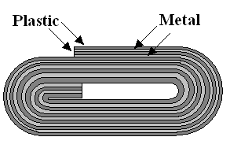
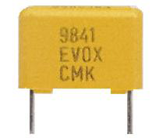

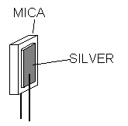
Topic 1 – DC Theory
Capacitors – Types
Each capacitor has a maximum working voltage which if exceeded might cause the dielectric to break down and conduct.
Paper and Plastic: The dielectric is made of paper or plastic, plastic being the
more modern type.
Silver Mica
A piece of mica is the dielectric with silver deposited on each side to form the plates. They are encapsulated in wax impregnated with ceramic. Their advantage is high working voltage (typically 350V) and accuracy.

Slide 13

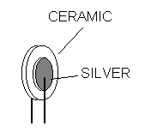
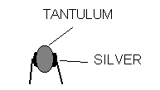

Topic 1 – DC Theory
Capacitors – Types
Ceramic
These may be disc shaped, tubular or flat. The dielectric is ceramic and metal films are deposited to form the plates. They are encapsulated in resin or epoxy.
Tantalum Bead
Tantalum is used as the dielectric and produces a large capacitance in small volume but with low working voltages. These small capacitors are encapsulated in resin.

Slide 14

Topic 1 – DC Theory
Capacitors – Types
Electrolytic
The construction consists of metal foil and impregnated cotton gauze layered
and rolled up into a cylinder.. Very large capacitances are possible. The dielectric is broken down by reversed current so they cannot be used with A.C. and polarity of the terminals must be observed.
Sizes range from less than 1 micro-Farad to many thousands of micro-Farads. The physical size also depends upon the working voltage.

Slide 15
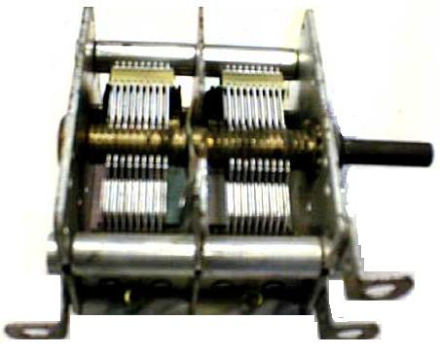
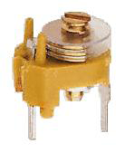
Topic 1 – DC Theory
Capacitors – Types
Variable
The picture shows a multiplate air spaced variable capacitor. There are two sets of metal plates or vanes, fixed and moving.
Preset or Trimmers.
These are small variable capacitors designed to be adjusted only occasionally. When a capacitance value is critical, a trimmer may be used instead of a fixed type so that the exact capacitance may be obtained.

Slide 16

Topic 1 – DC Theory
Capacitors – Symbols

Slide 17
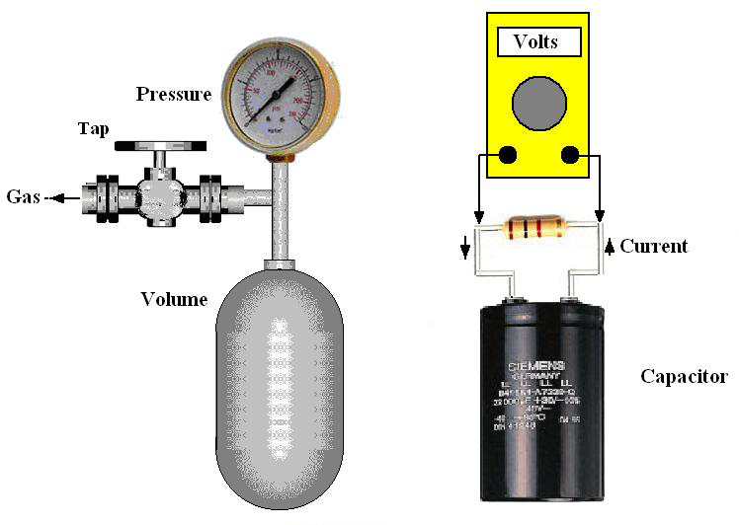
Topic 1 – DC Theory
Capacitors – Charging and discharging
It might be useful here to return to our analogy. Consider a gas bottle with a tap connected to it. If we crack open the tap and let the gas out, the pressure will fall with time until the bottle is empty.
This is like taking a fully charged capacitor and connecting a resistor across the terminals. The charge will flow through the resistor and the terminal voltage will fall with time.

Slide 18
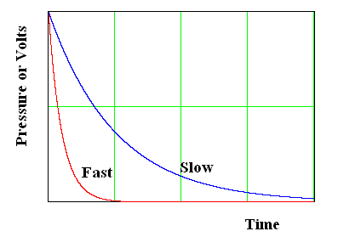
Topic 1 – DC Theory
Capacitors – Charging and discharging
The pressure and voltage will fall in a manner called an EXPONENTIAL DECAY.
The speed at which the pressure and voltage fall depends on the capacity and the resistance.
If we open the valve more, the bottle will discharge more quickly.
If we put a lower value resistor across the terminals, the voltage will fall more quickly.

Slide 19
Topic 1 – DC Theory
Capacitors –Discharging
In the case of the electrical system, the equation that gives the discharge curve is:
V_{s} is the starting voltage, t is the time and T is a time constant
given by T = RC
We see that if R and C are big,
T is big and the discharge is
slow.

Slide 20
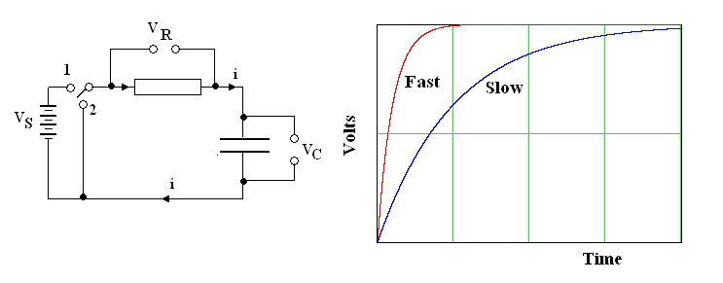
Topic 1 – DC Theory
Capacitors – Charging
The circuit shown below can be used to charge and discharge a capacitor.
When the switch is connected to (1) the capacitor charges through the resistor and the voltage across the capacitor rises exponentially to the source voltage.

Slide 21
Topic 1 – DC Theory
Capacitors – Charging
In the case of the electrical system, the equation that gives the charge curve is:
V_{s} is the starting voltage, t is the time and T is a time constant
given by T = RC

Slide 22
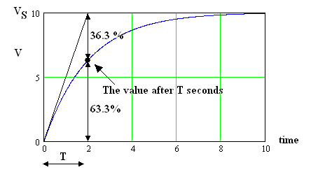
Topic 1 – DC Theory
Capacitors – Meaning of the time constant
Starting with the equation
If we put t=T we have
So the time constant is the time taken for the
voltage to change to 63.3% of the final value.
This is useful when finding T from a graph.
Note in theory that the final voltage is never
reached but if we calculate the voltage at
t = 4T we find V = 98.2%VS.

Slide 23
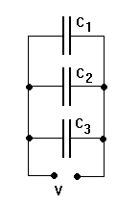
Topic 1 – DC Theory
Capacitors – In Parallel
Consider three capacitors C₁, C₂ and C₃ connected in parallel as shown.
The voltage is the same on each one. The charge stored on each is
Q₁ = C₁ V Q₂ = C₂ V Q₃ = C₃ V
The total charge stored Q_{T} = Q₁ +Q₂ +Q₃
Q_{T} = C₁ V + C₂ V + C₃ V
Q_{T} = V(C₁ +C₂ +C₃)
We define Q_{T} = C_{T}V where C_{T} is the total capacitance so it follows that
C_{T} =(C₁ +C₂ +C₃)
It follows that capacitors in parallel are added together.

Slide 24
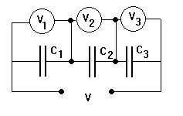
Topic 1 – DC Theory
Capacitors – In Series
Consider three capacitors in series with a voltage V across the
total but the voltage on each one is V₁, V₂ and V₃.
Since the movement of electrons must be the same onto and off all
the plates, the charge stored on each capacitor is the same and
equal to the total charge.
Q_{T} = Q₁ = Q₂ = Q₃
V = Q_{T} /C_{T} and V₁ = Q₁ /C₁ , V₂= Q₂ /C₂ and V₃ =Q₃ /C₃
Since V = V₁ + V₂ + V₃ then Q /C_{T} = Q/C₁ + Q /C₂ + Q/C₃
Cancelling Q we have 1 /C_{T} = 1/C₁ + 1 /C₂ + 1/C₃
Hence C_{T} = 1/(1/C₁ + 1 /C₂ + 1/C₃)
Note that capacitors in series follow the same rule as resistors in parallel.

Slide 25
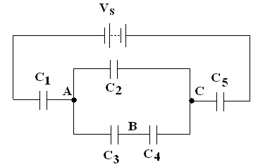
Topic 1 – DC Theory
Capacitors – Example
A network of capacitors is connected to a battery as shown. Given the listed data below, calculate the total capacitance, and the voltage at points A and C.
V_{s} = 50 V C₁ = 500 μF C₂ = 1000 μF C₃ = C₄ = 2000 μF
C₅ = 1500 μF
.

Slide 26
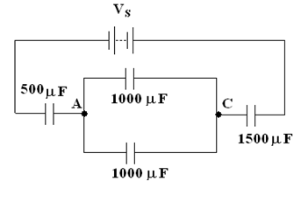
Topic 1 – DC Theory
Capacitors – Example
First evaluate the combined value of C₃ and C₄
Redrawing circuit for clarity:
.

Slide 27
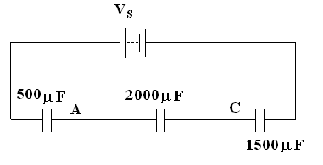
Topic 1 – DC Theory
Capacitors – Example
Next combine the parallel circuit
.

Slide 28
Topic 1 – DC Theory
Capacitors – Example
Finally calculate total capacitance
.

Slide 29
Topic 1 – DC Theory
Capacitors – Example
Now find the total charge Q = C_{T} V
Q = 315.79 x 10⁻⁶ x 50
Q = 15.789 x 10⁻³ Coulomb
The charge is the same on each series part of the circuit so this charge must exist on C₁ and C₅.
Identify that zero volts is on the left of the circuit and that we must now work in Farads.
Q = C₁V₁ = 15.789 x 10⁻³
V₁ = Q/C₁ = 15.789 x 10⁻³/ 500 x 10⁻⁶ = 31.578 V
The voltage at A is 0 + 31.578 = 31.578V
.

Slide 30
Topic 1 – DC Theory
Capacitors – Example
Q = C₅V₅ = 15.789 x 10⁻³
V₅ = Q/C₅ = 15.789 x 10⁻³/ 1500 x 10⁻⁶ = 10.526 V
V_{C} = 50 - 10.526 = 39.474 V
.

