Slide 1
Examination and Assessment of
the Knee

Slide 2

Objective Assessment
● Obs
● Quick Touch
● ROM (AROM, PROM, RROM)
● MMTs
● Lig stress tests
● Palpation
● Joints above and below
● Special Tests
● Functional Tests

Slide 3

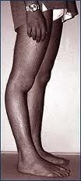
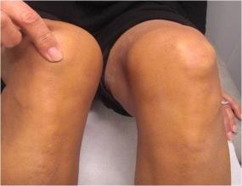
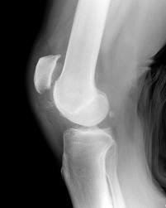
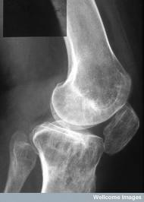
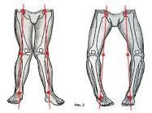
Observations of the Knee
● Patella alignment (alta or baja)
● Varus deformity/ Genu Varum
● Valgus deformity/ Genu Valgum
● Fixed flexion deformity
● Hyperextension

Slide 4
Quick Touch
● Back of the hand
● Bilateral comparison
● Temperature
● Texture

Slide 5
AROM
● Flexion (0 to 135º)
● Extension (-5 to 0º)
● Medial tibial rotation (seated at 90º)
● 10-20º
● Lateral tibial rotation (seated at 90º)
● 20-30º

Slide 6
PROM
● Active movement to EoR then passive overpressure applied- note range and end feel
● Flexion (soft)
● Extension (hard)
● Medial tibial rotation (springy)
● Lateral tibial rotation (springy)

Slide 7
RROM
● Can the joint protect itself from excessive movement EoR
● Flexion
● Extension
● Medial Tibial Rotation
● Lateral Tibial Rotation

Slide 8
MMTs (x 7)
● Quadriceps (as a group)
● Vastus medialis obliquus (isolated)
● Rectus femoris
● Iliotibial band (TFL)
● Hamstrings (as a group)
● Popliteus
● Gastrocnemius

Slide 9
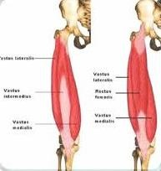
Quadriceps as group
● Vastus Lateralis
● Greater trochanter, Intertrochanteric line, and Linea aspera of the
Femur
● Vastus Medialis
● continuous line of attachment on the femur, which begins on the front and middle side (anteromedially) on the intertrochanteric line of the femur
● Vastus Intermedius
● arises from the front and lateral surfaces of the body of the femur in its upper two-thirds, sitting under Rectus Femoris
● Rectus Femoris
● anterior inferior iliac spine and the exterior surface of the bony ridge which forms the iliac portion of the acetabulum
Insertion
● Patella via the Quadriceps tendon and Tibial tuberosity via the Patellar ligament

Slide 10
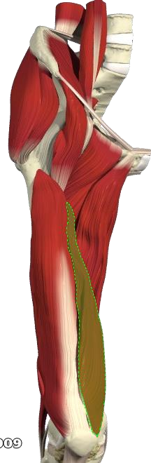
Vastus Medialis Obliquus
● Continuous line of attachment on the femur, which begins on the front and middle side (anteromedially) on the intertrochanteric line of the femur.
● The fibres converge onto the inner (medial) part of the quadriceps femoris tendon and the inner (medial) border of the patella

Slide 11
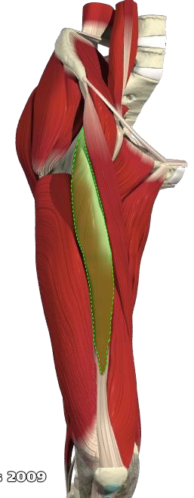
Rectus Femoris
● Origin
● anterior inferior iliac spine and the exterior surface of the bony ridge which forms the iliac portion of the acetabulum
● Insertion
● Patella via the Quadriceps tendon and Tibial tuberosity via the Patellar ligament

Slide 12
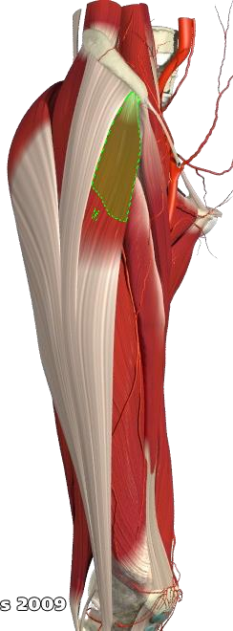
Tensor Fascia Latae
Origin
● It arises from the anterior part of the outer lip of the iliac crest; from the outer surface of the anterior superior iliac spine, and part of the outer border of the notch below it, between the gluteus medius and sartorius
Insertion
● Gerdy’s tubercle (lateral tubercle of tibia) and lateral retinaculum of patella

Slide 13
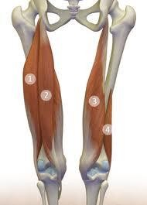

Hamstrings over the knee
Muscle | Origin | Insertion | Nerve
Semitendinosus 2 | ischial tuberosity | medial surface of tibia | tibial
Semimembranosus 3 | ischial tuberosity | medial tibial condyle | tibial
biceps femoris - long head 1 | ischial tuberosity | lateral side of the head of the fibula | tibial
biceps femoris - short head 4 | linea aspera and lateral supracondylar line of femur | lateral side of the head of the fibula (common tendon with the long head) | common fibular

Slide 14
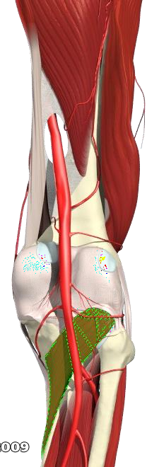
Popliteus
● Posterior to the knee
● Flexes the knee (weak) and MEDIALLY ROTATES tibia on the femur
● Un-locks the SCREW HOME MECHANISM
● Origin: outer surface of lateral condyle of femur
● Insertion: posterior surface of tibia above soleal line
● Also has attachment to lateral meniscus drawing it posteriorly to prevent impingement

Slide 15
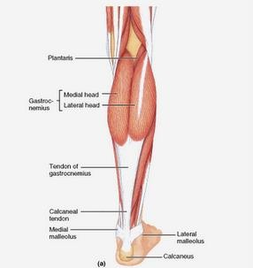
Gastrocnemius
● Origin
● Medial head
● Medial supracondylar ridge and adductor tubercle of femur
● Lateral head
● Outer surface lateral condyle of femur
● Insertion
● Via Achilles tendon to calcaneous
● Action
● Plantarflexion of ankle and assists knee flexion

Slide 16
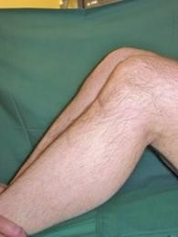
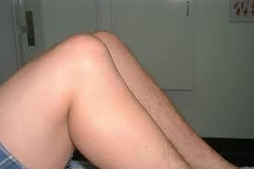
Ligament Stress Tests
● CAUTION!
● Watch for the Posterior Sag Sign!
● Give False Positives on ACL Tests AND False negative on PCL test

Slide 17
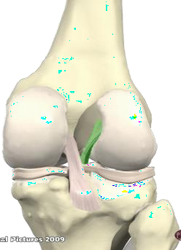
Ligament Stress Tests (x4)
The Anterior Cruciate Ligament
● ACL passes posteriorly, laterally and proximally from the anterior tibial spine to the medial surface of the lateral condyle of femur
● Spirals medially through 110º
● Anteriomedial band – limits flexion
● Posterolateral band – limits extension
● Provides approx 86% anterior tibial restraint and 30% of medial restraint

Slide 18
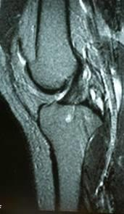
Ligament Stress Test
● Anterior Drawer Test (90º)
● ACL stress test
● Normally springy end feel within approx 6mm of anterior translation
● Positive test
● Pain (up to grade II+)
● Laxity
● Abnormal/no end feel with large amount of excursion (15mm+)
DDX
● MCL and posterior capsule provide secondary restraint
● Click? Meniscal

Slide 19
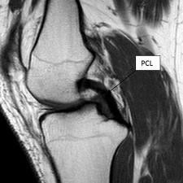
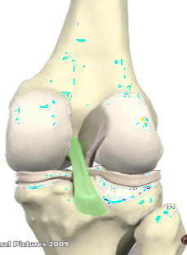
Ligament Stress Test
● Posterior Cruciate Ligament
● Passes anteriorly, medially and proximally from the posterior intracondylar area of the tibia to the lateral side of the medial femoral condyle
● 2 bundles
● Anterolateral band – limits flexion
● Posteromedial band – limits extension
● Provides 94% posterior tibial restraint and 36% of lateral tibial restraint

Slide 20
Ligament Stress Test
● Posterior Drawer Test
● PCL Stress Test
● Normal PCL will restrain posterior tibial translation
● Positive Test
● Laxity (greater than 9.2mm indicates Grade III)
● Pain (grade I-II)
● Other structures involved
● PLCC: Arcuate complex, popliteal oblique ligament AND ITB
● If suspect PLCC repeat at 30o
● Laxity at 90o and 30o = PCL and PLCC
● Laxity at 90o ONLY = PCL in isolation

Slide 21
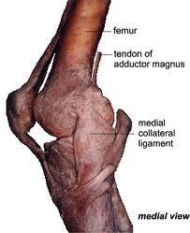
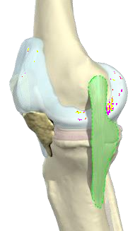
Ligament Stress Test
● Medial Collateral Ligament
● Medial epicondyle of the femur to the medial condyle and shaft of tibia
● Flat and broad
● Superficial fibres extend below the level of the tibial tuberosity (1:3)
● Deep fibres attach via the capsule to the medial meniscus
● Covered by Pes Anserinus Tendons (SGT)

Slide 22
Ligament Stress Tests
● Valgus Stress Test
● 0º and 30º
● Positive Sign
● Pain over MCL
● Loss of normal springy end feel
● Increased laxity
● 5mm Grade I
● 5-10mm Grade II
● 10mm+ Grade III
● 15o + valgus significant and may suggest secondary damage to ACL and PCL
● Especially if LAXITY is present at 0o

Slide 23
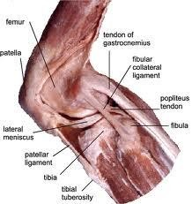
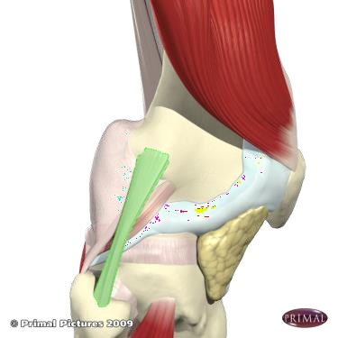
Ligament Stress Test
● Lateral Collateral Ligament
● Round, cord like ligament
● Superficial (does not blend with capsule)
● Lateral epicondyle of femur to lateral surface of the head of fibula (anterior to the apex)

Slide 24
Ligament Stress Test
● Varus Stress Test
● Normal Varus is approx 7º
● Positive sign
● Pain (up to grade II)
● Laxity (8mm is consistent with Grade III)
● Where grade III suspected consider damage to ACL, PCL, PLCC, ITB
● Performed at 0º and 30º
● PCL will restrain Varus forces in knee extension

Slide 25
Palpation
● Bony landmarks
● Head of fibula, anterior tibial border, tibial condyles, Gerdy’s tubercle, tibial tuberosity, patella, femur, medial and lateral condyles and epicondyles.
● Other soft tissues
● LCL, ITB, Biceps Femoris, patella tendon/ligament, MCL, pes anserinus, semi membranosus and tendinosus, popliteal fossa, hamstrings belly...

Slide 26
Joints above and below
Above
AROM
● Hip Flexion
● Hip Extension
Below
AROM
● Talocrural Plantar and Dorsiflexion

Slide 27
Special Tests
● Ligament
● Meniscal
● Others (patella and proprioceptive)

Slide 28
Special Test
● Lachman’s Test
● Up to 30º flexion
● Positive sign
● Pain (up to grade II)
● Laxity
● <5mm Grade I
● 5-10mm Grade II
● 10mm+ Grade III

Slide 29
Special Test
● Slocum Test (AMRI and ALRI)
● Similar to anterior drawer but therapist adds a medial or lateral rotation on prior to drawer
● AMRI: (add LR) pain and laxity
● <12mm Grade I
● 12-20mm Grade II
● 20mm+ Grade III
● MCL, Medial Joint Capsule, POL and ACL (chronic MM)
● ALRI (add MR)
● Posterolateral capsule, cruciates, popliteus, LCL and ITB

Slide 30
Special Test
● McMurray’s Test
● Meniscal Injury
● Full PROM flexion, Full PROM LR (medial meniscus)
● Move to in to extension
● Positive sign
● Pain
● Click
● Lock
● Apprehension
● Repeat with full PROM MR (lateral meniscus)

Slide 31
Special Test
● Apley’s Compression and Distraction Test
● Test distraction first
● MR and LR
● Test Compression second
● MR and LR
● Positive sign
● Pain and/or apprehension that is present on compression diminishes on distraction

Slide 32
Special Test
● Thessaly’s Test
● Meniscal Test
● 5º and 20º

Slide 33
Special Test
● Patella Sweep Test
● Pressure applied to lateral side of patella will push swelling to medial side of patella
● And vice versa
● Sweep 2-3 times per side
● Can combine with ballotable/ballotment test (aka milk or float test)
● Tests for swelling in the knee

Slide 34
Special Test
● Patella apprehension test
● Knee in loose packed position (30º flexion)
● Apply a lateral glide to patella
● Pain, apprehension or subluxation/dislocation indicate instability or pain coming from PFJ

Slide 35
Special Test
● PF Grind Test
● Pain and/or apprehension of PFJ (degenerative changes to articular
cartilage)
● Fix patella and compress, then add inferior/superior/medial/lateral glide to compressive hold
● CAUTION: if enough pressure is applied it will be painful in ALL patients: even those w/o PFJ problems!

Slide 36
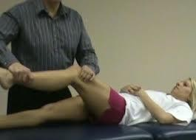
Special Tests: Other Noble Compression Test
● Test for Iliotibial Friction Syndrome
● Pt in supine
● Hip and knee passively flexed to 90o
● Compress over lateral femoral condyle and hold whilst passively extending knee
● Positive Sign
● Pain at 30o extension
● Reproduction of symptoms
● Crepitus

Slide 37
Functional Tests
● Proprioception
● DL static balance test
● Tandem test
● SL static balance test
● Strength endurance
● SL calf raise
● Toe Walk
● DL Squatting
● Landing
● Jumping
● SL squat
● Landing
● Hopping

Slide 38
1. Observation
SHS5062 E&A Knee Protocol
4. Manual Muscle Tests
• Quadriceps (as a group)
• Vastus medialis obliquus (isolated)
7. Joints above & below
•Bilateral comparison
•Active movements
• Ankle and hip
•Need to be in shorts.
•T-shirts, shoes and socks off
•Observe from back, front & both sides.
•Should be whole body observation, but paying particular attention to lower limb (knee)
• Rectus femoris
• Iliotibial band (TFL)
• Hamstrings (as a group)
• Popliteus
• Gastrocnemius
8. Special Tests
Ligaments
• Ligament stress tests (don’t need to repeat if done)
• Lachman’s
• Slocum (AMRI, ALRI)
Meniscus
• McMurray’s
• Thessaly
• Medial joint line palpation
• Apley’s
Others
• Apprehension test (patella)
• PF grind test
• Patella sweep
• Noble Compression Test
2. Quick Touch
•Bilateral comparison
•Back of hand
5. Ligament Stress Tests
• Sag sign first
• MCL - 0º and 30º
• LCL – 0º and 30º
• PCL (post drawer)
• ACL (ant drawer)
3. Range of Movement
• Bilateral comparison
• AROM
• PROM (end range with O/P)
• RROM (end range with O/P, client resists O/P)
6. Palpate
Head of fibula, Patella
Tibial tuberosity, Tibial plateau (joint line), Condyles, Ligaments
All associated muscles & tendons
9. Functional
Proprioception, calf raise Walking / jogging / running / hopping / skipping / jumping & landing / kicking / twisting / turning
• Flexion
• Extension
• Medial rotation (in flexion)
• Lateral rotation (in flexion)

