Slide 1

Equality Law
Brayne and Carr (2013: 95-110)

Slide 2
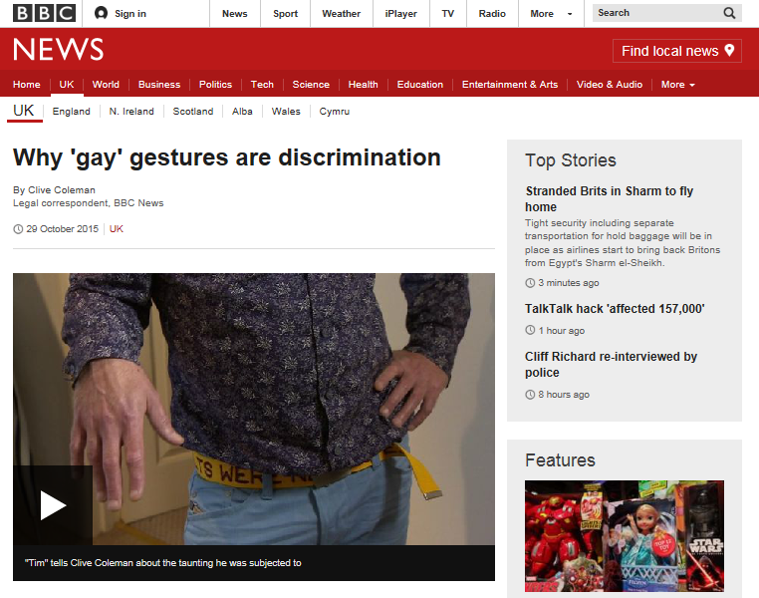
29.10.15
"You don't have to be a wallflower, you don't have to be a shrinking violet, you can report this kind of behaviour. As it said in the final order, it is 'unlawful direct discrimination'. I think those three words sum it up," he says.

Slide 3
Prohibited Conduct
Discrimination arising from a disability
Occurs when a person (A) discriminates against a disabled person (B) and treats the person less favourably because of an issue arising from the disability
and (A) cannot show the treatment is a proportionate means of achieving a legitimate aim.
Not unlawful if (A) did not know or could not have reasonably been expected to know that (B) had a disability

Slide 4
Reasonable adjustments
Employers are required to make reasonable adjustments to the physical environment to ensure disabled people are not disadvantaged
Again, knowing about the disability is a key consideration
Example:
An assessment establishes that a student has dyslexia but a university official refuses to allow additional time in an examination thereby creating a substantial disadvantage

Slide 5

Policies and procedures
What do we refer to when we speak of ‘policies and procedures’?
Public service organisation, like those from other sectors, have a range of policies and procedures
What is their purpose?
How might they help to support the work of organisations?
How might they help to support employees?
http://www.acas.org.uk/index.aspx?articleid=1461

Slide 6
Victimisation
Detrimental treatment following a complaint or allegation, or has given evidence against someone else in relation to the same

Slide 7
Victimisation example
At an internal grievance hearing an employee gives evidence for a colleague who believes he has been refused promotion due to a visual impairment.
Shortly afterwards the person who gave evidence is demoted to another post which detrimentally effects her future prospects.

Slide 8
Harassment
Occurs when an employer or someone for whom the employer is responsible harasses another person

Slide 9
Harassment example
When a social worker complains of racial abuse from one of the families she is supporting her manager says that’s just part of the job
Colleagues repeatedly laugh and joke about a female colleague whose partner is significantly younger than her

Slide 10
The TUC and unions
In 1868, a group of trade unionists from all over the UK came to Manchester, and together they held the first meeting of the Trades Union Congress, at the Mechanics' Institute.
This first Congress passed a resolution highlighting the need for the unions to come together each year
‘… for the purpose of bringing the trades into closer alliance, and to take action in all Parliamentary matters pertaining to the general interests of the working classes’.
https://www.tuc.org.uk/our-history

Slide 11
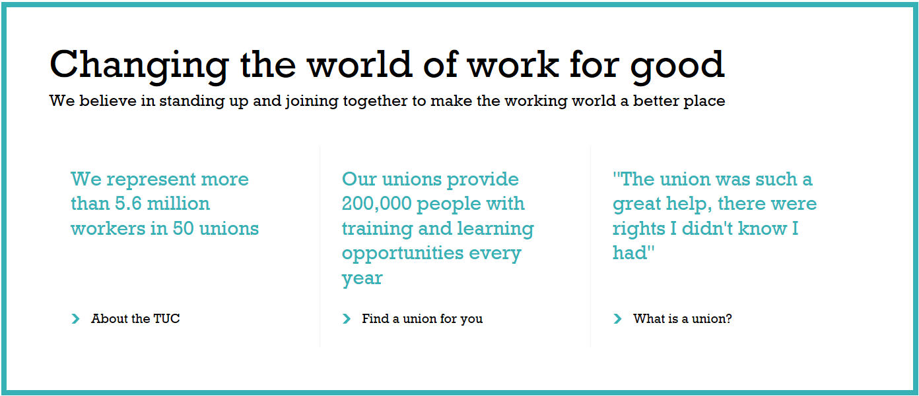
What proportion of women said they were sexually harassed at work in a 2016 survey by the Trades Union Congress (TUC)?

Slide 12
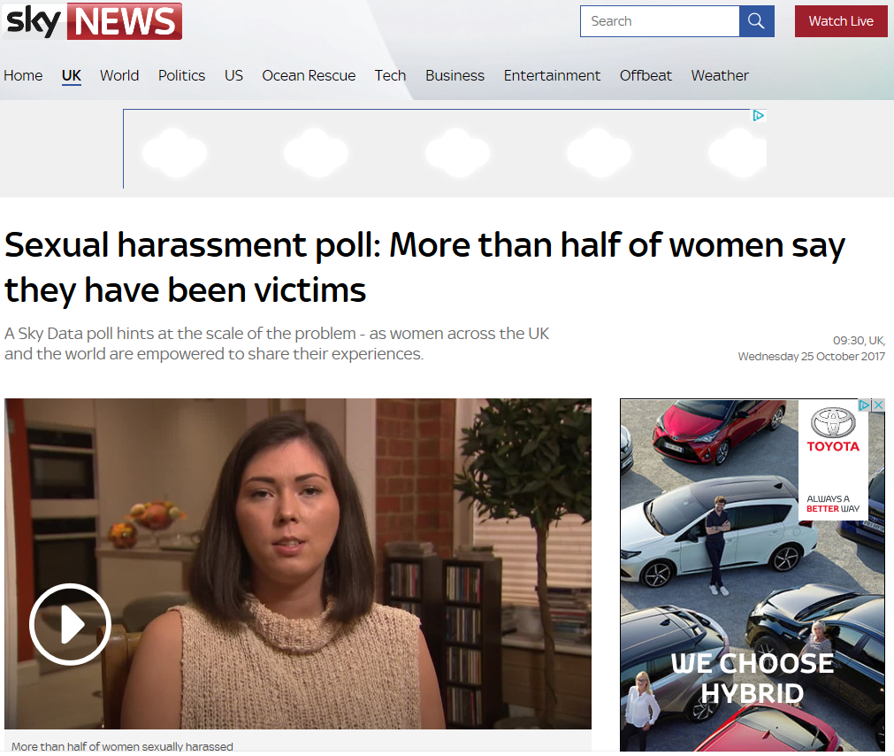
http://news.sky.com/story/sexual-harassment-poll-more-than-half-of-women-say-they-have-been-victims-11097511

Slide 14
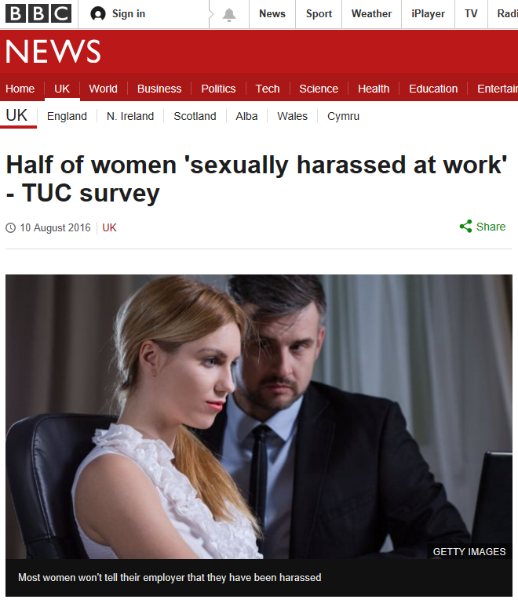

Slide 15
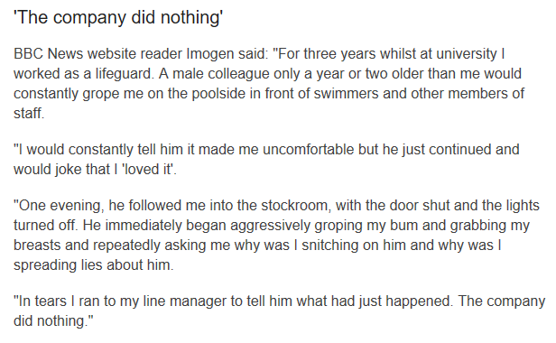
A survey of 1,500 women saw 52% cite the problem and also found a third had been subjected to unwelcome jokes and a quarter experienced unwanted touching.
Sexual harassment at work can take many forms, from inappropriate comments and jokes about a colleague's sex life to unwanted touching, hugging or kissing and even demands for sexual favours, the TUC said.
We all have different perspectives and humour does have a right and proper place. However, when concerns are raised we must always take them seriously!

Slide 16
Key features
Positive action
EA 2010 enables positive action under s.158
Enforcement in race and sex discrimination cases
Recourse to an employment tribunal within 3 months of the last discriminatory act
Outside the employment field cases can be brought to the county court within 6 months of the last act complained of, or 8 months in the case of education

Slide 17
Duties on public authorities
The ‘public sector equality duty’ is set out under s. 149 of the EA 2010
Again, a positive duty upon public bodies to take action to eliminate discrimination and advance equality of opportunity
Equality considerations to be built into the design of policy and delivery of services

Slide 18
References
Crown Copyright (2010), Equality Act, The Stationery Office (Her Majesty’s Stationery Office); London.

Slide 19

Any Questions?
C.Newton-Evans@UWTSD.ac.uk

