Slide 1

Student: Moveta Douglas
Student no: 2329297
Lecturer: Dr Farah Wiita
BMHP6029
Psychopathological Classifications and Provisions Component 1: Poster Presentation
Acknowledgement of the use of AI tools
I confirm that I have not used any AI tools in the research and creation of this assignment. I confirm that I have not presented any AI-generated materials as my own work. I confirm I have copies of my drafts, notes, and other resources I used, which I may be asked to provide in evidence.

Slide 2
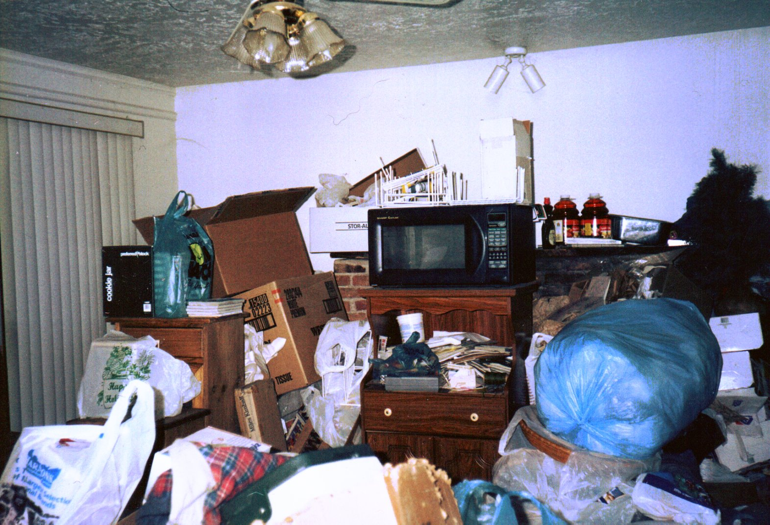


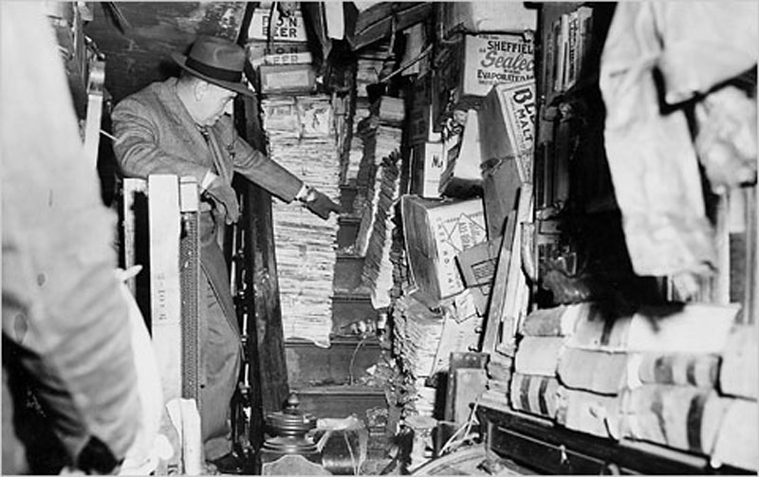
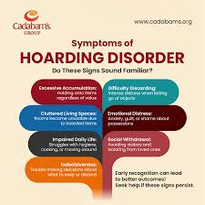
Obsessive-Compulsive Disorder and Related
Hoarding Disorder Research Poster
By Moveta Douglas
Introduction
Diagnosis
A medical professional can ask questions to evaluate how the hoarding started. The intended questions, such as the kind of item the individual collected, and how long it had been started, and the history of the patient's lifestyle (Nordsletten, Reichenberg, Hatch, et al. 2013)
Historical perspectives and treatments
Current services and treatments
There are several different services of treatment for hoarding.
Behavioural Therapy – which looked at changing the thoughts and patterns of the individual.
Motivational interview – encourages the person to take steps in reducing their items.
Support groups – linking the hoarder with like-minded individuals who are going through the same situation or have gone through it.
There are no specific medications for hoarding, but some people may be given anti-anxiety medication or antidepressant medication.
Involving the family can be very helpful, as family members can help the person return to reality by reminding them of life before the hoarding (Steketee, 2022).
Recommendations
To manage this disorder, individuals can use mindful techniques that help to minimise anxiety, which helps to promote self-awareness regarding attachment. Education is a powerful tool, helping people learn more about hoarding and its effects on one's life. As soon as the clutter is removed, the hoarder can practice organizational skills, which allow them to better manage items ( Kanda, Nakao, 2019).
Furthermore, a person-centred approach should be considered. Individuals should be approached with empathy and not with judgment. (Mind, 2026)
Conclusions
Hoarding disorder is known to affect 2.5% of the United Kingdom population, which is about 2 million people of different ages and genders. Hoarding can also be associated with other mental health problems, which can lead to the individual starting to hoard.
Research in the United Kingdom shows that hoarding may vary, as many cases may not be known to the National Health Service or reported(NHS.uk, 2026).
The broader category of hoarding disorder is Obsessive-compulsive and related disorder.
Definition
According to (ICD-11, 2024), hoarding disorder is a mental health condition characterised by the persistent accumulation of things that becomes clutter in almost all living areas. This is not just about the accumulation of this; it can also reflect stress on a person's well-being or some emotional condition.
A person with a hoarding disorder sometimes feels anxious, an extreme feeling of discomfort when they are faced with the reality of getting rid of their things. Emotion rises when they may think that all their valuables will be destroyed or taken away. Some may have memorable things from childhood, childhood things, memories that they want to hold on to that remind them of the past.
Moreover, this may result in poor relationships and quality of life. There is also a psychological condition associated with hoarding, which may lead to that person isolating themselves from the real world, and this can lead to depression.
Causes
The specific causes of hoarding disorder are not yet certain or fully understood; it may be a combination of many factors, including environmental, psychological, and neurobiological. There could also be someone feeling empty and alone ( Beer, 2025).
Symptoms
A person with a hoarding disorder may be experiencing more than one feeling. The excessive accumulation of things can be from distress, impairment, Attachment, anxiety, and indecisiveness (NHS.uk, 2026).
Hoarding disorder is not new in health and social care, stemming from mental issues like isolation, depression, and neglect; this happens to be a part of society. Nevertheless, it is not talked about enough or highlighted clearly in the UK. This is a behaviour that leads to clutter; the impact can be very severe and can lead to anxiety. We see where it's an ongoing, lasting struggle, even mentioned in history.
References
Beer, H (2025). “Scared of the emptiness” Exploring the Therapeutic Experience of people with hoarding disorder: An Interpretative Phenomenological study. University of Wales Trinity St David.
Fontenelle, L.F. (2016) “Vallejo-Nágera (1926–1990) and the concept of ‘soteric neurosis’: a forgotten sketch of hoarding disorder in the obsessive-compulsive spectrum literature,” Journal of medical biography, 24(1), pp. 85–89.
ICD-11 (2024). International Classification of Diseases, 11th Revision. Mortality and Morbidity Statistics. UWTSD.
Kanba, S, Nahao, T. (2019). Psychiatry and clinical neuroscience. Pathophysiology and treatment of hoarding disorder. Vol. 73 (7). Pp.370-375.
Legislation.gov.uk. (nd). Mental Health Act 1983. available at: https://www.legislation.gov.uk/ukpga/1983/20/section/1/enacted accessed March 5,2026.
NHS.uk (2026). Symptoms of hoarding disorder. Available at https://www.nhs.uk/mental-health/conditions/hoarding-disorder/ accessed March 2026.
Mind,( 2026). Helping yourself with hoarding.
https://www.mind.org.uk/information-support/types-of-mental-health-problems/hoarding/helping-yourself-with-hoarding/. Accessed March 24,2026.
Nordsletten.A.E, Reichenberg.A, Hatch.S.L, Pertusa.A, et al. (2013). The British Journal of Psychiatry. Epidemiology of hoarding disorder. Vol. 203, (6), pp. 445-452.
NHS England (2013). DSM( Diagnostic and Statistical Manual of Mental Disorders). https://www.lpft.nhs.uk/young-people/lincolnshire/young-people/camhs-jargon-buster/dsm-diagnostic-and-statistical-manual-mental-disorders accessed March 6, 2026.
Steketee, G. (2022). ScienceDirect. Cognitive and behavioural Practice. Vol. 29 (3) pp 515-519.
This Photo by Unknown Author is licensed under CC BY-SA-NC
History shows that people were viewed as dirty and lacking training in cleanliness. Furthermore, they were also seen as filthy and neglectful, mad or sick. Society would shun those people and stay away from them, thinking they were nobody; they should not be a part of society. They were seen on the lower spectrum of society. (Fontenelle,2016).
This has changed as medical research and society have improved through different policies and Acts. Educating people and professionals, including the community, about hoarding is essential, and we see where the Mental Health Act 1983 plays an important role. This Act was also amended in 2007 to ensure we are moving in line with what's happening in our population and community(Legislation.gov.uk (nd).
According to( NHS England and DSM-5 2013), the Manual helps professionals to understand hoarding and the stages to have a better view and sympathy for those who suffer from this mental illness. Initially, professionals used to see this as OCD and did not choose to take a deeper look or diagnosis. They would sometimes see it as the person being lazy rather than thinking it’s a mental health issue. Dismissal by a medical professional also leads to misdiagnosis and the distinctiveness of the disorder.
This Photo by Unknown Author is licensed under CC BY-SA

