Slide 1
Judaism: Texts and Traditions
Anti-Judaism and Jewish-Christian Relations

Slide 2
Definition of Terms
Anti-Judaism: opposition to the Jewish religion
Anti-Semitism: hatred of the Jews in a racial sense.
Holocaust: it stems from the Greek translation of the Hebrew word olah (burnt offering) – to appease a wrathful God?
Shoah: the Hebrew word for destruction (desolation and doubt).

Slide 3
Key Issues and Topics
Attitude to the state of Israel.
Relationship with the Palestinians and their Jewish neighbours.
Rise of anti-Semitism (especially in Eastern Europe and the Middle East).
The consequences of 9/11 and ‘the Arab Spring’.
The role of interfaith relations and dialogue

Slide 4
Origins
Jesus and his Jewish movements: his Jewish followers believed that he was the Messiah (30-33 CE).
One Jewish group among others: Sadducees, Pharisees, Zealots, Essenes.
Consequences of the destruction of the Temple in Jerusalem in 70 CE.
The work of the apostle Paul – spread of Christianity through the Roman Empire

Slide 5
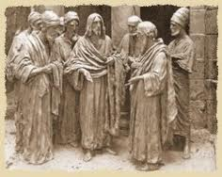
Developments around 70 CE
Pharisees – reconstruction in the form of rabbinic Judaism; the descendants of Moses and Ezra. They are the main opponents of Jesus according to the Gospels, but they have much in common:
The coming of the Messiah
Angels
Life after death
Resurrection of the dead
Day of Judgement (Eschatology)
How reliable is the presentation of the Pharisees in the four Gospels? Tendency to generalize and to offer stereotypes, depicting them in complete opposition to Jesus (negative impact on later relations between Jews and Christians).

Slide 6
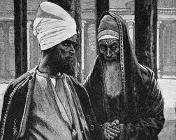
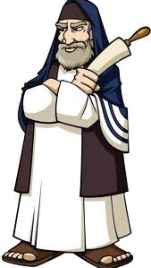
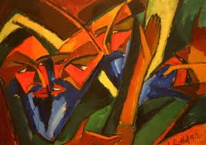
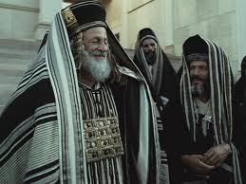
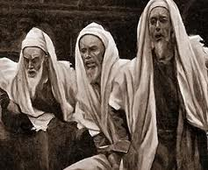
The Pharisees: The Enemies of Jesus?

Slide 7
Conflict and Opposition:
Polemical Language
Use of polemical language between Jews and Christians. Has it contributed to hatred towards the Jews?
Can the roots of anti-Semitism be found within the pages of the New Testament?
Debates between Jews about Jewish issues.
Not Christian arguments about ‘outsiders’.
Reading these texts within their historical context.
It is also necessary to distinguish between context and effect (reception).
These are authoritative texts that are open to misinterpretation and manipulation.

Slide 8
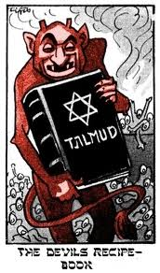
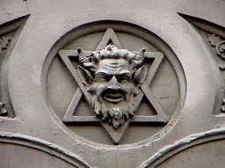
John’s Gospel and the Jews
‘You are the children of your father, the devil, and you seek to fulfil the wishes of your father. He was a murderer from the beginning; he does not stand in the truth for there is no truth in him’ (John 8:44).

Slide 9
John’s Gospel and Judaism
Is it possible to discover anti-Semitic potential in the Gospel of John?
‘The Gospel of John has proved to be a dangerous document, for although it may not itself be anti-Semitic, it has given aid and comfort to anti-Semites’
(D. Moody Smith).
References to ‘the Jews’: this group personifies opposition to Jesus.
It is emphasized that ‘the Jews’ (hoi Ioudaioi) were responsible for Jesus’ death. Pilate announces that Jesus was innocent (18:38; 19:4, 6, 12) while the Jews persevere and accuse him of blasphemy (19:7). ‘Then Pilate handed him [Jesus] over to them [the Jews] to be crucified’ (19:16).

Slide 10
Who are ‘the Jews’?
A symbol of unbelief
Judaeans - i.e. the inhabitants of Judaea (but see John 12:9, 11; 19:20).
Jewish religious authorities, often juxtaposed with references to the Pharisees (11:46-52, 18:1-3, 18:12-14).
Those who are themselves Jews fear ‘the Jews’ (7:13; 19:22).

Slide 11
Historical Context
Tension between Jesus believers and synagogue Jews (see John 9:22; 16:2).
‘In an era when there were ill feelings between the Church and the synagogue, ‘the Jews’ was a term used with a connotation of hostility to Christians….. This does not mean that the evangelist has forgotten the true circumstances of Jesus’ ministry in the anachronistic use of ‘the Jews’. By this term he indicates his belief that the Jews of his own time are the spiritual descendants of the Jewish authorities who were hostile to Jesus during the ministry’ (R.E. Brown, The Gospel according to John, lxxii).

Slide 12
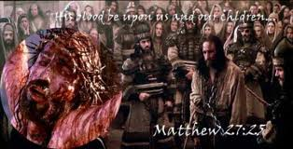
Accusations against the Jews
So when Pilate saw that he could do nothing, but rather that a riot was beginning, he took some water and washed his hands before the crowd, saying “I am innocent of this man’s blood…”. Then the people as a whole answered, “His blood be on us and on our children!”’ (Matthew 27:24-25).

Slide 13
Accusations against the Jews
So when Pilate saw that he could do nothing, but rather that a riot was beginning, he took some water and washed his hands before the crowd, saying, ‘I am innocent of this man’s blood; see to it yourselves’. Then the people as a whole answered, ‘His blood be on us and on our children!’
(Matthew 27:24-25).
Whitewashing of Pilate’s character (note what Jewish authors – Philo and Josephus – say about him).
Pilate mixes the blood of Galileans with their sacrifices (Luke 13:1-4)

Slide 14
‘His blood be on us and on our children….’
‘Christ’s blood was not only found on those who were present at the time, but also on all generations of Jews until the end of the world’ (Origen).
Historical or theological record?
Does the word people (laos) refer a) to the Jewish nation or b) ‘all those who stood in front of Pilate at the time’ (cf. Matthew 4:23; 9:35).
Who are the ‘children’? One generation or all generations (descendants)? Destruction of the Temple as punishment for the people’s sins (i.e. one generation alone , if the Gospel of Matthew was composed shortly after 70 CE).

