Slide 1

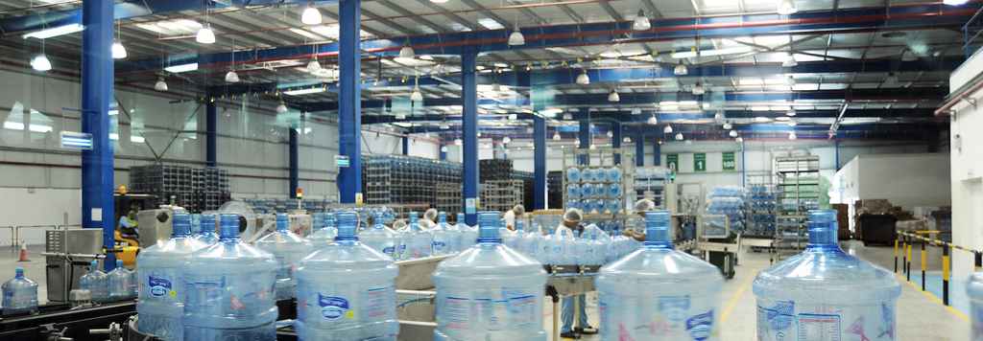

Enterprise and entrepreneurship-
Hydrate Britain
LCLM4006
Jay Yamah - 2318740
T

Slide 2
Contents
Overview of business idea
Legal format and management structure of the start up enterprise.
PESTEL analysis
Marketing strategies
Funding required and cashflow projections
References

Slide 3

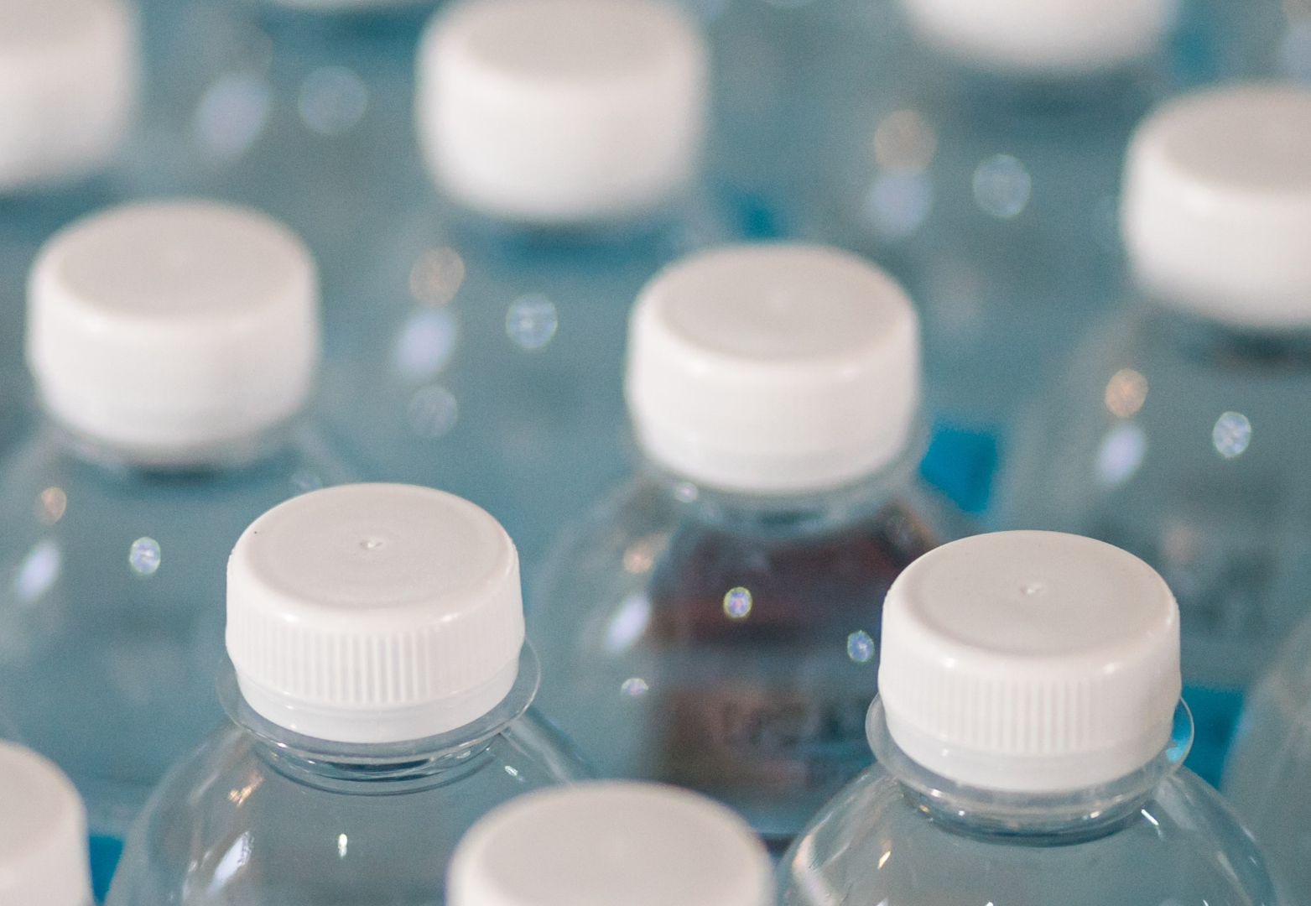


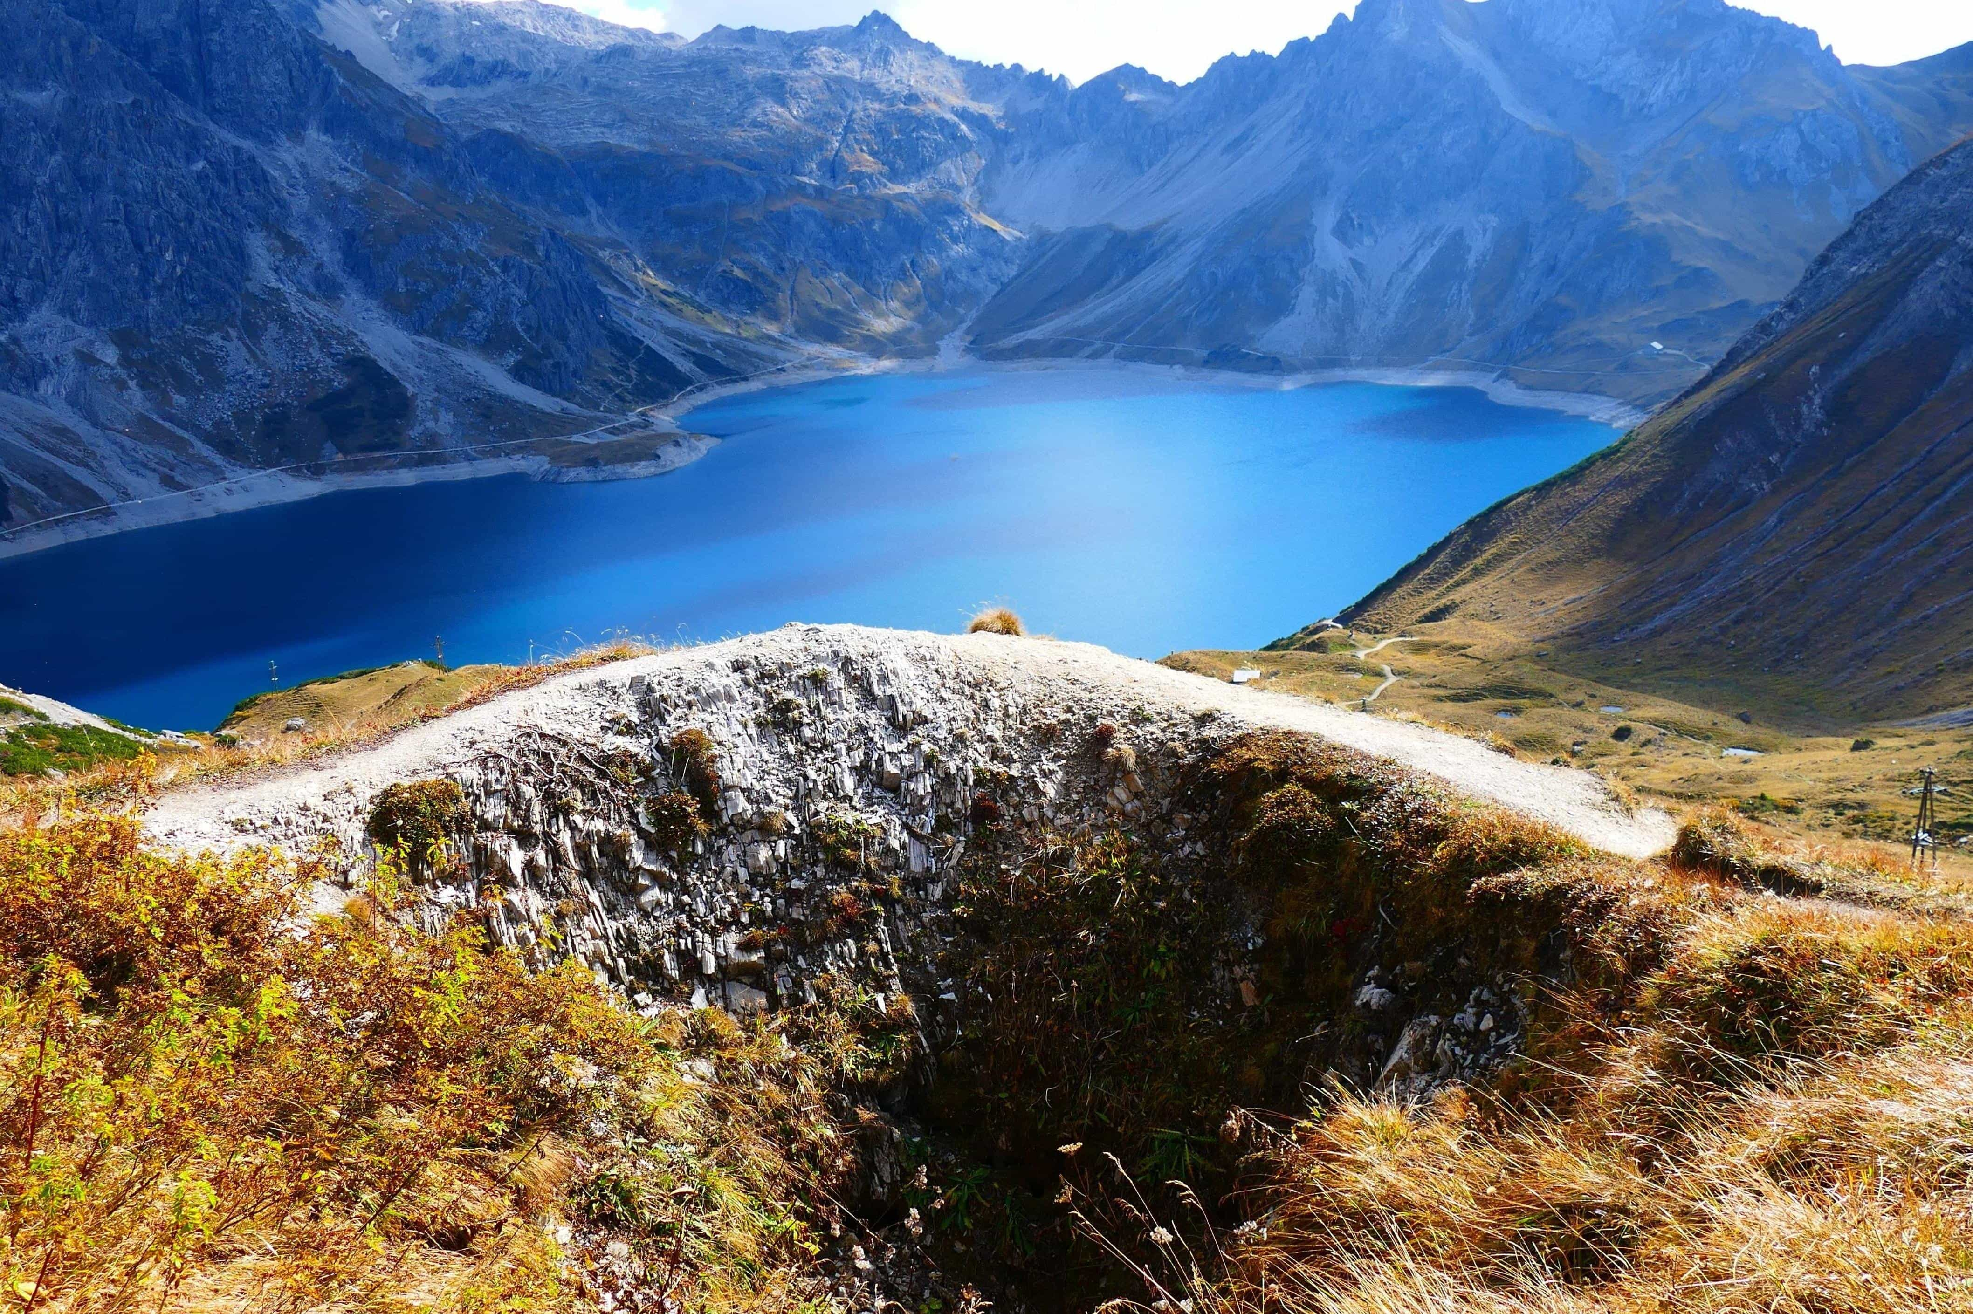

Hydrate Britain
Hydrate Britain is a new non-profitable water facility in Hertfordshire that has been aiming to distribute clean natural water filled with minerals from one of the UK's most pretentious mountain valleys in Worcestershire producing affordable and great quality spring water. Hydrate Britain also uses recycled bottles and bottles with caps attached to stop pollution in the oceans and to reduce climate change.

Slide 4
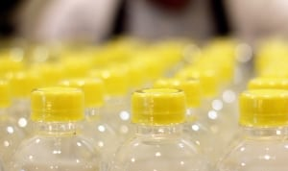
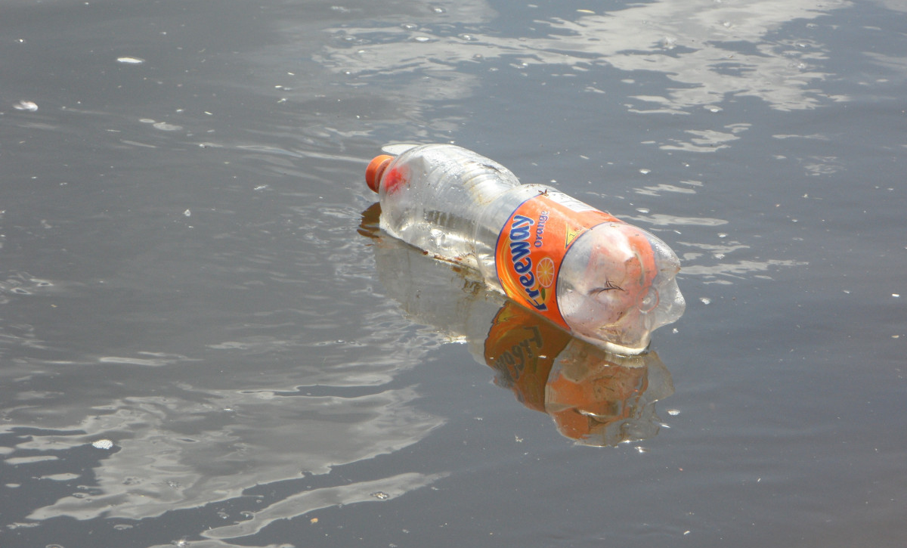
Legal format
I have chosen social enterprise (non-profit) as my legal format because just like its name we aim to ‘Hydrate Britain’ we are here to help people have a cheap and better option of fresh water and to encourage people to drink more water and stay hydrated hence why all our profits are used to advance the business to help in the expansion and distribution of our spring water so that we can aim for all areas of Britain. And with our signature recycled bottles that are also purchased with our profits, to ensure the environment is clean and to make a difference in the state of climate change and pollution.

Slide 5

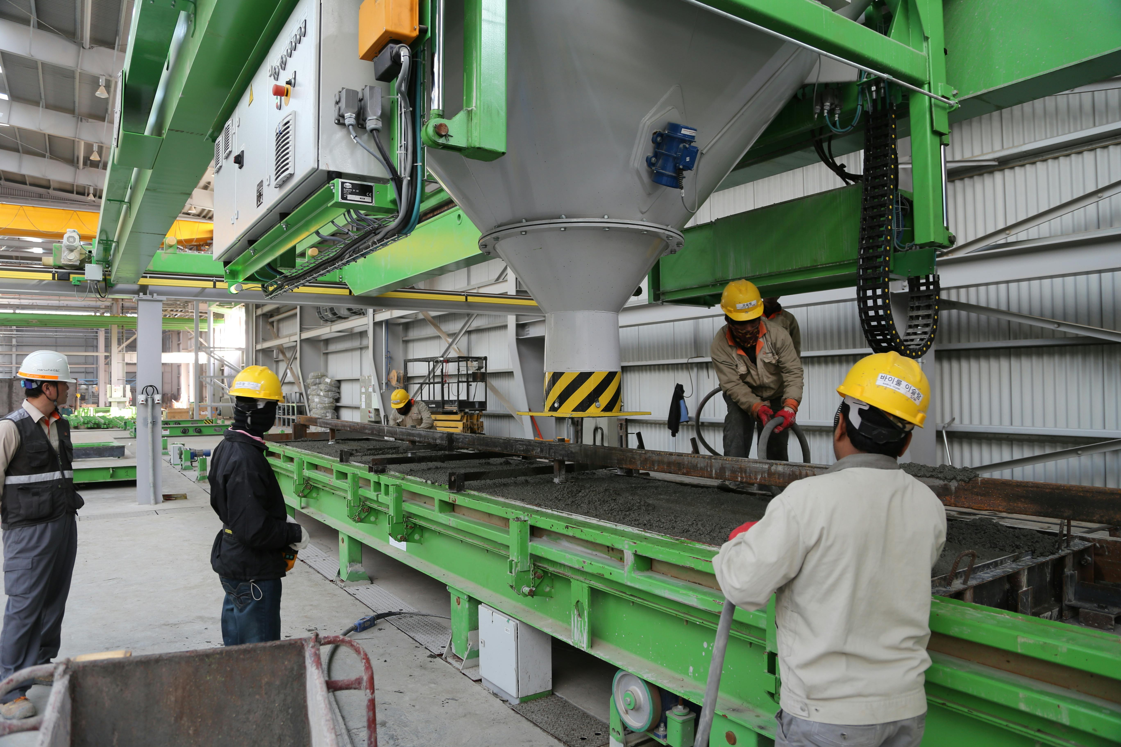
Management and Structure
The business will be jointly ran by a body of people with the same goal to keep the environment clean and to keep the people of Britain hydrated
As we are a non-profit orginisation, we have a wonderful team of volunteers who want to help achieve our goal and they help in the production and distribution of our clean spring water
The business will be jointly ran by a body of people with the same goal to keep the environment clean and to keep the people of Britain hydrated
As we are a non-profit orginisation, we have a wonderful team of volunteers who want to help achieve our goal and they help in the production and distribution of our clean spring water through our facility

Slide 6
PESTLE analysis And Funding
PESTLE
Funding
Political: the bottled water industry is strict on regulations from the government for water sourcing, chemical levels and facility inspections
Economic: The market has strong price competition which can pressure margins.
Social: consumption of water varies by age, with younger demographics consuming more bottled water.
Technology: it will be easier for a social enterprise to share its goals on a digital platform for more reach.
Legal: the facility most comply with laws regarding the extraction, use and quality of water sources.
Environmental: clear solutions for plastic waste and pollution must be shown to reduce ocean pollution.
We were lucky to get grants from water firms to fund Hydrate Britain as there was a few firms that were very interested and supportive of our mission.
We happily accepted that as our choice of funding as it was easier to start up our business and gave us one step forward to achieving our goal.

Slide 7
Cash Flow
MONTH
Cash In | 1
Loan start up Capital | 29,000
Sales | 9,500
Other | 0
Total cash in-flows | 38,500
Month
Cash out | 1
Rent or Premises costs | 3,000
utilities | 1,150
insurance | 900
Transport and delivery | 1,200
Marketing and advitising | 500
Total cash out-flows | 6,750

Slide 8
References
https://www.brita.co.uk
https://www.scribd.com
https://www.responsiblepurchasing.org
https://www.fortunebusinessinsights.com

