Slide 1
PRACTICUM LEVEL 5
(1) RESTORATIVE PRACTICE
(2) GESTALT THERAPY
Restorative practice in action and how Gestalt therapy works in the therapy room

Slide 2
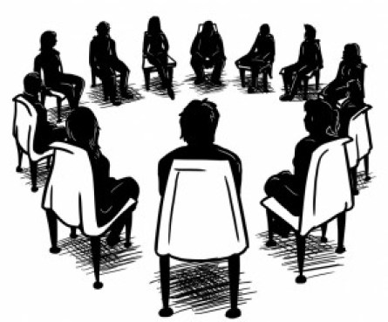
OPENING ROUND….

Slide 3
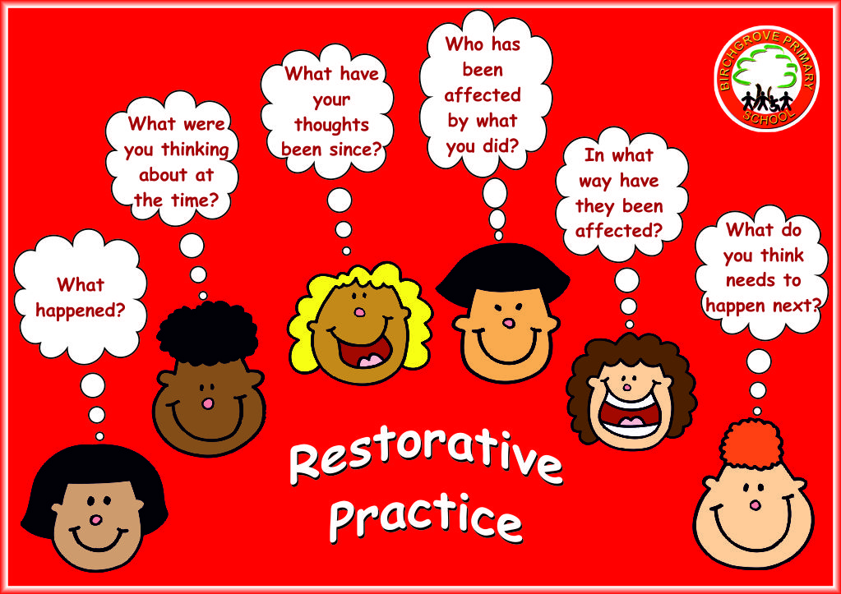
Restorative Practice

Slide 4
RESTORATIVE PRACTICE
1. I can see that you are (angry, upset, sad, etc.)
2. What has happened?
3. What were you thinking about at the time?

Slide 5
RESTORATIVE PRACTICE
4. What were you feeling at the time?
5. What have your thoughts been since?
6. What would you like to happen now?

Slide 6
RESTORATIVE PRACTICE
7. Who else has been affected by what you did?
8. In what way have you been affected?
9. What do you think needs to happen next?
10. How are you feeling now?

Slide 7
Starting our work on
Humanistic approaches in the consulting room:

Slide 8

Discussion on Gestalt therapy … … …

Slide 9
Gestalt therapy … … ..
Gestalt therapy is a phenomenological-existential therapy founded by Frederick (Fritz) and Laura Perls in the 1940s.
It teaches therapists and patients the phenomenological method of awareness, in which perceiving, feeling, and acting are distinguished from interpreting and reshuffling pre-existing attitudes.

Slide 10
Three Gestalt techniques and how they may be applied … … …
1.
2.
3.

Slide 11
Gestalt Personality Theory Concepts
Gestalt psychology:
A psychological approach that studies the organisation of experience into patterns or configurations.
Gestalt psychologists believe that the whole is greater than the sum of its parts and study, among other issues, the relationship of a figure to its background.

Slide 12
Gestalt Personality Theory Concepts
Ground: The background that contrasts with the figure in the perceptions of a field.
Figure: That part of a field that stands out in good contour clearly from the ground.
Gestalt therapy allows what is figural to surface

Slide 13
The Field Theory Perspective
The field is a whole in which the parts are in immediate relationship and responsive to each other and no part is uninfluenced by what goes on elsewhere in the field. The field replaces the notion of discrete, isolated particles.
No action is at a distance: what has effect must touch that which is affected in time and space.
Work is in the here and now, with sensitivity to how the here and now includes residues of the past, such as body posture, habits, and beliefs.

Slide 14
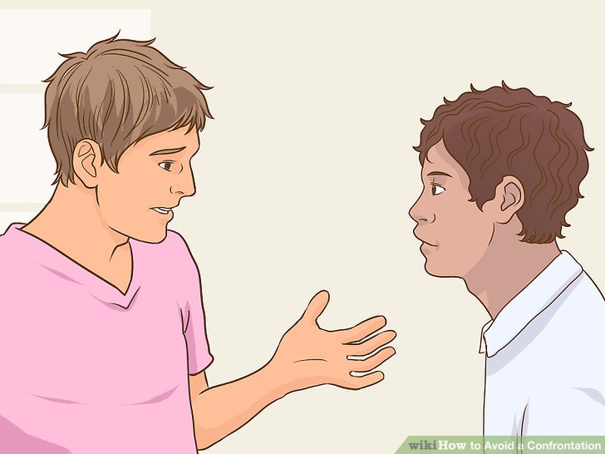
More emphasis on … … …

Slide 15
The Phenomenological Perspective
A method of awareness, in which perceiving , feeling, and acting are distinguished from interpreting and reshuffling pre-existing attitudes.
Phenomenology is a discipline that helps people stand aside from their usual way of thinking so that they can tell the difference between what is actually being perceived and felt in the current situation and what is residue from the past.

Slide 16
The Existential Perspective
Existential phenomenologists focus on people’s existence, relations with each other, joys and suffering, etc., as directly experienced .
Most people operate in an unstated context of conventional thought that obscures or avoids acknowledging how the world is.
Self-deception is the basis of inauthenticity: living that is not based on the truth of oneself in the world leads to feelings of dread, guilt, and anxiety.

Slide 17
Goal of Gestalt Therapy
By becoming aware, one becomes able to choose and/or organize one’s own existence in a meaningful manner. (Jacobs, 1978; Yontef, 1982, 1983).

Slide 18
Gestalt therapy ….
“ I and thou”
“Here and now.”
“Now” is the zero point between the past and the future, neither of which exists; only the now exists.

Slide 19
Gestalt = Whole
Humans are viewed holistically, as a whole entity consisting of body, mind, and soul
Clients are best understood when viewed through their own eyes, not by looking back into the past but by bringing the past into the present.

Slide 20

Gestalt therapy works by…..
Helping clients to define what is truly being experienced, rather than what is merely an interpretation of the events.
Exploring thoughts, feelings, behaviours, beliefs and values to develop awareness of how they present themselves and respond to events in their environment.
Creating an opportunity to identify choices, patterns of behaviour and obstacles that are impacting their health and well-being, and preventing them from reaching their full potential.

Slide 21
Dialogue….
A gestalt therapist will engage their client in meaningful and authentic dialogue regarding particular ways of behaving and/or thinking.
This often moves beyond simple discussion to more creative forms of expression

Slide 22
Attention to body language…..
Gestalt therapy concentrates strongly on body language.
Body language is considered a subtle indicator of intense emotions.
Specific body language observed is drawn to the attention of the client, and they may be asked to exaggerate these movements or behaviours.
This intensifies the emotion attached to the behaviour and highlights inner meaning.
For example, if a client were clenching their fists or frowning, the therapist may ask something such as, ‘What is this movement saying?’.

Slide 23
Gestalt therapy…
This therapeutic process typically uses expressive techniques and creative experiments which are collaboratively developed between therapist and client, tailored for the client and their specific problems.

Slide 24
Awareness:
Attending to and observing what is happening in the present.
Types of awareness include sensations and actions, feelings, wants, and values or assessments.

Slide 25
Locating Emotion … … …
During a session, it is common for people to talk about emotion. Talking about emotion is different than experiencing an emotion, which is what the Gestalt therapist is wanting the client to do in sessions.
As a client talks about emotion, the therapist may ask them where they feel that emotion in their body… … ….

Slide 26
Locating Emotion … … …
An example of this could be, "a heavy weight in my chest," or “a lump in my throat”, or “butterflies in my stomach or “my chest feels tight“.
Bring the emotional experience to awareness in the body helps the client stay present and process their emotions more effectively

Slide 27
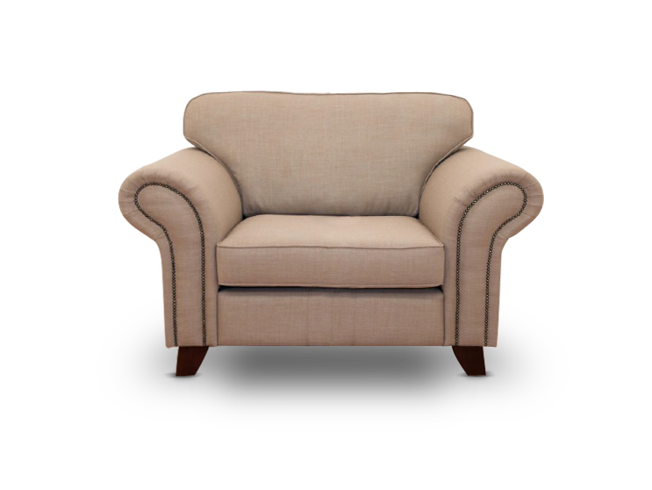
The Empty Chair … … …

Slide 28
The empty chair technique….
The empty chair technique is a quintessential gestalt therapy exercise that places the person in therapy across from an empty chair.
He or she is asked to imagine that someone (such as a boss, spouse, or relative), they, or a part of themselves is sitting in the chair. The therapist encourages dialogue between the empty chair and person in therapy in order to engage the person’s thoughts, emotions, and behaviours.
Sometimes the roles are reversed and the person in therapy assumes the metaphorical person or part of a person in the chair. The empty chair technique can be especially useful for helping people become mindful of the whole situation and forgotten or disengaged pieces of their own self

Slide 29
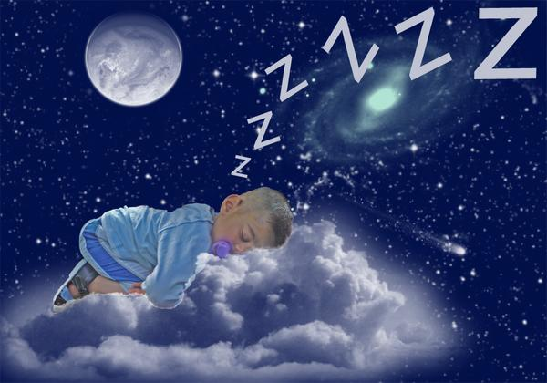
Dreams contain existential messages, and each piece of dream work leads to assimilation of disowned aspects of the self.

Slide 30
Role play…..
Role play helps individuals:
Experience different feelings and emotions
Better understand how they present and organise themselves.

Slide 31
In summary……
These are just some parts of gestalt therapy used to help people in therapy increase their awareness of immediate experiences.
Through exercises and spontaneous experiments, gestalt therapy also allows people to reconnect with parts of themselves they may minimize, ignore, or deny.

Slide 32

Any questions?
So, what do you think?

Slide 33
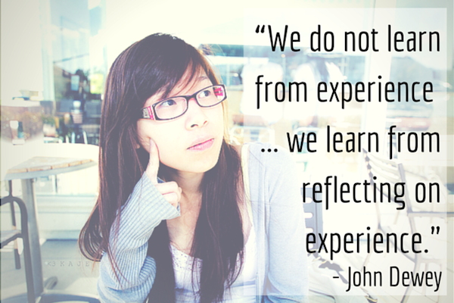
Your reflections on the research process and experience

Slide 34

TRIADS … SO LET’S TRY SOME OF THESE SKILLS

Slide 35
Questions ?

Slide 36
CLOSING ROUND….

