Slide 1
Module: Foreign Languages and Cultural Awareness
Module Code: BMIH5003
Student Name: A K M Amdadul Hoque
Student ID:2107424
Lecturer Name: Giulia Chifari

Slide 2
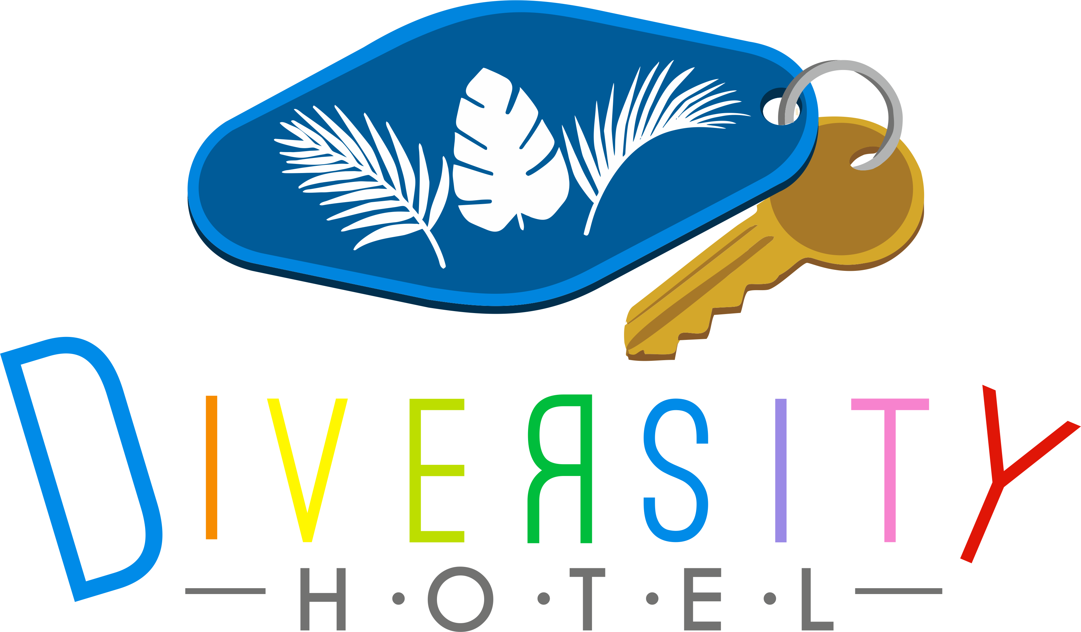
Diversity Hotel & Spa, London

Slide 3
Benefits of Multilingualism
Enhanced Customer Experience
Easier to communicate with guests from different linguistic backgrounds (Žerajić, 2020)
Making guests feel more comfortable by fast navigation of cultural nuances and customs
Improved Reputation
Providing more personalized and tailored customer experience to the guests
Increased customer turnover by positive online reviews and word of mouth shared by guests
Operational Efficiency
Effective communication with colleagues and team members resulting in improved teamwork (Hussain, 2023)
Minimum confusion and misunderstanding through multilingual signs and instructions
Competitive Advantage
Increased international guests can be attracted to diverse services expanding foreign reserve
Increased revenue by offering space for international conferences and additional services in guests’ native language (Žerajić, 2020)
Cultural Exchange
& Diversity
Fostering an inclusive environment for guests where they feel welcomed and respected
Learning from each other through promoting cultural understanding and mutual tolerance (Hussain, 2023
Globalization
Adaptability to changing tourism trends and new tourist demographics catering to their needs
More versatile and adaptable staff capable of handling a wider range of guests’ needs and inquiries

Slide 4
Importance of Language Awareness Skills for hotel staff
(Park et. al., 2021)
Effective communication with guests, colleagues and other stakeholders
Excellent customer services to guests from diverse cultural backgrounds
Rapid problem-solving through easy navigation of linguistic misunderstanding
Higher customer preferences and ratings over other leading to increased revenue and competitive advantage
Efficient teamwork and inclusive workplace culture
Higher opportunities for career growth and promotion

Slide 5
French and its Linguistic Overview
Origin: French is a Romance language that emerged in the Middle Ages (Lossio, 2016)
Official Status: French is used as the official language in 29 countries including France, Switzerland, and Canada.
Alphabet and Grammar: There are 26 letters of the Latin Alphabet. Major grammatical ingredients are nouns, gender, verbs, and articles.
Cultural Significance: It historically contributes to art, literature, philosophy, cuisine, and fashion as well as diplomatic relations.
Difficulties: Its pronunciation may be complex due to linking words and dropping syllables.

Slide 6
Polite and Impolite Behavior in the Context of Business
(Ho, 2017)
Polite Behavior
Impolite Behavior
Professional Communication
Active listening
Punctuality
Respect toward different cultures
Courtesy and mannerism
Professional dress code
Constructive conflict resolution
Rudeness
Irritating others
Excessive and unnecessary resource usage
Lack of gratitude
Violating instructions
Inappropriate comments

Slide 7
Some Examples of Polite & Impolite Behavior in Hotel
(Tanji, H., 2010)
Using Polite Phrases:
I really appreciate…….
It was nothing at all.
I apologize for…....
Impolite Behavior:
Yelling on someone
Abusing someone by showing attitude
Violating parking instructions

Slide 8
References
Žerajić, A., 2020, September. Multilingualism in tourism. In Tourism International Scientific Conference Vrnjačka Banja-TISC (Vol. 5, No. 1, pp. 518-535).
Hussain, A., 2023. The Impact of Multilingualism on Personality Development. Strength for Today and Bright Hope for Tomorrow Volume 23: 6 June 2023 ISSN 1930-2940, p.146.
Park, S., Moon, J., Kim, S., Cho, W.I., Han, J., Park, J., Song, C., Kim, J., Song, Y., Oh, T. and Lee, J., 2021. Klue: Korean language understanding evaluation. arXiv preprint arXiv:2105.09680.
Lossio-Ventura, J.A., Jonquet, C., Roche, M. and Teisseire, M., 2016. Biomedical term extraction: overview and a new methodology. Information Retrieval Journal, 19, pp.59-99.
Ho, V., 2017. Giving offense and making amends: How hotel management attempts to manage rapport with dissatisfied customers. Journal of Pragmatics, 109, pp.1-11.
Tanji, H., 2010. Polite Expressions Used in Hotel Industry. [online] Hospitality Management - Free Waiter, Front Office,Housekeeping, Hotel job Training Tutorials. Available at: https://www.hospitality-school.com/polite-expressions-used-in-hotel-industry/ [Accessed 7 Oct. 2023].
‌

