Slide 1

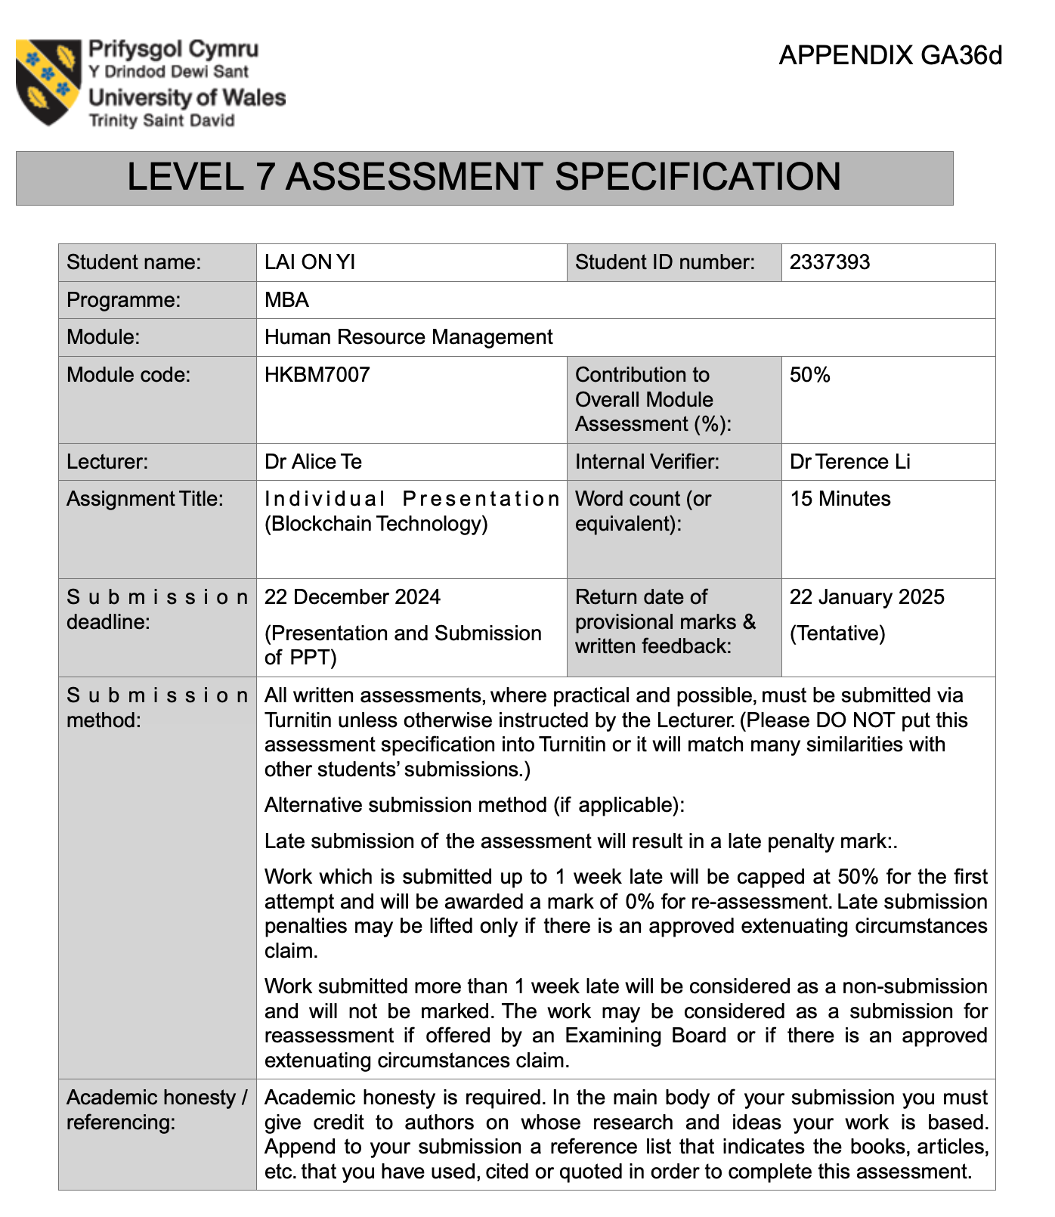

Human Resource Management
(HKMB7007)
How Blockchain
Enhances Human Resource Performance
22 December 2024
LAI ON YI (DORY)
Student ID: 2337393

Slide 2

Table of Content
Introduction Blockchain
Embracing and Incorporating Blockchain in HR
Analysis and Reflection
Challenges for HR leaders
Conclusion and Recommendations
Reference(s)

Slide 3




Understanding Blockchain Technology
FinTech
Blockchain Concepts
Distributed ledger technology (DLT)
An online decentralised and continuously growing list of records
Resistant to modification or changes of the saved data
Crypto-currency
(Bitcoin, Ethereum)
Virtual Assets
(NFT)
Source: Kshetri, 2022; Zhang, Jiang, and Xuan, 2024

Slide 4






Understanding Blockchain Technology
Scenario
Graduation
First Employment
N Employment
Verify Profile
Working Proof
Working Proof
Digital
Certification
Smart
Contract
Industries
Healthcare
Supply Chain
Real Estate
Education
Legal
Source: Williams, 2020

Slide 5
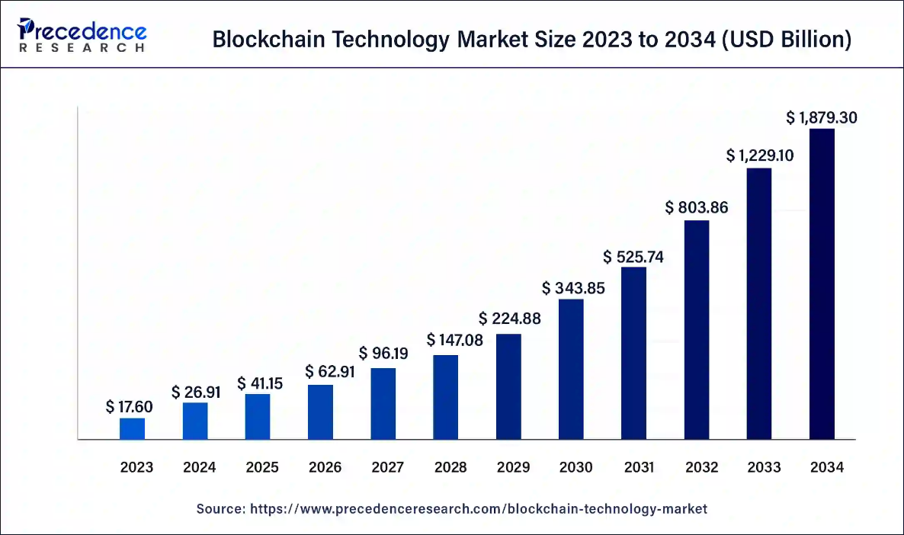
Understanding Blockchain Technology
Blockchain Technology
Market Size in the global
Year
USD in Billion
CACG of 52.9%
From 2024 to 2034
2024
26.09
1,879.30
2034
Source: Precedence Research (2024)

Slide 6
Embracing and Incorporating Blockchain in HR
The 12 Key Functions of
Human Resource
Follow-up Item(s)
Establish Strategic
Align goal with company and HR objective
Administrative Responsibilities
Learning & Development
Industrial Relations
Human Resource
Planning
Career Planning
Employee Participation
& Communication
Pilot Project
Small scale project to
gather feedback
Recruitment & Selection
Recruitment & Selection
Function Evaluation
Health & Safety
Change Management
Implement strategic to ensure smooth transition
Performance
Management
Rewards
Personal Well Being
Integration with System
Customize solution to
meet actual requirements
Contributed by the writer
Source: Baluswamy et al. 2023; Gnan and Flamini, 2021

Slide 7



Analysis and Reflection
(Recruitment & Selection)
Pain Point of Bad Hiring
IBM Watson Talent
Negative Financial Impact
Disrupts Reputation
Low Productivity
Create a Cultural Imbalance
    Company Name | Number of Employees
ANZ Bank 40,300
  Mizuho Bank 52,420
York University. 4,431
Repeat Entire Procedure of
Recruitment & Section
Oracle Talent Management
Source: Fachrunnisa and Adhiatmam, 2024; APPS RUNE THE WORLD, 2024

Slide 8
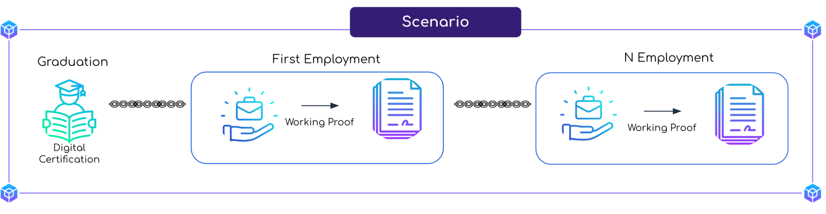


Analysis and Reflection
(Recruitment & Selection)
Impact
Insights
of Blockchain Implementation
Enhanced Data Security
Efficiency and Accuracy
Cost Savings
Automated Verification Process
(Automated validation of candidate
credentials)
Smart Contracts
Data Privacy
30% decrease in security incidents
Source: Madhani, 2022; Agnihotri et al. 2024

Slide 9
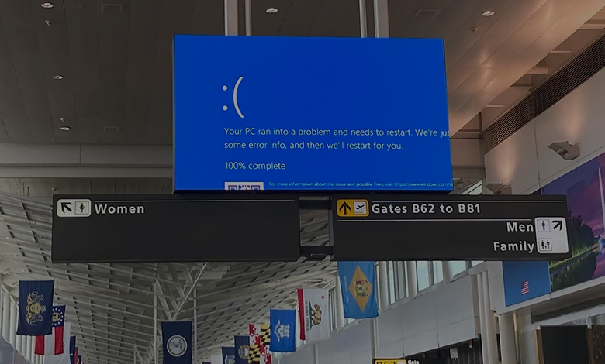

Analysis and Reflection
(Recruitment & Selection)
Lessons
Continuous Skill Development
Adaptation to Technological Shifts
Data Integrity
Data Privacy Compliance
Vendor Evaluation
CrowdStrike Update Event 2024
Direct Damage Cost in USD 5 Billions
Source: Psico-smart Editorial Team (2024); Fung (2024)

Slide 10


Analysis and Reflection
(Recruitment & Selection)
Observation
Challenge of HR
Reduced Fraudulent Activities
Data Security and Privacy
Expectation Management
Widespread adoption of Blockchain
Technological Integration
School Certification, Job Reference
Data Privacy and Security Concerns
Employee Resistance and Training Needs
Cost and Resource Constraints
Regulatory and Compliance Changes
Gupat (2018) states “No software is secure enough. All software can be attacked.”
Arguments
Return of Investment (ROI)
Update Compliance and Auditing
Engagement
Source: Gupat, 2018; Fachrunnisa and Adhiatmam, 2020; Chafio et al. 2024

Slide 11

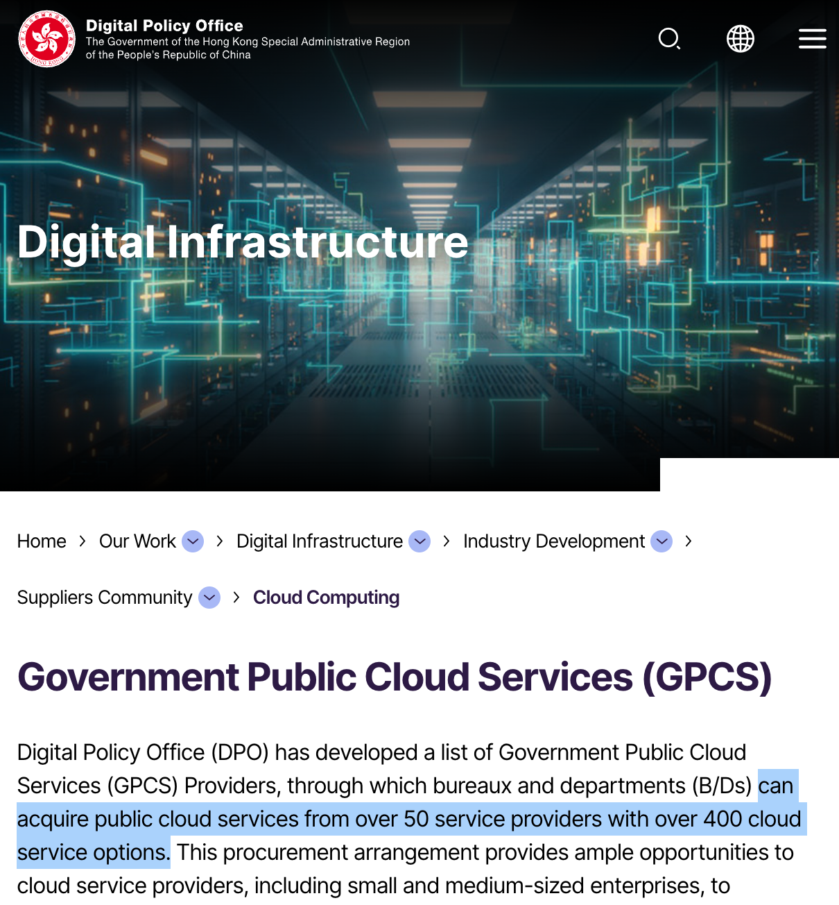






Suggestion and Recommendations
Internal
External
Collaborate
Across Departments
Ensure Data Security and Privacy
Stay updated on Industry Trends
(Integration of AI, and Cloud Computing)
Fulfil Local Law
Develop
Clear Strategy
Pilot Projects
Seek Feedback
Monitor and Evaluate
Invest in Education and Training

Slide 12
Reference(s)
Academic References:
Agnihotri et al. (2024) Impact of New Technology on Next-Generation Leadership. India: Timely Knowledge.
Baluswamy, B. et al. (2023) The Adoption and Effect of Artificial Intelligence on Human Resources Management. UK: Emerald Publishing Limited.
Chafio et al (2024) 'Investigating the potential of blockchain technology for geospatial data sharing: Opportunities, challenges, and solutions', Geomatica, 76(2). DOI: 10.1016/j.geomat.2024.100026.
Fachrunnisa, O. and Adhiatmam, A. (2020) 'Blockchain-based human resource management practices for mitigating skills and competencies gap in workforce', International Journal of Engineering Business Management, 12(1), pp1-11. DOI: 10.1177/1847979020966400.
Fachrunnisa, O. and Adhiatmam, A. (2024) 'Blockchain-based human resources management practices to support performance efficiency: A literature survey', Human Resources Management and Services, 4(1), pp1-15. DOI: 10.18282/hrms.v4i1.3473.
Gnan, L. and Flamini, G. (2021) Designing and Implementing HR Management Systems in Family Businesses. Italy:Timely Knowledge.
Gupta, B (2018) Computer and Cyber Security Principles, Algorithm, Applications, and Perspectives. United States: CRC Press.
Kshertri, N. (2022) The Rise of Blockchains: Disrupting Economies and Transforming Societies. UK: Edward Elgar Publishing Limited.
Madhani, P,M. (2022) 'Blockchain Applications in HR: Key Advantages', HRM Review, 18(1), pp17-22.
Williams, I. (2020) Cross-Industry Use of Blockchain Technology and Opportunities for the Future. Denmark: Aalborg University.
Zhang, H., Jiang, S., and Xuan, S. (2024) 'Decentralized federated learning based on blockchain: concepts, framework, and challenges', Computer Communications, 216, pp. 140-150. DOI: 10.1016/j.comcom.2023.12.042.
Other References:
APPS RUN THE WORLD (2024) List of IBM Watson Customers. Available at: https://www.appsruntheworld.com/customers-database/products/view/ibm-watson/name/asc/10/2 (Accessed: 21 December 2024).
Fung, B. (2024) 'We finally know what caused the global tech outage - and how much it cost', CNN Business, 24th July. Available at: https://edition.cnn.com/2024/07/24/tech/crowdstrike-outage-cost-cause/index.html (Accessed 21st December 2024).
Precedence Research (2024), Blockchain Technology Market Size to Achieve USD 1,879.30 Billion by 2034. Available at: https://www.globenewswire.com/news-release/2024/09/05/2941723/0/en/Blockchain-Technology-Market-Size-to-Achieve-USD-1-879-30-Billion-by-2034.html (Accessed: 8th December 2024).
Psico-smart Editorial Team (2024) 'Blockchain Technology for Secure HR Data Management', Vorecol [blog]. 28 August. Available at: https://psico-smart.com/en/blogs/blog-blockchain-technology-for-secure-hr-data-management-12147 (Accessed: 21 December 2024).
Thank You!

