Slide 1
March 5th
Self Directed Study!
  PCSO’s & Police Reform Act (2002)
  I am away at the NPCC Local Policing Conference in Leicester. Send me drafts over the weekend to keep me occupied on my 5 hour train journey!

Slide 2

What’s in the news?
Class discussion on current affairs around policing

Slide 3

Taser

Slide 4
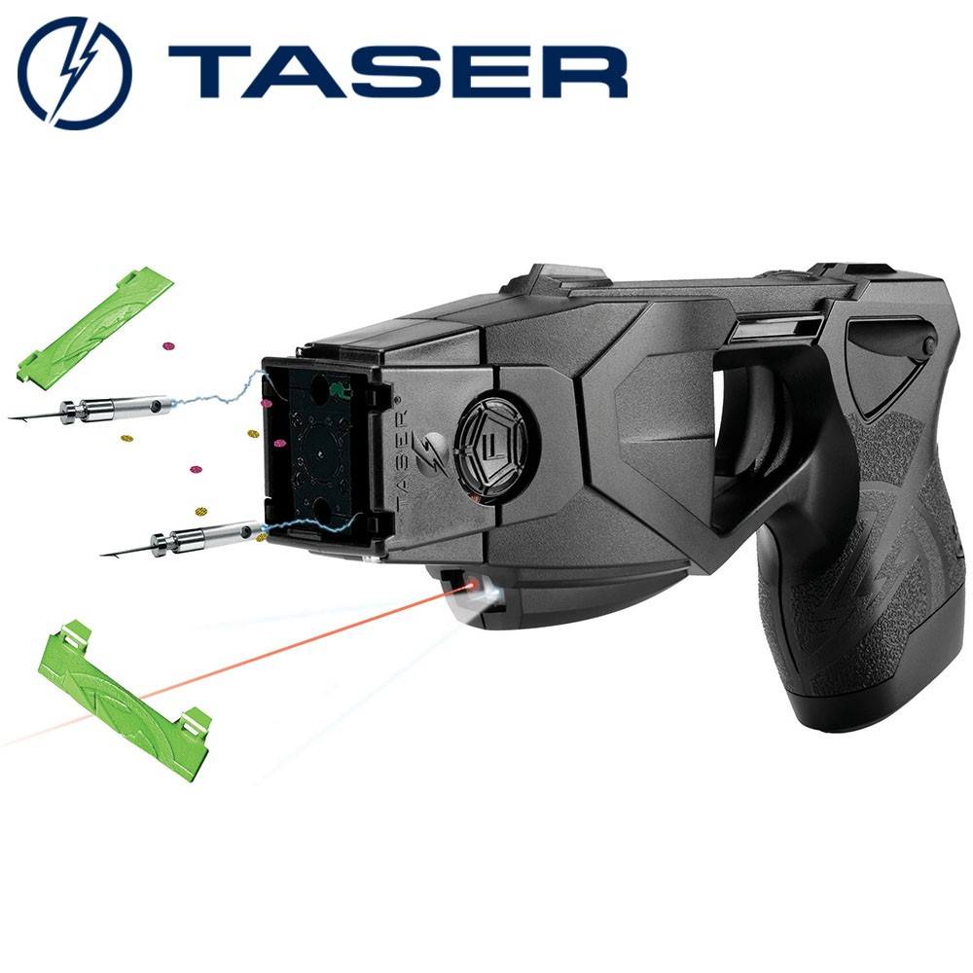
Taser
As Taser is rolled out… the public have a lot to fear
(Khan, 2013).

Slide 5
An overview
Simply; 50,000 Volts delivered by 2 barbed hooks connected by wires to a battery.
A less lethal weapon compared to a firearm,
Not classed as PPE
Its use is controversial across the UK and USA

Slide 6
Should the police have more Tasers in London? It’s an important question to ask, especially of those who may be subjected to their use. The arguments for more Tasers would be that Tasers are a less lethal option compared to a firearm. The arguments against their increased availability is that they would be seen to arm the police by stealth and have the potential to cause seriously injury.
Khan (2013)
What are the other options?
Baton
PAVA / CS (Pepper Spray)
Firearm / Baton round

Slide 7
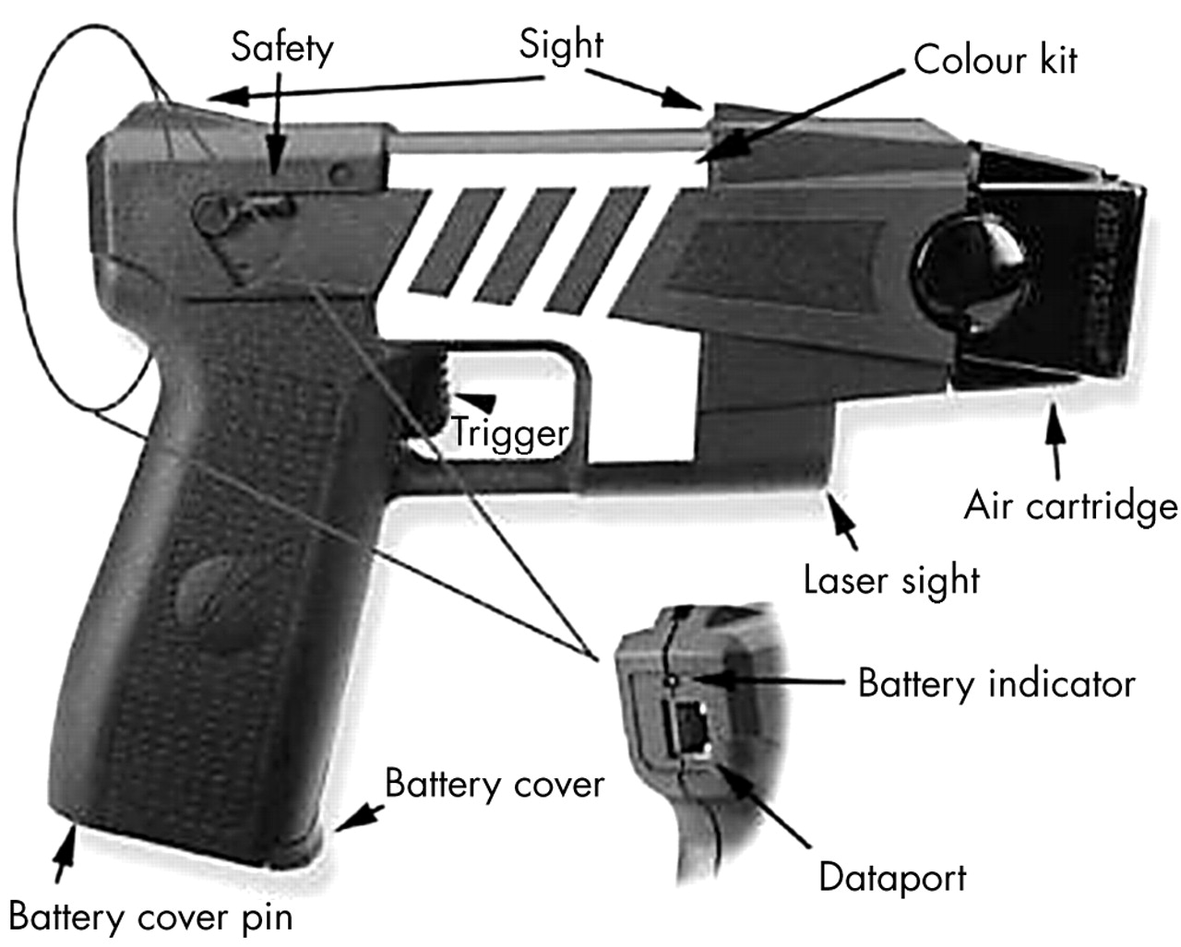
The Advanced Taser is a battery-operated unit resembling a hand gun that fires two barbed electrodes on 21-foot-long copper wires at 180 feet/second (fig 1). The weapon is aimed by a laser sight. The barbs attach to the subject’s skin or clothing and deliver up to 50,000 volts of electricity in rapid pulses over five seconds. The current can cross up to two inches of clothing.

Slide 8


Slide 9
Police have a limited number of use of force options when confronting dangerous or violent suspects. Police officers are legally and morally required to use the lowest level of force necessary to control a situation and to de-escalate at the earliest opportunity. Use of force options start with good communication skills, then escalate from unarmed physical skills (holds, restraints, strikes), deployment of incapacitant sprays, up to the use of batons. At present, when facing levels of threat that exceed the capacity of an officer deploying a baton, there remains only the use of a firearm.
Police agencies have searched for “less lethal” weapons to fill the operational gap between the baton and the gun.
Bleetman et al (2004)

Slide 10
A range of “less lethal” weapons have been evaluated by various government, forensic, and humanitarian agencies. Recent examples of these include: impact devices, (baton rounds, bean bags, rubber projectiles); water cannon; long range chemical delivery devices; electrical devices (stun guns, sticky shocker, Tasers); and distraction and disorientation devices (lasers, stun grenades, noise generation devices, malodourants, smoke, nets, foam, grease, and tranquillisers).
From these, the Association of Chief Police Officers (ACPO) selected the Advanced Taser for an operational trial by firearm units of five police forces in the UK. This will inevitably result in “tasered” subjects being brought to emergency departments.
Bleetman et al (2004)

Slide 11
Effects
The usual reaction of a person exposed to CED discharge in probe mode is loss of some voluntary muscle control accompanied by involuntary muscle contractions. During the discharge the subject may:
not be able to respond to verbal commands during the discharge
be confused or disorientated after the cycle
feel exhausted after cycle
‘freeze’ on the spot
call out or make involuntary vocal noises
College of Policing (2018)
not be able to control their posture – consider risk of injury from uncontrolled fall
experience their legs going rigid, which could be mistaken for kicking out (especially if they are in prone position)
convulse, curl up in a ball, spasm, or stiffen (plank)
experience intense pain

Slide 12
High profile cases
Raoul Moat
A&S Police Race Advisor
Raoul Moat's death followed a six-hour stand-off with armed officers who had cornered him in Rothbury, Northumberland.
He had been on the run for a week after shooting his former partner, Samantha Stobbart, killing her new boyfriend, Chris Brown, and blinding PC David Rathband by shooting him in the face.
The shootings sparked a huge police manhunt for the 37-year-old former nightclub doorman.
A police force that shot its own race relations adviser with a stun gun in 2017 after mistaking him for a wanted man has once again confused him for the very same person.
Officers from Avon and Somerset police approached Judah Adunbi on Wednesday and asked him if he was Royston McCalla.

Slide 13
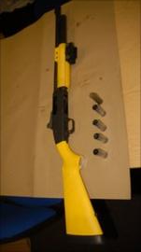
Raoul Moat
IPCC commissioner Nicholas Long said:
"It is clear from the evidence that there is no suggestion any discharge from the XREP Tasers caused Moat to inadvertently pull the trigger.
"Moat was struck by one of the XREP Tasers, but this appears to have been a glancing blow which would have had very little effect.
"All the evidence shows a further distinct movement by Moat to raise the shotgun to his head before firing."

Slide 14
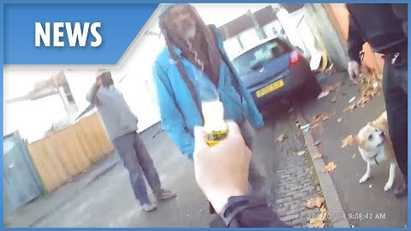

Slide 15
An Avon and Somerset Constabulary police officer has been cleared of gross misconduct following her use of Taser on a man in Bristol.
An independent panel at a misconduct hearing held by Avon and Somerset Constabulary concluded today that PC Claire Boddie did not breach the standards of professional behaviour for her use of force. The hearing was held following an IOPC investigation into the use of Taser on Judah Adunbi in January 2017, in the Easton area of Bristol.
A complaint from a member of the public who witnessed the aftermath of the incident was voluntarily referred to the IOPC by the force on 19 January 2017. At the conclusion of our investigation in June 2017, we referred the matter to the Crown Prosecution Service who charged PC Boddie with common assault. PC Boddie was found not guilty of assault at a trial in May 2018.
Following PC Boddie’s acquittal, Avon and Somerset Constabulary agreed that PC Boddie had a case to answer for gross misconduct and proceeded with the misconduct hearing.
IOPC (2018)

Slide 16
Discussion
Balance the pro’s and con’s of Taser use, the dangers, the controversy and the uncertainty from members of the public… is this leading to routine arming of the police service?
Does the controversial use of Taser undermine the legitimacy of the police service, and should safety of officers be put ahead of public concern?

Slide 17
Taser References
Ariel B, Lawes D, Weinborn C, Henry R, Chen K & Hagit B S (2019), The “Less-Than-Lethal Weapons Effect”—Introducing TASERs to Routine Police Operations in England and Wales, Criminal Justice And Behaviour, Volume 46, Issue 2, Pages 280 – 300.
Bleetman, Steyn R & Lee, C (2004), Introduction of the Taser into British policing. Implications for UK emergency departments: an overview of electronic weaponry, Emergency Medical Journal, Volume 21, Pages 136 – 140.
College of Policing (2018), Authorised Professional Practice; Conductive Electrical Devices (Taser) (Online) Available at https://www.app.college.police.uk/app-content/armed-policing/conducted-energy-devices-taser/ Accessed 27th February 2019.
Independent Office of Police Conduct (2018), Avon and Somerset police officer cleared of gross misconduct for use of Taser (Online) Available at
https://policeconduct.gov.uk/news/avon-and-somerset-police-officer-cleared-gross-misconduct-use-taser Accessed 28th February 2019.
Khan, S (2017), A less lethal weapon? As Taser use is rolled out across London, the public has much to fear, (Online) Available at https://www.independent.co.uk/voices/comment/a-less-lethal-weapon-as-taser-use-is-rolled-out-across-london-the-public-has-much-to-fear-8881351.html Accessed 25th of February 2019.

Slide 18

Any Questions?
C.Newton-Evans@UWTSD.ac.uk

