Slide 1
ESD and Youth Work
Practice within the Youth Work Sector

Slide 2
Aims of Session
1.Explore the role of ESD practice within Youth Work
2. Identify own knowledge and experience
ESD activities for practice

Slide 3
Sustainability : Definitions
“development that meets the needs of the present without compromising the ability of future generations to meet their own needs” (Brundtland commission, WCED 1987:43.
What are the issues with this definition?

Slide 4
How does it relate to the green theories we looked at last week?
Another problem with the Bruntland definition is that it is not clear where it stands on the issue of inequality.
This definition is problematic, however, as the notion of ‘needs’ is so subjective. For example, people in parts of the western world, such as Wales, and people in less developed countries such as many parts of Africa, might have very different views of what ‘needs’ means.

Slide 5
This definition of sustainable development is better at incorporating the idea of social equality:
“the need to ensure a better quality of life for all, now and into the future, in a just and equitable manner, while living within the limits of supporting ecosystems” (Agyeman et al, 2003:2).
Agyeman's definition clearly addresses social equality, and although the notion of 'a better quality of life' is still slightly subjective, it does specify 'within the limits of supporting ecosystems'.

Slide 6
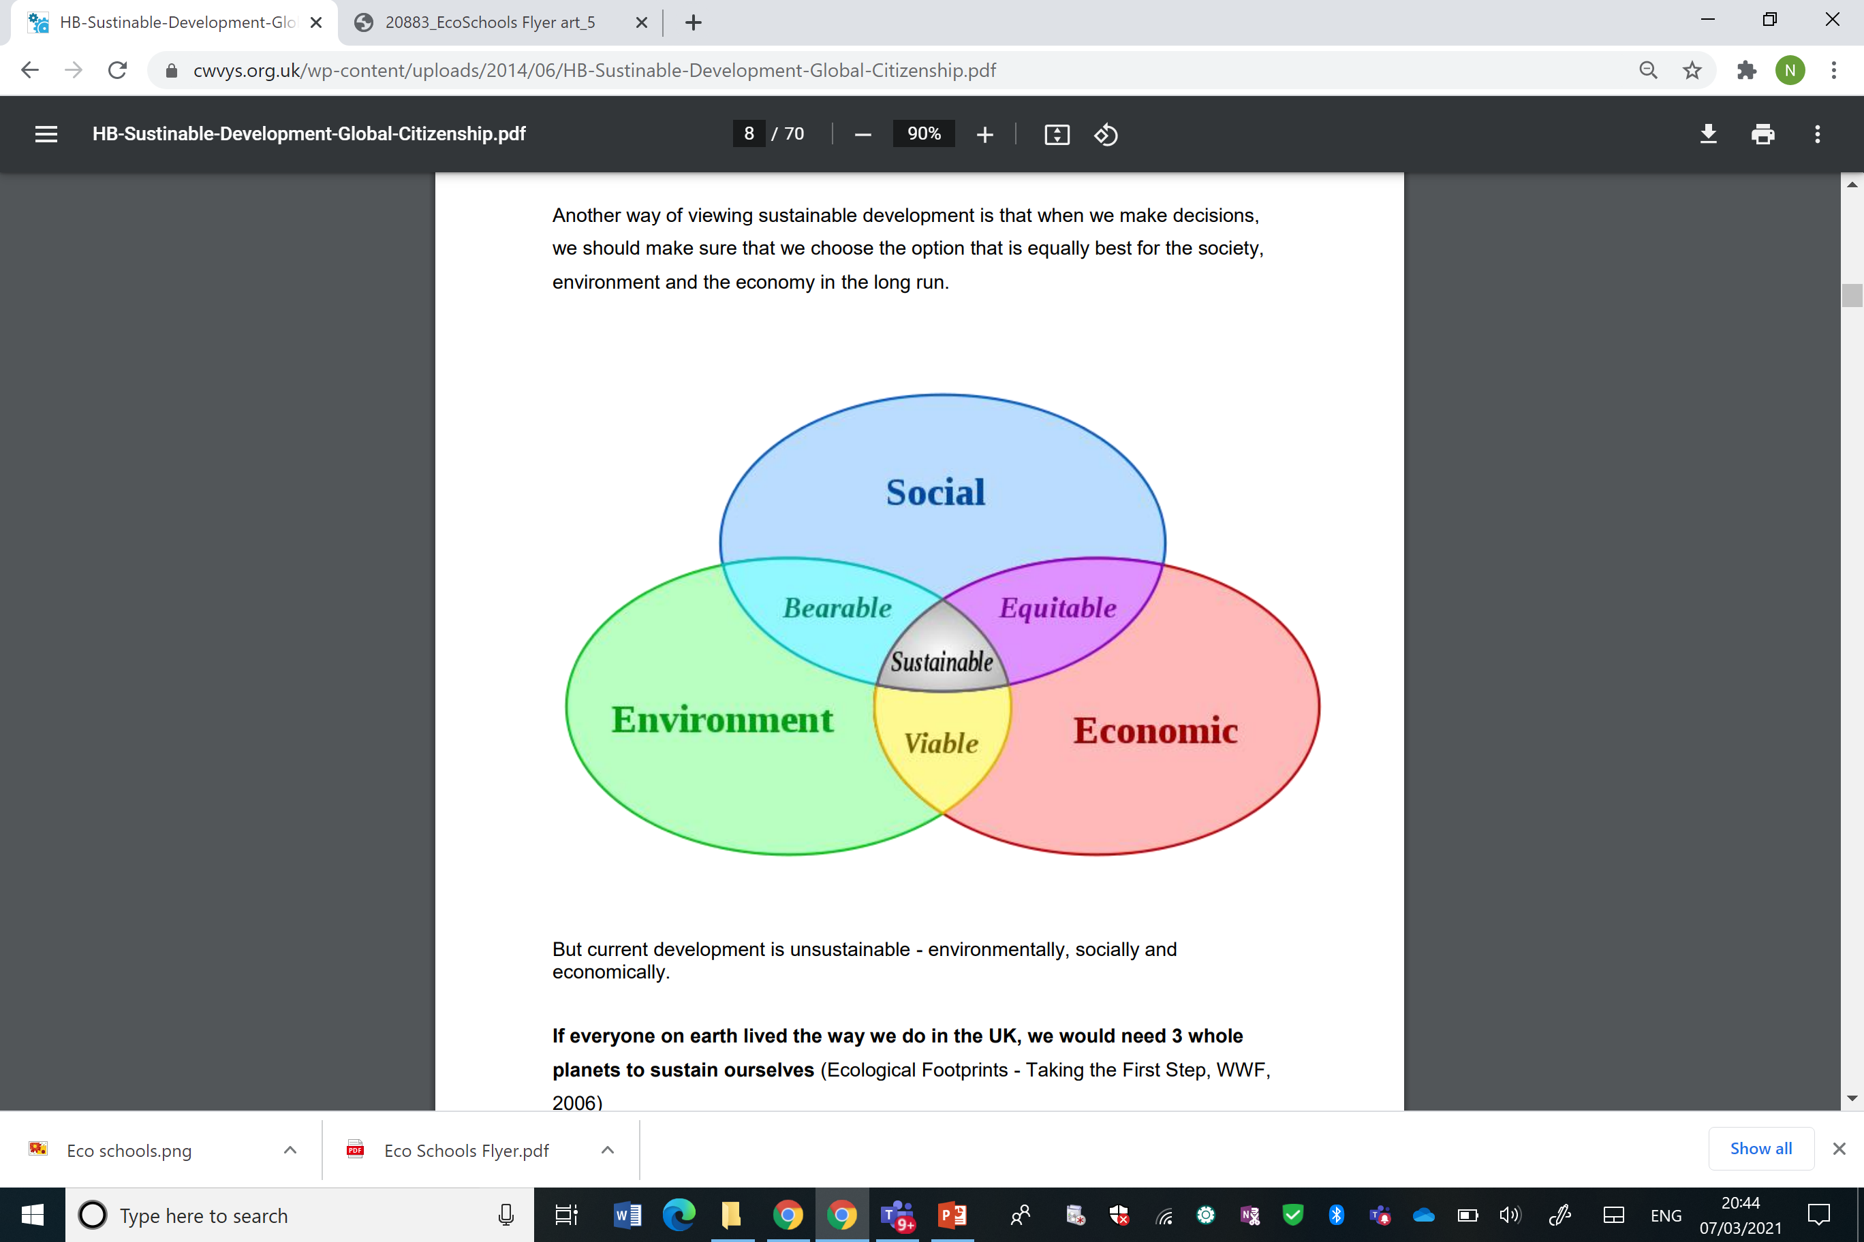

Slide 7
More than being “green”…
Sustainability is not only about addressing environmental threats,
It is also about ensuring that everyone is able to enjoy the full set of human rights, in a way which does not jeopardise the rights of human beings in the future.
These rights should include social and economic, civil and political, cultural and environmental rights.
sustainability demands a quality of life for all which not only meets physical needs, but also meets social and cultural needs, and which is distributed equitably.
For this reason, it is now accepted that sustainable development demands action across at least three different dimensions: environmental protection, social inclusion and economic development.

Slide 8
A sustainable world is one where economic growth and social inclusion are contained within the environmental limits that will allow the model to continue into the future:
the dimension of environmental protection includes questions relating to stewardship of the planet’s natural resources, e.g. water, air, minerals, carbon deposits, flora and fauna. This dimension also includes the impact on the environment of housing, agriculture, emissions and waste, etc.;
the social dimension refers to issues such as equality, democracy, human rights, social justice, community resilience and adaptation to environmental challenges;
the economic dimension refers to practices associated with production, the use and management of resources, and also to issues such as consumption, technology, labour and wealth distribution.
A fourth dimension is sometimes added to these three, that of cultural sustainability. The cultural dimension relates to cultural identity, diversity, creativity, the role of art, memory, heritage, spirituality and community planning.

Slide 9

Sustainable Development Goals

Slide 10
Why ESD?
Why do we need to change education (formal , non-formal, Informal?
What are the challenges young people are faced with today?
From your own perspective think about : What are the Most Important Issues Facing the World and its Inhabitants
https://sustainabledevelopment.un.org/?menu=1300

Slide 11
Education and youth work for sustainability
Education for Sustainable Development (ESD) is about shaping a better tomorrow for all – and it must start today. (UNESCO 2014):
Global Action Programme (GAP) on Education for Sustainable Development.
The purpose of GAP is “to generate and scale up action in all levels and areas of education and learning to accelerate progress towards sustainable development” (UNESCO 2014). It has two objectives:
“to reorient education and learning so that everyone has the opportunity to acquire the knowledge, skills, values and attitudes that empower them to contribute to sustainable development;
to strengthen education and learning in all agendas, programmes and activities that promote sustainable development.” (UNESCO 2014)

Slide 12

Youth Work For Sustainability
In addition to the family and the formal education system, youth work exerts a strong influence on young people’s transition to adulthood, and it can help in promoting their participation in society…
Youth work has a long tradition of supporting young people’s understanding of the world around them and promoting such values as justice and equality.

Slide 13

The DNA of youth work
There is no internationally agreed definition of youth work or its outcomes, and there are various methods and models of youth work across the world
. Some of these include:
  recreational;
  personal development;
  critical social education;
  radical social change.

Slide 14

Wales: ESDGC
This document will be really helpful for your assignment. But it is a bit out of date so you will need to reference more recent policies.
ESDGC in a youth work context starts from the young people’s experiences,
encourages a critical understanding of the links between their lives and histories with those in their community and others throughout the world,
making the connections between society, economy, the environment and politics.
It reflects on attitudes and values, and develops skills to enable active participation in creating a more just and sustainable world.
Welsh Government (2008)

Slide 15

Is education responding?
Education as the answer or the problem?
‘The destruction of the planet is not the work of ignorant people. Rather it is largely the result of work by people with BAs, BScs, LLBs, MBAs and PhDs.’
David Orr (1994) ‘What is education for’? Earth in Mind, Island Press

Slide 16
Is education responding?
“Education is the most powerful weapon you can use to change the world”
Nelson Mandela

Slide 17
Reorienting Education
Important to consider HOW we educate:
Rather than Transmissive education Transformational Education e.g:
Problem solving
Critical thinking
A say in decisions
Examine values and cultural perspectives
Empowering learners to take appropriate action

Slide 18
ESDGC and Youth Work
So what is the difference between ESD in youth work and good youth work?
The answer for many is not much:
“ Youth work has a long tradition of supporting young people’s understanding of the world around them, and the values that youth work promotes such as justice and equality link strongly with the introduction of global themes. Therefore ESDGC in a youth work context is entirely consistent, and many are engaging in ESDGC in youth work, even if they’re not giving it that name”.
(Welsh Government 2008)

Slide 19
Principles and purposes of Youth Work
Educative
Expressive,
Participative,
Inclusive
Empowering
ESDGC in youth work settings is distinct because it follows the same principles as youth work practice;
What are the purposes and principles of youth work practice?

Slide 20
promote and actively encourage opportunities for all young people in order that they may fulfil their potential as empowered individuals and as members of groups and communities;
support young people through significant changes in their lives and assist them to understand their responsibilities;
support young people to be able to understand and exercise their rights;
encourage young people to gain and develop knowledge, understanding, attitudes and values and to make constructive use of their skills, resources and time;
promote opportunities and access for all young people whatever their race, gender, sexual identity, language, religion, disability, age, background or personal circumstances;
challenge oppression and inequality;
support and enable young people in keeping themselves safe.
recognises the importance and value of the Welsh language and the need to promote its use;
recognises that Wales is a country with a diversity of languages and cultures;
recognises the importance of sustainable development and equips young people with the knowledge and skills to play their part in shaping the future;
encourages young people as local, national and global citizens to exercise their responsibilities;
encourages young people to protect their own rights and those of others.

Slide 21
ESDGC in youth work:
Recognises the links between our own lives and those of people throughout the world
Recognises histories, both our own and those of others throughout the world
Seeks to include black and minority ethnic (BME) perspectives locally and throughout the world
Is concerned with needs and rights of both the present and future generations
Addresses the relationship between power, resources and human rights
Enables young people to understand the global forces which shape their lives
Equips young people to participate in decision making and take action for change
Enables young people to question, to think critically, and to empathise

Slide 22
ESDGC is not:
  Confined to project work
  A series of discrete concepts or themes
  The responsibility of one or two people in the service or organisation
  About transmitting a set of answers to learners
  Separate from core youth work practice

Slide 23
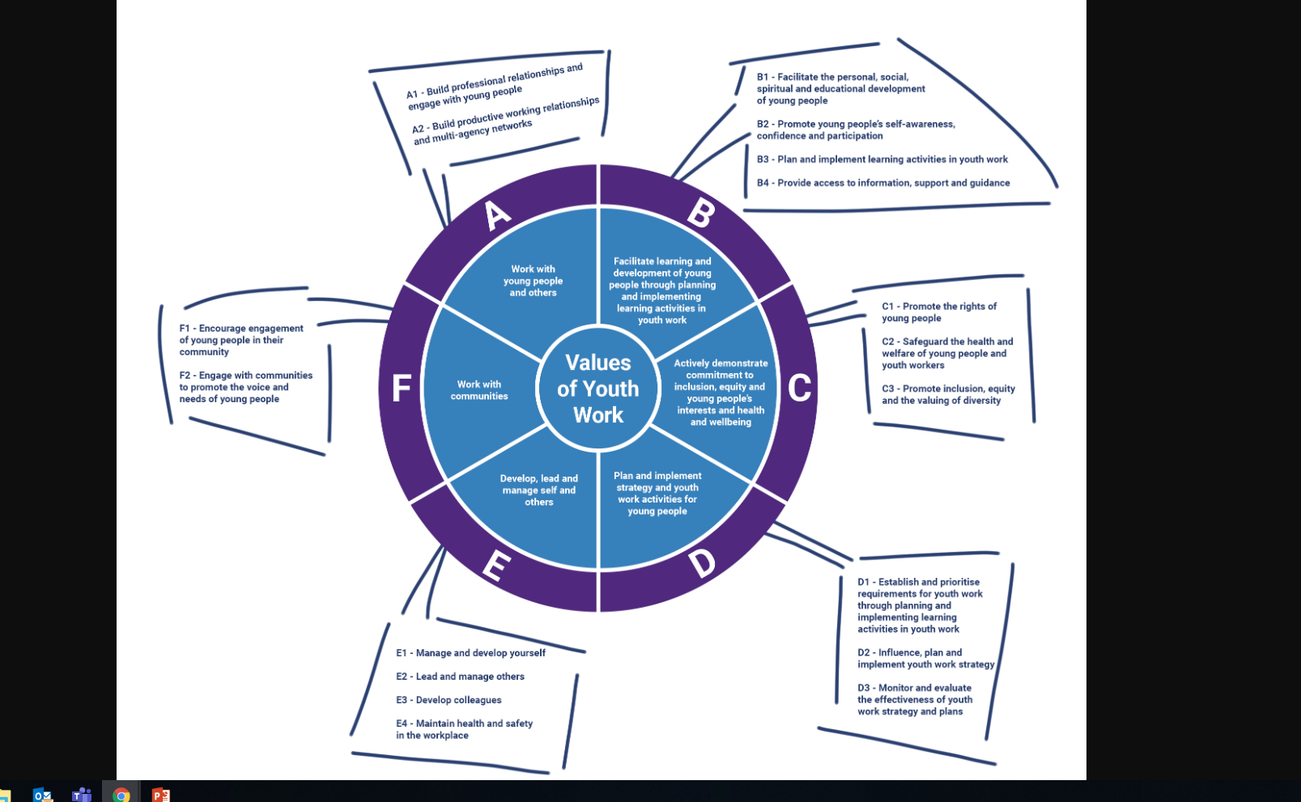
National Occupational Standards Youth Work
Which NOS do you think link to to ESDGC?
Look at the list and discuss in small groups:
https://nya.org.uk/resource/national-occupational-standards/
https://nya.org.uk/wp-content/uploads/2014/06/nos-table-pie-draft-1-1.jpg
(CLD Standards Scotland, 2018)

Slide 24
ESDGC concepts
Concepts | Themes
1. Quality of life 2. Sustainable change 3. Diversity 4. Interdependence 5. Citizenship and stewardship 6. Conflict resolution 7. Need and rights 8. Values and perceptions 9. Uncertainty and precaution | 1.Identity and culture 2. Choices and decisions 3. Health 4. Natural environment 5. Consumption and waste 6. Climate change 7. Wealth and poverty

Slide 26
How can we link themes when working with Young People?

Slide 27
ESDGC
In groups choose at least two jigsaw themes , and consider an activity you may undertake in your youth work practice relating to the themes:

Slide 28
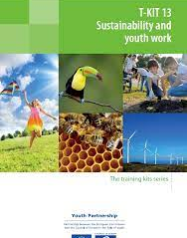
See PDF Sustainability and youth work

Slide 29
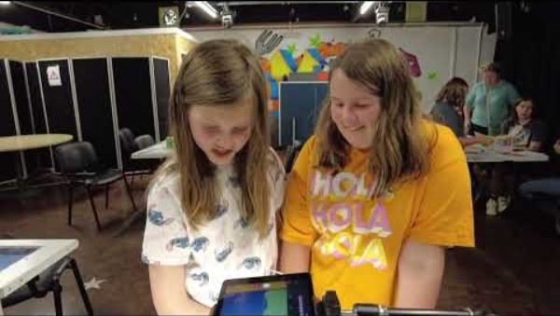
Engaging Young People
Christopher Monk, Lead Digital Youth Worker at Dr Mz, highlighted the positive impact of the project, stating, "The young people who attended the sessions came away feeling much more confident about the impact they can have on the climate crisis that we face."
The participants expressed a newfound confidence in motivating adults to listen to their views and opinions, and they are eager to share their animations with the wider community through posters, screenings, and discussions with their families and friends.”

Slide 30


Examples of practice: EcoSchools
https://www.eco-schools.org.uk/
Look at the flyer on moodle / or go the link in the chat Would this be model be useful to Youth work? If so why? If not why not?

Slide 31
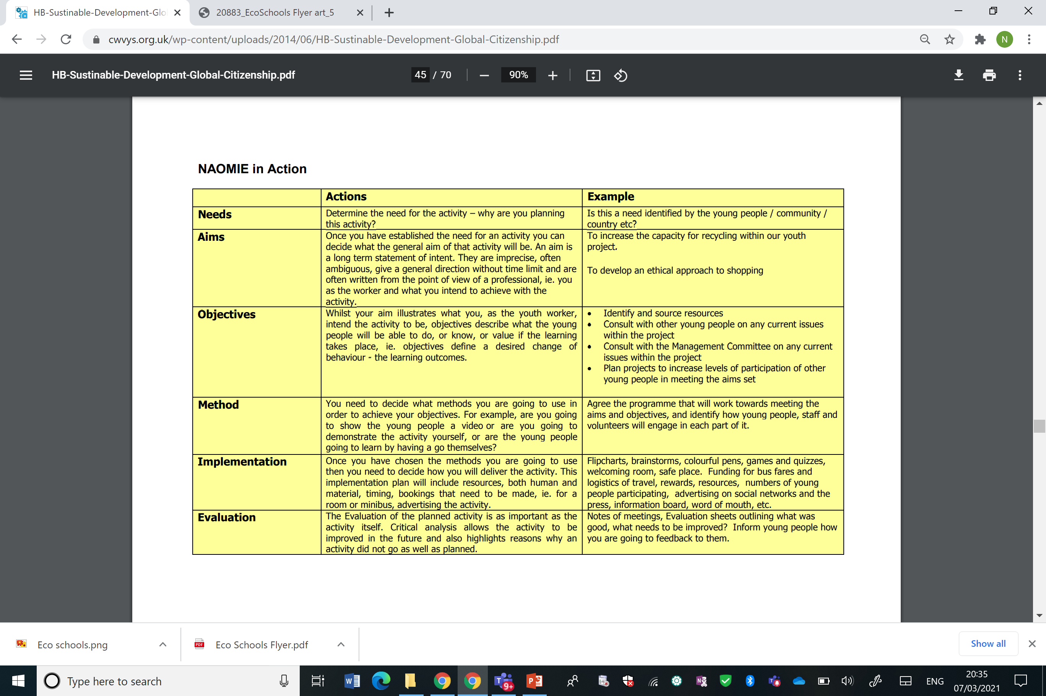
Planning your activity: NAOIME

Slide 32

The Story of Stuff
Look at the movie,
The Story of Electronics:
https://storyofstuff.org/movies/story-of-electronics/

Slide 33
Your own experiences?
Have you experience of working with the themes identified?
How can we embed ESDGC in to practice? What needs to happen?

Slide 34
Reflection
What are your thoughts now on ESD and your practice?

Slide 35
Directed Study
You will find on moodle resources / tool kits for ESD, please read these and consider how you could apply these to a youth work setting.

Slide 36
Key References (available on Moodle)
CLD Standards Council Scotland, (2018) Youth Work NOS.
CWVYS, (2018) Youth Work in Wales: Principles and Purposes
Council of Europe and European Commsion, (2018) T_Kit 13 Sustainability and Youth Work. EU
McKeown R (2002). ESDGC Toolkit Available from http://www.esdtoolkit.org/esd_toolkit_v2.pdf link to open resource
Welsh Government (2008 ). Education for Sustainable Development and Global Citizenship: A Common Understanding for the Youth Work Sector. Cardiff: Welsh Government

