Slide 1
Waste law & policy:
US Superfund
Lara Hopkinson
M6X01894 – Environmental law and policy

Slide 2
outline
US Superfund – what is it?
Case studies
Policy developments
Lessons learnt

Slide 3
What is superfund?
Comprehensive Environmental Response, Compensation and Liability Act 1980 (CERCLA)
Allows US EPA to clean contaminated sites
Main aims:
  Protect human health & environment by cleaning contaminated sites
  Makes responsible parties pay
  Involve communities
  Return Superfund sites to productive use

Slide 4
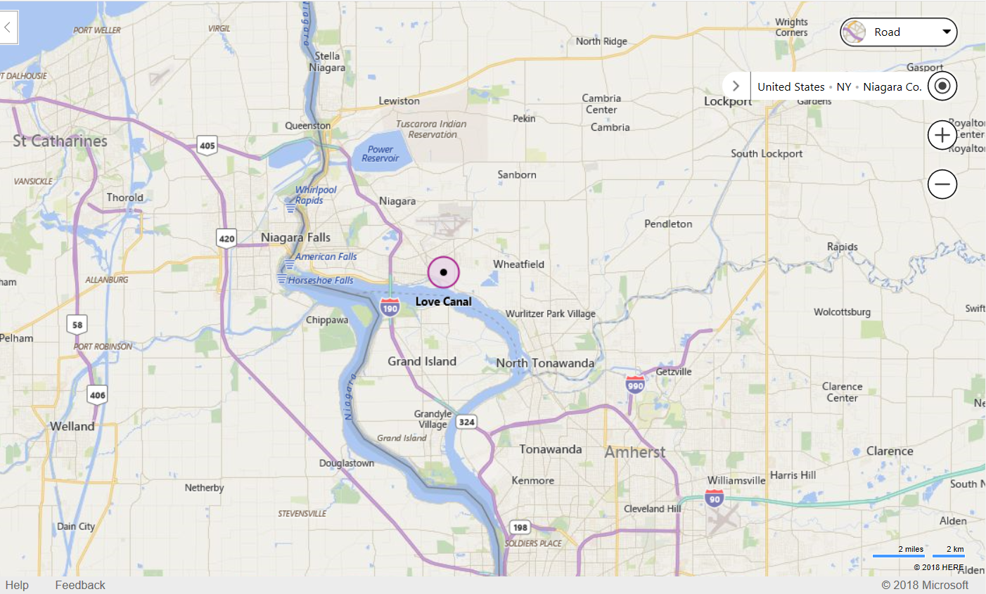
Case study – love canal, usa
Source: Google Maps

Slide 5
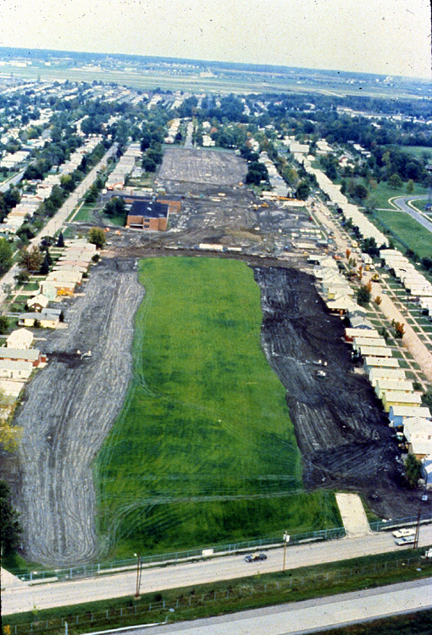
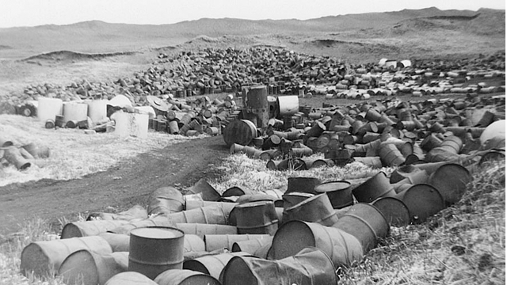
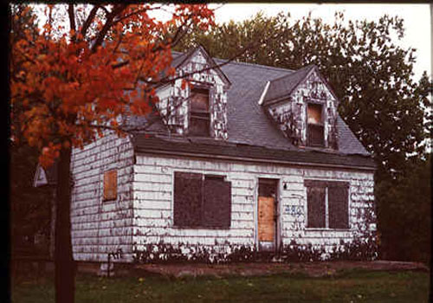
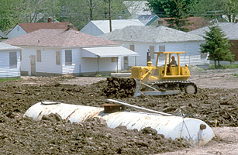
Case study – Love Canal, USA
Sources: US EPA / Time / Pinterest / Believe it or Not

Slide 6
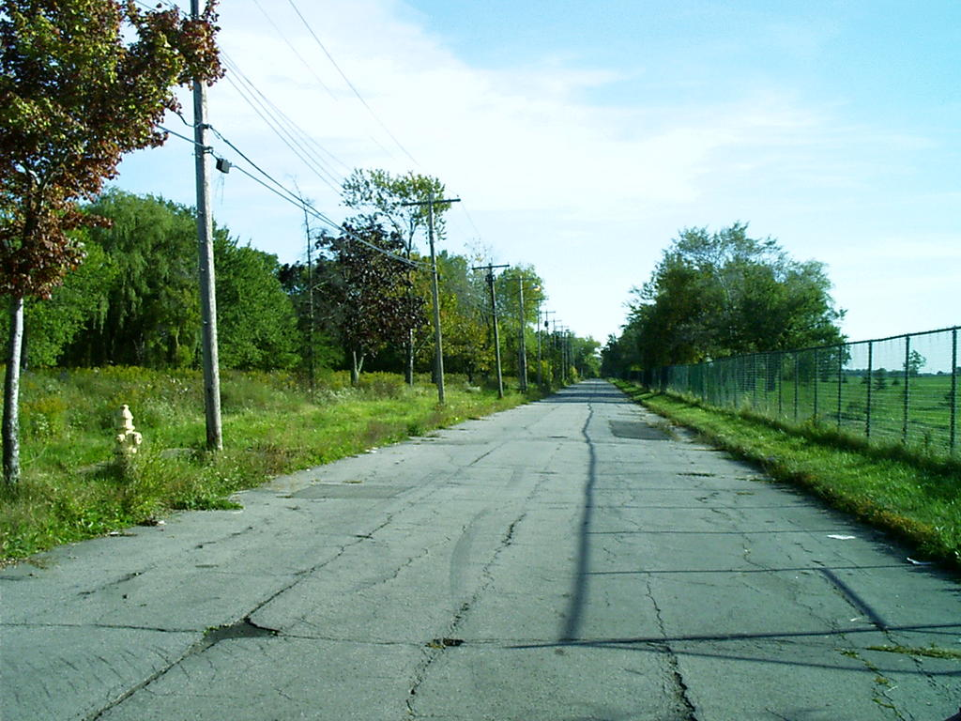
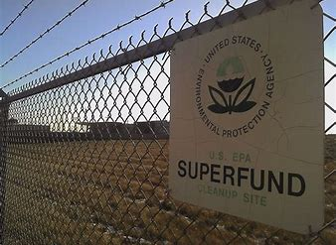
Love canal today

Slide 7
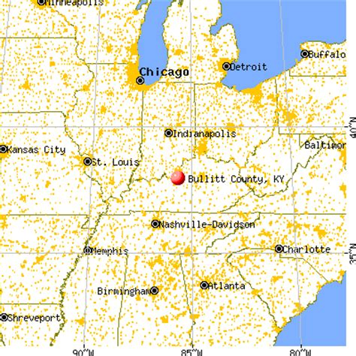
Case study: valley of the drums

Slide 8
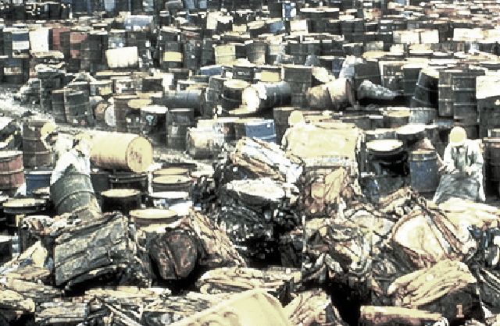
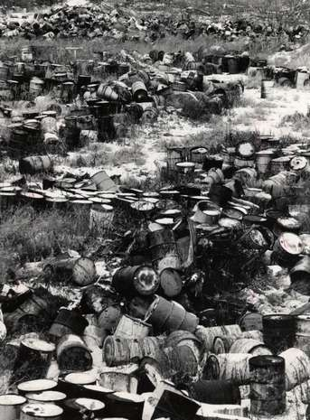
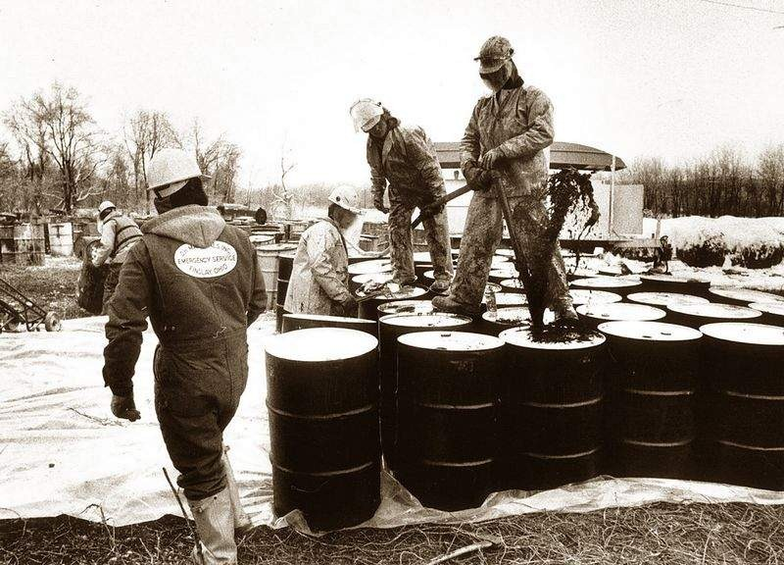
Sources: Bullitt County History / Amusing Planet

Slide 9
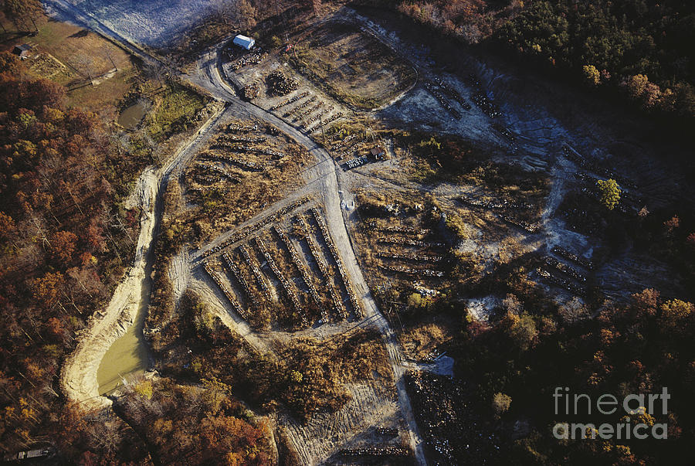

Slide 10
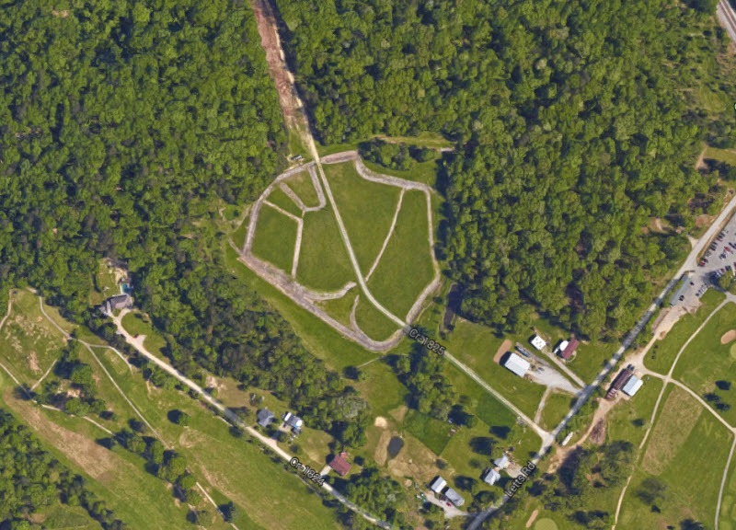
Valley of the drums today
Source: Amusing Planet

Slide 11
cercla
Passed by US Congress in 1980
In response to case studies highlighted
Programme for:
  Emergency response
  Information gathering & analysis
  Liability for those responsible
  Site clean-up

Slide 12
superfund
Administered by US EPA
Sites are ‘discovered’
  Reported by residents, businesses, or local, state, tribal or federal agencies
Two basic responses:
  Removal actions
  Remedial actions

Slide 13
The superfund process
Preliminary Assessment / Site Inspection (PA / SI)
  National Priorities List (NPL)
Remedial Investigation / Feasibility Study (RI / FS)
Record of Decision (ROD)
Remedial Design (RD)
Remedial Action (RA)

Slide 14



Responsibility for site clean-up
Potentially Responsible Party (PRP)
State / Tribal Government Involvement

Slide 15
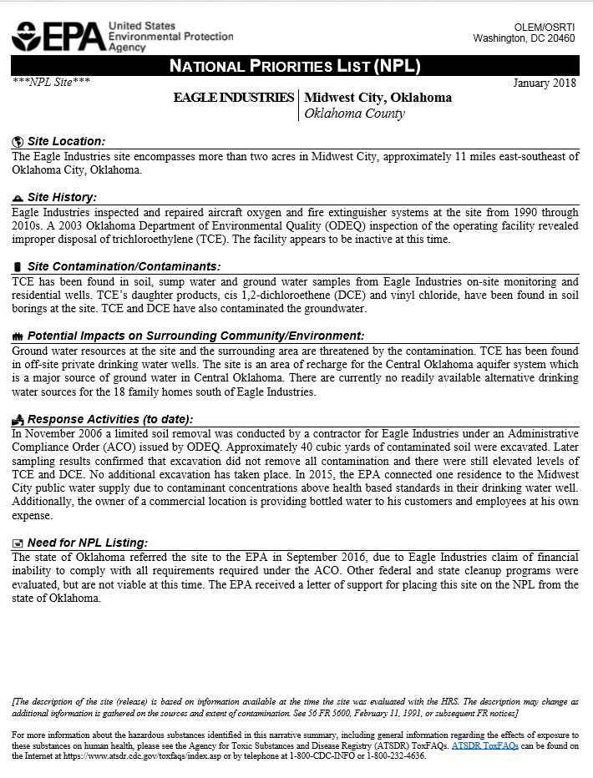
New npl entry: eagle industries, oklahoma

Slide 16
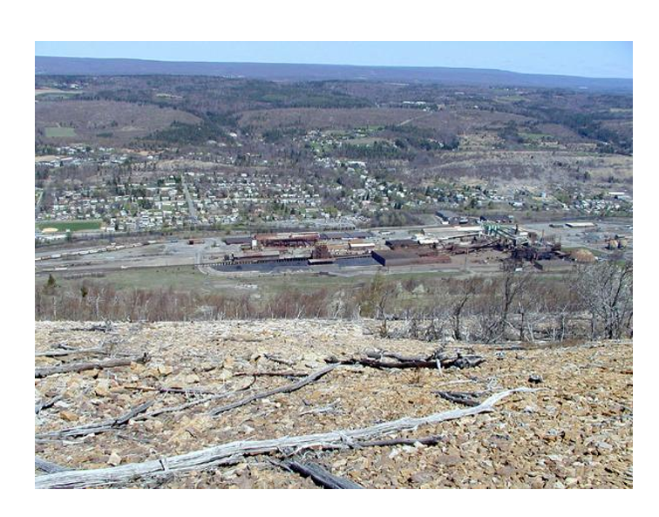
Success story:
Palmerton zine pile site

Slide 17
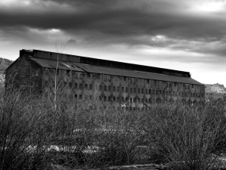
Source: Dennis Hendricks / Creative Commons

Slide 18
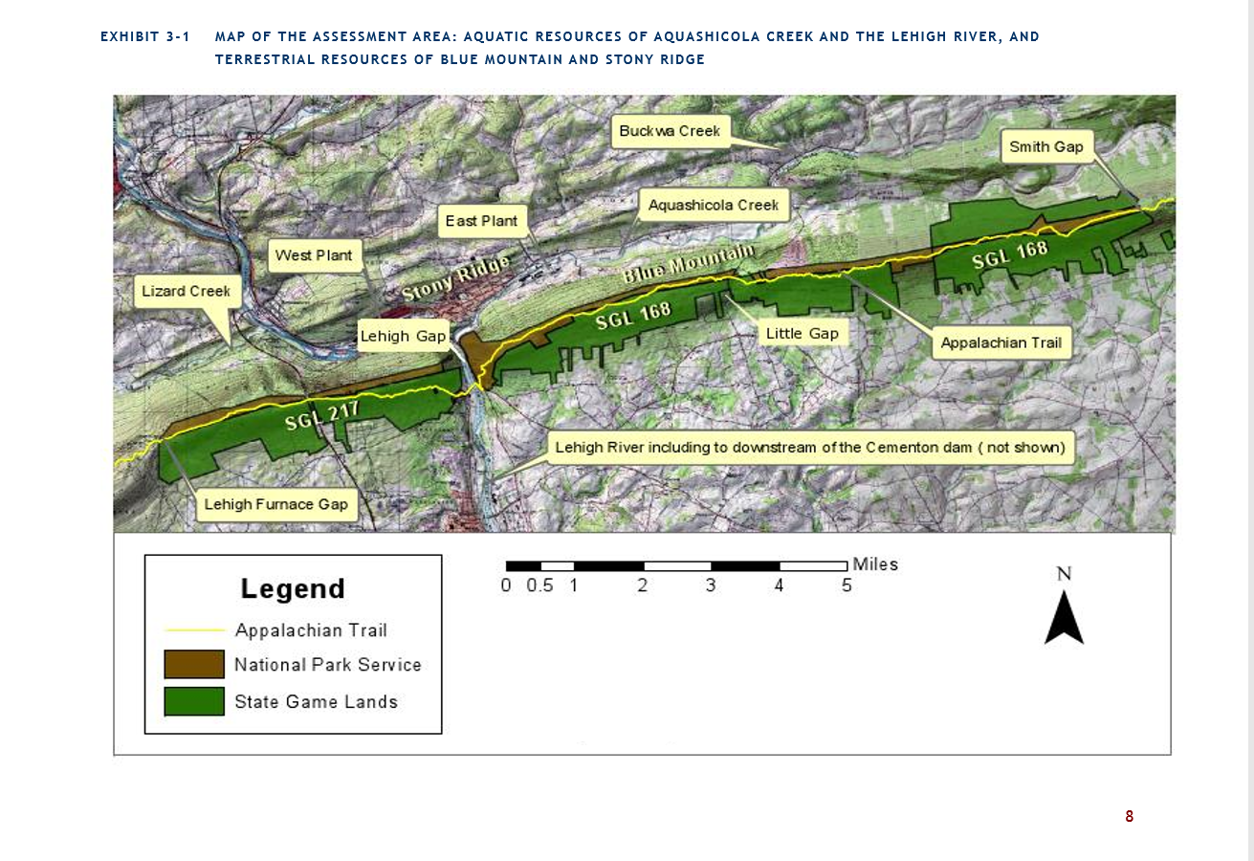
Source: Final Restoration Plan & Environmental Assessment, 2011

Slide 19
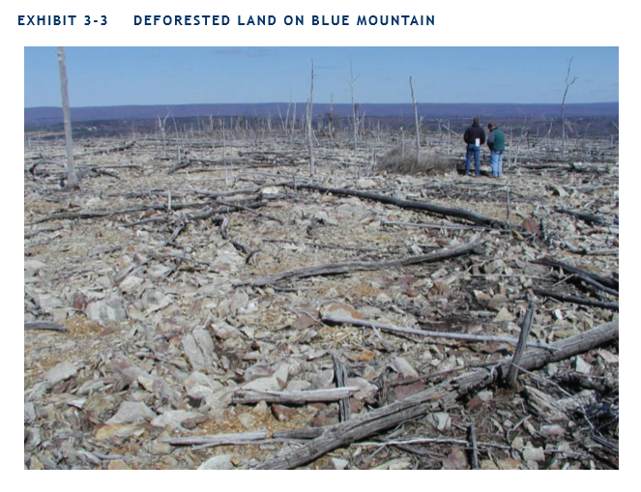
Source: Final Restoration Plan & Environmental Assessment, 2011

Slide 20
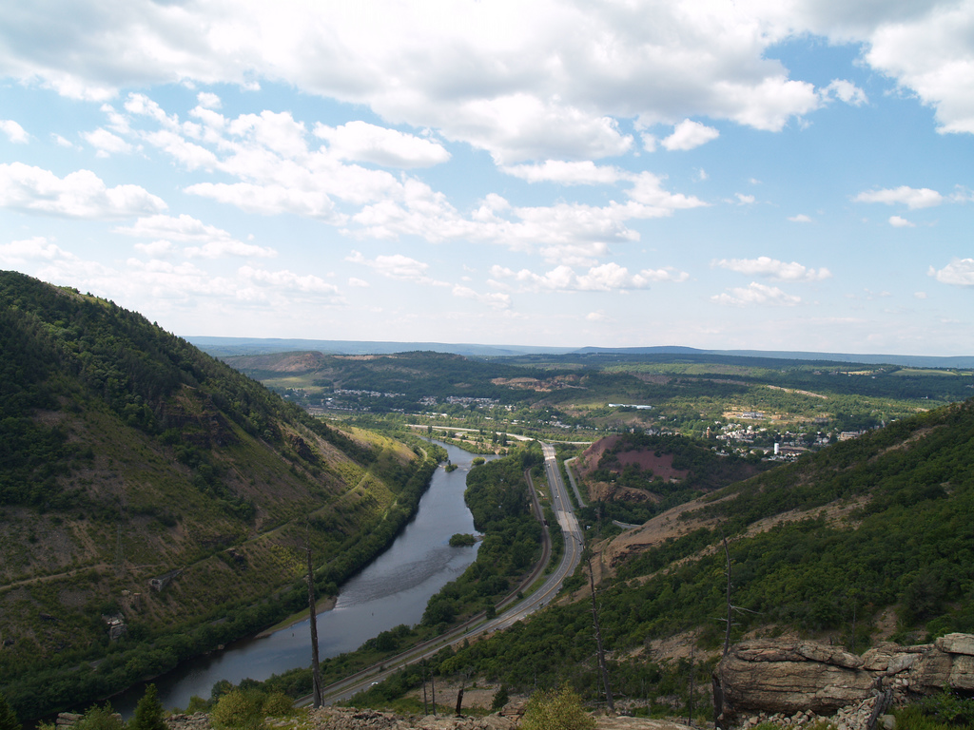

Slide 21
Useful information
Superfund (www.epa.gov/superfund)
NOAA’s Response and Restoration Blog (www.blog.restoration.noaa.gov)
Damn Interesting (www.damninteresting.com)
Green Criminology (www.greencriminology.org)

