Slide 1

Wellbeing and Performance
Julie Thomas

Slide 2
By the end of today’s session you will have:
A good understanding of how managers can support the wellbeing of their staff
A good awareness of how wellbeing affects performance
An enhanced appreciation of the importance of emotional intelligence skills in maintaining wellbeing

Slide 3
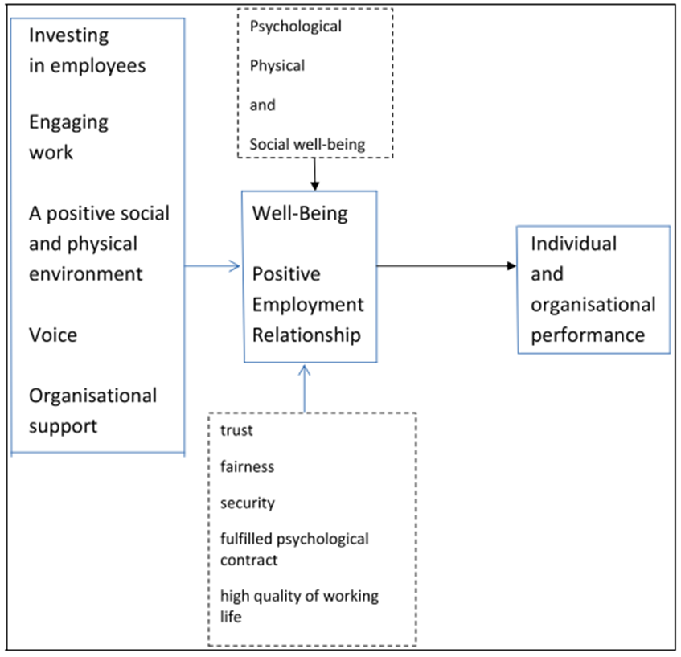
Reminder - HR Practices that Promote Wellbeing - Guest (2017)

Slide 4
6 Steps to help your team thrive in work (CIPD, 2020)
Get to know your team better
Lead by example to promote healthy working habits
Review workloads, duties and responsibilities
Reflect on your own management style
Discourage presenteeism in your team
Manage the mental health of your team while remote working

Slide 5
Four Core EI Skills (Bradberry, 2020)
Self-Awareness is your ability to accurately perceive your emotions and stay aware of them as they happen.
Self-Management is your ability to use awareness of your emotions to stay flexible and positively direct your behaviour.
Social Awareness is your ability to accurately pick up on emotions in other people and understand what is really going on.
Relationship Management is your ability to use awareness of your emotions and the others’ emotions to manage interactions successfully.

Slide 6
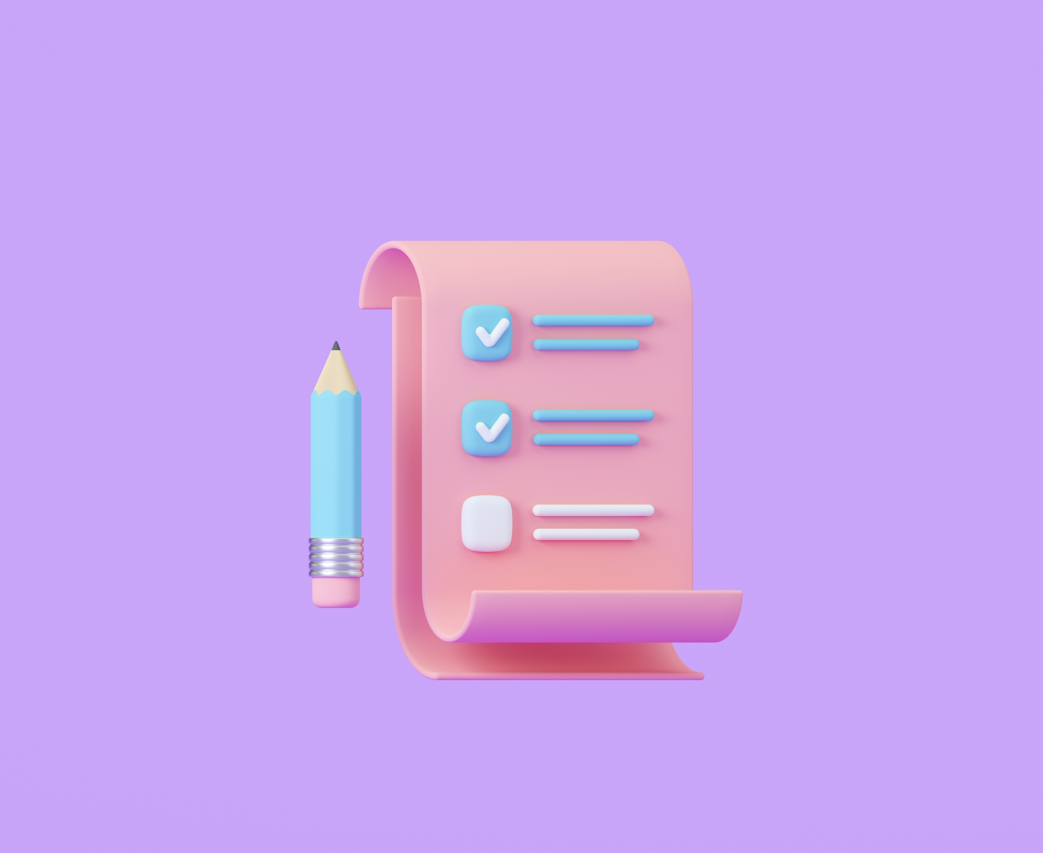
Activity
Read the CIPD Document.
Critically analyse the importance of having strong emotional intelligence skills to carry out each step successfully
Keep your notes to underpin points in your assignment

Slide 7
Role of Emotional Intelligence
Managers and employees need to be aware of their emotions and ability to regulate them.
They need to use this awareness to manage their relationships with other people.
Managers have the ability to influence employees’ wellbeing – they can use their EI skills to provide the right support for individuals. They can also adopt appropriate management styles.
Employees with good EI skills will be more resilient, suffer less stress and have an enhanced sense of wellbeing
Well employees are more likely to thrive and perform well.

Slide 8

Mental Health Awareness Week - 2026
Theme – Take Action
This Mental Health Awareness Week we’re asking people to join us in taking action to support good mental health. Even small actions can help us feel hopeful and less powerless. And while our individual actions matter, when we come together we are even more powerful.
Resources for Mental Health Awareness Week | Mental Health Foundation

Slide 9

Mental Health Awareness Week - 2026
This year the theme is ‘take action’.
How could your employer support this theme?
What wellbeing initiatives would you like to see introduced at your work?

Slide 10
Increasing Resilience
‘Bounce-backability’
Ability to recover quickly from set-backs, manage stress
Change the narrative – write about your experiences, think about the positives that have come out of it
Face our fears – expose yourself in small doses to experiences that you fear, e.g. public speaking
Practice self-compassion – recognise your feelings (be mindful); recognise that others sometimes feel that way; be kind to yourself (ask yourself, how would you treat a friend who was feeling this way?)
Meditation
Cultivate forgiveness – let go of grudges
(Newman, 2016)

Slide 11
Practical Tips for Daily Self-Regulation
The ability to self-regulate can be learned and improved. One tip to help you practice improving your self-regulation skills involves using the four-step Stop-Breathe-Reflect-Choose approach:
When you feel upsetting emotions, tell yourself to calm down and think more clearly.
Try to relax by taking deep slow breaths, counting to 10, or taking a walk.
Don't react until you feel like you have your emotions under control.
Think about responding instead of simply reacting (Catanaese, 2024).

Slide 12
Pausing before Reacting
A challenge to increase self-awareness and to practice self-regulation.
Over the next few weeks, whenever you encounter a situation which evokes strong feelings in yourself (anger, frustration, despair, for example), consciously pause before reacting (either verbally - saying something, or physically, e.g. waving hands etc).
Use a journal to record how you feel. Do you feel less stressed as a result? Were you glad you didn’t react? Did you react anyway and find this challenge difficult? Are you triggered by certain things?

Slide 13
Sources:
Self-regulation for adults: Strategies for getting a handle on emotions and behavior - Harvard Health

Slide 14
Assignment Guidance
See separate Powerpoint slides on Moodle.

Slide 15
Activity
Search the library catalogue for articles that link wellbeing and performance/productivity – what are their conclusions?
Search the internet for wellbeing initiatives and find good organisational examples, where the business benefits are discussed.
Report back your findings.

