Slide 1

Leadership
Motivation
Laura James

Slide 2

Leadership

Slide 3

What is the difference between a Manager and a Leader?
Notes:
Activity:
In groups, discuss what the difference is between a Manager and a Leader. Use your Flipchart paper to illustrate this. Be prepared to discuss your findings.

Slide 4
Difference between Leadership and Management
Management involves controlling a group in order to achieve a specified objective.
A Leader is responsible for controlling an organization, a group, or a set of entities to achieve an objective.
Is it possible to be both a manager and a leader at the same time?
YES!.....BUT….
Just because someone is a great Manager it doesn’t necessarily make them a great Leader and Visa Versa.
There are some key differences

Slide 5
Activity….
Can you sort the definitions?

Slide 6
achieve their goals by using coordinated activities and tactical processes
Their vision is bound to the implementation strategies, planning and organising tasks
They set out to achieve organisational goals by implementing processes
They are visionaries
They assist individuals in envisioning their function in a wider context and the possibility for future growth that their efforts may give.
They set pathways to excel the organisational growth
They break down long-time goals into tiny segments and organize available resources to reach the desired outcome.
They are more concerned with how to align and influence people
They ask what and why
focuses on the questions how and when
not required to assess and analyze failures
one might question and challenge the authority to reverse decisions that may not be in the better interests of the team
Notes:
Visionaries: LEADER
Pathways to excel org growth: LEAER
Implementing processes: MANAGER
Their vision is bound to the implementation strategies, planning and organising tasks: MANAGER
achieve their goals by using coordinated activities and tactical processes
achieve their goals by using coordinated activities and tactical processes: MANAGERS
They break down long-time goals into tiny segments and organize available resources to reach the desired outcome.: managers
are more concerned with how to align and influence people: LEADERS
assisting individuals in envisioning their function in a wider context and the possibility for future growth that their efforts may give.: leaders
asks what and why: LEADER
focuses on the questions how and when: MANAGER
one might question and challenge the authority to reverse decisions that may not be in the better interests of the team: LEADER
not required to assess and analyze failures: manager
]

Slide 7
It is a role that frequently refers to a specific job within an organization's structure
It emerges as a result of your actions
you act in a way that inspires others to do their best
is a job title that comes with a fixed set of responsibilities.
Notes:
is a role that frequently refers to a specific job within an organization's structure: manager
emerges as a result of your actions: leader
you act in a way that inspires others to do their best: leader
is a job title that comes with a fixed set of responsibilities: manager

Slide 8
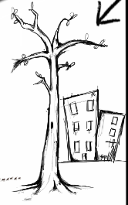


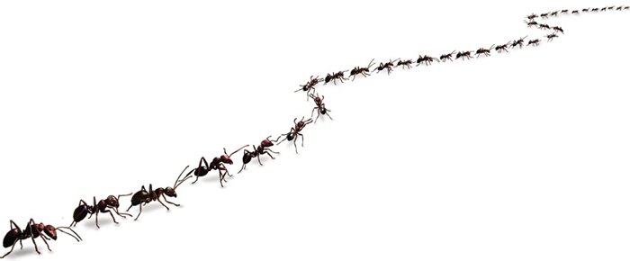
LESSONS FROM NATURE ?

Slide 9

Let’s consider the Ant.
Ants work together to overcome an obstacle
Qualities of the ant
Strong
Team working
Tenacious
Tireless
Organised
Uncompromising
Fierce
Structured
Hierarchical

Slide 10


Slide 11
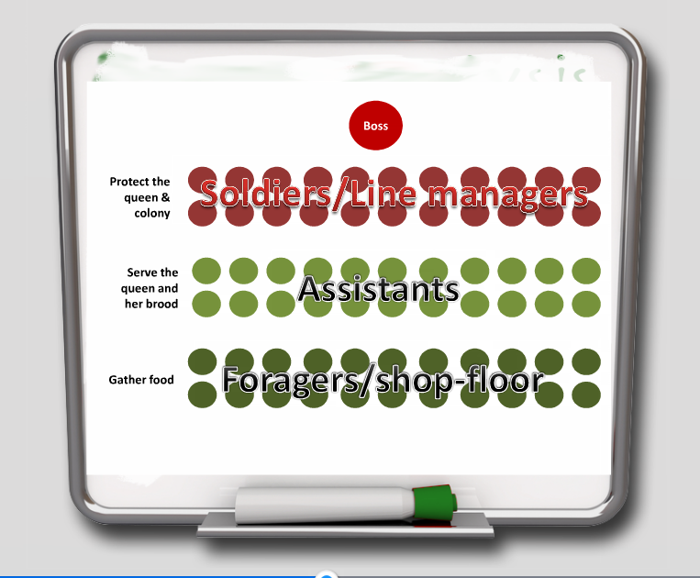

Slide 12
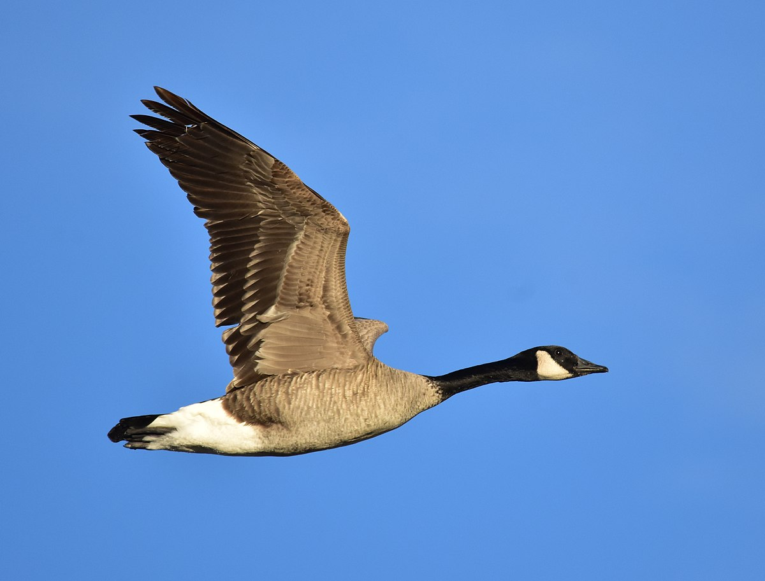
Now Ducks / Birds….
Qualities of Ducks
Team work
Supportive
Intelligent
Focused
Tireless
Trusting
Sharing
Compromising
Successful

Slide 13
Lessons from nature

Slide 14

LEADERSHIP STYLES –
TRANSACTIONAL + TRANSFORMATIONAL .
WHAT IS THE DIFFERENCE BETWEEN THESE TWO?

Slide 15
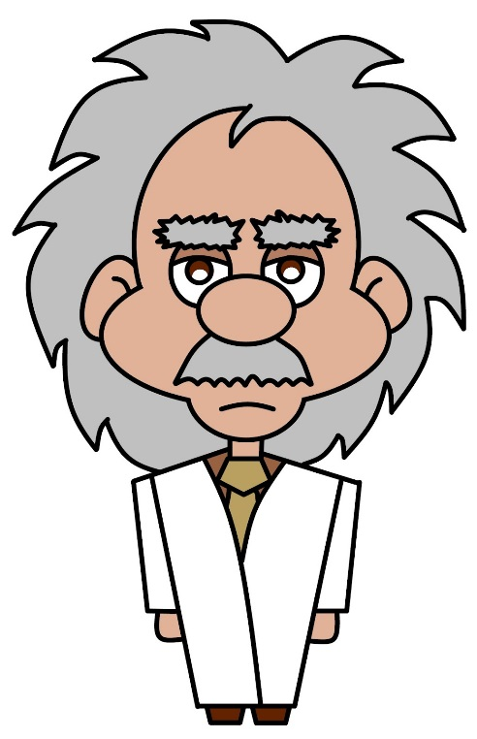
Transactional Leadership:
Isn’t about changing the future.
It’s about getting the job done.
Transactional Leaders exchange rewards and punishments according to the quantity/quality of the work produced.
NB: “If people are good only because they fear punishment,
and hope for reward then we are a sorry lot indeed.”
(Albert Einstein)

Slide 16
Transactional Leadership
Transactional leadership places Great importance on short term goals & the observance of standard operating procedures & rules

Slide 17
Transformational Leadership:
Transformational leadership is a leadership style in which leaders encourage, inspire and motivate employees to innovate and create change that will help grow and shape the future success of the company.

Slide 18
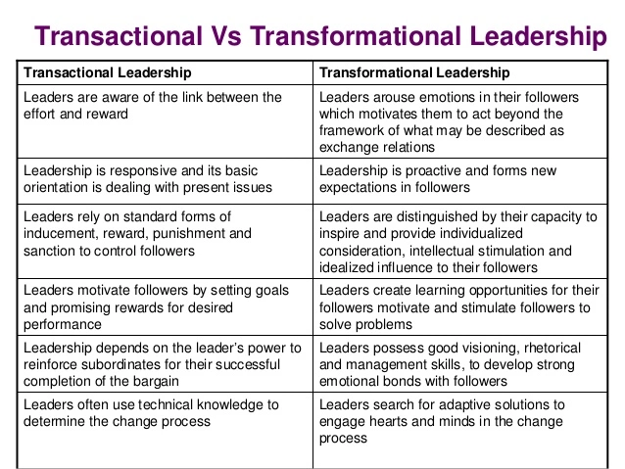
Transactional Vrs Transformational Leadership

Slide 19
Activity!
A volunteer is needed- you will be blindfolded!
You will be guided from one end of the classroom to the other by one of your fellow students using words like ‘right, left, forwards, backwards’ etc.
No taking your blindfold off or cheating!
Notes:
Communication, listening and trust

Slide 20
Components of an authentic Leader

Slide 21

Notes:
Poll Title: Do not modify the notes in this section to avoid tampering with the Poll Everywhere activity.
More info at polleverywhere.com/support
A leader should be...
https://www.polleverywhere.com/free_text_polls/KQrPxUkQYNkOeoTnBGFGo

Slide 22
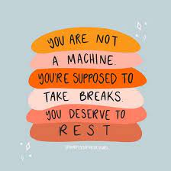
Take a break!

Slide 23
Motivation

Slide 24

What is motivation?
Some definitions:
“Degree to which an individual wants and chooses
to engage in certain specified behaviour”
        (Mitchell 1982:80, cited in Murton et al 2010:93)
“The willingness to apply one’s efforts towards the achievement of the organisation’s goals, while concurrently an individual need is satisfied”
(Taylor, 2010)

Slide 25
Q. What is performance?
A. Performance is essentially behaviour because when you perform, you are doing something i.e. you are behaving.
Q: All things being equal, why do some people
perform or behave better than others?
A: Because their motivational levels are different

Slide 26

What motivates you?

Slide 27
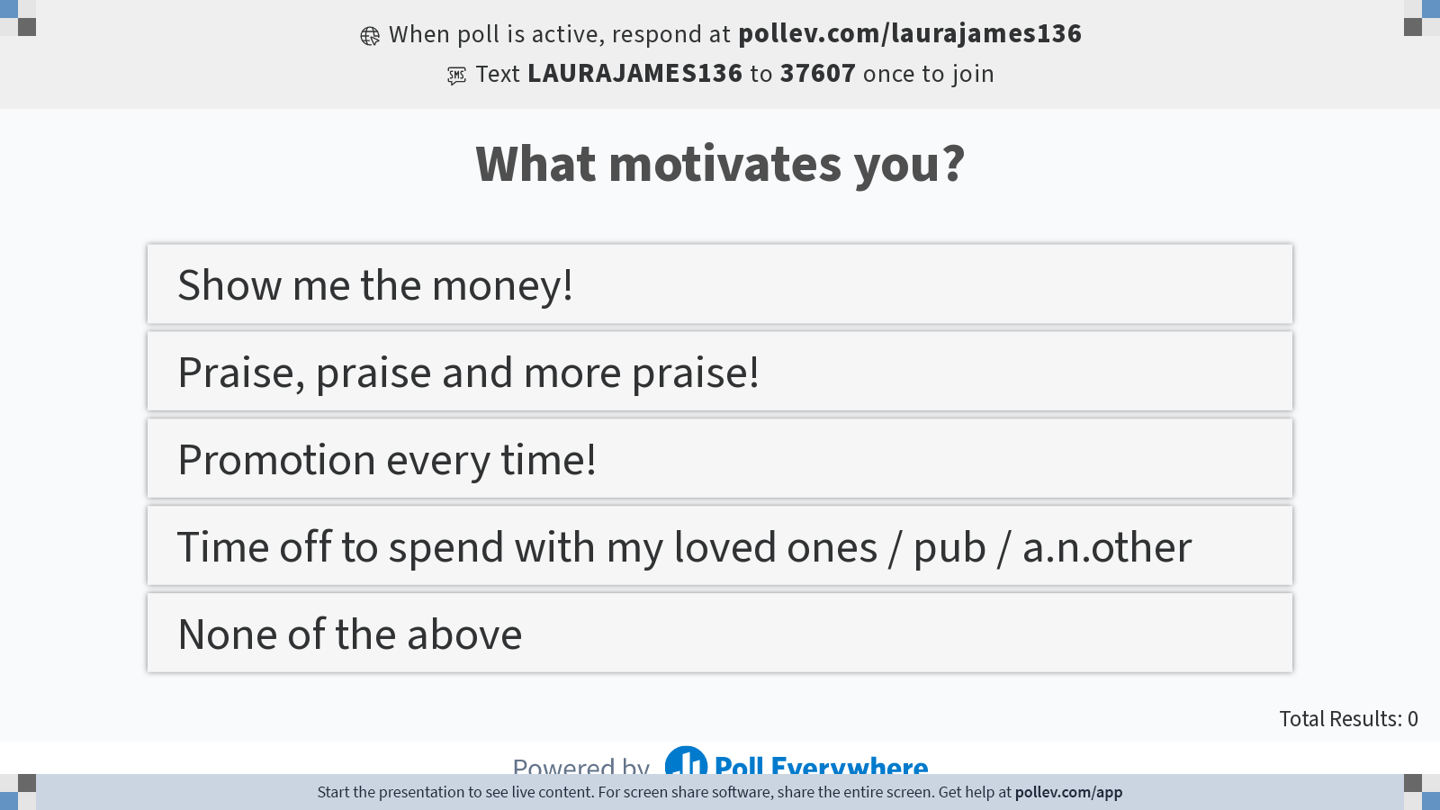
Notes:
Poll Title: Do not modify the notes in this section to avoid tampering with the Poll Everywhere activity.
More info at polleverywhere.com/support
What motivates you?
https://www.polleverywhere.com/multiple_choice_polls/1vthJURKPjVf7qB7oKLyD?display_state=instructions&activity_state=opened&state=opened&flow=Engagement&onscreen=persist

Slide 28
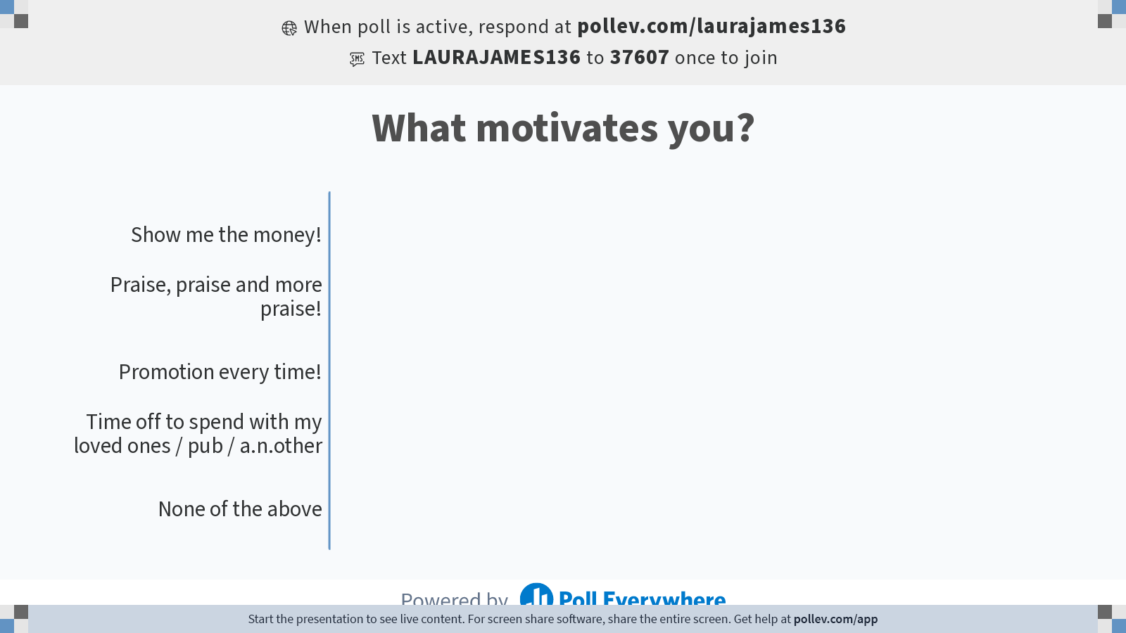
Notes:
Poll Title: Do not modify the notes in this section to avoid tampering with the Poll Everywhere activity.
More info at polleverywhere.com/support
What motivates you?
https://www.polleverywhere.com/multiple_choice_polls/1vthJURKPjVf7qB7oKLyD?display_state=chart&activity_state=opened&state=opened&flow=Engagement&onscreen=persist

Slide 29
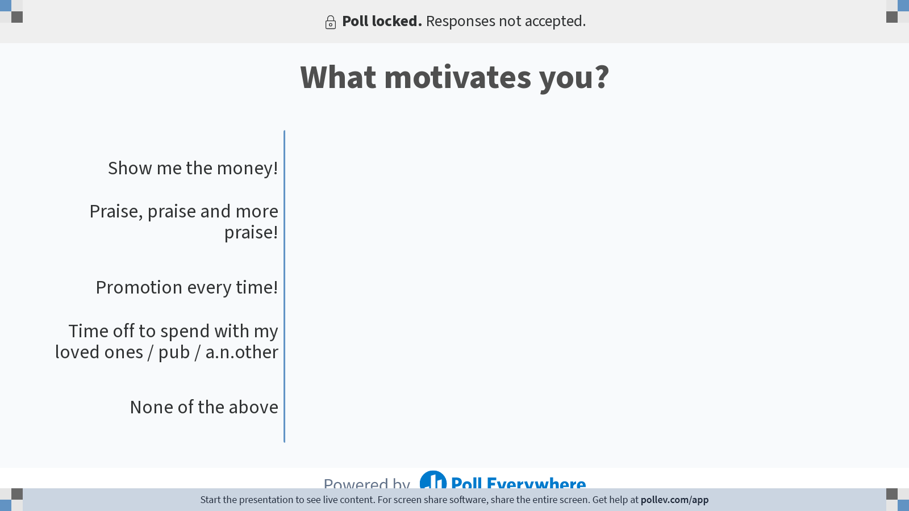
Notes:
Poll Title: Do not modify the notes in this section to avoid tampering with the Poll Everywhere activity.
More info at polleverywhere.com/support
What motivates you?
https://www.polleverywhere.com/multiple_choice_polls/1vthJURKPjVf7qB7oKLyD?display_state=chart&activity_state=closed&state=closed&flow=Engagement&onscreen=persist

Slide 30
What motivates people to work?
Does your list include any of the following:
Financial rewards e.g. wages/salary, bonuses
Good working conditions e.g. flexitime, holiday entitlement, training & development opportunities, sickness & maternity leave/pay above statutory minimum
Additional benefits e.g. company pension, car, private health care, subsidised child care & canteen, gym membership etc
Interesting & varied work, contributing to organisational, community & societal wellbeing
Appreciative & open environment, opinions & efforts valued, team ethos & spirit, sense of belonging i.e. psychological rewards
Notes:
Wordwall activity

Slide 31

Early Ideas on Work Motivation
F.W.Taylor (1900)Scientific management – ‘economic man’
Employees motivated primarily by money
Important to ensure jobs enabled maximisation of earnings
Jobs had to be examined scientifically to establish the ‘best’ method and ‘best’ workers
Payment by results
Notes:
Is this type of thinking still relevant in todays organisations?
McDonalds, Amazon?

Slide 32

Early Ideas on Work Motivation
‘social man’ (1920’s)The Hawthorne Experiments
Workers studied over a period of time
Changes were made to rest breaks, start & finish times, refreshments, payment schemes, lighting
Production increased by 30%
Rewards should be seen in a broader context
Notes:
Productivity increased whether the lights were on or off. Why??

Slide 33
Key Motivation Theories
Maslow’s Hierarchy of Needs
Self
actualisation
Need to fulfil ones potential
Need to feel valued by self and others
esteem
Need for attachment to person/group
social
(belongingness)
Need for security, physical & psychological
safety
Need for warmth, food, drink, sex etc
physiological
Notes:
Once lower level of needs is satisfied, no longer acts as a motivator
Individuals transcend upwards towards fulfilment of higher level
Each level is distinct
Individuals may operate at more than one level

Slide 34
Vroom’s Expectancy Theory
Management must demonstrate to employees that effort will be rewarded
People prefer certain outcomes from their behaviour than others.
Onus on management to establish schemes to reward the behaviour it wants
Click here to view a YouTube video about Expectancy Theory
Notes:
Motivation =

Slide 35
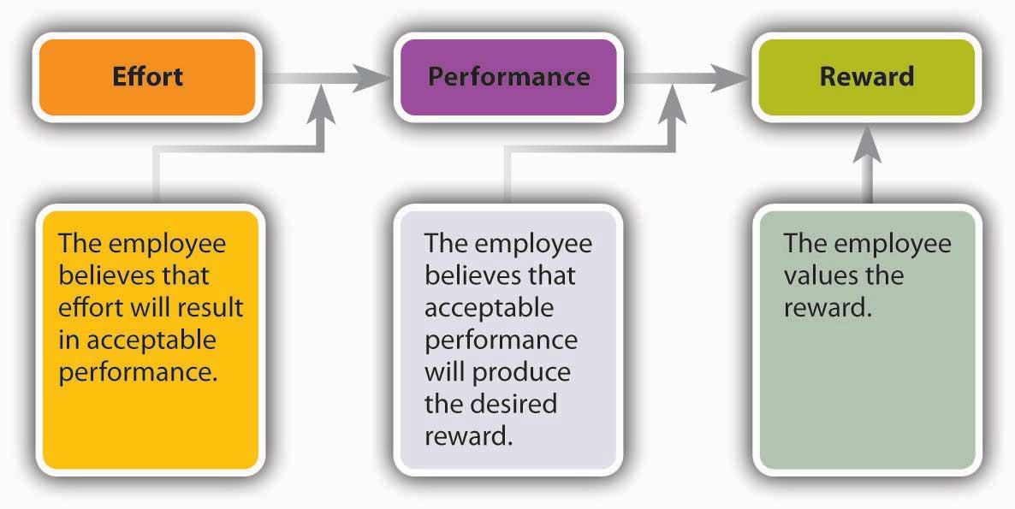
Vroom’s expectancy theory

Slide 36
Equity Theory (Adams,1963)
Based on our perception of fairness
Inequity when get more or less reward than perceived as deserved
Perceived imbalance between reward and contribution is not easily tolerated
Click here to view a YouTube video about Equity Theory

Slide 37
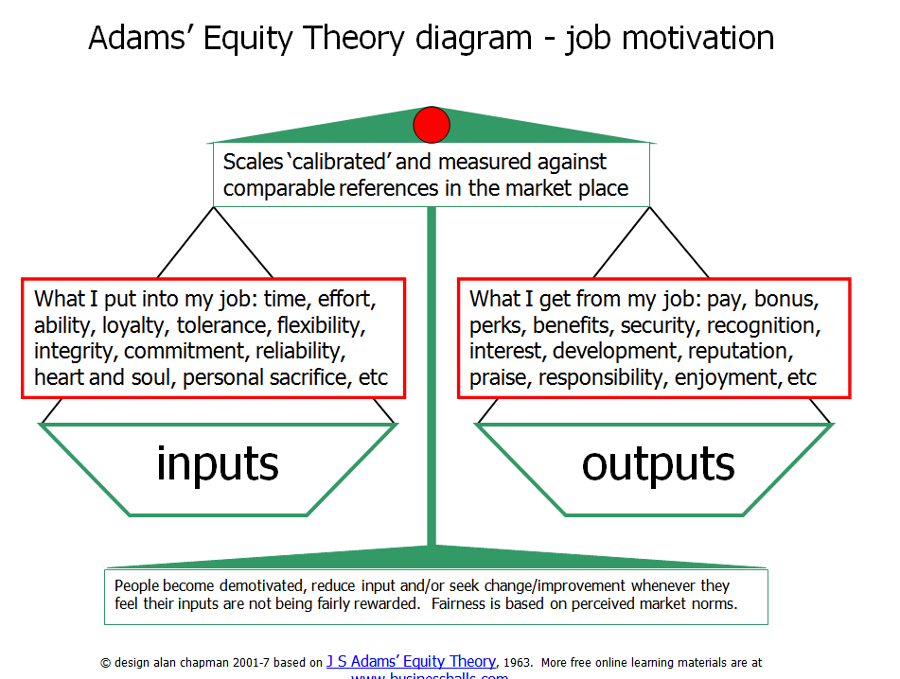

Slide 38
Q. Why is it important to understand what motivates
individuals?
A. Because it aids organisational decision making & encourages the development & use of strategies which will successfully develop high performing individuals
Q. What can organisations do to positively influence motivation?
A. Motivation may be positively influenced via:
Training & development
Safe working environment
Tools for the job
Positive employee relations
Reward – financial & non-financial
Adopting appropriate leadership style/s

Slide 39
The ideal situation
“To get the best from their employees organisations need to create conditions where staff actively want to get in early and stay late because they enjoy what they do and associate the company’s success with their own, just getting paid for attending work is not going to do this. What is required is an employee relationship where the employee regards themselves a stakeholder in the long tem success of the company”
(Murton et al, 2010: p93)

