Slide 1
Substance misuse
Sophie Price
2213749

Slide 2
Ai
I confirm that I have not used any AI tools in the research and creation of this assignment. I confirm that I have not presented any AI generated materials as my own work. I confirm I have copies of my drafts, notes, and other resources I used, which I may be asked to provide in evidence

Slide 3
I have chosen to talk about substance use and how this has an impact of the aces of a young person
And how it works the other way around the aces they have experience eg homelessness, neglect and that’s why they are using substances as a way of coping

Slide 4
This is a safe space for everyone
Confidentiality
NHS Helpline- 0300 123 6600
FRANK- 0300 123 6600
Samaritans- 116 123
Mind- 0300 123 3393

Slide 5
Aces- defining key terms
Adverse Childhood Experiences (ACEs) are “highly stressful, and potentially traumatic, events or situations that occur during childhood and/or adolescence. They can be a single event, or prolonged threats to, and breaches of, the young person’s safety, security, trust or bodily integrity.” (Young Minds, 2018).
Adolescence is ‘the period following the onset of puberty during which a young person develops from a child into an adult.’ (Oxford dictionary, 2025)

Slide 6
Contemporary issues that young people face
Lack of boundaries
parents using substances
Accessibility of substances
Mental health
Social media
Peer pressure
Addiction
Lack of education/ prevention programs
Exploitation/ vulnerability
Notes:
This could be during adolescence

Slide 7
Policies
Policies that I have identified
Having prevention and educative programmes, this could be having a school based youth worker, youth clubs, referrals, 1-1s
giving young people harm reduction advice
Training- naloxone
Parental/ family support- this could be social worker, therapy services, CAMHS, FIT worker
National occupational standards
5 ways of wellbeing
Child exploitation plan
Child protection plan
Multi agency working
UNCRC
Notes:
In my work practice
Nos is describes the knowledge, skills and understanding an individual
5 ways of well being- making sure the young people are taking care of their well being
UNCRC- United Nations Convention on the rights of the child making sure the voice of the child is heard and us as youth workers are advocating for the young person

Slide 8
Adolescence development
During this time of adolescence the young people are experimenting with substances, According to Better health channel, no date. ‘The teenage years can be a time of experimentation for young people– and taking substances can be part of adolescent risk-taking behaviour. this is normally the crucial part of their life where they are going through pubity, moving from autonomy to maturity, and they are transitioning from adulthood to childhood.’
According to Barnardo’s , 2025 ‘effects to their physical and mental well-being (including losing some/all control of their body) anti-social behaviour. effects to their school attendance and grades (i.e poor attendance and low grades) being exposed to criminal activity, which can lead to child criminal exploitation.’ This is the most crucial time of a young persons life
Notes:
Discuss my role

Slide 9
Through these years of their life a young person could also be faced with
Homelessness
Poverty
Bullying
Friendships
Living
Areas- crime

Slide 10
Theories
Specifically with substance use:
The young person could appear angry all the time (school exclusion) looking more into this this could be learnt behaviours. ‘According to Maslow, not having emotional needs met can be at the core of conditions such as addiction’ (through the glass recovery, 2025)
Pembrokeshire county council have an activities officer they can do activities and identify risk taking behaviour this could be by rock climbing.
This time in a young persons life is main time for young people to ‘as the team develops maturity and ability, relationships establish, and leadership style changes to more collaborative or shared leadership.’ (West Chester university, 2024)
Finding identity- Erickson describes identity as ‘Identity involves the experiences, relationships, beliefs, values, and memories that make up a person's subjective sense of self’ (verywell mind, 2023)

Slide 11
Categories
3 types of aces
- Abuse
- Neglect
- Household dysfunction
Notes:
In these fits more catergories
Abuse- Physical, Emotional or psychological, and sexual
Neglect- physical and emotional
Household dysfunctional- Substnace use, mental illness, domestic violence, parental separation or divorce and incarceration
10 adversities

Slide 12

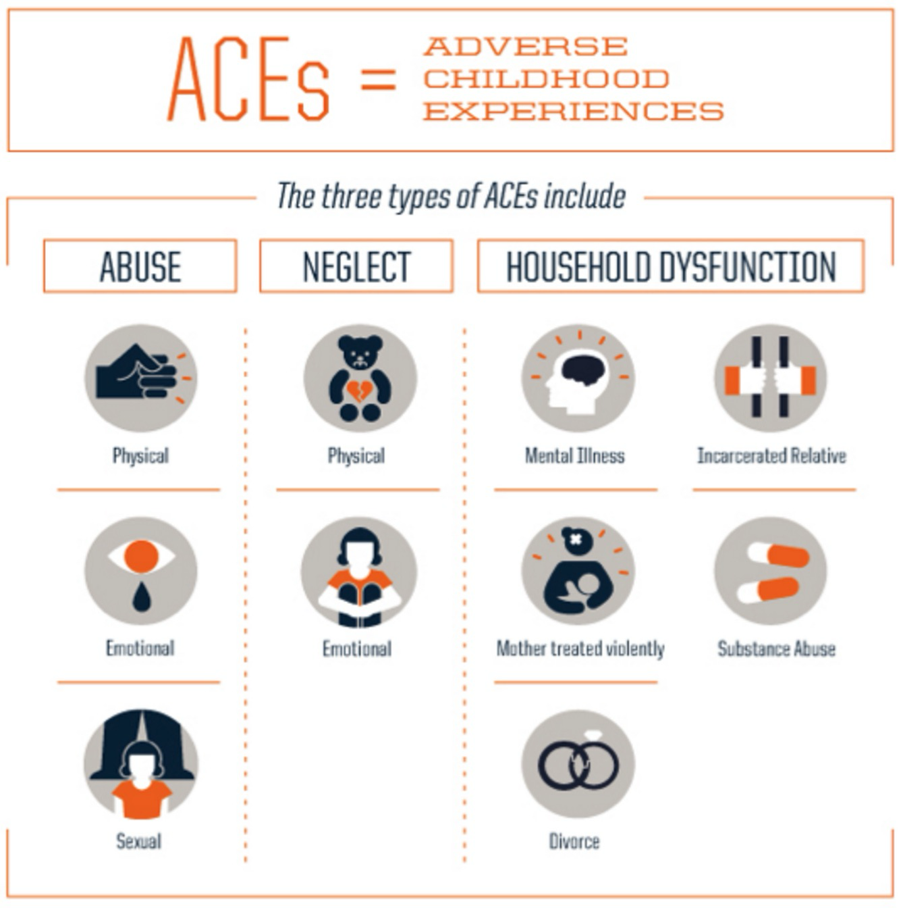
Here is a list of all the the three types of aces include.
(Advokids, no date)

Slide 13
Video
https://youtu.be/0tyZnASq8aQ?si=xNBNqyGSGyBtUHew
(Royal Society for public health, 2019)
Notes:
(

Slide 14
In that video you can see that the boy identifies he has aces but and identifies he could turn to alcohol. Dad is also alcohol dependant, this could be generational ace. These years of this boys life is crucial and it is crucial that he gets help and support
What aces could we identify in that video?
Notes:
Abuse
Physical- all the drinking and fighting I am scared
Emotional abuse boy sitting in his room crying
Neglect physical- no money for food
Emotional neglect- no money for toys
Substance use
Mental illness- mum takes tablets

Slide 15
Overall we have specifically looked at substance use and critically explored the adolescence and the Aces the young people could have or develop. We have also looked at current interventions.

Slide 16
Any questions?

Slide 17
Advokids. (no date). the types of aces. [Online]. advokids. Last Updated: no date. Available at: https://advokids.org/adverse-childhood-experience-study-aces/three-types-of-aces-include/ [Accessed 13 January 2025].
Barnardo’s. (2025). Alcohol and other drug misuse. [Online]. Barnardo’s. Last Updated: 2025. Available at: https://www.barnardos.org.uk/get-support/support-for-parents-and-carers/child-abuse-and-harm/alcohol [Accessed 7 January 2025].
better health channel. (no date). Drugs, teenagers and parenting. [Online]. better health channel. Last Updated: no date. Available at: https://www.betterhealth.vic.gov.au/health/healthyliving/drugs-teenagers-parenting [Accessed 7 January 2025].
2025

Slide 18
Kendra Cherry. (2023). Identity vs. Role Confusion in Psychosocial Development. [Online]. Verywell minsd. Last Updated: 4 December 2023. Available at: https://www.verywellmind.com/identity-versus-confusion-2795735#:~:text=Erikson%20defines%20identity% [Accessed 13 January 2025].
Oxford dictionary. (2025). adolescence meaning. [Online]. Oxford dictionary. Last Updated: 2025. Available at: https://languages.oup.com/google-dictionary-en/ [Accessed 7 January 2025].
Royal Society for public health. (2019). Adverse childhood experiences. [Online]. YouTube. Last Updated: 2019. Available at: https://www.youtube.com/watch?v=0tyZnASq8aQ [Accessed 13 January 2025].
Through the glass recovery. (2025). when your emotional needs are not met. [Online]. through the glass recovery. Last Updated: 2025. Available at: https://throughtheglassrecovery.com/emotional-needs-not-met/#:~:text=According%20to%20Maslow%2C%20no [Accessed 13 January 2025].
West Chester university. (2024). TUCKMAN'S STAGES OF GROUP DEVELOPMENT. [Online]. West chester university. Last Updated: 4 December 2024. Available at: https://www.wcupa.edu/coral/tuckmanStagesGroupDelvelopment.aspx#:~:text=These%20stages%20are%20commo [Accessed 13 January 2025].
Young minds. (2018). What is adversity?. [Online]. young minds. Last Updated: 2018. Available at: https://www.youngminds.org.uk/professional/resources/understanding-trauma-and-adversity/#:~:text=Adv [Accessed 7 January 2025].

