Slide 1
Smart Buildings

Slide 2
What is a smart building?
A new build or retrofitted building, that uses technology to collect data, analyze it, and control operations to optimize building performance.

Slide 3

How does a smart building work?
Smart buildings are designed to monitor, control, and optimise various aspects operations, often leveraging the Internet of Things (IoT) and artificial intelligence (AI). Key features of smart buildings include:
Energy efficiency
Automated systems
Data analytics
Connectivity and interoperability
Occupant comfort and experience
Safety and security
Maintenance optimization
Sustainability

Slide 4
Internet of Things (IoT)
The Internet of Things (IoT) refers to a network of physical devices, vehicles, appliances, and other physical objects that are embedded with sensors, software, and network connectivity, allowing them to collect and share data.
IoT devices—also known as “smart objects”—can range from simple “smart home” devices like smart thermostats, to wearables like smartwatches and RFID-enabled clothing, to complex industrial machinery and transportation systems. Technologists are even envisioning entire “smart cities” predicated on IoT technologies.
IoT enables these smart devices to communicate with each other and with other internet-enabled devices. Like smartphones and gateways, creating a vast network of interconnected devices that can exchange data and perform various tasks autonomously
IBM (2023)

Slide 5
Energy efficiency
It’s possible to minimise energy consumption through strategies such as reducing or diverting resources to where they are required…
Efficient HVAC systems, optimised lighting, and intelligent power management. It uses sensors and data analysis to adjust energy usage based on occupancy and external factors.
This could be done manually, using specialist software or by AI software.

Slide 6
Automated systems
By integrating various systems, such as heating, ventilation (mechanical and natural), air conditioning, lighting, security, and access control, into a centralised automation platform. This allows seamless and coordinated control of systems to optimise performance and reduce waste.

Slide 7
Data analytics
By collecting data from sensors, meters, and other devices. Data can be analysed to gain insights into building performance, occupant behavior, and potential areas for improvement for better decision-making.

Slide 8
Connectivity and interoperability
Interconnected IoT devices and sensors that enable seamless communication and data exchange among building systems and subsystems. This ensures that information flows efficiently to improve overall building operations.

Slide 9
Occupant comfort and experience
Aims to enhance occupant comfort and productivity. Systems can adapt to individual preferences, providing personalised lighting, temperature, and other settings for a more pleasant living or working environment.
Quite simply, improved building performance also improves comfort factors.

Slide 10
Safety and security
Advanced security measures, such as biometric access control, surveillance systems, and fire detection systems. AI-based algorithms can detect anomalies and potential threats, improving overall safety.

Slide 11
Maintenance optimisation
Predictive maintenance is a key feature of smart buildings. By monitoring equipment health and performance in real time, potential issues can be detected early, reducing downtime and repair costs.

Slide 12
Sustainability
Promoting eco-friendly practices by reducing energy consumption, optimising resource usage, and integrating renewable energy, reducing a building's carbon footprint and overall environmental impact.

Slide 13

Potential Risks?
According to IBM researchers, building automation systems are often poorly protected and connected to the Internet, making them vulnerable to cyber attacks.
Their survey found that 84% of facility managers reported their building automation systems are connected to the Internet, while only 29% had taken action to improve cybersecurity
https://securityledger.com/2016/02/ibm-research-calls-out-smart-building-risks/
https://www.marsh.com/en-gb/services/risk-consulting/insights/smart-intelligent-buildings-cyber-security-considerations.html

Slide 14
Examples:
1. THE EDGE
2. GLUMAC: SHANGHAI HQ
3. 800 FULTON MARKET
4. THE EMPIRE STATE BUILDING
5. BURJ KHALIFA, DUBAI

Slide 15
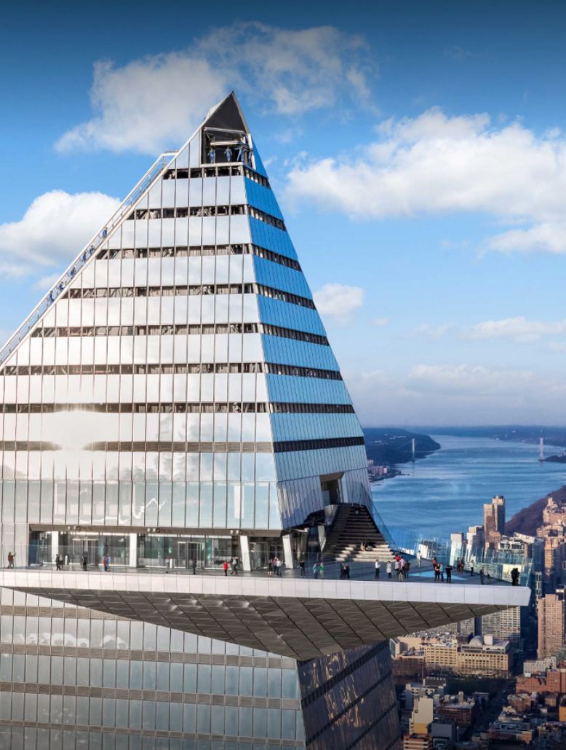
1. The Edge
Location: Amsterdam, Netherlands
Type: Office
Size: 15 stories / 40,000 sq. meters
Architect: London-based PLP Architects
Completion Date: 2014

Slide 16
1. The Edge
Including more than 28,000 Iot sensors and a plethora of other smart features, has an ” exceptional ” BREEAM score, making it one of the greenest buildings in the world.
Mapiq, a smartphone software that can do anything from point you in the direction of open parking, change the thermostat, arrange your workout schedule, or book a workspace. Nobody at the Edge has a dedicated desk. Employees wander about the facility and reserve various workstations that are tailored to their schedules and comfort preferences via the app. The Edge can accommodate 2,850 employees across 1,080 desks using this method.
https://www.bloomberg.com/features/2015-the-edge-the-worlds-greenest-building/

Slide 17
1. The Edge
From smart panels and data dashboards to security robots and automated coffee makers, but one of the most noteworthy for our purposes is its expert use of BIM to visualize energy efficiency and monitor maintenance issues, a prime example of how BIM can be used to make buildings more sustainable.
The Edge is a “net-zero” building, which means that 100% of its energy comes from renewable resources. Its 4,200 square meters of solar panels, the majority of which are situated on the rooftops of nearby structures, provide all the building’s energy. 500 bicycles can be parked in the basement, which also contains a bank of electric car charging outlets.
Ironically, The Edge’s smart use of low-tech, passive design characteristics is what contributes most to its sustainability profile. The construction’s southern facade’s load-bearing concrete walls particularly serve as a thermal mass, absorbing and dispersing heat from the sun. The remaining heating requirements of the building are met by a geothermal heat pump system

Slide 18
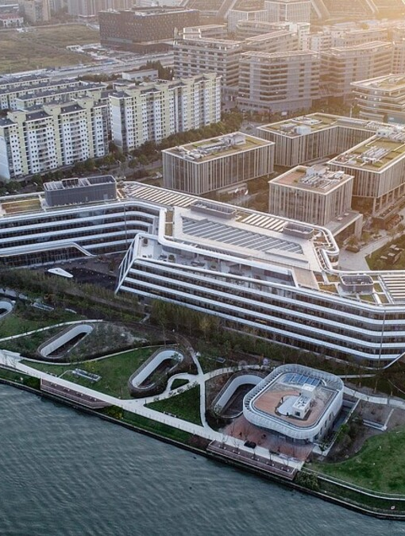
2. GLUMAC: SHANGHAI HQ
Location: Shanghai, China
Type: Office
Size: 6,450 sq. ft.
Architect: Collaboration between Glumac, sustainability consultants Terrapin Bright Green, San-Francisco based architecture firm Gensler, Japanese construction company Shimizu, and Shanghai-based green materials consultant GIGA
Completion Date: 2014

Slide 19
2. GLUMAC: SHANGHAI HQ
Since air pollution has long been a significant problem in China’s main cities, engineering company Glumac gave interior air quality first priority when remodeling its Shanghai office space, which is located on the third story of the 100-year-old Rockefeller Mansion
https://glumac.com/new-steps-for-sustainability-glumac-brings-the-living-building-challenge-to-asia/

Slide 20
1. The Edge
Low-flow fixtures have reduced water use by 63%, while water and recycling systems have produced almost three times as much as the residents need. All energy is generated by solar, and a large portion of the structure is designed with biophilic concepts, which increase a building’s livability and health by allowing residents more opportunities to interact with nature. The living green wall in the area, has plants that filter the air.
The building’s air-purification system, a mobile app called RESET, which also provides details about the office’s plant life’s capacity to filter the air, allows building occupants to receive real-time information regarding indoor air quality.

Slide 21
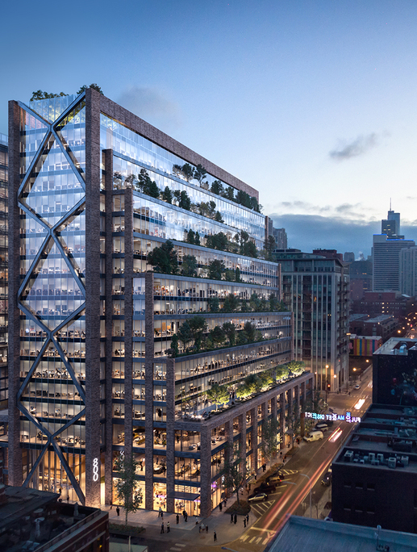
3. 800 FULTON MARKET
Location: Chicago, Illinois
Type: Mixed Use
Size: 19 stories / 90,000 sq. ft.
Architect: Skidmore, Owings & Merrill
Completion Date: 2021

Slide 22
3. 800 FULTON MARKET
More than 8,000 IoT sensors for recording occupancy data and a cloud-based management platform that connects 12 distinct building systems are just some of the smart features the building has to offer. Smart disinfection control system and smart wellness monitoring.
https://800fultonmarket.com/smart-building

Slide 23

4. THE EMPIRE STATE BUILDING
Location: New York City, New York
Type: Office
Size: 102 stories / 2.7 million sq. ft.
Architect: Shreve, Lamb & Harmon
Completion Date: 1931

Slide 24
4. THE EMPIRE STATE BUILDING
A the $38 million effort to lessen the Empire State Building’s carbon footprint was launched in 2006 and has been successful in reducing the structure’s energy usage by as much as 50%. According to the group that owns the building, carbon neutrality will be attained by 2030.
https://time.com/6026610/empire-state-building-green-retrofit/

Slide 25
The Empire State Building’s energy efficiency has increased from one of the lowest in New York City to one of the highest. Triple-paned windows, improved insulation, regenerative lift braking, and a significant chiller plant upgrade that included the installation of CO2 trackers and a sophisticated temperature control system.
The structure also makes use of an AI platform, which is said to have reduced carbon emissions by 300 metric tons and water use by 7.5 million gallons.

Slide 26
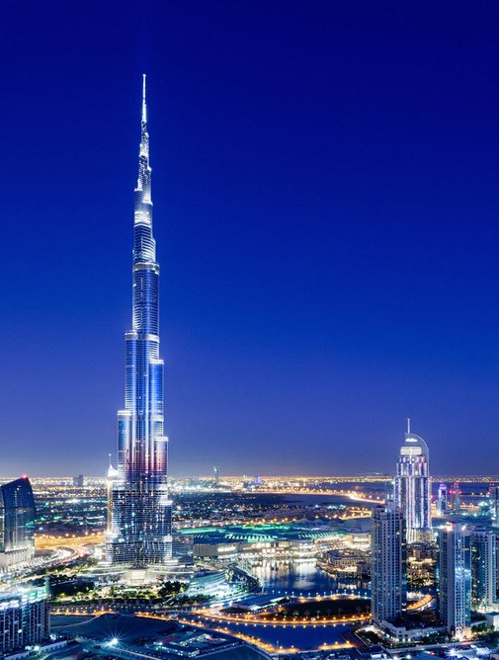
5. BURJ KHALIFA, DUBAI
Location: Burj Khalifa Park by Emaar
Type: skyscraper
Size: 309,473 m2 (3,331,100 sq. ft.)
Architect: Adrian Smith, George J. Efstathiou, Marshall Strabala
Completion Date: January 4, 2010

Slide 27
5. BURJ KHALIFA, DUBAI
The tallest building in the world has a number of smart building technologies that enhance the residents’ access to better air quality, lighting, and temperature control. The IoT platform from Honeywell receives real-time data from the intelligent building automation system and employs algorithms to spot anomalies and maintenance problems. This information can be used by facility managers to increase asset reliability and building maintenance.
https://www.thefirstgroup.com/en/news/burj-khalifa-named-the-uae-s-smartest-building/

Slide 28
References
IBM (2023) - What is the Internet of Things (IoT)? IBM Available at:
https://www.ibm.com/think/topics/internet-of-things

