Slide 1
Module: Community Care and Management of Longer-term Conditions
Module code: LCHS7003
Student Name: Shivangi Tank
Student ID:2530748
BLOOD CANCER

Slide 2
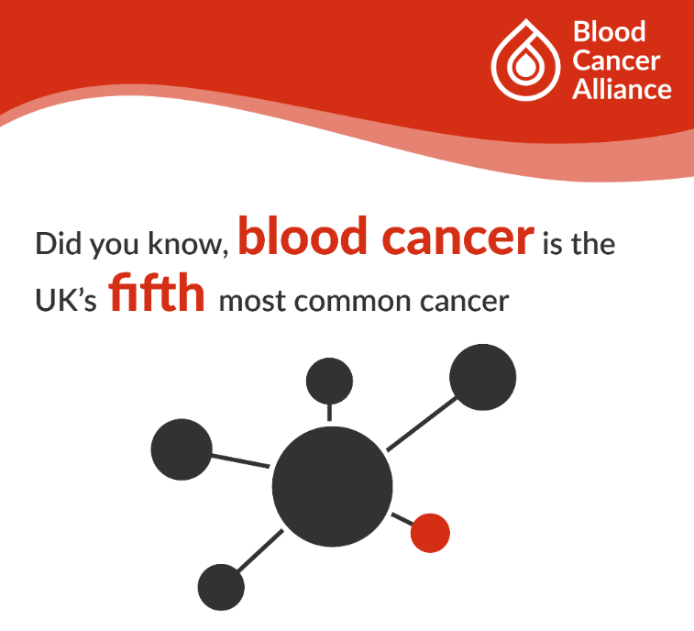
Introduction
The presentation will focus on Blood Cancer the 5th most common cancer in the UK (Blood Cancer Alliance, 2024).
15,000 people in the UK die of blood cancer every year, with 40,000 people being diagnosed with it every year (Blood Cancer UK, 2026).
GPs, community nurses, haematology nurses, hospital-based haematology specialists, pharmacists, and social care professionals who provide person-centred care for cancer will be benefitted through this presentation.
In the presentation diagnosis, assessment, treatment, prevention, and also recommendations for personalised long-term management will be discussed.
(Blood Cancer Alliance, 2024)

Slide 3
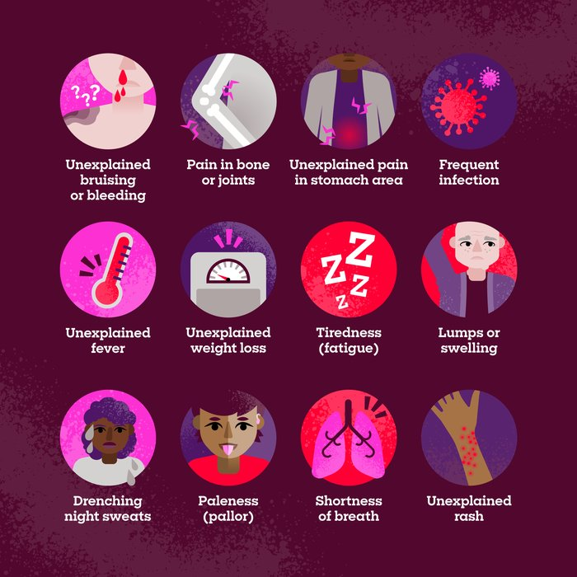
What is Blood Cancer?
Blood cancer affects blood cells, bone marrow or the lymphatic system.
The main symptoms are: 1) fatigue, 2) bruising/bleeding, 3) infections, 4) swollen lymph nodes, 5) weight loss, 6) night sweats, and 7) unexplained pain in stomach area and many more (Blood Cancer UK, 2025).
Types of blood cancer are leukaemia, lymphoma, myeloma, MDS and MPNs Chronic Obstructive (Blood Cancer UK, 2026).
Some types of blood cancer can be cured or controlled for long-term.
(Blood Cancer UK, 2025)

Slide 4
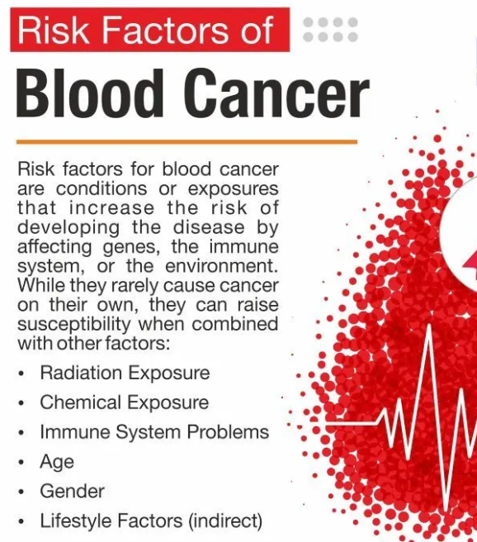
Aetiology and risk factors
The main cause of the disease may vary and often remain unclear.
Risk factors related to blood cancer include age, genetics, gender, chemical exposure, immune problems, lifestyle, and exposure to radiation (PACE Hospitals, 2026).
Additionally, other contributors of blood cancer are smoking, obesity, and consumption of alcohol.
(PACE Hospitals, 2026)

Slide 5
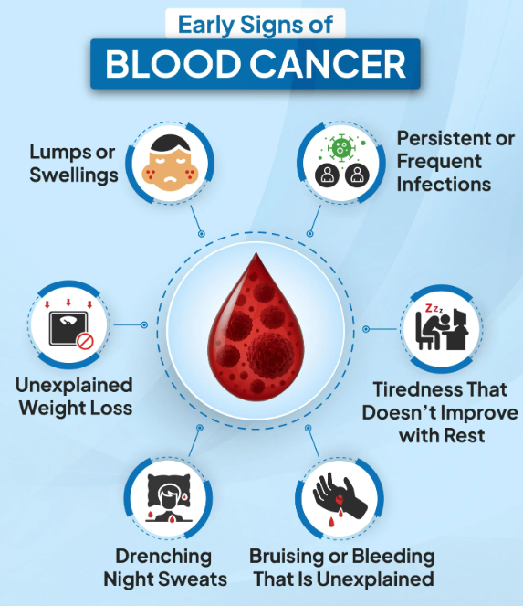
Symptoms and disease progression
There are many symptoms of blood cancer like tiredness, lumps or swellings, bruising/bleeding, and infections (Ghanekar, 2024).
Often the symptoms are vague, increasing the chances of delayed diagnosis.
It is important to recognise early because some blood cancer like leukaemia and lymphoma progress rapidly if remain unchecked (Gulshan, 2025).
Timely treatment can be ensured through early referral.
(Ghanekar, 2024)

Slide 6
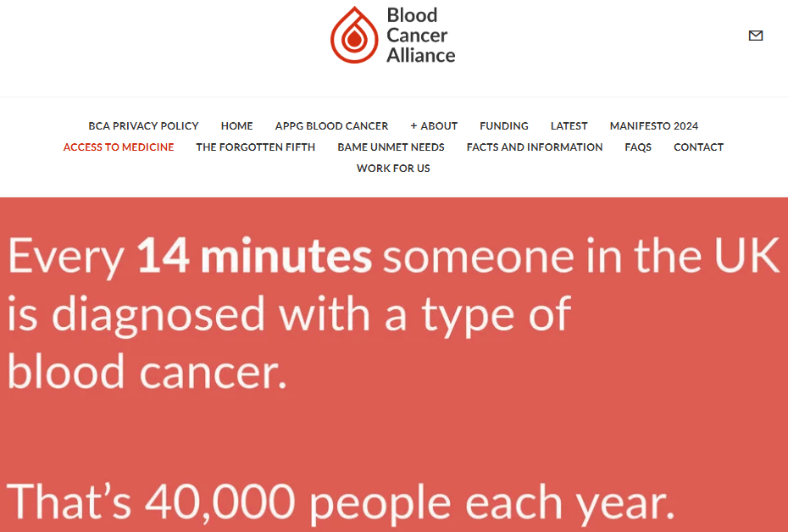
Prevalence: UK
Blood cancer is 5th most common cancer in the UK with patient with blood cancer is diagnosed every 14 minutes (Blood Cancer Alliance, 2026).
One in every 16 men as well as one in every 22 women has risk of developing the disease in their lifetime (ICR, 2025).
Almost 250,000 people in the UK are currently living with blood cancer (The christie NHS Foundation Trust, 2026).
Almost 5,000 deaths each year due to leukaemia (Leukaemiauk, 2026).
(Blood Cancer Alliance, 2026)

Slide 7
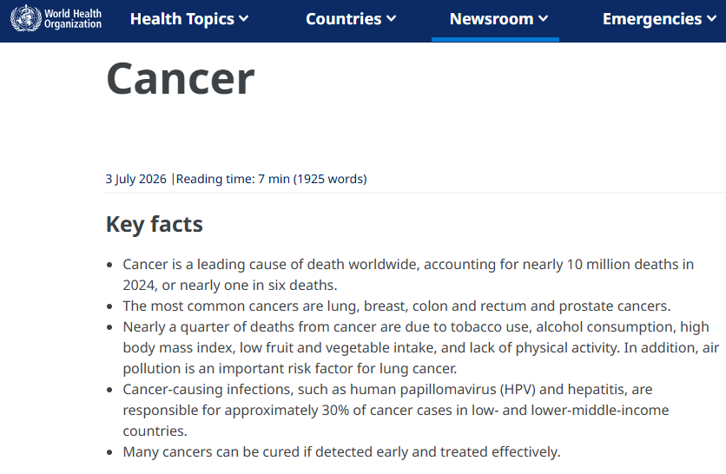
Global Prevalence
WHO estimates that blood cancer cause 10 million deaths globally which is one in six deaths (World Health Organization, 2026).
Blood cancers accounted 6.6% of total cancer cases and 7.2% of total cancer related deaths (AACR, 2025).
Early diagnosis is necessary to increase positive treatment outcomes.
(World Health Organization, 2026)

Slide 8
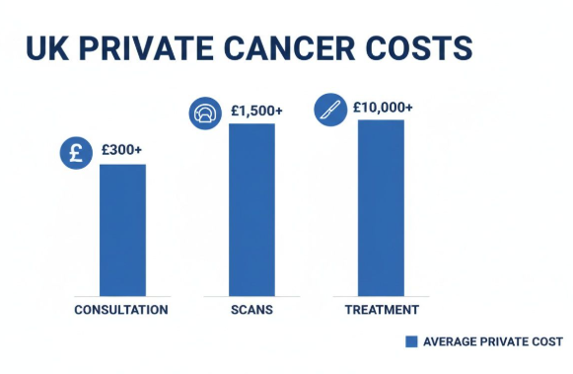
Economic and social burden
Blood cancer requires high cost which includes consultation, scans, and the treatment may cost more than £10,000 (Leroys, 2025).
With an estimated annual cost of US$2,281,447, hematologic cancers are presenting a significant health burden for the National Health Service (NHS) (Patel et al., 2025).
Blood cancer significantly impacts independence, finance, and employment (Ohlsen et al., 2024).
(Leroys, 2025)

Slide 9
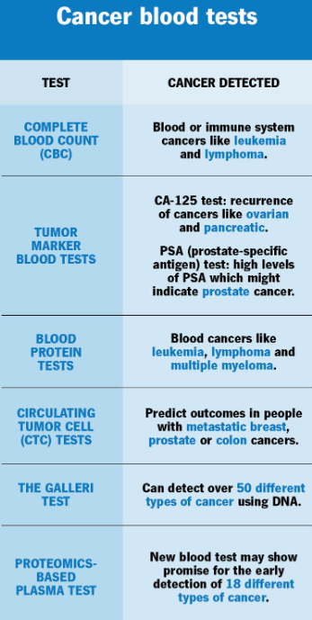
Diagnosis
Suspect blood cancer if patient reports abnormal blood counts, recurrent infections, lymphadenopathy, bruising/bleeding.
It is important to assess history, previous major treatments, and relevant symptoms.
Complete blood count is required to for diagnosis of leukaemia (American Society of Hematology, 2021), where serum protein electrophoresis and serum-free light chains are needed for diagnosis of myeloma.
Other blood tests like tumour marker blood test and blood protein test can confirm blood cancer (Clevelandclinic, 2024).
(Clevelandclinic, 2024)

Slide 10
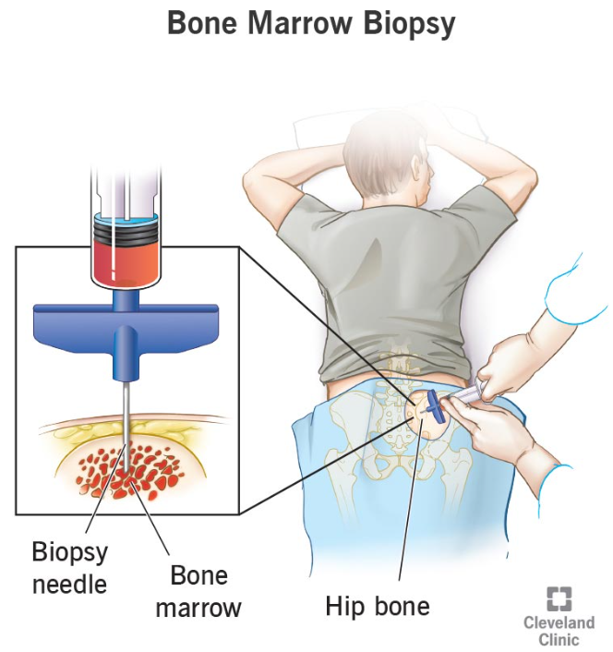
Initial assessment
It is important to assess physical symptoms, functions, activities, psychological wellbeing, nutrition, and treatment effects initially.
Comorbidities that have adverse impact on patients while treatment should be identified (Peng et al., 2026).
For confirming the disease, several blood tests, biopsy, and also bone-marrow assessment are needed.
Support needs as well as stage of cancer should be reflected through the assessment.
(Cleveland Clinic, 2022)

Slide 11
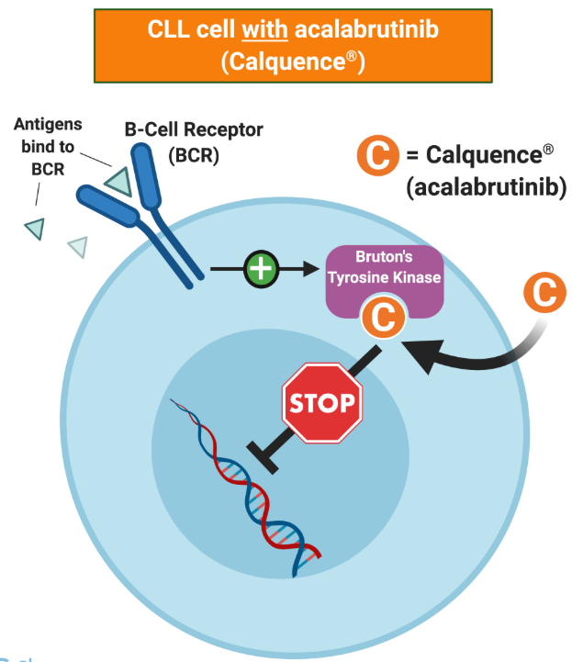
NICE Guidelines for Blood Cancer
England and Wales will have new initial treatment options for chronic lymphocytic leukaemia (CLL) and mantle cell lymphoma (MCL).
NICE has approved the combinations of two acalabrutinib-based drugs (Pinching, 2026).
The guidelines support an approach to treatment that considers individual elements of patients' cases.
(Chemoexperts, 2026)

Slide 12
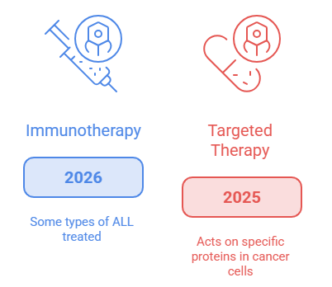
Pharmacological treatment
Chemotherapy: May use drugs to destroy or stop the growth of the abnormal or rapidly growing cells in the blood, in combination with other therapy.
Targeted therapy: Acts on specific proteins found in cancer cells; examples include imagine, dasatinib and venetoclax (National Cancer Institute, 2025).
Immunotherapy: Enhances immune reactions towards cancer; In 2026, some types of ALL are treated with blinatumomab and CAR-T therapy (National Cancer Institute, 2026).
Figure: Cancer Treatment Effectiveness
(Source: Author)

Slide 13
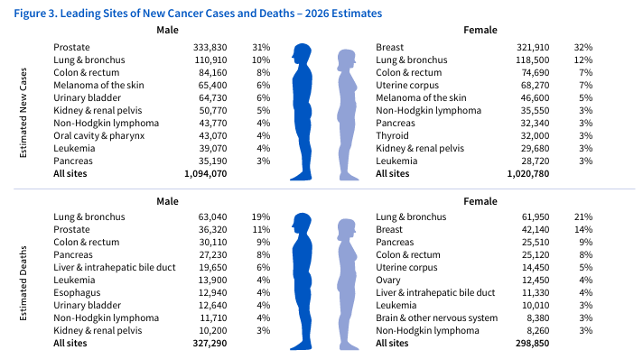
Non-pharmacological treatment
Chemotherapy: Involves the use of drugs to kill dividing blood-cancer cells; will depend on the type and stage of cancer.
Targeted therapy: Targets proteins that are only found in cancer cells: imatinib, dasatinib, and inotuzumab were included in 2026 for selected ALL patients (Aqil et al., 2026).
Immunotherapy supports the body's immune system in fighting leukaemia; 67,790 new cases of leukaemia are predicted in the US in 2026 (American Cancer Society, 2026a).
Figure: Leading Sites of New Cancer Cases and Deaths – 2026 Estimates
(Source: American Cancer Society, 2026a)

Slide 14
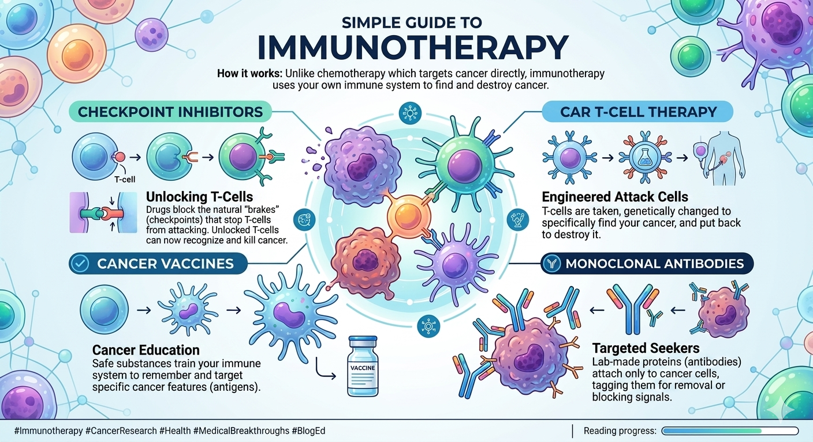
Exacerbation management
Treatment with chemotherapy- Both acute leukaemias are most often treated with chemotherapy, which is a medication that kills quickly dividing cells (Cheng and Chen, 2025).
Tyrosine-kinase inhibitors, a form of targeted therapy, make a great difference in the outcome for people with CML as they target particular genetic abnormalities.
Immunotherapy: Activates an immune response against cancer; In 2026, there are expected to be 6,250 new cases of ALL (American Cancer Society, 2026b).
Figure: Immunotherapy
(Source: Manipal Hospitals, 2026)

Slide 15
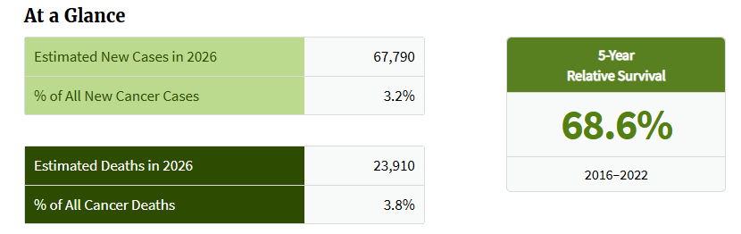
Comorbidities
Anaemia – A decrease in the number of red blood cells, which may lead to tiredness and shortness of breath and which may be caused by cancer or treatment.
Infections: Leukaemia is expected to represent 3.2% of all new cancer cases in the UK in 2026 (National Cancer Institute, 2026a).
Kidney problems: Kidney problems may result from multiple myeloma and must be monitored in conjunction with multiple myeloma treatment and support.
Figure: 2026 New Cases Cancer
(Source: National Cancer Institute, 2026a)

Slide 16
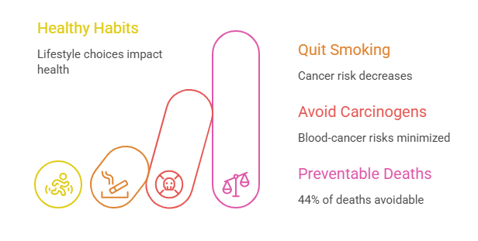
Prevention
To quit smoking: cancer risk decreases after quitting tobacco and tobacco is a leading cause of preventable cancer in 2026 (Feliu et al., 2026).
Minimise exposure to harmful substances: Avoid carcinogens such as benzene, unnecessary radiation, etc., which increase blood-cancer risks.
The 2026 projected number of cancer deaths is 44 per cent preventable by maintaining healthy weight, physical activity, diet and drinking moderate amounts of alcohol (American Cancer Society, 2026c).
Figure: Healthy Habits Reduce Cancer Risks
(Source: Author)

Slide 17
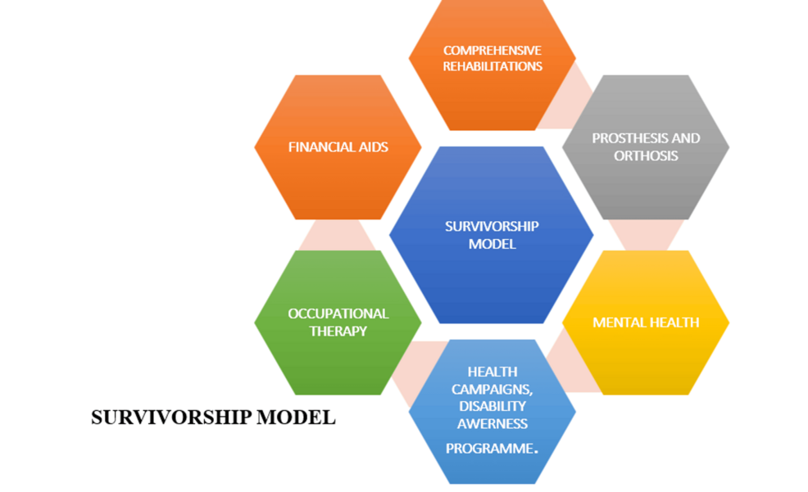
Models for improving outcomes
Multidisciplinary care: Involves specialists, nurses, pharmacists and supportive services, and enhances coordinated decision-making along all blood-cancer treatment pathways.
Patient-centred care: They make shared decisions and provide education and personalised care; Survival rate for ALL (73.2% 5 year), there is a trend of improving survival over time (National Cancer Institute, 2026a).
Survivorship model: Offers rehab services, monitoring and psychosocial support; 70% five-year survival achieved throughout all cancers by 2026 (American Cancer Society, 2026c).
Figure: Survivorship model
(Source: Cureus, 2026)

Slide 18
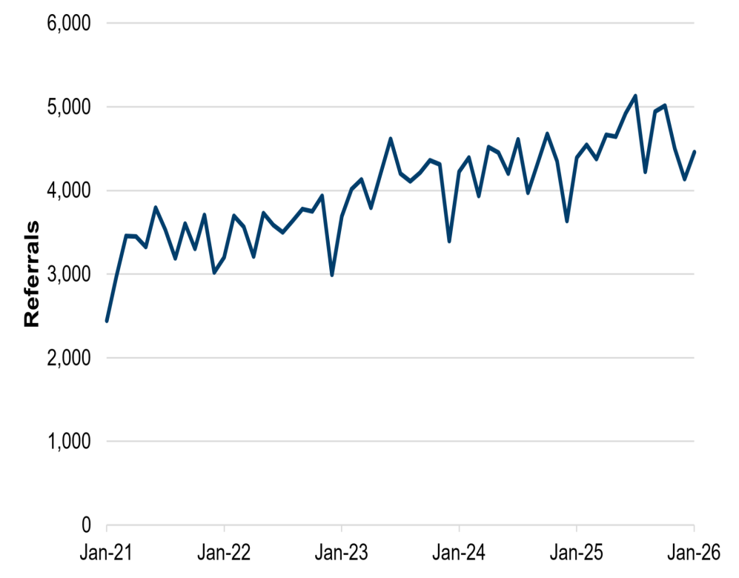
Co-productive care: skills, values and behaviours
Communication: During personalised blood-cancer treatment, patients and professionals collaborate to communicate information, decisions, responsibility and goals.
Respect: Collaborative planning of and during treatment is respectful of patients preferences, experiences, values, and cultural needs.
Shared decision-making – in 2026, 91.4% of people in hospitals across England for cancer had an NHS Cancer Specialist who they could speak to about their care (NHS England, 2026a).
Figure: Average daily referrals for first outpatient appointment, by month
(Source: Welsh Government, 2026)

Slide 19
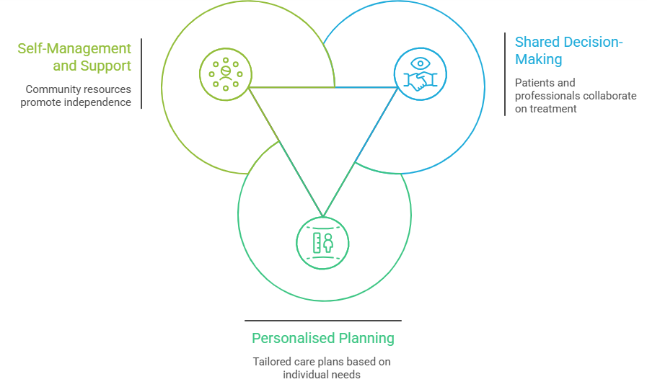
Six components of personalised care
Shared decision-making: Patients and professionals collaborate on decisions about treatment, making treatment for blood cancers reflect the person's goals, preferences and needs (Messina, 2025).
Personalised planning allows patients to have control over care and in 2026, 700,000 cancer treatments began under NHS England (NHS England 2026a).
Self-management and support: These community resources of social prescribing, self-management and personal budgets promote independence, confidence and comprehensive blood-cancer care.
Figure: Enhancing Blood Cancer Care
(Source: Author)

Slide 20
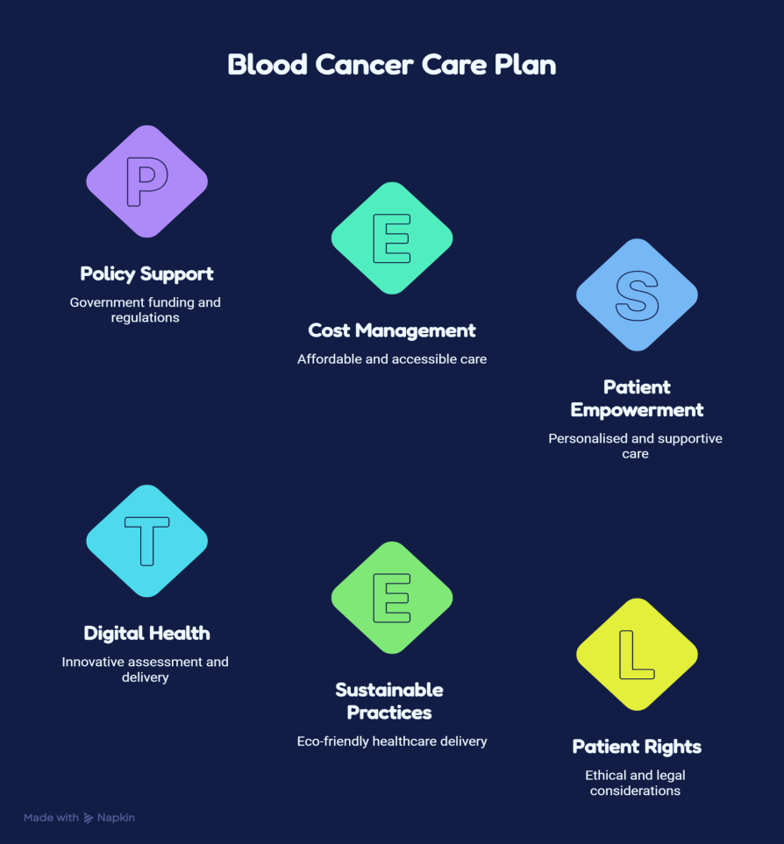
Applying personalised Blood Cancer care
Personalised assessment: Assess blood-cancer type, symptoms, effectiveness of treatment, co-occurring diseases and personalised goals to create suitable care plan(s).
Self-management support: Deliver personalised education, inhaler optimisation, smoking cessation and pulmonary rehab; 90% of those completing rehab report improved quality of life (NHS England 2026b).
Integrated care: Coordination of primary, specialist rehabilitation and community services; Specialist input to 65% within 24-hours of an emergency admission for Blood Cancer (NHS England 2026c).
Figure: Blood Cancer Care Plan
(Source: Author)

Slide 21
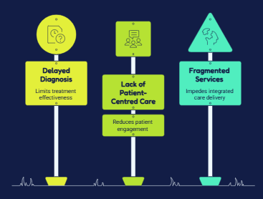
Conclusion
Early diagnosis and treatment: It is vital to identify blood cancer early, to provide the right treatment and treat the patient individually.
Shared decision making, respect, communication, independence and personalised support are encouraged by the multidisciplinary, patient-centred approach to care.
Evidence build management, prevention, self management and integrated services lead to better outcomes.
Figure: Blood Cancer Challenges
(Source: Author)

Slide 22
References
AACR (2025). A decade of progress: Transformative advances in blood cancer - CPR25. [online] Cancer Progress Report. Available at: https://cancerprogressreport.aacr.org/progress/cpr25-contents/cpr25-transformative-advances-in-blood-cancer-research-and-treatment/.
American Cancer Society (2026b) Key Statistics for Acute Lymphocytic Leukemia (ALL). Available at: https://www.cancer.org/cancer/types/acute-lymphocytic-leukemia/about/key-statistics.html
American Cancer Society (ACS) (2026a) Cancer facts & figures 2026. Available at: https://www.cancer.org/content/dam/cancer-org/research/cancer-facts-and-statistics/annual-cancer-facts-and-figures/2026/2026-cancer-facts-and-figures.pdf
American Cancer Society (ACS) (2026c) Cancer Prevention & Early Detection Facts & Figures. Available at: https://www.cancer.org/research/cancer-facts-statistics/cancer-prevention-early-detection.html
American Society of Hematology (2021). Leukemia. [online] www.hematology.org. American Society of Hematology. Available at: https://www.hematology.org/education/patients/blood-cancers/leukemia.
Aqil, M.S., Al-Marrawi, Y., Yaldo, M., Abu-Mahfouz, A., Singh, L., Gopishetty, S., Idogun, P., Ezekwudo, D., Jaiyesimi, I. and Weiner, A.J. (2026) ‘Ocular toxicities of targeted therapies and immunotherapies in hematologic malignancies’, Frontiers in Oncology, 15, p. 1691518. Available at: https://www.frontiersin.org/journals/oncology/articles/10.3389/fonc.2025.1691518/full
Blood Cancer Alliance (2024). Blood cancer alliance. [online] Blood Cancer Alliance. Available at: https://www.bloodcanceralliance.org/the-forgotten-fifth.
Blood Cancer Alliance (2024b). Blood cancer alliance. [online] Blood Cancer Alliance. Available at: https://www.bloodcanceralliance.org/.
Blood Cancer Alliance (2026). Blood cancer alliance. [online] Blood Cancer Alliance. Available at: http://bloodcanceralliance.org/access.
Blood Cancer UK (2025). Blood cancer UK | blood cancer symptoms and signs. [online] Blood Cancer UK. Available at: https://bloodcancer.org.uk/understanding-blood-cancer/about-blood-cancer/blood-cancer-signs-symptoms/.
Blood Cancer UK (2026a). Blood cancer UK | blood cancer types. [online] Blood Cancer UK. Available at: https://bloodcancer.org.uk/understanding-blood-cancer/blood-cancer-types/.
Blood Cancer UK (2026b). Blood cancer UK | facts and information about blood cancer. [online] Blood Cancer UK. Available at: https://bloodcancer.org.uk/news/blood-cancer-facts/.
Cancer Research UK (2025). Non-hodgkin lymphoma statistics. [online] Cancer Research UK. Available at: https://www.cancerresearchuk.org/health-professional/cancer-statistics/statistics-by-cancer-type/non-hodgkin-lymphoma.

Slide 23
Chemoexperts (2026). Acalabrutinib (Calquence®) + Obinutuzumab (Gazyva®) for CLL | ChemoExperts. [online] Cheacalabrutinib-calquence-obinutuzumab-gazyva-cll.htmlmoexperts.com. ChemoExperts. Available at: https://www.chemoexperts.com/.
Cheng, D.H. and Chen, W.L. (2025) ‘Treatment Modifications Due to Toxicities During Chemotherapy in Leukemia’, in Leukaemia - Recent Advances in Diagnosis and Therapeutic Modalities. IntechOpen. Available at: https://www.intechopen.com/chapters/1236778
Cleveland Clinic (2022). Bone marrow biopsy: What it is, procedure & results. [online] Cleveland Clinic. Available at: https://my.clevelandclinic.org/health/diagnostics/17735-bone-marrow-biopsy.
Clevelandclinic (2024). Blood tests for cancer: Diagnosis & treatment. [online] Cleveland Clinic. Available at: https://my.clevelandclinic.org/health/diagnostics/22338-blood-tests-for-cancer.
Cureus (2026) A community-based survivorship model for individuals with orthopedic disabilities in rural areas. Available at: https://www.cureus.com/articles/350944-a-community-based-survivorship-model-for-individuals-with-orthopedic-disabilities-in-rural-areas#!/
Feliu, A., Anderson, A.S., Bauld, L., Fernández, E., Leitzmann, M., Morris, S., Srour, B., Vardavas, C., Vlad, I., Vuik, S. and Weijenberg, M. (2026) ‘European Code Against Cancer, –tobacco and nicotine containing products, second‐hand smoke, alcohol and cancer’, Molecular Oncology, 20(1), pp. 6-27. Available at: https://febs.onlinelibrary.wiley.com/doi/abs/10.1002/1878-0261.70177
Ghanekar, V.D. (2024). Truemeds. [online] Truemeds.in. Available at: https://www.truemeds.in/diseases/cancer/blood-cancer-49.
Gulshan, S. (2025). Blood cancer early detection benefits & treatment success. [online] Peerlesshospital.com. Available at: https://www.peerlesshospital.com/blog-details.php?i=blood-cancer-the-importance-of-early-detection-in-fighting-blood-cancer.
ICR (2025). What is blood cancer? [online] Icr.ac.uk. Available at: https://www.icr.ac.uk/research-and-discoveries/cancer-blogs/detail/science-talk/what-is-blood-cancer.
Leroys, V. (2025). The real cost of private cancer treatment UK an honest guide. [online] https://marcoscarci.co.uk/. London Leading Thoracic Surgeon | Mr. Marco Scarci. Available at: https://marcoscarci.co.uk/cost-of-private-cancer-treatment-uk/.

Slide 24
Leukaemiauk (2026). Securly - geolocation sharing. [online] Leukaemiauk.org.uk. Available at: https://www.leukaemiauk.org.uk/research-and-advocacy/our-funded-research/.
Manipal Hospitals (2026) Immunotherapy Treatment. Available at: https://www.manipalhospitals.com/ranchi/blog/immunotherapy-treatment/
Messina, A.J. (2025) Measuring What Matters to Patients: A Multiple Methods Sequential Study of Disease Burden, Quality of Life, and the Alignment of Patient-Reported Outcome Measurements for High-Risk Myelodysplastic Syndrome and Acute Myelogenous Leukemia Patients. PhD Dissertation. George Washington University. Available at: https://hsrc.himmelfarb.gwu.edu/smhs_crl_dissertations/42/
National Cancer Institute (2025) Targeted Cancer Therapies Approved Drug List. Available at: https://www.cancer.gov/about-cancer/treatment/types/targeted-therapies/approved-drug-list
National Cancer Institute (2026) National Cancer Institute. Available at: https://www.cancer.gov/
National Cancer Institute (NCI) (2026a) Cancer Stat Facts: Any Lymphocytic Leukemia. Available at: https://seer.cancer.gov/statfacts/html/alyl.html
NHS England (2026a) Cancer patients rate NHS care highly as record numbers checked and treated. Available at: https://www.england.nhs.uk/2026/07/cancer-patients-rate-nhs-care-highly-as-record-numbers-checked-and-treated/
NHS England (2026b) Pulmonary rehabilitation. Available at: https://www.england.nhs.uk/ourwork/clinical-policy/respiratory-disease/pulmonary-rehabilitation/
NHS England (2026c) 26/27 NHS Payment Scheme Annex C: Best practice tariffs. Available at: https://www.england.nhs.uk/wp-content/uploads/2026/03/26-27NHSPS-Annex-C-Best-practice-tariffs.pdf
Ohlsen, T.J.D., Murphy-Banks, R., Beauchemin , M.P., Rodday , A.M., Freyer , D.R., Miller, K.A., Fleisher , E., Xiang , Q., Linendoll , N., Chan , R.Y., Crosswell, H.E., Roth, M.E. and Parsons , S.K. (2024). Checking your browser - reCAPTCHA. [online] Nih.gov. Available at: https://pmc.ncbi.nlm.nih.gov/articles/PMC12704815/.
PACE Hospitals (2026). Blood cancer: Types, symptoms, diagnosis & treatment. [online] Pacehospital.com. Available at: https://www.pacehospital.com/blood-cancer.
Patel, N., Farid, S. and Gomes, M. (2025). Cost-effectiveness of chimeric antigen receptor (CAR) T-cell therapy for BLOOD CANCERS: An updated systematic review. PharmacoEconomics - Open, 10(1), pp.35–51. doi:10.1007/s41669-025-00614-x.

Slide 25
Peng, T., Chen, S., He, X., Yang, Y., Ren, Y., Sun, Y., Shi, F., Lv, Y., Wen, X., Wen, Y., Yu, P., Liu, W., Chen, Q., Yang, X., Xu, S. and Li, J. (2026). Cancer comorbidities: Clinical impacts, mechanistic insights, and management strategies. MedComm – Oncology, 5(1). doi:10.1002/mog2.70052.
Pinching, J. (2026). NICE backs new blood cancer regimens - PharmaTimes. [online] PharmaTimes. Available at: https://pharmatimes.com/news/nice-backs-new-blood-cancer-regimens/.
The christie NHS Foundation Trust (2026). Blood cancer awareness. [online] The Christie. Available at: https://www.christie.nhs.uk/your-treatment-and-care/services/lymphoma/blood-cancer-awareness.
Welsh Government (2026) NHS activity and performance summary: January and February 2026. Available at: https://www.gov.wales/nhs-activity-and-performance-summary-january-and-february-2026
World Health Organization (2026). Cancer. [online] World Health Organization. World Health Organization. Available at: https://www.who.int/news-room/fact-sheets/detail/cancer.

