Slide 1


Midlands EV Charging Solutions Ltd
Business Plan Presentation
Programme: CertHE Business Skills for the Workplace
Module: LCLM4006 Enterprise and Entrepreneurship
Student: Muhammad Waheed Nadeem
Student ID: 2434525
Lecturer: Stephen Malone
Submission Date: 16th,March 2026

Slide 2
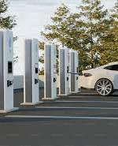
Business Idea
Purpose
Designed to meet the growing demand for reliable EV charging infrastructure in Birmingham.
Mission
Provide fast, reliable, and affordable EV charger installation services.
Problem
Limited home charging infrastructure
Long installation waiting times
Lack of transparent pricing
Services
EV charger installation (homes & small businesses)
Site surveys and electrical testing
Goal
Become a trusted EV charger installer in Birmingham and expand across the West Midlands.
(Zap-Map, 2024)
Electric vehicle charging station. Source: Unsplash

Slide 3
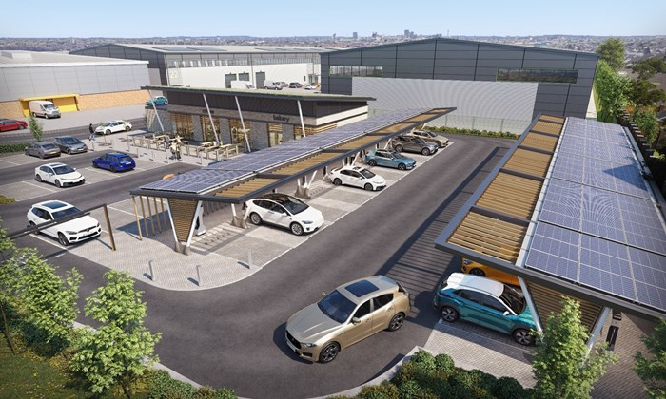
Unique Selling Points and Business Structure
Unique Selling Points
Installation within 5 working days
Transparent fixed pricing
Specialist EV installation service
Business Structure
Private Limited Company (Ltd)
Managing Director
Certified electrician (Burns, 2016)
Image: West Midlands Combined Authority (WMCA).

Slide 4


Legal Structure & Management
Legal Structure
Private limited company (ltd)
Limited liability protection
Increased business credibility (Burns, 2016)
Management Structure
Managing director – business operations and strategy
Certified electrician – installation services
Outsourced admin and marketing initially (storey,2016)

Slide 5

Key PESTEL Factors
Political
UK ban on petrol and diesel vehicles by 2035
Government policies supporting EV adoption
(department for transport, 2023)
Economic
Rising fuel prices increase EV demand
Evs cheaper to run than petrol cars
(office for national statistics, 2023)
Environmental
UK net zero emissions target for 2050
Increased focus on sustainable transport
(HM Government, 2021)

Slide 6
Marketing Strategies
1. Digital Marketing
SEO-optimised website
Google Business Profile
Google Ads & Facebook Ads
Target customers searching for EV installers
(Chaffey and Ellis-Chadwick, 2019)
2. Strategic Partnerships
Car dealerships
Estate agents
Solar panel companies
Customer referrals and reviews

Slide 7

Funding Requirements
Total Startup Funding Required: £18,000
Funding Sources
Personal Funding start up: £18000
Government start-up loan: £10,000
Purpose of Funding
Cover initial setup costs
Support early operations and working capital (Burns, 2016)

Slide 8

Funding allocation
Breakdown of £18,000 Startup Capital
Tools & equipment – £6,000
Certification & registration – £3,000
Insurance – £1,200
Website & branding – £1,000
Marketing – £2,500
Working capital – £4,300
(Burns, 2016)

Slide 9
References
Burns, P. (2016) Entrepreneurship and Small Business. London: Palgrave.
Chaffey, D. and Ellis-Chadwick, F. (2019) Digital Marketing. 7th edn. Harlow: Pearson.
Department for Transport (2023) Zero Emission Vehicle Statistics. Available at: GOV.UK.
HM Government (2021) Net Zero Strategy: Build Back Greener. London: HMSO.
Office for National Statistics (2023) Environmental Sustainability Data. Available at: ONS.
Unsplash (n.d.) Electric vehicle charging station. Available at: https://unsplash.com/s/photos/electric-vehicle-charging (Accessed: 15 March 2026).
West Midlands Combined Authority (2025) CGI of electric vehicle charging station in Erdington. Available at: https://www.wmca.org.uk/media/hqknzg2j/evcats-erdington-cgi.jpg (Accessed: 15 March 2026).
Zap-Map (2024) UK EV Infrastructure Report. Available at: zap-map.com.

Slide 10


THANK YOU

