Slide 1
Hemispheric Organisation – Split Brain.
Dr Stuart Jones

Slide 2
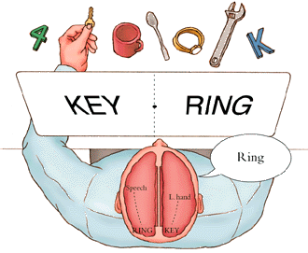
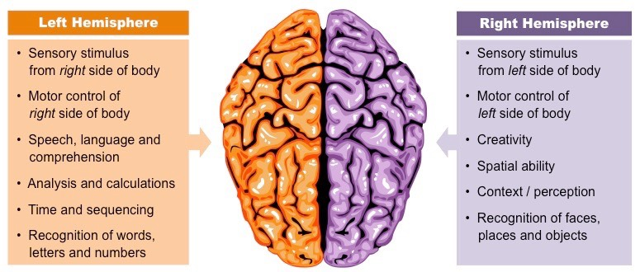
Hemispheric Organization:
Split Brain Patients

Slide 3
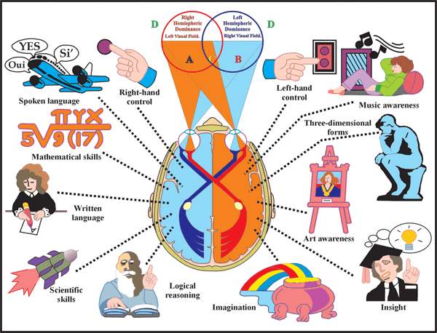

Slide 4
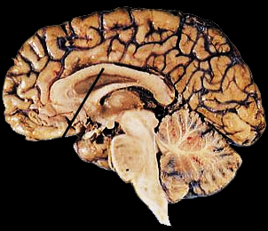

Corpus Callosum
Major (but not only) pathway between sides
Connects comparable structures on each side
Permits data received on one side to be processed in both hemispheres
Aids motor coordination of left and right side
Corpus Callosum
Notes:
Example : You read a geometry problem in a textbook. The words are seen and the visual forms translated into meaning by the language center in the left hemisphere. To solve the problem you have to imagine a cone shaped object. This is accomplished by centers in the right hemisphere. The solution is written down using language generated by the left hemisphere.
What would happen in cases like this if the callosum was damaged ?

Slide 5
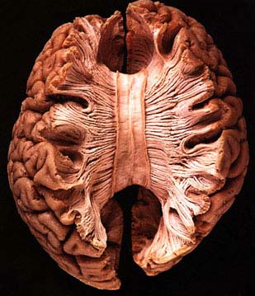
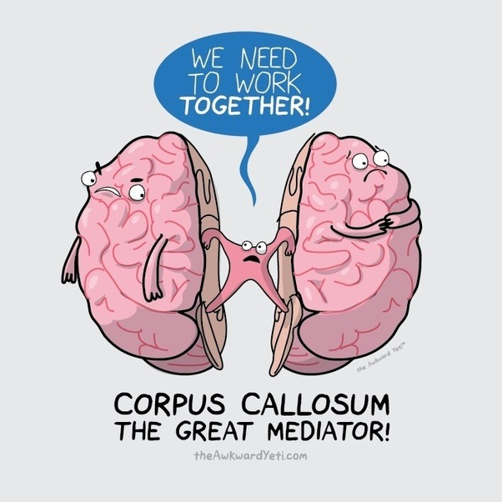
Corpus Callosum
What happens when the corpus callosum is cut?
  Sensory inputs are still crossed
  Motor outputs are still crossed
  Hemispheres can’t exchange data
Notes:
key words: left hemisphere; right hemisphere; corpus callosum; epilepsy
One method used to treat severely epileptic patients involves cutting the corpus callosum to prevent the spread of seizures across the entire brain. The video clip on this slide shows a man who has had such a surgery. Double click on video to start video clip. This clip discusses the types of information processing deficits associated with cutting the corpus callosum and shows a task often used to assess corpus callosum damage. This task is also represented in drawing form on the following slide as well.

Slide 6

Short-Term Complications of Split-Brain Operation
Left hand unbuttons a shirt while the right hand buttons it.
Left hand puts grocery store items back on the shelf after the right hand put them in the cart.
One woman, after a stroke to her corpus callosum, complained that occasionally her left hand would fly up to her throat and try to strangle her, requiring her right hand to push it away.

Slide 7
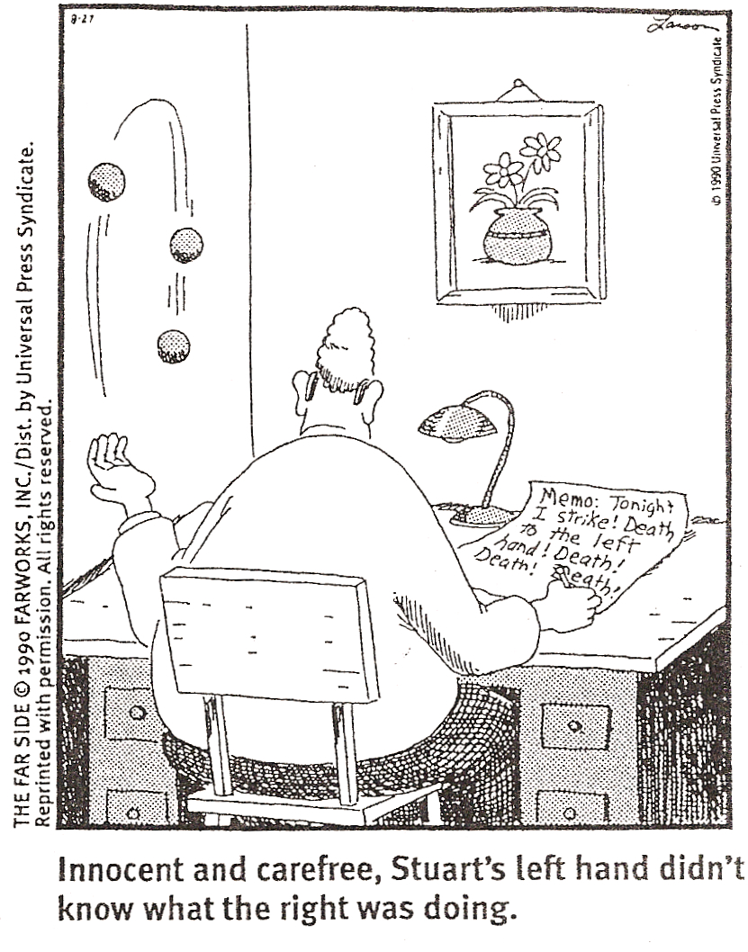

Slide 8
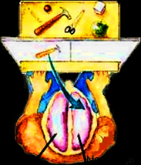
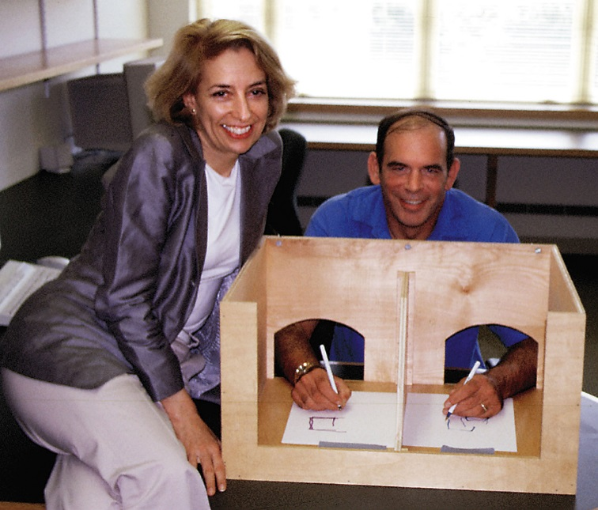

The ‘Split Brain’ studies
Surgery for epilepsy : cut the corpus callosum
Roger Sperry, 1960’s
Special apparatus
  picture input to just one side of brain
  screen blocks objects on table from view
Verbal
left
hemisphere
Nonverbal
right
hemisphere
Notes:
key words: left hemisphere; right hemisphere; corpus callosum; epilepsy
This slide is a schematic of the task shown in the video clip on the previous slide

Slide 9
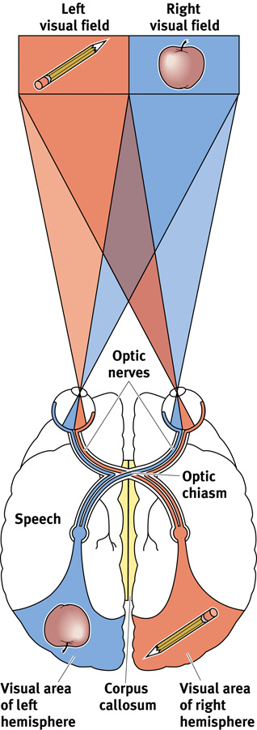
Visual Fields & the Split Brain Patient
Information from the left half of your field of vision goes to your right hemisphere, which controls your left hand.
  Left Hand will point at PENCIL
Information from the right half of your visual field goes to your left hemisphere, which usually controls speech.
  Person will SAY, “Apple”
The data received by either hemisphere are quickly transmitted to the other across the corpus callosum.
In a person with a severed corpus callosum, this information sharing does not take place.
  (Note, however, that each eye receives sensory information from both the right and left visual fields.)

Slide 10
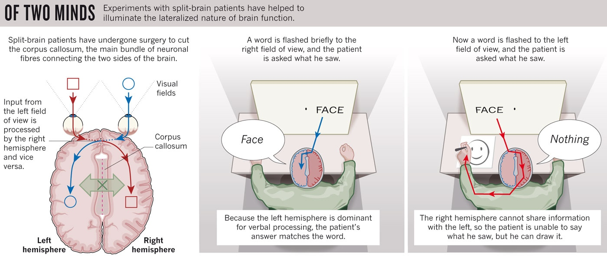
Split Brain Studies

Slide 11
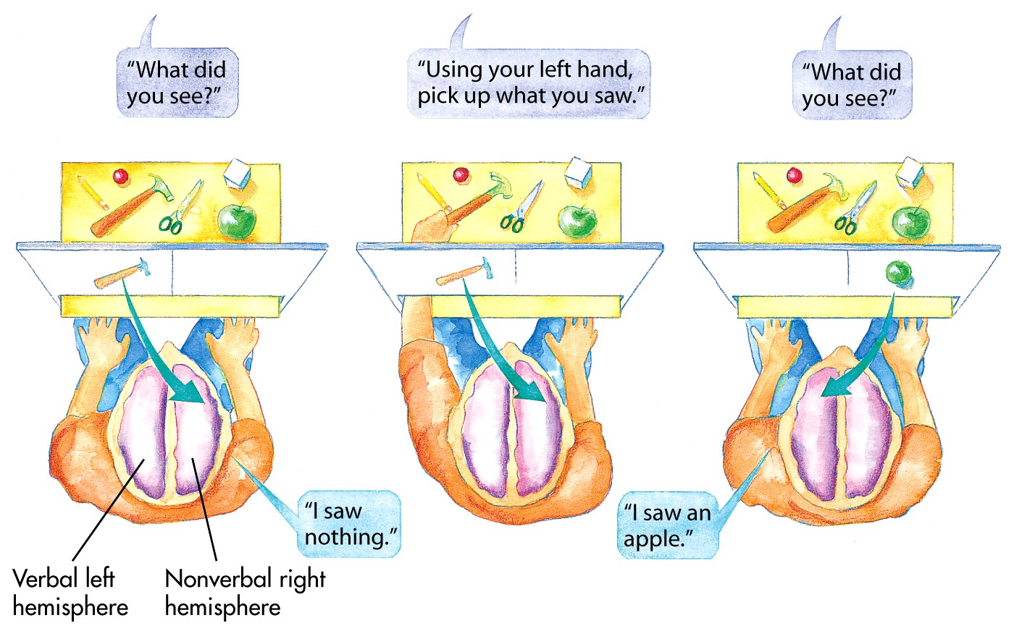
A Hammer is Flashed in the LEFT visual field of a split brain patient.
When asked, “What did you see?”
What will they say?

Slide 13
When asked to pick up the object they just saw with their LEFT hand they are able to do it.
Why is this?

Slide 14
An apple is shown to the split brain patient in their RIGHT visual field. When asked, “What did you see?” What will be their response?

Slide 15
They can say that they saw the apple.
Why do you think this is?

Slide 16
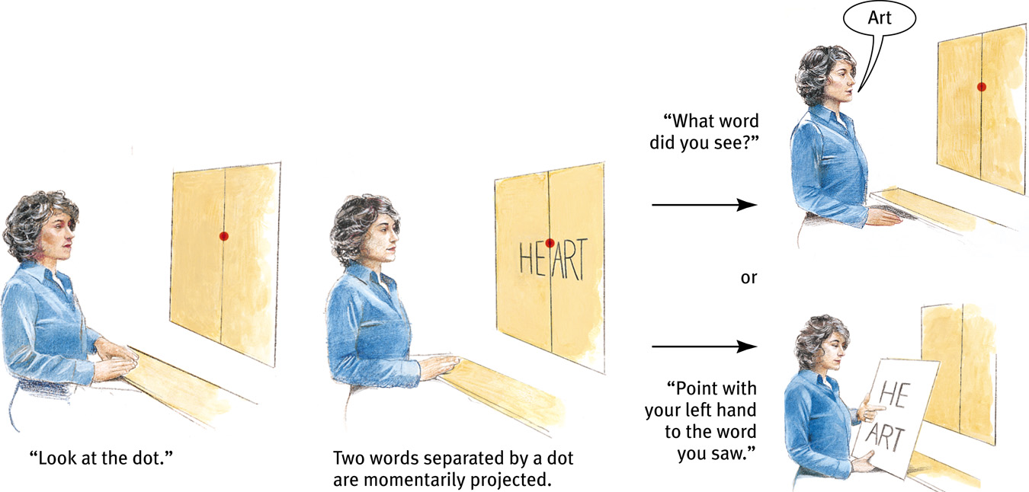
Split Brain Experiments

Slide 17
Split Brain Experiments

Slide 18
Split Brain Experiments

Slide 19
Split Brain Experiments
HE
ART

Slide 20
Split Brain Experiments

Slide 21


