Slide 1

Assessment 1: LCHS4010
Psychology in Health and Social Care
Applying Bowlby's Attachment Theory to Isaac's Development
Student name: Agnieszka Plikunas
Student ID: 2512522
Lecture name: Lou Wells
AI Acknowledgement: Artificial Intelligence (AI) was used only to create the images included in this presentation.

Slide 2
Introduction
Introduce Bowlby's Attachment Theory (Bowlby, 1969).
Explain how early attachment affects child development.
Apply the theory to Isaac's situation.
Consider nature and nurture influences (Shonkoff et al., 2020).
Evaluate strengths and limitations.
Recommend practical interventions for Isaac and his family (Department for Education, 2025).
Conclusion.

Slide 3
Bowlby's Attachment Theory
Children are biologically programmed to form attachments.
Primary attachment usually develops during the first two years.
Secure attachment provides a "secure base.“
Consistent caregiving promotes emotional security.
Separation or inconsistent care may result in insecure attachment.
Important Terms
Secure attachment
Insecure attachment
Internal Working Model
Secure Base
Maternal deprivation
(Bowlby, 1969)

Slide 4
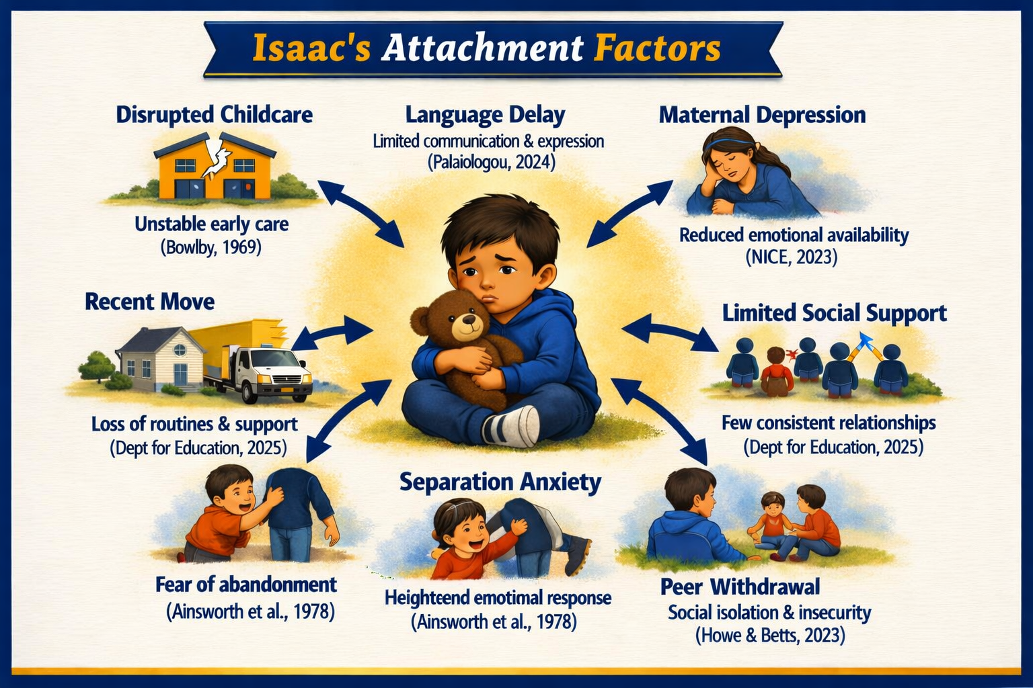
Why Bowlby's Theory Fits Isaac’s
Isaac’s experiences=
Insecure attachment

Slide 5
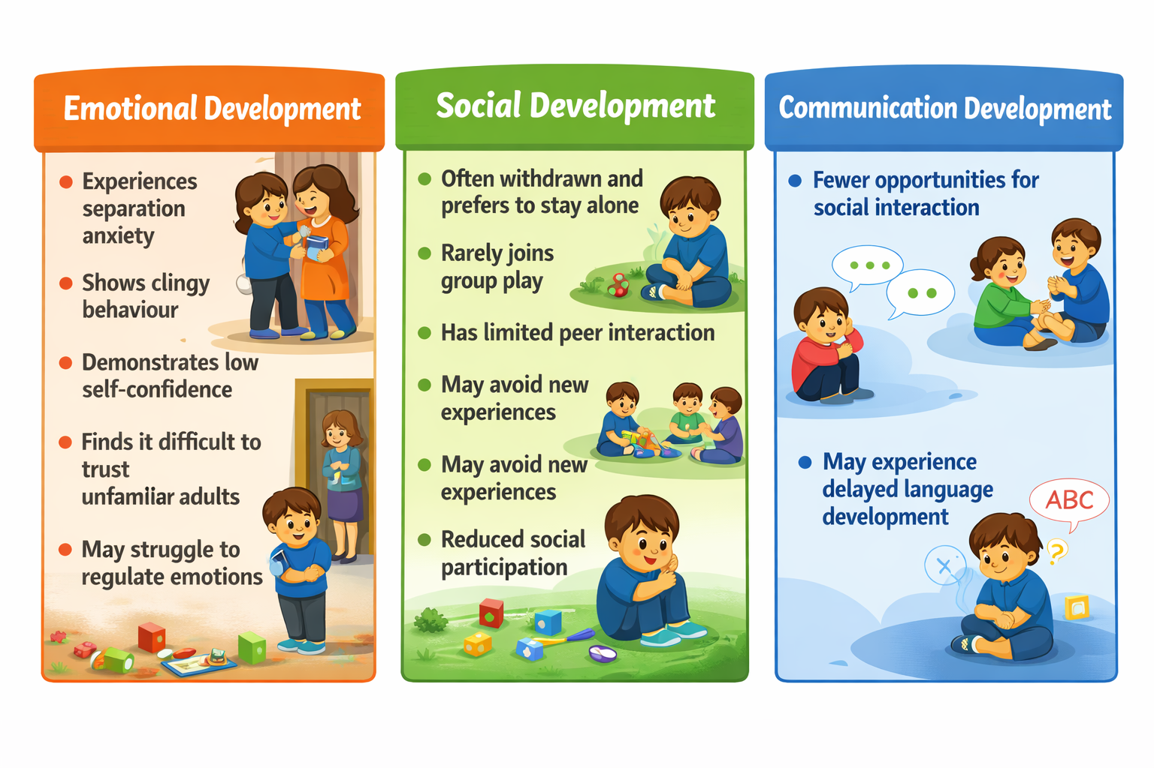
Applying the Theory
(Bowlby, 1969)

Slide 6
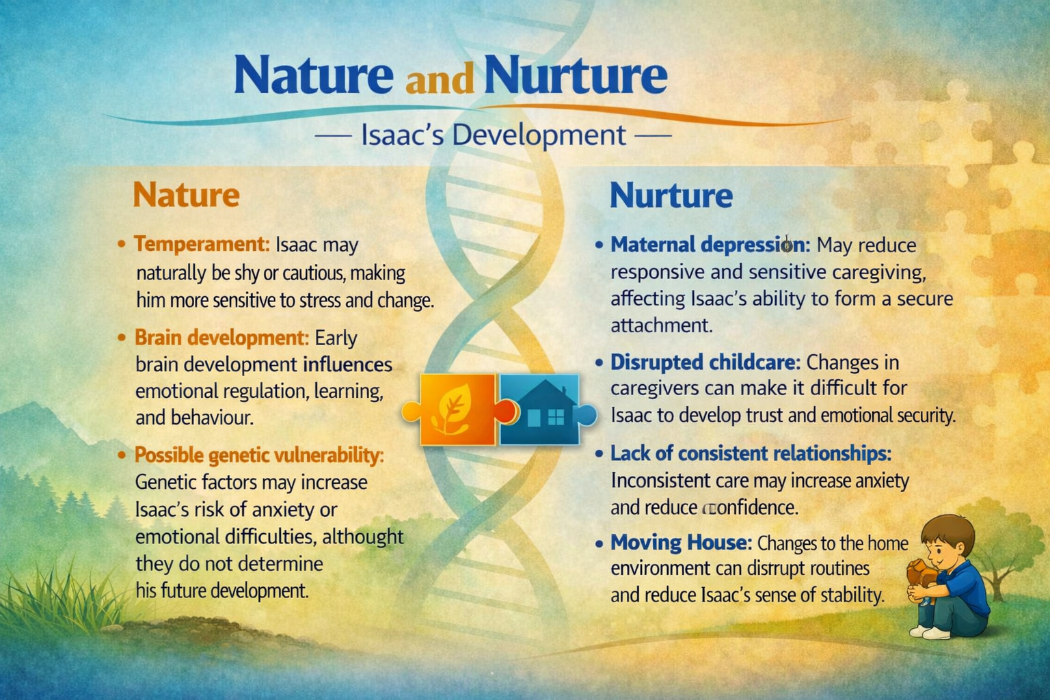
Both nature and nurture affect development (Kail and Cavanaugh, 2023).

Slide 7
Strengths Limitations
Explains the importance of early relationships (Ainsworth et al., 1978).
Supported by research (Bowlby, 1969).
Influences Early Years practice (Department for Education, 2024).
Promotes family-centred care (Howe and Betts,2023).
Focuses mainly on mothers (Lamb, 2010).
Fails to recognise the importance of fathers and other caregivers (Schaffer and Emerson, 1964).
Gives less consideration to cultural differences (Rothbaum et al., 2000).
Children's resilience may reduce long-term effects (Howe, 2011).

Slide 8
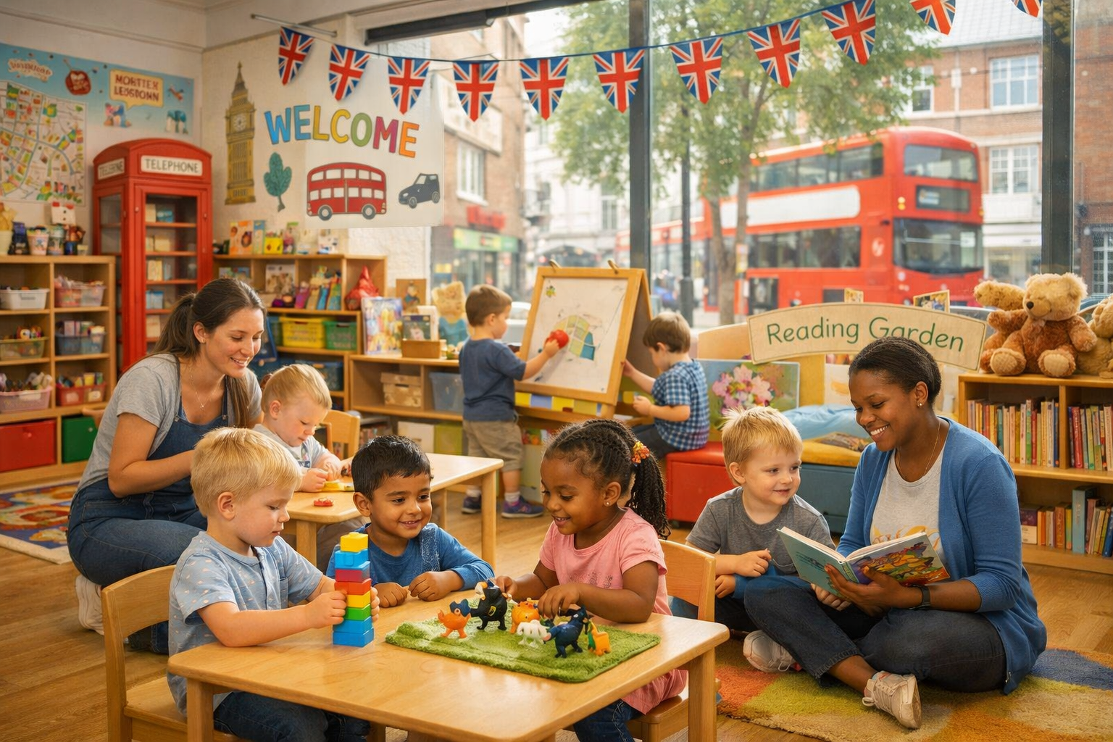


Support Plan for Isaac
Early Years Centre
Mother
Multi-agency support
Source: AI date: 03.07.2026
Source: iStock
Source: wakefieldscp.org.uk
Key worker system (Department for Education, 2025)
Predictable daily routines (Howe, 2011)
Language support
Play therapy
Activities for small groups
  Mental health support
Parenting programmes
Family support worker
Local parent group
Speech and Language Therapy
Health Visitor
Educational Psychologist
Early Help Team
(National Scientific Council on the Developing Child, 2020)

Slide 9
Conclusion
Bowlby's theory explains Isaac's behaviour well ( Bowlby, 1969).
Early attachment influences emotional, social and language development (Ainsworth et al., 1978).
Both nature and nurture contribute (Kail and Cavanaugh, 2023).
Early intervention improves outcomes (Department for Education, 2025).
Multi-agency working provides the best support.

Slide 10


Source: ar.inspiredpencil.com

Slide 11
References
Ainsworth, M.D.S., Blehar, M.C., Waters, E. and Wall, S. (1978). Patterns of Attachment. Hillsdale, NJ: Lawrence Erlbaum.
Bowlby, J. (1969). Attachment and Loss. Volume 1: Attachment. London: Penguin.
Department for Education (2025) Early years foundation stage statutory framework: for group and school-based providers. Dated: 14 July 2025. Effective: 01 September 2025. Available at: https://assets.publishing.service.gov.uk/media/68c024cb8c6d992f23edd79c/Early_years_foundation_stage_statutory_framework_-_for_group_and_school-based_providers.pdf.pdf. (Accessed: 05.07.2026 ).
Howe, D. (2011) Attachment Across the Life Course: A Brief Introduction. 2nd ed. Basingstoke: Palgrave Macmillan.
Howe, D. and Betts, L.R. (2023). Attachment Across the Lifecourse. Bloomsbury Academic.
Kail, R.V. and Cavanaugh, J.C. (2023) Human Development: A Life-Span View. 9th ed. Boston: Cengage Learning.
Lamb, M.E. (2010) The Role of the Father in Child Development. 5th ed. Hoboken: Wiley.
.

Slide 12
References
National Scientific Council on the Developing Child (2020) Connecting the Brain to the Rest of the Body: Early Childhood Development and Lifelong Health Are Deeply Intertwined. Cambridge, MA: Centre on the Developing Child at Harvard University.
NICE (2023) Social and emotional wellbeing: key to giving vulnerable children best start in life, says NICE. Available at: https://www.nice.org.uk/guidance/ph40/documents/social-and-emotional-wellbeing-key-to-giving-vulnerable-children-best-start-in-life-says-nice. (Accessed: 05.07.2026)
Rothbaum, F., Weisz, J., Pott, M., Miyake, K. and Morelli, G. (2000) "Attachment and Culture: Security in the United States and Japan", American Psychologist, 55(10), pp. 1093–1104.
Schaffer, H.R. and Emerson, P.E. (1964) "The Development of Social Attachments in Infancy", Monographs of the Society for Research in Child Development, 29(3), pp. 1–77.
Shonkoff, J.P. et al. (2020) Connecting the Brain to the Rest of the Body: Early Childhood Development and Lifelong Health Are Deeply Intertwined. Centre on the Developing Child at Harvard University.

