Slide 1
PEST and SWOT Analysis
By
Andrew Thorn

Slide 2
PEST Analysis
Is a useful tool for understanding market growth or decline, and as such the position, potential and direction for a business
PEST Analysis is a business measurement tool
PEST is an acronym for Political, Economic, Social and Technological factors, which are used to assess the market for a business

Slide 3
PEST Analysis
PEST analysis can be used for marketing and business development assessment and decision-making
It encourages proactive thinking, rather than relying on habitual or instinctive reactions

Slide 4
Political Factors
How stable is the political environment?
Will government policy influence laws that regulate or tax your business?
What is the government’s position on the economy?
Does the government have a view on culture and religion?
Is the government involved in trading agreements such as EU, NAFTA, ASEAN

Slide 5
Economic Factors
Inflation
Interest rate
Fiscal policy
Employment rates
Investment

Slide 6
Social Factors
Dominant religion
Attitudes to foreign products and services
How much time do consumers have for leisure?
How long are populations living?
Green issues
Language

Slide 7
Technological Factors
Does technology allow for automation?
Allows products to be made more cheaply
Does technology allow consumers and businesses more innovative products and services 5G networks
Does technology offer companies new ways to communicate

Slide 8
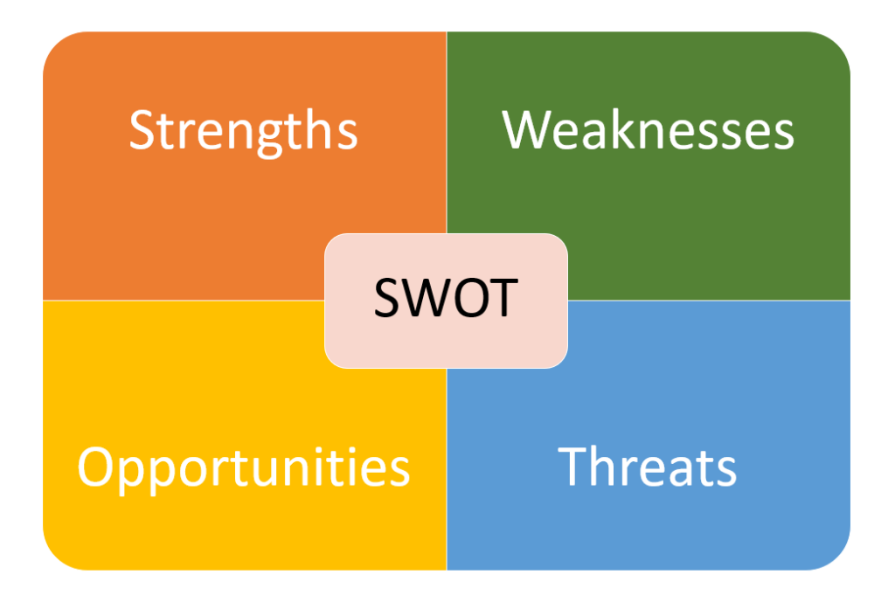
SWOT Analysis

Slide 9
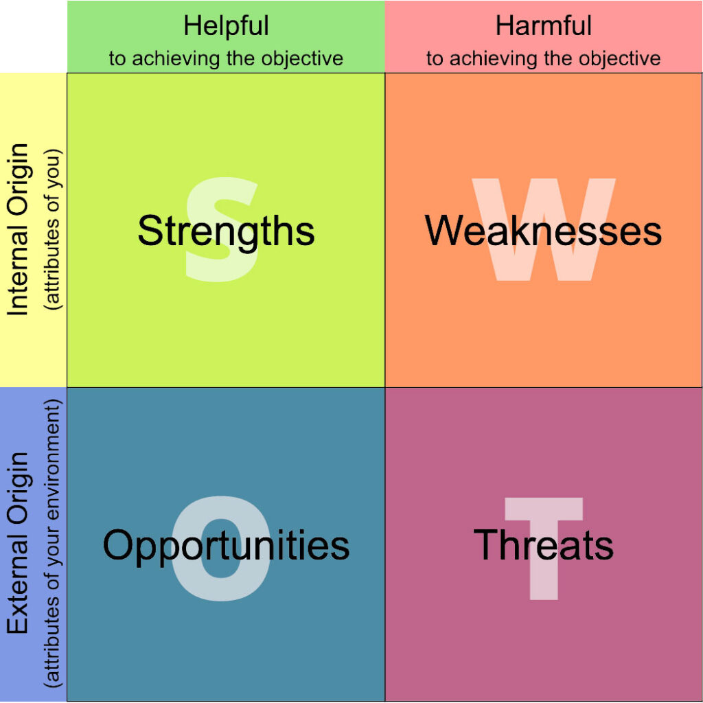
SWOT Analysis

Slide 10
SWOT Analysis
SWOT analysis is a tool for auditing an organization and its environment.
It is the first stage of planning and helps businesses to focus on key issues.
Strengths and weaknesses are internal factors.
Opportunities and threats are external factors.

Slide 11
SWOT Analysis
A strength is a positive internal factor.
A weakness is a negative internal factor.
An opportunity is a positive external factor.
A threat is a negative external factor.

Slide 12
SWOT Analysis
We should aim to turn our weaknesses into strengths, and our threats into opportunities.
Then finally, SWOT will give managers options to match internal strengths with external opportunities.
The outcome should be an increase in ‘value’ for customers – which hopefully will improve our competitive advantage.
The main purpose of the analysis has to be to add value to our products and services so that we can recruit new customers, retain loyal customers, and extend products and services to customer segments over the long-term.

Slide 13
SWOT Analysis
Simple rules.
Be realistic about the strengths and weaknesses of your organization.
It should distinguish between where your organization is today, and where it could be in the future.
It should always be specific. Avoid grey areas.
Always apply the tool in relation to your competition i.e. better than or worse than your competition.
Keep your audit short and simple. Avoid complexity and over analysis
It is subjective.

Slide 14
SWOT Analysis
A strength could be:
Your specialist marketing expertise.
A new, innovative product or service.
Location of your business.
Quality processes and procedures.
Any other aspect of your business that adds value to your product or service.

Slide 15
SWOT Analysis
A weakness could be:
Lack of marketing expertise.
Undifferentiated products or services (i.e. in relation to your competitors).
Location of your business.
Poor quality goods or services.
Damaged reputation.

Slide 16
SWOT Analysis
An opportunity could be:
A developing market such as the Internet.
Mergers, joint ventures or strategic alliances.
Moving into new market segments that offer improved profits.
A new international market.
A market vacated by an ineffective competitor.

Slide 17
SWOT Analysis
A threat could be:
A new competitor in your home market.
Price wars with competitors.
A competitor has a new, innovative product or service.
Competitors have superior access to channels of distribution.
Taxation is introduced on your product or service.

