Slide 1
Qualification: CIPD Diploma in Applied Human Resources
Module Name:
The Function of Human Resources
Word Count:
2991
Student Name: Sarah Mason
Student Number: 2005783
By signing below, I confirm that the work/evidence presented is my own, unaided work. I understand the regulations pertaining to candidate malpractice and the action that may be taken as a result.
Signed: Sarah Mason
Date: 21st January 2021

Slide 2

The function of Human Resources
By Sarah Mason

Slide 3

Notes:
The main objectives of the Human Resource Management is to ensure that a business has the availability of a competent and willing workforce as well as meeting the needs and aspirations of each colleague.
The business objectives are profit, growth, competition, survival and have stability and diversification.
HR are responsible for the needs, demands and challenges and should follow legal restrictions. The function also has to develop healthy relationships between management and unions.
HR is important for organisational effectiveness. HR management has to prepare and plan recruitment and selection, induction, training and developing the team. This is to achieve the organisational objectives of profit, growth, survival and stability diversification. Objectives can be influenced by labour markets, changing priorities and trends such as Brexit.
HR maintain the departments contribution; the main responsibility of the function is to ensure the tasks happen to monitor consistency and timeframes.
HR assist employees in achieving goals such as salaries, job satisfaction, working hours, promotions and welfare, however the list is not exhaustive.
To achieve goals by utilising human resource correctly.
To develop and maintain great working relationships amongst all employees.
To integrate individual and group goals .
To create opportunities for development .
To identify needs, such as fair pay, incentives, welfare facilities, recognition, security and status.
To motivate the team.
To encourage and maintain relationships between management and employees.
Develop the team.
To provide a healthy and hygienic place to work.
To retain the workforce.
The job of a HR manager is wider than personal management, when an employee joins a organisation till retirement HR covers all activities.
Resource planning.
Recruitment and selection.
Placement.
Induction.
Training and development.
Promotion.
Job evaluation.
Motivation.
Communication.
Welfare.
Working hours.
Health and safety

Slide 4
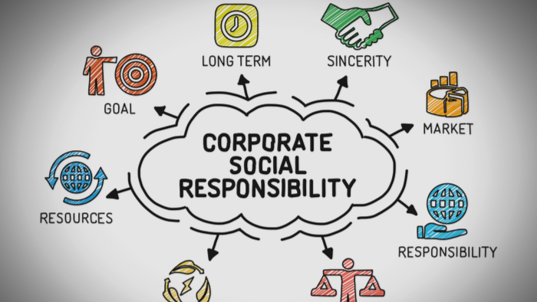
Notes:
HR has a social responsibility role and should support a broad strategy by aligning policies and practices and communication training on social responsibilities. HR should have strong employment and people management practices, ensuring strategies are met.
Corporate responsibilities.
Community – Focus on how the organisation affects the general public.
Employees – Focuses on the rights of the employees and their wellbeing.
Environment – From switching lights off, to recycling materials to the carbon footprint of the organisation.
Market Place – Such as issues with fair trade, corporate taxes and anti bribery.
The rationale for corporate social responsibility is to lower the risk of problems and make sure the business has sustainable practises. It includes ensuring the business is making a positive contribution, increases efficiency and reduces waste. This builds trust and supports employee engagement, retention and becomes our brand.

Slide 5

Notes:
The HR function evolves and priorities change. During the Covid-19 pandemic the function has shifted. Before the pandemic the focus was on employee engagement, employee health and well being and learning and development. During the pandemic the focus changed to employee health and well being, employees engagement and retention(CIPD).
Human resource continues to evolve using transactional v transformational. The difference between transactional and transformational HR work is that the transactional is administrative (some companies outsource this) and transformational is change management and continual improvement. The future will bring in different automation systems so it will reduce the requirement for HR colleagues to undertake the transitional work.

Slide 6
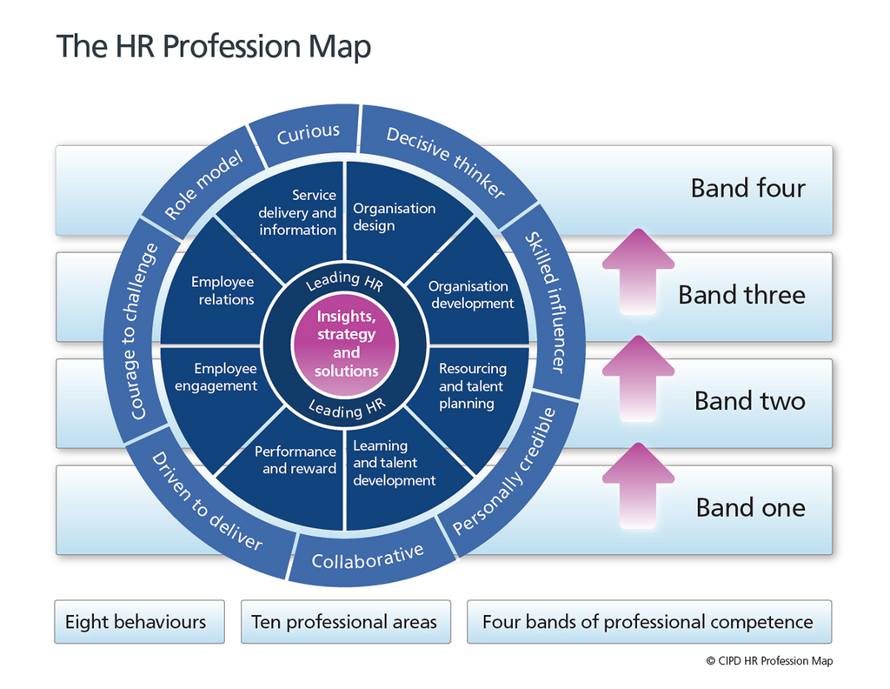
Notes:
CIPD have designed a profession map to support with the human resource function, the purpose is to champion better work and working environments. Its about Creating opportunities, organisations and working environments and getting the best out of our people. The map is used to make better decisions, act with confidence, perform at your peak, drive change and progress with your career(CIPD).
There are four key areas: purpose and value, core knowledge, core behaviours and special knowledge. Everything flows from the purpose which is to champion better work and working lives. By following which area and choosing your path you will be able to transform the Human Resource function to drive the performance, increase your HR capability to work across strategic issues and build the HR credibility enabling you to challenge the business (CIPD).

Slide 7

Notes:
Change Management.
For effective change management it has to be at three levels;
Individual
For a business to successfully change, individuals need to change. The success of projects lies with employees doing things differently.
Change is also only successful if everyone is onboard and has the desire to change.
Organisational
To be successful in a rapid changing environment, change management must be the norm in everything they do. The change must be led from the top. By making change management a core capability, it will bring success.
Projects
Change happens one person at a time, by using project-level change across a group. You would prepare, manage and reinforce the change.
Change management is an important business, it helps improve revenues, remain profitable and relevant, increases profitability of a projects success and ensures a match between requirements and results (managementstudy).
Change management is not easy and can be impacted by a lack of senior support, a lack of support for change or a change resistant culture across the business.
Managing change has never been more critical for organisations and if taken seriously they are ahead of the game. Change can have a positive or negative impact on staff morale.
(Management study HQ)

Slide 8
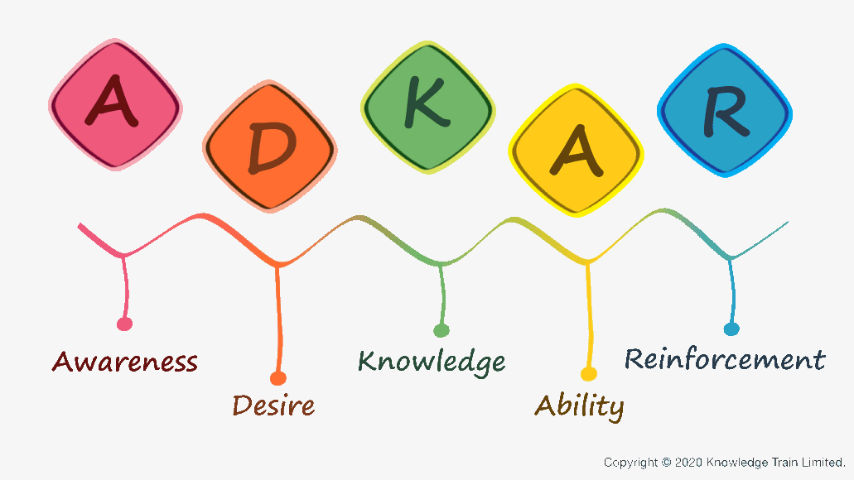
Notes:
ADKAR Model.
The ADKAR model is a tool for its people-focused approach to change management. It was created by Jeffery Hiatt and it helps facilitate change on an individual level. It is often more about the person’s reaction and less about the change itself.
Awareness – Awareness of the change needed.
Desire – Desire to participate and support the change.
Knowledge – Knowledge of how to change.
Ability – Ability to implement the change.
Reinforcement – Reinforce to sustain the change.
As organisational change is directly dependant upon the employee and the implementation, it is crucial that employees have a clear understanding of what the changes are, why the change is happening and how it affects them. The model helps with this process (lucidchart).

Slide 9

Notes:
Human Resources Services.
HR services delivery refers to the function that supports and provides the services to the employees. The HR service will span the entire employee lifecycle, from hire to retire. The most important focus is to optimize the employee experience to improve their satisfaction and make them efficient and productive.
The traditional approach is that the human resources function receive employees requests, this is normally done via email or telephone. The HR team would respond accordingly (Frisby).
A more modern approach, one of which is increasingly being adopted by organisations, is a ‘multi tiered’ model and solution based on Ulrich’s 1998 three legged model of human resource service delivery.

Slide 10
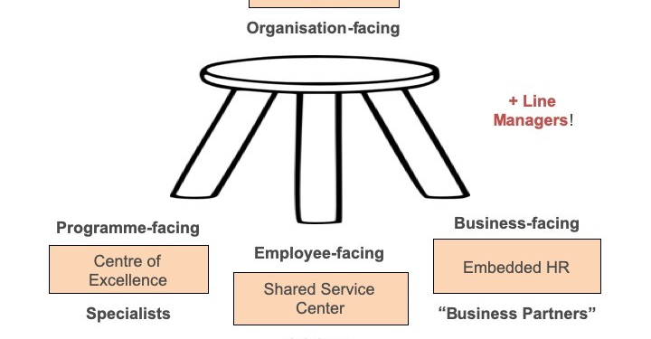
Notes:
Ulrich Model.
The model is commonly looked at as a basic structure for organising a company’s HR function and it can be adapted.
HR Business Partners (HRBP) – The HRBP’s role are consultant seniors. They are generalists providing strategic information, giving advice and support. They are often referred to as the liaison between the manager and the HR services.
Centre of excellence/centre of expertise (CoE) – They are a teams of experts with specialist knowledge who work to provide and develop best practises. This includes recruitment, development, benefits, employee relations, and change management.
Shared services/shared service centres – Shared services is a separate business that handles administrative activities, e.g. instead of having payroll carried out across multiple sites, shared services centralise this activity through a single point. Shared services can involve HR functions such as IT, finance or procurement. They could be set up inhouse or outsourced, they often provide intranets, service portals or help desks. Some companies charge a fee, whilst others incorporate the costs into the general running costs (DTS technology).

Slide 11

Notes:
Line Managers.
The main reason HR and line managers should work closely is because they both have a vested interest in the business and its success. Through working together the line manager becomes proficient in HR functions, therefore the HR professional is able to focus more on strategics (Mayhew 2020).
HR can work to provide guidance on the development and introduction of policies and procedures concerns with effective employee engagement or helping to formulate a flexible working arrangement to encouraging job satisfaction. HR are always conscience of best working practices.
HR can provide technical support advice regarding legislation and employment law. Advising on managing the recruitment process, taking into account diversity and inclusion and discrimination and always ensuring fairness and transparency.
HR managers can also help with practical issues such as learning and development. This could be formulating development plans to tailoring individual needs, as well as looking at the organisations strategy (Armstrong/Taylor).
Recruitment - The human resources department supports the need for workforce in the organisation. HR and line managers should work closely and have regular communication to determine vacancies and learning development to have a seamless operation. HR and line managers need to review job descriptions for accuracy during the recruitment and selection stage, they are there to identify talented candidates .
Workforce – HR and line managers should have a strategy plan concerning future business demands. This could be to determine if training current employees is the correct plan by looking at succession planning. By working together the organisation benefits from the appropriate succession and adequate staffing.
Performance Management – Training and development is a HR function that prepares the line manager for leadership tasks. Leadership training could include how to provide employees with constructive feedback or an unbiased assessment of an employees performance. HR and line managers should work together to ensure a consistent approach, inconsistencies can be negative on employee job satisfaction.
Conflict resolution – This is likely whenever departments employees represent different cultures, work styles and personalities, HR are typically asked to resolve these. A positive working relationship between HR and line manager can support easier handling of investigations or mediation. A great working relationship also gives greater confidence that things are done correctly in accordance with company policies (Mayhew ).

Slide 12

Notes:
Ethical Practises.
Ethics are about building trust by role modelling behaviours and applying principles and values consistently. Ethical values provide the moral compass by which we live our lives and make any decisions.
‘Doing the right thing because it’s the right thing to do’ (CIPD).
Behaviour in business includes obeying rules and regulations, effective communication, taking responsibility, professionalism, trust and mutual respect for all employees at work (CIPD).
As HR professionals we are responsible for adding value and contributing to the ethical success. We are responsible for our decisions and our actions and we are advocates by engaging in activities that enhances its values.
We build respect and strategic importance for the HR function within business and we assist in achieving goals. We positively influence recruitment practises, encourage professional decisions and responsibility.
The HR function work within guidelines that adhere to the highest standards of behaviour, complies with the law and works consistently within the values. We strive to achieve the highest level of service and performance. We advocate the appropriate appreciation of all employees being human beings, and advocate open and honest communication to influence (Shrm).
HR professionals are expected to fix ethical problems and bring stability back into the organisation (CIPD).
We must act ethically in every professional interaction. Lead by example, question to ensure that decisions are made ethically, and have the ability to recognise and resolve issues, using core skills, knowledge and influencing behaviours.

Slide 13

Notes:
Ethics are moral principles that govern behaviours and conduct. It is the difference between good and bad; unethical is the immoral principles of people.
A HR professional must regularly monitor the organisation recruitment and hiring process. This is done to make sure that there are no discrimination based on ethnicity, sexual orientation, race, religion and disability. However by simply following the equal employment guidelines, does not ensure ethical behaviour. If a candidate is recommended in order to fill a vacancy, that would be unethical, as it would remove other candidates that may be more suitable and qualified.
A HR manager can support benefits such as bonuses and this could be made based on KPI’s, it becomes an ethical dilemma if it comes to giving benefits differently for those that don’t achieve.
Labour costs within organisation must be kept down. Ethics would come at the forefront if we were to outsource labour to different countries with lower wages. There is nothing wrong with outsourcing, however it could give your business a bad reputation for potentially using underpaid workers to save labour costs.
Companies are expected to provide fair working conditions for employees. Fair pay and benefits are an obvious factor within a work place. we must practice diversity and inclusion and not discriminate our workforce. We will have different cultures, backgrounds or beliefs and no one should be discriminated in anyway.

Slide 14

Notes:
Evaluation.
Managing a HR function includes not only putting processes, procedures and tools into action, it also entails implementing and maintaining a continuous improvement process.
Audits are inspections and investigations. They are conducted to investigate whether HR standards are being met or evaluate relationships between the HR function and the client, they could be planned or random. It is a management and evaluation approach.
HR information systems are computer systems to collect data and analyse, they can assist in making decisions. They are also good for analysing and evaluating data which can support with broader goals. It can be used to evaluate turnover, absence, costs and benefits and can also be used for questionnaires so we can understand our employees values and attitudes.
Benchmarking allows you to compare your services and processes against those of other companies. This would be a good activity to do before a decision to out source your HR function, as it will support with and help identify the level of service we have now and what we would be looking for.
Whether you don’t plan to receive or you ask for feedback it is always forms a part of monitoring your function. Feedback can be qualitative or quantitative and can be obtained both formally and informally (Disweb).
Research.
A 2011 survey, researched that the HR function spent more time dealing with discipline and grievances than other issue, including learning and development and recruitment (Wanrooy 2013). Therefore the management of workplace conflict remains the role for the HR function. However ideally it needs to adopt a more strategic role. The ACAS research identified that HR played a key role in workplace conflict, it suggests that they are able to develop more trust with line managers and employees therefore more informal solutions to workplace conflict is more likely (Jones and Saunders 2012).
However more recent research in the area (Saundry) found more evidence that there are actually are barriers to the HR function contributing to the workplace. This is due to some businesses using shared services, therefore HR is remote from the workplace and employee relations in general, and conflict management is not seen as a strategic priority.
The ACAS research looked a various models such as the ‘Ulrich model’. The finding is that conflict management is a key pillar of productivity, the longer term consequences of these developments for organisational performance and well-being are a major cause of concern. Despite the outcome they believed that ‘good work’ offers a basis for reinforcing the CIPD’s vision of ‘championing a better work and working lives’ (Cheese). Peter Cheese 2017 in an article stated that ‘good work’ is engaging, gives people a voice, treats them fairly, is good for well-being and helps them progress. In order to embed this agenda HR and all other levels need to see that building the competence of the line managers is key. Fairness underpins trust, which is essential for a productive workplace. This means the demands on line managers goes beyond just procedural. Instead line managers need to build a positive relationship with their staff and resolve conflict when it arises.
Juan Lopez-Cortarelo, Warwick Business School researched that line managers play an essential role in the HR function. Qualitative research was used in a UK based organisations, examining the roles of managers in HRM. In a survey, it found that there was a wide variation within organisations in the consistency of the implementation and the quality of the HR process, due to line management involvement. The typical line manager are low skilled and likely to identify with the workers interest, rather than top management. The findings were portrayed as serious impediments to the success of HR (Mcgovern et al 1997).
The research was based on a retail firm with several stores nationwide, the HR policies are applicable to all. Initially the Head of HR commented ‘Our managers do not have any discretion what's so ever, they do what we tell them to do’ The researcher designed questions to determine their roles in HR, what policies they carried out and what HR decisions they made. The findings were that that there were clear HR policies and they were widely known. In general. the managers viewed HR as value adding partners, and were praised for the support. The role of the line manager was very much to do as instructed, therefore there was no buy in or motivation to own the responsibility of their people. The conclusion of the research determined that companies design their HR systems to enable various levels of discretion and take steps towards aligning line managers HR decision with organisational aims. It showed that the relationship between HR and line managers is important and if broken down it would have implementations on outcomes such as employee behaviours and attitude and therefore on organisational performance (Lopes-Cotarelo).

Slide 15
References
ACAS https://archive.acas.org.uk/
Armstrong and Taylor https://askanacademic.com/
Change Management https://www.managementstudyhq.com/
CIPD profession map 2020 https://peopleprofession.cipd.org
Disweb disweb.rmit.edu.au
DTS International https://www.dtssydney.com/
Hitecsh Bhasin 2019 https://www.marketing91.com/ https://www.hrmexam.com/
Jones, C. and Saundry, R. (2012) https://archive.acas.org.uk/
Juan López-Cotarelo, Industrial Relations Research Unit, Warwick Business School https://warwick.ac.uk/
Lucid Chart https://www.lucidchart.com/
Peter Cheeese CIPD Profession Map 2020
Richard Saundry, University of Sheffield https://archive.acas.org.uk/
Ruth Mayhew https://smallbusiness.chron.com/
SHRM 2014 https://www.shrm.org
Sue Kinsey, University of Plymouth https://archive.acas.org.uk/
Ulrich Model https://www.marketing91.com/
Virginia Fisher, University of West England https://archive.acas.org.uk/

