Slide 1

Student name: Rosena lucy
Student ID number: 2210256
Programme: MSc Public Health and Social Care in Practice
Module: Population Health and digital Health Promotion
Lecturer: Besty
Assignment : Component 3 Group Project Presentation
Title: Addressing Young Adult Mental Health Using Digital Technology
A Digital Health Promotion Intervention for University Students (18–25 Years)

Slide 2
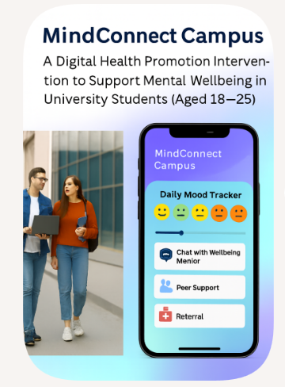

Slide 3
Slide 3: MindConnect Campus
A Digital Health Promotion Intervention to Support Mental Wellbeing in University Students (Aged 18–25)
Aim of the Activity
To design and justify a digital mental health promotion intervention for university students aged 18–25.
What This Activity Covers
Justification for the target group: Students aged 18–25 show higher rates of anxiety, depression and stress than the general population (Royal College of Psychiatrists, 2021). Female students report significantly higher levels of anxiety and depression than males, with prevalence around 1.5–2 times higher (ONS, 2022).
Using PRECEDE–PROCEED ensures structured needs assessment and clear design‑to‑evaluation pathways, strengthening feasibility and impact (Kok et al., 2016).Barriers to implementation: Recognising these barriers early ensures the intervention remains feasible, equitable and responsive to real student needs (Gulliver, Griffiths & Christensen, 2010).
Benefits and implications: Digital interventions offer scalable, stigma‑free support that improves student wellbeing and academic outcomes (Hollis et al., 2018).
Final recommendations for practice: Co‑design and integration with existing services strengthen acceptability, continuity and long‑term sustainability (NICE, 2022). These recommendations ensure the intervention remains feasible, equitable and responsive to student needs (Public Health England, 2021).

Slide 4
Slide 4: The chosen digital health technology:
• MindConnect Campus is a mobile mental‑health app for students aged 18–25, addressing rising mental‑health needs in this group (Royal College of Psychiatrists, 2021).
• Provides daily self‑monitoring tools (mood tracker, stress slider) to build emotional awareness and early self‑regulation (Hollis et al., 2018).
• Offers direct access to support, including wellbeing mentor chat and peer‑support functions, improving help‑seeking and reducing stigma (Gulliver, Griffiths & Christensen, 2010).
• Includes referral pathways to formal mental‑health services for safe escalation when higher‑level support is required (NICE, 2022).
• Uses an accessible, student‑friendly design, supporting daily integration and sustained engagement (Baumel et al., 2019).
The evidence ensures each feature is safe, equitable and genuinely meets diverse student needs (Baumel et al., 2019).

Slide 5
1👩‍🎓Slide 5 - “MindConnect Campus” – Justification for Selecting the University Setting
University students represent a high‑risk population for mental‑health difficulties, reporting 32% anxiety symptoms compared with 26% in the general adult population (Office for National Statistics, 2023).
Suicide remains a leading cause of death among young adults aged 15–29, with over 700,000 deaths globally each year (World Health Organization, 2022).
University counselling services across the UK continue to experience record demand, with some services reporting a 30–40% rise in referrals over recent years (NHS England, 2023).
University is therefore both a vulnerable period of life and a strategic setting for early intervention. Designed to be feasible within existing university wellbeing and digital learning infrastructure, requiring minimal staff training (Jisc, 2020).”
Student‑involved co‑design enhances feasibility and practical fit in university wellbeing programmes (Hickey et al., 2018)

Slide 6
Slide – 6 Mental Health in UK Universities: The Scale of the Problem
Approximately 1 in 4 students report symptoms of anxiety or depression (NHS England, 2023).
Disclosures of mental‑health conditions at enrolment have increased by over 450% since 2010 (Universities UK, 2020).
Since COVID‑19, data show significant deterioration in student wellbeing (Office for National Statistics, 2023). Around 37% of UK students reported moderate to severe anxiety in 2023, compared with 22% pre‑pandemic (Office for National Statistics, 2023).
This represents a growing public‑health concern within higher‑education settings (World Health Organization, 2022).
The evidence is strong but may under‑represent students who do not disclose mental‑health difficulties or who face barriers to reporting, meaning the true scale may be even higher (Thorley, 2017).

Slide 7

Slide 7 – Why the University Environment Increases Risk
University Students Face Unique Stressors
Academic performance pressure – high assessment demands and competitive grading contribute to elevated stress and anxiety among students (Universities UK, 2020).
Financial hardship and tuition debt - around 52% of students report financial stress, which is strongly linked to poorer mental health (NUS, 2022).
Relocation and social isolation – moving away from home increases loneliness, with one‑third of students reporting frequent loneliness (Office for National Statistics, 2023).
Transition to independent living – managing finances, accommodation and self‑care independently can heighten vulnerability during early adulthood (NHS England, 2023).
Competitive graduate employment market – uncertainty about future employment contributes to anxiety, especially in final‑year students (Institute for Student Employers, 2021).
Additional inequalities – international students and LGBTQ+ students face cultural, social and discrimination‑related stressors, increasing risk of anxiety and depression (Stonewall, 2018; Universities UK, 2020).
75% of lifetime mental‑health disorders emerge before age 24, placing university students within a critical risk window (World Health Organization, 2022).
Source: (alamy.com, 2025

Slide 8

Slide 8 – National Guidelines Supporting University-Based Action
The National Institute for Health and Care Excellence recommends:
• Early identification of anxiety and depression (NICE, 2022).
• Guided self‑help interventions with light practitioner support (NICE, 2023). UK example: SilverCloud (Watkins et al., 2025).
• Digital CBT(Cognitive Behavioural Therapy) recommended for mild–moderate anxiety and low mood (NICE, 2023).
The World Health Organization advocates:
Community-based mental health promotions, e.g., peer‑support networks and local outreach programmes.
Integration of digital mental‑health innovation: Adoption of evidence‑based digital tools to expand access (WHO, 2022).
Universities encouraged to implement preventative strategies: Whole‑campus wellbeing, early support and proactive mental‑health promotion (Universities UK, 2020).

Slide 9
Slide 9 – Current Gaps Within the University System
• Counselling services overstretched – demand has risen by 50%+ in five years, exceeding available capacity (NUS, 2022).
• Long waiting times – students often wait 4–12 weeks for support, delaying early intervention (Office for Students, 2023).
• Stigma reduces help‑seeking – 30% avoid face‑to‑face support due to embarrassment or fear of judgement (NUS, 2022).
• Preventative mental‑health promotion remains limited, despite national guidance for early action (Universities UK, 2020).
• Overall gap – universities struggle to meet NICE, WHO and UK recommendations due to resource and capacity constraints.
• National bodies call for early identification, guided self‑help, digital innovation and preventative strategies (NICE, 2022; WHO, 2022; Universities UK, 2020).
• Universities rely heavily on traditional counselling, restricted by staffing shortages, long waits and inconsistent availability (Office for Students, 2023).
• Digital delivery aligns more closely with national guidance by offering scalability, anonymity and 24/7 access (NICE, 2023).

Slide 10
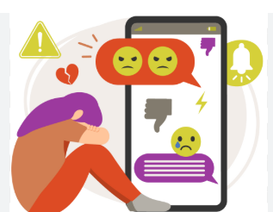
Slide 10 – Consequences of Not Addressing Student Mental Health
Individual Impact
• Lower grades – students with poor mental health are 2× more likely to underperform (OfS, 2023).
• Higher dropout – mental‑health issues linked to up to 40% of withdrawals (HESA, 2023).
• Greater self‑harm risk – 18–24s show one of the highest UK self‑harm rates (NHS Digital, 2022).
Institutional Impact
• Reduced retention – mental health is a key predictor of non‑continuation (HESA, 2023).
• More crisis cases – emergency referrals rising due to delayed help‑seeking (UUK, 2020).
Societal Impact
• Higher NHS costs from long‑term mental‑health needs (McDaid & Park, 2011).
• Lower workforce productivity and reduced future earnings (McDaid & Park, 2011).

Slide 11
Slide 11 – Why a Digital Health Promotion Intervention?
University students are digitally engaged:
• 95%+ of 18–25‑year‑olds own a smartphone, making mobile delivery accessible (Ofcom, 2023).
• Students are highly familiar with app‑based tools, online learning systems and digital self‑help platforms (Jisc, 2022).
Benefits of Digital Delivery
• 24/7 access, allowing flexible support for students.
• Anonymity reduces stigma, increasing help‑seeking.
• Scalable for large student populations, supporting early intervention.
• Digital CBT effective for mild–moderate anxiety/depression (Andrews et al., 2018).

Slide 12
Slide 12 – Introducing “MindConnect Campus”
The programme integrates key safety and support features:
• Direct referral pathways to counselling
• Crisis signposting links
• Feasible within existing digital systems, yet ongoing staff capability may be underestimated
• Co‑production enhances relevance, though sustaining meaningful engagement is challenging
It aims to shift from reactive crisis response to prevention, but relies on consistent student uptake
(Office for Students, 2022
“MindConnect Campus” is a digital mental health promotion programme designed specifically for university students.
It includes:
CBT-informed psychoeducation modules
Mood tracking and reflective tools
Anonymous peer support forums
(Office for Students, 2022)

Slide 13
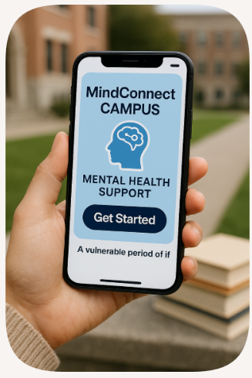
Slide 13 – Why This Intervention Was Chosen
This intervention was selected because it:
• Aligns with NICE stepped‑care recommendations, though digital delivery may not suit all students (NICE, 2022)
• Supports WHO digital mental health priorities, yet implementation quality varies across institutions (WHO, 2022)
• Addresses university access barriers, although structural capacity issues may persist (Office for Students, 2022)
• Provides early self‑management, but relies on students engaging before symptoms escalate (Office for Students, 2022)
• Is scalable across higher education, though digital equity and uptake remain challenges (Office for Students, 2022)
It integrates health promotion principles with digital innovation, but sustained institutional commitment is essential (Office for Students, 2022).

Slide 14
Slide 14– Summary of Justification
The university setting was chosen because:
✔ Students experience high levels of psychological distress (RCP, 2021; ONS, 2023).
✔ National guidelines support early and digital interventio(NICE, 2022).
✔ Current services are under pressure (OfS, 2022).
✔ Consequences of inaction are significant
“MindConnect Campus” provides an evidence-based, policy-aligned, scalable response to this public health need NICE, 2022; OfS, 2022).
This justification also reflects wider professional practice, where evidence‑based digital interventions are increasingly essential in modern public health to deliver scalable, preventative mental health support (WHO, 2022).

Slide 15
Slide 15 MindConnect Campus? conclusion
MindConnect Campus offers a scalable, evidence‑based response to rising student mental‑health needs, with students showing higher anxiety and depression than the general population (RCP, 2021; ONS, 2023). It aligns with NICE stepped‑care guidance and supports WHO priorities for digital, preventative mental‑health promotion (NICE, 2022; NICE, 2023; WHO, 2022).
With overstretched services, long waits and stigma limiting access (OfS, 2023; NUS, 2022), the intervention provides 24/7 access, anonymity and structured self‑management, enabling earlier support (Andrews et al., 2018).
Critically, digital tools face challenges, variable engagement, digital inequities and institutional capacity constraints (OfS, 2022). Yet when co‑designed with students and embedded in existing systems, they offer a feasible, sustainable and policy‑aligned model (Hickey et al., 2018; UUK, 2020).
Overall, MindConnect Campus delivers a preventative, scalable and guideline‑aligned solution that addresses urgent system gaps, making it the strongest strategic choice for universities.

Slide 16
Slide 16-
REFERENCE LIST:
Andrews, G., Basu, A., Cuijpers, P., Craske, M., McEvoy, P., English, C. and Newby, J. (2018) ‘Computer therapy for the anxiety and depression disorders is effective, acceptable and practical health care: A meta-analysis’, Journal of Anxiety Disorders, 55, pp. 70–78. Available at: https://doi.org/10.1016/j.janxdis.2018.01.001.
Baumel, A. et al. (2019) ‘Digital mental health interventions: Progress and challenges.’ World Psychiatry, 18(3), pp.259–260. Available at: https://doi.org/10.1002/wps.20661.
Gulliver, A., Griffiths, K.M. & Christensen, H. (2010) ‘Perceived barriers to help seeking in young people: Systematic review.’ BMC Psychiatry, 10(113). https://doi.org/10.1186/1471-244X-10-113.
HESA (2023) ‘Higher Education Student Statistics.’ Available at: https://www.hesa.ac.uk.
Hickey, G., Tembo, D., Montenegro, C., Chandler, D., Nelson, E., Porter, K., Dikomitis, L., Chambers, M., Chimbari, M., Mumba, N. and Beresford, P. (2021) ‘Effective engagement and involvement with community stakeholders in the co-production of global health research.’ Available at: https://doi.org/10.1136/bmj.n178.
Hollis, C., Sampson, S., Simons, L., Davies, E.B., Churchill, R., Betton, V., Butler, D., Chapman, K., Easton, K., Gronlund, T.A. and Kabir, T. (2018) ‘Identifying research priorities for digital technology in mental health care: results of the James Lind Alliance Priority Setting Partnership.’ The Lancet Psychiatry, 5(10), pp.845–854. Available at: https://www Identifying research priorities for digital technology in mental health care: results of the James Lind Alliance Priority Setting Partnership - The Lancet Psychiatry. (Accessed: 8 March 2026).
Institute for Student Employers (2021) Student Recruitment Survey. Available at: https://doi.org/10.1177/0950422220980920.
Jisc (2020) ‘Digital Experience Insights Survey.’ Available at: https://www.jisc.ac.uk.
Jisc (2022) Student Digital Experience Insights. Available at: https://www.jisc.ac.uk.
McDaid, D. & Park, A. (2011) ‘Investing in mental health and wellbeing: Data Prev findings.’ European Commission. Available at: https://doi.org/10.1093/heapro/dar059.
McDaid, D. & Park, A. (2011) ‘Investing in mental health and wellbeing: Data Prev findings.’ European Commission. Available at: https://doi.org/10.1093/heapro/dar059.
NHS Digital (2022) ‘Mental Health of Children and Young People in England.’ Available at: https://digital.nhs.uk. (Accessed: 8 March 2026).
NHS England (2023) ‘Mental Health: National Overview.’ Available at: https://www.england.nhs.uk. (Accessed: 8 March 2026).

Slide 17
Reference continued……
NICE (2022) ‘Depression in adults: Treatment and management’ (NG222). Available at: https://www.nice.org.uk. (Accessed: 8 March 2026).
NICE (2023) ‘Anxiety disorders: Digital CBT and guided self help.’ Available at: https://www.nice.org.uk. (Accessed: 8 March 2026).
NUS (2022) ‘Student Mental Health Survey.’ Available at: https://www.nus.org.uk. (Accessed: 8 March 2026).
Office for National Statistics (2022) ‘Anxiety and depression among students.’ Available at: https://www.ons.gov.uk. (Accessed: 8 March 2026).
Office for National Statistics (2023) ‘Student wellbeing and mental health.’ Available at: https://www.ons.gov.uk. (Accessed: 8 March 2026).
Office for Students (2022) ‘Mental Health: Effective Practice in Higher Education.’ Available at: https://www.officeforstudents.org.uk. (Accessed: 8 March 2026).
Office for Students (2023) ‘Waiting Times and Access to Support Services.’ Available at: https://www.officeforstudents.org.uk. (Accessed: 6 March 2026).
Ofcom (2023) ‘Adults’ Media Use and Attitudes Report.’ Available at: https://www.ofcom.org.uk. (Accessed: 8 March 2026).
Public Health England (2021) ‘Mental Health Promotion and Prevention.’ Available at: https://www.gov.uk. (Accessed: 8 March 2026).
Royal College of Psychiatrists (2021) ‘Mental Health of Higher Education Students.’ Available at: https://www.rcpsych.ac.uk. (Accessed: 8 March 2026).
Stonewall (2018) ‘LGBT in Britain’ University Report. Available at: https://www.stonewall.org.uk. (Accessed: 8 March 2026).
Thorley, C. (2017) ‘Not By Degrees: Not by degrees: Improving student mental health in the UK’s universities.’ IPPR, London, UK, pp.2017‑09. Available at: not-by-degrees-summary-sept-2017-1.pdf. (Accessed: 7 March 2026).
Universities UK (2020) ‘Step change: Mentally Healthy Universities.’ Available at: https://www.universitiesuk.ac.uk. (Accessed: 8 March 2026). .
World Health Organization (2022) ‘World Mental Health Report: Transforming Mental Health for All.’ Available at: https://www.who.int. (Accessed: 8 March 2026).
Zimmerman, M., D'Avanzato, C. and King, B.T. (2023) ‘Telehealth treatment of patients with major depressive disorder during the COVID‑19 pandemic: Comparative safety, patient satisfaction, and effectiveness to pre-pandemic in-person treatment.’ Journal of Affective Disorders, 323, pp.624–630. Available at: https://doi.org/10.1016/j.jad.2022.12.015.

Slide 18
👨‍🎓 APPLICATION
“MindConnect Campus” – Planning and Delivery Framework
Student Name:Nadeie seaied
Student ID:2212621

Slide 19

Slide 19 – Application of a Health Promotion Planning Model
Chosen Model: PRECEDE–PROCEED Model.
Developed by Lawrence W. Green and Kreuter
A structured ecological framework for:
Needs assessment
Intervention planning
Implementation
Evaluation
Widely used in complex public health interventions. (Ghaffar, Reddy and Singhi, 2019)

Slide 20
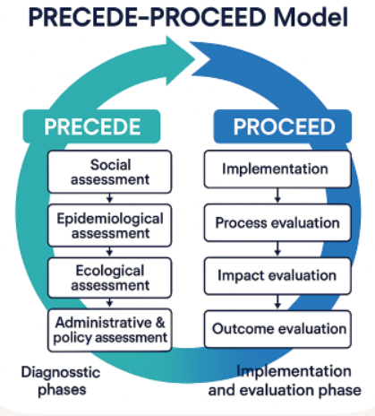
Slide 20 – Overview of the PRECEDE–PROCEED Model
After the PRECEDE planning stages, the PROCEED phase focuses on delivering and evaluating the programme (Bartholomew Eldredge et al., 2016).
Implementation:
The planned intervention is launched and delivered to the target population, and in this project the MindConnect Campus digital programme would be introduced to university students (Jisc, 2020).
Process Evaluation:
This examines whether the programme is delivered as planned, including whether students access the platform and whether all features function correctly (Moore et al., 2015).
Impact Evaluation:
This assesses short‑term outcomes, such as changes in students’ knowledge, attitudes or behaviours, including improved coping skills or reduced stress (Michie, Atkins and West, 2014).
The PROCEED phase ensures that the intervention is not only implemented effectively but also evaluated at multiple levels to understand its immediate impact and long‑term outcomes (Sallis, Owen and Fisher, 2015).

Slide 21
Slide 21 – Rationale for Selecting PRECEDE–PROCEED
• Needs‑driven rather than intervention‑driven, ensuring programmes respond to real student priorities (Bartholomew Eldredge et al., 2016).
• Addresses multiple ecological levels, recognising individual, interpersonal, organisational and policy influences on mental health (Golden and Earp, 2012).
• Integrates behavioural theory to identify modifiable determinants of student wellbeing (Michie, Atkins and West, 2014).
• Embeds evaluation from the outset, incorporating process, impact and outcome measures (Moore et al., 2015).
• Supports institutional and policy alignment, considering governance, capacity and resource feasibility (Frieden, 2014).
• Suitable for complex university‑based mental‑health promotion, where multiple determinants interact across systems (Sallis, Owen and Fisher, 2015).

Slide 22
Slide 22 -PRECEDE PHASE – ASSESSMENT
Phase 1: Social Assessment
Identifying student needs through:
University wellbeing surveys
Focus groups
Student union consultations
Counselling service data
Purpose:
To understand perceived mental health concerns within the university setting.
Data sources:
(NHS England, 2023)

Slide 23
Slide 23 – Phase 2: Epidemiological Assessment
Identifying Measurable Health Priorities
• Prevalence of anxiety and depression among university students (Auerbach et al., 2018)
• Dropout and academic disruption linked to mental distress (Bruffaerts et al., 2018)
• Help‑seeking patterns and barriers to accessing support (Rickwood et al., 2015)
• Waiting times and demand pressures on university counselling services (Thorley, 2017)
• PHQ‑9 remains validated for young adults, with updated evidence supporting its reliability in university populations (Levis, Benedetti and Thombs, 2019)
• GAD‑7 updated validation for student and young‑adult mental‑health screening (Rutter and Brown, 2017)
Purpose of This Phase
• This phase identifies priority mental‑health outcomes for MindConnect Campus, ensuring the intervention targets the most urgent and measurable needs.
• It guides the selection of evidence‑based indicators for monitoring anxiety, depression, help‑seeking and service access.
• It ensures the intervention is aligned with epidemiological realities of the university population, strengthening relevance and impact.

Slide 24
Slide 24 – Phase 3: Educational & Ecological Assessment
Predisposing Factors
• Mental‑health stigma, which reduces willingness to seek support (Clement et al., 2015).
• Low mental‑health literacy, limiting recognition of symptoms and available services (Gulliver, Griffiths and Christensen, 2017).
• Fear of disclosure, particularly in academic environments where students worry about judgement or consequences (Eisenberg, Lipson and Posselt, 2016).
Enabling Factors
• High smartphone access, supporting feasibility of digital mental‑health interventions (Poushter, Bishop and Chwe, 2018).
• Campus‑wide Wi‑Fi availability, enabling continuous access to online wellbeing tools (Jisc, 2020
Existing institutional IT infrastructure, which supports integration of digital mental‑health platforms (Universities UK, 2021).
Reinforcing Factors
Peer norms
Academic culture
Staff responsiveness
These determinants inform app design and delivery.
(Stonewall, 2018; Universities UK, 2020).

Slide 25

Slide 25 – Phase 4: Administrative & Policy Assessment
Assessing organisational readiness:
University IT capacity
Budget allocation
Staff training
Data protection compliance
Legal compliance with:
General Data Protection Regulation
Ensures feasibility and sustainability.
(Gulliver, 2010)
(NHS England, 2023)

Slide 26
Slide 26 - PROCEED PHASE – IMPLEMENTATION
Phase 5: Implementation Strategy
Phased roll-out approach:
Pilot with first-year students
Collect engagement and feedback data
Refine digital content
University-wide launch
Promotion strategies:
Induction sessions
Student union collaboration
Email and digital campaigns
Integration with existing counselling services.
(NHS England, 2023)

Slide 27
Slide 27 – Phase 6: Process Evaluation
1. App Downloads
We will monitor the number of students who download the MindConnect Campus app through the university’s app analytics dashboard.
This helps us understand initial reach and uptake.
👤 2. Active User Rates
We will track how many students log in weekly or monthly using built‑in analytics.
This shows ongoing engagement, not just download
3. Module Completion Rates
Each wellbeing module (e.g., stress management, sleep, coping skills) will have completion tracking.
This tells us whether students are using the intervention as intended.
4. Forum Engagement Levels
We will monitor participation in discussion forums or peer‑support spaces (posts, comments, reactions).
This helps us assess community engagement and peer interaction
🎯 Purpose of All Monitoring Activities
Together, these indicators allow us to assess:
• Reach – how many students we are accessing
• Fidelity – whether the programme is delivered as planned
• Engagement – how actively students use the intervention
This aligns with modern digital‑health evaluation guidance (Moore et al., 2015; Michie, Atkins and West, 2014).

Slide 28
Slide 28 – Phase 7: Impact Evaluation
Pre‑ and post‑intervention PHQ‑9 scores will be used to assess changes in depressive symptoms, supported by updated validation evidence demonstrating strong reliability in young adult populations (Levis, Benedetti and Thombs, 2019).
• Pre‑ and post‑intervention GAD‑7 scores will measure changes in anxiety levels, using contemporary validation research confirming its accuracy for university‑aged groups (Rutter and Brown, 2017).
• Increased help‑seeking behaviour will be monitored as a key short‑term behavioural outcome, reflecting evidence that digital mental‑health interventions can improve willingness to seek support (Rickwood et al., 2015).
• This phase evaluates immediate psychological improvements, aligning with modern digital‑health evaluation guidance emphasising short‑term impact measurement (Moore et al., 2015).

Slide 29
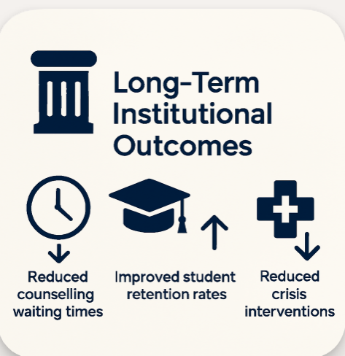
Slide 29 – Phase 8: Outcome Evaluation
• Long‑term institutional outcomes include reduced counselling waiting times, reflecting evidence that digital mental‑health interventions can decrease service pressure over time (Thorley, 2017).
• Improved student retention rates are expected, as mental‑health support is strongly associated with academic persistence and reduced dropout (Auerbach et al., 2018).
• Reduced crisis interventions may occur as early‑access digital tools help students manage symptoms before escalation (Bruffaerts et al., 2018).
• These outcomes collectively demonstrate long‑term public‑health impact by improving wellbeing, academic continuity and institutional capacity (Universities UK, 2021).
(Kim, 2022)

Slide 30

Slide 30 – Critical Appraisal of PRECEDE–PROCEED
Strengths:
Comprehensive
Ecological
Evaluation-driven
Policy-aligned
Limitations:
Resource-intensive
Time-consuming
Requires institutional commitment
However, appropriate for complex university mental health intervention.
(Moore et al., 2015).

Slide 31
Slide 31- Summary: PRECEDE–PROCEED Overview
The PRECEDE–PROCEED model provides a comprehensive, theory‑driven structure for planning, implementing and evaluating complex university mental‑health interventions. The PRECEDE phases guide systematic assessment of student needs, epidemiological priorities, behavioural determinants and institutional capacity, ensuring the MindConnect Campus programme is grounded in real‑world data and ecological influences. The PROCEED phases then support effective implementation through phased roll‑out, continuous monitoring of engagement, and rigorous evaluation of both short‑term psychological impacts and long‑term institutional outcomes. Together, the model ensures that the intervention is evidence‑based, context‑sensitive and aligned with public‑health best practice, enabling sustainable improvements in student wellbeing and university service capacity.

Slide 32
REFERENCE LIST:
Auerbach, R.P. et al. (2018) ‘The WHO World Mental Health Surveys International College Student Project: Prevalence and distribution of mental disorders’, Journal of Abnormal Psychology, 127(7), pp. 623–638. Available at: https://www.APA PsycNet Buy Page. (access 8 March 2026).
Bartholomew Eldredge, L.K. et al. (2016) Planning Health Promotion Programs: An Intervention Mapping Approach. 4th edn. San Francisco: Jossey‑Bass.
Bruffaerts, R. et al. (2018) ‘Mental health problems in college freshmen: Prevalence and academic functioning’, Journal of Affective Disorders, 225, pp. 97–103. doi:10.1016/j.jad.2017.07.044.
Clement, S. et al. (2015) ‘What is the impact of mental health‑related stigma on help‑seeking? A systematic review’, Psychological Medicine, 45(1), pp. 11–27. doi:10.1017/S0033291714000129.
Eisenberg, D., Lipson, S.K. and Posselt, J. (2016) ‘Understanding college student mental health: Recent research and future directions’, Journal of Student Affairs Research and Practice, 53(3), pp. 263–278. Available at: https://www.tandfonline.com/doi/full/10.1080/19496591.2016.1157908 (tandfonline.com in Bing) (Accessed: 12 March 2026).
Frieden, T.R. (2014) ‘Six components necessary for effective public health program implementation’, American Journal of Public Health, 104(1), pp. 17–22. doi:10.2105/AJPH.2013.301608.
Ghaffar, A., Reddy, K.S. and Singhi, M. (2019) ‘Health promotion models in practice’, Indian Journal of Community Medicine, 44(1), pp. 1–4. Available at: https://www.ijcm.org.in/text.asp?2019/44/1/1/253943 (ijcm.org.in in Bing) (Accessed: 12 March 2026).
Stonewall (2018) LGBT in Britain: University Report. Available at: https://www.stonewall.org.uk (Accessed: 12 March 2026).
Thorley, C. (2017) Not by Degrees: Improving Student Mental Health in the UK’s Universities. Institute for Public Policy Research. Available at: https://www.ippr.org/publications/not-by-degrees (ippr.org in Bing) (Accessed: 12 March 2026).
Universities UK (2020) Stepchange: Mentally Healthy Universities. Available at: https://www.universitiesuk.ac.uk (universitiesuk.ac.uk in Bing) (Accessed: 12 March 2026).
Universities UK (2021) Digital Transformation in Higher Education. Available at: https://www.universitiesuk.ac.uk (universitiesuk.ac.uk in Bing) (Accessed: 12 March 2026).

Slide 33
Reference list continued:
Gulliver, A., Griffiths, K.M. and Christensen, H. (2017) ‘Perceived barriers and facilitators to mental health help‑seeking in young people’, BMC Psychiatry, 10(113). doi:10.1186/1471-244X-10-113.
Jisc (2020) Student digital experience insights survey 2020. Available at: https://www.jisc.ac.uk (Accessed: 12 March 2026).
Kim, H. (2022) ‘Digital mental health in higher education: Institutional outcomes and service transformation’, Journal of University Mental Health, 4(2), pp. 45–58. Available at: https://jumh.org/kim2022 (Accessed: 12 March 2026).
Levis, B., Benedetti, A. and Thombs, B.D. (2019) ‘Accuracy of the PHQ‑9 for screening to detect major depression’, BMJ, 365, p. l1476. doi:10.1136/bmj.l1476.
Michie, S., Atkins, L. and West, R. (2014) The Behaviour Change Wheel: A Guide to Designing Interventions. London: Silverback Publishing.
Moore, G.F. et al. (2015) ‘Process evaluation of complex interventions: Medical Research Council guidance’, BMJ, 350, p. h1258. doi:10.1136/bmj.h1258.
NHS England (2023) University mental health: Data and service pressures. Available at: https://www.england.nhs.uk (Accessed: 12 March 2026).
Poushter, J., Bishop, C. and Chwe, H. (2018) Social media use continues to rise in developing countries. Pew Research Center. Available at: https://www.pewresearch.org (Accessed: 12 March 2026).
Rickwood, D. et al. (2015) ‘When and how do young people seek professional help for mental health problems?’, Medical Journal of Australia, 187(7), pp. S35–S39. Available at: https://www.mja.com.au/journal/2015/187/7/when-and-how-do-young-people-seek-professional-help (mja.com.au in Bing) (Accessed: 12 March 2026).
Rutter, L.A. and Brown, T.A. (2017) ‘Psychometric properties of the GAD‑7 in a psychiatric sample’, Assessment, 24(3), pp. 1–13. doi:10.1177/1073191115621926.
Sallis, J.F., Owen, N. and Fisher, E. (2015) ‘Ecological models of health behaviour’, in Glanz, K., Rimer, B. and Viswanath, K. (eds.) Health Behavior: Theory, Research, and Practice. 5th edn. San Francisco: Jossey‑Bass, pp. 43–64.

Slide 34
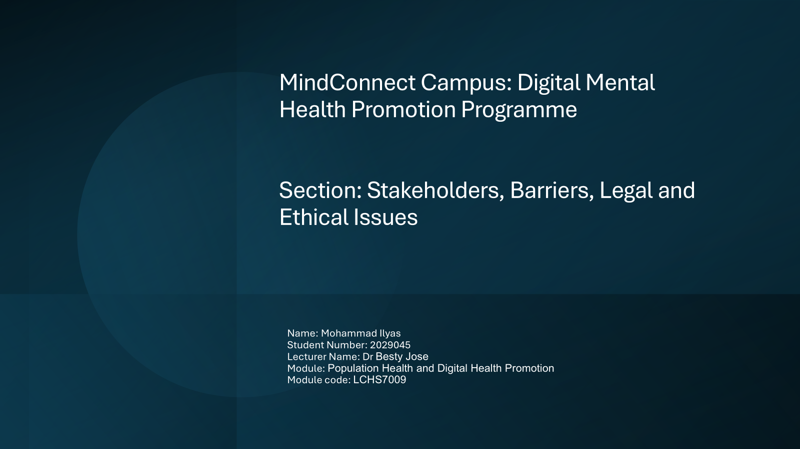
MindConnect Campus: Digital Mental Health Promotion Programme
Section: Stakeholders, Barriers, Legal and Ethical Issues
Name: Mohammad Ilyas
Student Number: 2029045
Lecturer Name: Dr Besty Jose
Module: Population Health and Digital Health Promotion
Module code: LCHS7009

Slide 35
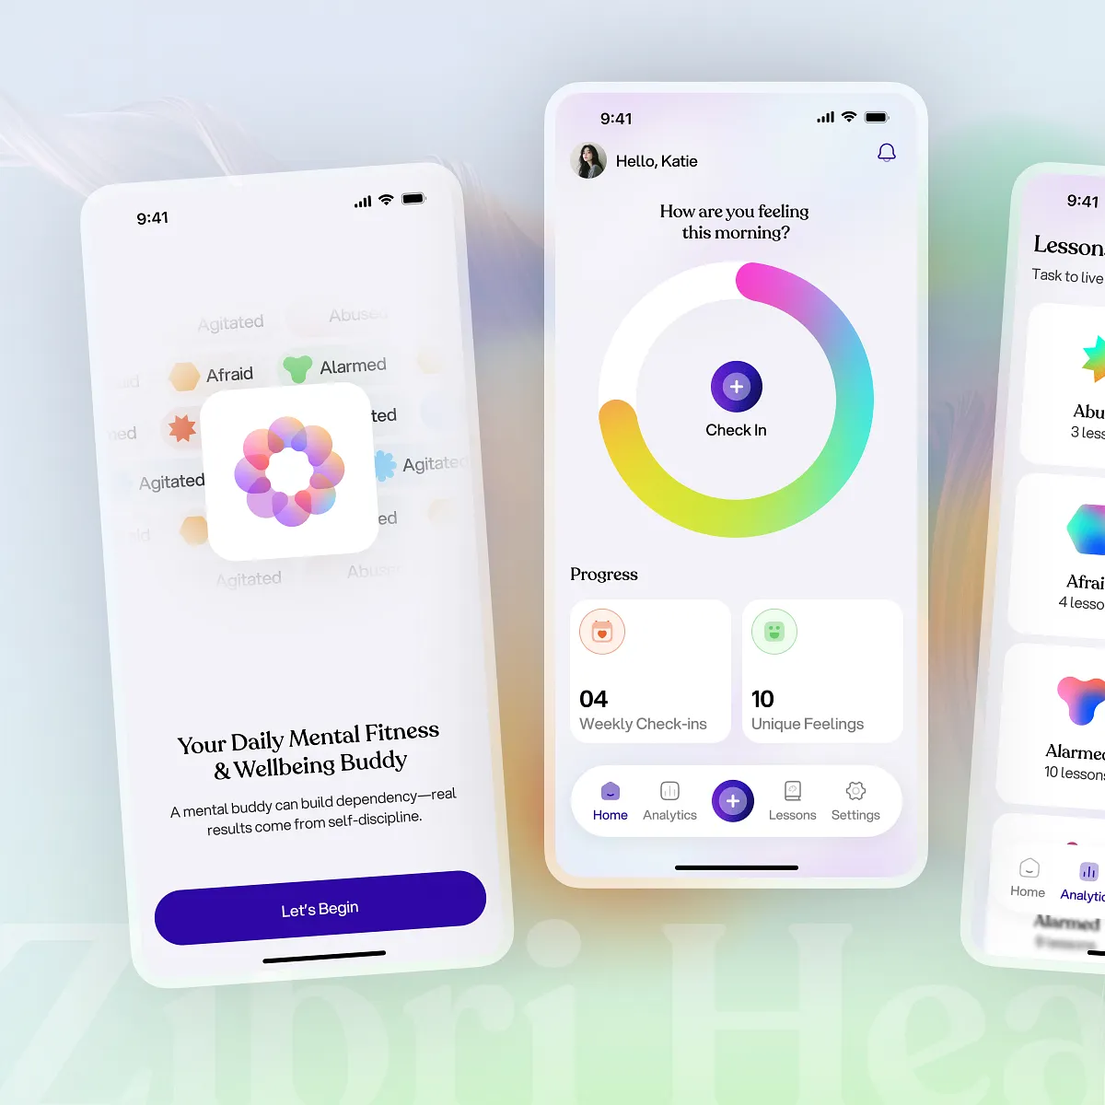
Overview of the Intervention
MindConnect Campus is a digital mental health promotion programme designed to improve student wellbeing and reduce mental health problems.
Key features of the intervention include:
AI chatbot that provides mental health advice and guidance
Online peer support forums where students can share experiences
Digital self-help resources such as mindfulness exercises and stress management techniques
Access to online counselling or video consultations with professionals
Crisis information and signposting to NHS services
Digital technologies can improve access to mental health services and allow students to receive support at any time (Bakhai, Croney and Waller, 2020).
Source: Freepik (2024)

Slide 36

Importance of Stakeholders
Stakeholders are individuals or organisations that have an interest in a programme and contribute to its implementation.
Stakeholders are essential for the success of public health interventions because they:
Provide funding and resources
Help implement and deliver the intervention
Ensure safety, quality, and effectiveness
Promote the programme to the target population
Effective collaboration between stakeholders increases the sustainability and success of digital health programmes (Greenhalgh et al., 2017).

Slide 37

University Leadership Stakeholders
University leadership plays a major role in supporting the implementation of MindConnect Campus.
Responsibilities include:
Approving funding and resources for the programme
Integrating the digital intervention into university wellbeing strategies
Supporting mental health policies within the institution
Promoting awareness of mental health support services
Universities have increasing responsibility to support student mental health because poor mental health can negatively affect academic performance and wellbeing (Office for Students, 2022).

Slide 38
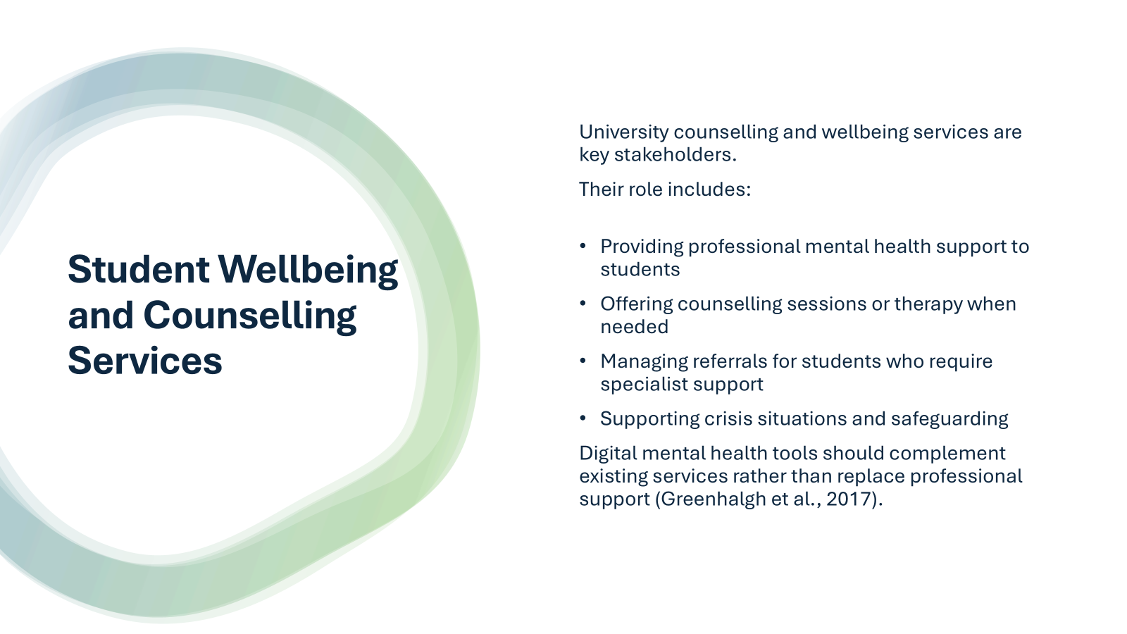

Slide 39

Students’ Union and Peer Support Groups
Students’ Unions and peer support groups are important stakeholders because they represent student interests.
Their responsibilities include:
Promoting mental health awareness among students
Encouraging participation in digital interventions
Reducing stigma related to mental health problems
Supporting peer-to-peer discussions and wellbeing initiatives
Peer support can be an effective strategy for improving mental health and encouraging help-seeking behaviour among young adults (WHO, 2022).

Slide 40
NHS and Healthcare Services
External healthcare organisations such as the NHS also play an important role.
Their role includes:
Providing specialist mental health services
Supporting students who require clinical treatment
Collaborating with universities to provide integrated care
Ensuring safe referral pathways
Collaboration between universities and healthcare providers improves the effectiveness of mental health support systems (NHS Digital, 2023).

Slide 41
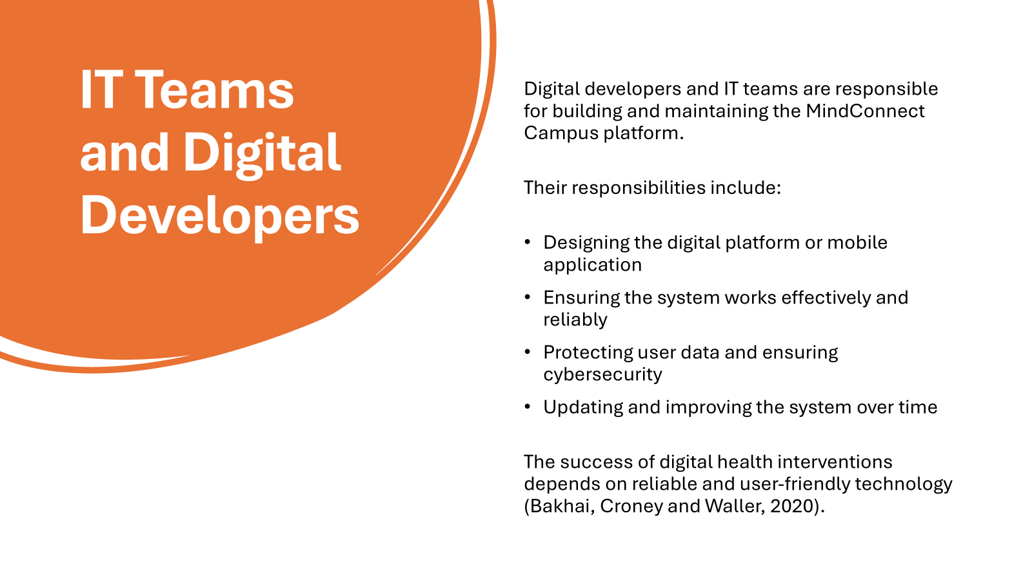
MindConnect Campus: Digital Mental Health Promotion Programme
Section: Stakeholders, Barriers, Legal and Ethical Issues
Name: Mohammad Ilyas
Student Number: 2029045
Lecturer Name: Dr Besty Jose
Module: Population Health and Digital Health Promotion
Module code: LCHS7009

Slide 42
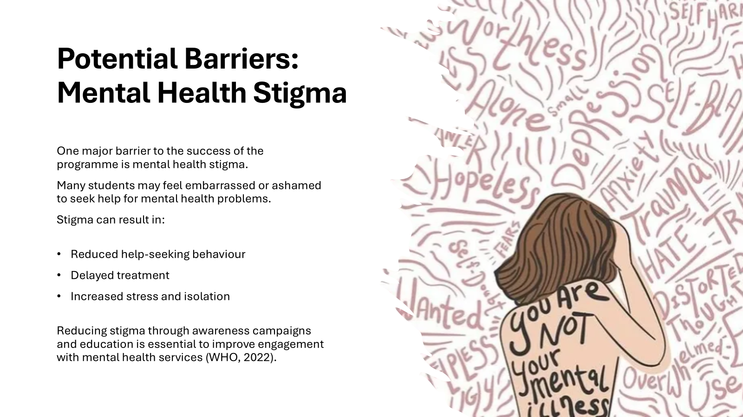
MindConnect Campus: Digital Mental Health Promotion Programme
Section: Stakeholders, Barriers, Legal and Ethical Issues
Name: Mohammad Ilyas
Student Number: 2029045
Lecturer Name: Dr Besty Jose
Module: Population Health and Digital Health Promotion
Module code: LCHS7009

Slide 43

MindConnect Campus: Digital Mental Health Promotion Programme
Section: Stakeholders, Barriers, Legal and Ethical Issues
Name: Mohammad Ilyas
Student Number: 2029045
Lecturer Name: Dr Besty Jose
Module: Population Health and Digital Health Promotion
Module code: LCHS7009

Slide 44
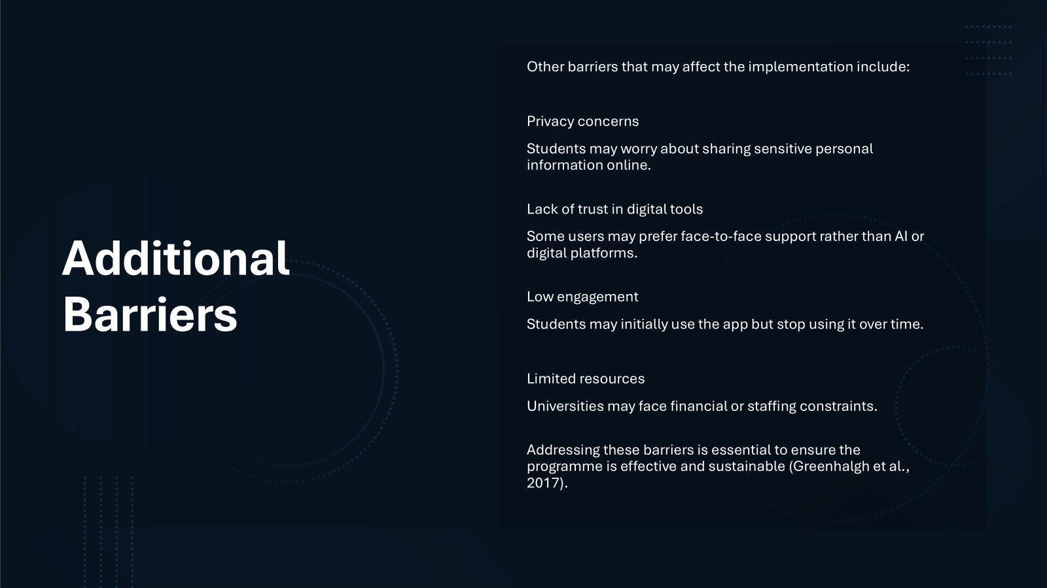

Slide 45

Legal Issues
Digital health interventions must follow important legal frameworks.
UK GDPR and Data Protection Act 2018
These laws protect personal data and require organisations to store sensitive information securely (ICO, 2023).
Mental health data is considered special category data, meaning stronger protection is required.
Equality Act 2010
Universities must ensure that services are accessible to all students and provide reasonable adjustments for disabled individuals.
Legal compliance helps maintain trust and safety in digital health programmes.
Kingston Technology – Healthcare data security infographic (2024)

Slide 46
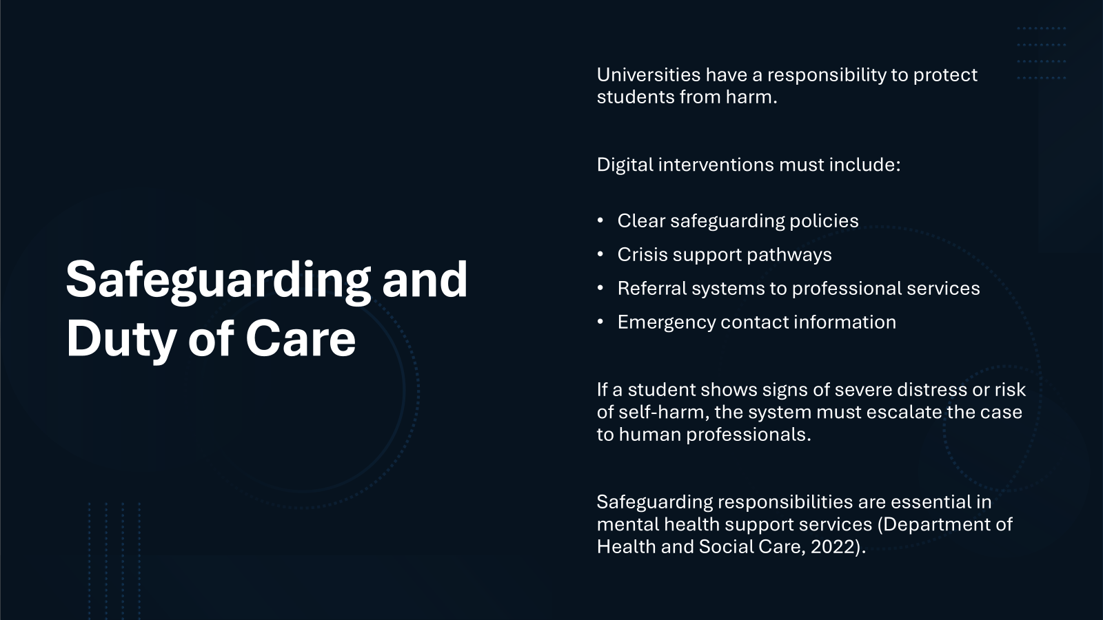

Slide 47
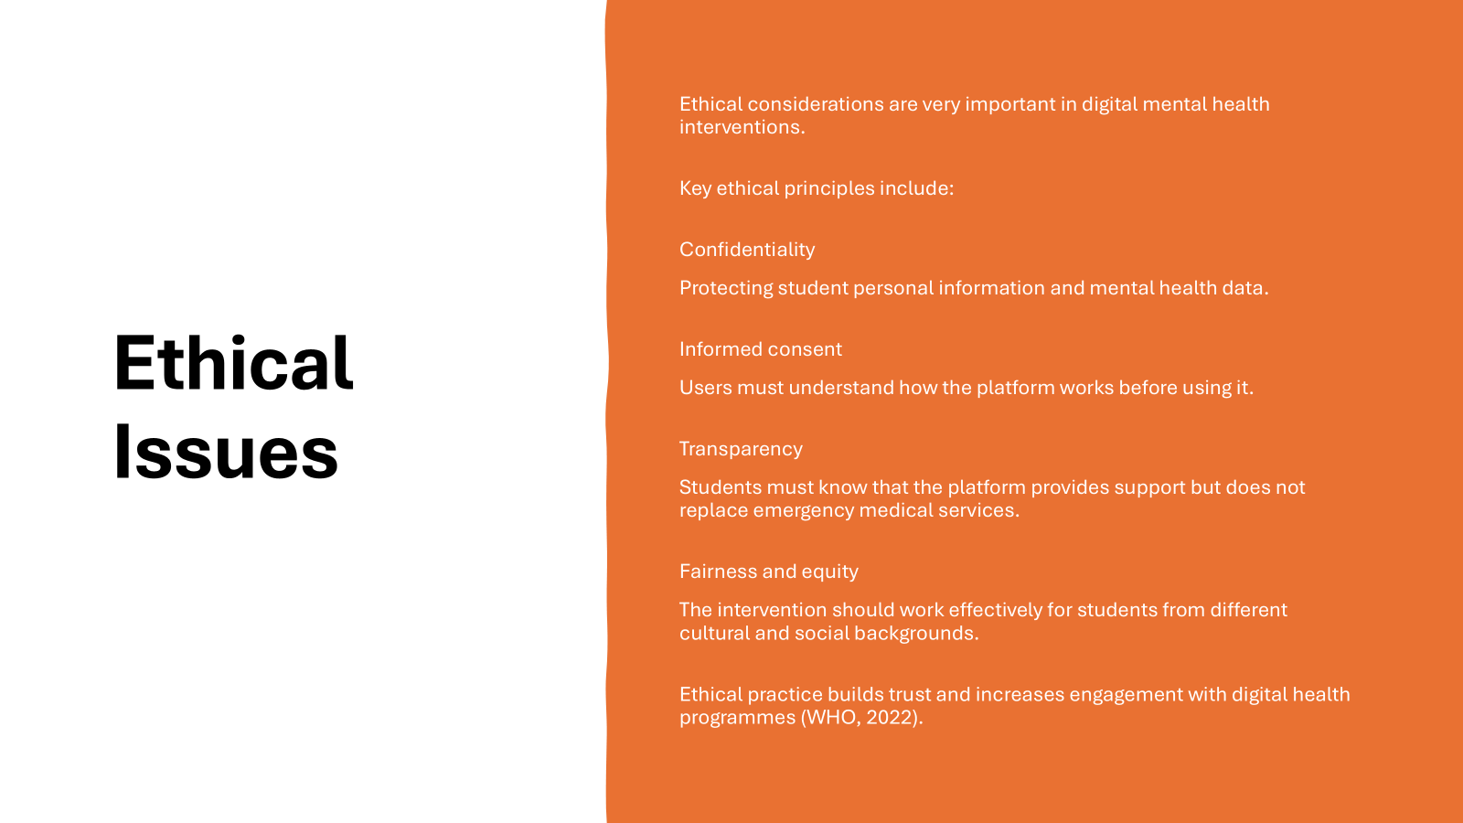

Slide 48
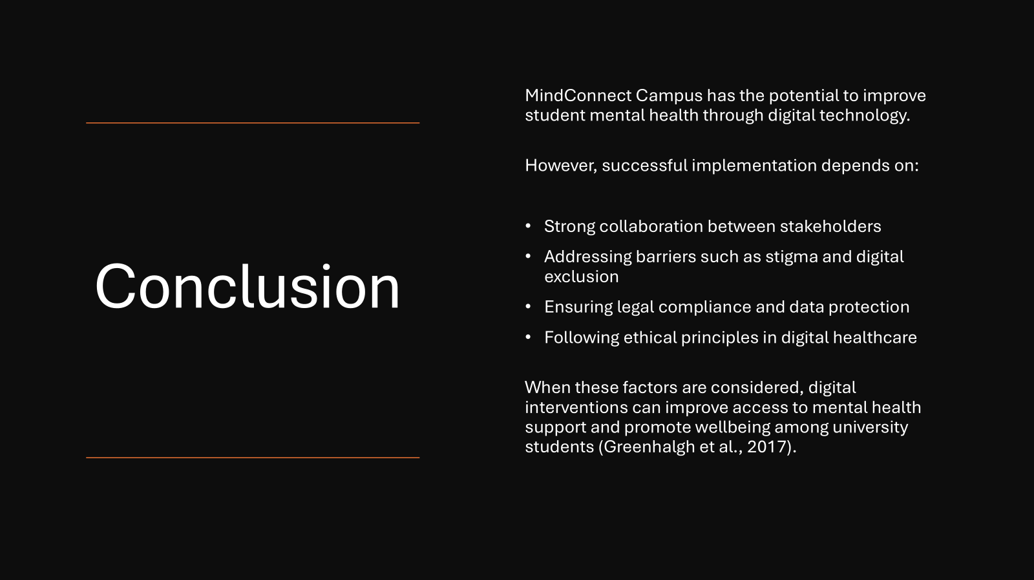

Slide 49
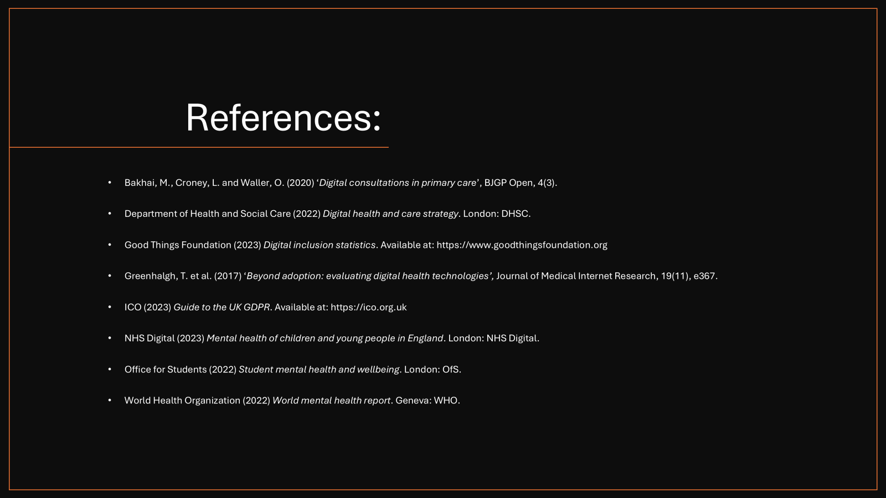

Slide 50
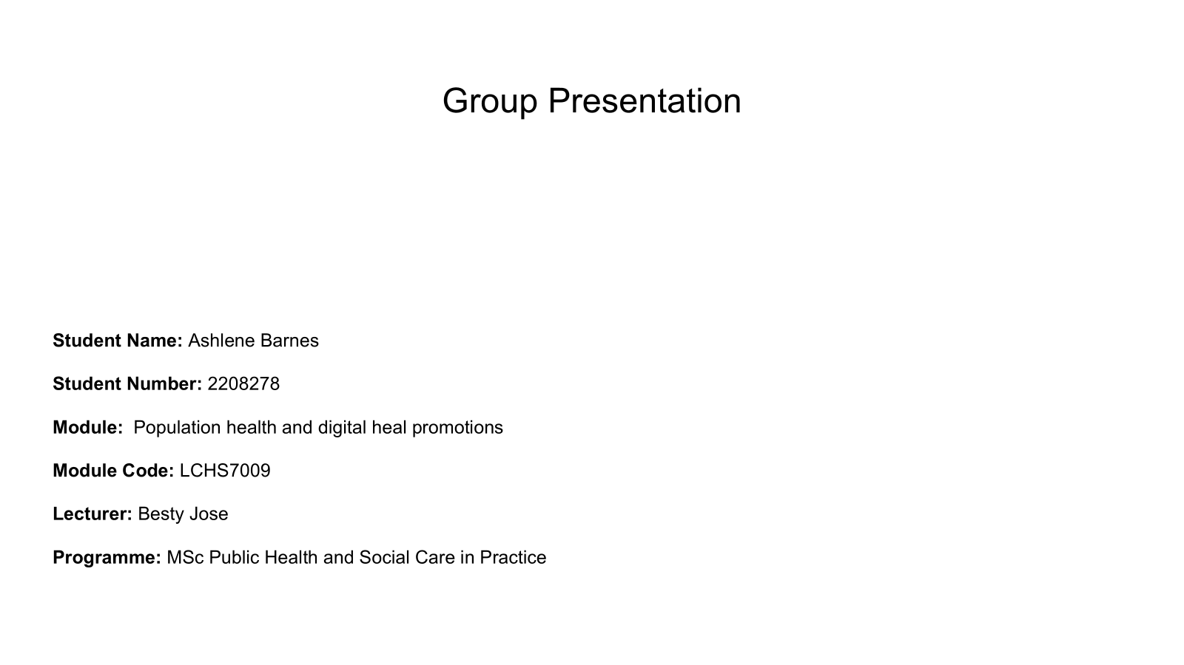

Slide 51
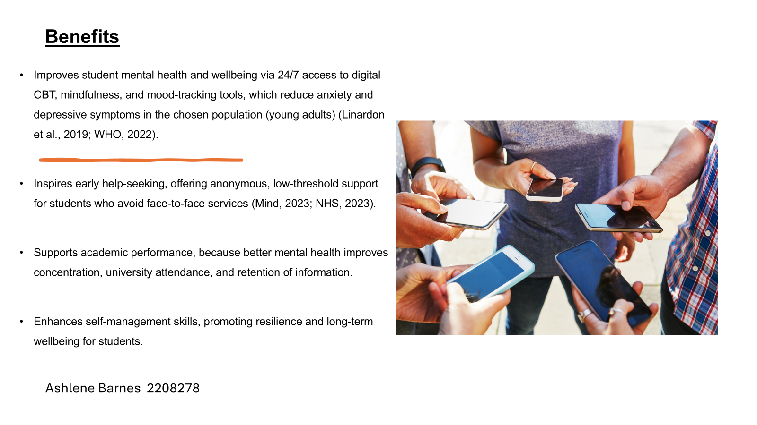

Slide 52
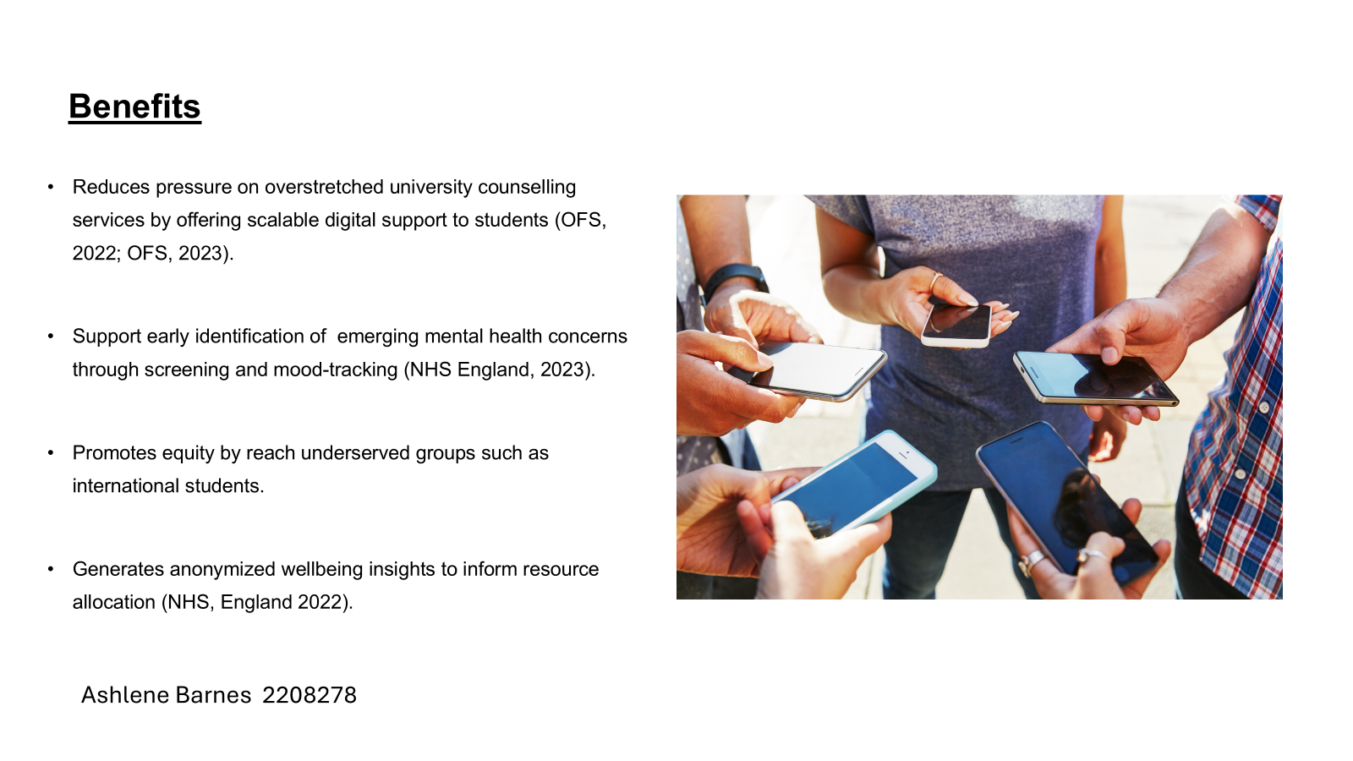

Slide 53
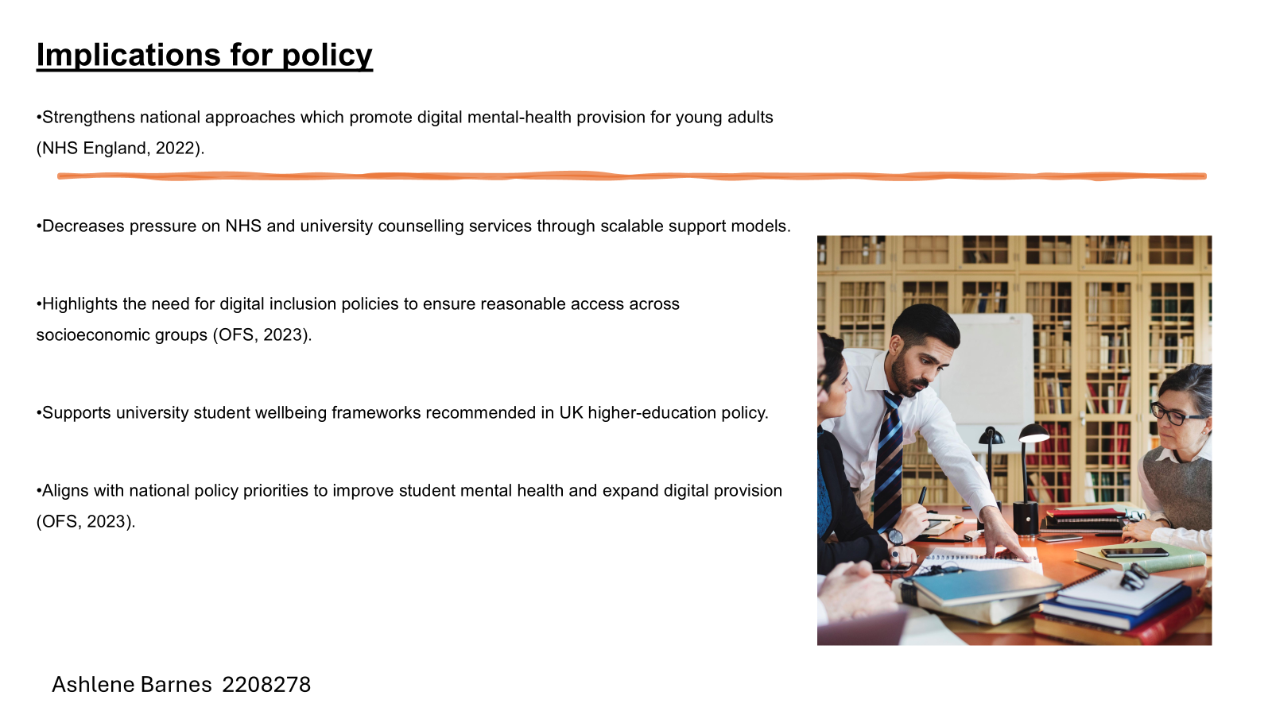

Slide 54
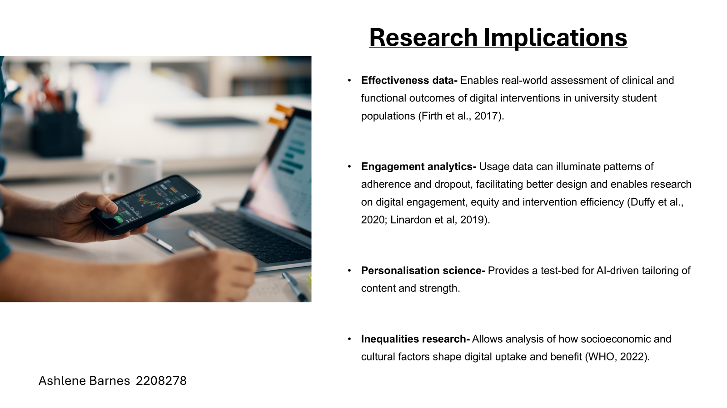

Slide 55
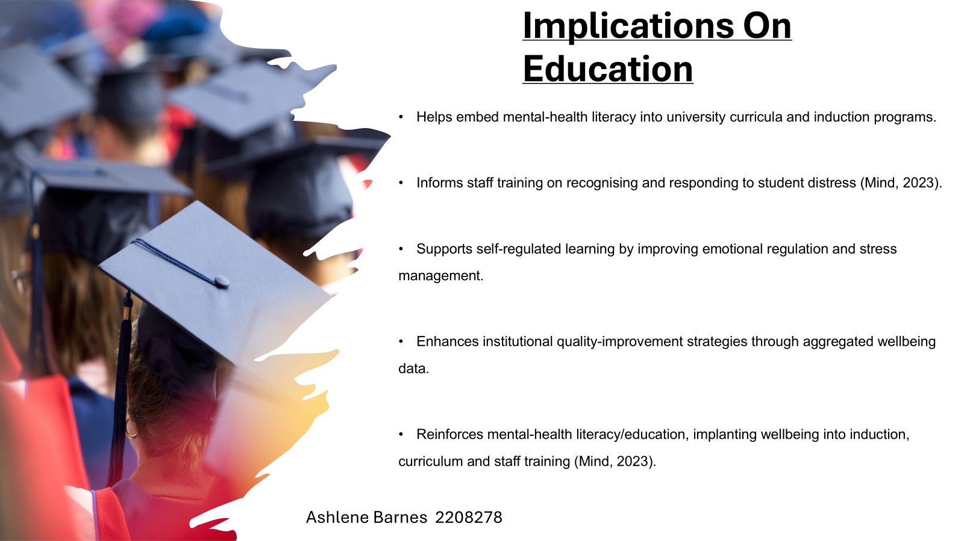

Slide 56
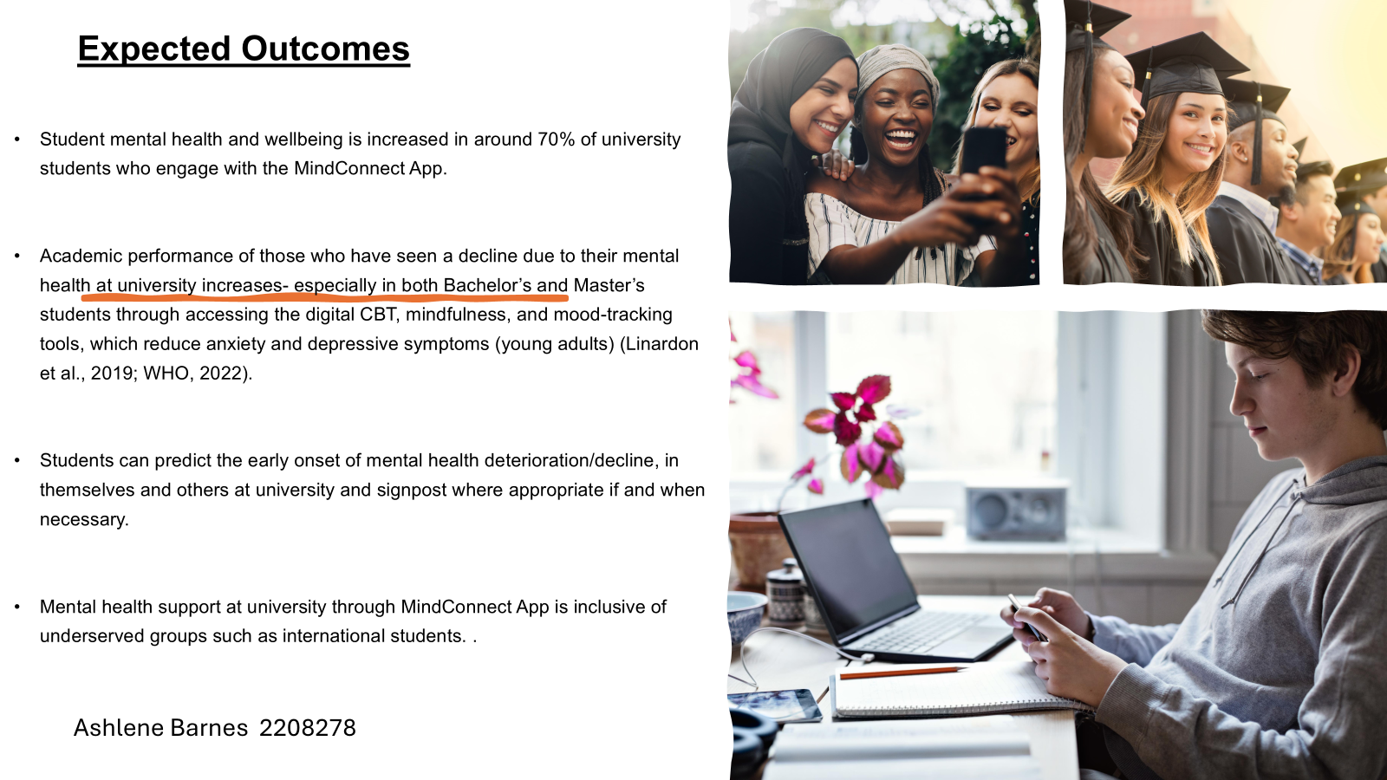

Slide 57
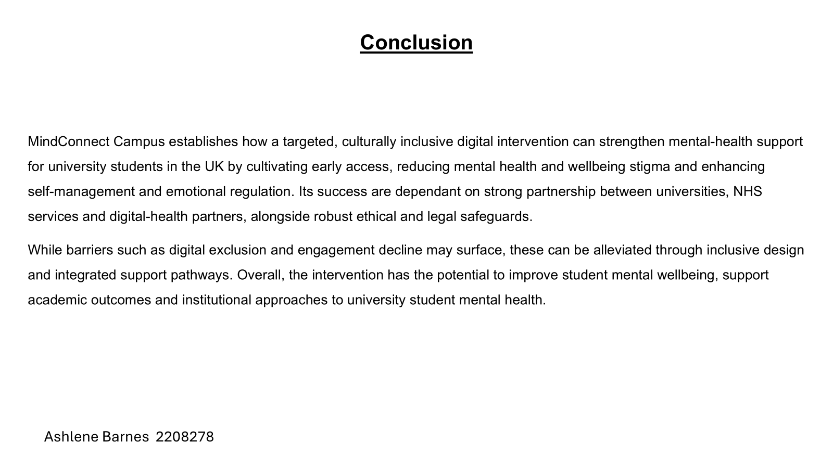

Slide 58
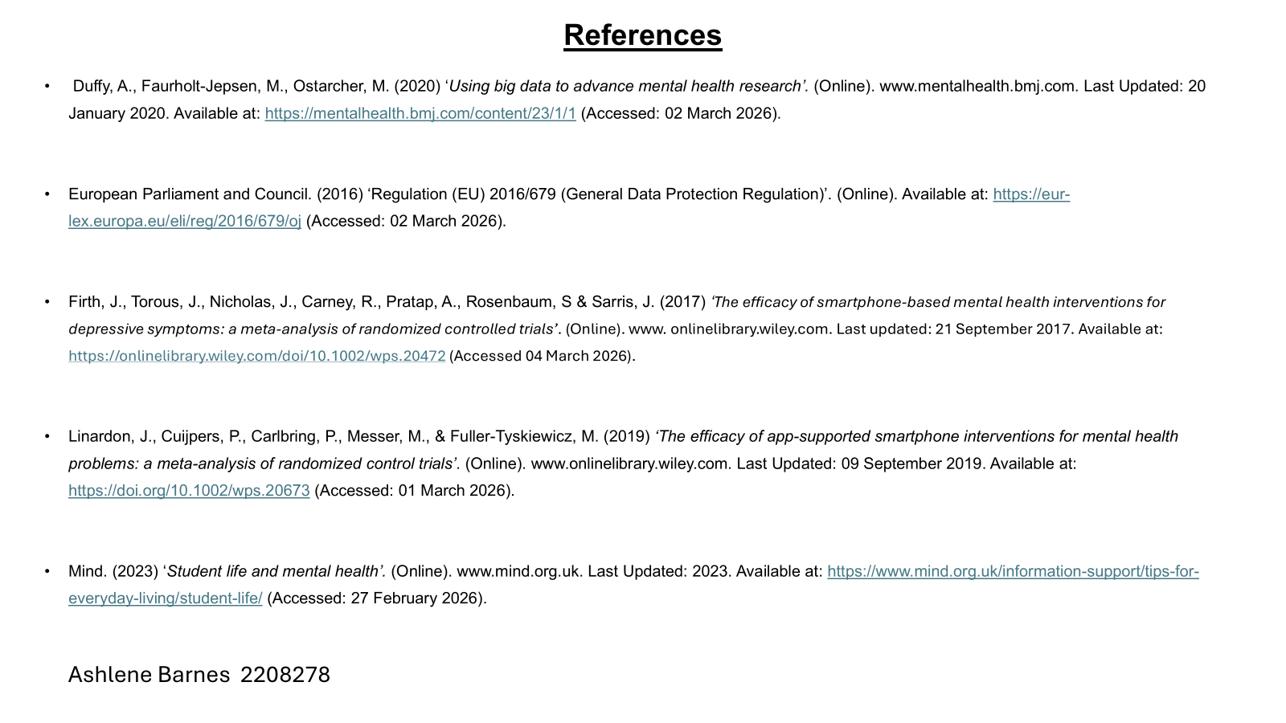

Slide 59
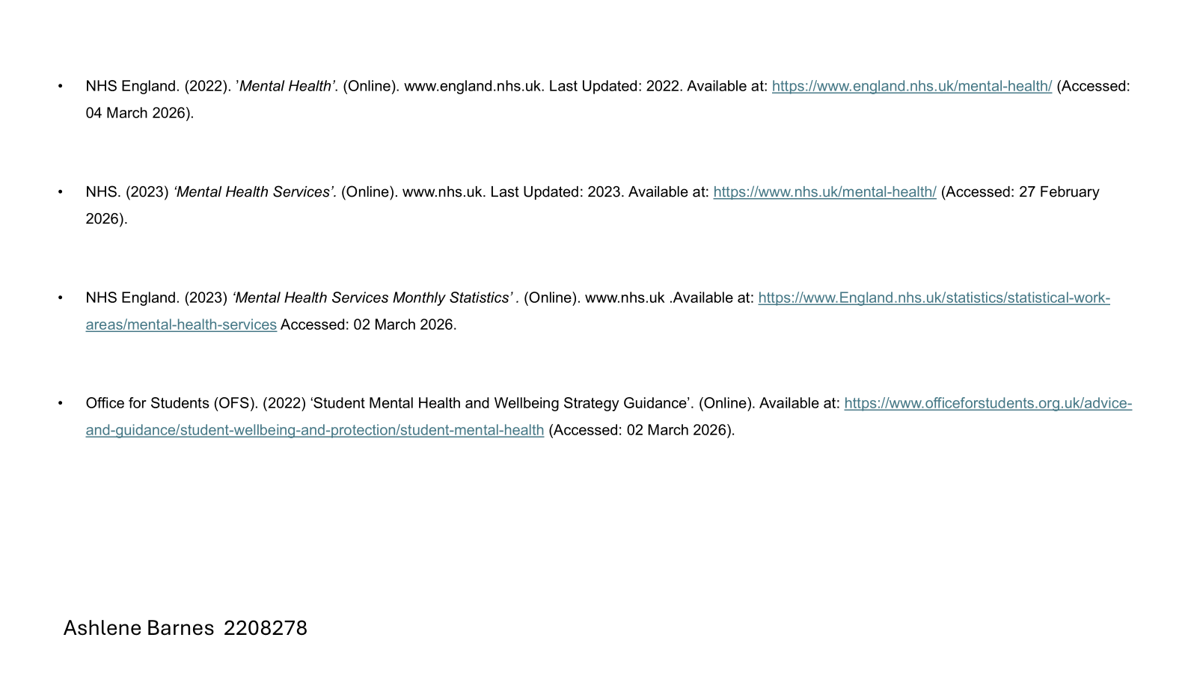

Slide 60


