Slide 1

Sustainable Development: Hospitality Industry
M6X01931_LON
Lecturer Dale Clarke
Erol Asan
1814997
1814997@student.uwtsd.ac.uk
July 2020

Slide 2
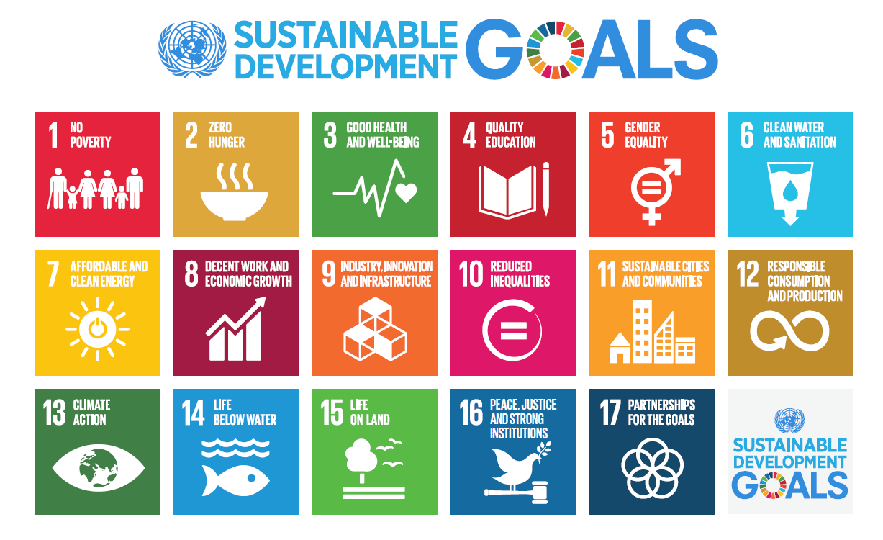
Sustainable Development

Slide 3


Marriott and S. D.
Their organisational goal is that by the year 2025, all properties under their brand will have reached a sustainable standard for LEED certification.

Slide 4
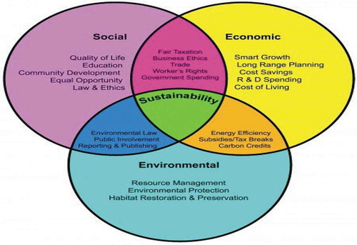
Major trends for today’s Modern Hotel’s

Slide 5

Environmental Issues
Negative impact derived from:
Waste
Water
Energy usage and Generation.

Slide 6
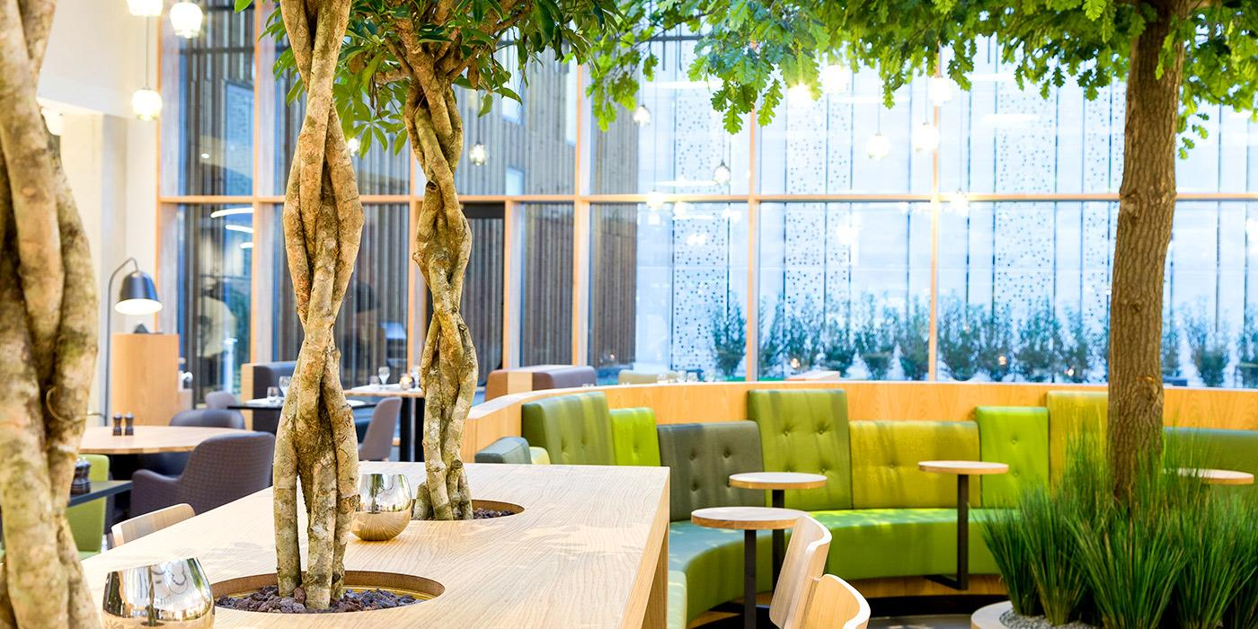
Recommendations:

Slide 7
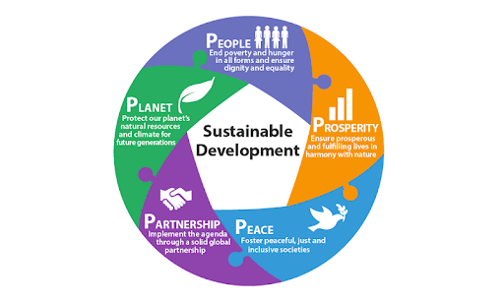
Conclussion:

Slide 8

The Future Is NOW!!!

Slide 9
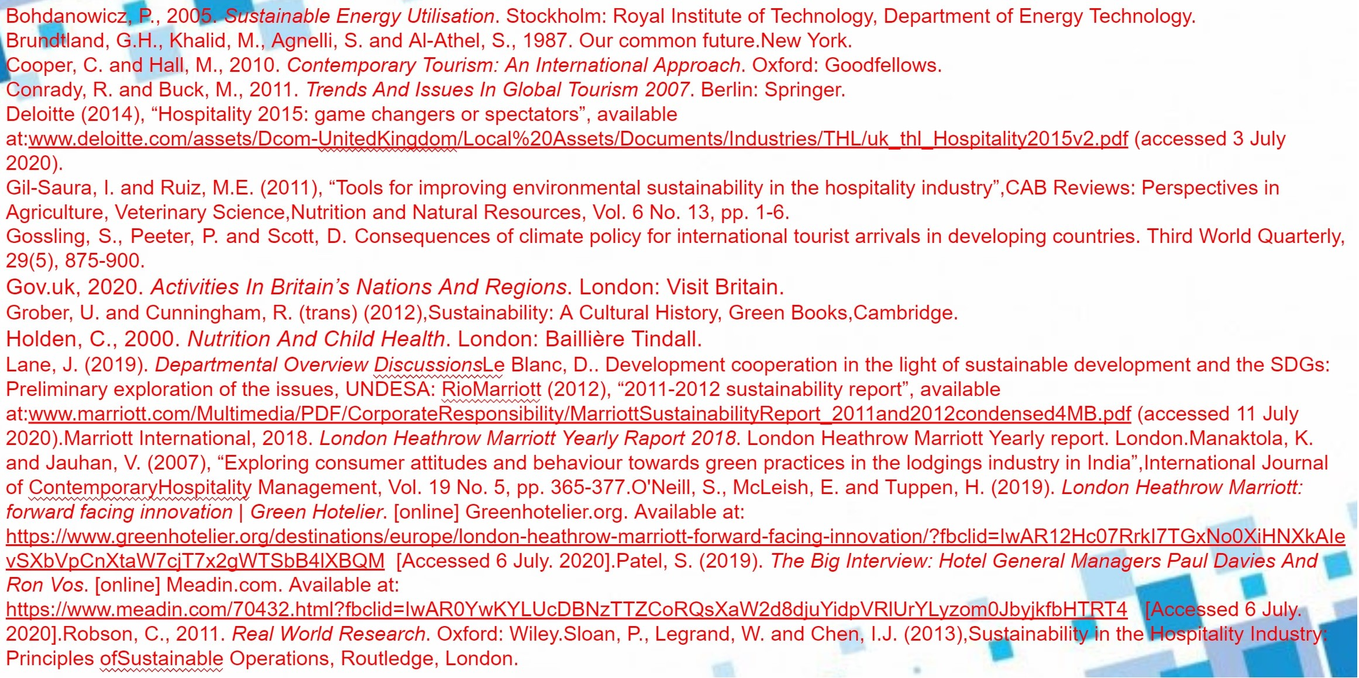
Bibliography

