Slide 1
Six Sigma Measure Phase
By
Andrew Thorn

Slide 2
Measure Phase
The define phase aims to refine the Project Team’s understanding of the of the problem (scope) to be addressed and select the CTQs
The measure phase aims to establish techniques for collecting data about current performance in meeting CTQs

Slide 3
Measure Phase Elements
Complete FMEA
Collect Data and Assess Capability
Perform Measurement System Analysis
Develop Data Collection Plan
Determine Data Type
Identify Measurement and variation

Slide 4
Measure Phase Elements
At the end teams will have: -
Plan for collecting data, key measures to provide the data, and techniques for collecting the data
Validated measurement system that ensures the accuracy and consistency of the data collected
Sufficient data set for problem analysis

Slide 5
Measure Phase Objectives
Define process measures
Identify types, sources and causes of variation in processes
Determine data requirements for 6 sigma project
Develop a data collection plan
Perform measurement system analysis
Conduct data collection
Determine the baseline capability as a sigma value
Complete an FMEA on the current process

Slide 6
Identify Measurement and Variation
The types and sources of variation and the impact of variation on process performance
Different types of measures for variation and the criteria for establishing good process measures
The different types of data that can be collected and the important characteristics of each data type

Slide 7
Definition of Measure
A measure describes the quantity, capacity, or performance of a product, process or service, based on observable data

Slide 8
Measurement Usage
Measurements occur at three stages of a process
Inputs to the process
The process itself
Outputs of the process

Slide 9
Measurement Usage
Measurements of the outputs tell how well customer needs and requirements are being met
Measurements of the process usually taken at critical points in the process that connect to the pertinent output measure (CTQs)
Input measures evaluate contributions to the process that are turned into value for the customer

Slide 10
Why Measure?
Allows you to establish baseline process performance
Isolate sources of variation
Identify areas in which improvements can be made

Slide 11
All Processes Have Variation
All repetitive activities of a process have a certain amount of fluctuation
Input, process, and output measures also fluctuate
This fluctuation is called variation

Slide 12
Variation
Variation frequently occurs during the normal execution of a process
Such variation can mean the process may not deliver on CTQs
Variation, could be the major cause of customer dissatisfaction
The goal of 6-sigma is to reduce variation, improve the capability of the process to deliver customer CTQs, and improve customer satisfaction

Slide 13
Sources of Variation
Machines
Materials
Methods
Measurement
Mother nature
people

Slide 14
Why Bother about Variation
In 6-sigma, variation is the enemy
We reduce variation by dealing with the sources
We need to understand sources of variation
We need to assess how controllable each source of variation is in terms of effort and cost

Slide 15
Data Types
Variable
Attribute

Slide 16
Why Use Two Data Types
Validate information is collected by measurements, as it can represent
Whether something happened or not
Information about what happened

Slide 17
Advantage of Variable Data
Available earlier during the process
Reflective of short-term trends, allowing immediate correction
Smaller in quantity for a given level of understanding

Slide 18
Develop Data Collection Plan
Needs to consider
What the team wants to know about the process
Potential sources of variation in the process
How long must the data be collected to obtain a true picture of the process
Who will collect the data
How the measurement system will be tested

Slide 19
Develop Data Collection Plan
Needs to consider
Whether operational definitions contain enough detail
How data will be displayed once collected
Whether data is currently available
What data collection tools will be used if current data does not provide enough information
Where errors in data correction might occur and how errors can be prevented or corrected

Slide 20
Data Collection Plan
Definition
A document that will help organise data collection activities and ensure that everyone involved with data collection understands the goals

Slide 21
Data Collection Plan
Documentation of: -
What: - data will be collected?
Why: - it is needed?
Who: - is responsible
How: - it will be collected?
When: - it will be collected?
Where : - it will be collected?

Slide 22
Purpose of Data Collection Plan
A well prepared data collection plan helps ensure successful analysis of the problem by making sure there is useful data collected

Slide 23
How to Collect Data
Existing versus New
Have / Need more

Slide 24
How to Collect Data
Is the necessary data currently available?
Will available data provide enough information to identify the potential causes of the problem?
What data collection tools will be used if current data does not provide enough information

Slide 25
Sources of Data
 | Y | X₁ | X₂ | X₃ | X₄
Existing Data
Needed Data

Slide 26
Data Collection Tools
Includes: -
Forms
Checklists
Check sheets
Process logs
Record-keeping devices

Slide 27
Why Develop Data Collection Tools
Helps organise data collection
Helps standardise the data collection process
Accommodates stratification
Accommodates sampling
Allows the Project Team to collect comments and exception data

Slide 28
Developing Data Collection Tools
Data collection tools should be simple to use and understand
The form should be tested before it’s fully implemented
The tool should include only the information needed
The tool should include instructions on how to record data
The tool should provide space for comments and exception reporting

Slide 29
Sampling
Is the process of taking a “look” at a few items to make some estimates about the total population
Sampling is used to determine process performance when it is unreasonable to examine each item going through the process
Lesser amounts of data can be used in order to draw a statistical inference about the data for the process

Slide 30
Sampling Points
Population refers to all of the units that make up a particular
Sample refers to some of the units in that particular group
The sample must be random

Slide 31
Purpose of Sampling
It is often impractical or too costly to collect all the data
Some times data collection is a destructive process
Sound conclusions can often be made from a relatively small amount of data

Slide 32
Types and Ways of Sampling
Process sampling: - helps us understand the nature and condition of the process
Population sampling: - determines the characteristics of the population

Slide 33
Methods of Sampling
Random Sampling: - each item has equal probability of being selected
Systematic Sampling: - every nth item is selected
Stratified Random Sampling: - population ‘stratified’ into groups: random selection occurs within each group
Systematic Subgroup Sampling: - three samples at that point each hour

Slide 34
Methods of Sampling
Regardless of the sampling method used, ensure data collection remains true to the 2Rs of sampling: “random” and “representative”

Slide 35
Sampling Considerations
How often should we take our samples
How many are necessary to see the trend toward a concern?
What kind of samples should we take?
How confident are we that we are really looking at enough?

Slide 36
Sampling Considerations
Ease of obtaining the samples
Ease in taking the measurements of the samples
Cost of taking the samples
Cost of failing to detect process problems
Time it takes to sample
Process knowledge
Cyclical occurrences in the production process (breaks, line stoppage)
Changes that occur in the process or the system which could cause mean shifts or variation

Slide 37
Sampling Plan
A sampling plan must be able to: -
Detect changes in progress or product as rapidly and economically as possible accounting for the risk to the customer
Provide sound data as the basis of decisions to take process actions
Provide data that allows you to analyse and answer the right questions

Slide 38
Sample Size Recommendations
Sample size should be small enough so the process of obtaining data is affordable
Sample size should be large enough to obtain accurate estimate of the process characteristics

Slide 39
Measurement System Analysis (MSA)
Will indicate whether the variation measured is from the process or the measurement tool
Begins with data collection plan and ends when a high level of confidence is attained that the data collected accurately depicts the variation in the process

Slide 40
Measurement System Analysis
Definition
Is a quantitative evaluation of the tools and process used in making data observations

Slide 41
Purpose of a Measurement
System Analysis
Is to ensure the information collected is a true representation of what is occurring in the process
Ensures that variation reflected by the data collected represents only process variation
Performed on a regular basis to ensure data is valid and reliable

Slide 42
Information Obtained From an MSA
Is the measurement system capable for this study?
How big is the measurement error?
Are the measurements being made with measurement units that are small enough to properly reflect the variation present?
What are the sources of measurement error?
Can we detect process improvement if and when it happens?
Is the measurement system stable over time?

Slide 43
Types of Measurement
System Analysis
Operational definitions
“Walking the process”
Gage R & R
- Variable data
- Attribute data

Slide 44
Operational Definitions
The measurement system will be set up using operational definitions constructed by the Project team to ensure that all measurement takers completely understand what is expected during the data collection phase

Slide 45
Walking the Process
Is necessary when developing a new data collection process to ensure that all measurement takers understand how to properly evaluate the characteristics of interest

Slide 46
How to “Walk the Process”
Train data collectors prior to beginning the data collection activity
Follow the data collection process from beginning to end to ensure data is being properly collected
Continue “walking the process” until all data collectors effectively understand the new measurement process
Assess the accuracy
Assess variability due to the measurement system

Slide 47
MSA Attribute Data
A measurement system is acceptable only if all measurements do not agree, the measurement system must be improved or replaced
Changes to the measurement system could include revision to the operational definition and additional training for the measurement takers
A gage is generally acceptable if the % effectiveness is greater than 90%

Slide 48
MSA Quantitative Aspects
Accuracy how close the indicated value is to the true value
Stability ability to produce the same results over time
Linearity difference in accuracy across the range of measures
Repeatability variability in values when everything else is held constant
Reproducibility variability in values associated with different people measuring the same elements under the same conditions

Slide 49
Gage R & R Definition
Gage R & R is a method of determining
- Measurement system repeatability
- Measurement system reproducibility

Slide 50
Gage R & R Repeatability
Repeatability: - is the variation in measurement obtained with one measurement instrument when used several times by a “measurer” while measuring the identical characteristic on the same part

Slide 51
Repeatability
Refers to
Inherent variability of the measuring system
Variation occurs when repeated measurements are made of the same item under identical conditions by
- Same operator
- Same setup
- Same units
- Same environmental conditions

Slide 52
Reproducibility
Reproducibility is the variation in the average of the measurements made by different “measurers” using the same measuring instrument when measuring the identical characteristics on the same item

Slide 53
Gage R & R Reproducibility
Reproducibility variation occurs when measurements are made by different people
- Different operators
- Same setups
- Same units
- Same environmental conditions

Slide 54
Typical Measurement System Analysis
2 to 3 measurement takers
10 process outputs (units/samples)
2 or 3 measurements of each unit/sample by each measurement taker
Samples chosen to represent typical output of the process

Slide 55
Component Variation
Part/Product variation is used in the measurement study analysis to help determine if our measurement system is capable of producing the same type of consistency if we vary the range of measurements, or the size of parts
Total variation in a measurement system analysis is made up of the measurement variation and the Part/Product variation

Slide 56
Measurement System Analysis
If the measurement system is deficient
- Improve the gauge
- Improve the measurement process
- Train measurement takers

Slide 57
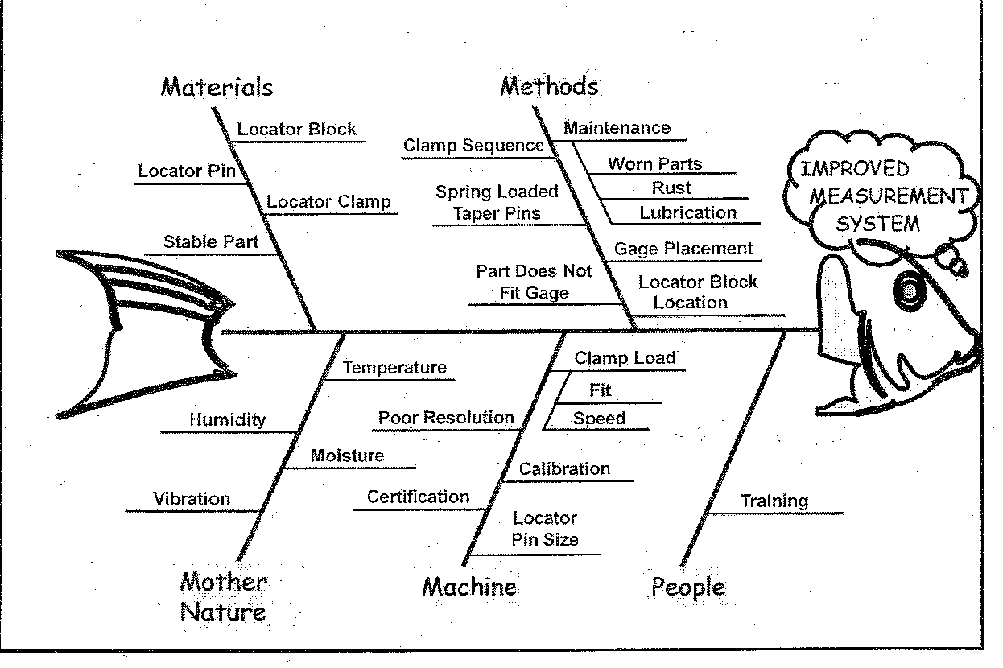
Gage R & R Cause & Effect Diagram

Slide 58
Perform Data Collection
Data collection is a process by which we accumulate enough information to calculate the current process capability (baseline) and identify the potential cause of the problem
Too much data can add complexity to the data review and analysis
Too little data may force the team to engage in unnecessary and costly secondary data collection efforts

Slide 59
Training Data Collectors
To ensure the best quality data is collected
Properly train the data collector(s)
Monitor the data collection process frequently
Check whether the data looks reasonable, and challenge the data results if it doesn’t
Collect several small samples over time rather than one large sample at a single point in time
Ensure measurements remain stable and consistent

Slide 60
Capability Analysis
Studies how well a process is performing in meeting the expectations of customers (CTQs)
It must be determined whether the process, given its natural variation is capable of meeting established customer requirements
Capability analysis establishes (1) A current performance baseline for the process and (2) A reference point to evaluate the impact of improvement

Slide 61
Relationship to Process
Performance Metrics
Using sigma as a metric, the performance of any process can be compared with another regardless of data type (variable or attribute)
Sigma values can also represent performance of a process based on short-term or long-term data samples

Slide 62
Relationship to Process Performance Metrics
In consumer driven 6- sigma process performance is reported using the universal measure of sigma value
Variable
Data
Attribute
Data
Type of data Type of metric one metric
Cp
Cpk
Pp
Ppk
σ
ppm
Dpu
Dpmo

Slide 63
Differences in Process Capability
Over Time
Data collected over a short period of time will often indicate a higher level of process capability than that calculated from data collected over a longer period of time
One reason for the difference in process capability over time is a phenomenon known as “shift & drift”
Shift is a sudden change in process capability, while drift is a change that occurs slowly over time

Slide 64
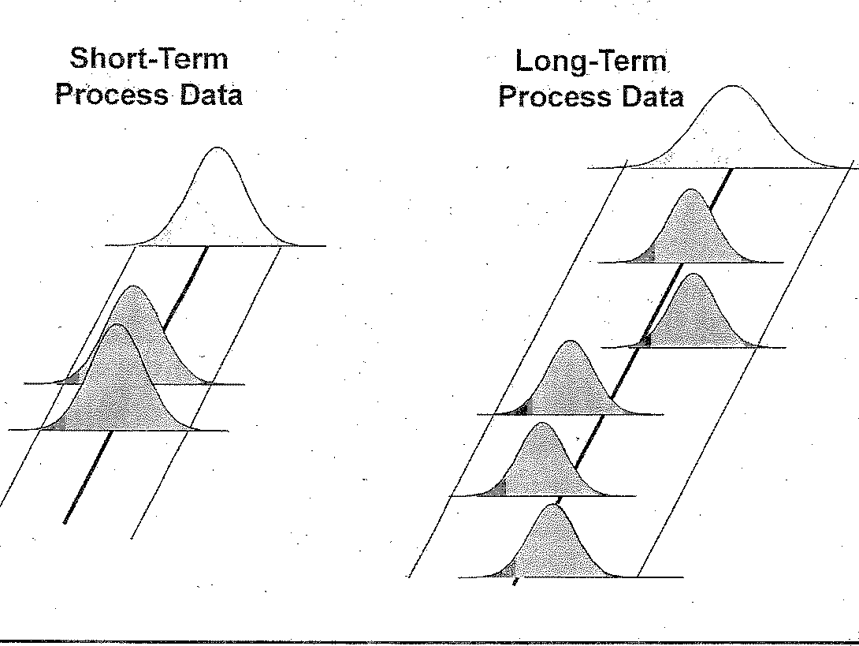

Slide 65
Capability Analysis- Attribute Data
Before learning how to calculate process capability using attribute data, it is important to understand a few key terms
Unit (N)
Defect (D)
Opportunity (O)
DPMO

Slide 66
Calculating Process Capability Using Attribute Data
The first step is to define
The unit (N)
The defect (D)
The number of opportunities for generating a defect per unit (O)

Slide 67
Calculating Process Capability Using Attribute Data
The second step is to calculate DPMO using the formula below:
DPMO = Total number of defects x 10⁶
Total units x Opportunities per unit
DPMO = D___ x 10⁶
N x O

Slide 68
Calculating Process Capability Using Attribute Data
The final step is converting DPMO to a sigma value using the Z-value conversion table

Slide 69
Example Calculating Process Capability Using Attribute Data
500 part orders (N)
3 opportunities (O)
- Late
- Wrong part
- Wrong address
57 errors are made (D)
12 caught
45 Defects observed by customers

Slide 70
Example Calculating Process Capability Using Attribute Data
Number of units processed N = 500
Total number of defects made (include defects made and later fixed) D = 57
Number of defect opportunities O = 3
4. DPMO = D___ x 10⁶
N x O
5. DPMO = 57___ x 10⁶
500 x 3
= 38,000

Slide 71
First Time Through
Used to calculate process capability because: -
Defects once produced, add waste and cost even if the customer doesn’t see them
Even the best inspection processes cannot catch all defects ultimately reach the customer, causing customer dissatisfaction and additional cost through warranty, replacements or lost business

Slide 72
Process Capability Exercise
Using the following delivery pattern, calculate the process capability
Number of tables delivered: 40
Number of opportunities per table: 1
Number of tables not delivered within 30 days: 16

Slide 73
Guidelines for Determining How Many Opportunities Per Unit
Must be important to the customer
Opportunities per unit stay constant before and after improvement
Number of opportunities per unit can be used to level the playing field for processes and outputs of different complexities
Count only opportunities where defects can reasonably happen

Slide 74
Capability Analysis-Variable Data
Before determining process capability using variable data, it is important to review a few terms and symbols to go along with those already defined:
Target Centering
Specification limits Deviation
Data distribution Std Deviation
Normal distribution Prob of defect
Mean Yield

Slide 75
Capability Analysis-Variable Data Terminology
Target
For every measurable characteristic, there is a desired level of performance commonly the target
Examples
- Body temperature 37.6°C
- Overnight delivery 10.00am next day
- Crankshaft main diameter 62.00mm

Slide 76
Capability Analysis-Variable Data Terminology
Specification
Specification limits provide boundaries of acceptable performance above or below the target
- Lower specification limit (LSL) lowest
value acceptable
- Upper specification limit (USL) highest
value acceptable
Example LSL Target USL
Overnight delivery 8 AM 10 AM Noon

Slide 77
Capability Analysis- Variable Data Terminology
Data Distribution
How measurement data “fits” around the target and between lower and upper spec limits
Example (overnight delivery
- Measurement = No of packages delivered
8 am = 2, 9 am = 3, 10 am = 8, 11 am = 4
and 12 pm = 1

Slide 78
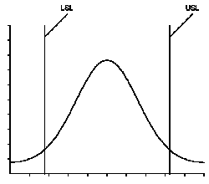
Capability Analysis- Variable Data Terminology
Normal Distribution
Data distribution characterised by a smooth bell-shaped curve
Target

Slide 79
Capability Analysis- Variable Data Terminology
Mean
The average of a set of values, usually represented by the symbol (x bar)
Example (body temperature)
- Temperature
98.3 + 99.0 + 98.6 +98.9 + 99.1 + 100.5
+ 99.3 / 7 = 99.1

Slide 80
Capability Analysis- Variable Data Terminology
Centering
Based on the relationship of the mean to the performance target, centering is the process of making the mean consistent with the target

Slide 81
Capability Analysis- Variable Data Terminology
Deviation
Deviation refers to the distance between a particular measurement and the average of all measurements within that data set
 X

Slide 82
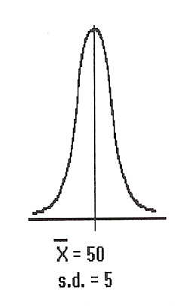
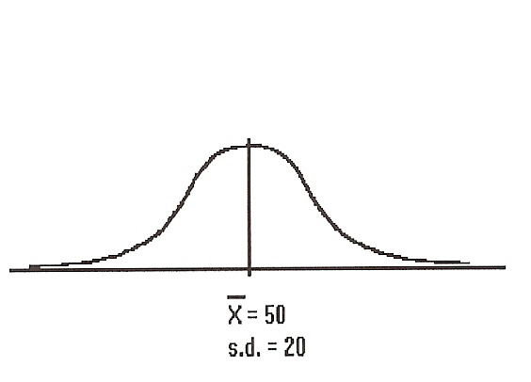
Capability Analysis- Variable Data Terminology
Standard Deviation
Standard deviation refers to the collective deviation of the entire data set

Slide 83
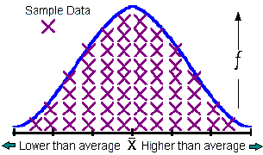
Capability Analysis- Variable Data Terminology
Probability of Producing a Defect
The percent of data underneath the curve, but beyond the lower and upper spec limits
1.5%
11.5%
1.5%
LSL USL

Slide 84
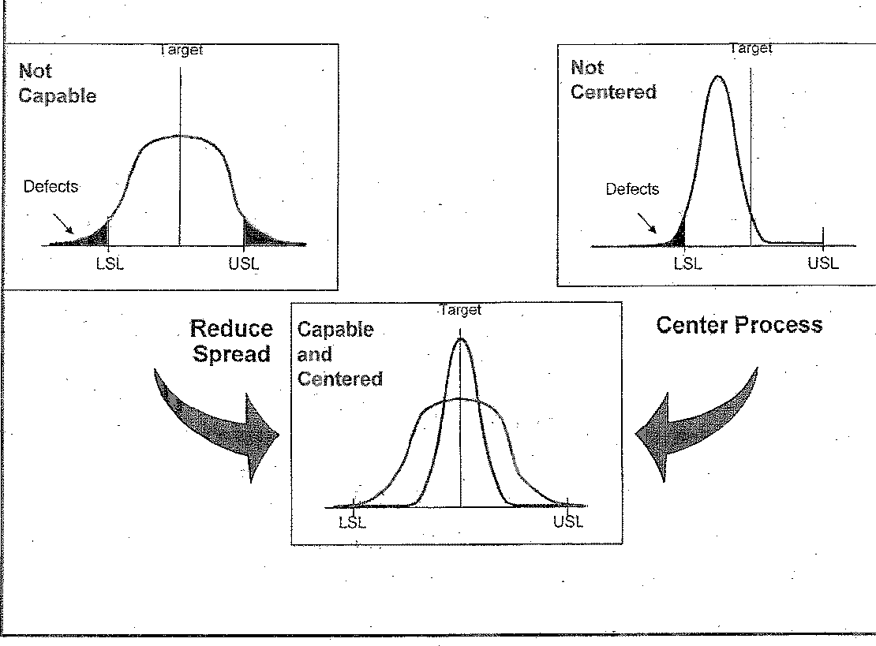
Relationship Between Variation & Process Capability

Slide 85
Process Capability
Refers to the capability of a process to consistently produce a product/service meeting customer specification limits
Measures all the effects on the process
Is based on a set of examples taken over a period of time

Slide 86
Cp and Cpk
A capacity index is a number that represents the capability of the machine or process
It is a comparison between the process spread (what the process is able to do) and the specification spread (what the customer requires)

Slide 87
Cp and Cpk
Cp: - indicates whether the process is able to produce parts with a process spread less than the specified customer spread
This is the potential process performance
Cpk: - index indicates whether the process is actually producing parts within the specification spread
The index indicates the actual process
performance

Slide 88
Cp/Cpk- P Six Sigma Process
In this example, the process is operating within the specification limits. The process width is defined as ± 3σ from the process centre
In this case, the design width is ± 6σ or twice the process width

Slide 89
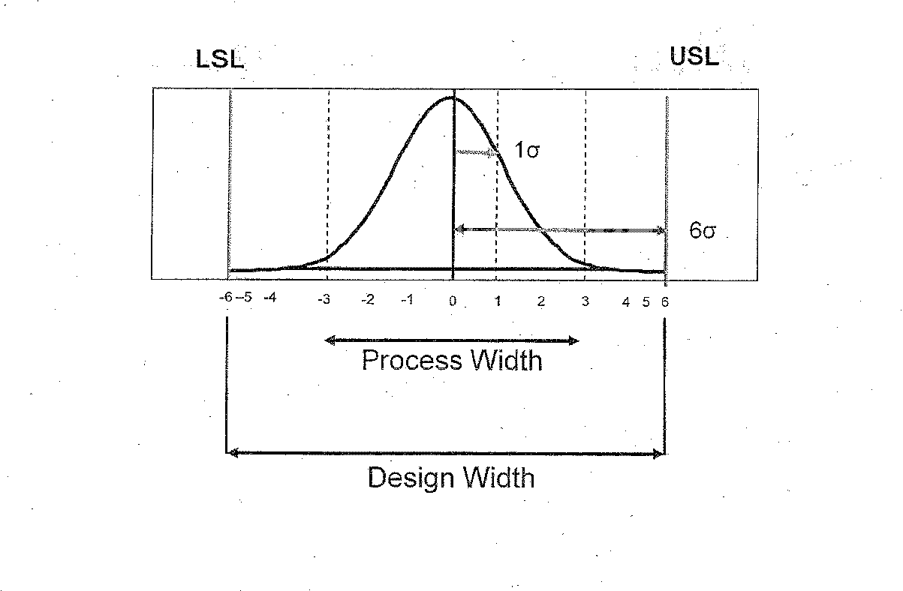
Cp/Cpk- 6 Sigma Process

Slide 90
Capability Analysis- Variable Data Terminology
Yield (probability of Success)
The percentage of data underneath the curve and between the lower and upper spec limits
Yield 97%
1.5%
1.5%
LSL USL

Slide 91
Capability Analysis- Variable Data Terminology
Yield
Example
- Defects per million = 6,210
- Defects per hundred = 0.621
- Probability of producing a defect
= 0.0062 (0.621%)
Yield = 100 – 0.621 = 99.379%

Slide 92
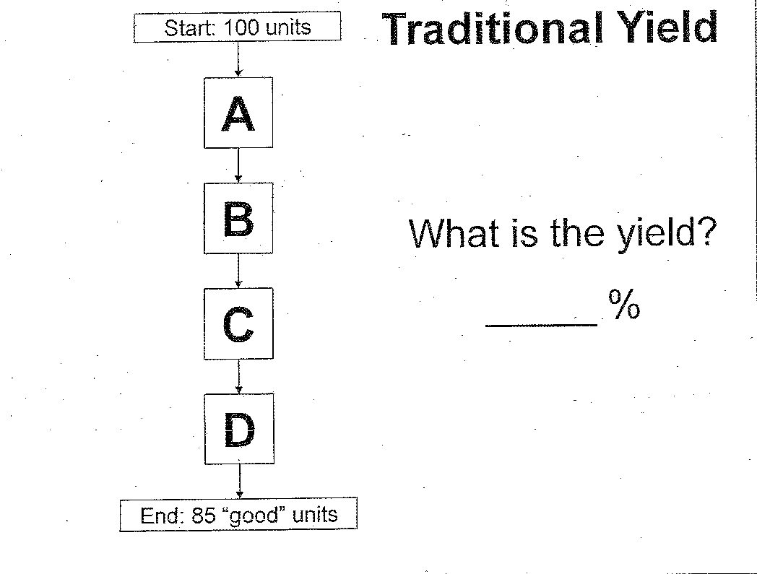
Traditional Yield

Slide 93
Traditional Yield
The term “yield” is often used to refer to the number of “good” units produced
Used in this manner, yield is expressed as a percentage of the total number of units produced

Slide 94
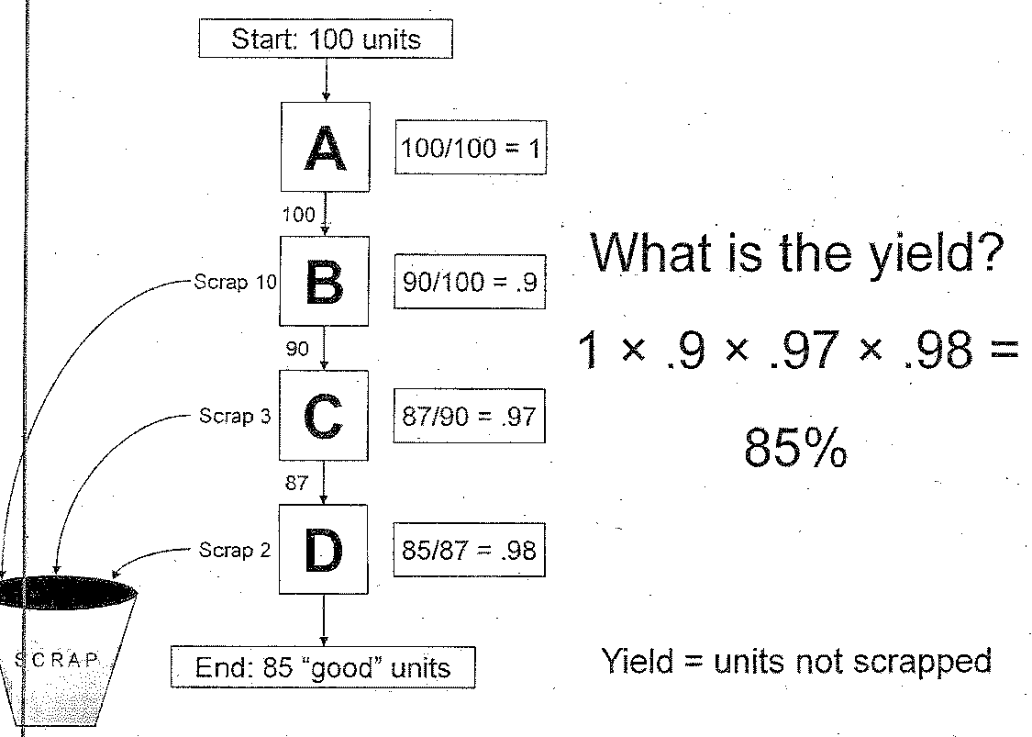
Calculating Final Yield

Slide 95
Calculating Final Yield
Final Yield is the product of the yield values for each step of the process
Yield for a process step includes all units not scrapped
Yield is expressed as a proportion or percentage with final yield calculated by multiplying yield values for each step

Slide 96
First-Time Through Yield
Yield somewhat overstates process output, because it fails to account for units that require rework prior to proceeding to the next process step
First-time through yield accounts for this lost output by only counting those units that were not scrapped and did not require rework
Time and resources expended through rework are referred to as the ‘Hidden Factory’

Slide 97
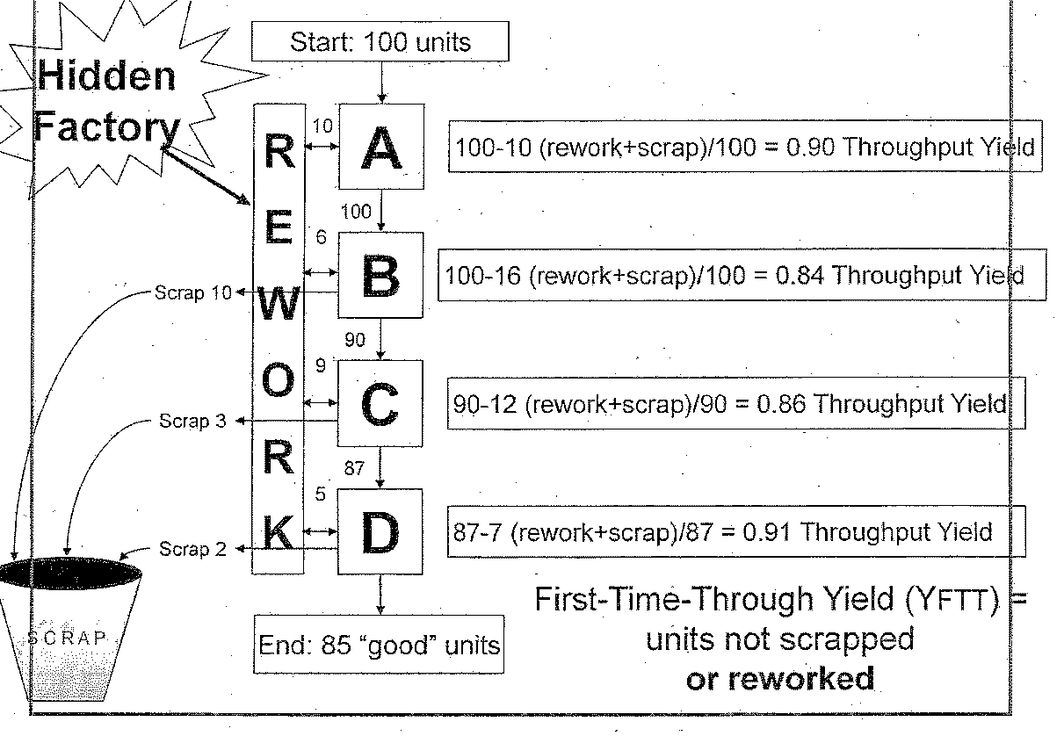
First-Time Through Yield and the Hidden Factory

Slide 98
Calculating Rolled Throughput Yield (YRT)
Rolled throughput Yield is a more accurate representation of process output, because rolled throughput yield accounts for the impact of both scrap and rework on the production of ‘good’ or defect free units

Slide 99
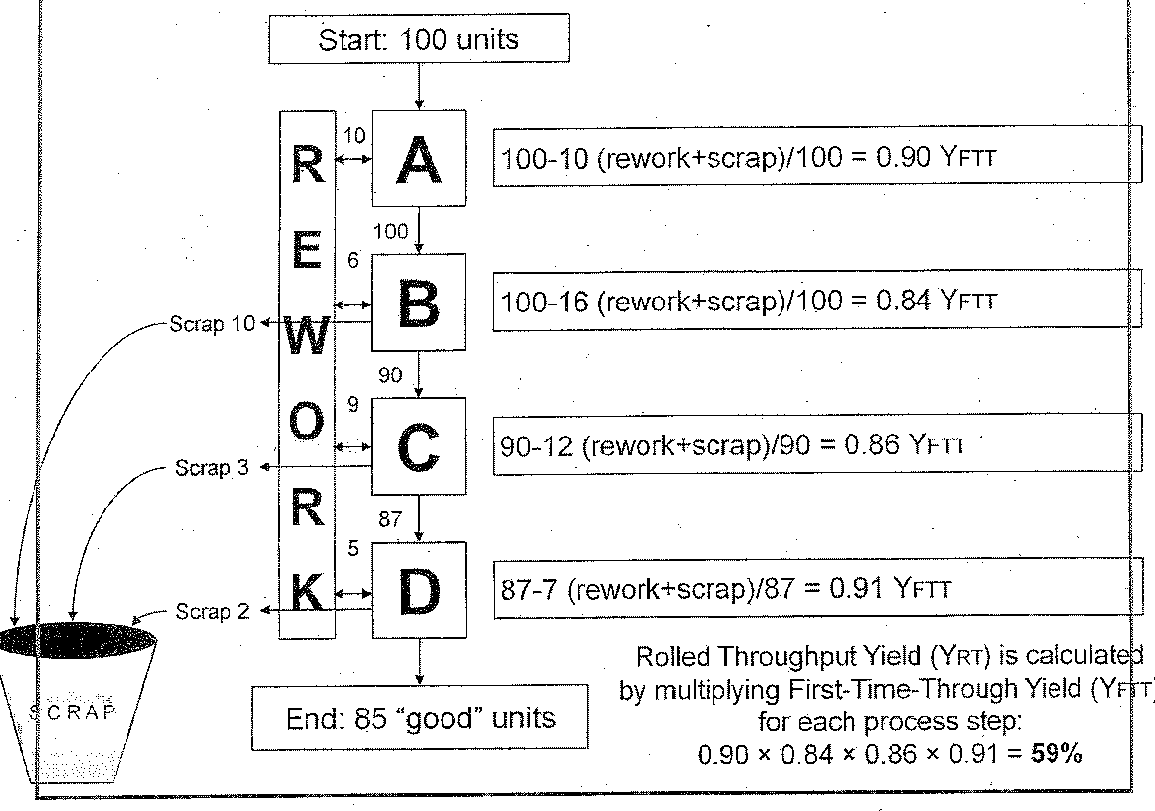
Rolled Throughput Yield

Slide 100
Complete FMEA
FMEA is an effective tool that helps the team take a closer look at the customer potential process/product failure modes to ensure they are considered and addressed
Like many consumer Driven 6-sigma tools, FMEA can be used in a number of locations in the DMAIC process

Slide 101
FMEA Purpose
Used in the measure phase to identify “Low-Hanging Fruit” in the current process
Documents the potential failures (and their respective causes) in the current process
Identifies (and tracks) actions to eliminate or reduce these failures in the future

Slide 102
FMEA Purpose
Provides the team with: -
A list of potential failure modes
A list of effects
Documentation of current controls
Documentation and prioritisation of recommended improvement actions
A historical record of improvements
FMEA documentation should be updated after each change to the process is implemented
This means that analysis is never over, unless the process is completely withdrawn

Slide 103
FMEA Key Definitions
Failure mode: - The manner in which the item could potentially fail to meet the design intent of the process requirements
Effect: - An impact on customer requirements- either external customers or downstream processes
Severity: - Relative weighting of an effect

Slide 104
FMEA Terminology
Item/Function: - Name of the process step, part number or issue to be addressed
Failure mode: - The manner in which a process fails to meet specification
Potential Effect(s): - The impact on the customer if the failure mode is not eliminated or mitigated
Severity (SEV): The significance of the impact of the Failure Effect on the customer
Classification (Class): Classifies any special products or process characteristics

Slide 105
 | Severity of Effect
Effect | Customer Effect | Ranking
Hazardous without warning | Failure mode affects safe vehicle operation and/or involves non compliance with government regulation without warning | 10
Hazardous with warning | Failure mode affects safe vehicle operation and/or involves non-compliance with government regulation with warning | 9
Very High | Vehicle/item in operable (loss of primary function) | 8
High | Vehicle/item operable but at a reduced level of performance. Customer very dissatisfied | 7

Slide 106
Severity Rating Table
 | Severity of Effect
Effect | Customer Effect | Ranking
Moderate | Vehicles/Item operable but comfort/convenience item(s) inoperable. Customer dissatisfied | 6
Low | Vehicle/Item operable but comfort/convenience item(s) operable at a reduced level of performance. Customer somewhat dissatisfied | 5
Very Low | Fit and finish/squeak and rattle item does not conform. Detect noticed by 75% of customers | 4

Slide 107
Severity of Effect
 | Severity of Effect
Effect | Customer Effect | Ranking
Minor | Fit and finish/Squeak and rattle item does not conform. Defect noticed by 50% of customer | 3
Very Minor | Fit and finish/Squeak and rattle item does not conform. Defect noticed by discriminating customers (>25%) | 2
None | No discernible effect | 1

Slide 108
Severity Rating Table
 | Severity of Effect
Effect | Manufacturing Effect | Ranking
Hazardous without warning | May endanger operator (machine or assembly) without warning | 10
Hazardous with warning | May endanger operator (machine or assembly) with warning | 9
Very High | 100% of product may have to be scrapped, or vehicle/item repaired in repair department with a repair time greater than one hour | 8

Slide 109
Severity Rating Table
 | Severity of Effect
Effect | Manufacturing Effect | Ranking
High | Product may have to be sorted and a portion (less than 100%) scrapped, or vehicle/item repaired in repair department with a repair time between half an hour and an hour | 7
Moderate | A portion (less than 100%) of the product may have to be scrapped with no sorting, or vehicle/item repaired in repair department with a repair time less than half an hour | 6
Low | 100% of product may have to be reworked, or vehicle/item repaired off-line but does not go to repair department | 5

Slide 110
Severity Rating Table
 | Severity of Effect
Effect | Manufacturing Effect | Ranking
Very Low | The product may have to be sorted with no scrap and a portion (less than 100%) reworked | 4
Minor | A portion (less than 100%) of the product may have to be reworked, with no scrap, on-line but out-of-station | 3
Very Minor | A portion (less than 100%) of the product may have to be reworked, with no scrap, on-line but in-station | 2
None | Slight inconvenience to operation or operator, or no effect | 1

Slide 111
FMEA Terminology
Potential Cause of Failure: - Sources of variability associated with key process input variables
Occurrence (OCC): - Rates the likelihood that causes of a failure mode will occur
Current Controls: - Description of process controls that either prevent the failure mode from occurring or detect the failure mode when it occurs

Slide 112
FMEA Terminology
Detection (DET): - Rates the likelihood that the current system will detect causes of failure modes if they occur
Risk Priority Number (RPN): - The product of the severity, occurrence and detection rankings (RPN = SEV x OCC x DET)

Slide 113
Evaluating Risk
SEV
Criticality (SEV x OCC)
RPN = SEV x OCC x DET

Slide 114
Evaluating Risk
It is important to evaluate which potential failures have the highest risk
The severity ranking is probably the most likely to affect decision making
After considering severity, attention should be given to issues having high criticality (SEV x OCC)
When issues with high severity and criticality ranking have been addressed the team can use RPN values to prioritise remaining concerns

Slide 115
Measure Phase Summary Key Points
Utilise measurement as the application of metrics to determine the performance
Recognise the importance of variation because it exists naturally in any process and it is the reason 6-sigma projects are undertaken
Recognise the collection of data measurements taken time that if properly analysed, will show us where the variation occurs in the process

Slide 116
Measure Phase Summary Key Points
Identify Measurement System Analysis (MSA) as a way to ensure that the measurement techniques are reproducible and repeatable
Identify the Data Collection Plan and how to collect data so that we have an appropriate set of data necessary for use in the Analyse Phase
Utilise Capability Analysis as a process for establishing the current performance level of the process being studied

Slide 117
DMAIC Improvement Model
The purpose of the Define phase is to refine the Project Team’s understanding of the problem (scope) to be addressed and to select the Critical to Quality (CTQs)
The purpose of the Measure phase is to establish techniques for collecting data about the current performance of the process identified in the Define Phase

Slide 118
DMAIC Improvement Model
Improvement opportunities by taking a closer look at the data
Remember the phases and steps of the DMAIC model do not actually occur in a linear sequence
Most frequently, teams may find the need to loop back as they proceed from one phase of the project to the next

