Slide 1
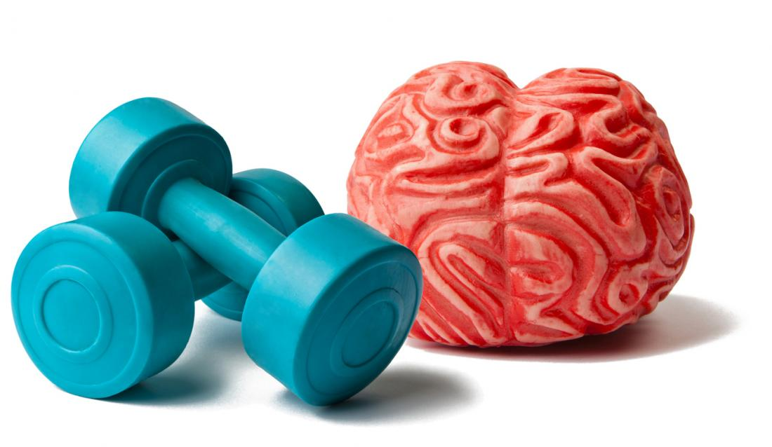
An Investigation into the impact of exercise on three facets of wellbeing: stress, depression and self-esteem.
By Melanie Williams.

Slide 2
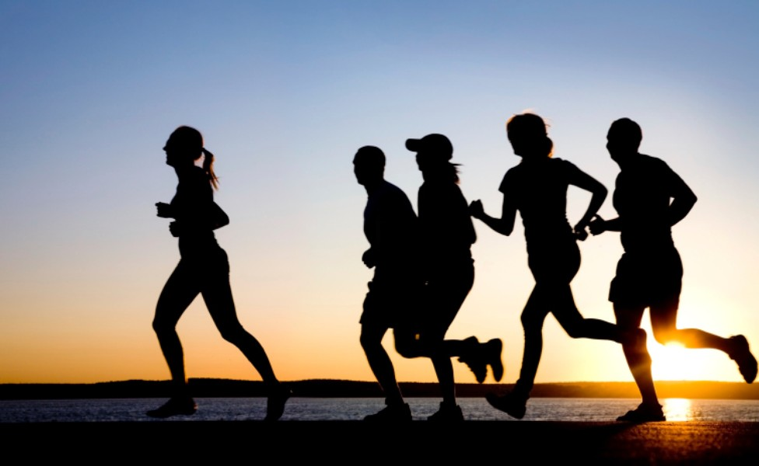
Definitions.
Physical activity/Exercise.
The term physical activity/exercise is frequently referred to during this investigation and is, by definition ‘any bodily movement produced by skeletal muscle that results in energy expenditure above resting level (Caspersen et al., 1985, p.128).
Summary. Research investigated whether exercise offers the potentially positive effects in the remedy of stress, depression and self-esteem. The research outcome, potentially assisting & supporting current exercise interventions in providing a more holistic approach to enhance psychological wellbeing.
AIMS.
The aim of the study was to explore whether frequent exercise has a positive effect on the well-being of adults.
The three facets of wellbeing explored were; stress, depression and self-esteem.

Slide 3
Review of Literature.
Effects of Exercise on Stress.
The plight to combat stress disorders is reflected by the catastrophic cost implications faced by the NHS and the burden and debt across the country (Boutcher & Faulkner, 2000). Most importantly is the need to sooth the distressing symptoms experienced by the sufferer and assist in creating a more pleasant daily life experience (Boutcher & Faulkner, 2000). Stress is implicated as a contributory factor to other serious health issues, such as psychological illness and coronary heart disease, (Boutcher & Faulkner, 2000). Studying the field of stress and anxiety is complicated, nevertheless the countereffect of physical activity in alleviating the symptoms associated with stress is remarkable and motivational. Research stipulates that physical activity affords individuals a marked reduction in ‘state anxiety’ thereby alleviating Physiological reactivity ( Boutcher & Faulkner, 2000).
According to Salmon (2001) analysis from cross sectional research and longitudinal studies alike sign post that the impact of aerobic exercise is entirely positive with antidepressant effects and anxiolytic outcomes, thereby increasing the resilience and offsetting the negative implications associated with stress on psychological and physical wellbeing (Salmon, 2001).

Slide 4
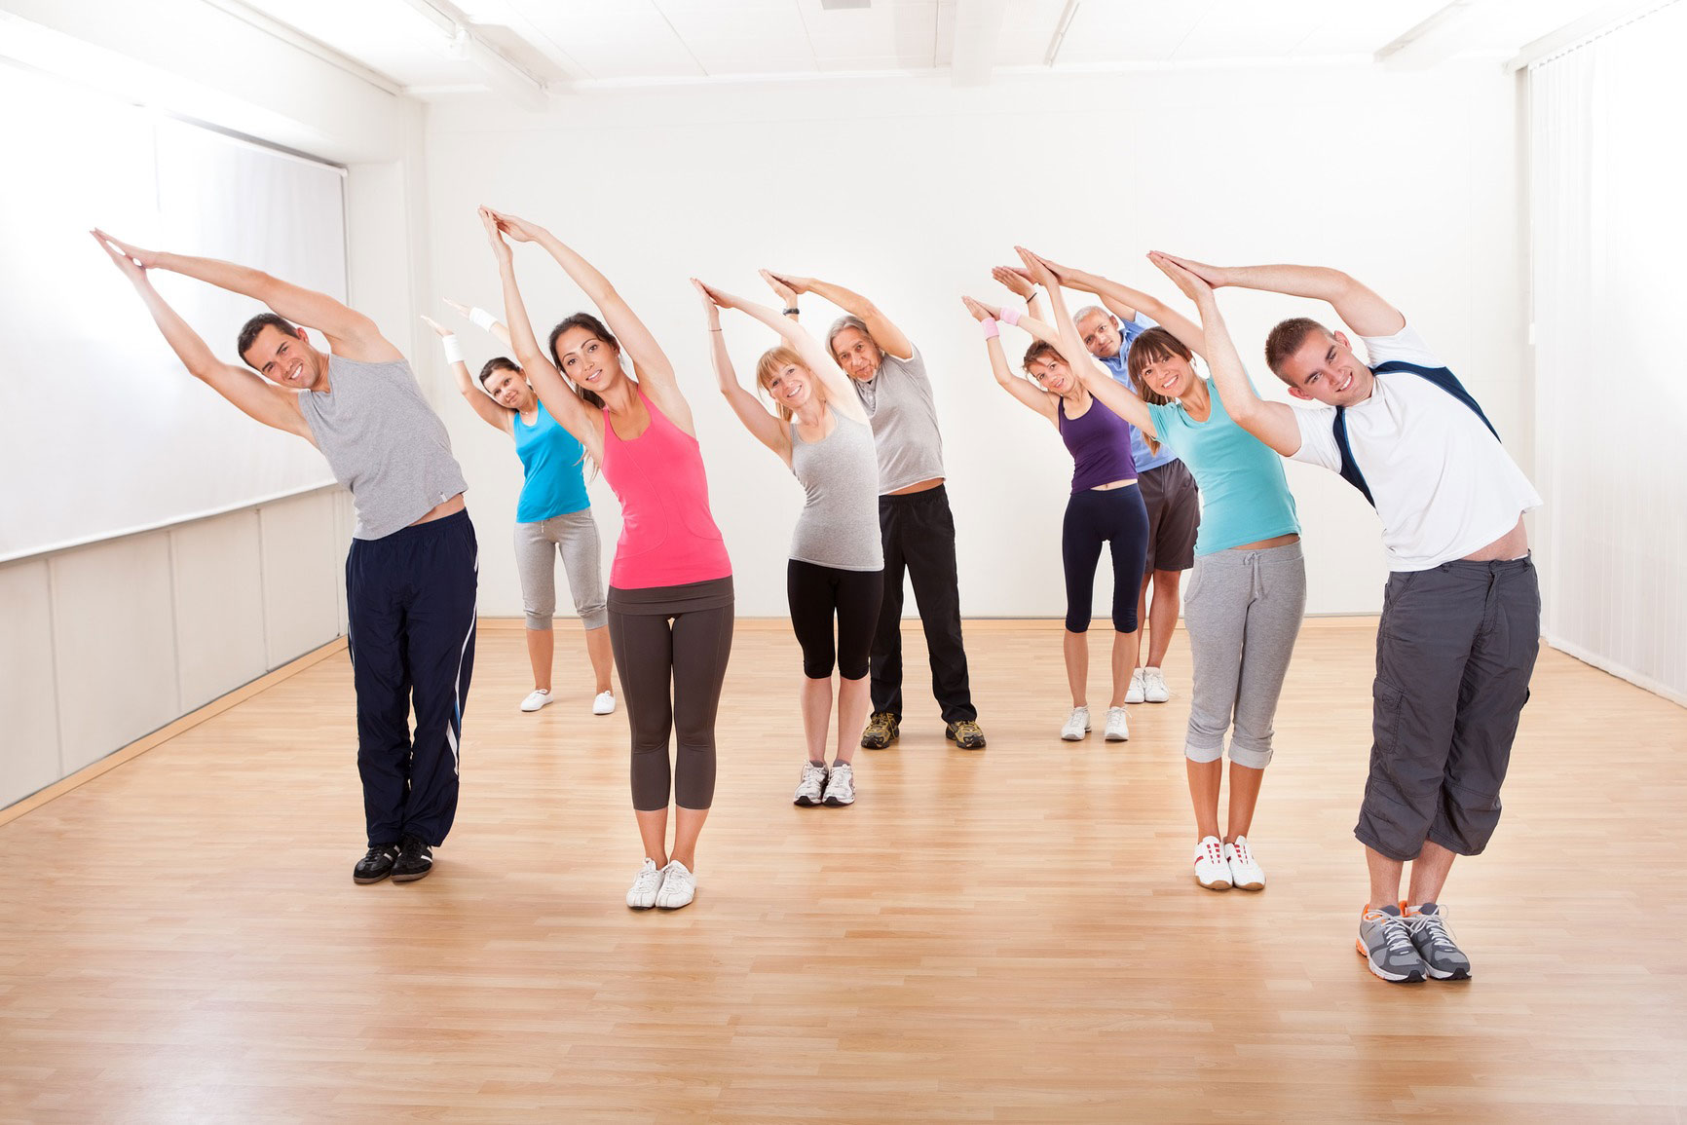

CONCLUSION.
Elements of this study support Salmon’s (2001) findings, further supported by a plethora of exercise and wellbeing studies including analysis from cross sectional research and longitudinal studies alike which signpost that the impact of exercise is entirely positive with antidepressant effects and anxiolytic outcomes, thereby increasing resilience and offsetting the negative implications associated with stress on psychological and physical wellbeing

Slide 5
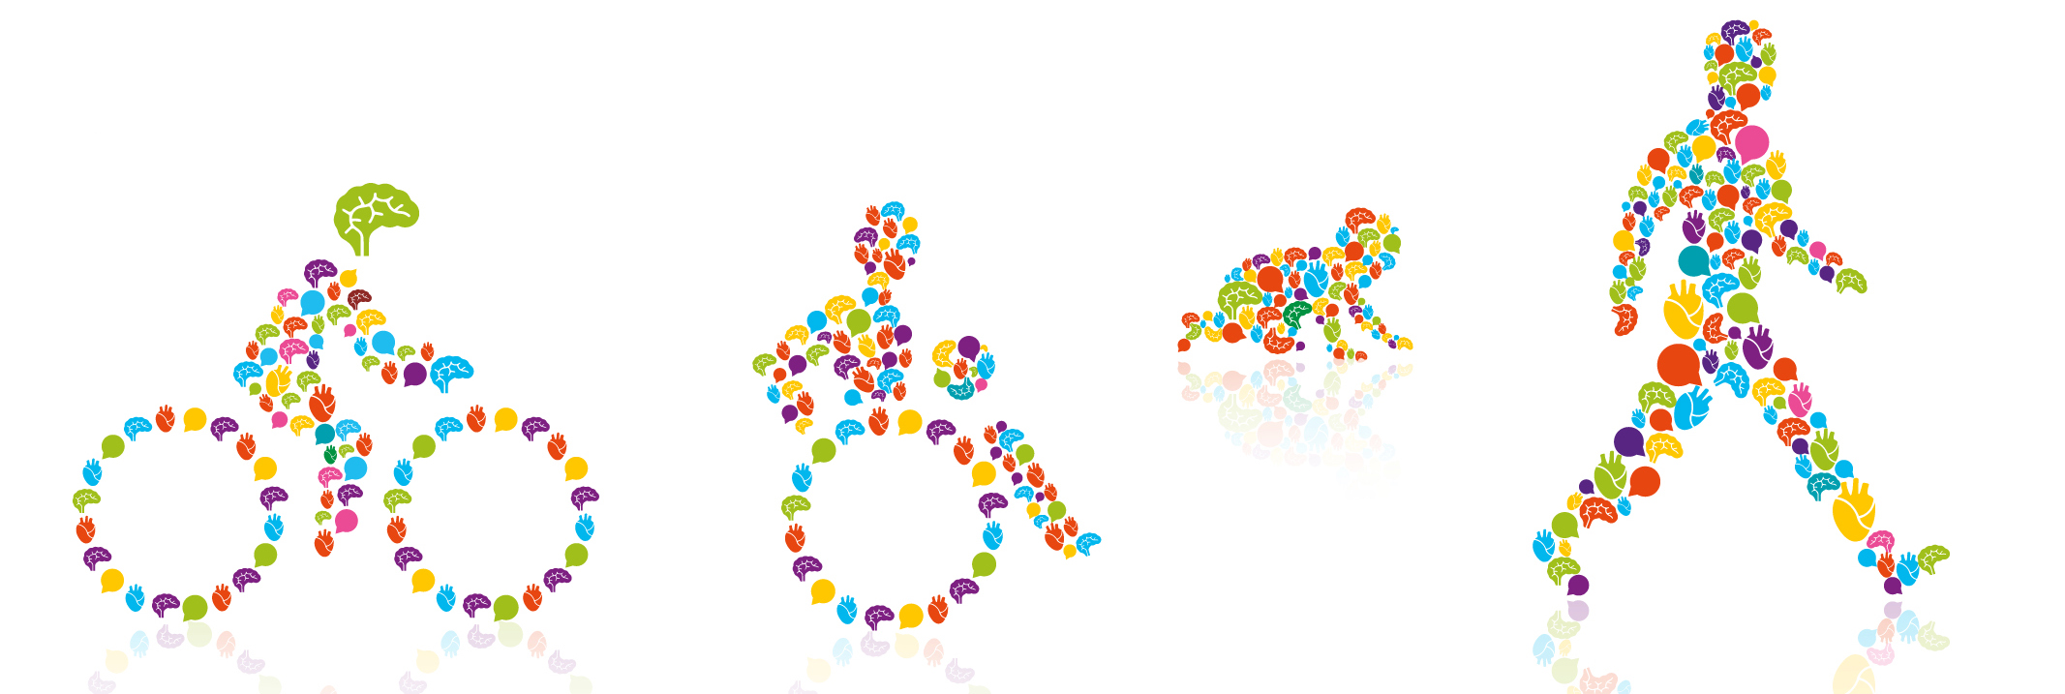
Effects of exercise on depression
According to the charity Mind (2013) the term wellbeing alludes to ‘mental state’ in terms of how the individual feels and their overall tolerance and coping mechanisms in relation to everyday life.
Refreshingly, the evidence is sufficing to support that a correlation is present between exercise and a reduction in clinical depression. Furthermore, experiments indicate that ‘inactivity’ is linked to relapse of depression and that exercise is an effective remedy when treating depression ( Boutcher & Faulkner, 2000).

Slide 6
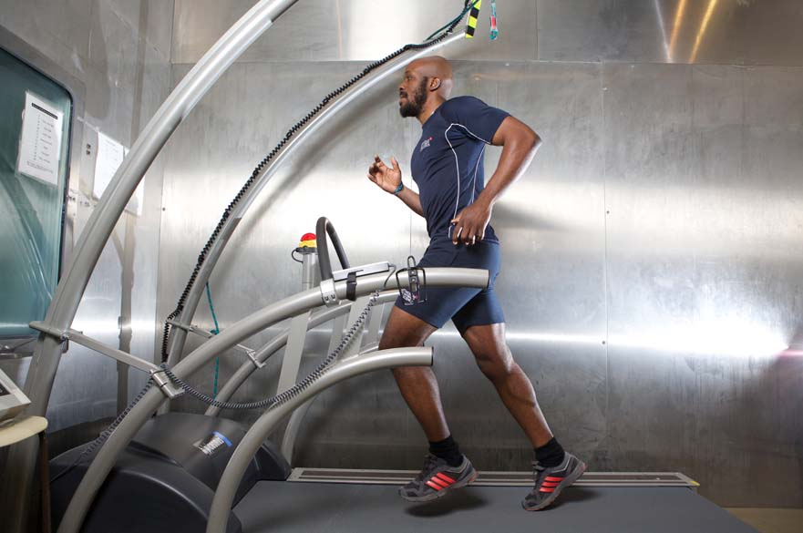

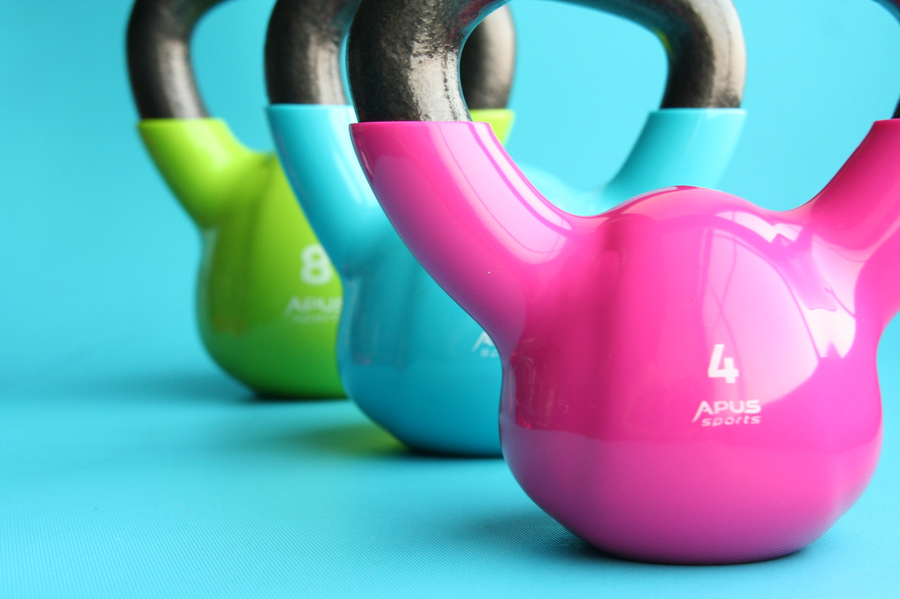
Furthermore Craft & Perna (2014)’s research indicates that the advantage of partaking in exercise may have a long term positive effect, what research found was that adults who participated in exercise intervention, exhibited considerably better development in reducing depressive symptoms, anxiety & self-esteem, compared with individuals in a control group, following a 12 week exercise programme, the Beck’s Depression Inventory (BDI) results reflected a reduction of depression by 5.1points through exercise assignment compared with 0.9 for the control group. Furthermore, these gains were not short lived and depression alleviation was maintained during the 12 month review (Craft & Perna, 2014).
Craft & Perna (2014) state that most of studies utilize aerobic exercise such as walking or jogging; the effectiveness of nonaerobic exercise has not been completely overlooked, one such example which implemented resistance/weight training schedules versus a control group reported a reduction in depressive symptoms compared with the control group.

Slide 7
Effects of exercise on Self-esteem
Murphy (1947, p.996 as cited by Fox, 2000) defines Self-esteem as a “self-rating of how well the self is doing”, meanwhile Campbell (1984 as cited by Fox, 2000) describes self-esteem as “an awareness of good possessed by self”.
Self-esteem is also viewed as a fundamental aspect of human emotional balance, the domain of Self-esteem has been heavily researched and has generated a plethora of interest (Fox, 2000). The significance of Self-esteem must never be overlooked, it is considered a central component in relation to quality of life and sadly low self-esteem is implicated with Psychological illness and poor well-being, furthermore is commonly associated with depressive illness, feelings of hopelessness, neurosis and suicide (Fox, 2000).
A qualitative study carried out by Greenway & Price (2018) highlighted the engagement of negative behaviours in an attempt to address low-self-esteem and feelings of worthlessness. The study consisted of 8 Male participants who initially engaged with anaerobic weight lifting exercise to increase ‘body image’ in view of inflating self-esteem, however when ‘excessive weightlifting’ results plateaued, self-esteem reportedly declined, Ebbeck, Watkins, Concepcion, Cardinal & Hammermeister (2009 as cited by Greenway & Price 2018). Individuals then fall risk to potentially destructive behaviours, such as the engagement of anabolic-androgenic steroid use in conjunction with their anaerobic training, in attempt to increase the deflated self-esteem, 5 of the 8 male participants in Greenway & Price (2018) study reported low self-esteem and feelings of worthlessness as the catalyst for their engagement with steroids.

Slide 8
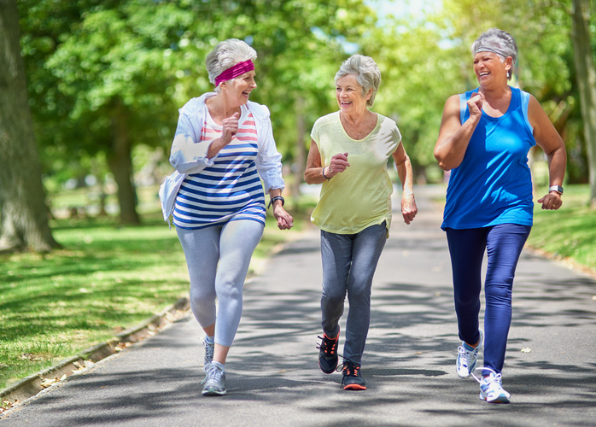
Rationale.
To establish whether frequent exercise positively impacts on three facets of well-being, those being stress, depression and self-esteem. This research could potentially provide a holistic remedy for those individuals at risk of, or suffering from stress, depression or low self-esteem. Insight gained from this study may assist in the devising of tailor made exercise programmes that promote exercise as a potential low cost, effective intervention strategy, that promotes increased well-being. Therefore providing a positive strategy for the difficulties experienced by sufferers of mental health conditions, that impact negatively on their well-being.
The study involved inviting participants to complete a questionnaire that required disclosing whether they exercise on a weekly basis and if so, whether they participate in aerobic or anaerobic exercise, and how frequently they exercise. The information provided a window of opportunity to ascertain whether frequent regular exercise has positive implications on mental health.

Slide 9
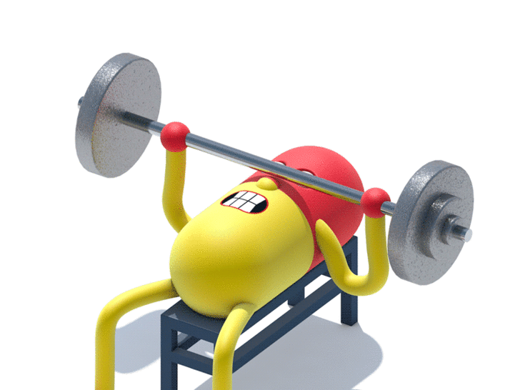
Methodology.
Three groups of adults participated in the study.
All BPS ethics were adhered to.
One group recruited for the study participated in aerobic exercise.
The second group of participants took part in anaerobic exercise.
The third group claimed not to exercise.
It was not entirely possible to obtain all exercise questionnaire responses from the desired groups, a portion of the responses came from a snowball sample.
Six, three one way ANOVA’S were carried out to explore ‘Impact’ of exercise activity and exercise frequency, gender and age on three facets of wellbeing. Stress, Depression & Self-esteem.
The study involved inviting participants to take part in the study, this included them consenting to take part in a wellbeing questionnaire.
The questionnaire included ‘The Major Depression Inventory’ – 5 part likert scale.
The Rosenberg Self-esteem scale – 5-item scale.
The Perceived Stress scale – 5-item scale.
The Dependent Variable (DV)’s were stress, depression and self-esteem.
The Independent Variable (IV)’s were Frequency of exercise, exercise type and age groups.
100 participants took part in this study

Slide 10
HYPOTHESIS 1.
Individuals that take part in frequent exercise will have greater self-esteem than those who don’t exercise.
Result
The hypothesis was supported and results indicated that those who frequently exercise have high scores on SE, particularly in males. Supported by Torres & Fernandez (1995) who postulated that high SE ‘constitutes a strong relationship with healthy type behaviours’ such as increased address to exercise, in turn building strong resilience and maintaining SE.
Hypothesis 2.
There will be a difference between Male/Female and their levels of stress.
Result
Scales indicated that Male participants have lower levels of stress than the females across all age groups, supporting the findings of both Boutcher & Faulkner (2000), Salmon (2001). Their findings highlight the positive impact of exercise upon relieving stress. Salmon (2011) advocated the positive correlation between physical activity and stress relief.
Hypothesis 3.
Individuals that take part in regular exercise will be less stressed than those individuals who don’t take part in exercise.
Result
The hypothesis was supported. Individuals that take part in regular exercise will be less stressed compared with those who don’t exercise is supported by Salmon (2001) who advocates that aerobic exercise is positively correlated with antidepressant effects and anxiolytic outcomes.
Hypothesis 4.
Individuals that take part in regular exercise will be less likely to suffer from depression compared with those individuals who don’t take part in regular exercise.
Result
This was not supported, which is unusual since majority of studies highlight the benefits of exercise to combat depression.
This outcome may have been down to the questionnaire being unreliable & the reliability of participants answers. The study wasn’t longitudinal and exercise wasn’t observed.

Slide 11
Discussion.
The purpose of the research was to study the impact of exercise on psychological wellbeing, three potentially significant findings were that in males, aerobic exercise lowers stress, and individuals who take part in frequent exercise will have greater self-esteem than those who don’t exercise. Results revealed that those who frequently exercise have higher scores on self-esteem, particularly in males.
Individuals that take part in regular exercise were less stressed than those individuals who don’t take part in regular exercise, highlighting the importance of frequent physical activity.
Male participants have lower levels of stress than females across the studied age groups. Individuals that take part in regular exercise will be less stressed than those individuals who don’t take part in exercise is supported, reiterating Salmon (2001) findings.
A reasonable amount of exercise is advantageous for individuals suffering from depression and participation in frequent exercise has the potential to ease the symptoms associated with clinical depression (Craft & Perna, 2004).

Slide 12
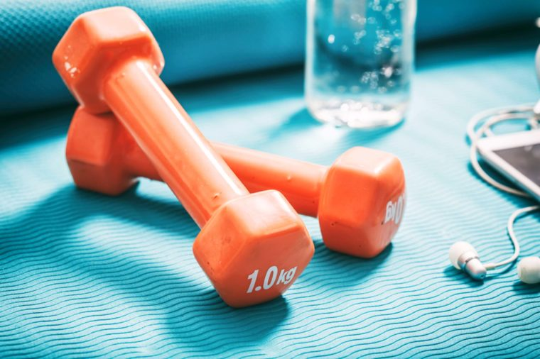

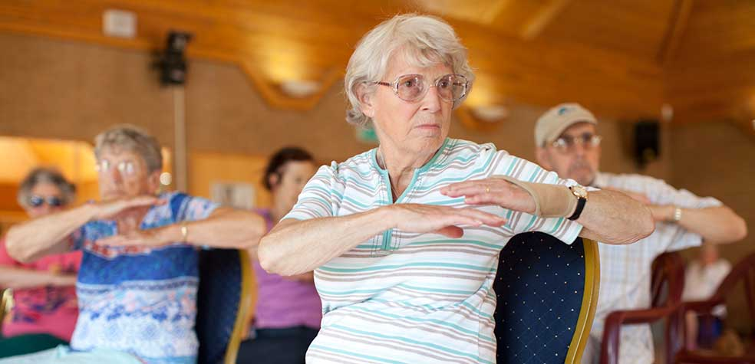
LIMITATIONS.
Examples of Limitations include: Small sample size, it was not entirely possible to generate data from the specific aerobic/anaerobic groups exclusively, the study was not longitudinal, a longer term study would have been more effective – this was supported by North et al, (1990) who stipulated that most significant effect of exercise improving depression was witnessed following at least 17 weeks of exercise – these findings reiterate the ‘strength’ of a long term study.
IMPLICATIONS.
Not all hypotheses were supported, however 4 supported the growing body of literature that endorses exercise as an excellent alternative therapy in the treatment of stress, depression and self-esteem, regardless of age, gender and exercise type.
FUTURE RESEARCH.
On going research in this field needs to be continued, longitudinal studies that assign various exercise prescriptions to large groups of individuals diagnosed with depression, low self-esteem and stress to provide further substance to existing literature.

Slide 13
Reference List.
Boutcher, S. H., & Faulkner, G. E. (2000). 8 The way forward for physical activity and the promotion of psychological well-being. Physical Activity and Psychological Well-being, 154.
Caspersen, C. J., Powell, K. E., & Christenson, G. M. (1985). Physical activity, exercise, and physical fitness: definitions and distinctions for health-related research. Public health reports, 100(2), 126.
Craft, L. L., & Perna, F. M. (2004). The benefits of exercise for the clinically depressed. Primary care companion to the Journal of clinical psychiatry, 6(3), 104.
Fox, K. R. (2000). The effects of exercise on self-perceptions and self-esteem. Physical activity and psychological well-being, 13, 81-118.
Greenway, C. W., Price, C. A. A qualitative study of the motivations for anabolic-androgenic steroid use: The role of muscle dysmorphia and self-esteem in long-term users. Performance Enhancement & Health (2018).
Mind (2013) https://www.mind.org.uk/information-support/your-stories/what-is-mental-health-and-mental-wellbeing/#.Wn2vqOjFKUk accessed Feb 4th 2018.
Salmon, P. (2001). Effects of exercise on anxiety, depression and sensitivity to stress. Clinical Psychology Review, 21(1), 33-61.

