Slide 1
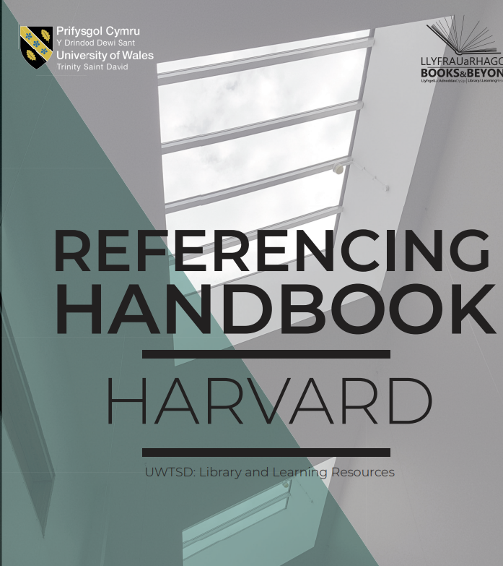
UWTSD’s Intro to Harvard Referencing
Lisa Ellis
Academic Liaison Librarian
Institute of Management and Health (IMH)

Slide 2
Background
You should already have a basic understanding of referencing and its importance if you have completed the following Library Infoskills Units:
Academic Integrity & Plagiarism.
Referencing: The Basics
It is strongly advised you complete both these units if you have not done so already. These will help you develop the academic skills required in identifying sources and referencing correctly.

Slide 3
Harvard Referencing
There are 2 parts to Harvard referencing:
The in-text citation: (A brief acknowledgement of your source in the body of your work.)
The reference list: (Providing your reader with the full reference details at the end of your work.)

Slide 4

Referencing your work is a bit like baking a cake…

Slide 5

Finding Sources
Finding recipes (Sources).
Similar to searching for recipes for a cake, you search in books and online for information and sources on your topic.

Slide 6

Information
Ingredients (Information).
Just as you gather ingredients listed in a recipe, you collate ideas, information, and quotes from your sources.

Slide 7

Integrating Information
Mixing (Integrating Information).
Combining ingredients for your cake, can be likened to integrating information from your sources into your work, using in-text citations.

Slide 8

Writing
Baking (Writing).
Baking the cake is like writing your assignment. Where you bring all your reading and notes into one cohesive piece.

Slide 9

Referencing
Decorating (Referencing).
The final decoration is essential to any professional finish.
Adding a full reference list at the end of your work, is a requirement when writing any academic work.

Slide 10
Writing your references
The in-text citation: (A brief acknowledgement of your source in the body of your work.)
The reference list: (Providing your reader with the full reference details at the end of your work.)

Slide 11
Integrating sources into your work
In-text citation...
Used to let you reader know when you have used the ideas or words of another.
Allows you to acknowledge and discuss their work in your text, by quoting, paraphrasing, or summarizing.
Forms part of your word count therefore, is brief.
It contains the following information only:
  Author / editor’s surname.
  Year of publication.
  Page numbers (if quoting or referring to a specific part or idea).

Slide 12

Quoting v Paraphrasing
Quoting: copying someone else’s words exactly as they appear in the original text.
Paraphrasing: using someone else’s words or ideas and writing in your own words.
Summarising: writing a brief overview of someone else's idea in your own words. Example: writing the findings of a research article in a journal in a few sentences.

Slide 13
Paraphrasing example...
  Bonding with primary caregivers in the formative years is essential for a child's emotional and psychological well-being.

Slide 14
Parenthetical citation
Author’s (Surname, year) in brackets.
  Bonding with primary caregivers in the formative years is essential for a child's emotional and psychological well-being (Myers, 2019).
The sentence is focusing on the idea, rather than who wrote it.
Easy to integrate into your writing and synthesise from multiple sources. Example: (Myers, 2019; Thomas, 2021; Williams, 2024).
Lack of quotation marks show your reader, you have paraphrased the ideas of the author cited in the sentence.

Slide 15
Paraphrasing example...
  Scotland is taking a radical approach to tackling knife crime by treating it as a public health issue.

Slide 16
Narrative citation
Author's Surname, (year) in brackets.
  According to Roberts (2019), Scotland is taking a radical approach to tackling knife crime by treating it as a public health issue.
Focus is on the author’s view or opinion.
Difficult to synthesise multiple opinions and sources.
Overuse can disrupt flow of your writing.
Lack of quotation marks show your reader, you have paraphrased the ideas of the author cited in the sentence.

Slide 17
Quoting
Quoting is acceptable (if referenced correctly) but does not show your understanding of what you have read.
Wherever possible, you should paraphrase. Whichever you do, you must give appropriate acknowledgement.
If using a short quote (less than 30 words), ensure you:
Use ‘quotation marks’.
Show page number, (location, or paragraph number, if not possible).
For longer quotations, please refer to the referencing handbook.

Slide 18
Example:
Parenthetical citation.
When writing assignments, the aim should always be to reference reliable sources of information (Pears and Shields, 2016, p. 2).
Narrative citation.
According to Pears and Shields (2016, p. 2) when writing assignments, the aim should always be to reference reliable sources of information.
Lack of quotation marks indicates to your reader you have paraphrased, not quoted the ideas of the author cited in the sentence.

Slide 19
Examples: Direct (short) quote
Parenthetical quotation.
When writing assignments, the “aim should always be to reference reliable sources of information” (Pears and Shields, 2016, p. 2).
Narrative quotation.
According to Pears and Shields (2016, p. 2) when writing assignments, the “aim should always be to reference reliable sources of information”.
Use of quotation marks show your reader, you have used the exact words of the author cited in the sentence.

Slide 20
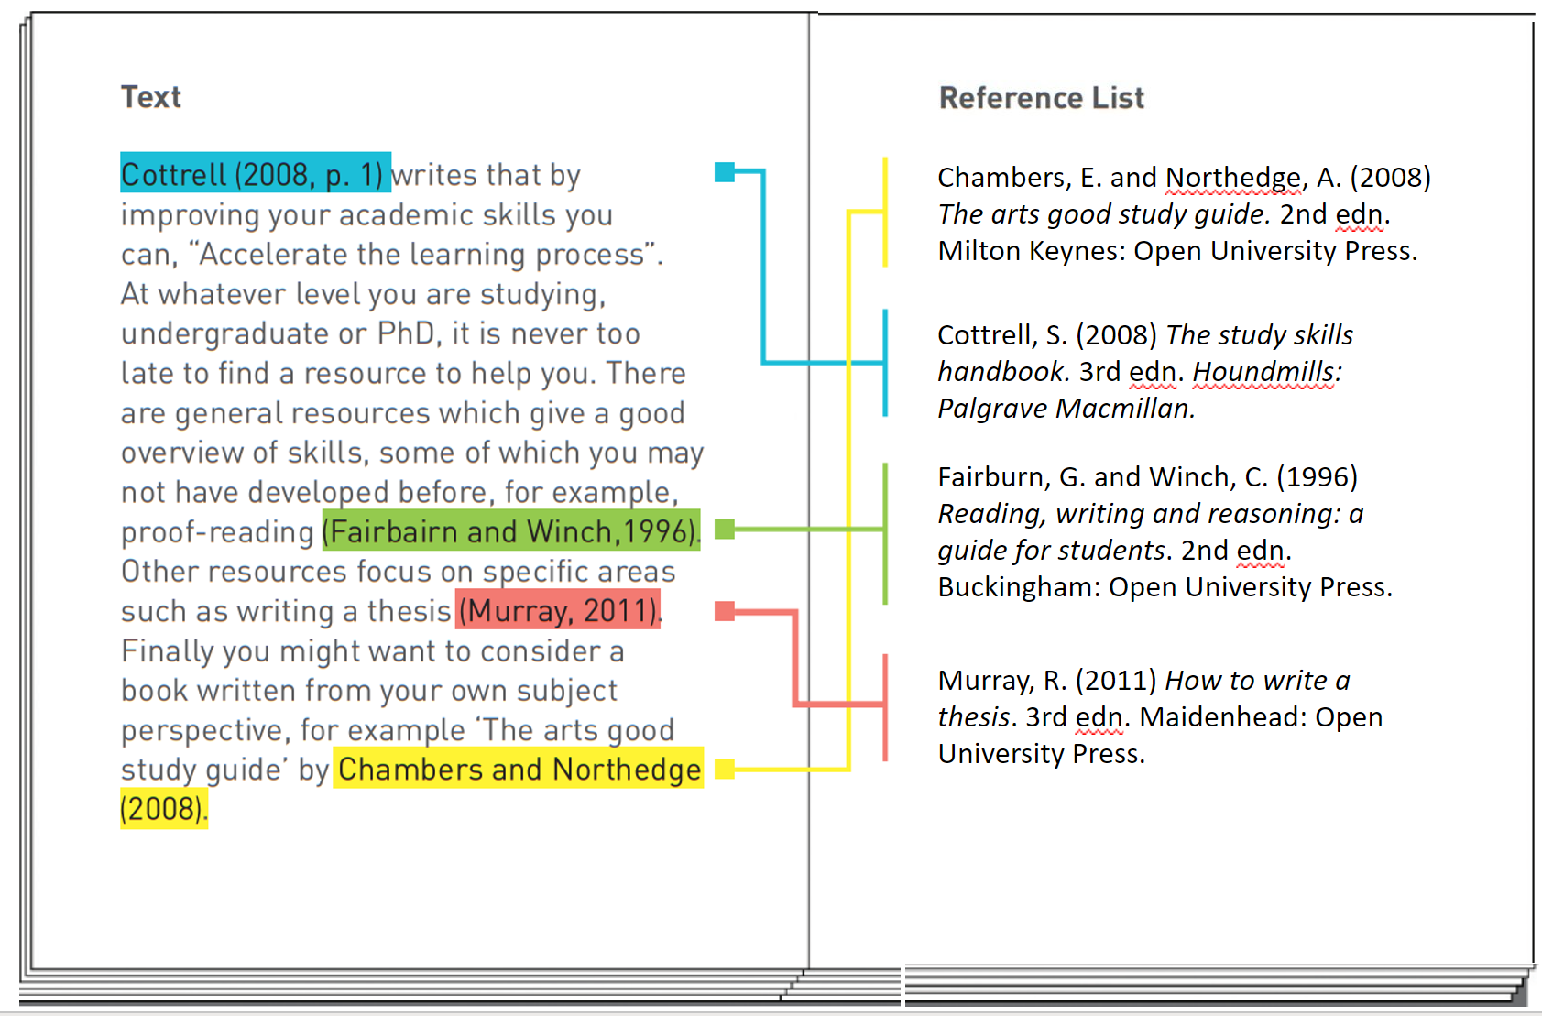
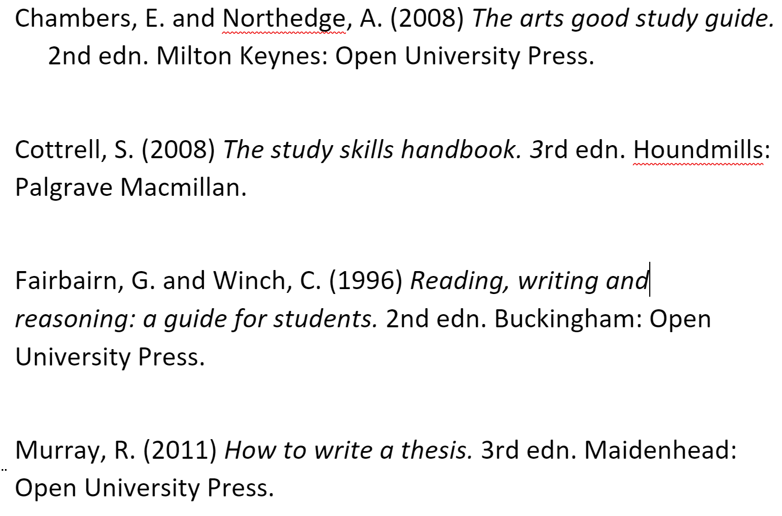
1. In-text citation
2. Full reference list
NOTE:
If your source has 4 or more authors listed, you can use et.al. in the in-text citation only.
Example:
(Rogers, et.al., 2023).
This work is licensed and adapted under a Creative Commons Attribution 4.0 International License. Attribution: Leeds Beckett University Library.

Slide 21
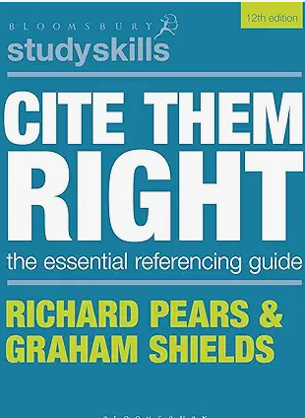
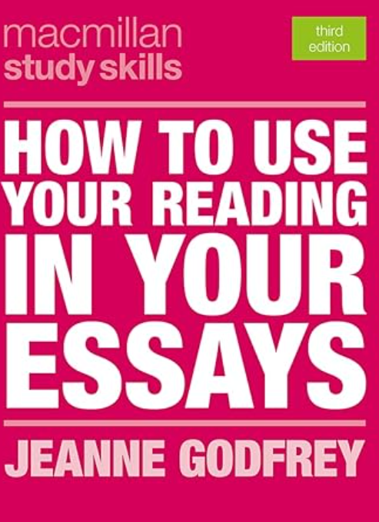
Useful Resources
How to use your reading in your essays.
Cite Them Right: Setting out citations.
Harvard Referencing: The Mechanics (infoskills).

Slide 22
The reference list…
Is listed alphabetically (by surname of author).
Is formatted according to the type of source you have cited. E.g. a journal, book, report, website, etc.
Provides full bibliographic details of the sources referred to in your text.
Is comprehensive enough to enable your reader to locate the information and contains the following:
  Who? (Author).
  When? (Date published).
  What? (Title).
  Where? (Location).

Slide 23
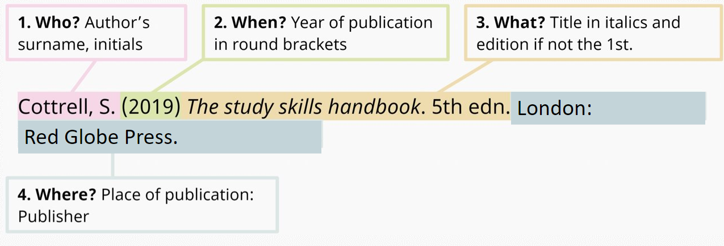
Reference List: book
In-text citation:
(Cottrell, 2019)

Slide 24
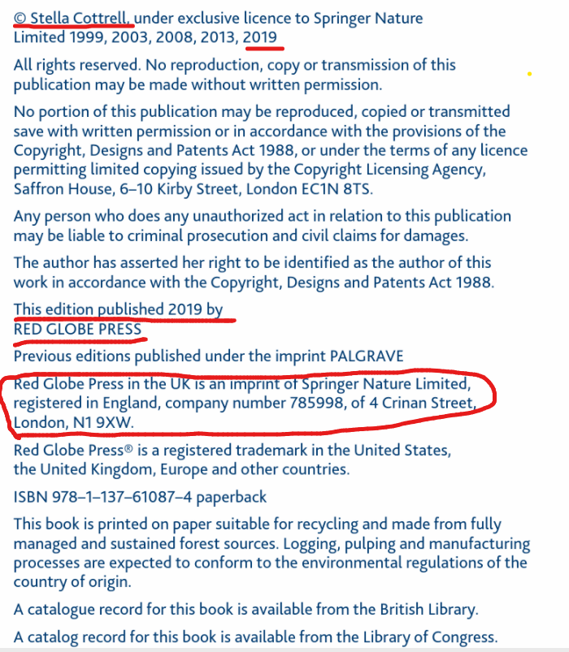
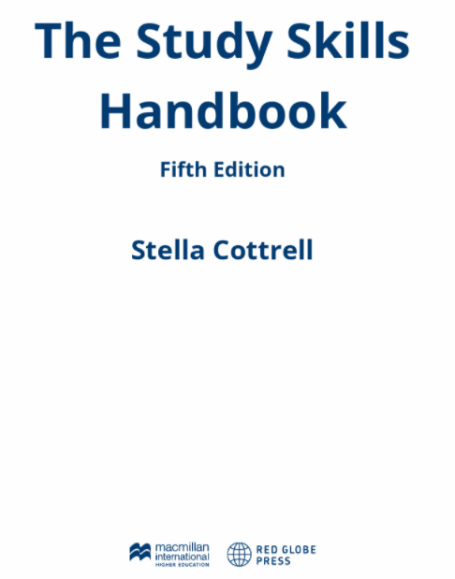
Copyright page...
Title
Edition
Date
Author ​
Place of Publication (publisher's address).
Publisher

Slide 25
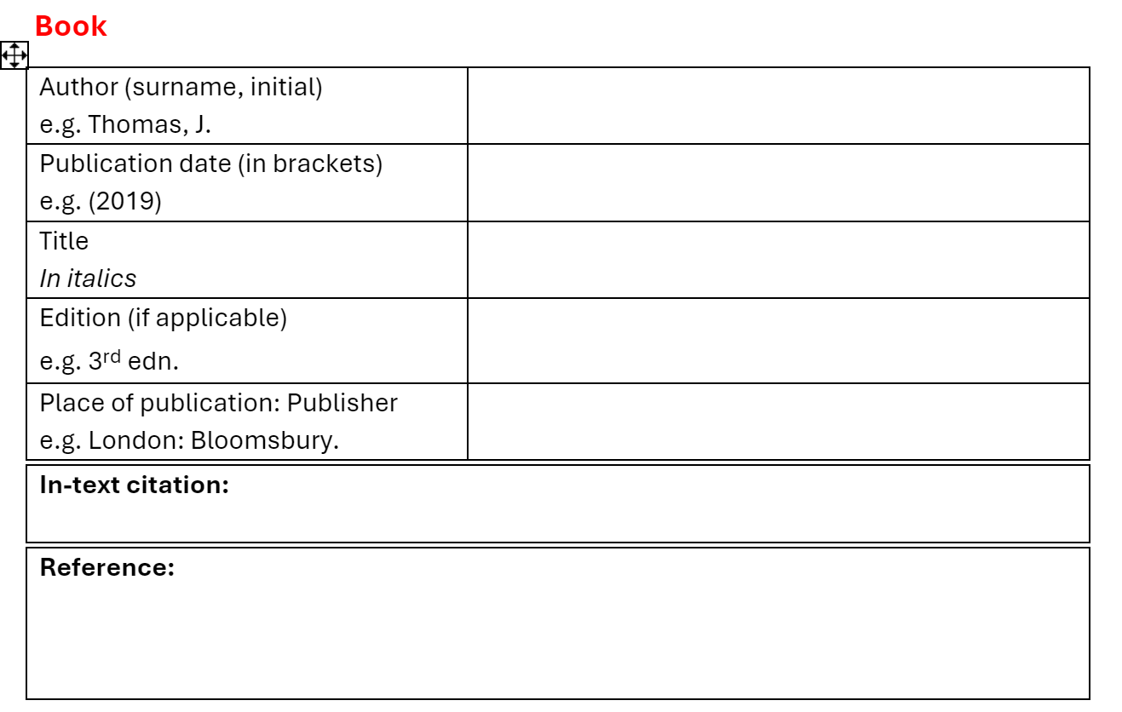
Your turn...

Slide 26
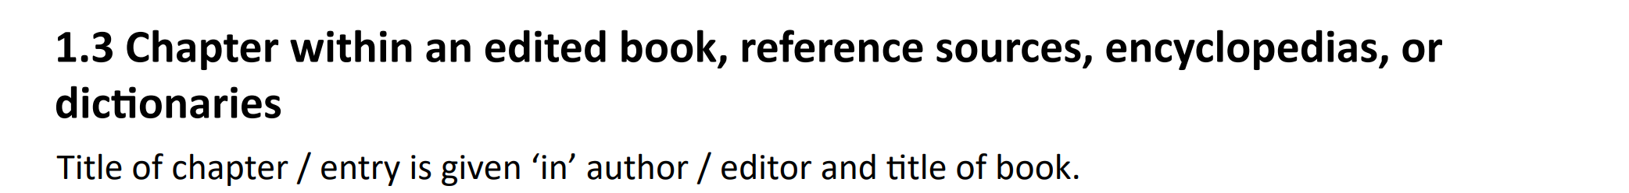
Edited book: Chapter
(Neyround, 2019, p.16.)
Neyround, P. (2019) 'Ethical leadership in policing: towards a new evidence-based, ethical professionalism?', in P. Ramshaw, M. Simpson and M. Silverstri (eds) Police leadership: changing landscapes. Basingstoke: Palgrave Macmillan, pp. 3-22.
UWTSD Harvard Referencing Guide

Slide 27
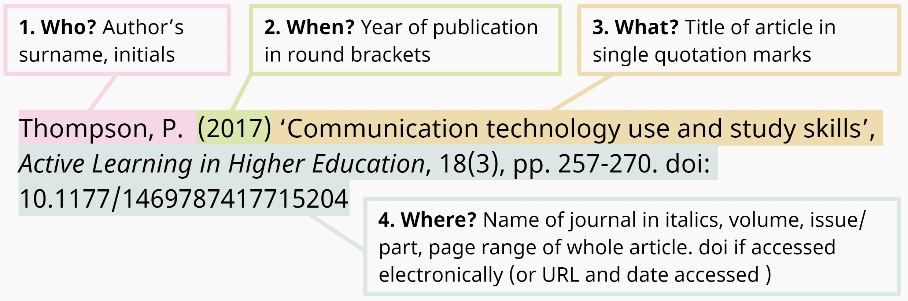
Reference List: journal article
Available at:
Available at: doi.org/
In-text citation:
(Thompson, 2017)

Slide 28
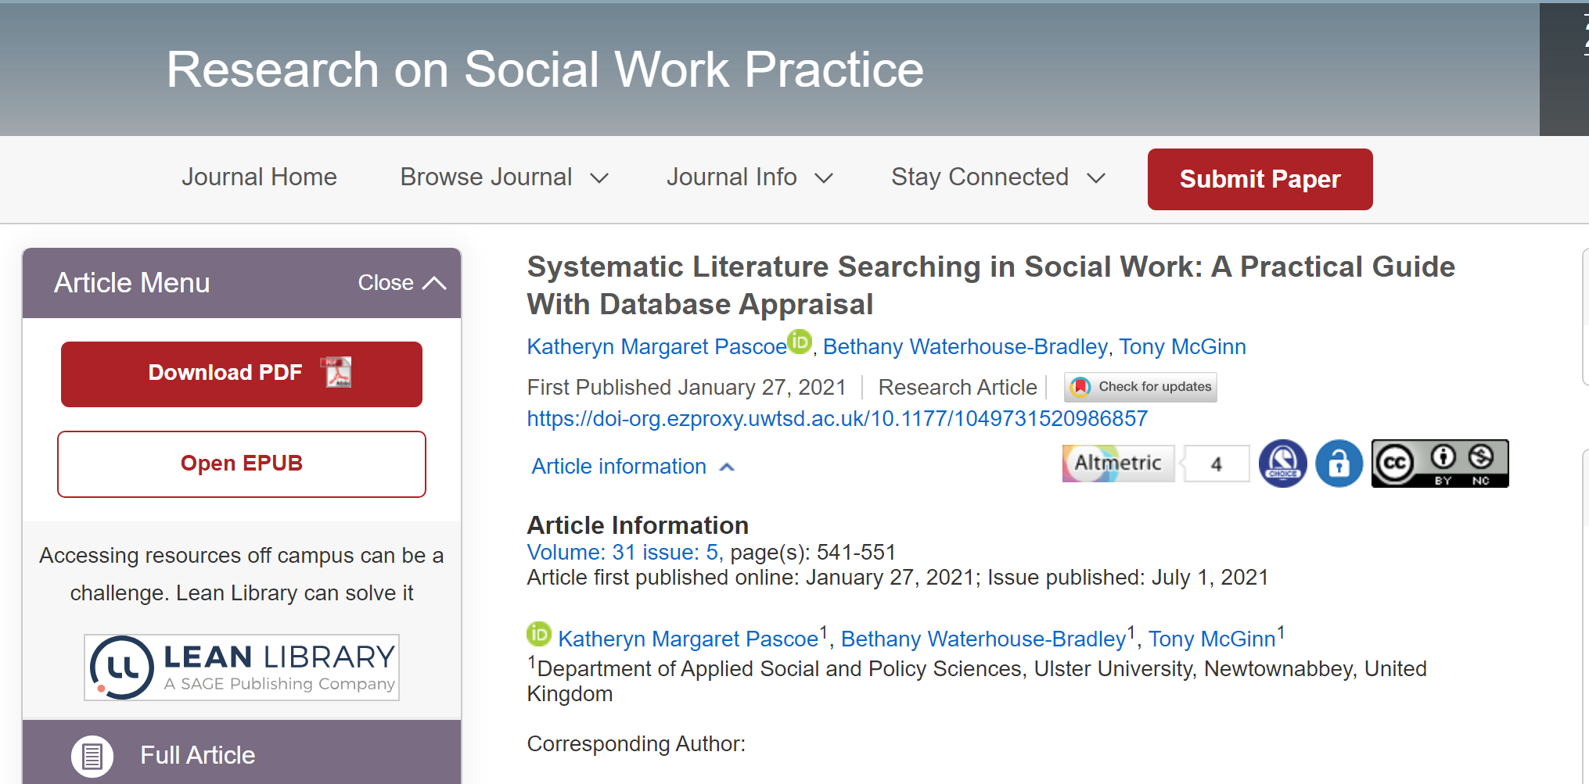
Finding the Information

Slide 29
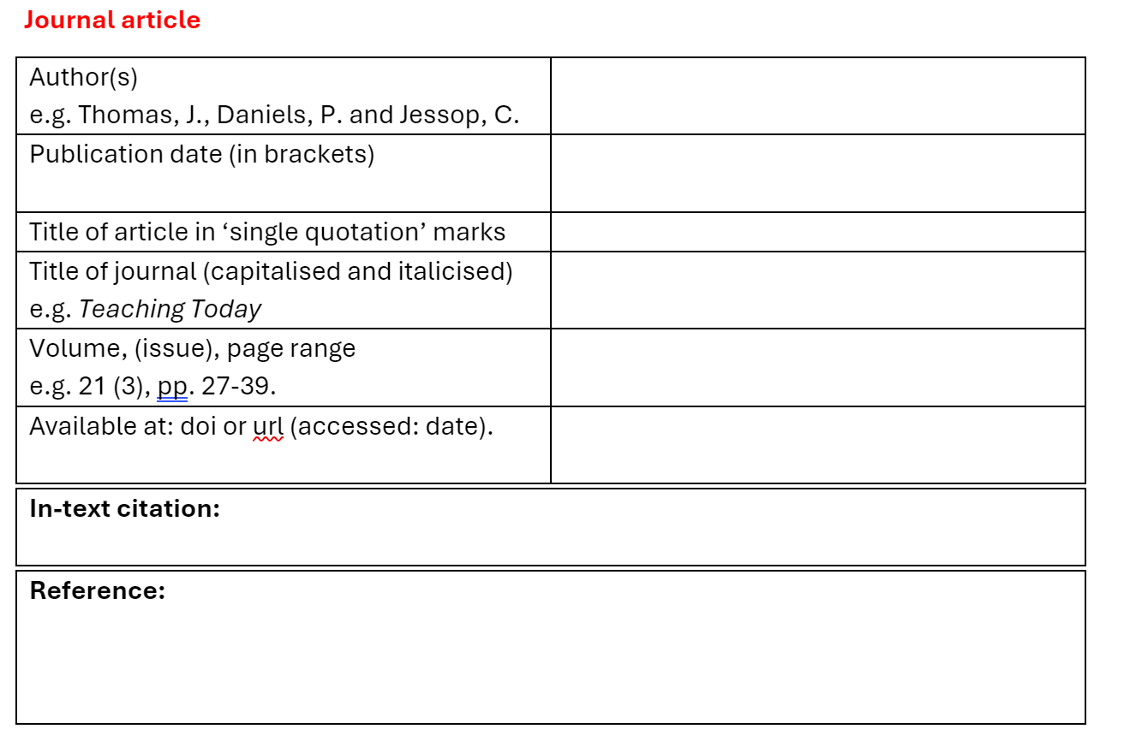
Your turn...

Slide 30
Web page
Who? Author's surname and initials
When? Date in round brackets
What? Title of webpage in italics
Holford, A. (2022) Student loans: would a graduate tax be a better option? Available at: https://theconversation.com/student-loans-would-a-graduate-tax-be-a-better-option-179253 (Accessed: 26 May 2022).
Where? URL and date accessed (in round brackets).
In-text citation:
(Holford, 2022)

Slide 31
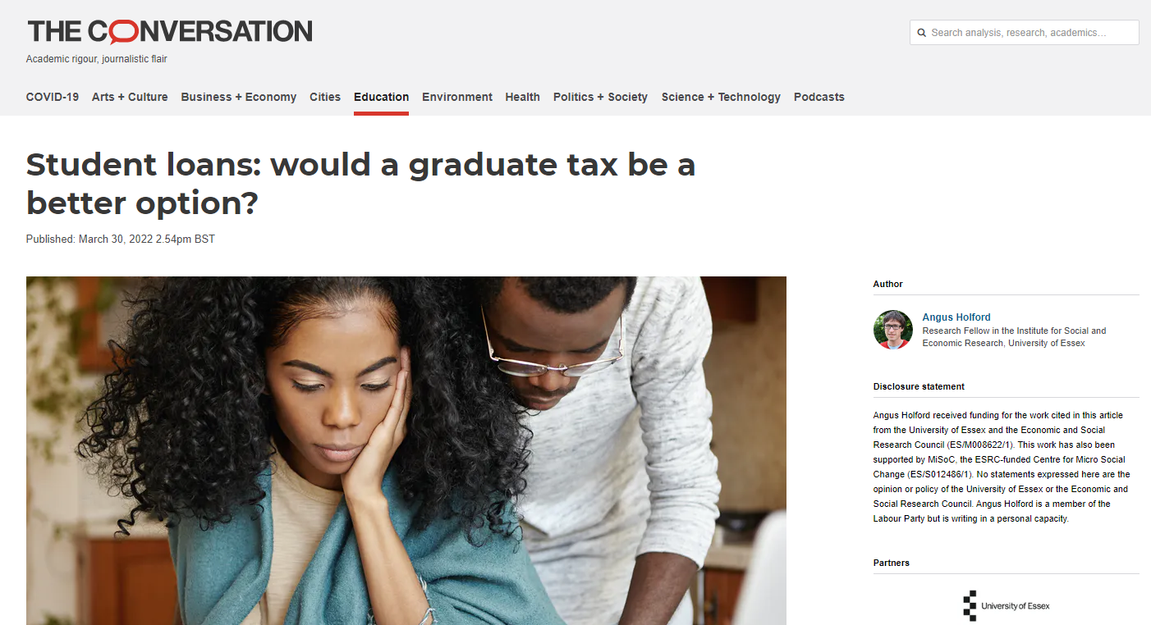
Webpage
TIP: Explore: Referencing: The Basics in Moodle to help identify different online resources.
The Conversation

Slide 32
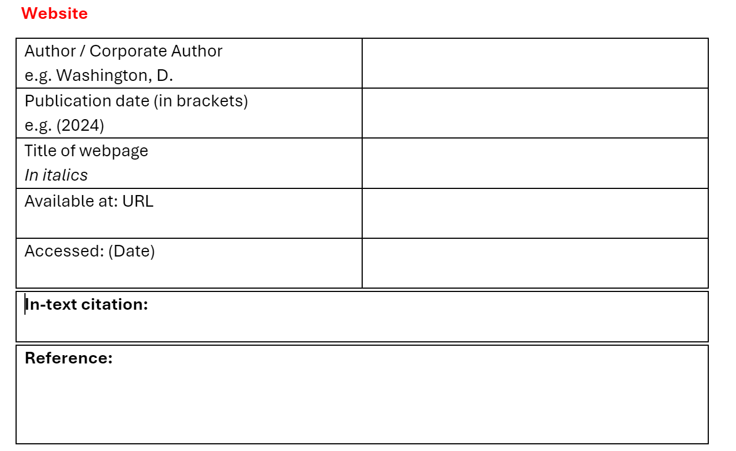
Your turn...

Slide 33
Alphabetical reference list example
Cottrell, S. (2019) The study skills handbook. 5th edn. London: Red Globe Press
Holford, A. (2022) Student loans: would a graduate tax be a better option? Available at: https://theconversation.com/student-loans-would-a-graduate-tax-be-a-better-option-179253 (Accessed: 26 May 2022).
Neyround, P. (2019) 'Ethical leadership in policing: towards a new evidence-based, ethical professionalism?', in P. Ramshaw, M. Simpson and M. Silverstri (eds) Police leadership: changing landscapes. Basingstoke: Palgrave Macmillan, pp. 3-22.
Thompson, P. (2017) 'Communication technology use and study skills', Active Learning in Higher Education, 18(3), pp. 257-270. Available at: doi: 10.1177/1469787417715204
Book
Website
Chapter in an edited book
Journal article
N.B. Alphabetical Order

Slide 34
Alphabetical reference list example
Cottrell, S. (2019) The study skills handbook. 5th edn. London: Red Globe Press
Holford, A. (2022) Student loans: would a graduate tax be a better option? Available at: https://theconversation.com/student-loans-would-a-graduate-tax-be-a-better-option-179253 (Accessed: 26 May 2022).
Thompson, P. (2017) 'Communication technology use and study skills', Active Learning in Higher Education, 18(3), pp. 257-270. Available at: doi: 10.1177/1469787417715204
Book
Website
Journal article
N.B. Alphabetical Order

Slide 35
1. In-text citation
2. Full reference list
This work is licensed and adapted under a Creative Commons Attribution 4.0 International License. Attribution: Leeds Beckett University Library.

Slide 36
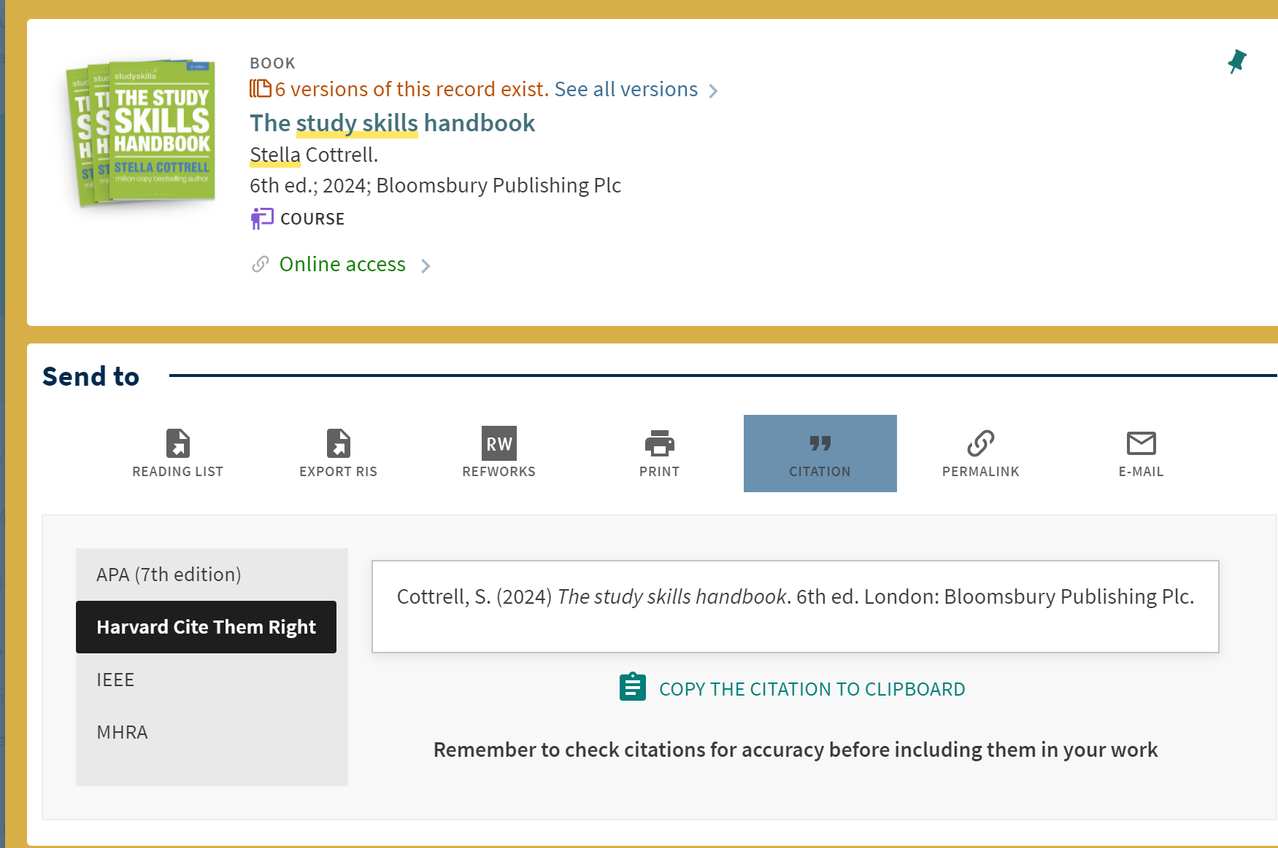
Useful resources
Citation tool in the item record on the library catalogue.
Link to Catalogue record

Slide 37
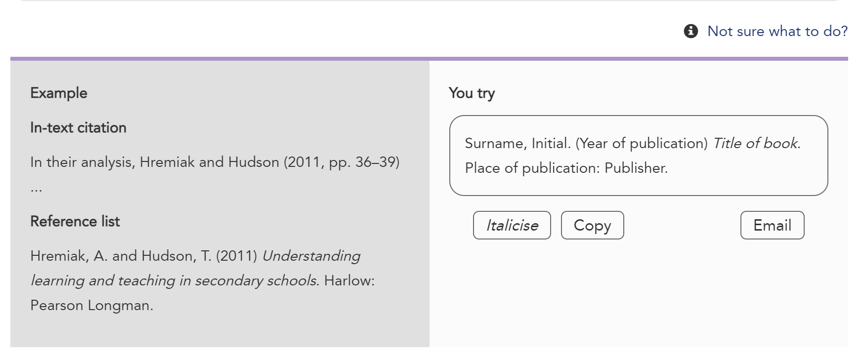
Useful resources
'You try' option in the Cite Them Right Database.

Slide 38
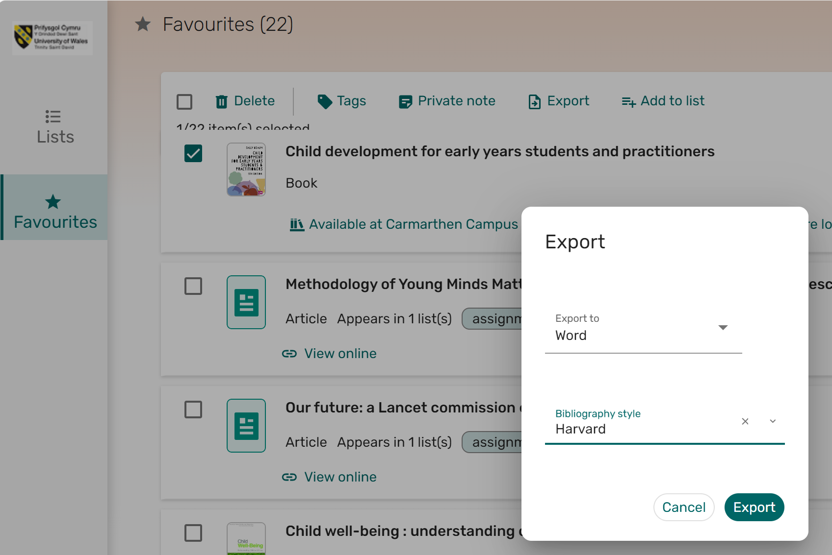
Useful resources
Export function in your online resource list.

Slide 39
Citation manager tools
Many citation tools available, but they are not 100% accurate all of the time.
Personal choice.
Some you may wish to explore:
MyBib.
ZoteroBib.
RefWorks (Supported by UWTSD).
Mendeley.
TIP:
Explore Library Infoskills:
Referencing: Managing Information to find out more.

Slide 40






Referencing Process
Make notes as you read.
Link perspectives.
Critically analyse viewpoints.
Write in your own words.
Accurately record your sources.
Search for and explore research and ideas from different sources.
Produces original written work with ideas built on correctly referenced sources.
Notes:
Read widely and assimilate information from different sources, such as lectures, moodle, web, books, journals, tv, newspapers and more.
Take notes as you go along, making sure to highlight any quotes, paraphrasing, where you got the idea / words/ information from.
Focus on ideas not quoting or paraphrasing. Keep asking yourself, How do you know this information? Whose idea is it? Attribute the information.
Note taking is a skill that is necessary to develop to become a good scholar.
Draw your own conclusions based on your understanding of the evidence and information you have found and reference and acknowledge your sources, also known as attribution.
Repeat to yourself as you are writing How do I know this? Where did I read this? This will help you avoid plagiarism.

Slide 41

Useful Resource Links
Library Infoskills
Cite Them Right Database
UWTSD’s Harvard Referencing Handbook.
TurnitIn: Evaluating Sources Playlist

Slide 42

Contact
Lisa Ellis: l.ellis@uwtsd.ac.uk
Library: library@uwtsd.ac.uk
Infoskills: infoskills@uwtsd.ac.uk
Source: Pixabay: image by Geralt
Notes:
Questions

