Slide 1
Rich Internet Application Development
Themes and Styles

Slide 2
Definitions
A theme refers to the layout of an application or a site
A style refers to a method to implement a theme
“A theme is a collection of CSS files, skins and images...” – ASP.NET 2.0 e-commerce in C# [1]

Slide 3
What CSS?
Cascading Style Sheets provide a common approach to implementing themes for HTML and XML based sources
It provides a mechanism that separates out the Visual aspects of a site from the content
CSS allows for rapid changes to be made to an entire site
[2]

Slide 4
CSS Adoption
CSS is used today my many web-sites and is supported by Adobe Flash Builder
It is difficult to predict how a site may look from one browser to another (due to different levels of browser compliance)
Silverlight does not use CSS in favour of its own XAML based approach

Slide 5
Silverlight Styles
Silverlight implements styles by modifying the APP.XAML file (which is added when a new project is created)

Slide 6
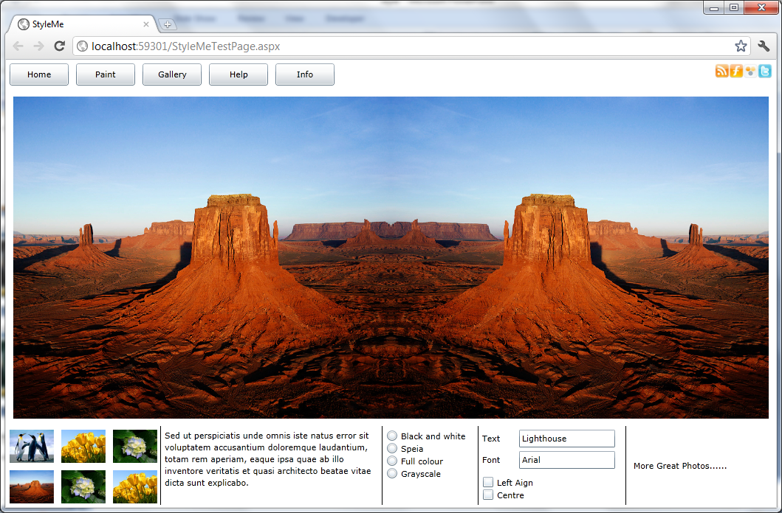
Silverlight Theme Examples

Slide 7
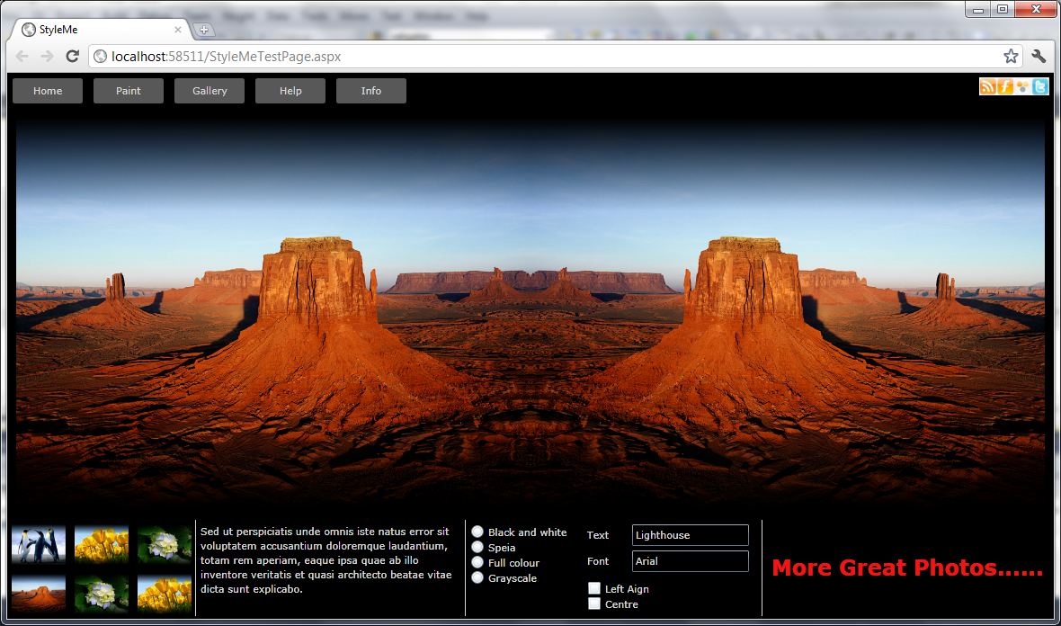
Silverlight Theme Examples

Slide 8
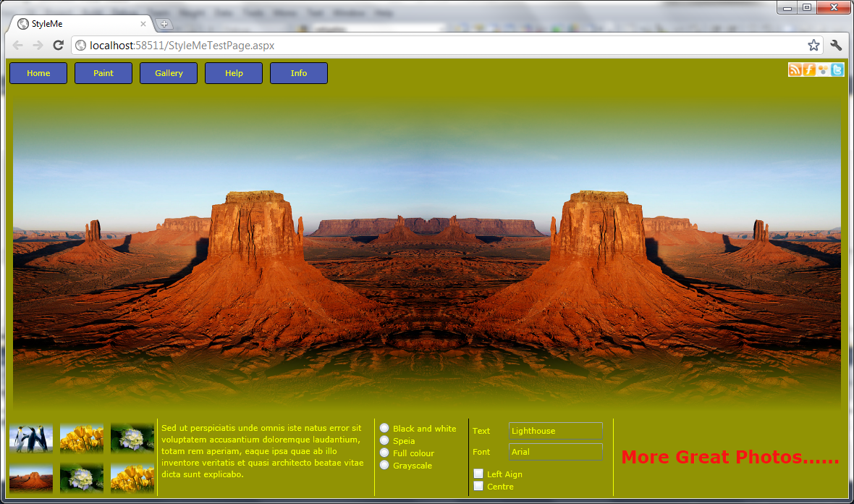
Silverlight Theme Examples

Slide 9
References
[1] Darie, Cristian; Watson, Karli
Begining ASP.NET 2.0 e-Commerce in C#2005, Apress 2005
[2] Powers, David
Getting Started with CSS, Friends of ED 2009

