Slide 1
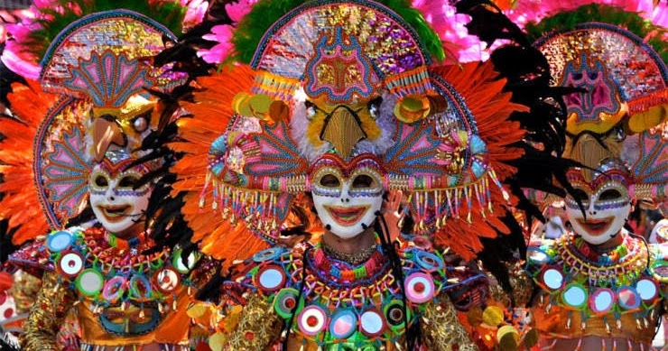
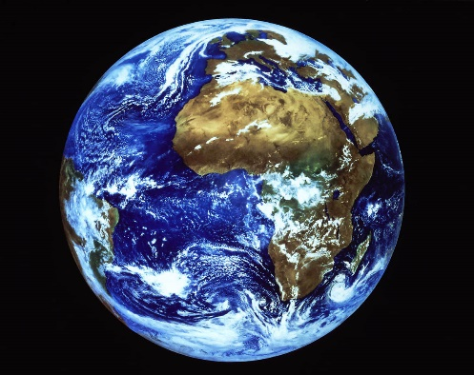
ECAD5008 Deepening Practice
Poetry
Tuesday, 18th February 2020

Slide 2
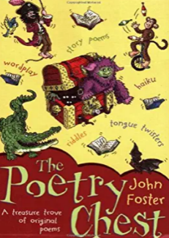
Today’s session
Think about what poetry is;
Look at the current curriculum a and the new curriculum;
Look at some poems and try reading them: what are the characteristics of good readers?
Think about how we can develop children’s love of poems by getting them to perform poetry – what are the characteristics of good;
Prepare some poetry for performance;
Break
Share
Why write poetry?
Different from of poetry – why they might be useful
Writing poetry
Notes:
Ask students to explain what poetry is …….. new slide with definition

Slide 3

What is poetry?
“Poetry is an art form in which human language is used for its aesthetic qualities in addition to, or instead of, its notional and semantic content. Poems frequently rely for their effect on imagery, word association, and the musical qualities of the language used.”
www.poetry.org
Notes:
The word “poetry” cover a very wide range of literature.
Read two examples:
Whale Song
My dad, your dad.
Semantic - relating to meaning in language or logic;
Aesthetic - concerned with beauty or the appreciation of beauty;
Notional - existing as or based on a suggestion, estimate, or theory; not existing in reality;
Imagery - visually descriptive or figurative language

Slide 4



The boring bits
Old Curriculum – 3 Strands
Oracy
Reading
Writing
New curriculum – 4 What matters statements
Language
Listening and reading
Speaking and writing
Literature
Notes:
We are focusing on KS2 but …….. explain changes: 3 strands go to 4 What Matters statements
Activity?
Skim through documents and see where poetry is mentioned
This is very boring so simply tell them where the mentions are: particular mentions in current curriculum but very little specific in new. Neither mention particular forms of poetry.

Slide 5

The fourth “What Matters Statement”
“Learners should experience a language-rich environment across the key stage where oracy, reading and writing experiences are connected.”
Welsh Government (2015) English Programme of Study
Notes:
The addition of this WMS suggests that there will be greater emphasis on literature and creativity
Stress the need to read poems in the classroom, having one’s own collection of books and being able to read poems well.
Model some good reading: Little Red Riding Hood and the Wolf

Slide 6

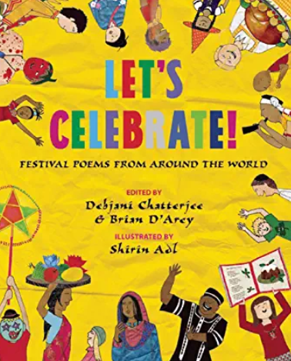


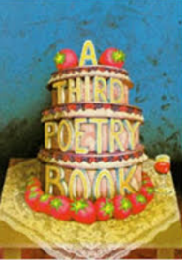


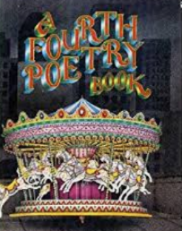
Let’s look at some poetry books
Notes:
Read a poem as an example of good reading.
Let the students look at the books.
Ask for volunteers to have a go.

Slide 7
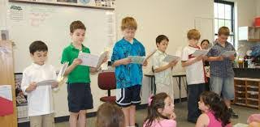
Children performing poetry
What are the benefits?
Notes:
Why encourage children to recite poetry?
Children need to be surrounded by language in many forms, including poetry. Often poetry uses rich and varied language, expressing thoughts and ideas in novel and stimulating ways; poetry can make you think deeply, but it can also make you laugh. In my experience, children grow to love poetry if you read a variety of different types of poem to them often, starting with the real “show-stopper” poems that will grab their attention, like The Visitor, but then diversifying to more thought provoking pieces.
The way you read a poem is crucial to gaining children’s attention and appreciation of poems. You have to enjoy poetry and enjoy reading poetry so that your enthusiasm is transmitted to the children. It is also important that you are able to read (or recite!) poems with great expression, intonation and feeling to assist the children’s understanding of the poem.
Obviously poetry is an excellent way to improve oracy skills (see below for links to the current curriculum), but, more crucially, getting children to recite poetry is a marvellous way to develop their confidence and self-esteem. Even very shy children and / or children who generally will not speak up are buoyed up by the applause and acclaim reciting poetry to an audience can bring.
The important things is that you begin by using poems that you like and are either going to grab the children’s attention from the outset, or are poems you are going to explain to the children (e.g., Falling Leaves).
The poems you choose can:
use different imagery that you can exploit in a recitation (e.g., Falling Leaves);
have different “roles” that the children can adopt / act out (e.g., The Visitor);
include rhythm / repetition / choruses that can be exploited in the recitation;
lend themselves to hand and / or body movements to support the words.
It is important that you model the way the children might recite the poem in the first instance. Then you and the class can decide how best to perform the poem:
will different children recite different bits?
are there roles for people to play?
will one person recite some line alone or will lines be said in a chorus?

Slide 8

Moon Cakes Performance.MOV
Notes:
Explain how this selection came about.
Celebrations

Slide 9

Falling Leaves
The leaves in autumn
Swing on the boughs
Pushed by the wind,
Backwards and forwards
Far above the ground.
The wind blows hard
And the leaves let go
Their hold,
Flying over the wood
Like a flock of birds
And brown as sparrows
Flying above the house.
The wind lets them fall
Helter skelter
Towards the ground
Or sets them spinning
On a roundabout;
You can watch them
And try to catch them
Coming down.
They crowd together
By walls at corners
Or chase each other
Up the road.
Sometimes when you open
The kitchen door
A leaf blows in
And lies exhausted
On the floor.
Stanley Cook

Slide 10
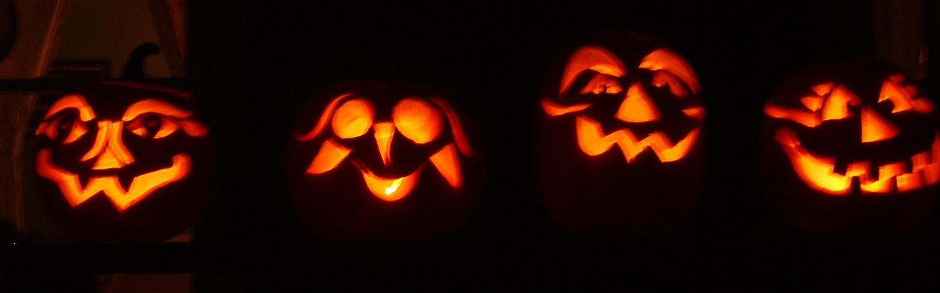

The Visitor
“I’m coming!” A skeleton opened the door.
“Give me my ring!” It was crossing the floor.
“What was that, William? What did it say?”
“Don’t worry, my dear. It’ll soon go away.”
“I’m reaching you now! I’m climbing the bed.”
The wife pulled the sheet right over her head.
It was torn from her grasp and tossed in the air;
“I’ll drag you out of bed by the hair!”
“What was that, William? What did it say?”
“Throw the ring through the window! THROW IT AWAY!”
She threw it. The skeleton leapt from the sill,
Scooped up the ring and clattered downhill,
Fainter … and fainter .. Then all was still.
Ian Serraillier
A crumbling churchyard, the sea and the moon;
The waves had gouged out grave and bone;
A man was walking, late and alone …
He saw a skeleton on the ground;
A ring on a bony hand he found.
He ran home to his wife and gave her the ring.
“Oh, where did you get it?” He said not a thing.
“It’s the loveliest ring the world,” she said.
As it glowed on her finger. They skipped off to bed.
At midnight they woke. In the dark outside,
“Give me my ring!” a chill voice cried.
“What was that William? What did it say?”
“Don’t worry, my dear. It’ll soon go away.”
“

Slide 11

Chinese Dragon
I’m the dragon who dances in the street.
I’m the dragon in the festival.
I leap and twist on caterpillar feet.
I’m the dragon who dances in the street.
I snap and snort and stamp to the beat.
I shiver my scales. I can’t keep still.
I’m the dragon who dances in the street.
I’m the dragon in the festival.
I’m the dragon of red and green and gold.
I’m King of the Chinese New Year.
I come from the land of stories of old.
I’m the dragon of red and green and gold.
I can breathe out fire or smoke that’s cold.
If you’ve been good then you’ve nothing to fear
From the dragon of red and green and gold –
The King of the Chinese New Year.
Catherine Benson

Slide 12
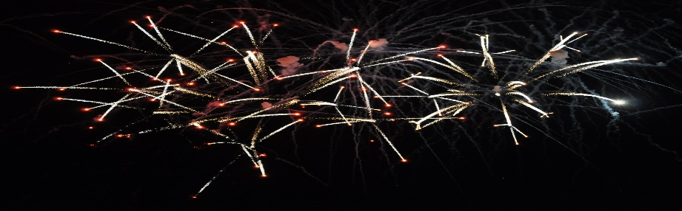
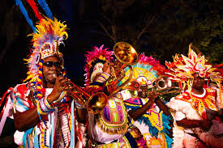
Carnival
Carnival! Carnival! Everybody shout out – Carnival! Carnival!
Carnival! Everybody shout out – Carnival!
Banner flyin’ in de air
An de pickney dem a cheer,
Jumpin’ up an’ shoutin’ ‘bout Carnival.
What a party! What a spree!
What a joyful jamboree!
Jumpin’ up an’ shoutin’ ‘bout Carnival.
Carnival! Carnival! Everybody shout out – Carnival! Carnival!
Carnival! Everybody shout out – Carnival!
Valerie Bloom
Carnival! Carnival! Everybody shout out – Carnival! Carnival!
Carnival! Everybody shout out – Carnival!
Ah walking up de street,
Everybody dat ah meet
Jumpin’ up an’ shoutin’ ‘bout Carnival.
Ah climb into de bus,
Everybody meck a fuss,
Jumpin’ up an’ shoutin’ ‘bout Carnival.
Carnival! Carnival! Everybody shout out – Carnival! Carnival!
Carnival! Everybody shout out – Carnival!
Ah step into de mall
Everybody start to bawl
Jumpin’ up an’ shoutin’ ‘bout Carnival.
Ah drive down to de market
In me car, nowhere to park it.
Dey jumpin’ up an’ shoutin’ ‘bout Carnival.

Slide 13
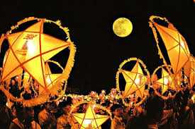
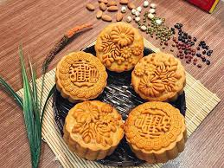
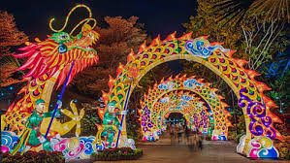
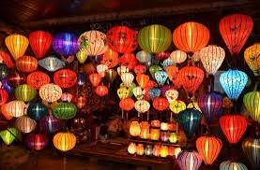
Moon Cakes for Trung Thu
In Vietnam, the moon glowing white
fills the children with great delight.
For an autumn full moon, big and bright,
bring cakes and sweets. It’s Trung Thu Night.
Drums and cymbals and dancing feet,
star-shaped lanterns lighting the street.
Stalls sell Moon Cakes for us to eat –
fish and flower shapes, sticky and sweet.
Wearing masks, no one knows who is who:
“Who’s there?” “It’s me!” “Who are you?”
A sky full of stars, full moon shining through:
Hunter’s Moon, Harvest Moon, bright Trung Thu.
Many Coe

Slide 14

Eid Mubarak! Eid Congratulations!
Eid Mubarak! Eid Congratulations!
Let each home have celebrations.
Friend or foe, stranger or dear one,
Whether near or far away,
I send you greetings on this day.
I give myself to all, with love for everyone.
In zakat charity I offer God this aching heart forever.
Whether beggar or emperor,
Let us sing of His splendour.
I bring a cup of fellow-feeling;
Come, believers, for Iftar dining.
Come together in love and let us share God’s blessing.
Kazi Nazrul Islam

Slide 15
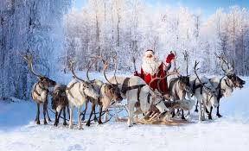
Twas the Night before Christmas
Twas the night before Christmas, when all through the house
Not a creature was stirring, not even a mouse.
The stockings were hung by the chimney with care,
In hopes that St Nicholas soon would be there.
The children were nestled all snug in their beds,
While visions of sugar-plums danced in their heads.
And mamma in her ’kerchief, and I in my cap,
Had just settled our brains for a long winter’s nap.
When out on the lawn there arose such a clatter,
I sprang from the bed to see what was the matter.
Away to the window I flew like a flash,
Tore open the shutters and threw up the sash.
The moon on the breast of the new-fallen snow
Gave the lustre of mid-day to objects below.
When, what to my wondering eyes should appear,
But a miniature sleigh, and eight tiny reindeer.
Clement Clarke Moore

Slide 16
On your way back, please collect some fallen leaves for our next activity

Slide 17

Showtime!
Chinese Performance.MOV

Slide 18
Different types of poems
This is an extremely useful book and all of the following examples have been taken from it.

Slide 19
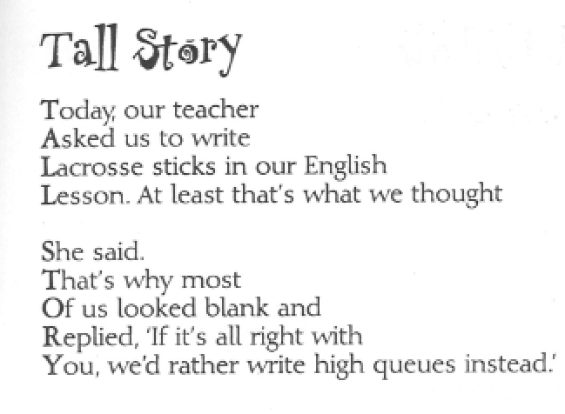
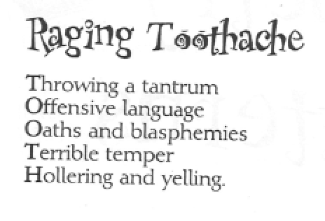
Acrostic Poems
Poems in which certain letters of a word in each line together form a word, which is the subject of the poem.

Slide 20
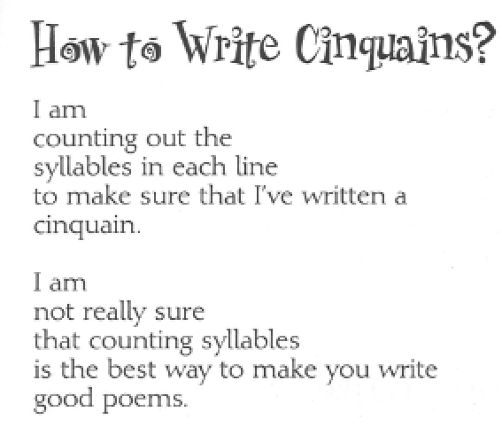
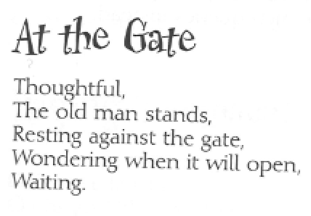
Cinquains
A form of syllable poem consisting of five lines adding up to 22 syllables. Line 1 has two syllables, line 2 has four syllables, line 3 has six syllables, line 4 has eight syllables and line 5 has 2 syllables.

Slide 21
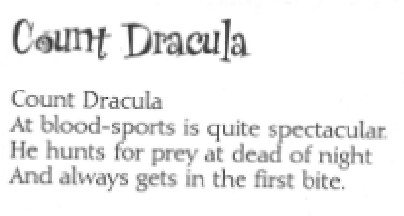
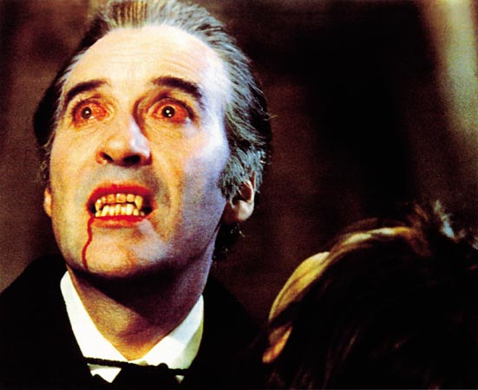
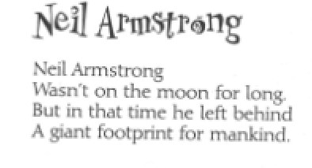
Clerihews
A clerihew is a four-line verse about a person, which consists of two rhyming couplets. The first line of the clerihew is the name of the person. Finding words which rhyme with people’s names isn’t easy so clerihews are difficult to write

Slide 22
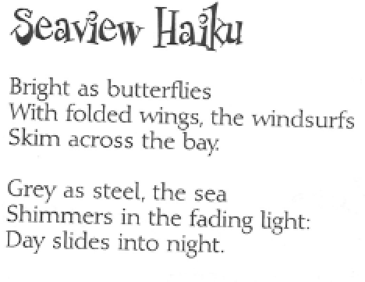
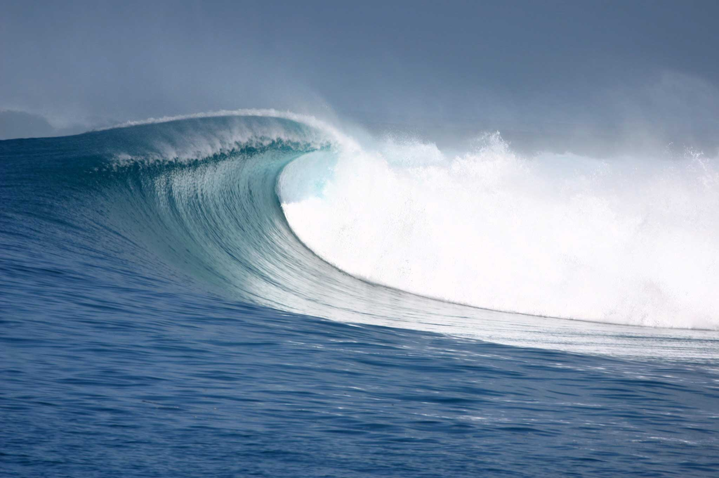
Haiku
Haikus are traditional Japanese verse-form, consisting of three lines and a total of seventeen syllables, arranged in the pattern 5-7-5.

Slide 23
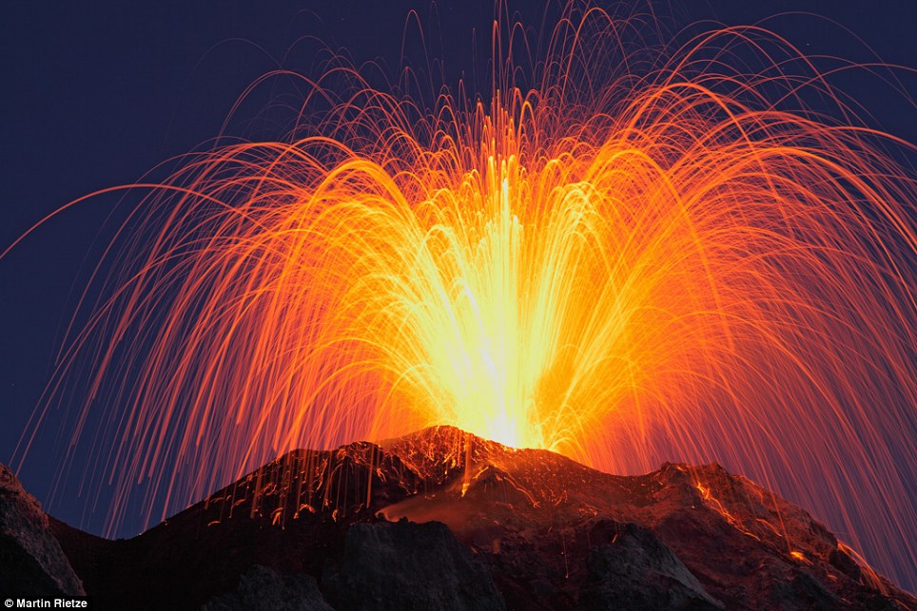
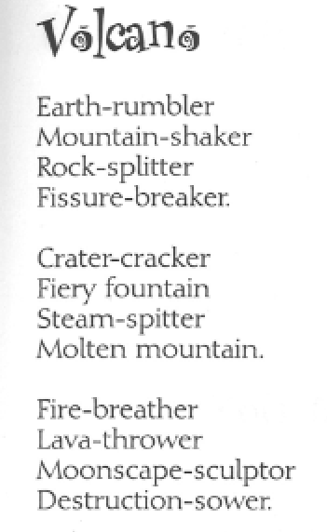
Kenning
A keening is a descriptive phrase, or compound word, which is used to name something instead of a noun. Anglo-Saxon poets often used kennings in their poems, for example, a river is sometimes describes as a “swan path”. A kennings poem is a poem consisting of a list of kennings.

Slide 24
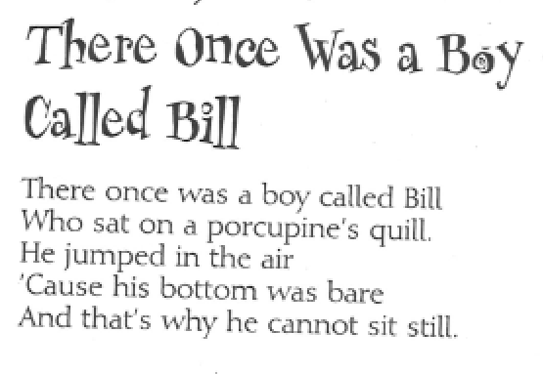
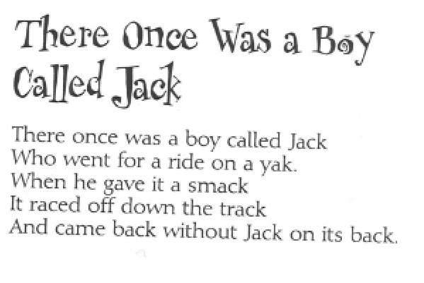

Limericks
A limerick is a humorous five-line poem with a particular pattern. It has a rhyme scheme of aabba: lines 1 and 2 are longer lines of 3 beats ending with a rhyme; lines 3 and 4 are shorter lines of two beats that end with a rhyme; line 5 is a longer line of thee beats that rhymes with lines 1 and 2.

Slide 25
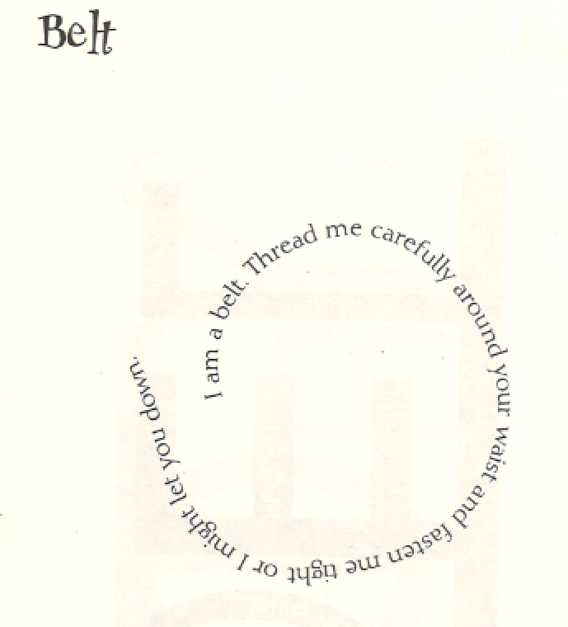
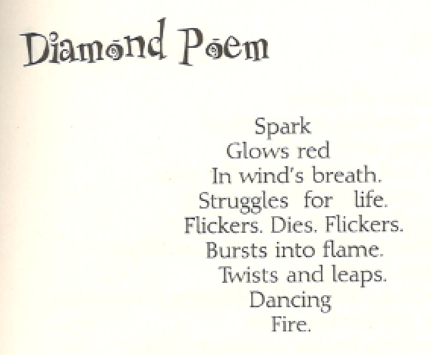
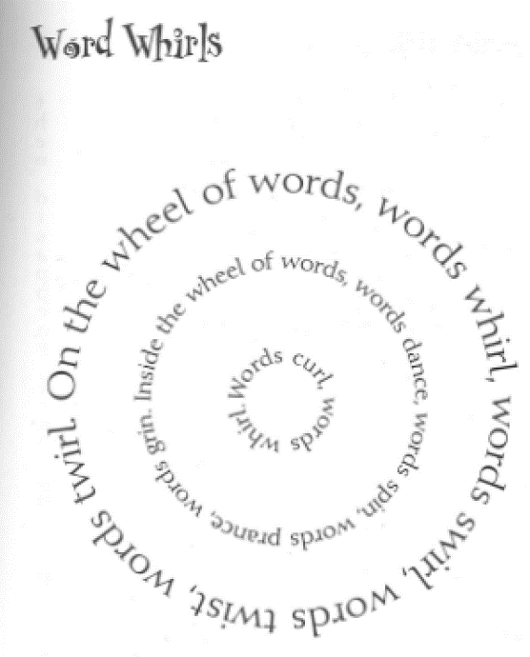
Shape poems
A shape poem is one in which the lines of the poem are arranged to make a picture or shape. You can make a shape poem about any kind of object. In the simplest form of shape poem, the words are written so that they make a shape of the object.

Slide 26
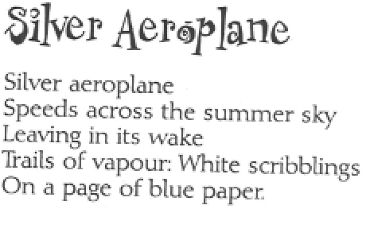
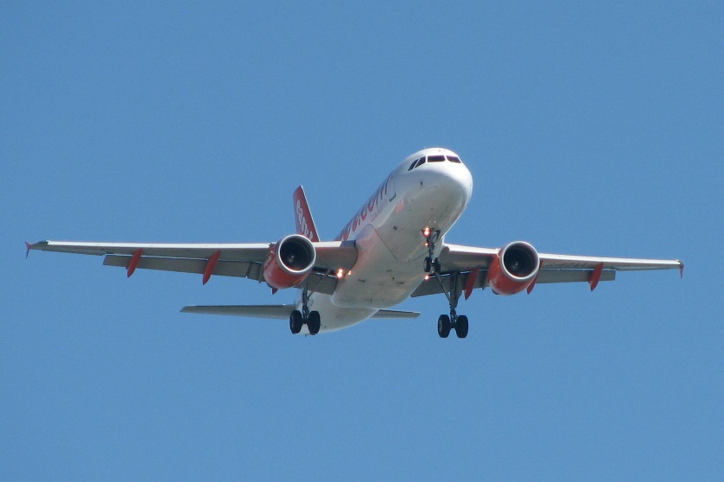
Tankas
Tankas are a type of Japanese syllable poem, consisting of five lines and 31 syllables arranged in the pattern 5-7-5-7-7.

Slide 27
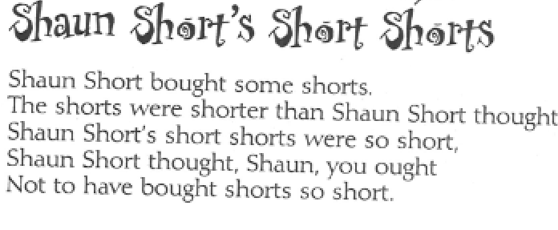
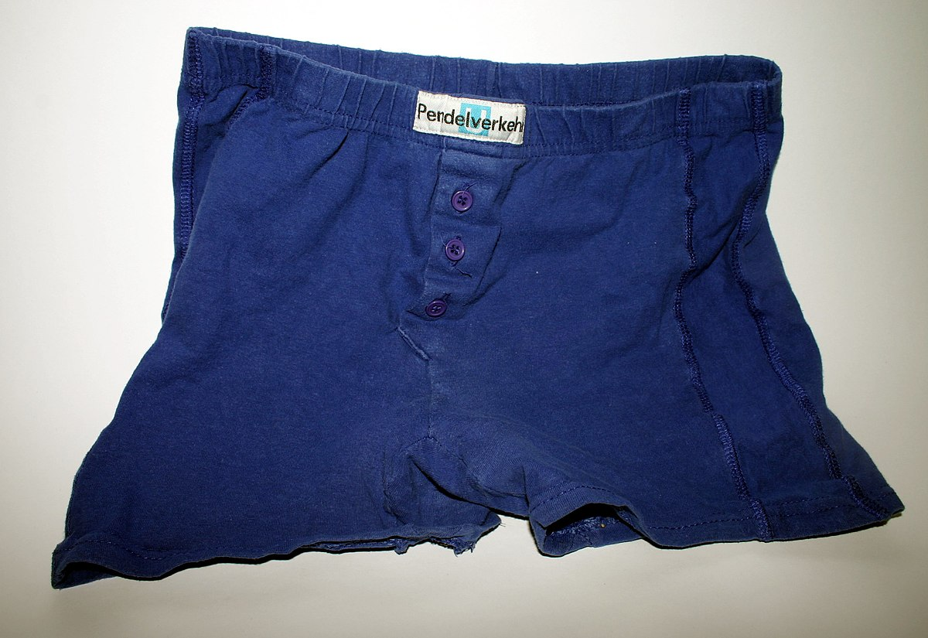
Tongue-twisters
A rhyme that is difficult to say properly because it uses similar or repeated sounds, e.g., She sells sea-shells on the seashore.

Slide 28
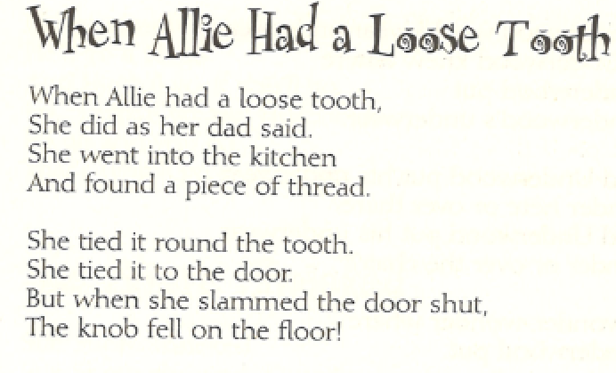
Story poems
Poems that tell a story.

Slide 29
Writing Poetry
Notes:
You MUST read poetry to children; don’t just make them write poetry!!!

Slide 30
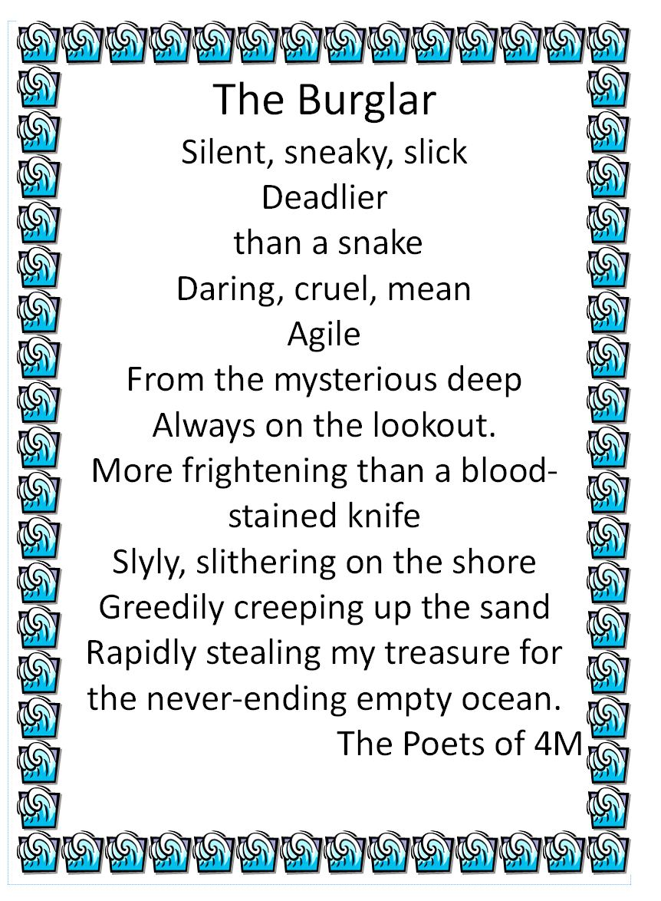
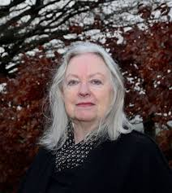
Metaphorical Poetry – thanks to Gillian Clarke
http://www.gillianclarke.co.uk/gc2017/
Notes:
Make a list of words that describe the object.
Think of something completely different that could be described by that word.
Look at the second list – can you see any objects / themes / ideas that are emerging from that list? For example, in the above poem, although the children were describing the sea they began to imagine it as a burglar.
Once you have decided on that idea you build a poem using words you have already got, and adding some, to create that image.
Read and refine as many times as is needed.

Slide 31

Thank you so much for your participation today.
There is a handout you can download for yourself.

