Slide 1
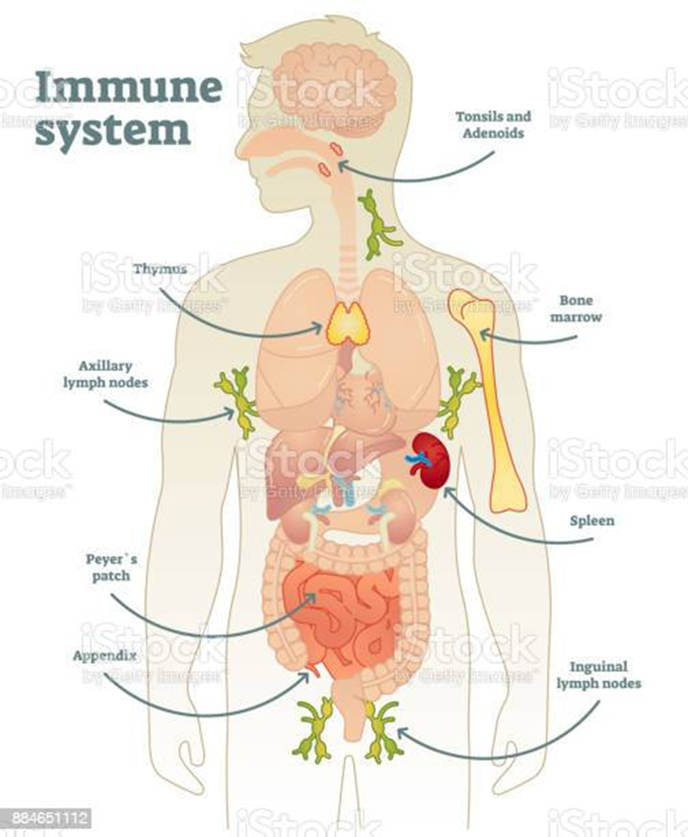


Structures Of The Immune System
The Structure of the Immune System is:
Acts as a Defence
  Kill Pathogens
  Reduce Inflammatory
  Keep Response high
Three Pathways
  Classical Pathway (CP)
  Lectin Pathway (LP)
  Alternative Pathway (AT)
Different Cell Types
  Soluble Protein
    Regulator & Receptors
  Protein Types
    Helps with Liver
Different Molecules
Name: Karen Elizabeth Bailey
Student I.D: 2015942
Module Code: BHMP5003_BIRM
Lecturer’s Name: Dr Muhammed Humza

Slide 2
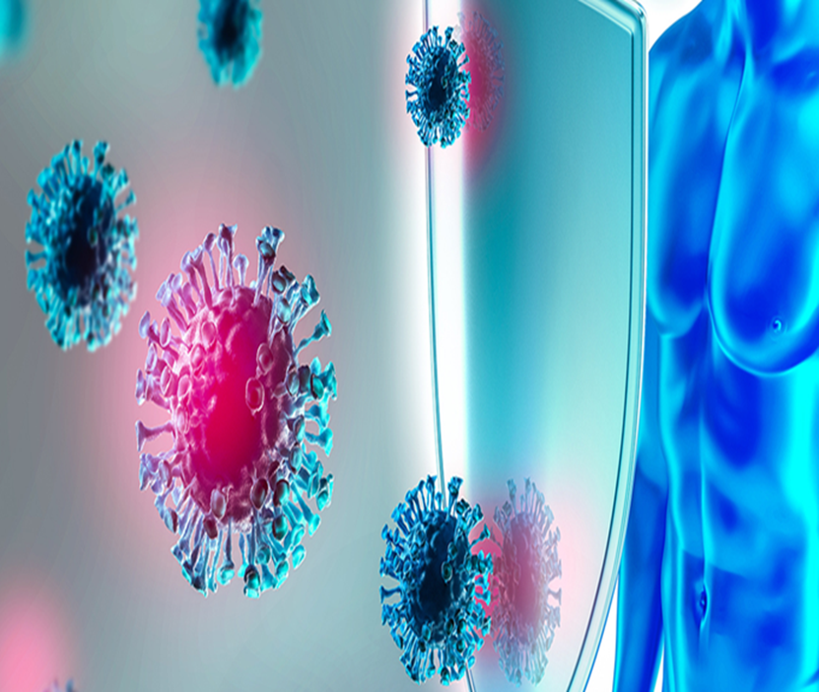

FUNCTION
The Main Functions:
Fights Diseases Causing changes in the body (Cancer)
Recognises harmful substances
Protects the body from harmful substances
If the Immune System is weak it cannot fight any bad bacteria off
Immune System can attack healthy cells Autoimmune System
Three Types Of Severe Combined Immunodeficiency Diseases
  Variant
  Typical Or Class
  A Typical Or Classic
Mechanisms thrive on blood
Lymphoid's & Tissues help circulate antibody’s
Kills & helps block any activation
Controls infection’s
Two escape antibody’s which are:
  Perpetuated antigenic
  Antibodies
Immunosenescence series of age related
Change of age & vulnerable of infection’s/Diseases
Can affect immunity
Affecting age of cells
Adaptive to function immune system
Lymphoid’s/ cancer affect blood cells the whole body e.g leukaemia

Slide 3
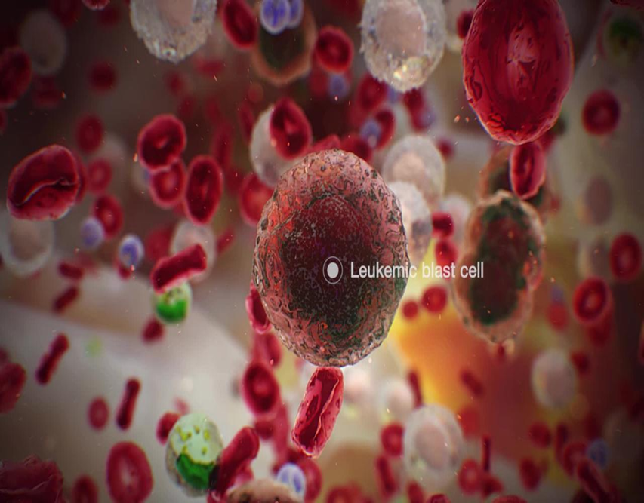
LEUKAEMIA
Lymphoblastic Leukaemia (All) Is A Heterogeneous Disease Leukaemia is a type of blood cancer
It starts in the blood-forming tissue (in the bone marrow)
Has Distinct Biological & Prognostic Groupings
Diagnosis By Traditional Cytomorphological & Immunohistochemical Evaluation
Abnormalities
Poor Prognosis In Adults & Children
Symptoms caused by to many abnormal cells
Not enough white cells
Red cells& platelets
Feeling tired & sick/ high temperature
Losing weight/ Fever
Your lymph nodes swollen
Joint pains & pain in bones
Weak/ Tired & fatigue
(Emadi & Law, 2020)
(Cancer Research 2021)

Slide 4
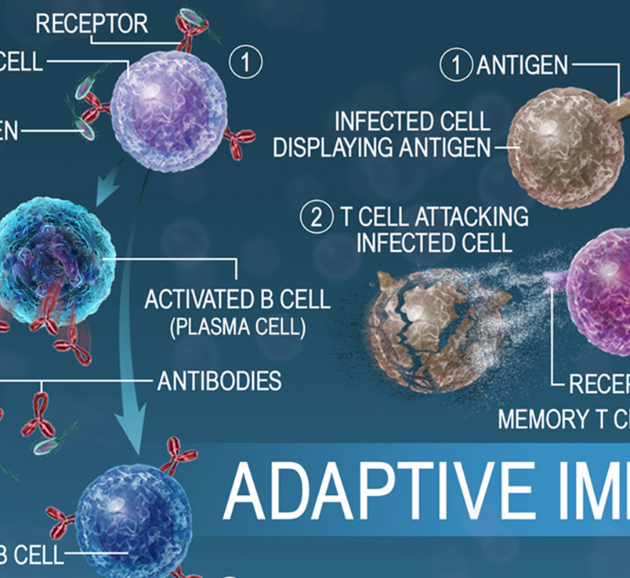

Care - Planning
From experience my friend with leukaemia:
Regular Turning Intervals
Dietary Requirements
Fluid Intake (IV Fluids)
Incontinent (Catheter)
Tubes (Oxygen/Feeding/Medication)
Visitors (Low Immune System)
Cleanliness (Low Immune System)
Regular Exercise (Muscle Seizing)
Severe Combined Immunodeficiency (SCID)
Mutations In Different Genes
Functions Of Infections Fighting Immune Cells
T Cells, B Cells And K Cells (Lymphocytes)
  (Chandra, 2020)

Slide 5
REFERENCES
Biomedicine Holistic Healing Clinic., (2021) Importance Of The Immune System [Online] Available at: https://biomedicinenutrition.ca/importance-of-the-immune-system/ (Accessed on: 1st June 2022)
Chandra, S., (2020) Severe Combined Immunodeficiency Disease (SCID) [Online] Available at: https://www.cincinnatichildrens.org/health/s/severe-combined-immunodeficiency-disease-scid (Accessed on: 6th June 2022)
Cancer Research UK,. (2021) Symptoms Of Acute Lymphoblastic Leukaemia (ALL) [Online] Available at: https://www.cancerresearchuk.org/about-cancer/acute-lymphoblastic-leukaemia-all/symptoms (Accessed on: 1st July 2022)
Emadi, S., and Law, J. Y., (2020) Leukemias Are Cancers Of White Blood Cells Or Of Cells that Develop Into White Blood Cells [Online] Available at: https://www.msdmanuals.com/home/blood-disorders/leukemias/overview-of-leukemia (Accessed on: 24th June 2022)
HealthJade., (2019) Immunity [Online] Available at: https://healthjade.net/immunity/ (Accessed on: 23rd June 2022)
iStock., (2022) Immune System Stock Illustration [Online] Available at: https://www.istockphoto.com/vector/immune-system-gm884651112-245914146 (Accessed on :24th June 2022)
Kebriaei, P., Anastasi, J,. and Larson, R, A,. 2002, Acute lymphoblastic leukaemia: diagnosis and classification, Best Practice & Research Clinical Haematology, Volume 15, Issue 4, Pages 597-621
Lubbers, R., Van Essen, M.F., Van Kooten, C. and Trouw, L.A., 2017. Production of complement components by cells of the immune system. Clinical & Experimental Immunology, 188(2), pp.183-194.
Magez, S., Pinto Torres, J.E., Obishakin, E. and Radwanska, M., 2020. Infections with extracellular trypanosomes require control by efficient innate immune mechanisms and can result in the destruction of the mammalian humoral immune system. Frontiers in immunology, 11, p.382.
Nall, R., (2020) What To Know About White Blood Cells [Online] Available at: https://www.medicalnewstoday.com/articles/327446 (Accessed on: 23rd June 2022)
NIH, (2020) How Does The Immune System Work? [Online] Available at: https://www.ncbi.nlm.nih.gov/books/NBK279364/ (Accessed on: 20th July 2022)
Ridoy, M.A.R. and Islam, M.R., 2020, November. An automated approach to white blood cell classification using a lightweight convolutional neural network. In 2020 2nd international conference on advanced information and communication technology (ICAICT) (pp. 480-483). IEEE.
Tigner, A., Ibrahim, S.A. and Murray, I., 2020. Histology, white blood cell.
Vellinga, J., (2020) How Does The Immune System Work? [Online] Available at: https://www.tcimedicine.com/post/how-does-the-immune-system-work (Accessed on: 1st June 2022)
Visible Body (2022) Reacting And Adapting To Disease: How The Immune System Protects The Body [Online] Available at: https://www.visiblebody.com/learn/lymphatic/lymphatic-immunity (Accessed on: 1st June 2022)
Nikolich-Žugich, J., 2018. The twilight of immunity: emerging concepts in aging of the immune system. Nature immunology, 19(1), pp.10-19.

