Slide 1


Critical reflection on Digital Technologies Module by Corina Chelu

Slide 2


IT experience at the beginning of the module
Now, I can fully admit that my IT experience was very limited before starting this module and I truly believe that during this term I gained knowledge and skills that will help me to operate and easily work in an IT department.
Having the opportunity to study Digital Technologies Module especially those days when many employers prioritizing potential over experience and the fact that I can prove my commitment into learning a new skill represents a massive step for my future.

Slide 3
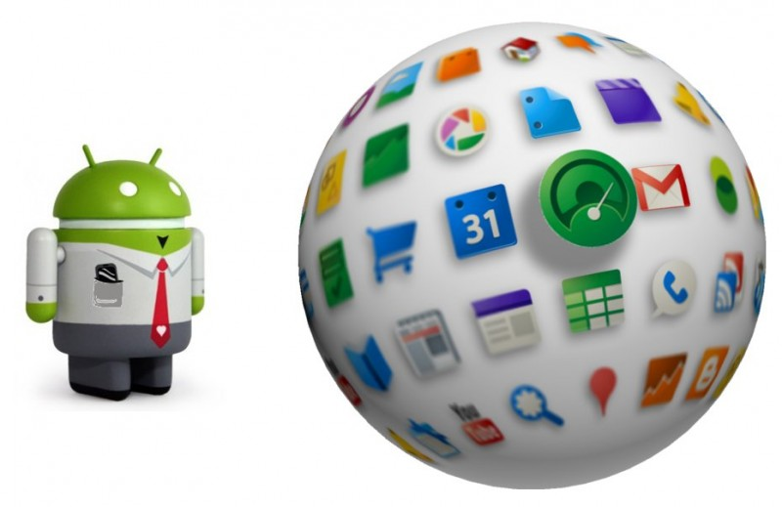
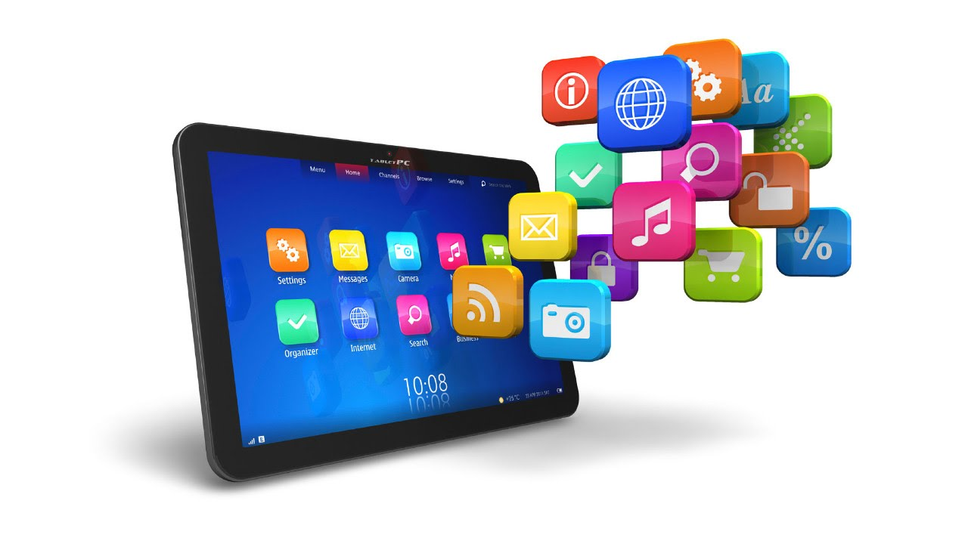

Engineers use a variety of tools for activities such as version control, code review, soft ware, development or bug tracking.
An excellent career in engineering is based on skills and knowledge with a great help from the variety of resources and software available to perform into a professional engineering career.
2022- Best Engineering Software used by professionals
- Mathcad
- Matlab
- FEA Software (Finite Element Analysis)
- Python
- Rhino
- Microsoft Excel
- VBA (Visual Basic for Applications
DIGITAL RESOURCES AND SOFTWARE USED BY PROFESSIONALS IN ENGINEERING

Slide 4

Digital skills with google
Applied Digital Skills is an online digital skills curriculum that is free of charge and the lessons and materials are appropriate for a wide range of learners.
During this module I undertook the following applied Digital skills with Google:
Data Analytics
Content Marketing
Search Engine Marketing
Online Framework
Coding And Software Enhancement
Copywriting

Slide 5

Overall, the Digital Technologies Module has been an excellent experience and I feel that I have gone from being on a very low level of digital knowledge to being on a path to becoming digitally native.
I have learned many important, interesting, helpful and encouraging ways to use digital technologies, by using various tools and class activities. Also, throughout this module I have experienced different activities and some I enjoyed more then others with a great journey trough this module.
Having the opportunity to use various apps and tools made me realize that Digital Technologies is the future for the new generation and represents ``a must`` for us.

Slide 6

Any question?
Thank you!

