Slide 1
Module code: BMSW4001
Module Leader: Timothy Hopkins
Student name: Joyce Heidinger
Student ID: 2133752

Slide 2
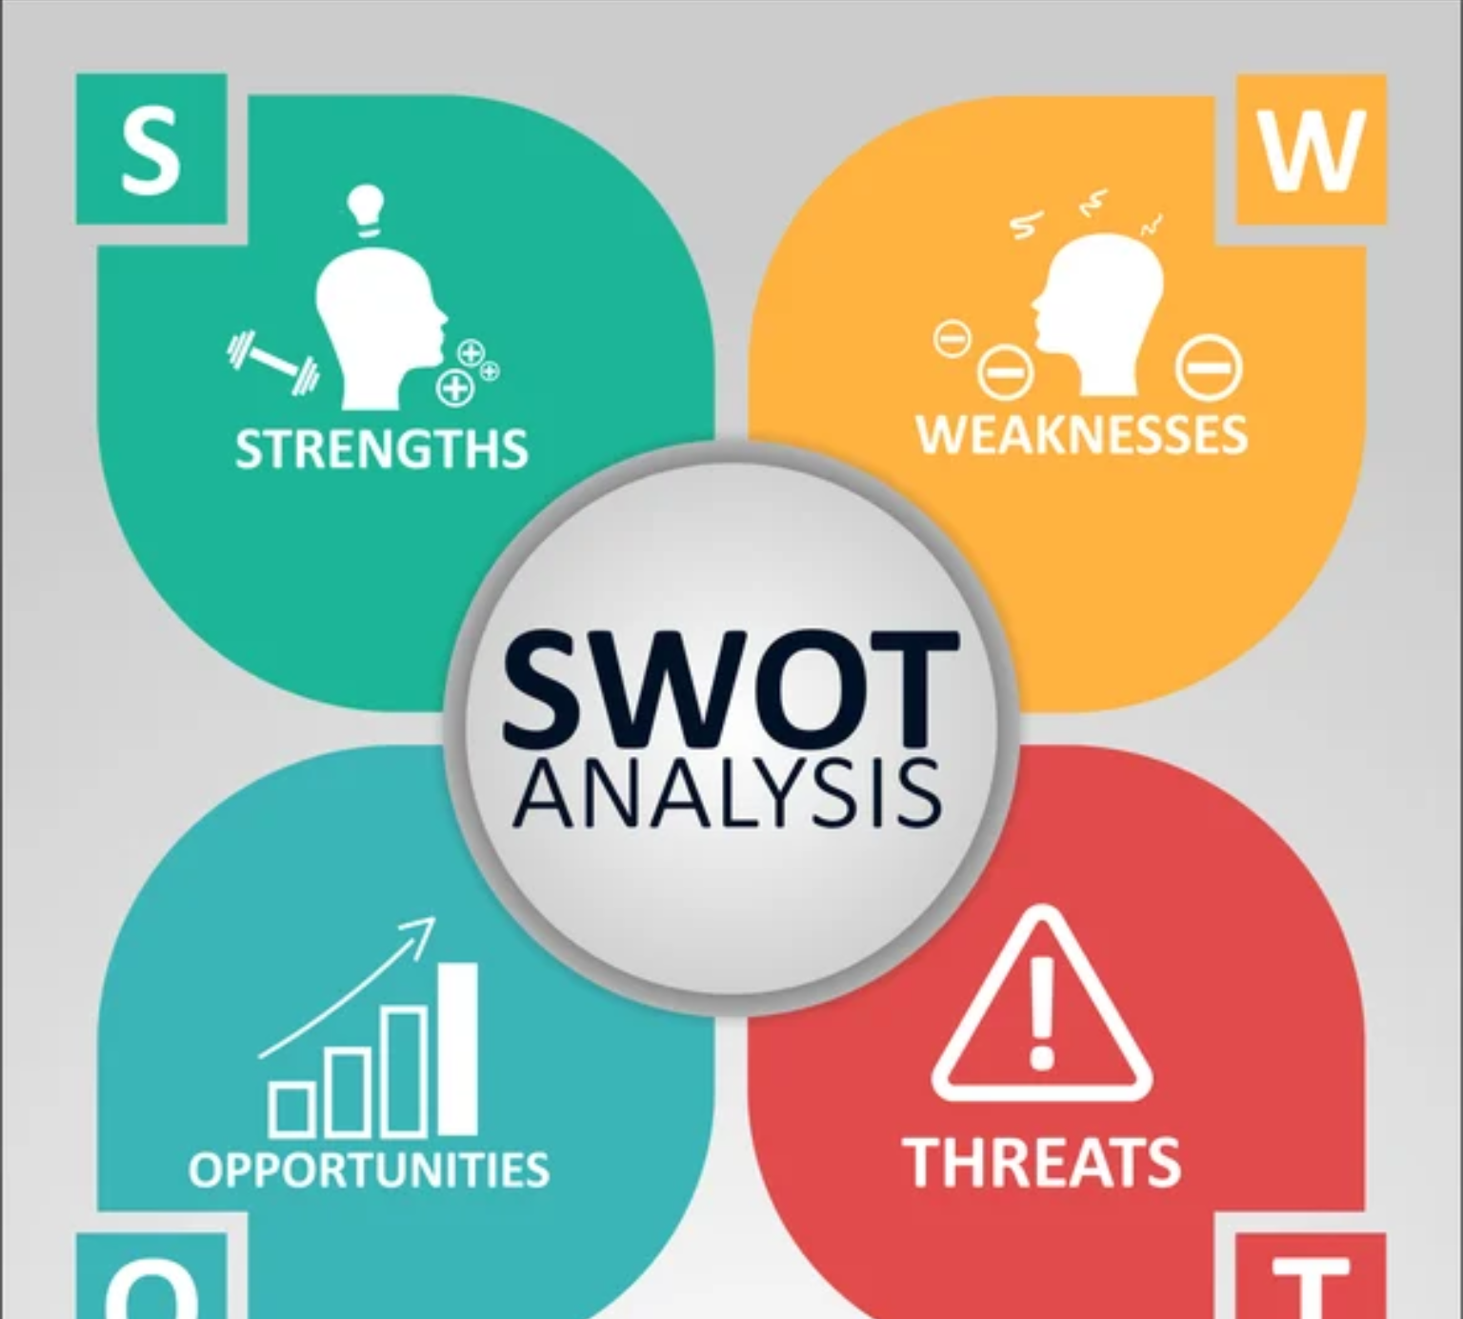
Strengths- Employability skills -
I currently have
I will be using SWOT analysis

Slide 3
Strengths
I am very friendly and respectful. For example, I know how to relate to people of all ages and backgrounds
I am disciplined which means I am punctual and know how to schedule my time
I am honest and always try to help others
According to prospects UK employers are looking for health care assistants with these qualities

Slide 4
Weakness
I find public speaking uncomfortable
According to research up to 75% of people get nervous during public speaking
A healthcare assistant may need to present in meetings

Slide 5
Opportunities
I have the passion to keep learning and getting new experiences such as starting this health and social care course
In my spare time I enjoy researching new ways to stay healthy using YouTube and reading research
A health care assistant needs to be able to create new ideas to improve patient satisfaction

Slide 6
Threats
I do not like aggressive confrontation such as arguments
Research shows 85% of people deal with conflict at work

Slide 7
Conclusion
I am currently trying to develop my knowledge and gain qualifications using this course so I can become a health care assistant.

Slide 8
References
CSP Online. 2022. Common Workplace Conflicts and How to Overcome Them | CSP Online. [online] Available at: <https://online.csp.edu/resources/article/common-workplace-conflicts/> [Accessed 4 August 2022].
Psycom. 2022. [online] Available at: <https://www.psycom.net/glossophobia-fear-of-public-speaking> [Accessed 4 August 2022].
Prospects.ac.uk. 2022. What skills do employers want? | Prospects.ac.uk. [online] Available at: <https://www.prospects.ac.uk/careers-advice/applying-for-jobs/what-skills-do-employers-want> [Accessed 4 August 2022].

