Slide 1

Master of Business Administration
Marketing Management [ LCMB7024 ]
Assessment component 2: Marketing Strategies Portfolio
MARKETING STRATEGY PORTFOLIO: BRAND EXTENSION OF PATEK PHILIPPE SMART HERITAGE WATCH
Lecturer name: Laila Maazouz, Dian Mayasari
Student name: Hari Mohan Singh
Student ID: 2506569
Word count: 209 words
Submission date: 05-04-2026

Slide 2
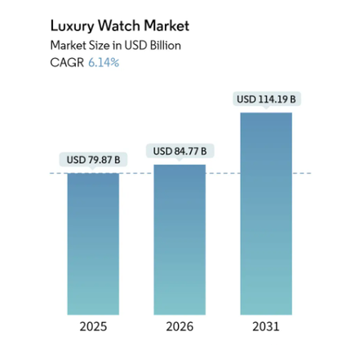
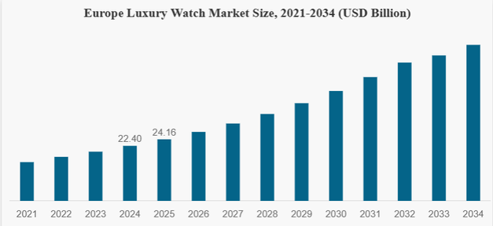
MARKETING STRATEGY PORTFOLIO: - BRAND EXTENSION OF PATEK PHILIPPE SMART HERITAGE WATCH
INTRODUCTION
BRAND EXTENSION
Patek Philippe is a luxury watch brand that is recognised all over the World for its craftsmanship, exclusivity, and heritage. The luxury watch market has been recording a stable growth following the growing need for quality and innovative goods. (MI, 2025).
Smart Heritage Watch is both a luxury item and a technology that will enter into a 75+ billion market with increased growth at a 5% per annum CAGR and advanced smart features.
BRAND EXTENSION AND CURRENT TRENDS
BRAND EXTENSION AND SUSTAINABILITY
The growth also follows the trends of the wearable technology given that the worldwide luxury watch is expected to reach over 120 billion by 2034 because of the increased demand in hybrid forms of smart luxury products (FBI, 2025).
Sustainability is promoted in the product by the use of long-lasting materials and minimised electronic waste. Luxury watches can be worn and used over a period of many decades, and thus are more sustainable to the environment compared to electronic gadgets having a short lifespan. (GVR, 2025).
CONCLUSION
REFERENCES
The Smart Heritage Watch manages to connect the innovative style with tradition, thus satisfying the needs of modern consumers and maintaining the brand and exclusivity.
  MI., (2025). LUXURY WATCH MARKET SIZE & SHARE ANALYSIS - GROWTH TRENDS AND FORECAST (2026 – 2031. An infographic is a visual representation of information, data, or knowledge designed to present complex information quickly and clearly.
  FBI., (2025). Luxury Watch Market Size, Share & Industry Analysis, By Type (Mechanical and Electronic), By Band Type (Strap-Based and Chain-Based), By Distribution Channel (Offline Stores and Online Channels), and Regional Forecast, 2026-2034. An infographic is a visual representation of information, data, or knowledge designed to present complex information quickly and clearly.
  GVR., (2025). Luxury Watch Market (2024 - 2030). An infographic is a visual representation of information, data, or knowledge designed to present complex information quickly and clearly.

