Slide 1
The Mysteries at Eleusis

Slide 2
What are the Mysteries?
The Mysteries at Eleusis is the archetypal mystery cult in the Greek and Roman worlds
Types of Mystery Cults:
1. Those linked to a specific worship centre, such as Eleusis (Demember & Kore), Samothrace, etc.
2. Those linked to specific deities but take a local and transient character and presided by occasional priests, such as those of Cybele, Dionysus, etc.
Initiation & Secrecy
Texts, Myths → Prescribed rituals
Connection to afterlife

Slide 3
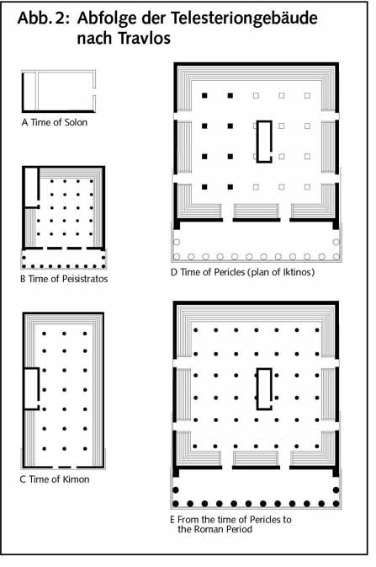
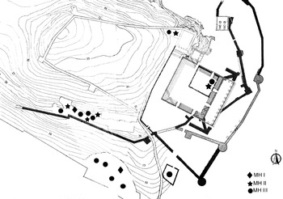
Eleusis = the oldest attested
Archaeology – 8th century BCE (and earlier Mycenean remains – question of continuity of cult)
Literature – 7th century (650-550) – Homeric Hymn to Demeter
Mycenean Megaron

Slide 4
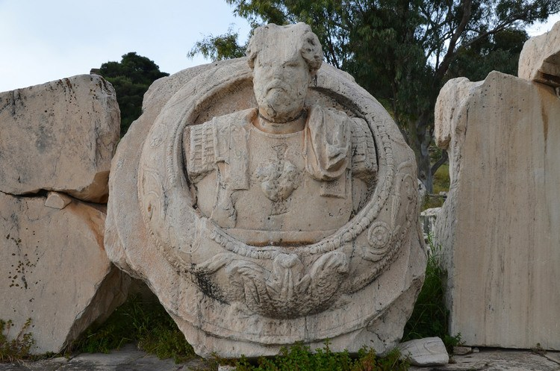
A story of popularity
Local significance in eighth and seventh centuries
Regional and Panhellenic in 6th century.
Importance continues in classical period.
In Hellenistic period popular across the Greek world, and the kingdoms.
In the Roman period, across the Roman empire, including the imperial family.
Destruction by Alaric in 395BCE – cult ends within a few decades
Bust of Roman Emperor (maybe Marcus Aurelius) in Propylaea of the sanctuary.

Slide 5
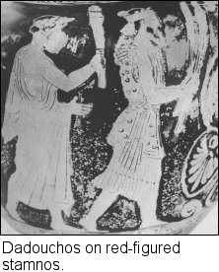
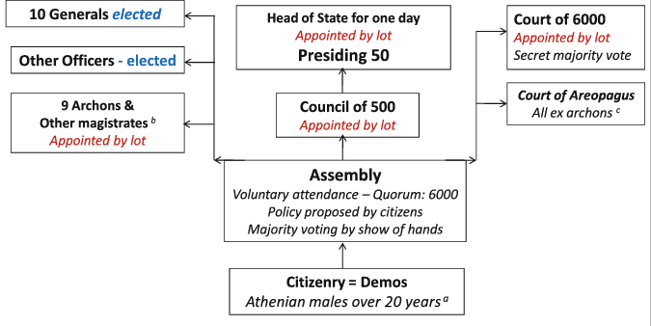
The Mysteries and the Athenian State
But the King [Archon] superintends, first, the mysteries, in co-operation with Superintendents elected by show of hands by the People, two from the whole body of the citizens, one from the Eumolpidae and one from the Heralds. Ps-Arist. AthPol 57

Slide 6
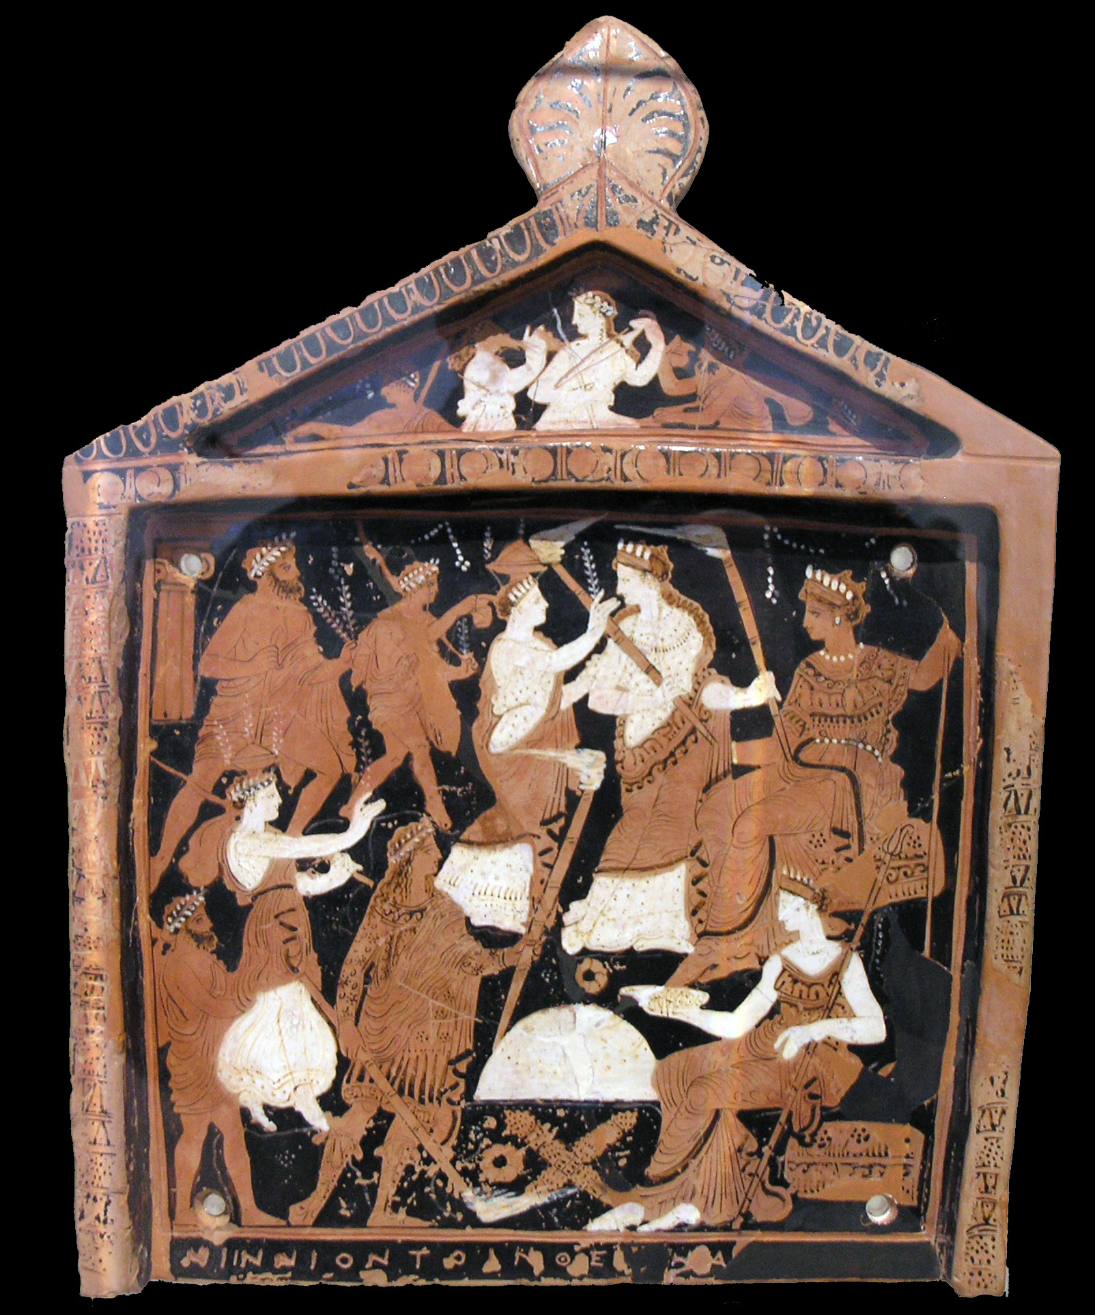
Two families = two priesthoods
Ninion Tablet
c370
Eumolpidae
hierophant = revelator
  + 2 female hierophants
Priestess of Demeter
I will first cite cases where this would be least expected. For example, the law directs that priests and priestesses be subject to audit, all collectively, and each severally and individually—persons who receive perquisites only, and whose occupation is to pray to heaven for you; and they are made accountable not only separately, but whole priestly, families together, the Eumolpidae, the Ceryces, and all the rest. Aeschines 3.18
Ceryces
Dadouchos = holder of torches
Hierokyrex = sacred herald

Slide 7
The Athenian Empire & the Sanctuary
…the Athenians shall give first-fruits of the harvest to the two Goddesses according to ancestral custom and the oracle from Delphi, at a rate of not less than a sixth of a medimnos per hundred medimnoi of barley and not less than half a sixth per hundred medimnoi of wheat; … and the demarchs shall collect the first-fruits by demes and hand them over to the sacred officials from Eleusis at Eleusis… and the allies too shall contribute first-fruits in the same way; and the cities shall choose 15 collectors of the crops in whatever way it seems to them that the crops will be best collected; and when they have been collected they shall send them to Athens; and those who bring them shall hand them over to the sacred officials from Eleusis at Eleusis… IG I3 78a (transl. Lambert & Osborne)

Slide 8
The Mysteries as the gift of Athens to the world
Now, first of all, that which was the first necessity of man's nature was provided by our city; for even though the story1 has taken the form of a myth, yet it deserves to be told again. When Demeter came to our land, in her wandering after the rape of Kore, and, being moved to kindness towards our ancestors by services which may not be told save to her initiates, gave these two gifts, the greatest in the world— the fruits of the earth, which have enabled us to rise above the life of the beasts, and the holy rite which inspires in those who partake of it sweeter hopes regarding both the end of life and all eternity - our city was not only so beloved of the gods but also so devoted to mankind that, having been endowed with these great blessings, she did not begrudge them to the rest of the world, but shared with all men what she had received. Isocrates 4.28-9

Slide 9
The Hermokopiday Affair and the Profanation of the Mysteries

