Slide 1
ECEY5009
WELLBEING,CARE AND HEALTHY LIVING
Lauren Spice

Slide 2
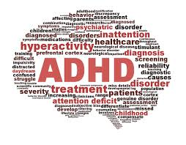

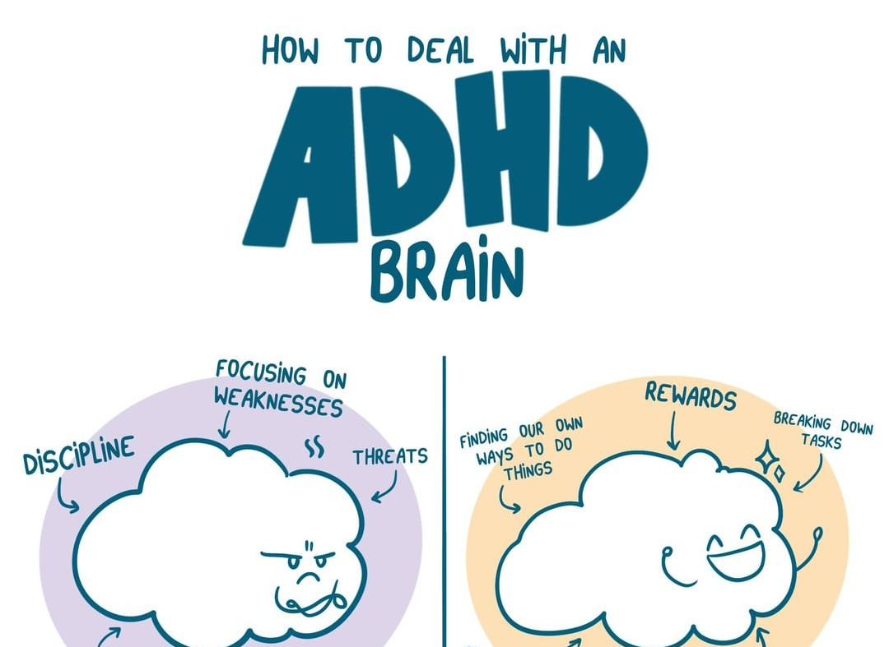
ADHD is a neurodevelopmental disorder that is with the person for life. It can affect children in many areas such as the basic daily life skills, relationships and school performance. When children's performance is affected and not managed it can trigger children's health and well-being, it lowers their self-esteem, academic struggles and social troubles. This can lead to having sensitivity to criticism through to adulthood and reduced self-worth. Children and adults with ADHD develop symptoms differently.ly: (Elmaghraby and Garayalde, 2022)
Notes:
ADHD – is known as Attention Deficity/Hyperactivity Disorder

Slide 3
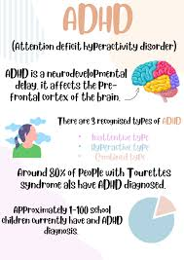
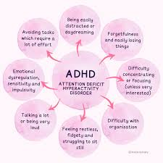
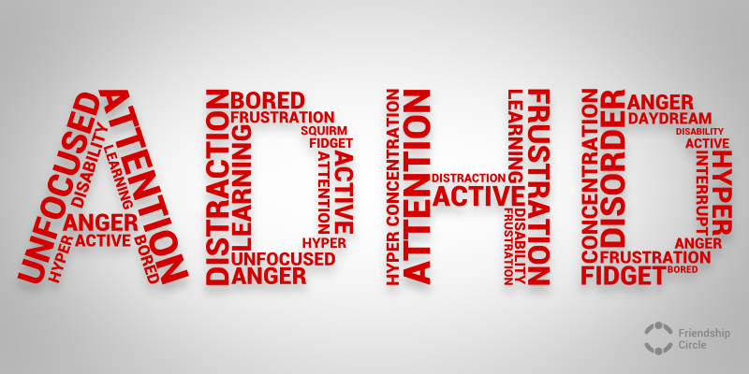
Notes:
Introduction (Define your chosen theme) ADHD Attention Hyperactivity Disorder, is a condition that affects a persons brain to work differently. It is the most common physichiatric disorder in childhood, it is more common in boys than girls and can persist into teens which can cause school difficulties without the right treatment/help and adulthood. ADHD is can have other disorders such as learning disorders and behavioural disorders, However this doesn’t mean the individual with ADHD is not intelligent it means people will have difficulties with attention, hyperactivity and impulsivity symptoms. It is important for parents/carers to test and help treat children with ADHD to help calm to help the child learn in their academic studies and also reduce the risk of academic difficulties and avoids anxiety and depression(Wender,2001 and NHS,2025).Children diagnosed with ADHDwill grow in an adult with adhd who may find it harder to focus on and stay still and manage their energy levels.there is no evidence to cure adhd as its how peoples brains function, however there are medication to help symptoms
However as we look at the symptoms of inattentive and hyperactivity. Most children under the age OF 5 will show all these symptoms but does not mean they have ADHD. https://www.nhs.uk/conditions/adhd-children-teenagers/
To Diagnose children with ADHD health care proffessionals use the criteria in the Diagnostic and statistical manual of mental disorders,Fith edition (DSM-5), the guidelines are to help and ensure consistant and accurate diagnoses, and to understand how ADHD can affect public health. The DSM-5 outlines that children under the age of 16 must show 6 or more symptoms and 16 and older must show 5 or more symotoms of the innatention and hyperactivity, both symptoms can intervene with peoples daily life and development (American Psychiatric Association,2013;Farone et al.,2015).

Slide 4
INATTENTATIVE
Doesn’t pay attention to details
Makes mistakes.
Has problems concentrating on tasks or activities,during lectures, conversations or reading.
Does not listen when being spoken to.
Struggles to follow instructions and doesn’t complete schoolwork, chores or job duties, may begin the tasks/chores but loses focus
problems organising challenges (Homework)
Avoids or dislikes tasks that require sustained mental effort, such as homework.
Often loses things needed for tasks or daily life, such as school papers, books.
Is easily distracted by unrelated things or thoughts.
Forgets daily routine tasks, such as doing chores, daily hygiene, food.
(Elmaghraby and Garayalde, 2022)
Notes:
These symptoms can impair the child's ability to maintaining attention and complete tasks. Children with ADHD often delay tasks due to their sustained focus and distracted during conversations.
However as we look at the symptoms of inattentive and hyperactivity. Most children under the age of 5 will show all these symptoms but does not mean they have ADHD. https://www.nhs.uk/conditions/adhd-children-teenagers/

Slide 5
Hyperactivity
Fidgits with their hands and feet, usually happens when their sitting down in class or at home.
Leaves their seat in situations when they a required to remain seated (school)
Finds it hard to wait and may interupt
Runs, climbs
Unable to play or engage activities queitly
Constantly active
Notes:
Hyperactivity is linked to children who have difficulties with remaining still or engaging in quiet time, due to the excessive energy and talking a lot, children having the hyperactivity symptoms often interrupt others when communicating without consideration. Some symptoms of attention may be present but less noticeable.(Cleveland Clinic, 2025)
What causes ADHD aren’t fully known, but numerous factors that include genetics and brain chemistry that are highly likely to be responsible.
Some people may be more likely to develop ADHD, including those born prematurely or with low birth weights or with epilepsy or brain damage(Mental Health Foundation,2021).

Slide 6

HOW DOES ADHD AFFFECT , HEALTH,WELLBEING AND LIFESTYLE

Slide 7
Relationship - social challenges and misunderstanding can affect relationships
Emotional struggles: Difficulty handling frustration, stress, or anger can cause mood swings or feeling burned out. (Mind,2022)
Emotional dysregualtion can cause anxiety , low mood and frustration
Forgetfulness can lead to missed medical appointments.
Planning, challenges can lead to irregular eating.
Poor sleep habits can affect focus, mood, and motivation.
(ADDA - Attention Deficit Disorder Association, 2025)
Having a balanced diet (NHS,2025).
Sleep patterns
Having poor physical health issues , sleep disorders and obesity can cause serious injuries, bad behaviour and lack of focus and attention(Mind,2022)
Oppositional defiant disorder (ODD) is a condition that can occur alongside ADHD , it is frequent frustration, irritability and defiant towards people (Youngminds,2021).
Having a busy envrimonet can also trigger social anxiety (Nice,2018).
Children can have difficulty to transitions when switching and activity (Nigg,2017).
Health ,Wellbeing and Lifestyle Affects.
Notes:
However to maintain a health ,wellbeing lifestyle with ADHD the NHS 2025 highlistys the importance to maintainging regular physical activity can reduce emotional and physical energy, this can also help your emotions, sleep patterns and physical health (World Health Organisation,2020). Maintaining and healthy balanced nutritious diet, that limits most sugary and caffine , can help energy levels and emotional wellbeing(NICE,2018). Children need a regular bedtime routine, and good sleep to enhance attention and productivity, by doing so reducing screen time can help lead healthier sleep patterns. Children often like structure with ADHD, as children and adolecents often need reminders to help with basic daily needs in order to function(American Psychiatric Association,2013).

Slide 9
References
Cleveland Clinic (2025). Attention Deficit Disorder (ADHD) | Cleveland Clinic. [online] Cleveland Clinic. Available at: https://my.clevelandclinic.org/health/diseases/4784-attention-deficithyperactivity-disorder-adhd.
Nigg, J.T. (2017) ‘Annual Research Review: On the relations among self‑regulation, ADHD, and health’, Journal of Child Psychology and Psychiatry, 58(4), pp. 361–383. Supports: lifestyle impacts, diet, exercise, long‑term health outcomes.
Wender, paul (2001). ADHD: Attention-Deficit Hyperactivity Disorder in Children, Adolescents, and Adults. oxford university press.
‌American Psychiatric Association (2013) Diagnostic and statistical manual of mental disorders: DSM‑5. 5th edn. Washington, DC: APA.
Faraone, S.V., Biederman, J. and Mick, E. (2015) ‘The age‑dependent decline of attention deficit hyperactivity disorder: A meta‑analysis of follow‑up studies’, Psychological Medicine, 36(2), pp. 159–165.
Mental Health Foundation (2021). Attention deficit hyperactivity disorder (ADHD). [online] www.mentalhealth.org.uk. Available at: https://www.mentalhealth.org.uk/explore-mental-health/a-z-topics/attention-deficit-hyperactivity-disorder-adhd.
‌
Elmaghraby, R. and Garayalde, S. (2022). What is ADHD? [online] American Psychiatric Association. Available at: https://www.psychiatry.org/patients-families/adhd/what-is-adhd.
ADDA - Attention Deficit Disorder Association. (2025). What Is ADHD? A Clear Guide for UK Adults - ADDA - Attention Deficit Disorder Association. [online] Available at: https://add.org/uk/what-is-adhd/.
mind (2022). ADHD and mental health. [online] www.mind.org.uk. Available at: https://www.mind.org.uk/information-support/tips-for-everyday-living/adhd-and-mental-health/.
‌
YoungMinds. (2021.). ADHD and Mental Health | Signs and Symptoms of ADHD. [online] Available at: https://www.youngminds.org.uk/young-person/mental-health-conditions/adhd-and-mental-health.
National Institute for Health and Care Excellence (NICE) (2018) Attention deficit hyperactivity disorder: diagnosis and management (NG87). London: NICE.
World Health Organization (2020) Guidelines on physical activity and sedentary behaviour. Geneva: WHO.
‌American Psychiatric Association (2013) Diagnostic and statistical manual of mental disorders: DSM‑5. 5th edn. Washington, DC: APA.
‌NHS (2025a). ADHD - Stay Well. [online] Managing ADHD. Available at: https://staywell-bob.nhs.uk/adhd/.
‌

Slide 10
Adhd an d
Barkley, R.A. (1997) ADHD and the Nature of Self‑Control. New York: Guilford Press. Barkley, R.A. (2015) Attention‑Deficit Hyperactivity Disorder: A Handbook for Diagnosis and Treatment. 4th edn. New York: Guilford Press.
Zametkin, A.J., Nordahl, T.E., Gross, M., King, A.C., Semple, W.E., Rumsey, J., Hamburger, S. and Cohen, R.M. (1990) ‘Cerebral glucose metabolism in adults with hyperactivity of childhood onset’, New England Journal of Medicine, 323(20), pp. 1361–1366.

