Slide 1
Hotel Administration &
Front Office Operations
BMIH4004
Week 5 Spring Term 2022

Slide 2

This week…
Module Learning Outcomes
Assignment 3 - Portfolio
Hotel Reputation Management
Building Your Reputation
Compliments and Complaints
Examples
Hotelier homework asks
Reference List

Slide 3
Module Learning Outcomes
Undertake
Undertake key Reception tasks within hotel administration and front office operations and gain an appreciation of the importance of work based key skills within this area of hotel operation.
Understand
Understand the key administrative and operational duties required within Hotel Administration and Front Office departments (Reception, Concierge, Switchboard, AYS, Finance).
Examine
Examine issues such as resource allocation, marketing, PMS systems, management styles, culture, health and safety and organisational/industry problems as they relate to specific departmental areas.

Slide 4

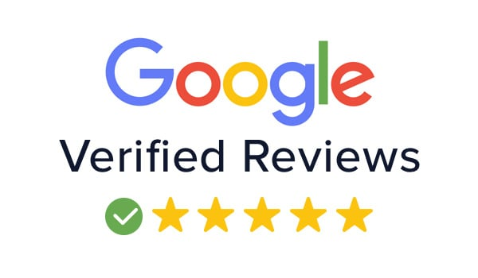



Assignment 3 Portfolio
Elements 2 & 3:
Write a response for the following scenarios:
Response to a complaint. Find a negative review (1 Star) on a review website for a hotel of your choice that does not have a response. As the Manager, you will write a response to the guest. You will need to include the original complaint (screenshot / copy and paste), and then write your response beneath.
Response to a compliment. Find a positive review (5 Star) on a review website for a hotel of your choice that does not have a response. As the Manager, you will write a response to the guest. You will need to include the original compliment (screenshot / copy and paste), and then write your response beneath.

Slide 5
Online Reputation
1) What is hotel reputation management?
2) What does managing a hotel's online reputation mean?

Slide 6

Reputation
93% of people find reviews important when determining which hotel to stay at.
(Customer Alliance, 2015).
Up to date and interactive presence online is key.
Reputation can start to decline if social spaces are not managed.
Guests want to feel listened to and valued.

Slide 7

How much does it really matter?
93%
of people find reviews important when determining which hotel they want to stay at.
53%
of people surveyed would not book a hotel without reading a guest opinion about it.

Slide 8
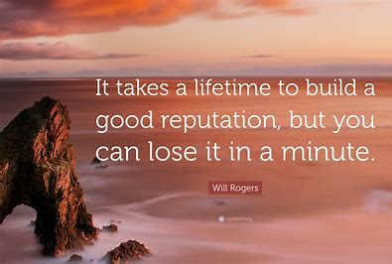

Building your Reputation

Slide 9



Understand
Understand the importance of online reputation management​
Set
Set reputation objectives and strategies​
Take
Take a team approach​
Be
Be prepared​
Optimise
Optimise your online presence​
Set up
Set up monitoring tools​
Analyse
Analyse feedback​
Take
Take action​
Recognise and reward
Recognise and reward​
Respond
Respond to reviews

Slide 10

Understand the importance of online reputation management​
2. Set reputation objectives and strategies

Slide 11


3. Share your reputation vision
4. Train and empower staff

Slide 12


5: Optimize your online presence
6: Set up monitoring tools

Slide 13
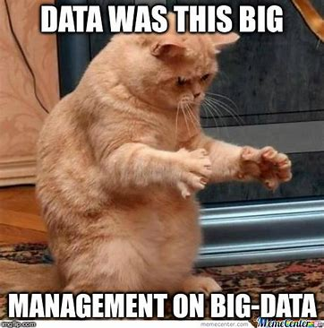

7) Analyse feedback
8) Take action

Slide 14


9) Recognise and reward
10) Respond to reviews

Slide 15

From a Guest Perspective…
80% of guests will read approximately 6- 12 reviews before making their decision.
53% of Tripadvisor users say they won't book a hotel if it has zero reviews.
(Fox, 2012)

Slide 16

Reputation Matters to Revenue
"Online reputation management is becoming hugely important to hotels because reviews have a direct correlation with demand, the holy grail of revenue management."
(Burr, 2020).

Slide 17
Online Reputation Recap

Slide 18

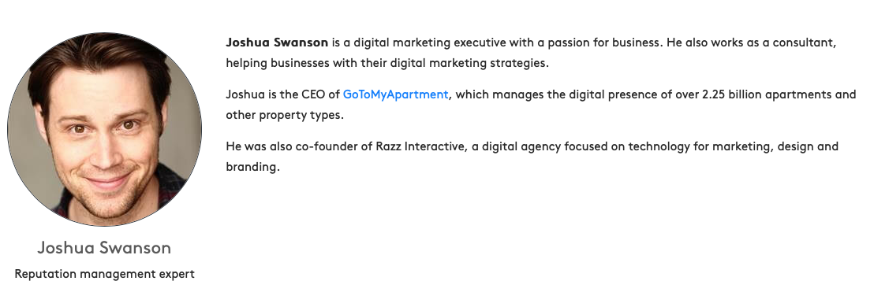
How to respond to positive online reviews

Slide 19




Slide 20
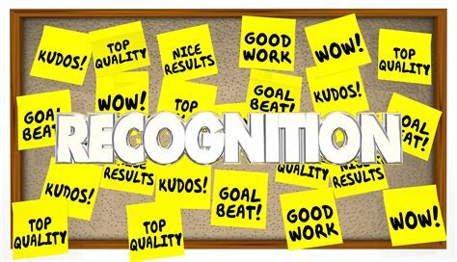
Acknowledge the staff

Slide 21
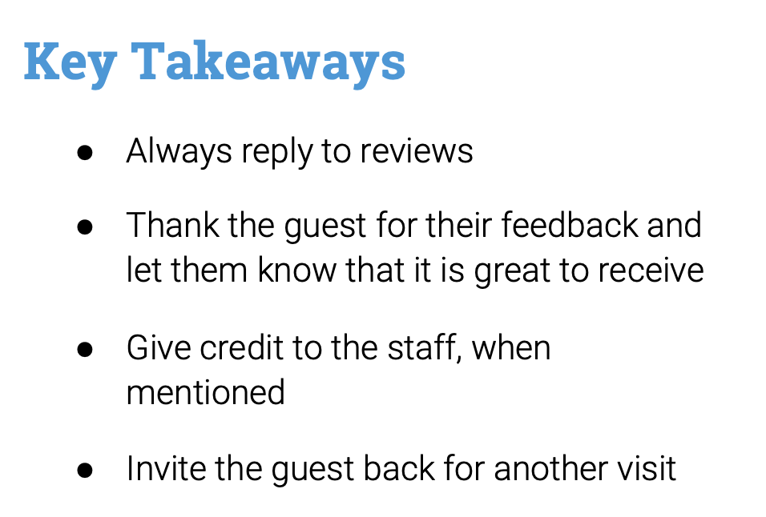



Slide 22
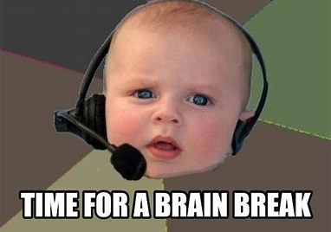

Slide 23



Find a 5-star online positive review for a hotel anywhere in the world.
Activity:

Slide 24
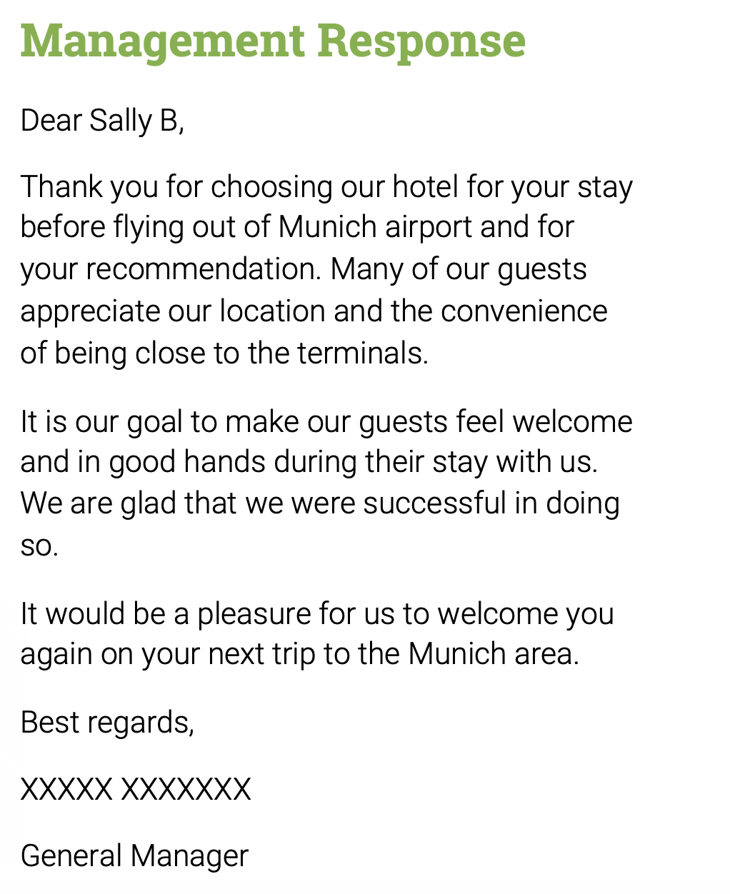
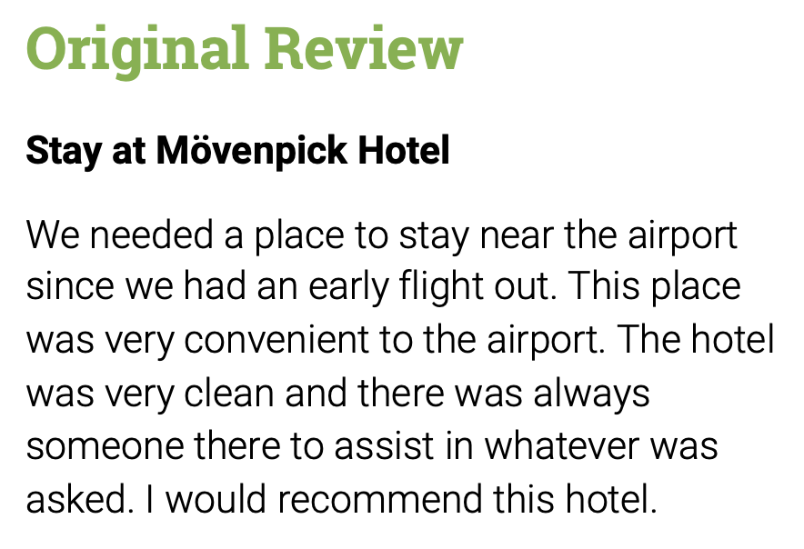
COMPLIMENTS - POSITIVE
Notes:
Let’s look at an example

Slide 25

How to respond to negative online reviews

Slide 26
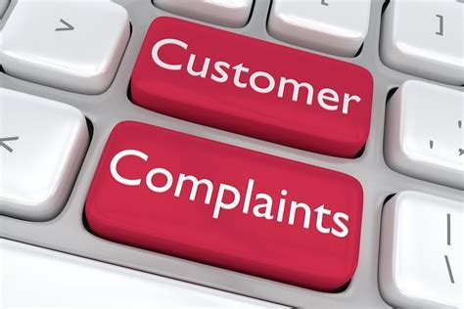
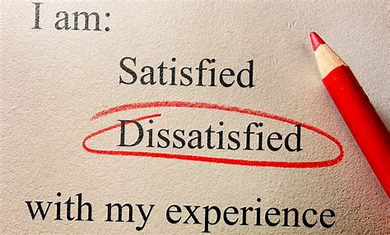
Open with a ‘Thank You!’
Address the issue
Assure the guest that necessary measures will be taken in future
End on a positive note and invite the guest back
Notes:
I

Slide 27

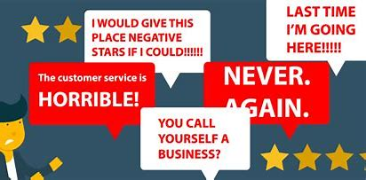
Don’t try to pass as the perfect hotel, because mistakes are made, accidents happen and most people can understand that it’s only human.
As long as you take responsibility and try to make amends, the guest will appreciate your honesty and effort.

Slide 28

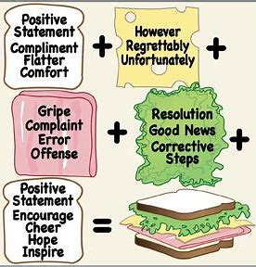

Slide 29
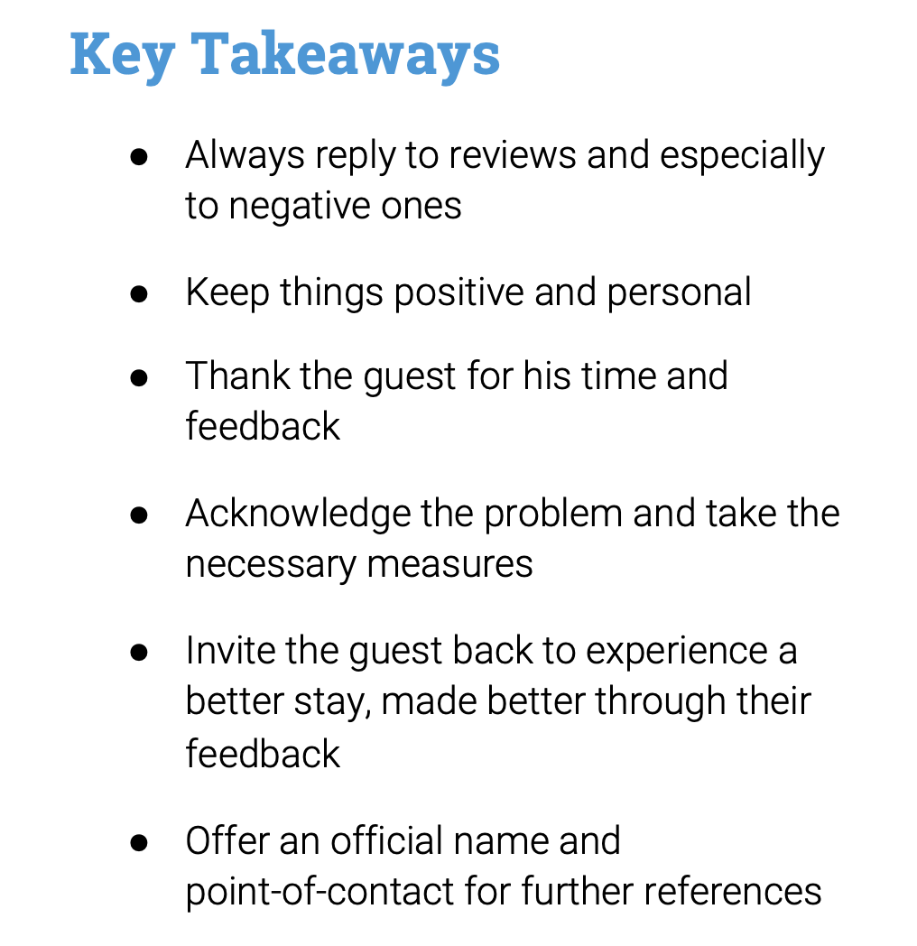

Slide 30
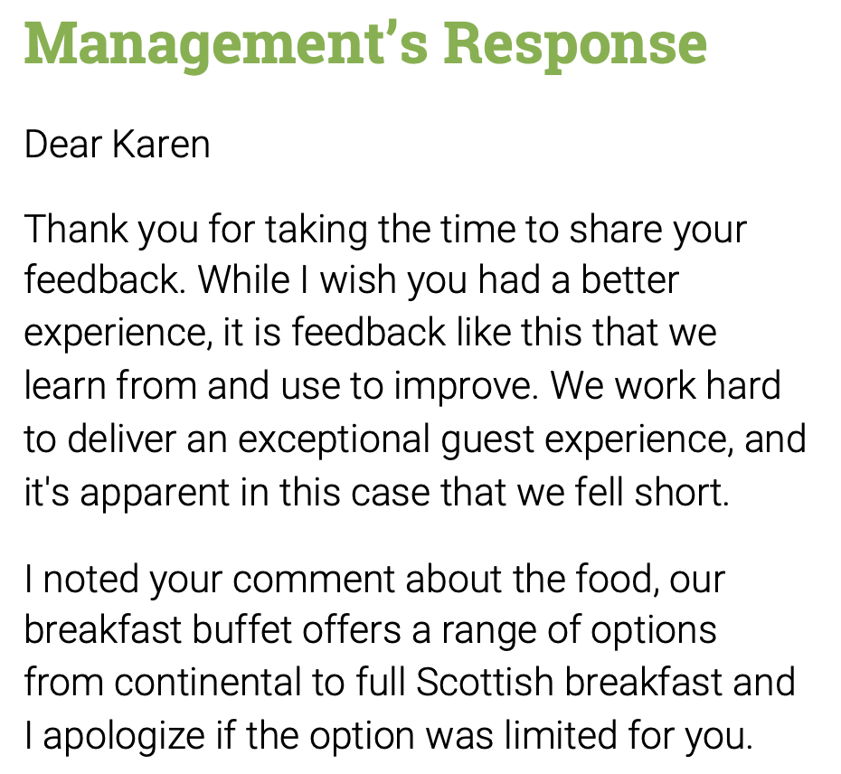
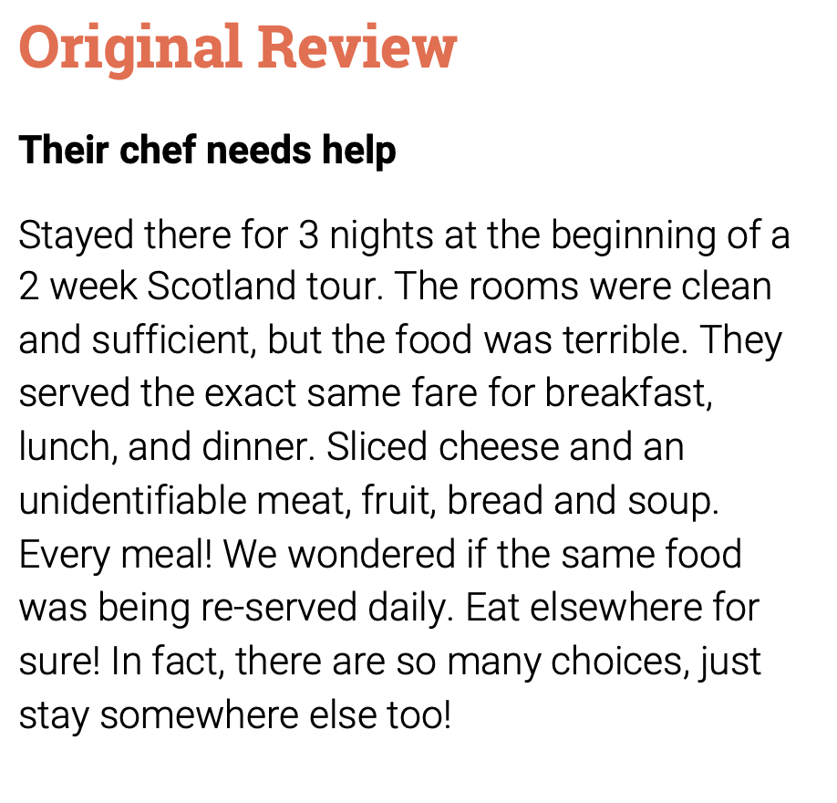
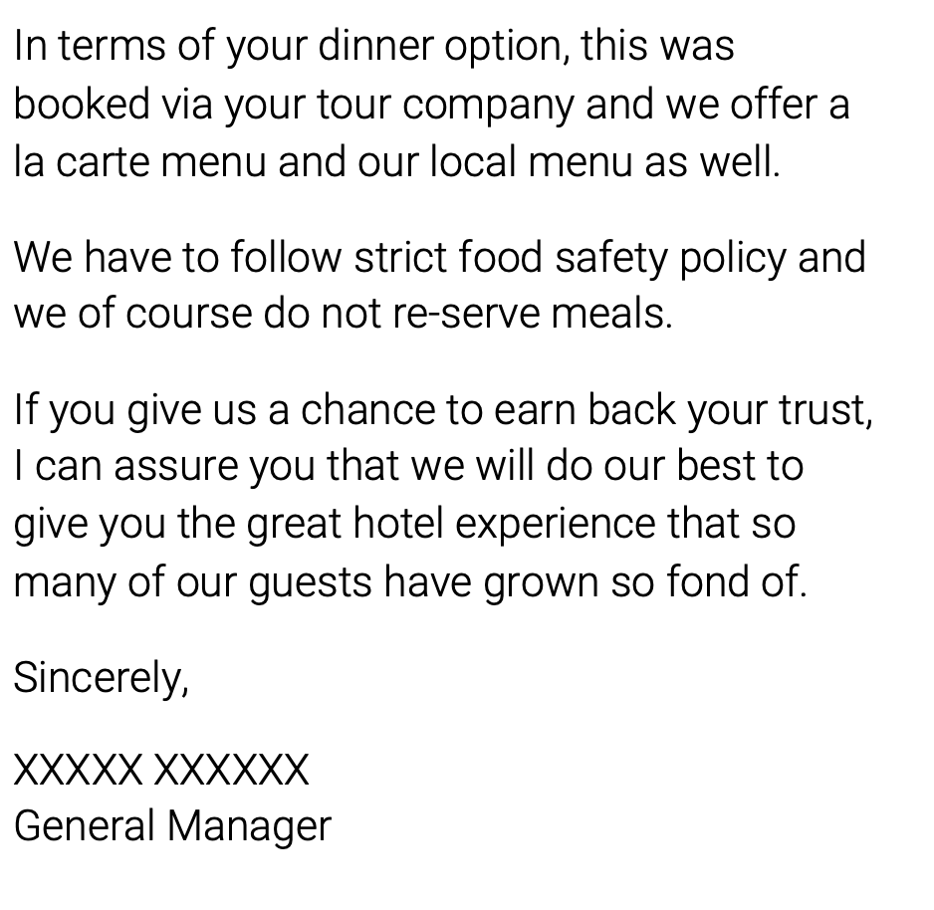

Slide 31
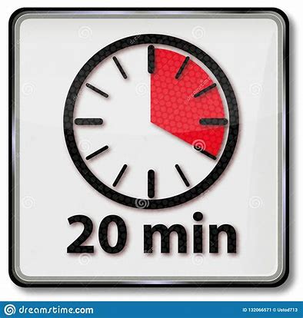
Activity
Find a 1-star negative review for a hotel anywhere in the world
Can you please compose a response as the manager of the hotel.

Slide 32
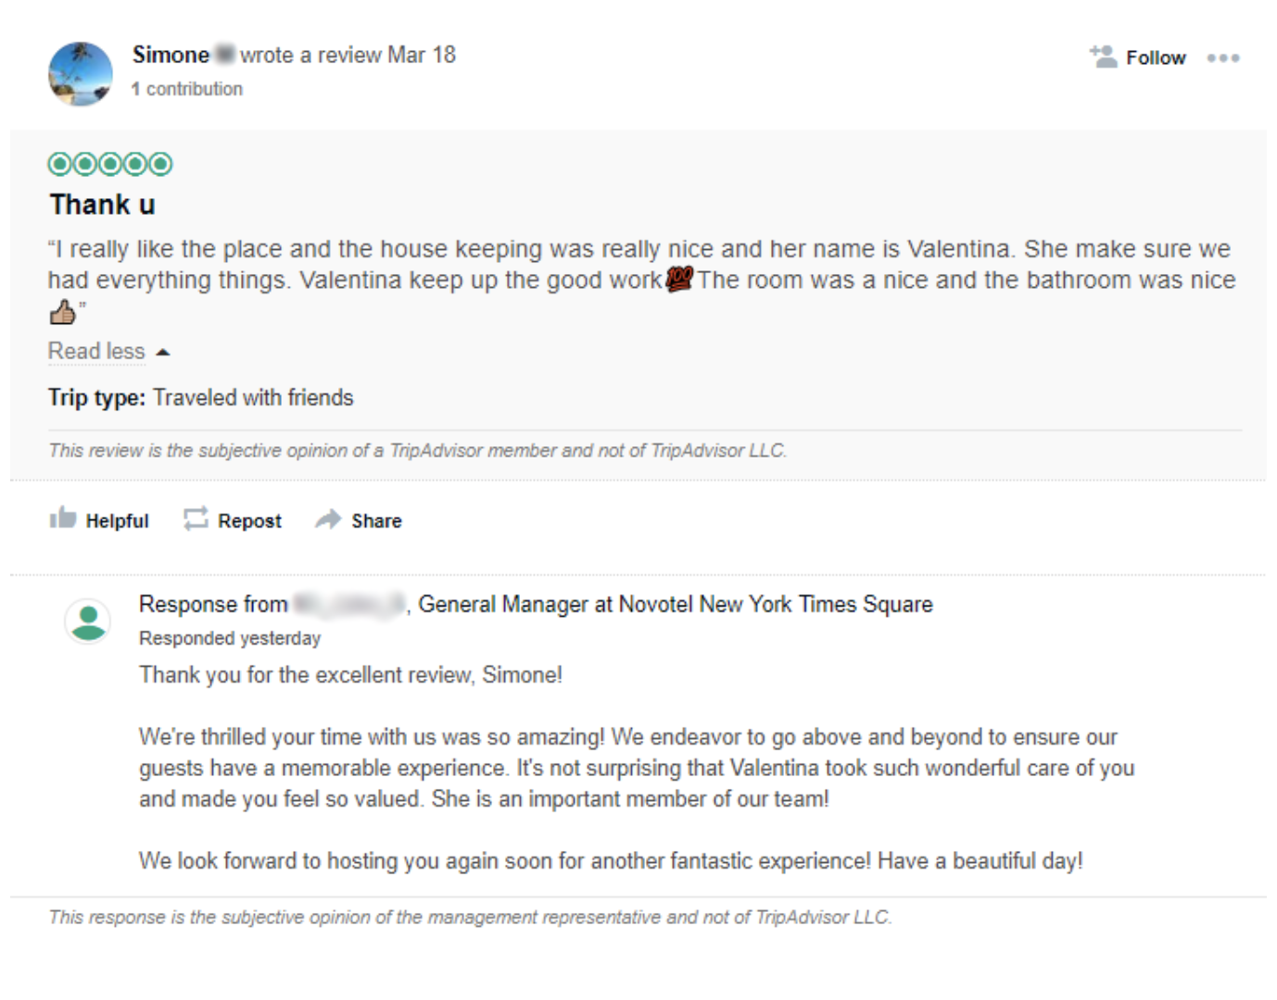
1) Recognise the Staff

Slide 33
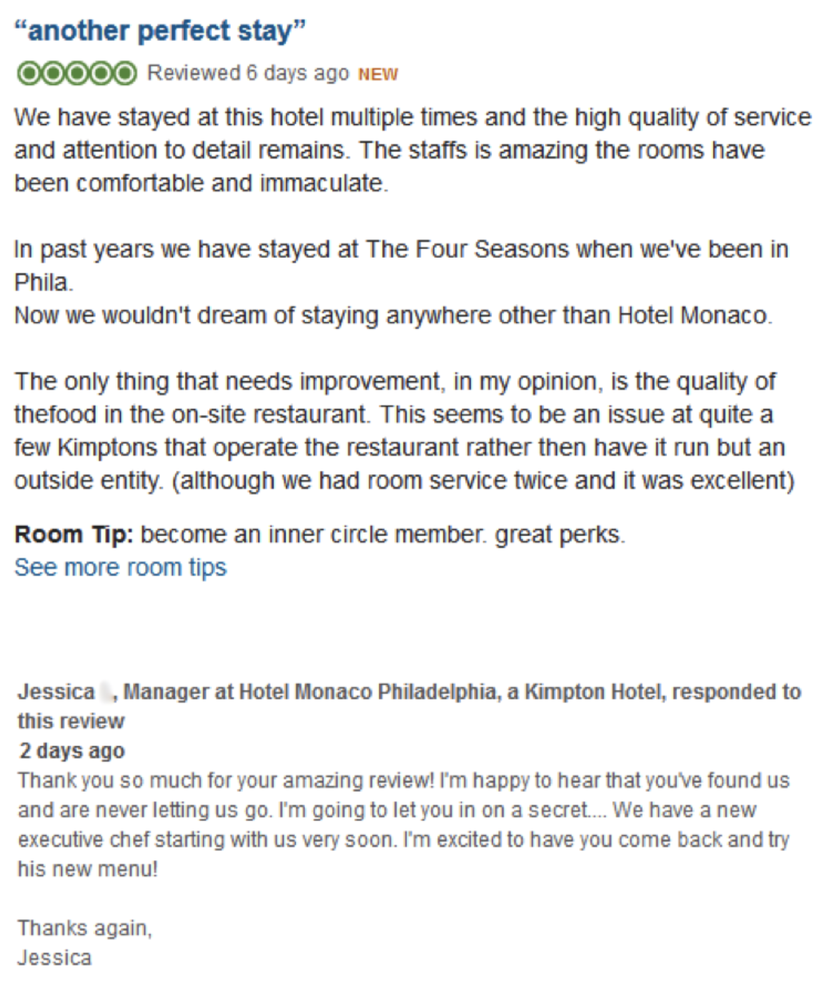
2) Offer a Solution

Slide 34
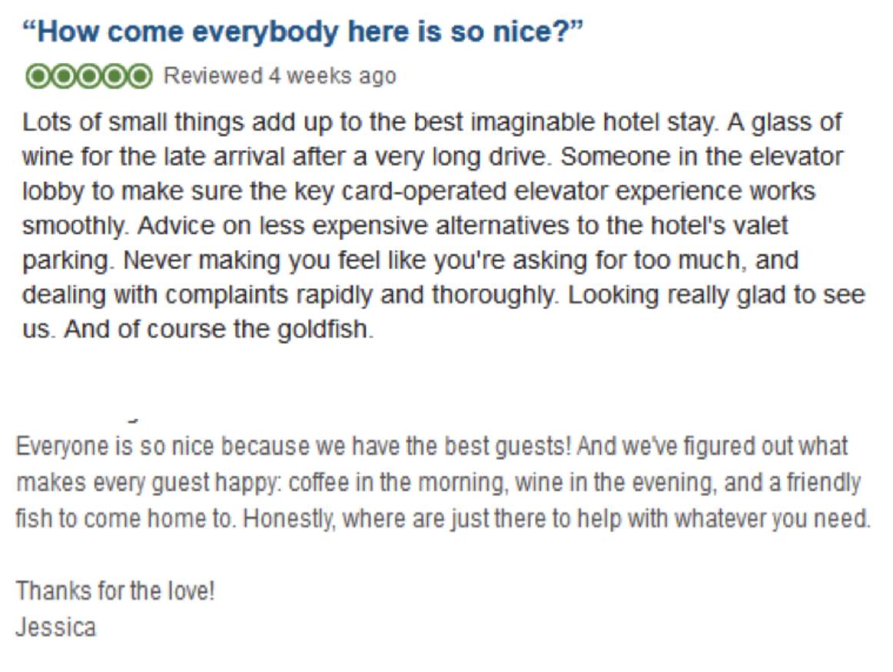
3) Guests love compliments too!

Slide 35
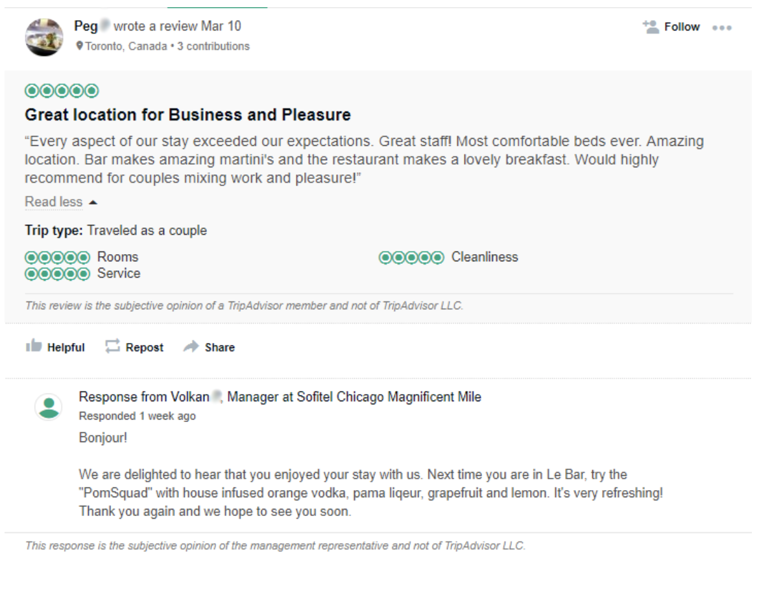
4) Make useful recommendations

Slide 36
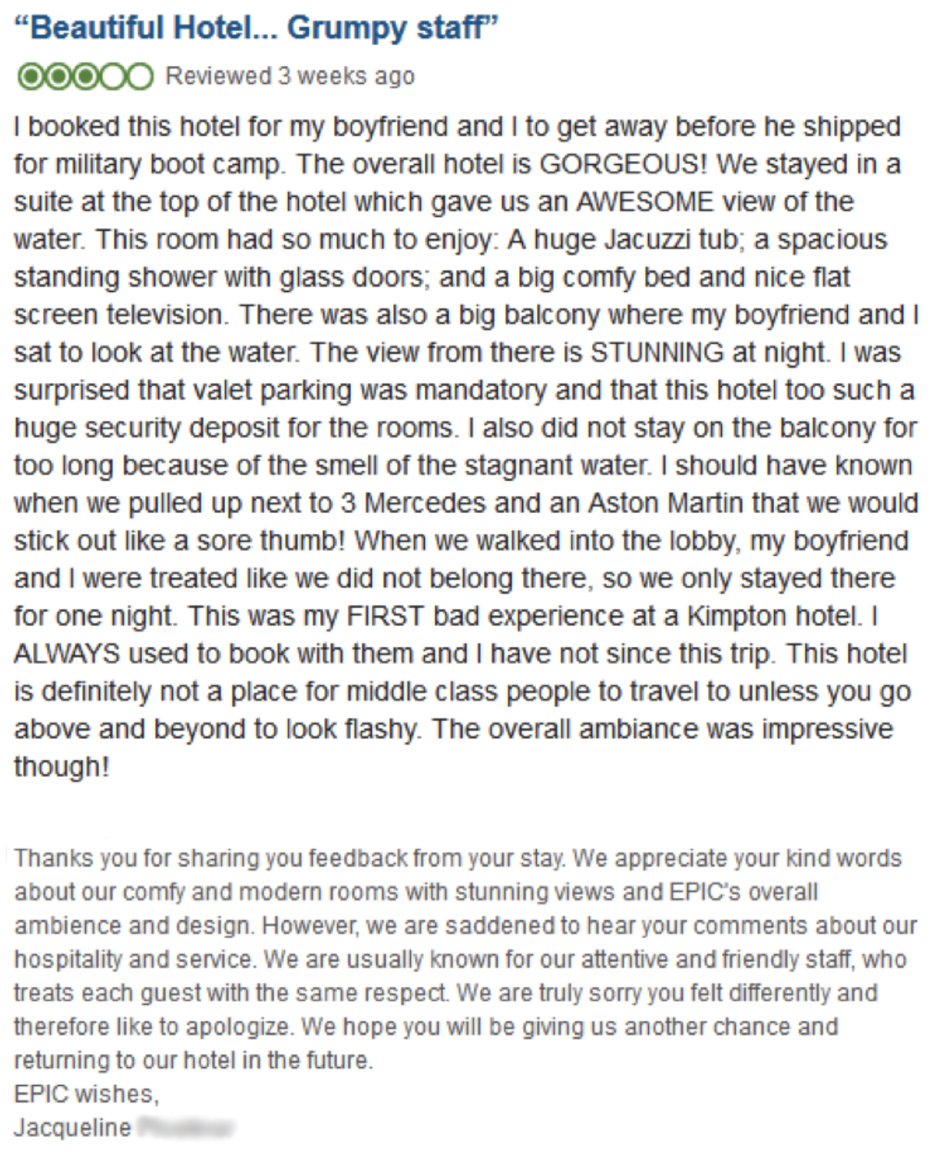
5) Invite guests back

Slide 37
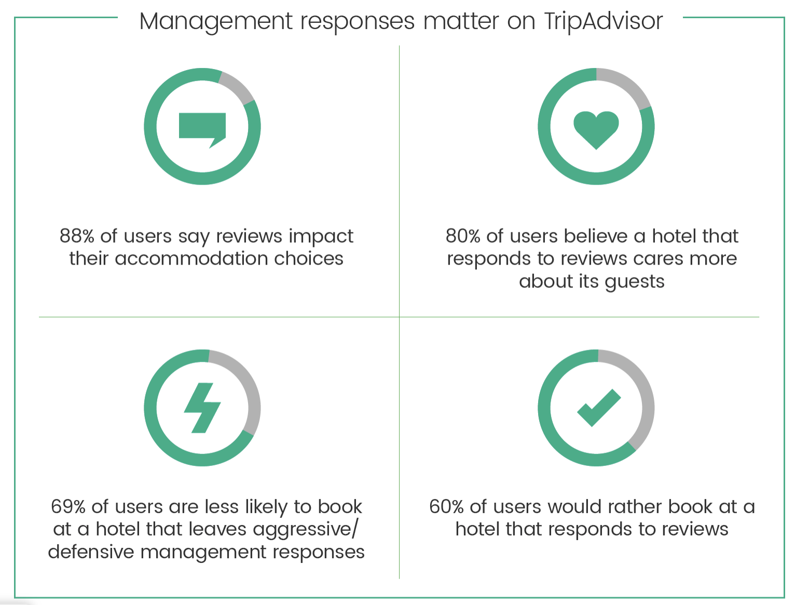

Slide 38

How to get more positive online reviews

Slide 39
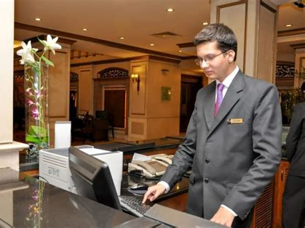
Hotelier
Notes:
So this is Week 5. There are no lectures next week, however, your student journal is due THIS FRIDAY FEBRUARY 11TH AT 4PM.
Please submit via the Turnitin Final link. There is a similarity check link for you.
Please can you spend this week making bookings, checking in and checking out, charging cards and adding composite items and departure notes. Your exam will be the week commencing March 7th. We will have practice time during lectures after reading week, but you need to know how to operate the system in order to be proficient in the exam.

Slide 40


Slide 41
Reference List
Burr, C. (2020) Online Reputation Management. [online] Bamboo Revenue. Available at: https://www.bamboorevenue.co.uk (Accessed: 20 May 2020).
Chamelian, S. (2014) Reputation Management. [online] Hotelier. Available at: https://insights.ehotelier.com/insights/2014/09/04/reputation-management-its-impact-on-hotel-revenue/ (Accessed: 20 May 2020).
Craig, D. (2015) 10 Essential Steps To Managing Your Hotel’s Online Reputation. [online] ReviewPro. Available at: https://www.reviewpro.com/blog/10-essential-steps-to-managing-your-hotel-online-reputation/ (Accessed: 20 May 2020).
Customer Alliance (2015) Why Is Hotel Reputation Management That Important?. [online] Available at: https://www.customer-alliance.com/en/articles/hotel-reputation-management/ (Accessed: 20 May 2020).
Fox, L. (2012) Extreme Comments Ignored And Few Focus On Negative Reviews Says Tripadvisor [INFOGRAPHIC] | Phocuswire. [online] Phocuswire.com. Available at: https://www.phocuswire.com/Extreme-comments-ignored-and-few-focus-on-negative-reviews-says-TripAdvisor-INFOGRAPHIC- (Accessed: 20 May 2020).

