Slide 1


Module :- Developing Relationships and Workplace achievement
Module code :- BMSW5102
Rebecca Travers – 2128316
Lecturer:- Sujeewa Herath

Slide 2
Content
Introduction................................................................................................................................................... Slide 3
Motivation within the workplace.....................................................................................................................Slide 4
Intrinsic & Extrinsic Motivation......................................................................................................................Slide 7
Maslow's motivational theory..........................................................................................................................Slide 9
Vrooms expectancy theory...............................................................................................................................Slide 10
Conclusion........................................................................................................................................................Slide 11
Intrinsic & Extrinsic Motivation.......................................................................................................................Slide 6
References.........................................................................................................................................................Slide 12
Motivational Theories.....................................................................................................................................Slide 8
What is motivation?..........................................................................................................................................Slide 5

Slide 3

Introduction
Motivation within employees has an essential link to a sustainable workforce. According to Lorincová, et al. (2020 p.8) . 'If employees are motivated, their initiatives are endorsed and, subsequently, enterprise goals are effectively achieved.'
This presentation will explore the definition of motivation, intrinsic and extrinsic motivation definitions and examples and current motivational theories choosing two for critical assessment to guide HRM in motivating employees.

Slide 4
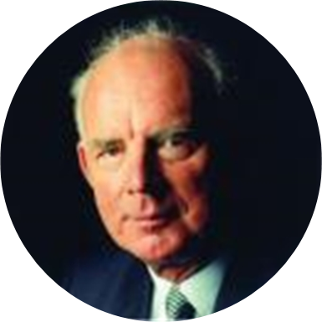
Motivation in the workplace
'Motivation is the force that energizes, directs and sustains behavior.' According to Armstrong (2012 p.170)
Employee motivation is defined as the force that drives the direction, intensity, and persistence of employee behavior. Pinder (2008 cited in Van den Broeck, et al. 2021, p.241)

Slide 5

What is motivation?
Armstrong (2012) describes motivation as containing 3 parts, strength, direction of behavior, and influential factors.
With motivations varying from person to person it is essential to know your employees and the specific motivations that increase performance.

Slide 6
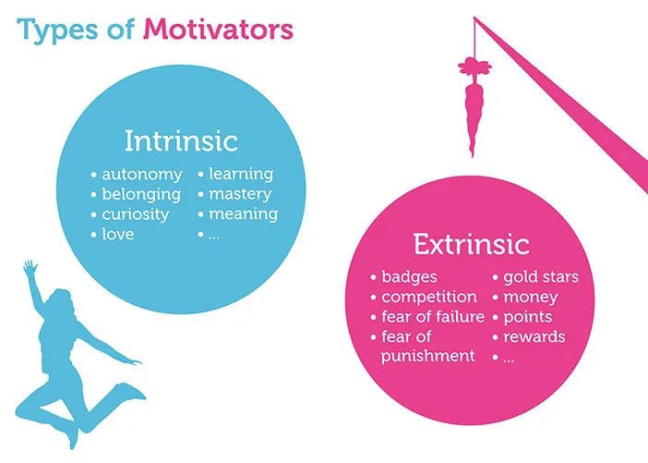
Intrinsic motivation & extrinsic motivation
Employee motivations are different and distinguishable based on reasons or goals. They can be intrinsic or extrinsic. Miao, Evans, and Shaoming, (2007) describe the cognitive dimension of intrinsic motivation as challenge seeking. Whereas extrinsic, 'which occurs when things are done to or for people to motivate them' Armstrong (2012 p.170)
The most basic distinction is between intrinsic motivation, which refers to doing something because it is inherently interesting or enjoyable, and extrinsic motivation, which refers to doing something because it leads to a separable outcome. Ryan & Deci (2000 p.55)

Slide 7
Intrinsic motivation & extrinsic motivation
 | Advantages | Disadvantages
Intrinsic motivation | Efficiency in learning Employees are loyal & dedicated High levels of performance. | Standards of safety may be overlooked if employee is over enthusiastic. Monetary rewards may become more desirable than intrinsic motivation.
Extrinsic motivation | Can help boost productivity Can encourage people to behave in a desired way Highly effective in increasing motivation | Can reduce intrinsic motivation meaning employees are working for pay rather than enjoyment. Continuous rewards will demotivate employees or encourage them to only work hard when extrinsic rewards are offered.
What motivates you at work?
According to a study conducted by Lorincová, et al. (2020 p.8) they found the following factors the most effective amongst Slovak employees:
finance related,
mutual relationships,
working conditions
Notes:
indicate which motivation type (with examples) motivates you mostly at work, and critically evaluate the advantages and disadvantages of each motivation types.
Employees often have a mixture of intrinsic and extrinsic motivations.

Slide 8
Motivational theories
Taylorism – is a theory created by Taylor (1911) which outlines individuals motivation based on rewards and punishments directly related to performance.
The motivation process – is a theory created by Hull (1951), in this theory reinforcement of successful actions is required to create motivation.
Hierarchy/ Set of needs – is a theory created by Maslow (1954) simplified by Alderfer (1972) which focuses on individuals being motivated by needs that are translated to goals.
Related to needs theory – Herzberg et al (1957) - is a two-factor theory based on intrinsic motivation (hygiene factor) and extrinsic motivation.
Expectancy theory – created by Vroom (1964), Porter and Lawler (1968), is a theory that shows correlation between motivation and expected rewards.
Goal theory - Latham and Locke (1979) is a theory relating to goal setting and feedback receiving.
Equity theory - Adams (1965) Provides correlation between fair treatment compared to others and motivation.

Slide 9
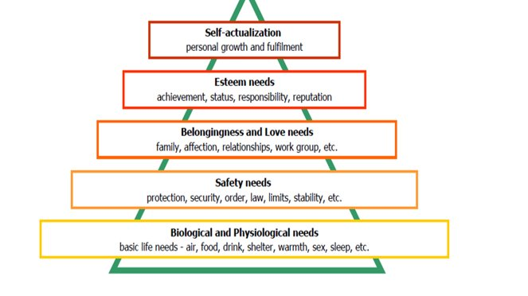

Maslow's Theory
'Abraham Maslow proposed that people are motivated by basic needs' King, Gontarz, and Wei,(2020 p.357)
Maslow's theory (1954) suggests that once lower needs are satisfied, they no longer act as a motivational factor, and you move up the hierarchy.
This concept has been commonly used and adjusted over the years to help motivate employees and workforces.

Slide 10
Vroom's Expectancy Theory
Force – is related to effort. The employees believe if that the effort put in will correlate in increased performance.
Valence – Is related to performance. The employees believe that increased performance results in rewards.
Expectancy – Is the value of the reward to the employee.
Vroom's theory in the form of an equation is force= valence×expectancy
Gyurko (2011 p.507)
"VET proposes that an individual's motivation in a given circumstance depends on how strongly the individual expects a given level of expended energy to yield a given outcome. It is also dependent upon how attractive the outcome is to the individual" Gyurko (2011 p.507)

Slide 11

Conclusion
Many factors make up employee motivation. Regular performance reviews aid in the process of getting to know what employees are looking for from their employment. Research suggests that setting specific, measurable, achievable, realistic and timed goals aid in motivating employees as well as offering certain intrinsic and extrinsic motivations occasionally.

Slide 12

References
Armstrong, M. (2012) Armstrong's handbook of human resource management practice. 12th edn.
Gyurko, C.C. (2011) ‘A synthesis of Vroom’s model with other social theories: An application to nursing education’, Nurse education today, 31(5), pp. 506–510. Available at: https://doi.org/10.1016/j.nedt.2010.08.010.
https://media.koganpage.com/media/image/author_michael-armstrong.jpg
https://images.squarespace-cdn.com/content/v1/5d04d2b6bdee400001e4e4af/1561879459674-JPRFRNI51JYQ6VICXGUE/Spirituality-and-Maslow%27s-Hierarchy-of-Needs.png
https://public-media.interaction-design.org/images/books/gamification_at_work/Fig5.1_Intrinsic_extinsic_motivation.jpg
King, A.T., Gontarz, J. and Wei, H. (2020) ‘Employee engagement and absenteeism: A step towards improving patient care’, Nursing forum (Hillsdale), 55(3), pp. 356–361. Available at: https://doi.org/10.1111/nuf.12435.
Lorincová, S. et al. (2020) ‘Sustainability in Business Process Management as an Important Strategic Challenge in Human Resource Management’, Sustainability (Basel, Switzerland), 12(15), p. 5941–. Available at: https://doi.org/10.3390/su12155941
Miao, C.F., Evans, K.R. and Shaoming, Z. (2007) ‘The role of salesperson motivation in sales control systems — Intrinsic and extrinsic motivation revisited’, Journal of business research, 60(5), pp. 417–425. Available at: https://doi.org/10.1016/j.jbusres.2006.12.005.
Oved, O. (2017) ‘Rethinking the Place of Love Needs in Maslow’s Hierarchy of Needs: III. Young Perspectives’, Society (New Brunswick), 54(6), pp. 537–538. Available at: https://doi.org/10.1007/s12115-017-0186-x.
Ryan, R.M. and Deci, E.L. (2000) ‘Intrinsic and Extrinsic Motivations: Classic Definitions and New Directions’, Contemporary educational psychology, 25(1), pp. 54–67. Available at: https://doi.org/10.1006/ceps.1999.1020.
Van den Broeck, A. et al. (2021) ‘Beyond intrinsic and extrinsic motivation:: A meta-analysis on self-determination theory’s multidimensional conceptualization of work motivation’, Organizational psychology review, 11(3), pp. 240–273. Available at: https://doi.org/10.1177/20413866211006173.

