Slide 1

Student Name: Ionut Claudiu Ungureanu
Student Number: 2323114
Programme: BA (Hons) Developing Leadership and Management
Module: People Management
Module code: BMSW5010
Assignment Title: BrightWave
Lecturer: Rebecca Francis-Davies

Slide 2

Executive Summary
28% turnover poses critical risks for developing contracts.
Strategic goal to enhance the client's trust and productivity (Ali et al., 2025).

Slide 3

Key People-Management Challenges
Rigid organisational culture and a managerial skills gap are core challenges for BrightWave Services Ltd (Kostal, 2025).
These challenges affect organisational culture and people management.

Slide 4
Theoretical Lens: Why BrightWave Is Underperforming
Theoretical Lens | Underperforming | Practical implications
Herzberg two two-factor theory | Employees are satisfied with hygiene factors. | BrightWave needs to implement stronger reward and recognition programmes (Ahmad et al., 2025).
Self-Determination Theory | The workplace culture is failing to effectively meet the basic psychological needs. | It should be helpful for managers to delegate more flexibility and authority.
Vroom’s Expectancy Theory | Employees do not believe the increased efforts will lead to better performance. | Leaders must clearly define the performance and ensure a transparent and fair reward system.
Herzberg's two-factor theory talks about the importance of hygiene factors in developing employee satisfaction (Ahmad et al., 2025).
Self-determination and Vroom’s expectancy theory also provide practical implications of leaders' skills.

Slide 5

Root Cause Analysis
Weak induction, low recognition, client complaints and huge competition are key root causes of BrightWave's current challenges.
Lack of appropriate reward and recognition hinders employees' productivity, and is also inversely related to turnover rate (Shahbaz, 2025).

Slide 6

Vision for the Future
By 2027, BrightWave tried to develop its core vision for future achievements (Davis, 2025).
Through developing people-centred and service-driven organisations, it can develop its future ambitions.

Slide 7

Strategy Pillar 1
Through engaging with CIPD or ILM, BrightWave follows steps to develop its managerial capability.
Key strategic components are giving proper training, developing management excellence and so on (Hock‐Doepgen et al., 2025).

Slide 8
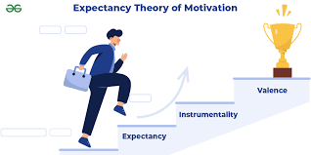
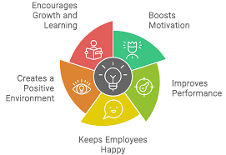
Strategy Pillar 2
Two theories can be useful in this strategy, like reinforcement and expectancy theory.
Reinforcement theory is used to motivate the employees.
Expectancy theory can be applied to promote the position of the employees when needed (Whatishumanresource, 2025).

Slide 9

Strategy Pillar 3
A friendly workplace will be fostered.
A programme named “before your early 90days with BrightWave” will be focused.

Slide 10
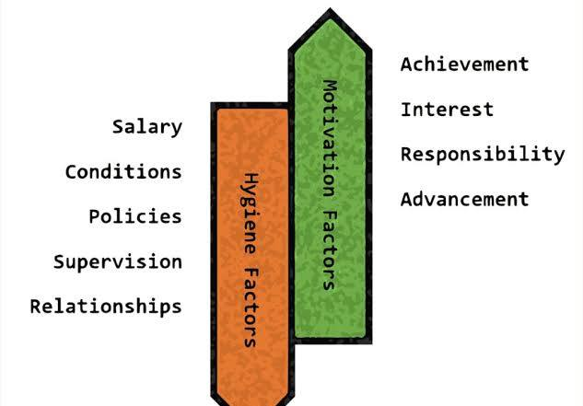
Strategy Pillar 4
Addressing the issue, a clear path towards promotion should be declared.
Herzberg's motivational theory can be emphasised for employee retention (Indeed, 2025).

Slide 11

Strategy Pillar 5
Cultural barriers can be improved through a change in the leadership style and by incorporating rewarding schemes.
Side-by-side collaboration in the team and active listening have to be developed, also.

Slide 12

Strategy Pillar 6
An employee's mental condition has to be taken into consideration (ModernHealth, 2023).
More flexibility should be given.
An annual report should be published to audit work and social value.

Slide 13

3-Year Roadmap
The first year will focus on training and performance framework (Continu, 2025).
The second work will be focused on showcasing hierarchy and cultural development.
3rd year is associated with consistency and improvement through analysis.

Slide 14
Expected Outcomes & KPIs
Expected outcome | Percentage
Employee turnover | Reduced to 10%
Recruitment process | 25%
Client complaints | Reduced to 50%
Development of an engagement scenario | 10%

Slide 15
References
Ahmad, M.F., Ma’amor, H., Samaan, S.S., Ahmad, S.F.S. and Dahalan, N.A., (2025). The Herzberg's Theory: Hygiene Factors and Job Satisfaction at a Public Agency in Federal Territories of Malaysia. Journal of International Business, Economics and Entrepreneurship, 10(1), pp.151-160. https://journal.uitm.edu.my/ojs/index.php/JIBE/article/view/5512
Ali, A., Iqbal, M.A.J. and Irfan, M., (2025). Strategic Corporate Social Responsibility and Financial Performance: Sectoral Evidence and Governance Implications. Journal of Business and Management Research, 4(2), pp.1053-1069. https://jbmrjournal.com/index.php/Journal/article/view/458
Continu, (2025) How to create a performance management framework, Continu. Available at: https://www.continu.com/blog/performance-management-framework (Accessed: 01 December 2025).
Davis, J.A., (2025). Web of Deception: How Cybersquatting and Fraudulent Entities Challenge Consumer Protection Laws. N. Ky. L. Rev., 52, p.365. https://heinonline.org/HOL/LandingPage?handle=hein.journals/nkenlr52&div=18&id=&page=
Hock‐Doepgen, M., Heaton, S., Clauss, T. and Block, J., (2025). Identifying microfoundations of dynamic managerial capabilities for business model innovation. Strategic Management Journal, 46(2), pp.470-501. https://sms.onlinelibrary.wiley.com/doi/full/10.1002/smj.3663
Indeed, (2025) Herzberg’s theory: A guide for boosting employee motivation | indeed.com. Available at: https://www.indeed.com/career-advice/career-development/herzberg-theory (Accessed: 01 December 2025).
Kostal, V., (2025). Restarting entrepreneurial culture, employee motivation, and organizational mindset during SME growth (Doctoral dissertation, Technische Universität Wien). https://repositum.tuwien.at/handle/20.500.12708/216207
ModernHealth, (2023) Supporting employee mental health is good for business, MH Blog. Available at: https://www.modernhealth.com/post/how-to-prioritize-employee-mental-health#:~:text=with%20the%20company.-,Why%20Prioritizing%20Employee%20Mental%20Health%20Matters,talent%20and%20improve%20organizational%20performance (Accessed: 01 December 2025).
Shahbaz, M., (2025). The Impact of Financial and Non-Financial Rewards on Employee Turnover in the Telecom Industry of Pakistan: The Moderating Role of Training and Development (Doctoral dissertation, University of Wales Trinity Saint David). https://repository.uwtsd.ac.uk/id/eprint/3654/
Whatishumanresource, (2025) Expectancy theory ( Victor Vroom) Whatishumanresource.com. Available at: https://www.whatishumanresource.com/expectancy-theory (Accessed: 01 December 2025).

