Slide 1

Hellenistic Astrology and its Place within Divinatory Practices
Dr Dorian Greenbaum
Cosmology, Magic and Divination
Seminar 8
26 March 2024

Slide 2
The Rise of Astrology in the Greco-Roman World (1)
Plato (Timaeus)
“What about which of [the gods] come into conjunction and opposition with one another, and in what order they pass in front of one another, and at what times any of them are veiled from our sight and then reappear, [so that] they send fears and signs of the future to those [un]able to calculate?” (40d) (trans. Waterfield, modified)

Slide 3
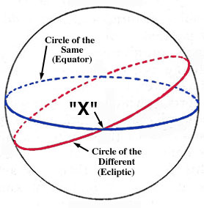
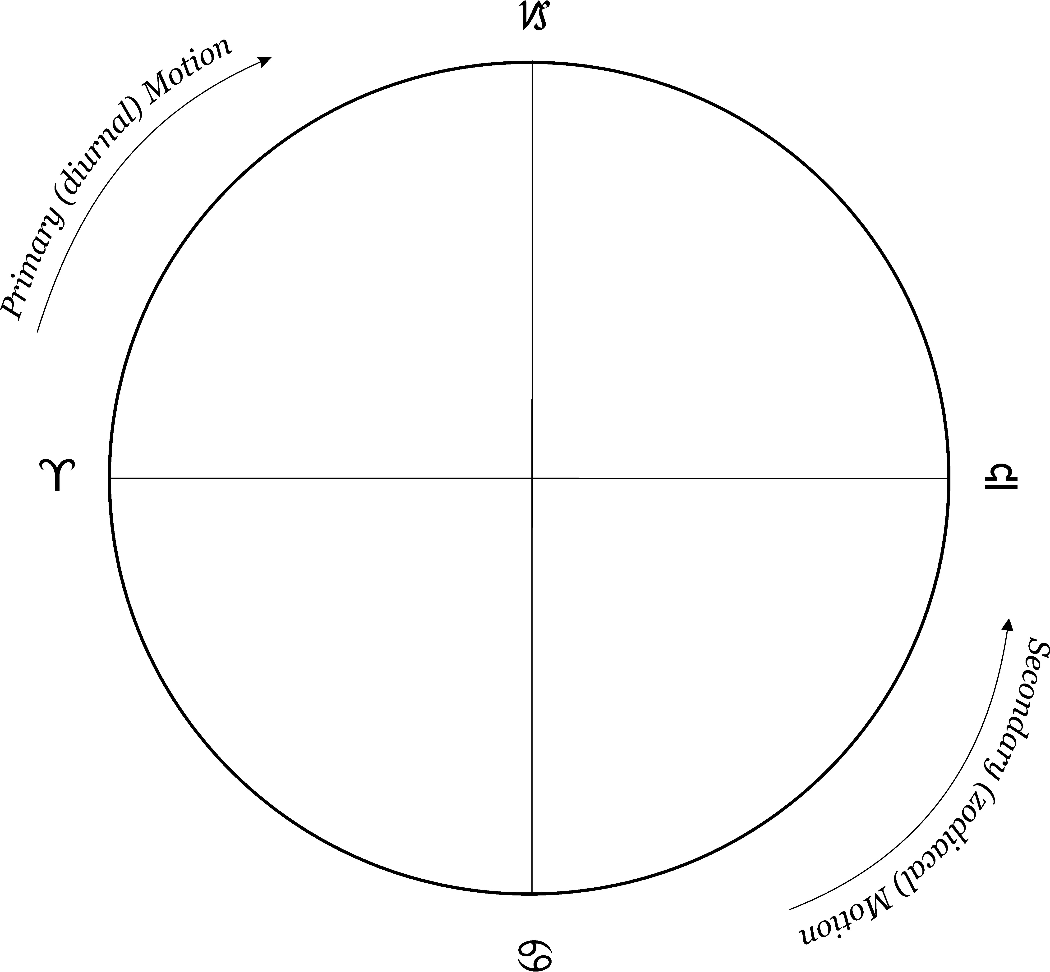
Primary and Secondary Motion: The Same and the Other/Different (Timaeus 36b-d)
south
Capricorn
☼
Aries
Libra
east
west
Cancer
north

Slide 4
The Rise of Astrology in the Greco-Roman World (2)
Plato (Timaeus)
“heavenly kind of gods” (39e-40a)
“the visible and generated gods” (40d)
Epinomis: “let none of us ever idly suppose that some of them are gods while others are not…but let us all declare and say that they are all cognate.” (986b)

Slide 5
The Rise of Astrology in the Greco-Roman World (3)
Stoics (Zeno as described by Cicero):
[gods] “Moreover, they are endowed with supreme beauty of form, and situated in the purest region of the heavens, so that they move and regulate their courses in such a manner that they seem to be conspiring together to preserve and protect all things.” (Cicero, De natura deorum II, 23) (trans. Rackham, modified)

Slide 6
The Rise of Astrology in the Greco-Roman World (4)
The Physical World of Heaven and Earth
Aristotle (qualities and elements)
On Coming-to-be and Passing-away (a.k.a. On Generation and Corruption) II, 3 [330b])
Fire = hot and dry
Earth = cold and dry
Air = hot and wet
Water = cold and wet
Stoics (elements and qualities)
Fire and Air are active; Earth and Water are passive
Fire and Air form pneuma (breath)
Diogenes Laertius Lives of Eminent Philosophers, 7.137:
Fire = hot
Earth = dry
Air = cold
Water = wet

Slide 7
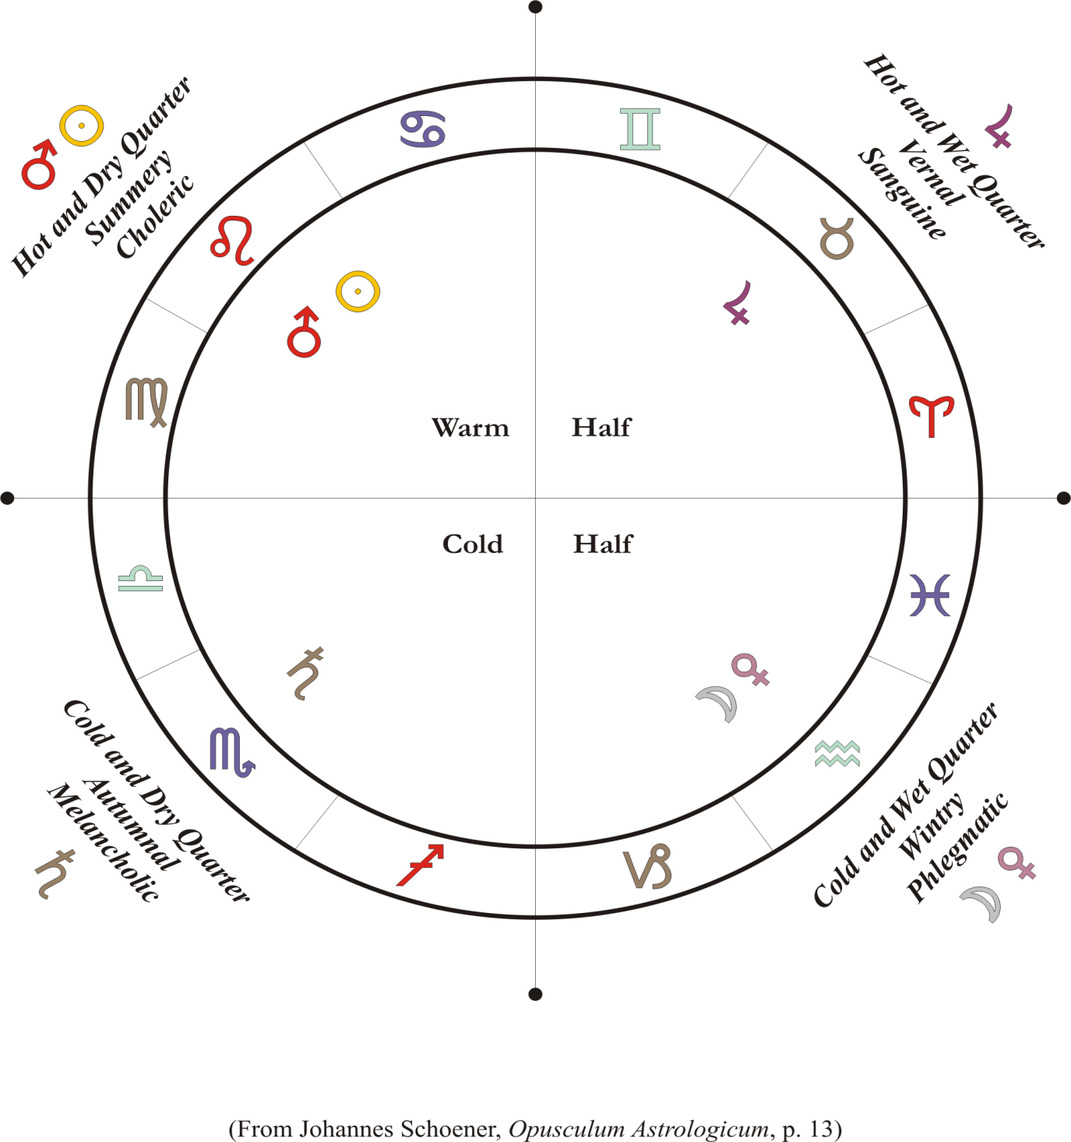
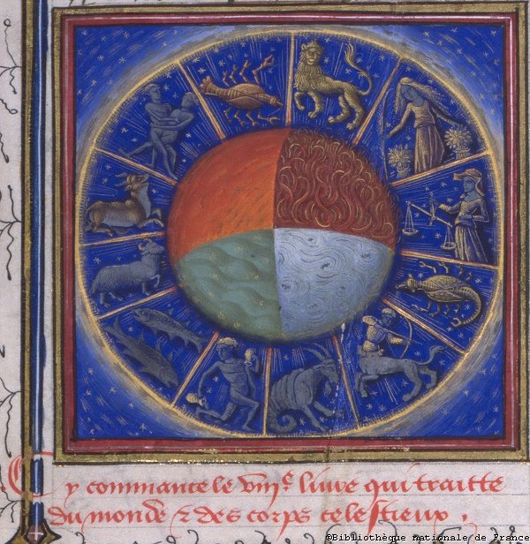
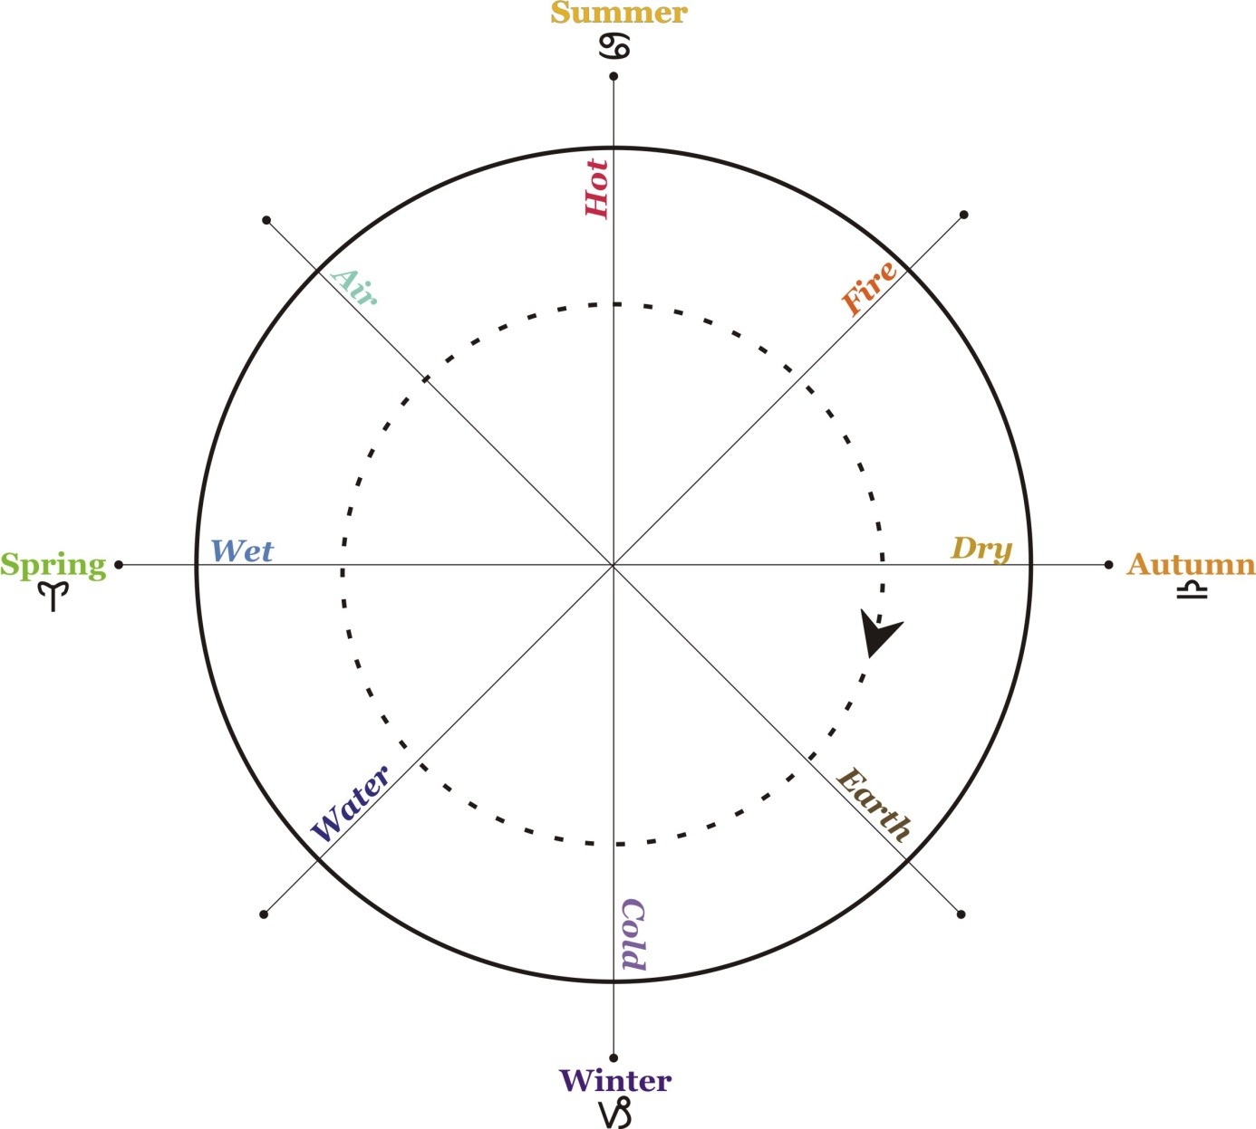
The Rise of Astrology in the Greco-Roman World (5)
Seasons, Elements, Qualities, Humours, Planets, Signs

Slide 8
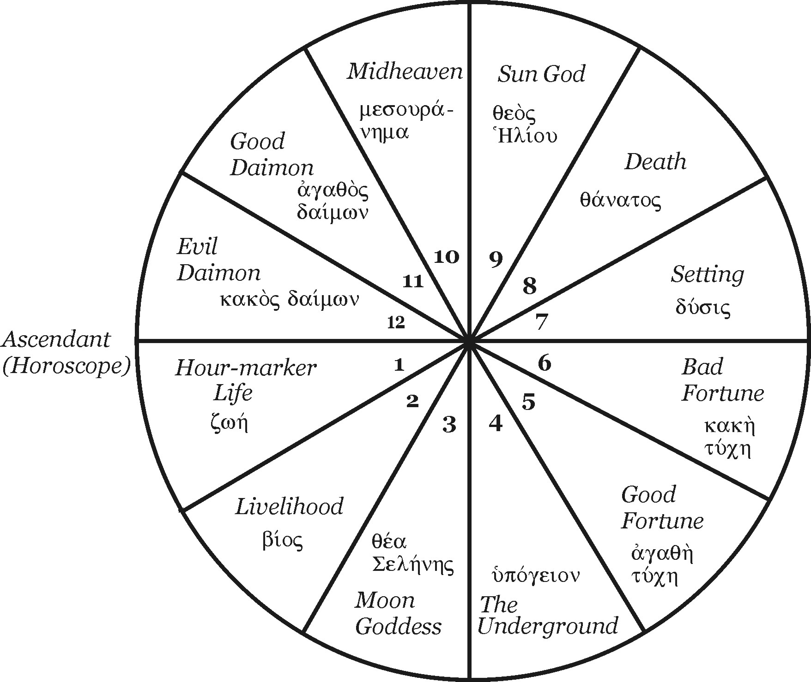
Arrangement of the Places and their Names

Slide 9
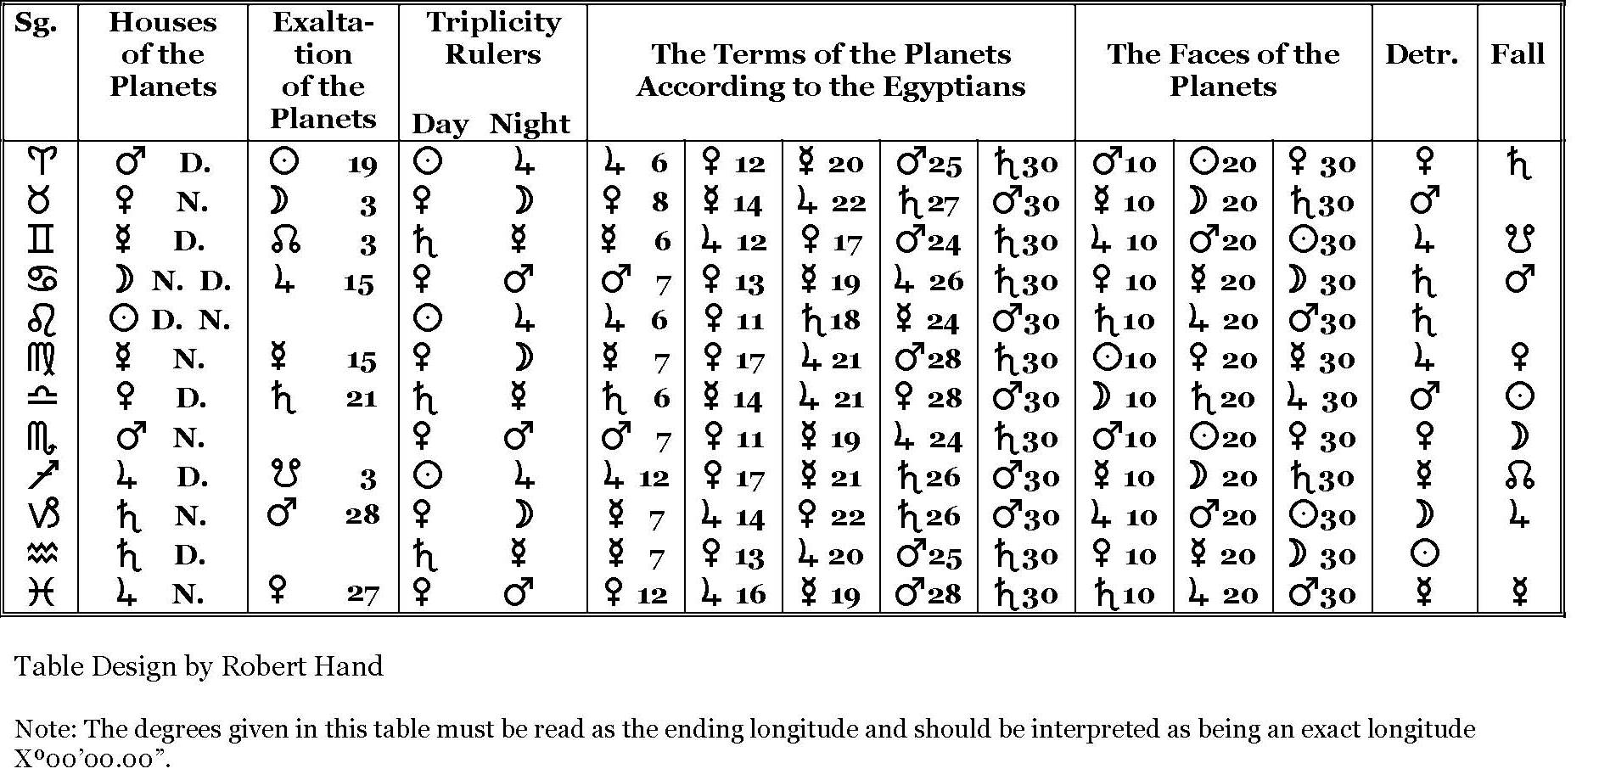
Table of Rulerships

Slide 10
Aspects

Slide 11
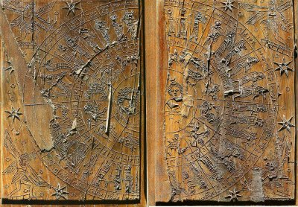
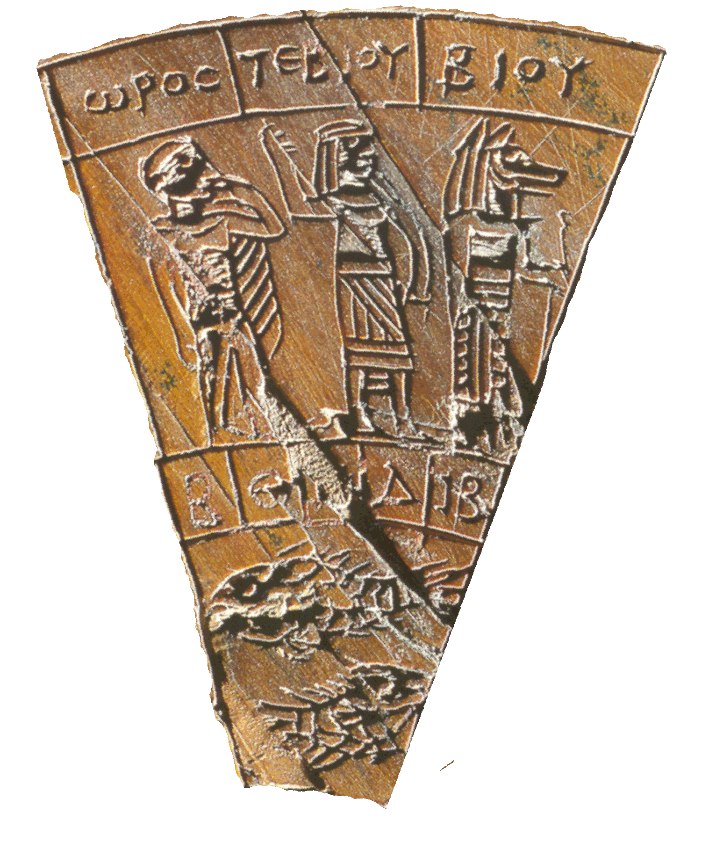
Astrological Board from Grand, France, showing Signs, Terms and Decans

Slide 12
Origins of Hellenistic Astrology
Developed out of astral omens and religious ritual involving stars and sky
Babylon/Mesopotamia (astral omens, birthcharts)
Egypt (Ascendant and Midheaven; decans)
Greece (some cosmology, systematization, symmetry)
Persia
It is a mongrel

Slide 13
Pingree’s Theory
However, sometime in the late 2nd or early 1st century B.C. someone, perhaps in Egypt, invented genethialogical astrology, which assumes an Aristotelian universe in which the earth at the center, consisting of the four sub-lunar elements, is surrounded by the eternally circling spheres of the seven planets in the so-called Hellenistic order (Moon, Mercury, Venus, Sun, Mars, Jupiter, Saturn).
From Astral Omens to Astrology: From Babylon to Bīkāner, Rome: Istituto italiano per l'Africa e l'Oriente, 1997, p. 26

Slide 14
Rebutting Pingree’s Theory
‘Someone...invented genethlialogical astrology’
‘in the late 2nd or early 1st century BC’
‘which assumes an Aristotelian universe in which the earth at the center, consisting of the four sub-lunar elements...’
‘surrounded by the eternally circling spheres of the seven planets in the so-called Hellenistic order’

Slide 15
Astrology and Divination (1)
Is astrology divination? Historically, yes
  Uses words and practices similar to other forms of divination
  Cicero
  Modern scholarship (with exceptions)
‘Natural’ and ‘Judicial’ astrology
  No ontological distinction between these two in antiquity: natural events (weather, moon, eclipses) could influence life on earth, but both natural and ‘judicial’ [making judgements] astrology were intrinsically connected by similar doctrines and practices

Slide 16
[Astrology and Divination (2)]
Student Presentation:Omens and Astrology
Pingree rejects connection between astral omens and astrology (Astral Omens to Astrology, pp. 21-22)
"...the notion that the planets, in their eternal rotations about the earth, transmit motion (change) to the four elements and to the assemblages of elements, animate and inanimate, in the sublunar world. This theory is completely different from that of celestial omens, in which the gods, whose physical manifestations are the constellations and planets, send messages concerning their intentions regarding kings and countries by means of celestial phenomena. That these divine intentions can be altered by the use of propitiatory rituals...emphasizes the fundamental conceptual difference between omens and astrology."

Slide 17
Astrology and Divination (3)
Whether astrology is divination is a debate among modern astrologers
  Why? Because of historic differentiation of parts of astrology?
  Divination as fortune-telling?
  Astrology as science more respectable?
  Influence of Ptolemy? Pingree?

Slide 18
Astrology and Divination (4)
Branches of astrology
  Natal astrology (for Ptolemy, ‘seed moment’[?])
  Mundane or universal (katholikos) astrology (includes weather, some medical, comets, earthquakes)
  Katarchic astrology (inceptions) (elections, events, interrogations, decumbitures)
Ptolemy’s position
  Astrology is stochastic
  Interested in physical causation; the physical relationship between the heavens and the earth
  [Does not mention katarchic astrology in the sense of electing times, but does talk about the birth moment as a ‘katarche’]

Slide 19
Katarchic astrology (1)
The word itself associated with religious ritual and beginning things at a propitious time (kairos)
kairos (καιρός): propitious time; the ‘right’ time; critical time, season, opportunity*
Katarchē means beginning, but a special kind of beginning, one associated with ritual – this word came into astrology
katarchē (καταρχή): (in religious sense) beginning of the sacrificial ceremony or rite; consecration of the victim first offered;* (in astrology) astrologically significant moment for beginning something
*Source: Liddell, Scott, Jones, Greek-English Lexicon, 9th ed. s.v. καιρός, καταρχή
Elections
Events
Interrogations (Horary)
Decumbiture

Slide 20
Katarchic astrology (2)
Porphyry on astrology in ritual:
‘“But these [who generate effective images],” the letter says, “observe the movement of the heavenly bodies, and they tell, from the presiding of a given star with another or others around the heavens, whether the divination will be true or false, and whether the rites performed will be of no purpose, or have annunciatory power and bring about the [desired] effects (apotelestika).”’Letter to Anebo 2.6c Sodano = DM III.30 [173.7-10] trans. Clarke/Dillon/Hershbell, modified

Slide 21
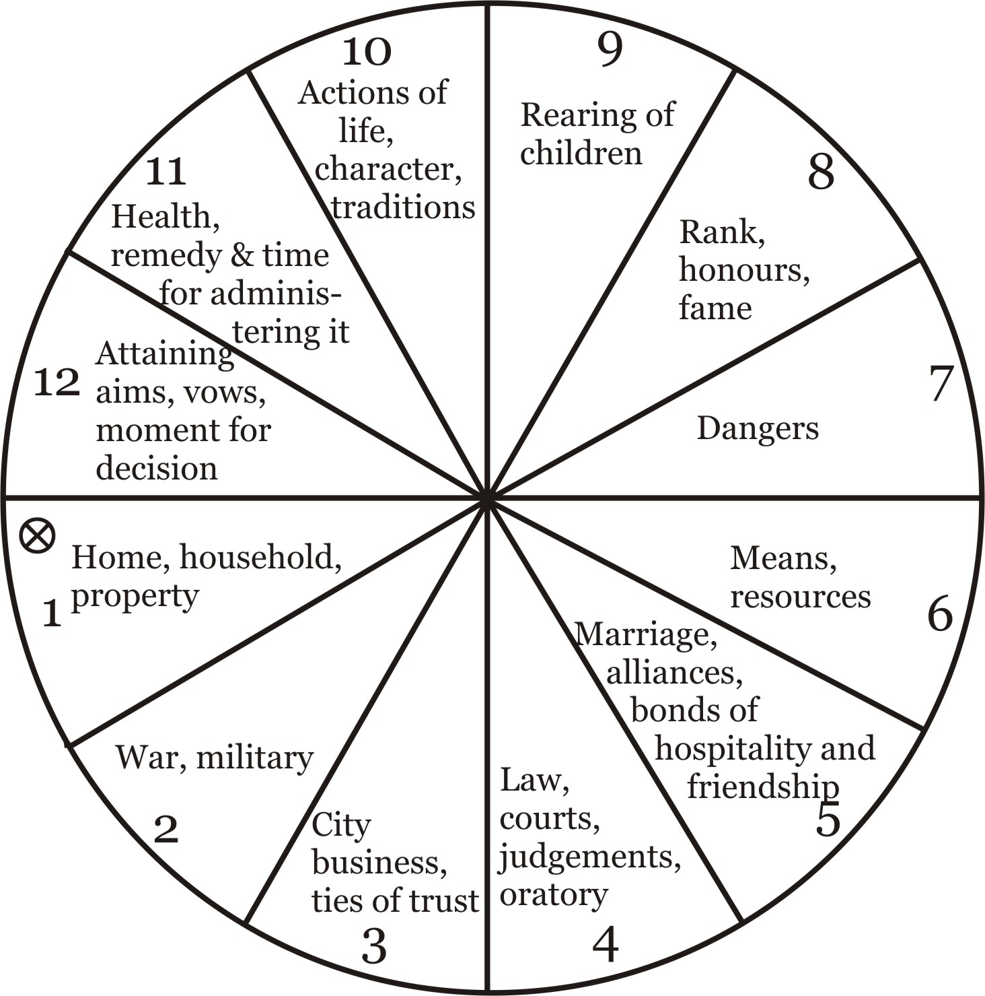
Katarchic astrology (3)
Manilius
‘choice of remedy and the moment for administering it, or in whose hour therapy and the mixing of life-saving potions have greater efficacy’ Astronomica III, 142-44, tr. Goold
‘this is the portion in which day and hour for a decision shall be given, if the planets as they move through the zodiac are favourably situated” Astronomica III, 154-55, tr. Goold

Slide 22
Katarchic astrology (4)
Dorotheus
Pentateuch V, 17: ‘[title] The courtship of a woman, and what occurs between a wife and her husband when she quarrels and scolds and departs from her house publicly. If you want to know, if she returns to him, whether he will profit from her or will see joy and happiness or other than this in her, then look at the hour in which you are asked about this at the position of the Sun and of Venus.’
Sim. in Heph. III, 11.2: ‘[According to] the katarchē in which the separation has come to be, or even in which hour someone inquires of you [my italics], look at Aphrodite and the Sun.’ [my trans.]

Slide 23
Katarchic astrology (5)
Valens
Astrology is provided by the gods to those with the proper outlook (like Valens):
“…but when I lit upon the divine and revered theory of the heavens, I wished to purify my way of life of every vice and pollution, and anticipate the immortal soul. From that point divine things seemed to converse with me, and I acquired the intellectual capacity for sober investigation.” (VI, 1.15-16) [my trans.]

Slide 24
Katarchic astrology (6)
For Valens, the katarchē must be synchronised with the ‘right moment’ (kairos):
Whence for every katarchē one must observe carefully, in putting out a fleet and military command…. Truly, it is useless to sacrifice to god or to consecrate offerings; for prayers will not be answered and god will not let himself be worshipped, but he will be called upon idly and ineffectively. (V, 2.22, 23)
And the right moment is coordinated with the movement of the stars:
“…the authority of the katarchē for beginning the action coming to be in accordance with the cosmic movement…” (IX, 12.31)

Slide 25
Katarchic astrology (7)
Hephaestio devotes a whole book of his treatise to katarchic astrology
Apotelesmatika III, 4: title: “How one may learn beforehand the inquiries of those wishing to investigate from a katarchē”
Apotelesmatika III, 4.1:
“One may learn the prior circumstances of those who are approaching and want to know predictions from a katarche, by making the inspection according to a general and panoramic form similar in method, especially, to that used for nativities.’
(My translation.)

Slide 26
Rituals and Timing
Mesopotamia
Texts giving the appropriate time to perform a ritual: UD.DA.KAM (adannu) (Bodi 2019)
These texts are based first on the month and day (STT 300, late 7th cent. BCE), and later correlated to zodiacal signs (BRM 4.19, BRM 4.20, late 4th cent. BCE)
Erica Reiner: ‘By determining the propitious time for initiating an activity, the genre represents an early example of the process known as catarchic astrology.’ [Astral Magic in Babylonia, p. 111]

Slide 27
Katarchic astrology and Greek Ritual
Hephaestio
Apotelesmatika III, 16.11:
“The composed katarchē points out each [part of the ritual] before the opening of the animal: the Hour-marker reveals the one making the sacrifice; the Setting [place] that which is sacrificed or the sacrificial victim; the Midheaven the god or gods; the Underground [place] the reason for the altar, the completion of the matter and how it is sacrificed. One must carefully consider the stars – in what places they are, their position and phase, and the four lots – Fortune, Daimon, Necessity, Love.”
Trans. Greenbaum

Slide 28
Katarchic Astrology and Greek Ritual (2)
Iamblichus, Kairos and Ritual
The importance of the right time for Iamblichus:
‘Taking his cue from the Egyptian astrologers, he is aware of the opportune moment (kairos) at which theurgic rituals, leading the soul to realms beyond fate and toward the highest god, should be begun: but they recommend that we ascend through the practice of sacred theurgy to the regions that are higher, more universal and superior to fate, towards the god who is the creator, without calling in the aid of matter or bringing to bear anything other than the observation of the opportune moment (kairos).’
De mysteriis VIII, 4, 267.6-10, trans. Clarke/Dillon/Hershbell, slightly modified

Slide 29
Scholars on the use and antiquity of katarchic astrology
Richard Gordon: ‘To judge by the range of such issues, katarchic astrology must have been extremely important in practitioners’ daily business…. …There can be little question that this relative neglect [of katarchic astrology in astrology manuals] is due not to the lack of significance of katarchic astrology in daily life but to the social and intellectual interest focused on the relationship between genethliacal astrology, the imperial power and the struggle to control such knowledge by legal means.’ ‘Will my child have a big nose?’, p. 101
Auguste Bouché-Leclercq: ‘…clients who asked them [astrologers] if the moment was favourable or not for such an enterprise. This kind of method, known by the name ‘Initiatives’ (Καταρχαί) or opportunities, was the normal occupation and the fuel of popular astrology. It contains the germ of genethlialogy, which came from it and which returned as a hybrid combination, as we will see in due course.’ L’astrologie grecque, p. 83 (my trans.)
‘…clients qui leur demandaient si le moment était ou non favorable pour telle enterprise. Ce genre de calculs, connu sous le nom d’«Initiatives» (Καταρχαί) ou opportunités, a été l’occupation normale et l’aliment de l’astrologie populaire. Il contient en germe la généthlialogie, qui en est sortie et qui y est rentrée à l’état de combinaison hybride, comme nous le verrons en temps et lieu.’
Wolfgang Hübner: ‘By the middle of the 1st cent. CE at the latest, the doctrine [of katarchic astrology] was essentially fully developed.’ Raum, Zeit und soziales Rollenspiel der vier Kardinalpunkte in der antiken Katarchenhoroskopie, p. 245 (my trans.)
‘Spätestens seit der Mitte des ersten Jh. n. Chr. ist die Lehre im wesentlichen voll entwickelt.’

Slide 30
Oracles and Astrology: Different ways to answer the same questions
Oracle Topics
Buying property, building buildings
Business; trade; buying or selling property
Marriage
Travel
Travel/Sea voyages
Health and disease
Journeys abroad
Slavery
Crime (esp. stolen property)
Ritual activity
Inquiry questions/What client is thinking
Military campaigns
Requests for truth
Treasure
Topics from Eidinow 2007, pp. 72-121
Katarchic Question Topics
Building
Buying and Selling
Marriage
Journeys
Ships/Voyages
Letters
Sickness
Exile, foreign journeys
Fugitives/Slaves
Theft
Rituals
Thought-reading
Adversaries/who will win (later Military)
Truth of a report
Topics from Dorotheus V and Hephaestio III

Slide 31
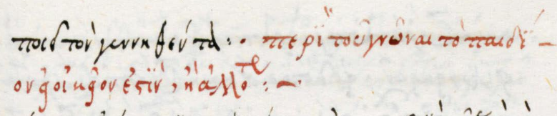
Typical questions asked in katarchic astrology
Will my child live or die? (fol. 57)
Is the unborn child mine or from another? (fol. 66)
What blessings and what harm will befall me? (fol. 199)
Reading a sealed letter (fol. 206v)
Finding a thief (Erasistratus fol. 210v; Dor. V 35; Heph. III 42-46)
If you are asked about a time when goods are stolen… (Dor. V 35, 1)
Moving house (fol. 220); moving residence abroad (fol. 223v)
If two adversaries argue and plead before a judge, which will be successful (Dor. V 33 title)
Will I find the slave/Will the slave return? (Serapion fol. 226v; Dor. V 36.77; Heph. III 47)
Buying land and residing there (fol. 230)
Folio numbers from Laur. plut. 28.33; Erasistratus in CCAG I, 94-97; Dor.=Dorotheus, Carmen Astrologicum; Heph. = Apotelematika III; Serapion in CCAG I, 101; see also Gordon 2013, pp. 99-101

Slide 32
Porphyry on trifling questions
‘Vain has their study of wisdom been, who worried the divine mind about finding a runaway slave, or buying a farm, or if a marriage or business deal should happen...’
  – Letter to Anebo, II.19b, ed. Sodano, p. 30 (my translation)

Slide 33
Astrology and Oracles
Oracle Topics/Questions Katarchic Topics/Questions
Topics: building, buying & selling, marriage, journeys, voyages, letters, sickness, exile, slaves, theft, ritual, truth of a report
What good or bad things will happen to me?’ [fol. 199]
‘Is the unborn child from mine or another?’ [fol. 66]
‘If you are asked about a man, whether he will depart from his land and his city or travel from it’ [Dor. V, 34.1]
‘the one inquiring about freeing slaves (slave’s viewpoint) [Heph. III, 21.2-3]
‘To know what someone wants to ask, from the Lot of Fortune [fol. 200 ch. 7]
‘To know the name of the thief’ [fol. 21v]
‘Topics: buying property, building, buying & selling, marriage, travel, health, journeys abroad, slavery, crime, rituals, military campaigns, requests for truth
of safety and fortune’ [E, p. 111]
‘Whether the child with which Annyla is pregnant is not from him? [E, p. 120]
‘Whether he will do better if he migrates to Alyzea? [E, p. 76]
[asked by a slave] What will happen to me if I leave? [E, p. 102]
‘Whether...what he has on his mind you also foretell as an oracle [E, p. 121]
‘Did Dorkilos steal the cloth?’ [E, p. 117]
Folio numbers from Laur. plut. 28.33; Heph. III; Dor.=Dorotheus; E=Eidinow 2007

Slide 34
Astrology and Oracles
Oracular Language in Astrology
Maximus of Ephesus, 4th c. CE (astrologer associated with the Emperor Julian)
Astrological poem on katarche: On Initiatives Περὶ καταρχῶν – critical edition and translation (French) 2016 by Nicola Zito
Maximus uses oracular language and style in his poem
Formulaic words of the Pythia: ameinon and loion, ‘better’, ‘more desirable’ The Pythia says: ‘it is/will be more desirable and better’ λώιον καὶ ἄμεινον ἐστιν/ἔσται
Maximus uses these same words, and so does Dorotheus in a passage on buying and selling (poem: Heph. III, 16.13-17)
The use of ‘if’ (εἰ) in katarchic questions recalls its use in oracles
Plutarch, The E at Delphi, 386C: ‘IF they will be victorious, IF they shall marry, IF it is to their advantage to sail the sea, IF to take to farming, IF to go abroad…’ (trans. Babbitt)
Citations from Zito 2016, pp. lvi-lviii

Slide 35
Bibliography
Primary Sources
Aristotle, On Coming-to-be and Passing-away, in Aristotle III, trans. E. S. Forster, Loeb Classical Library, Cambridge, MA: Harvard University Press, 1955.
Cicero, Marcus Tullius, De natura deorum, trans. H. Rackahm, online at https://archive.org/details/denaturadeorumac00ciceuoft (also in Loeb library on UWTSD database)
Cicero, Marcus Tullius. De senectute. De amicitia. De divinatione. Translated by W. A. Falconer. Cambridge, MA: Harvard University Press, 1923, repr. 2001. (Loeb)
Dorotheus of Sidon. Carmen Astrologicum. Edited and translated by David Pingree. Leipzig: B. G. Teubner, 1976Hephaestio. Apotelesmaticorum libri tres. Edited by David Pingree. 2 vols. Leipzig: B. G. Teubner, 1973.
Hephaistio, Apotelesmatica, Books I and II, trans. Robert Schmidt. Berkeley Springs, WV:The Golden Hind Press, 1994, 1998.
Hephaestion of Thebes, Apotelesmatics, Book III: On Inceptions, Trans. Eduardo Gramaglia, 2013 (with caution)
Iamblichus. On The Mysteries. Edited by John T. Fitzgerald. trans. and comm. Emma C. Clarke, John M. Dillon and Jackson P. Hershbell ed. Vol. 4, Writings from the Greco-Roman World 4. Atlanta: Society of Biblical Literature, 2003.
Manilius, Marcus. Astronomica. ed. and trans. George P. Goold, Loeb Classical Library. Cambridge, MA/London: Harvard University Press, 1977, repr. 1997.
Philip of Opus? Epinomis, trans. W. R. M. Lamb, available on line at http://web.archive.org/web/20071227160355/http://www.ac-nice.fr/philo/textes/Plato-Works/29-Epinomis.htm
Plato. Timaeus. Translated by R. G. Bury. In Plato, IX. Loeb Classical Library. Cambridge, MA: Harvard University Press, 1929, repr. 1989.
Porphyry. Lettera ad Anebo. Edited by A.R. Sodano. Naples: L'arte tipografica, 1958.
Riley, Mark. "Draft translation of Vettius Valens, Anthologiai, Books I-IX." At http://www.csus.edu/indiv/r/rileymt/Vettius%20Valens%20entire.pdf.
Robbins, F. E., trans. Ptolemy, Tetrabiblos. Vol. 435, Loeb Classical Library. Cambridge, MA: Harvard University Press, 1940, repr. 1994.
Tarán, Leonardo. Academica: Plato, Philip of Opus, and the Pseudo-Platonic Epinomis, Memoirs of the American Philosophical Society; v. 107. Philadelphia: American Philosophical Society, 1975.
Vettius Valens. Anthologiarum libri novem. Edited by David Pingree. Leipzig: B.G. Teubner, 1986.

Slide 36
Bibliography
Secondary Sources
Bezza, Giuseppe. 'The Development of an Astrological Term – from Greek hairesis to Arabic ḥayyiz'. Culture and Cosmos 11, no. 1 and 2 (2007): 229-60. http://www.cultureandcosmos.org/pdfs/11/11_Bezza_An_Astrological_Term_Vol11.pdf
Gordon, Richard. 'Cosmology, Astrology and Magic: Discourse, Schemes, Power and Literacy'. In Panthée: Religious Transformations in the Graeco-Roman Empire, edited by Laurent Bricault and Corinne Bonnet, 85-111, Leiden/Boston: Brill, 2013.
Gordon, Richard. '"Will my child have a big nose?"; Uncertainty, authority and narrative in katarchic astrology'. In Divination in the Ancient World: Religious Options and the Individual, edited by Veit Rosenberger, 93-137, Stuttgart: Franz Steiner Verlag, 2013.
Greenbaum, Dorian Gieseler. "Arrows, Aiming and Divination: Astrology as a Stochastic Art." In Divination: Perspectives for a New Millennium, edited by Patrick Curry, 179-209, Farnham, Surrey: Ashgate, 2010.
Greenbaum, Dorian Gieseler. The Daimon in Hellenistic Astrology: Origins and Influence. Leiden/Boston: Brill, 2015.
Greenbaum, Dorian Gieseler, and Micah T. Ross. "The Role of Egypt in the Development of the Horoscope." In Egypt in Transition: Social and Religious Development of Egypt in the First Millennium BCE, edited by Ladislav Bareš, Filip Coppens and Kveta Smolarikova, 146-82, Prague: Faculty of Arts, Charles University in Prague, 2010.
Heilen, Stephan. "Ptolemy's Doctrine of the Terms and Its Reception." In Ptolemy in Perspective, edited by Alexander Jones, 45-93, Dordrecht: Springer Science and Business Media, 2010.
Houlding, Deborah. "The Transmission of Ptolemy's Terms: An Historical Overview, Comparison and Interpretation." Culture and Cosmos 11 (2007): 261-307.
Pingree, David. From Astral Omens to Astrology: From Babylon to Bīkāner. Rome: Istituto italiano per l'Africa e l'Oriente, 1997.
Thomann, Johannes. 'Square Horoscope Diagrams in Middle Eastern Astrology and Chinese Cosmological Diagrams: Were These Designs Transmitted through the Silk Road?' In The Journey of Maps and Images on the Silk Road, edited by Philippe Forêt and Andreas Kaplony, 97-118, Leiden/Boston: Brill, 2008.
Waterfield, Robin. 'The Evidence for Astrology in Classical Greece'. Culture and Cosmos 3.2 (1999): 3-15. http://www.cultureandcosmos.org/pdfs/3-2/3-2_Waterfield_Astrology_in_Greece.pdf

Slide 37
Bibliography for Katarchic Astrology
Manuscript: Florence, Laurentianus pluteus 28.33, fols 56-230, http://mss.bmlonline.it/s.aspx?Id=AWOHyuL9I1A4r7GxMBxH&c=De%20mundanis%20apotelesmatibus%20excerptum%20ex%20libro%20Albumasaris#/book
Bodi, Daniel. 'Akkadian and Aramaic Terms for a "Favorable Time" (ḫidānu, adānu, and ‘iddān): Semitic Precursors of Greek kairos?' In Time and History in the Ancient Near East. Proceedings of the 56th Rencontre Assyriologique Internationale at Barcelona 26-30 July 2010, eds L. Feliu, J. Llop, A. Millet Albà and J. Sanmartín, 47-56, Winona Lake, IN: Eisenbrauns, 2013.
Bouché-Leclercq, Auguste. L'astrologie grecque. Paris: E. Leroux, 1899.
Catalogus Codicum Astrologorum Graecorum. Ed. Franz Cumont et al. 12 vols. Brussels: Henri Lamertin, 1898-1953 (Volume 1).
Dorotheus of Sidon. Carmen Astrologicum. Ed. David Pingree. Leipzig: B. G. Teubner, 1976
Eidinow, Esther. Oracles, Curses and Risk among the Ancient Greeks. Oxford: Oxford University Press, 2007.
Gordon, Richard. '"Will my child have a big nose?"; Uncertainty, authority and narrative in katarchic astrology'. In Divination in the Ancient World: Religious Options and the Individual, ed. Veit Rosenberger, 93-137, Stuttgart: Franz Steiner Verlag, 2013.
Hephaestio. Apotelesmaticorum libri tres. Edited by David Pingree. 2 vols. Leipzig: B. G. Teubner, 1973.
Iamblichus. On The Mysteries. Ed., trans. and comm. Emma C. Clarke, John M. Dillon and Jackson P. Hershbell. Atlanta: Society of Biblical Literature, 2003.
Hübner, Wolfgang. Raum, Zeit und soziales Rollenspiel der vier Kardinalpunkte in der antiken Katarchenhoroskopie. Band 194, Beiträge zur Altertumskunde. Munich/Leipzig: K. G. Saur Verlag, 2003.
Liddell, H. G., R. Scott, and H. S. Jones. A Greek-English Lexicon. 9th ed. Oxford: Clarendon Press, 1996.
Maximus of Ephesus. Des initiatives. Ed. and trans. Nicola Zito. Paris: Les Belles Lettres, 2016.
Porphyry. Lettera ad Anebo. Ed. A.R. Sodano. Naples: L'arte tipografica, 1958.
Plutarch. The E at Delphi. Translated by Frank Cole Babbitt. In Moralia, V. Loeb Classical Library. Cambridge, MA: Harvard University Press, 1936, repr. 2003.
Reiner, Erica. Astral Magic in Babylonia. TAPS, Vol. 85, no. 4. Philadelphia: Transactions of the American Philosophical Society, 1995.
Schwemer, Daniel. 'Beyond Ereškigal? Mesopotamian Magic Traditions in the Papyri Graecae Magicae'. In Cutural Plurality in Ancient Magical Texts and Practices: Graeco-Egyptian Handbooks and Related Traditions, eds L. M. Bortolani, W. D. Furley, S. Nagel and J. F. Quack, 62-85, Tübingen: Mohr Siebeck, 2019.

